Slide 1
Muscle adaptation to exercise
Collage of medicine
Physiology Dep.
DR Abdulrahman Alhowikan

Slide 2
Objective
Strength, power, and endurance of muscles
Effect of athletic training on muscles and muscle performance
Muscle hypertrophy
Fast-twitch and slow-twitch muscle fibers
Respiration in exercise
Oxygen consumption and pulmonary ventilation in exercise
Effect of training on vo₂ max
Cardiovascular system in exercise
Work output, oxygen consumption, and cardiac output during exercise
Effect of training on heart hypertrophy and on cardiac output
Role of stroke volume and heart rate in increasing the cardiac output
Body heat in exercise & heatstroke

Slide 3
Strength, Power, And Endurance Of Muscles
Muscles Strength: Refers to the amount of force a muscle can produce
Size of muscles influence by a maximal contractile force, Normally 3 -4 kg/cm²
E.g a cross-sectional area 150 cm² cause maximal contractile strength of 525 kilograms
Mechanical work of muscle = force applied by the muscle X distance

Slide 4
Strength, Power, And Endurance Of Muscles
Muscles Power : amount of work that the muscle performs in period of time ( kg-m/min)
Guyton & Hall12E

Slide 5
Strength, Power, And Endurance Of Muscles
Muscles Endurance: Ability of muscles to sustain repeated contractions against a resistance for period of time.
depends on glycogen stored in the muscle
Dynamic endurance: is defined as a muscle’s ability to contract and relax repeatedly.
Static endurance: is a muscles ability to remain contracted for a long period

Slide 6
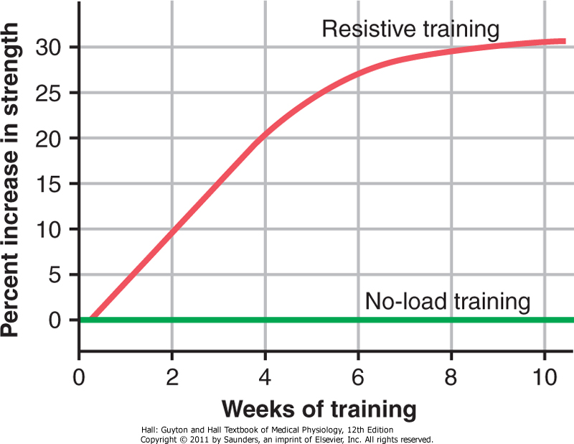
Effect of Training on Muscles and Muscle Performance
Maximal Resistance Training:
6 maximal muscle contractions X sets 3 days X one week increase in muscle strength, without muscle fatigue.
However !!!!
Muscles function under
no load little in strength
Approximate effect of optimal resistive exercise training on increase in muscle strength over a training period of 10 weeks.

Slide 7
Muscle Hypertrophy:
With training muscles hypertrophied 30- 60 %
Due to diameter of the muscle fibers ??
number of fibers ????
Changes in hypertrophied muscle:
myofibrils
120 % in mitochondrial enzymes( tricarboxylic acid)
ATP and phosphocreatine
50 % in stored glycogen
75 -100 % in stored triglyceride
oxidation rate 45 %

Slide 8
Fast-Twitch and Slow-Twitch Muscle Fibers
fast-twitch fibers: forceful and rapid contraction
E.G gastrocnemius muscle
slow-twitch muscle: for prolonged muscle activity
E.G leg muscle
fast-twitch fibers deliver power seconds to a minute slow-twitch fibers provide endurance, prolonged strength of contraction minutes to hours.
!!! differences between the fast-twitch and the slow-twitch fibers Read Guyton & Hall: Textbook of Medical Physiology 12E

Slide 9
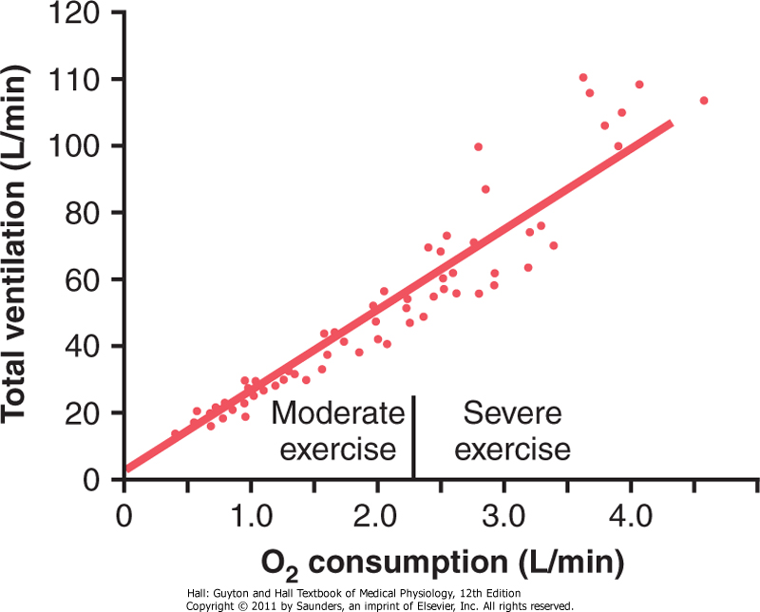
Respiration In Exercise
Oxygen Consumption VO2 and Pulmonary Ventilation VE in Exercise
VO2 at rest is about 250 ml/min , However !!! at Maximal efforts
VO2 and VE increase about 20-fold between the resting state and maximal intensity
F Effect of exercise on oxygen consumption and ventilatory rate. (Redrawn from Gray JS: Pulmonary Ventilation and Its Physiological Regulation. Springfield, Ill: Charles C Thomas, 1950.)

Slide 10
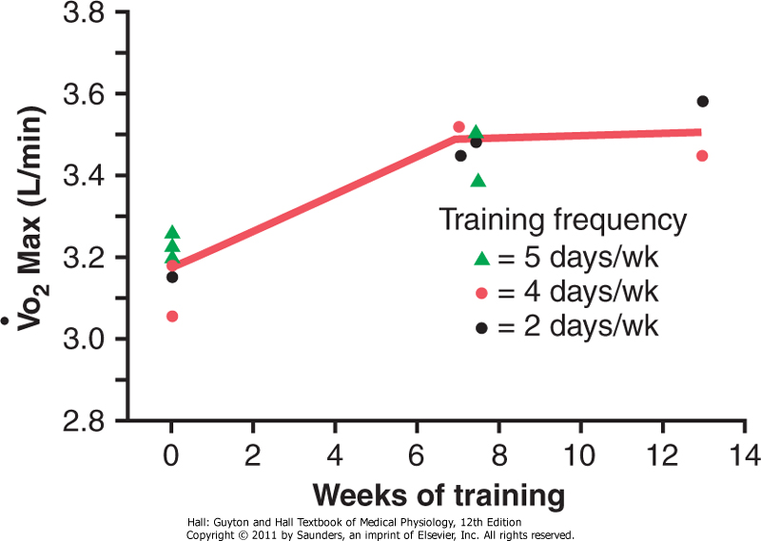
Effect of Training on Vo₂ Max
In below study Vo₂Max increased only about 10 percent by training, Moreover other factors !!!
Chest sizes in relation to body size
Increase respiratory muscles
For more
information check
Guyton & Hall12E
Increase in Vo2 Max over a period of 7 to 13 weeks of athletic training. (Redrawn from Fox EL: Sports Physiology. Philadelphia: Saunders College Publishing, 1979.)

Slide 11
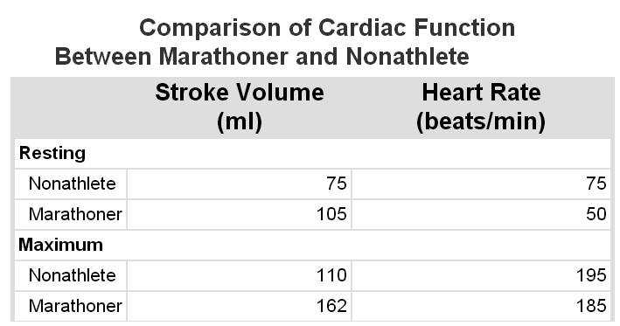
Cardiovascular System in Exercise
Work Output, Oxygen Consumption, and Cardiac Output During Exercise
All these are directly related to one another, muscle work output increases oxygen consumption, and increased oxygen consumption in turn dilates the muscle blood vessels, thus increasing venous return and cardiac output C.O .
Effect of Training on Heart Hypertrophy and on Cardiac Output:
Training increase C.O about 40 % greater than untrained persons SO,
heart chambers of marathoners enlarge about 40 percent in contrast to non trained
Heart size of marathoner larger than normal person
Guyton & Hall: Textbook of Medical Physiology 12E
Notes:
Guyton & Hall: Textbook of Medical Physiology 12E

Slide 12
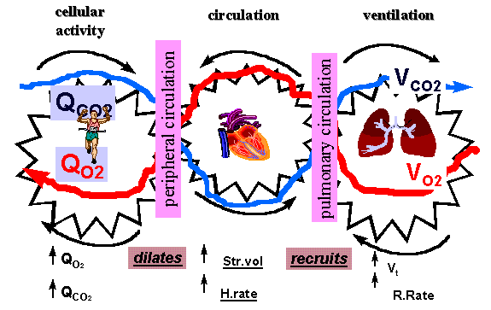
Cardiovascular System in Exercise cont…
Role of Stroke Volume and Heart Rate in Increasing the Cardiac Output

Slide 13
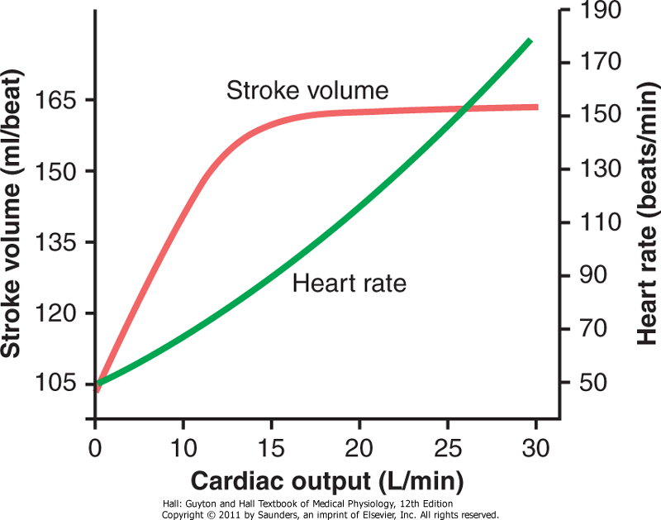
Cardiovascular System in Exercise cont…
The cardiac output increases from its resting level of about 5.5 L/min to 30 L/min.
The stroke volume increases from 105 to 162 milliliters, an increase of about 50 percent
Whereas the heart rate increases from 50 to 185 beats/min, an increase of 270 percent.
The heart rate increase a greater proportion of the increase in cardiac output than does the increase in stroke volume why ?????
Approximate stroke volume output and heart
rate at different levels of cardiac output in a
marathon athlete.

Slide 14
Body Heat In Exercise
Almost all the energy released by the body's metabolism converted into body heat.
Working muscle use only 20 - 25 %.
Remainder converted into heat as result of :
(1) resistance to the movement of the muscles and joints.
(2) friction of the blood flowing through the blood vessels, and
(3) muscle contractile converted into heat.
What will happen if sweating mechanism cannot eliminate the heat ???? see
Guyton & Hall12E

Slide 15
Heatstroke
During endurance training body temperature rises 98.6° to 102° or 103°F (37° to 40°C)
hot and humid conditions body temperature rise to 106° to 108°F (41° to 42°C)
Consequently, temperature destructive tissue cells mainly (brain cells) and symptoms !!! :
Body weakness, exhaustion, headache, dizziness, nausea (disgust), sweating, confusion, uncontrolled gait, collapse, and unconsciousness.
And may lead to death

Slide 16
Treatment of heatstroke
The most practical way :
Remove all clothing
Maintain a spray of cool water on all surfaces of the body or continually sponge the body.
Blow air over the body with a fan.
Physicians prefer total immersion of the body in water containing a mush of crushed ice if available.

Slide 17
Thank you !

Slide 18
Reference book
Guyton & Hall: Textbook of Medical Physiology 12E
Thank you

