Slide 1
Physical and Psychological Factors Affecting Sport Performance
Collage of medicine
Physiology Dep.
DR Abdulrahman Alhowikan

Slide 2
At the end of lecture students should know about
1-Muscle metabolic systems in exercise
-Adenosine triphosphate
-Phosphocreatine-creatine system
-Glycogen-lactic acid & aerobic system
2-Recovery of the muscle metabolic systems after exercise& Oxygen debt& Recovery of muscle glycogen
3-Nutrients used during muscle activity
4-Effect of smoking on pulmonary ventilation in exercise
5-Effect of heart disease and old age on athletic performance
6-Body fluids and salt in exercise
7-Drugs and athletes

Slide 3
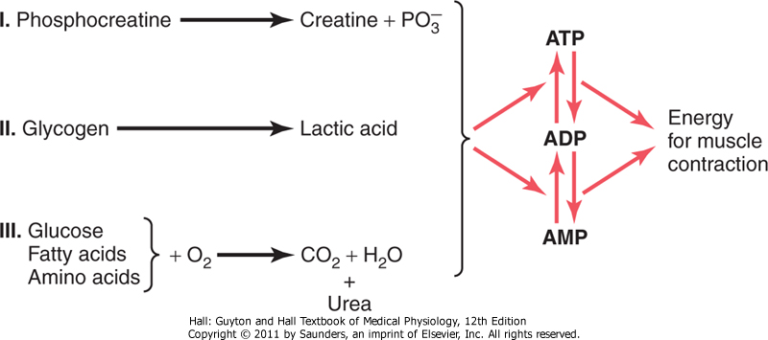
Muscle metabolic systems in exercise
There are 3 metabolic systems exceedingly important in understanding the limits of physical activity.
These are:
1- Phosphocreatine-creatine system
2- glycogen-lactic acid system
3- aerobic system

Slide 4
1-Adenosine Triphosphate (ATP)
Adenosine-po3 ˜ PO3 ˜PO3
Each one of the last 2 high energy phosphate bonds store 7300 calories per mole of ATP
used to energize the muscle contractile process.
Removal of the first phosphate converts the ATP into adenosine diphosphate (ADP), and removal of the second converts this ADP into adenosine monophosphate (AMP).
All ATP in muscle is sufficient for only 3 seconds of muscle power.(Enough for one half of a 50-meter dash)
It is essential to form new ATP continuously even during performance of short athletic events.

Slide 5
2-Phosphocreatine-creatine system= Creatine-phsphate system(creatine ˜ Po3)
Contain high energy phosphate bond has 10300 calories/mole
CP provide enough energy to reconstruct high energy bond of ATP.
Most muscle cells have 2- 4 times as much CP as ATP
Energy transfer from CP to ATP occurs within a small fraction of a second .
Energy of muscle CP is immediately available for contraction just as stored energy of ATP.

Slide 6
2-Phosphocreatine-creatine system= Creatine-phsphate system(creatine ˜ Po3) Cont….
Phosphagen energy system:-
Formed of combined amounts of cell ATP+CP
Together provide maximal muscle power for 8-10 seconds (enough for 100 meter run)
Energy of phosphagen system is useful for maximal short bursts of muscle power ( 8-10 seconds).

Slide 7
3-Glycogen-lactic acid system
a-Anaerobic metabolism ( glycolysis):-
-During glycolysis :- glycogen of the muscle split into glucose without use of O2
-Then each glucose split into:_
2 pyruvic acid + energy to form 4 ATP for each one glucose molecule
b-Oxidative stage:-
- Pyruvic acid in the mitochondria in presence of O2 will form more ATP.
- When there is insufficient O2 most of pyruvic acid converts into lactic acid which diffuse to blood stream

Slide 8
3-Glycogen-lactic acid system cont..
Characteristics of Glycogen-lactic acid system
Glycogen-lactic acid system can form ATP molecules( anaerobically) 2.5 times as rapidly as can oxidative mechanism of mitochondria
Anaerobic Glycolysis can provide large ATP amounts needed for short –moderate periods of muscle contraction ( ½ as rapid as phosphagen system)
Glycogen-lactic acid system provide 1.3-1.6 minutes of maximal muscle activity

Slide 9
Aerobic process:-
Oxidation of foodstuffs glucose, glucose, fatty acids, and amino acids in the mitochondrai in presence of O2 produces energy that coverts AMP to ADP to ATP

Slide 10
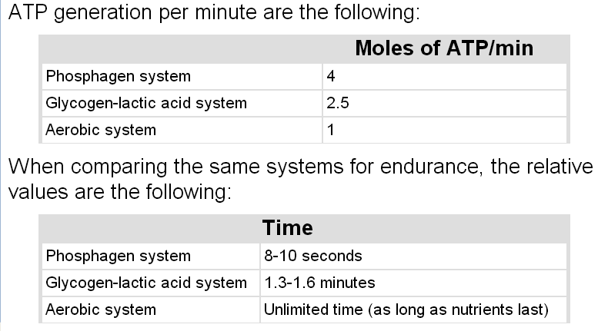
Comparing Energy Supply Aerobic Mechanism,glycogen-lactic Acid System And The Phosphagen System

Slide 11
Energy Systems Used in Various Sports

Slide 12
Recovery of muscle metabolic systems after exercise
Energy from CP reconstitute ATP
Energy from glycogen-lactic acid system reconstitute both CP&ATP
Energy from oxidative metabolism of aerobic system reconstitute all other systems:-glycogen-lactic acid system & CP&ATP
Reconstitution of Lactic acid system( removal of lactic acid):- Lactic acid causes fatigue so it should be removed by:- 1-portion converted into pyruvic acid which is oxidated by all body tissues 2-remaining is changed into glucose in liver to replenish glycogen stores of muscles

Slide 13
2-Recovery of aerobic system after exercise
1-Oxygen Dept:-
This is approximately about 11.5 Litres of O2 should be repaid after exercise is over.
a- 2 Litres of stored O2 (0.5 L in lungs+0.25 L dissolved in body fluids+1 L combined with Hb+ 0.3 L stored in muscle myoglobin)
-This is used within a minute of heavy exercise or for aerobic metabolism & replenished by breathing extra amounts of O2 above the normal needs.
b- 9 Litres more O2 must be consumed to reconstitute phosphagen & lactic acid system
-At first O2 uptake is high & fast to refill stored O2 & phosphagen system ( this is called a lacta cid O2 dept= 3.5 L)
- The later portion of O2 dept takes 40 minutes for lactic acid system removal, it is of lower level breathing, It is called (lactic acid O2 dept =8 L

Slide 14
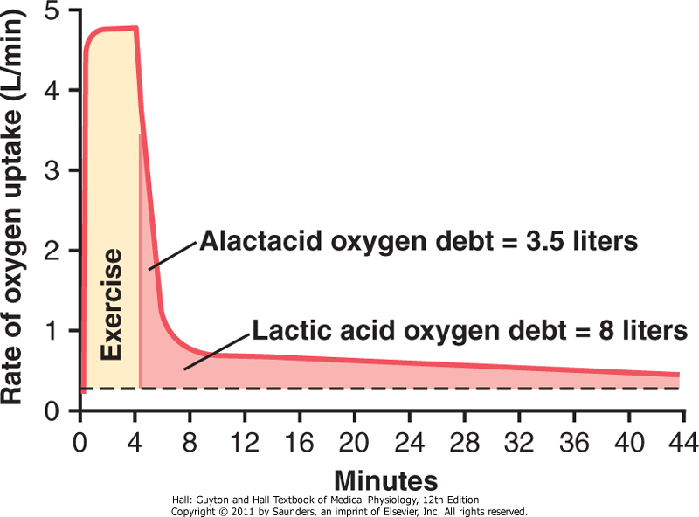
Oxygen Dept

Slide 15
3-Recovery of muscle glycogen
-Reduction of glycogen stores by heavy exercise needs days to be replenished
-On high CHO diet , recovery occurs in 2 days
-On high fat, high protein or on no food all show very little recovery
Message:_
1- Athlete should have high CHO diet before exercise
2- Not to participate in exhausting exercise during 48 hours preceding the event
Read Guyton & Hall: Textbook of Medical Physiology 12E

Slide 16
Nutrients used during muscle activity
During early stages of exercise& intense muscle activity body use CHO of muscle glycogen and blood glucose ,also fats as F.A & very little amino acids
In endurance athletic last longer than 4-5 hours & during exhaustion muscle glycogen is depleted& muscle depend on fats
CHO energy comes from muscle and liver glycogen
Glucose solution given to athletes to drink during athletic event supply 30-40% of energy required during prolonged event as marathon race

Slide 17
Effects of smoking on pulmonary ventilation in exercise
1-Nicotine causes constriction of terminal bronchioles &increases resistance of airflow into & out lung
2-Smoke irritation causes increased fluid secretion into bronchial tree& swelling of epithelial layer
3- Nicotine paralyse the cilia on respiratory epithelial cell surface
All lead to fluid & waste accumulation & level of performance reduced
chronic smokers may develop emphysema(obstruction of bronchiols+chronic bronchitis+destruction of alveoli) so slight exercise cause respiratory pain

Slide 18
Effects of heart disease and old age on athletic performance
Cardiac disease reduce C.O& reduce muscle power
Patient with CHF can not climb the bed
There is 50% decrease in C.O between 18-80
years& decrease in breathing capacity, muscle
mass & power with age
Read Guyton & Hall: Textbook of Medical Physiology 12E

Slide 19
Effect of body fluids and salts in exercise
Exercise for 1 hour during endurance athletic event causes 5-10 pounds of weight loss in hot humid atmosphere due to sweat loss
Loss of enough sweat reduce performance -5-10% loss of weight lead to cramps, nausea &serious effects ,so should be replaced
Sodium tablets or supplemental fluids contain potassium and sodium in form of fruit juice -effect of aldosterone?? Potassium loss results increased secretion of aldosterone then loss of potassium in the urine, and sweat

Slide 20
Drugs and athletes
Caffeine increase athletes performance
Unusual androgens(male sex hormone) & anabolic steroids ( activate ) intake increase athletes performance in men& women but they increase risk of heart attacks due to hypertension
In males male sex hormones decrease testicular functions & decrease natural testosterone secretion
Women develop facial hair, stoppage of menses, ruddy skin and bass voice
3- amphetamine&cocaine improve performance but overuse reduce performance they are psychic stimuli -reaction of these drugs with epinephrene and norepinephrene (hormone adrenal medulla ) secreted during exercise cause death by ventricular fibrillation
Read Guyton & Hall: Textbook of Medical Physiology 12E
Notes:
epinephrene A hormone secreted by the adrenal medulla that is released into the bloodstream in response to physical or mental stress,

Slide 21
Body fitness prolongs life
Multiple studies have shown that body fitness, exercise &weight control have additional benefit of prolonged life(between 50-70) Reasons:- 1-reduce CVD, heart attacks, brain stroke and kidney disease due to low blood pressure, low blood cholestrol ,low LDL, and high HDL
Body fitness reduce insulin resistance and type 2 diabetes Improved body fitness reduces the risk of breast, prostate, and colon cancer and reduces obesity

Slide 22
Thank you !

Slide 23
Reference book
Guyton & Hall: Textbook of Medical Physiology 12E
Thank you

