Slide 1
Community –Acquired Pneumonia
Ali Somily MD

Slide 2
Definition
Disease of alveoli and respiratory brochioles
Whole lobe , around brochi patchy (consuldation vs brocho-pneumonia) or interstial
Defined clinically as a new opacity on chest radiography in the presence of respiratory symptoms

Slide 3
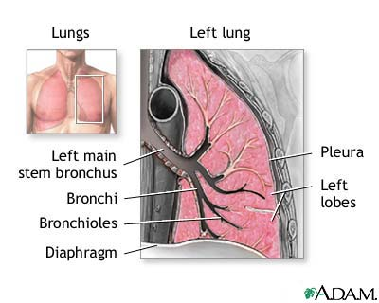
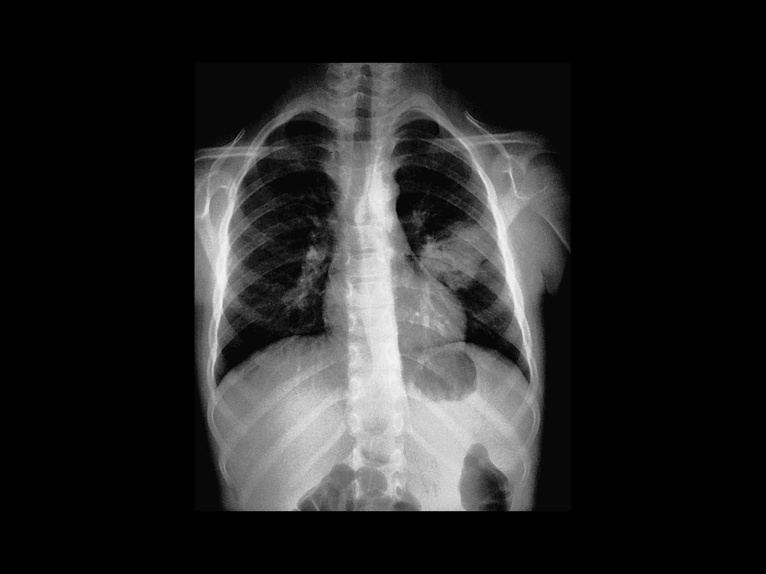
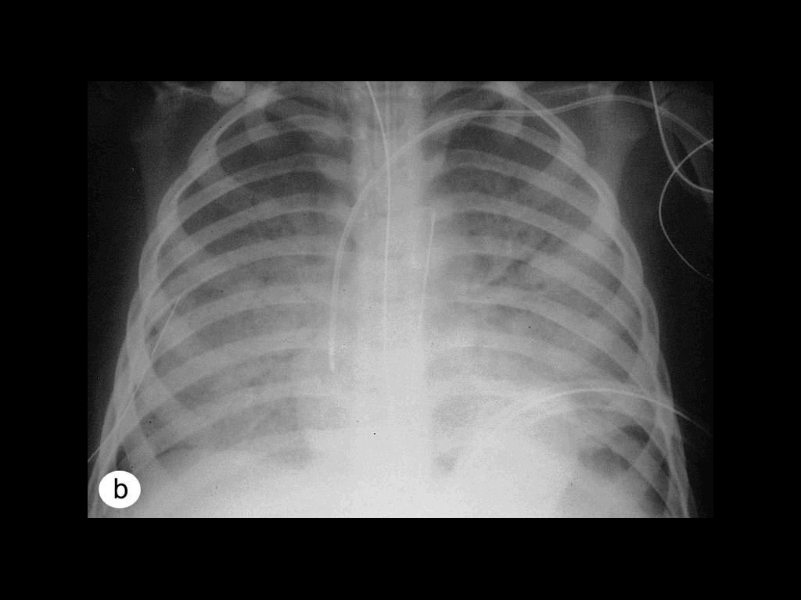
Lung Anatomy

Slide 4
Epidemiology
Common in winter months
It is the sixth leading cause of death in USA
3 millions develop pneumonia and 600,000 hospitalized in USA
The risk factors are old age, asthma, smoking, alcoholism diseases and immunosupression HIV,DM (Chronic lung and heart in S.pneumoniae)
Newly discovered organism and emerging resistance

Slide 6
Classification
Anatomy
Lobar: entire lobe
Bronchopneumonia
Interstitial
Pathogen
Gram-positive as Streptococcus pneumoniae , Staphylococcus aureus, Group A hemolytic streptococci
Gram-negative bacteria :Klebsiella pneumoniae, Hemophilus influenzae, Moraxella catarrhal and Escherichia coli
Atypical Bacteria :Mycoplasma pneumoniae, chlamydophila pneumoniae and legionella. Anaerobic bacteria
Viral and fungal
Acquired environment: community ,hospital ,nursing home acquired and immunocompromised host

Slide 7
What is the most common cause of community-acquired pneumonia?
Childern
Viral
Respiratory syncetial virus
Parainfluenza virus
Human metapneumovirus
Bacterial
S.pneumoniae
H.influenza type B
Group B streptococci in neonate
Adult
S.pneumoniae
Mycoplasma pneumoniae, chlamydophila pneumoniae or respiratory viruses depending on the season
Special conditions
Chronic lung diseases
S.pneumoniae
H.influenza
Recently hospitalized
Gram negative,legionella
Recent inflenza
S.pneumoniae
S.aureus

Slide 8
What is the difference between typical and atypical community-acquired pneumonia?
Variable | Typical | Atypical
Etiology | S.pneumoniae, H.influenza | Mycoplasma pneumoniae, chlamydophila pneumoniae , legionella, TB, viral or fungal
Clinical presentation | Sudden onset of fever, chill, productive cough, shortness of breath and chest pain | Gradual onset headache, sore throat and body ache
Diagnosis Gram Stain | Useful | Useless (no cell wall)
Radiography | Lobar infiltrate | Dramatic changes: patchy or interstitial
Treatment with penicillin | Sensitive | Resistant

Slide 9
Importance of history taking in patient with community-Acquired pneumonia
History
Solid organ transplant | Any pathogen Bacterial , viral, fungal,or parasitic
HIV | Pneumocystis jeroveci
Travel to some area in USA | Endemic Mycosis
Exposure to air-conditioning, cooling towers, hot tub, hotel stay, grocery sore mist machine | Legionella pneumophilla
Exposure to Turkeys, chickens, ducks or parrots | Chlamydia psittaci
Exposure to contaminated bat caves | Histoplasma capsulatum
Exposure tosheep, goat or cattle | Coxiella burnetii
Exposure to rabbits | Francisella tularensis
Occupation | Mycobacterium tuberculosis, HIV

Slide 10
Diagnosis
Physical examination
Respiratory signs on consolidation
Other systems
Chest x-ray examination
Laboratory
CBC- leukocytosis
Electrolytes (↓Na in legionella)
Urea, creatinine, LFT

Slide 11
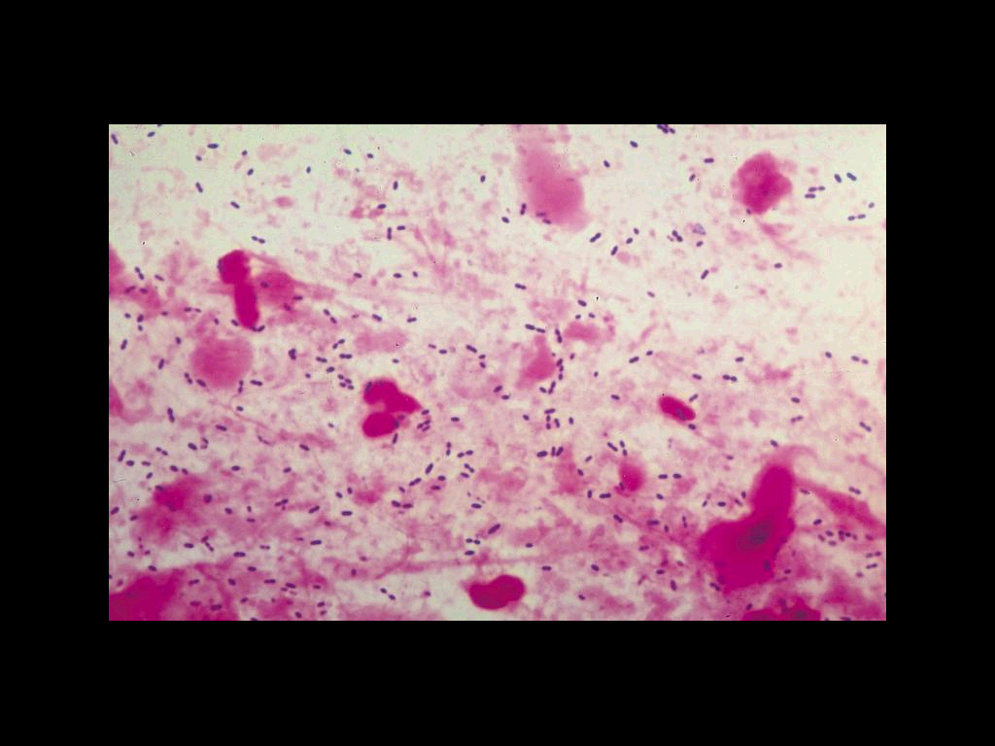
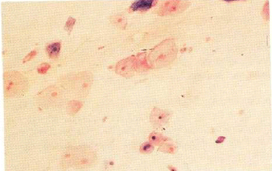
Diagnosis
Sputum Gram stain- 15%
Sputum culture
Bronchoscopic specimens
Blood culture 6-10%
NP swab for respiratory viruses
Legionella urine antigen
Serology for M.pneumoniae,
C.pneumoniae
Cold agglutination M.pneumoniae
More Invasive procedure in sick patient

Slide 12
Management
Outpatient or inpatient (hypotension, confusion and oxygenation) and age
Previous treatment in the past 3 months
Resistance patterns in the community

Slide 13
Antibiotics selection
 | Macrolide (Azithromycin or clathromycin) | Fluoroquinolone(FQ) | Ceftriaxone (βlactam)
Outpatient | √
Outpatient with comorbidity and or macrolides treatnet |  | √ | √ + macrolide
Inpatient Non ICU |  | √ | √+ macrolide
Inpatient ICU |  |  | √ +macrolide or FQ

Slide 14
Other Concerns
Organisms | Antibiotics
Pseudomonas | Macrolide + ceftazime or FQs
MRSA | Vancomycin or linazolid
Chlamydophila psittaci | Macrolide or tetracycline
Coxiella burnetti | Macrolide or tetracycline
Legionella | Erythromycin

Slide 15
Complications
Death 10% , 40% (ICU) within 5 days
Mainly old age with sever pneumonia
Respiratory and cardiac failure
Empyema 10%

Slide 16
Prevention
Vaccination
Influenza
S.pneumoniae
Prevention of Aspiration
Head Position
Teeth cleaning

Slide 17
Mycoplasma pneumonia.
Common adolescence crowded places like schools.
Usually gradual mild
Atypical pneumonia
May be associated with a skin rash and hemolysis
Chlamydophila pneumoniae
Obligate intracellular organism
50% of adults sero-positive
Mild disease
Sub clinical infections common
5-10% of community acquired pneumonia

Slide 18
Legionella pneumophila
Cause outbreak , ICU
Hyponatraemia common
(<130mMol)
Bradycardia
WBC < 15,000
Abnormal LFTs
Raised CPK
Acute Renal failure
Urinary antigen
Treatment erythromycin

