Slide 1
RESPIRATORY BLOCK Practical
2014

Slide 2
Streptococcus pyogenes = Group A Strep
Carried by 10-25% of many
in throat
often no symptoms
it is Cause of
strep throat
impetigo
Necrotizing fasciitis

Slide 3
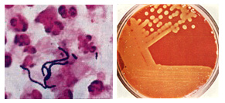
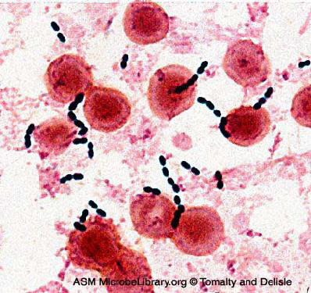
Streptococcus pyogenes. = Group A Strept
Left. Gram stain of Streptococcus pyogenes in a clinical specimen. Right. Colonies of Streptococcus pyogenes on blood agar exhibiting beta (clear) hemolysis

Slide 4
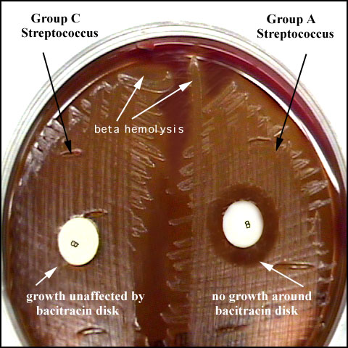
Principle:
Bacitracin test is used for presumptive identification of group A
To distinguish between S. pyogenes (susceptible to B) & non group A such as S. agalactiae (Resistant to B)
Bacitracin will inhibit the growth of gp A Strep. pyogenes giving zone of inhibition around the disk
Procedure:
Inoculate BAP with heavy suspension of tested organism
Bacitracin disk (0.04 U) is applied to inoculated BAP
After incubation, any zone of inhibition around the disk is considered as susceptible

Slide 5
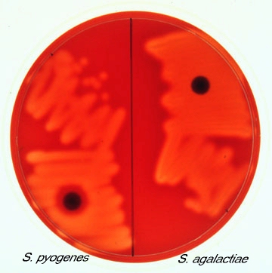
Bacitracin sensitivity

Slide 6
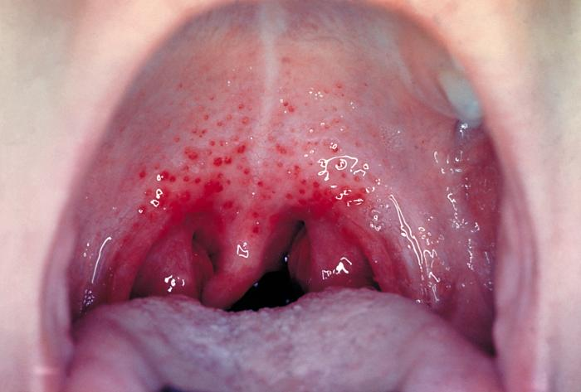
Case 1
A 5 year boy was brought to king Khalid University hospital, outpatient department complaining of fever and sore throat. He had regular vaccination history. On examination his temperature was 38.5° c, the tonsil area and pharynx were obviously inflamed with some foci of pus.

Slide 7
1. What is the differential diagnosis?
2. What investigation should be done?

Slide 8
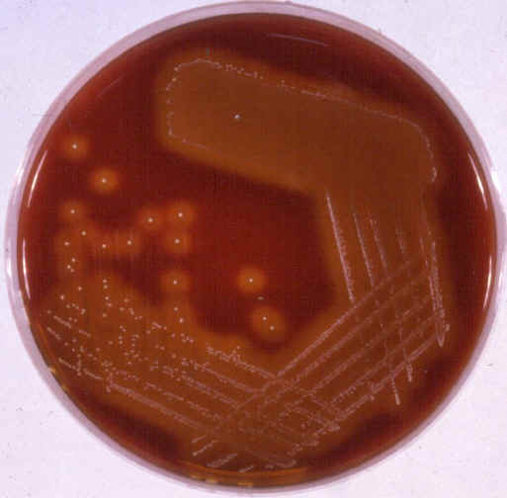
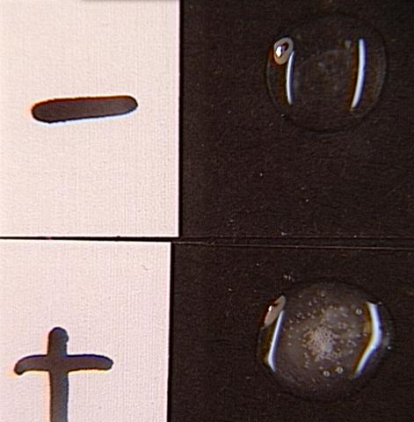
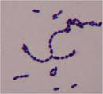
Lab tests
The full blood count showed a total white cell count of 15000ml.Throat swab culture showed colonies with clear haemolysis on blood agar. They were catalase negative .The gram stain of these colonies showed gram positive cocci in chains

Slide 9
1. What is the likely identity of the organism?
2. What is the best antibiotic therapy for this child?
3. If not treated what complication may this child have after 6 weeks period?

Slide 10
Streptococcus pneumoniae (Pneumococci)

Slide 11
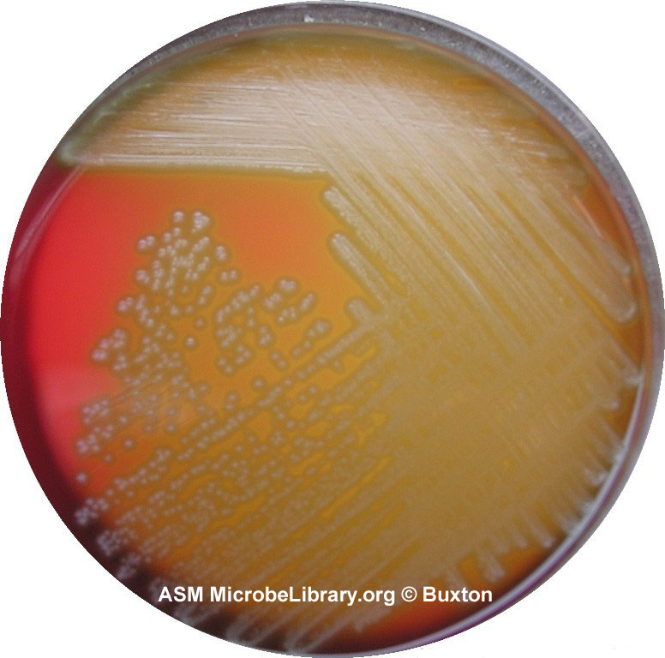
Alpha-hemolysis
Alpha-hemolytic Streptococcus species "Viridans group" streptococci, including species such as the Streptococcus mutans, mitis, and salivarius groups display alpha hemolysis.

Slide 12
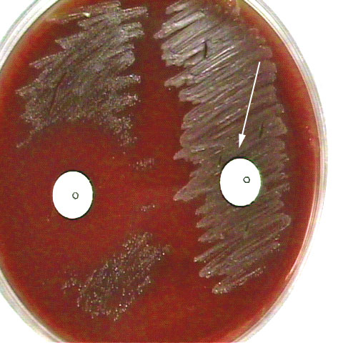
Optochin Susceptibility Test
Optochin resistant
S. viridans
Optochin susceptible
S. pneumoniae

Slide 13
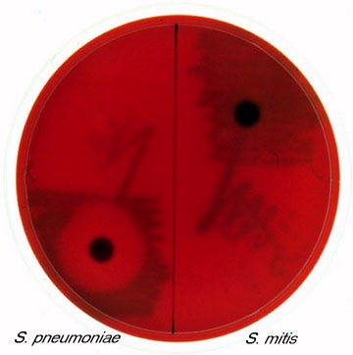
Optochin Sensitive

Slide 14
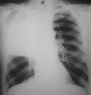
CASE 2
A 28 Year Old Female presented to the accident and emergency of KKUH with a sudden onset of fever, right sided chest pain and productive cough of purulent sputum. On examination her temperature was 39 °C. There were Rhonci and dullness on the right side of the chest. X-ray showed massive consolidation on the right side of the chest.

Slide 15
1. What is the most likely diagnosis?
2. What investigation should be done?

Slide 16
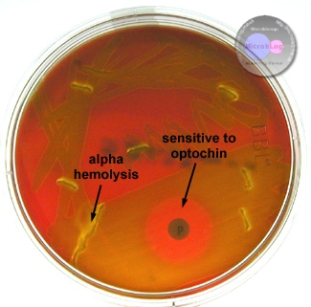
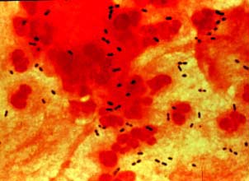
LAB TESTS
The blood counts showed a total white cell count 45,000/ ml 90% of the cells were neutrophils. The sputum culture showed alpha haemolytic colonies on blood agar. The gram stain showed gram positive diplococcic.which were catalase negative This organism was confirmed to be optician susceptible.
3. What should have been the empirical therapy for this case and why?

Slide 17
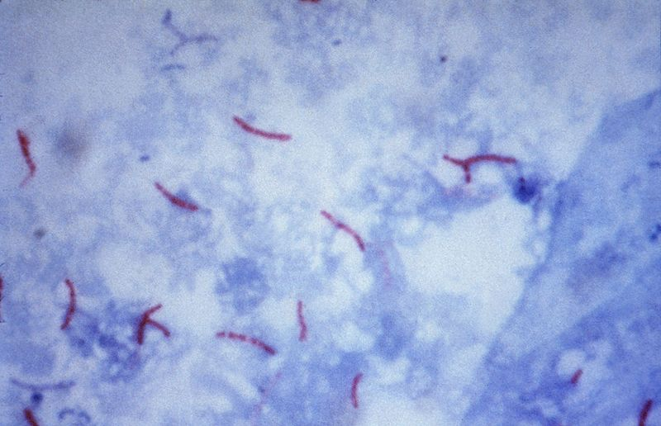
Sputum Microscopy
Mycobacterium tuberculosis: Ziehl-Neelsen stain

Slide 18
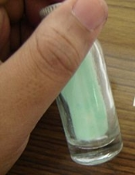
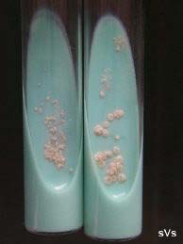
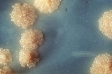
Mycobacterium tuberculosis
Growth on L.J medium( selective for mycobacteria

Slide 19
CASE 3
Abdul Karim is a 45 year old Saudi man who was admitted to King Khalid University Hospital because of 2-3 month history of loss of appetite, weight loss, and on and off fever with attacks of cough. Two days before admission .he coughed blood (haemoptysis) Abdul karim is diabetic for the last 5 years. His father died of tuberculosis at the age of 45 yrs.

Slide 20
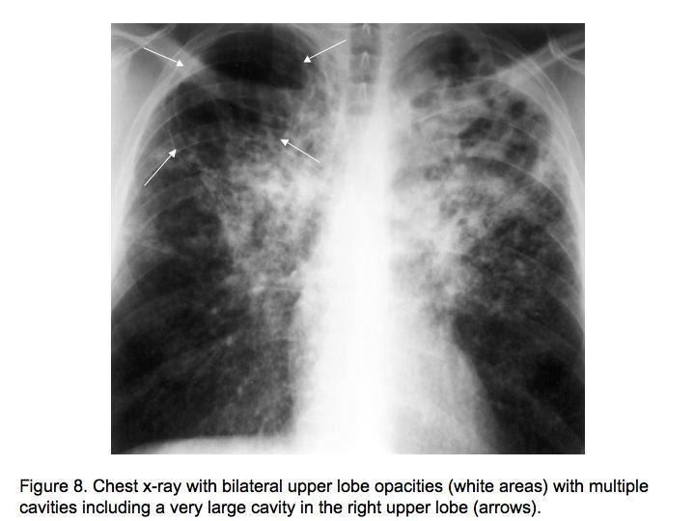
On examination Abdul Karim looked weak with a temperature 38.6 °C, CVS and Respiratory system examinnation was unremarkable.
The chest X- ray done showed multiple opacities and cavities
The ESR was increased (85 m /hour)
What further tests should be done?

Slide 21
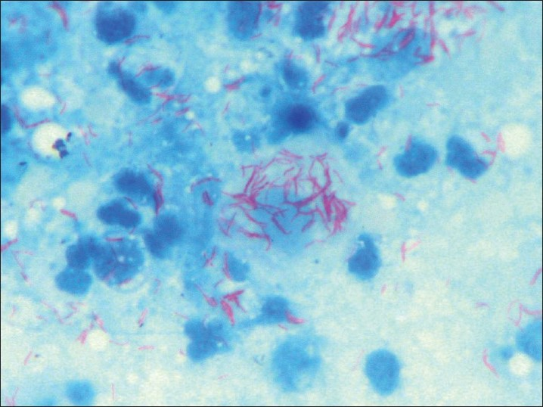
Sputum AFB smear
Sputum smear showed AFB
What is the probable diagnosis?
How can the diagnosis be confirmed?

Slide 22
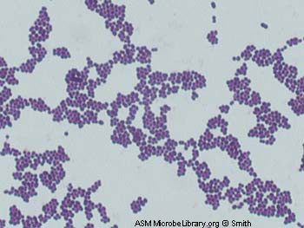
Gram positive, cocci, in clusters

Slide 23
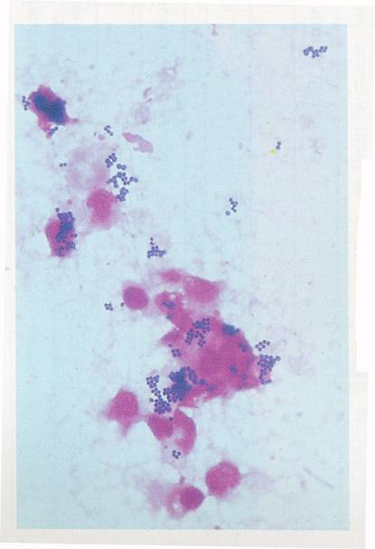
Staphylococci
Stained in Pus

Slide 24
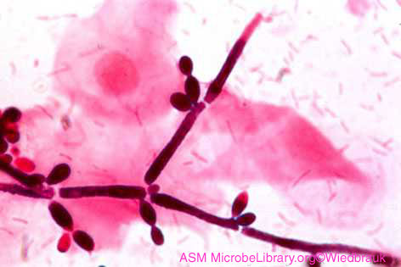
Vaginal Smear of a Person with Candida Vaginitis
Note epithelial cells, rod-shaped bacteria, and Candida albicans in its hyphal form

Slide 25
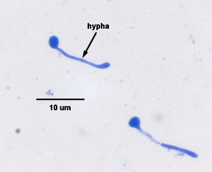
Candida albicans Producing
Germ tube
Dimorphic Candida albicans switching from a yeast form to a filamentous form

Slide 26
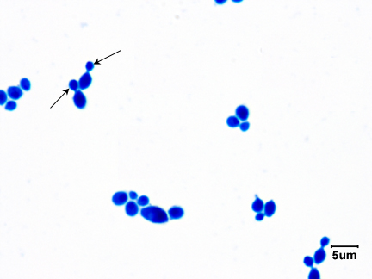
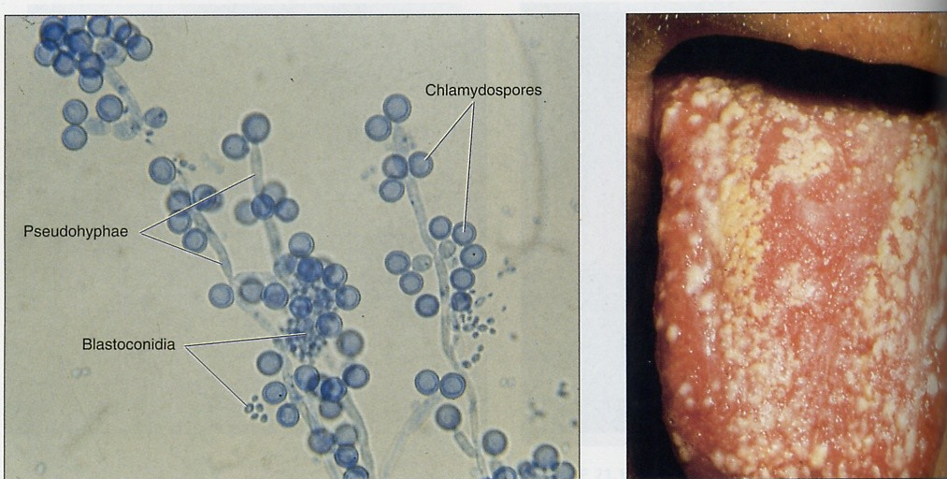
Gram stain of candida: ovoid budingYeast
Chlamydospore Oral Candida or oral thrush

Slide 27
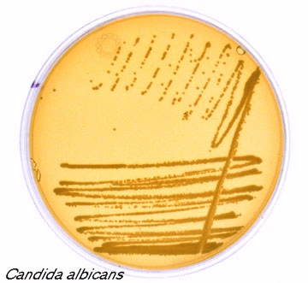
Growth on Sabouraud's Dextrose Media

Slide 28
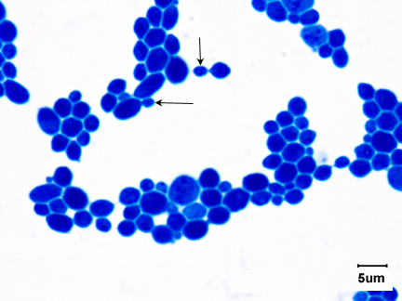
Gram stain of Candida albicans Showing budding yeast celols

Slide 29
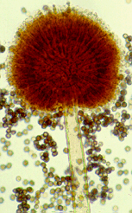
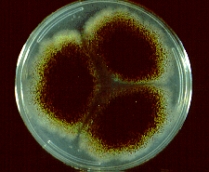
Aspergillus niger
Culture of Aspergillus niger.
Conidial head of A. niger

Slide 30
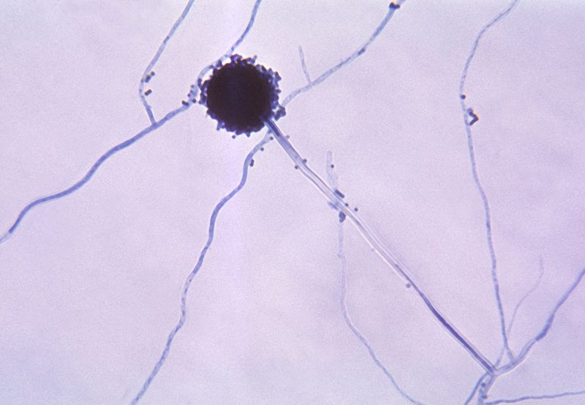
Aspergillus niger

Slide 31
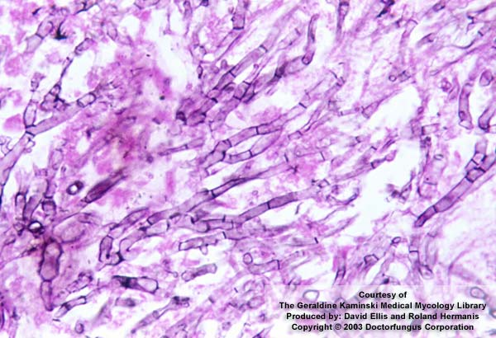
Aspergillosis
Methenamine silver (GMS) stained tissue section of lung showing dichotomously branched

