Slide 1
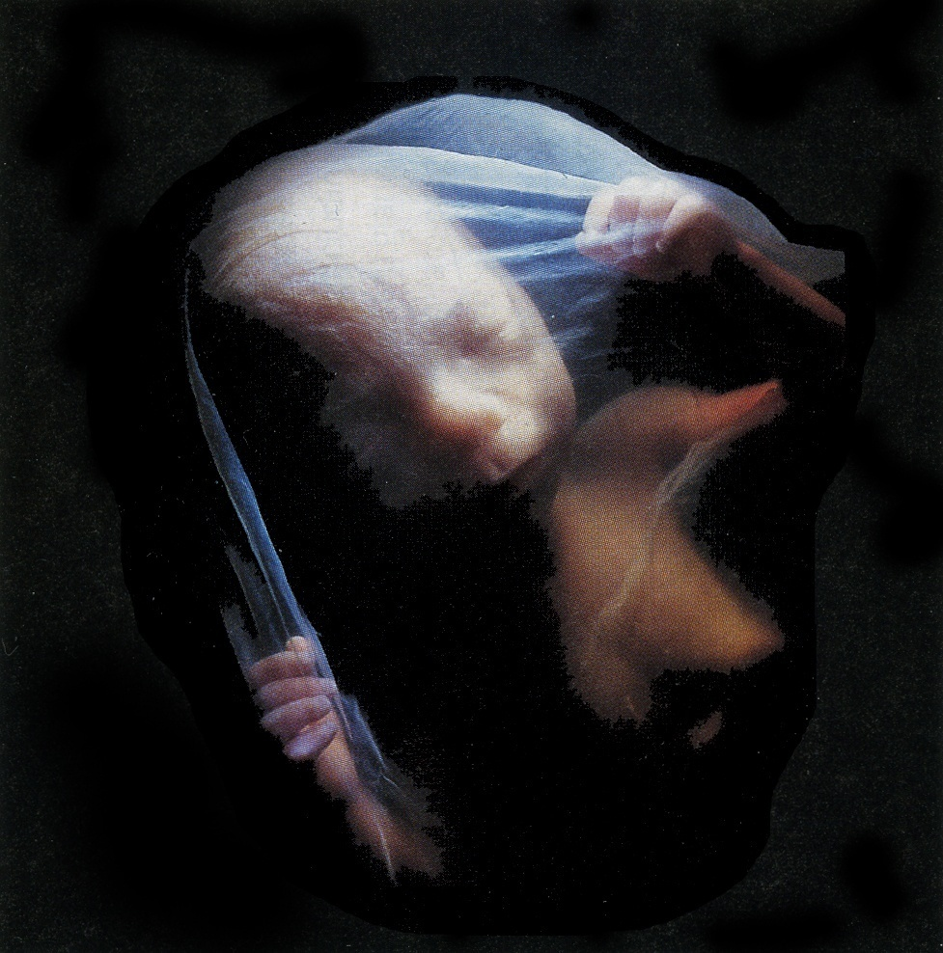
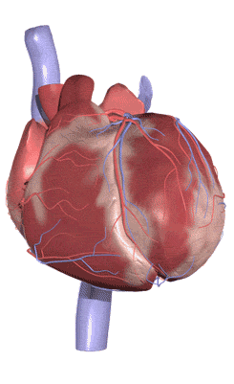
HEART DEVELOPMENT
Prof. Saeed Abuel Makarem

Slide 2
Objectives
By the end of the lecture the student should be able to:
Describe the formation, site, union, division of the of the heart tube.
Describe the formation and fate of the sinus venosus.
Describe the formation of the interatrial and the interventricular septae.
Describe the formation of the two atria and the two ventricles.
Describe the partitioning of the truncus arteriosus and formation of the aorta and pulmonary trunk.
List the most common cardiac anomalies.

Slide 3
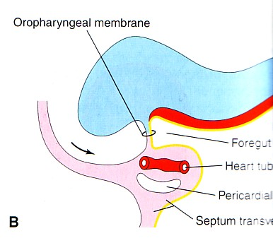
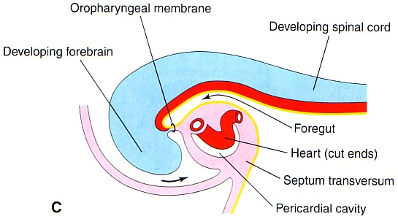
FORMATION OF THE HEART TUBE
The heart is the first functional organ to develop.
It develops from splanchnic mesoderm (cardiogenic area), cranial to the developing mouth and nervous system.
It lies ventral to the developing pericardial sac.
The heart primordium is first evident at 18 days (as an angioplastic cords which soon canalize to form the 2 heart tubes).
After completion of the head fold, the developing heart tubes lie in the ventral aspect of the embryo and dorsal to the developing pericardial sac.
After lateral folding of the embryo
the 2 heart tubes fuse together to
form a single endocardial heart tube.
It begins to beat at 22 to 23 days.

Slide 4
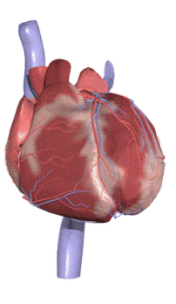
Blood flow begins during the beginning of the fourth week and can be visualized by Ultrasound Doppler

Slide 5
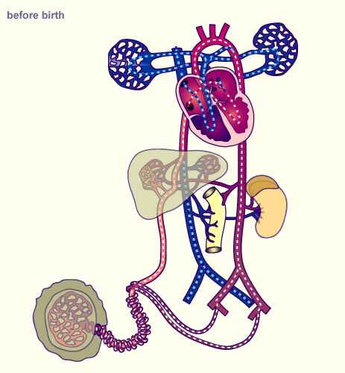

Slide 6
Development of the Heart tube
After lateral folding of the embryo, the 2 heart tubes approach each other and fuse in a craniocaudal direction to form a single endocardial heart tube within the pericardial sac.

Slide 7
What is the fate of the Heart Tube?
The heart tube grows faster than the pericardial sac, so it shows 5 alternate dilations separated by constrictions.
These are:
Sinus Venosus.
Truncus Arteriosus.
Bulbus Cordis.
Common Ventricle.
Common Atrium.
The endocardial heart tube has 2 ends:
1. Venous end; Sinus Venosus.
2. Arterial end; Truncus arteriosus

Slide 8
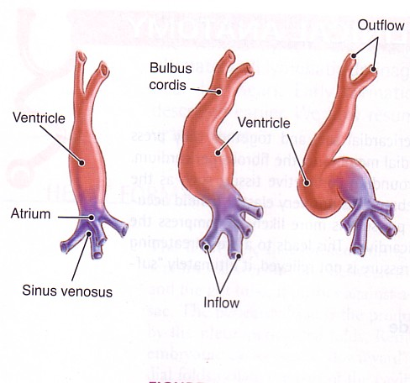
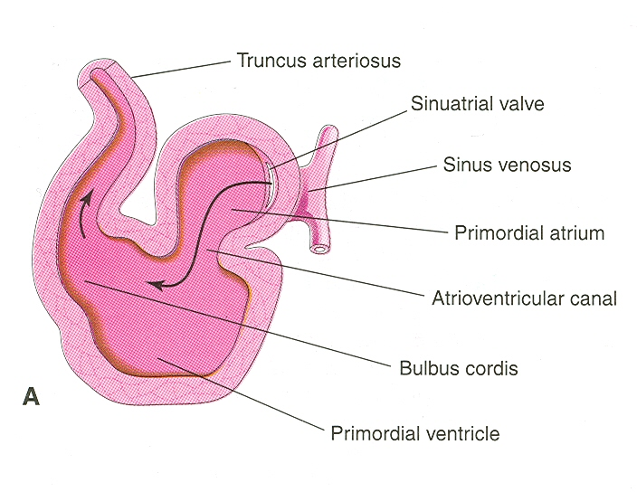
U-SHAPED HEART TUBE
Bulbus cordis and ventricle grow faster than the other regions.
So the heart bends upon itself, forming
The U-shaped heart tube, or (bulboventricular loop).
bulboventricular loop

Slide 9
Loop formation Or S-Shaped Heart Tube
As the heart tube develops it bends, upon itself:
SO, the atrium and sinus venosus become dorsal to the truncus arteriosus, bulbus cordis, and ventricle.
By this stage the sinus venosus has developed 2 lateral expansions, called the 2 horns ( right and left horns) and a body.

Slide 10
Veins Associated With Heart Development
Each horn of the sinus venosus receives
3 veins:
1.Common cardinal
2.Vitelline
3.Umbilical
Cardinal vein from the fetal body.
Vitelline from the yolk sac.
Umbilical from the placenta.

Slide 11
Fate of Sinus Venosus
The right horn forms the smooth posterior wall of the right atrium.
The left horn and the body of the sinus venosus atrophy and form the coronary sinus.
The left common cardinal vein forms the oblique vein of the left atrium.

Slide 12
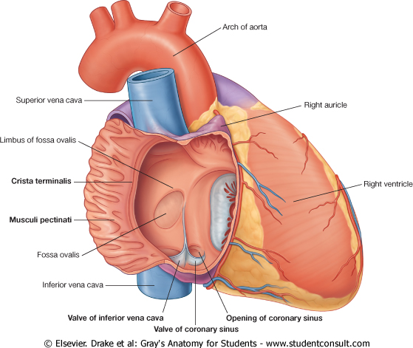
Right Atrium
The right horn of the sinus venosus forms the smooth posterior part of the right atrium.
Rough Trabeculated anterior part of the right atrium is derived from the primitive or primordial common atrium.
These two parts are demarcated by the crista terminalis internally and sulcus terminalis externally.

Slide 13
Left Atrium
Rough Trabeculated part: derived from the primitive or common primordial atrium.
The smooth part:
derived from the absorbed part of the Pulmonary Veins.

Slide 14
Partitioning of Primordial Heart
Partitioning of:
1- Atrioventricular canal.
2- Common atrium.
3- Common ventricle.
4- Bulbus cordis.
It begins by the
middle of 4th week.
It is completed by
the end of 5th week.

Slide 15
Partitioning of the atrioventricular canal
Two dorsal and ventral subendocardial cushions are formed on the dorsal and ventral walls of the AV canal.
The AV subendocardial cushions approach each other and fuse together to form the septum intermedium.
Dividing the AV canal into right & left canals.
These canals partially connect the primordial atrium and primordial ventricle.

Slide 16
Partition of the common atrium
Septum Primum
A sickle- shaped septum grows from the roof of the common atrium towards the septum intermedium.
So the common atrium is divides into right & left halves.

Slide 17
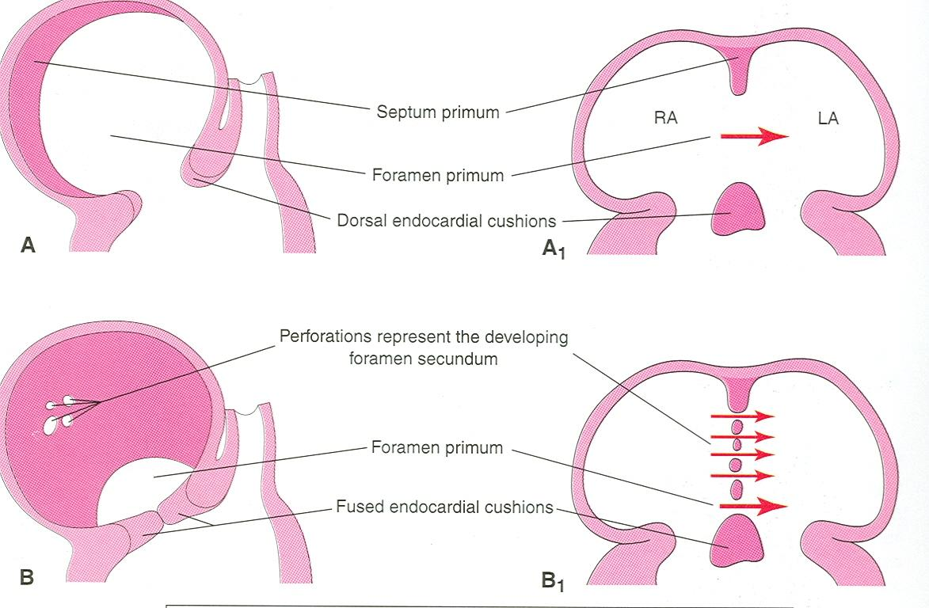
Ostium Primum
The two ends of the septum primum reach to the growing subendocardial cushions before its central part.
So the septum primum bounds a foramen called ostium primum.
It serves as a shunt, enabling the oxygenated blood to pass from right atrium to left atrium.
The ostium primum become smaller and disappears as the septum primum fuses completely with subendocardial cushions (septum intermedium) to form the interatrial septum.

Slide 18
Septum Secundum
The upper part of septum primum that is attached to the roof of the common atrium shows gradual resorption forming an opening called ostium secondum.
Another septum descends on the right side of the septum primum called septum secundum.
It forms an incomplete partition between the two atria.
Consequently a valvular foramen forms, (foramen ovale).

Slide 19
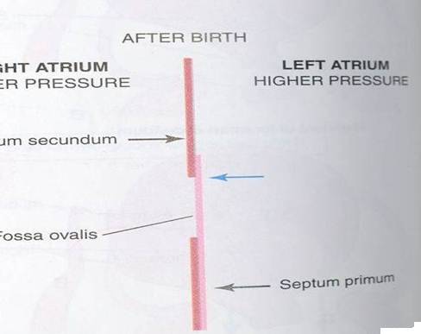
Fate of foramen Ovale
At birth when the lungs inflated and pulmonary circulation begins the pressure in the left atrium increases and exceeds that of the right atrium.
So the two septae oppose each other.
Its site is represented by the Fossa Ovalis.
The septum primum forms the floor of the fossa ovalis.
The septum secondum forms the margin of the fossa ovalis which is called the limbus ovalis or (anulus) ovalis.

Slide 20
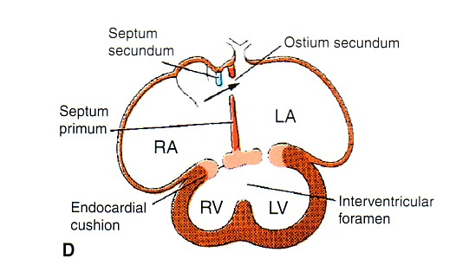
Partitioning of Primordial Ventricle
Muscular part of the interventricular septum.
Division of the primordial ventricle is first indicated by a median muscular ridge, the primordial interventricular septum.
It is a thick crescentic fold which has a concave upper free edge.
This septum bounds a temporary connection between the two ventricles called interventricular foramen.

Slide 21
Interventricular Septum
The membranous part
of the IV septum is
derived from:
1- A tissue extension from the right side of the endocardial cushion.
2- Aorticopulmonary septum.
3- Thick muscular part of the IV septum.

Slide 22
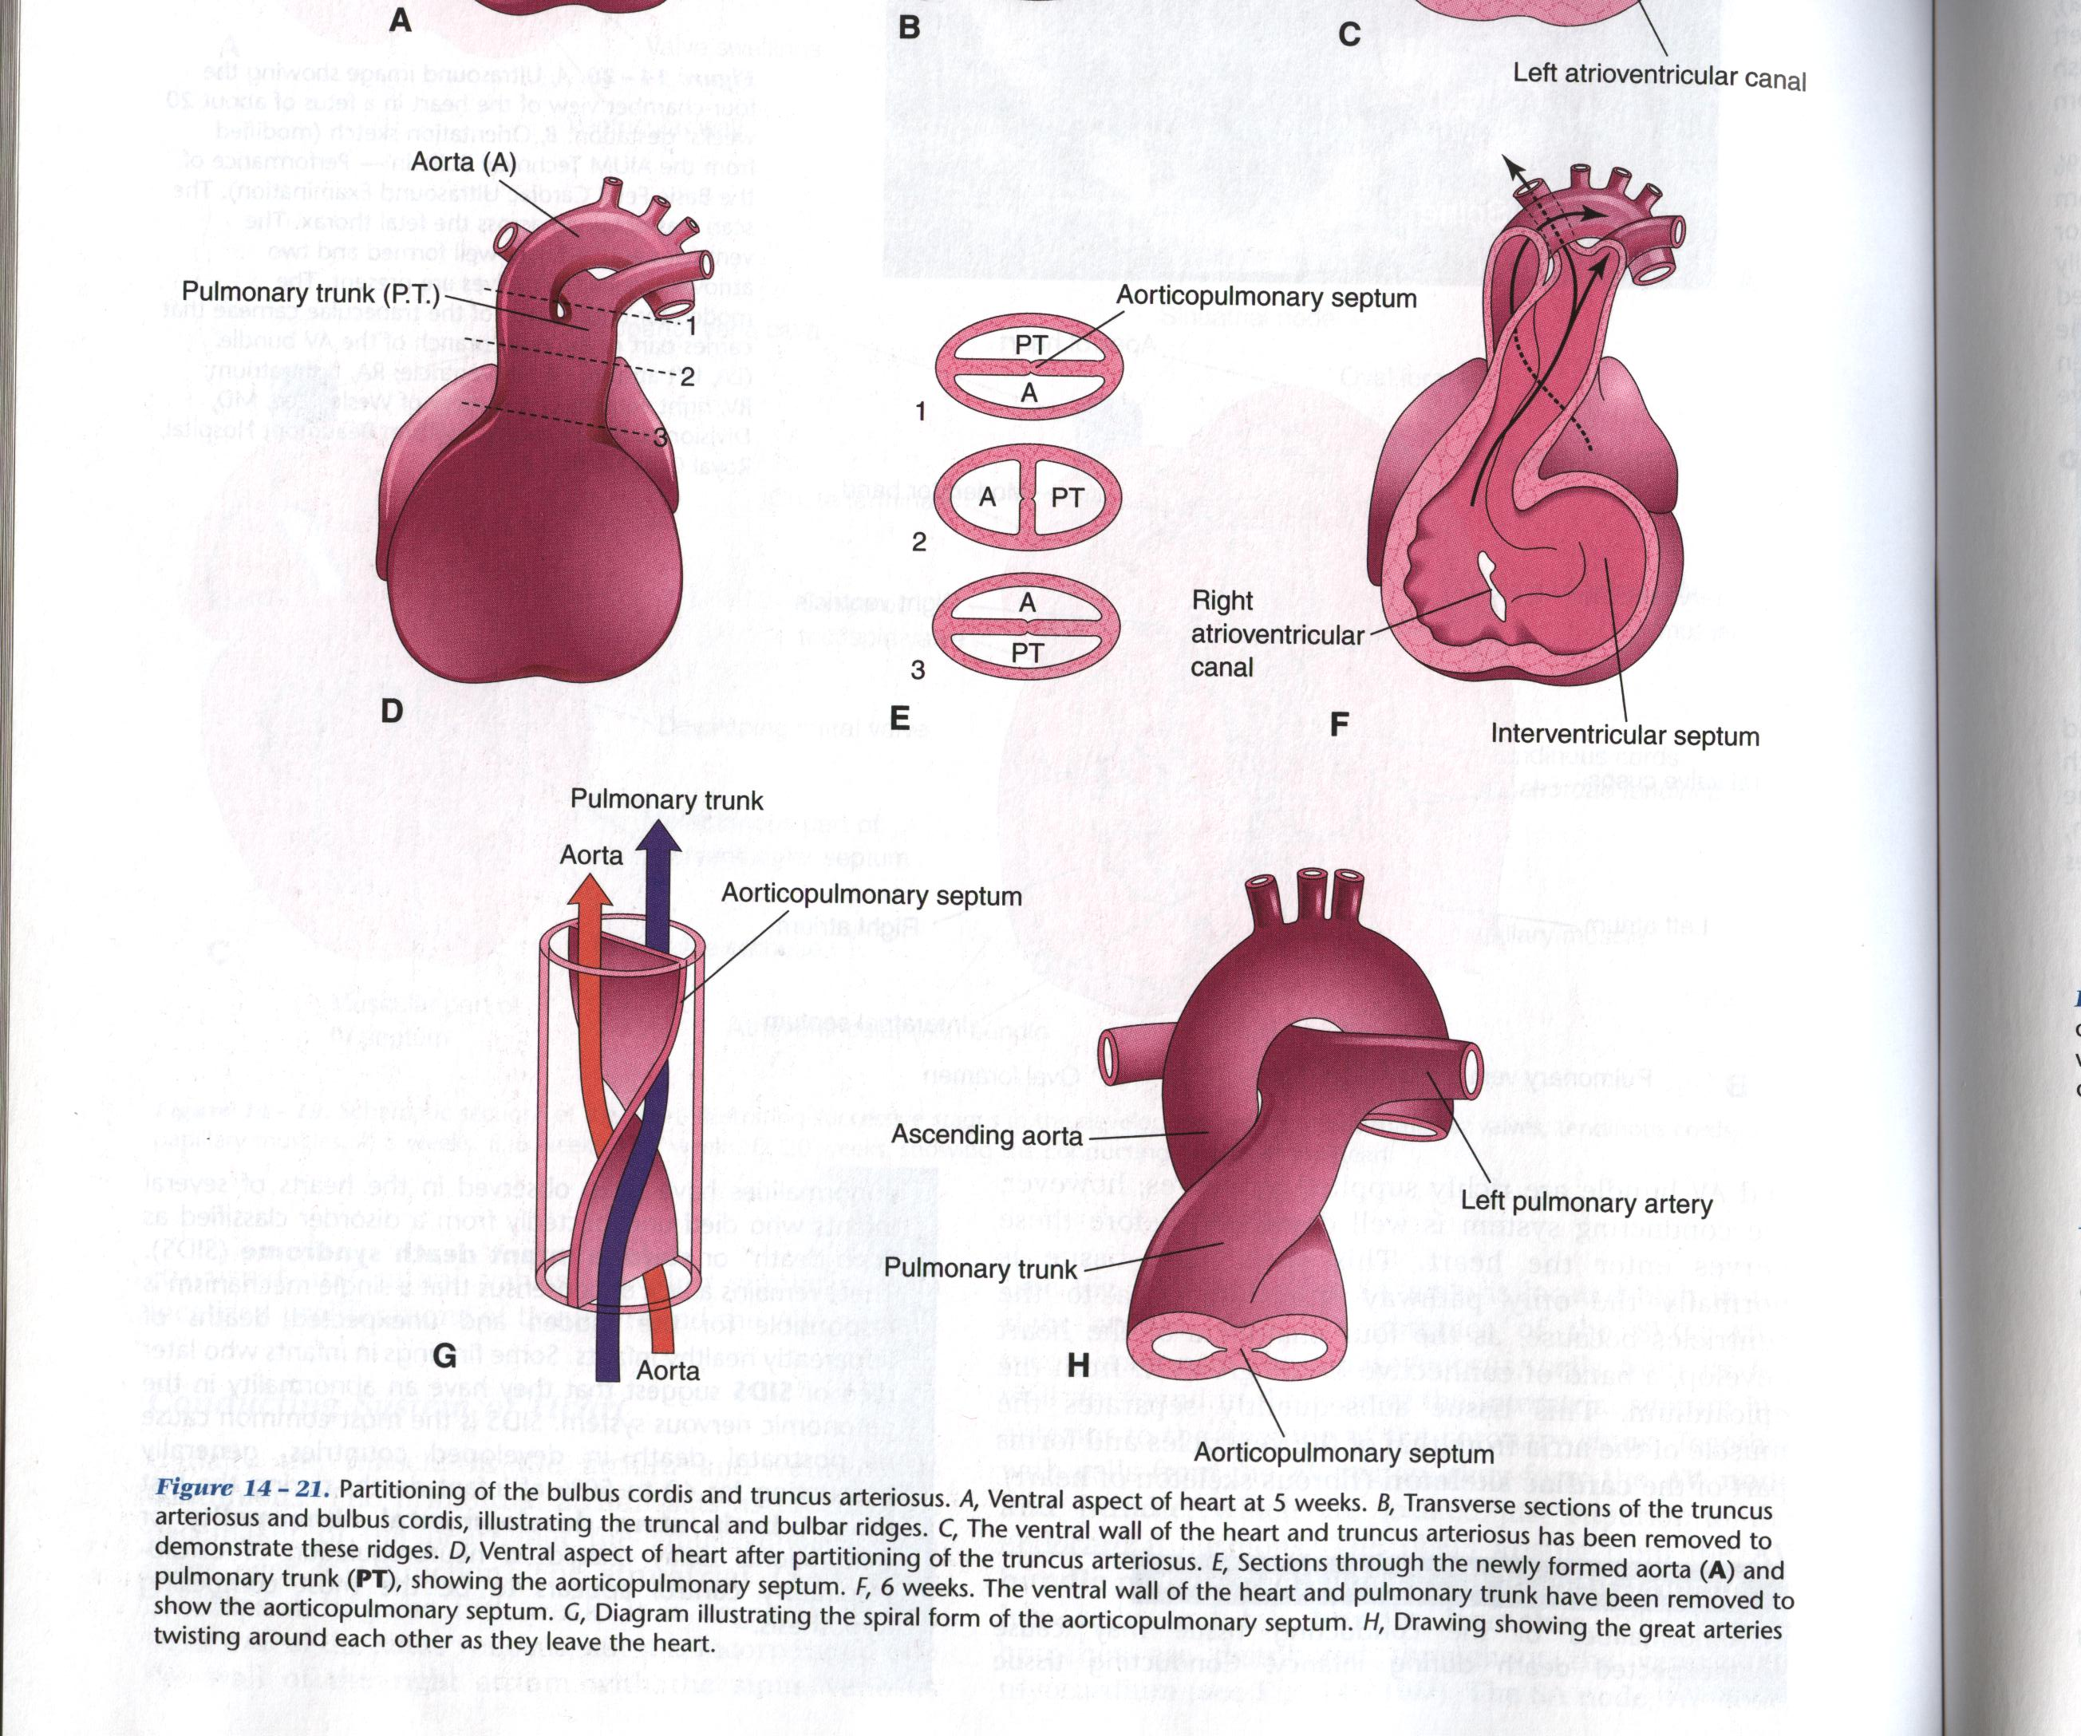
Spiral Aorticopulmonary Septum
A spiral septum develops in the truncus arteriosus dividing it into aorta and pulmonary trunk.
So, now the pulmonary artery joins the right ventricle while the aorta joins the left ventricle.

Slide 23
BULBUS CORDIS
The bulbus cordis forms the smooth upper part of the two ventricles.
Right Ventricle:
Conus Arteriosus or (Infundibulum) which leads to the pulmonary trunk.
Left ventricle:
Aortic Vestibule leading to ascending aorta.

Slide 24
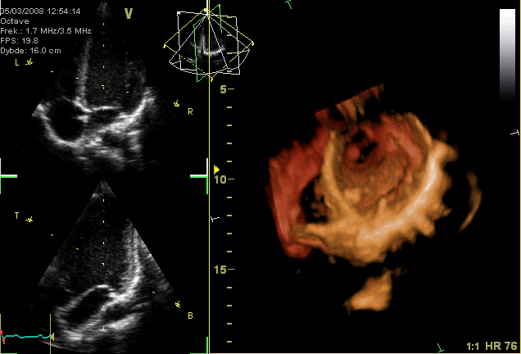
MAJOR CARDIAC ANOALIES

Slide 25
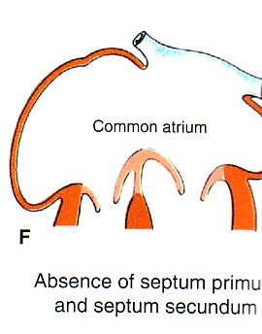
Atrial Septal Defects (ASD)
Absence of septum primum and septum secundum, leads to common atrium.
Absence of Septum Secundum

Slide 26
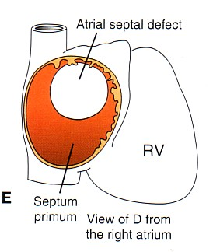
Excessive resorption of septum primum (ASD)
Patent foramen ovale

Slide 27
VENTRICULAR SEPTAL DEFECT (VSD)
Roger’s disease
Absence of the membranous part of interventricular septum.
Usually accompanied by other cardiac defects.

Slide 28
TETRALOGY OF FALLOT
Blue Baby
Fallot’s Tetralogy:
1-VSD.
2- Pulmonary stenosis.
3-Overriding of the aorta
4- Right ventricular hypertrophy.

Slide 29
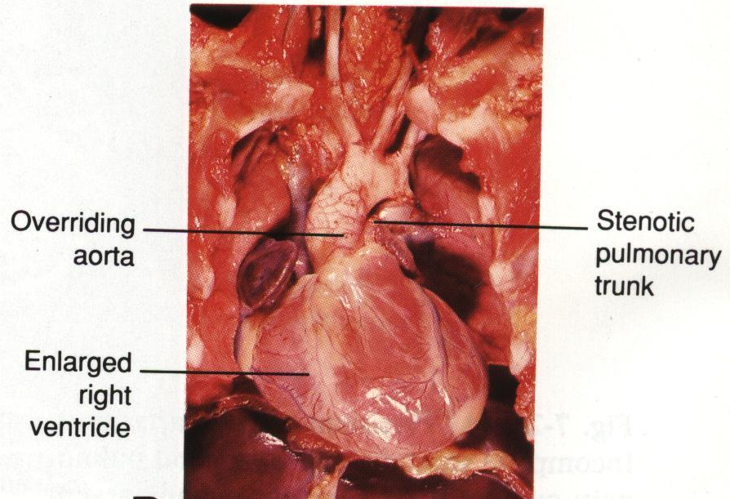
TETRALOGY OF
FALLOT
Blue Baby

Slide 30
(TGA) OR TRANSPOSITION OF GREAT ARTERIES
TGA is due to abnormal rotation or malformation of the aorticopulmonary septum, so the right ventricle joins the aorta, while the left ventricle joins the pulmonary artery.
One of the most common cause of cyanotic heart disease in the newborn
Often associated with ASD or VSD.
Blue Baby

Slide 31
Persistent Truncus Arteriosus
It is due to
failure of the
development of the
aorticopulmonary
(spiral) septum.
It is usually
accompanied with
VSD.

Slide 32
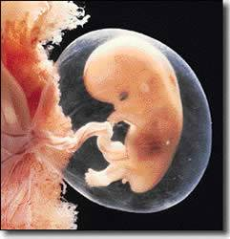
THANK YOU

