Slide 1
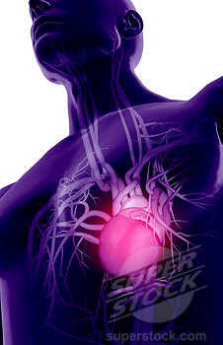
Venous System
Khaleel Alyahya, PhD, MEd
@khaleelya

Slide 2
#حوار_التشريح

Slide 3

Blood Vessels

Slide 4
Objectives
At the end of the lecture, the student should be able to:
  Define veins, and understand the general principles of venous system.
  Describe the superior & inferior Vena Cava and their tributaries.
  List major veins and their tributaries in the body.
  Describe the Portal Vein.
  Describe the Portocaval Anastomosis.

Slide 5
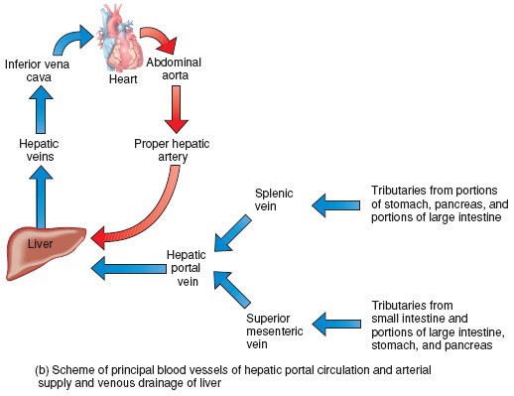
Veins
Veins are blood vessels that bring blood back to the heart.
All veins carry deoxygenated blood
  with the exception of the pulmonary veins and umbilical veins
There are two types of veins:
  Superficial veins: close to the surface of the body
    NO corresponding arteries
  Deep veins: found deeper in the body
    With corresponding arteries
Veins of the systemic circulation:
  Superior and inferior vena cava with their tributaries
Veins of the portal circulation:
  Portal vein

Slide 6
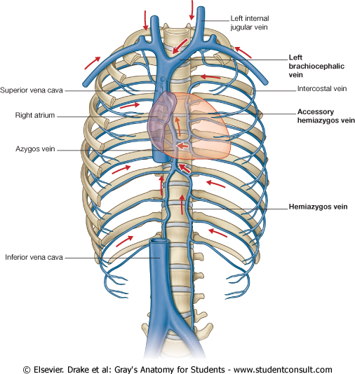
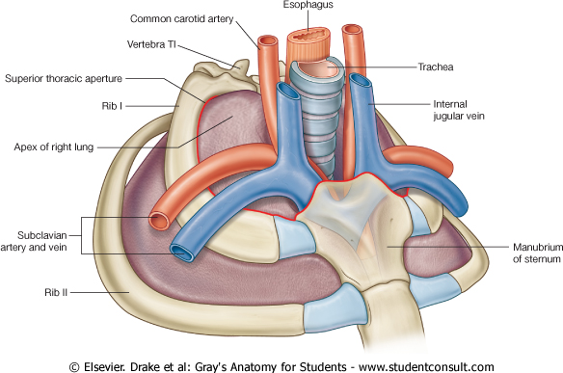
Superior Vena Cava
Formed by the union of the right and left Brachiocephalic veins.
  Brachiocephalic veins are formed by the union of internal jugular and subclavian veins.
Drains venous blood from:
  Head &neck
  Thoracic wall
  Upper limbs
It Passes downward and enter the right atrium.
Receives azygos vein on the posterior aspect just before it enters the heart.

Slide 7
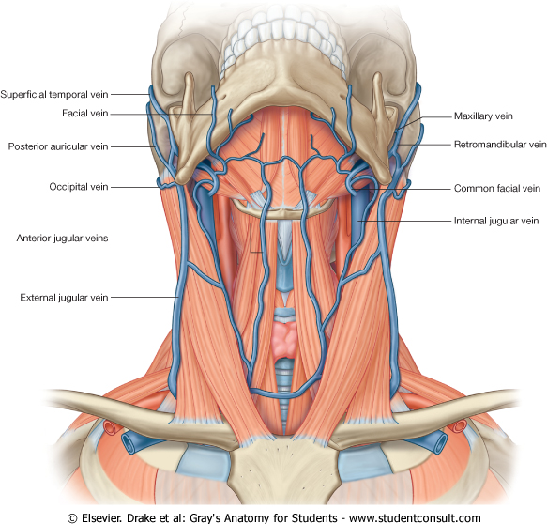
Veins of Head & Neck
Two divisions:
  Superficial Veins
    External Jugular veins
    Anterior jugular veins
  Deep Veins
    Internal Jugulars veins

Slide 8
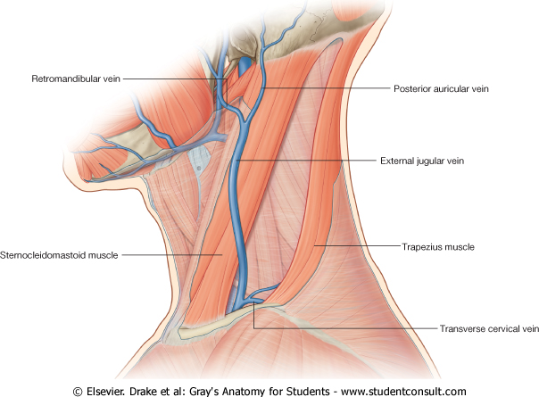
Superficial Veins of Head & Neck
External Jugular Veins:
  Lies superficial to the sternomastoid muscle
  It passes down the neck and it is the only tributary of the subclavian vein.
  It drains blood from:
    Outside of the skull
    Deep parts of the face.

Slide 9
Superficial Veins of Head & Neck
Anterior jugular veins:
  It begins in the upper part of the neck by the union of the submental veins.
  It descends close to the median line of the neck, medial to the sternomastoid muscle.
  At the lower part of the neck, it passes laterally beneath that muscle to drain into the external jugular vein.
  Just above the sternum the two anterior jugular veins communicate by a transverse vein to form the jugular arch.

Slide 10
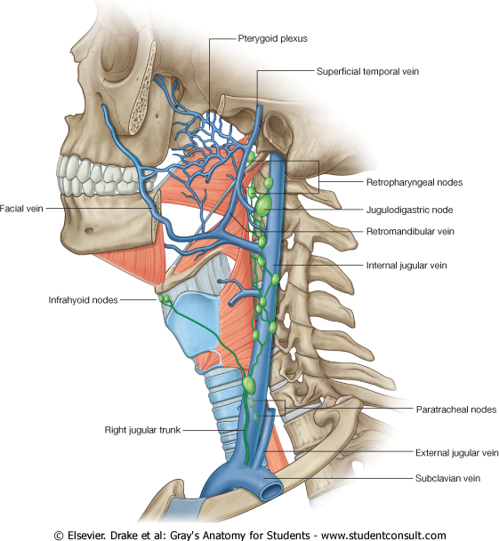
Deep Veins of Head & Neck
Internal Jugulars vein:
  Drains blood from the head, brain, face & neck.
  It descends in the neck along with the internal and common carotid arteries and vagus nerve, within the carotid sheath.
  Joins the subclavian vein to form the brachiocephalic vein.
  Tributaries:
    Superior thyroid
    Lingual
    Facial
    Occipital veins
    Dural venous sinuses

Slide 11
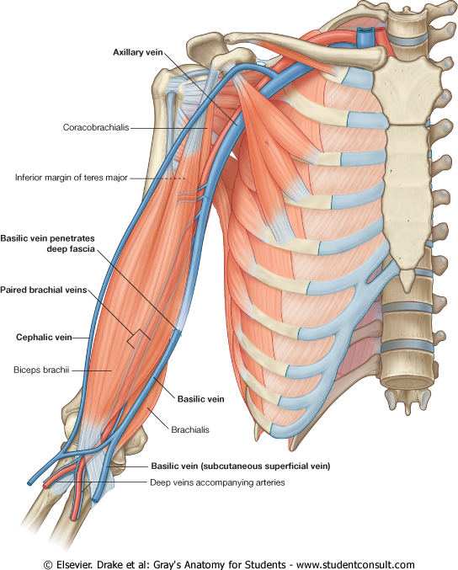
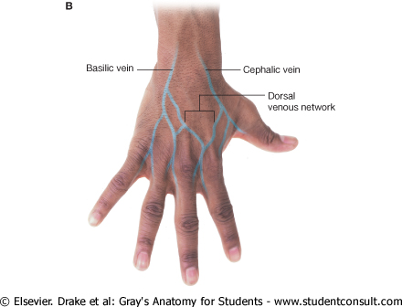
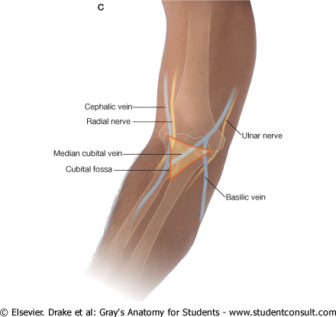
Veins of Upper Limbs
Two divisions:
  Superficial Veins
  Deep Veins

Slide 12
Veins of Upper Limbs
  Superficial Veins
  Cephalic vein
    Ascends in the superficial fascia on the lateral side of the biceps.
    Drains into the Axillary vein.
  Basilic vein
    Ascends in the superficial fascia on the medial side of the biceps.
    Halfway up the arm, it pierces the deep fascia
    At the lower border of the teres major it joins the venae comitantes of the brachial artery to form the Axillary vein.

Slide 13
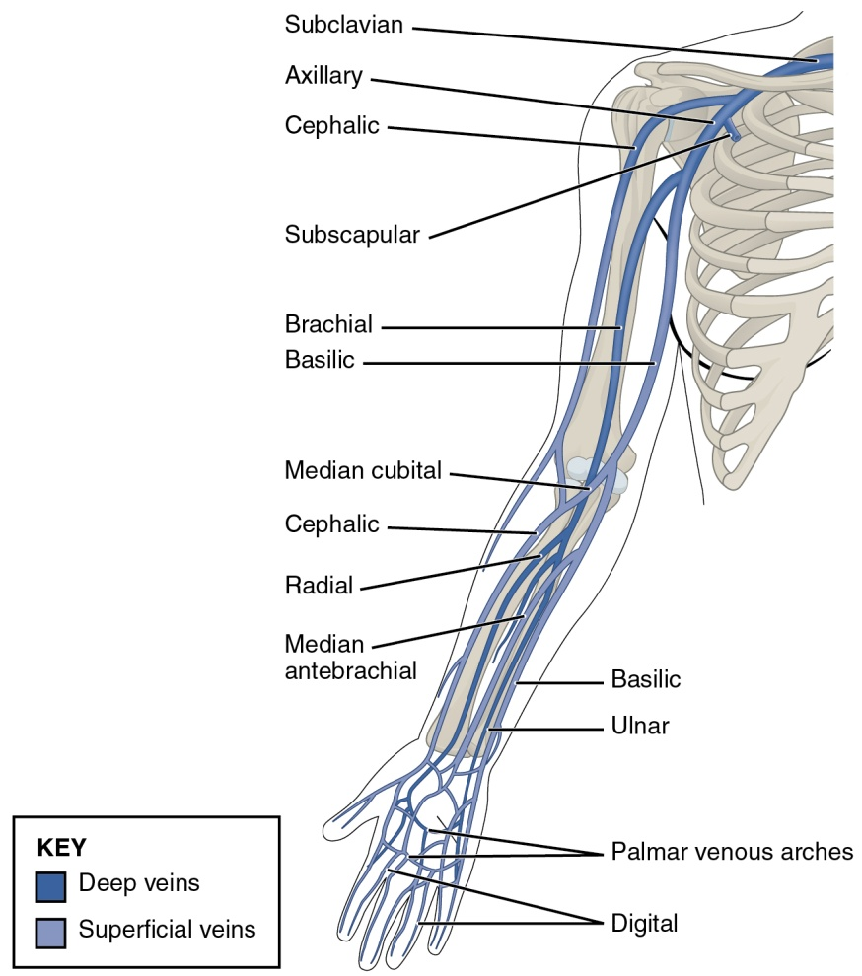
Veins of Upper Limbs
  Deep Veins
  Venae commitantes
    Which accompany all the large arteries, usually in pairs.
      Brachial Vein
      Ulnar Vein
      Radial Vein
  Axillary vein
    Formed by the union of basilic vein and the venae comitantes of the brachial artery.

Slide 14
Question for review
Which statement is not TRUE?
Venae commitantes accompany all the superficial arteries.
Basilic vein is considered one of deep veins.
Axillary vein is formed by the union of Basilic and Cephalic veins.
Always there are two types of veins (superficial & deep).
Anterior jugular veins lie within Carotid Sheath.

Slide 15
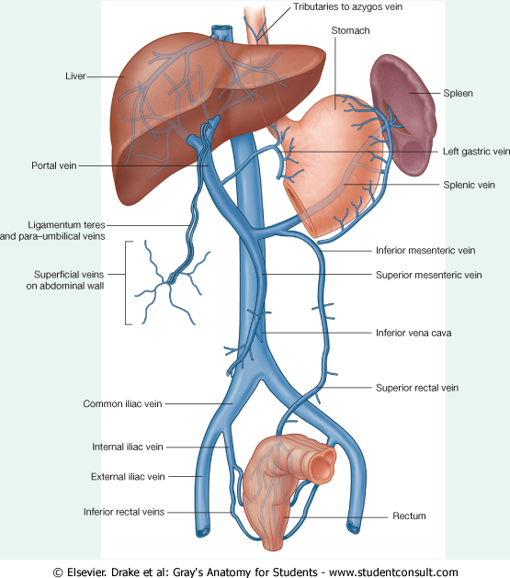
Inferior Vena Cava
Drains most of the blood from the body below the diaphragm to the right atrium.
Formed by the union of the 2 common iliac veins behind the right common iliac artery at the level of the 5th lumbar vertebra.
Ascends on the right side of the aorta
Pierces the central tendon of diaphragm at the level of the 8th thoracic vertebra.

Slide 16
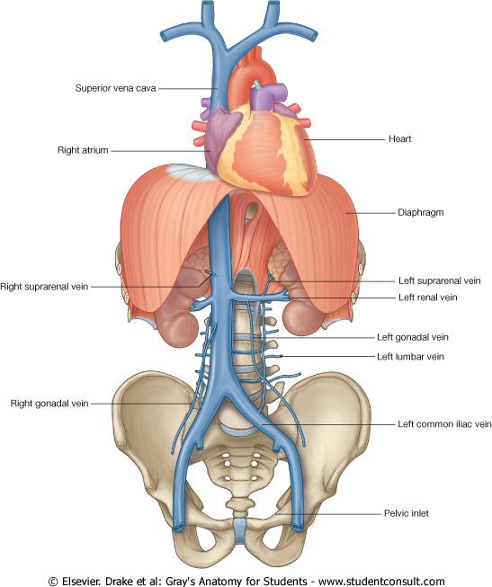
Tributaries of Inferior Vena Cava
Two common iliac veins
Median sacral vein
Four paired lumbar veins
Right gonadal vein
  the left vein drains into the left renal vein
Paired renal veins
Right suprarenal vein
  the left vein drains into the left renal vein
Hepatic veins
Paired inferior phrenic vein

Slide 17
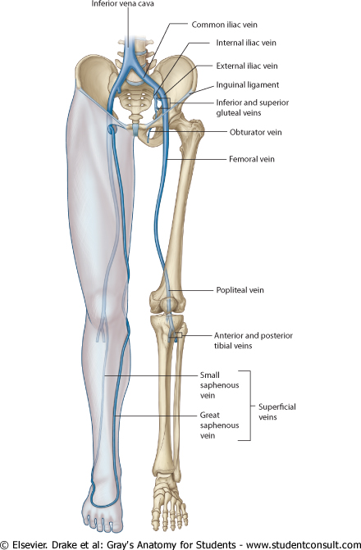
Veins of Lower Limbs
Two divisions:
  Superficial Veins
  Deep Veins

Slide 18
Veins of Lower Limbs
  Superficial Veins
  Form a network in the subcutaneous tissue
  Pattern is variable
  They are the tributaries of the:
    Great (long) saphenous vein
    Small (short) saphenous vein

Slide 19
Great Saphenous Vein
  The longest vein
  Begins from the medial end of the dorsal venous arch of the foot.
  Passes upward in front of the medial malleolus with the saphenous nerve.
  Then it ascends in accompany with the saphenous nerve in the superficial fascia over the medial side of the leg.

Slide 20
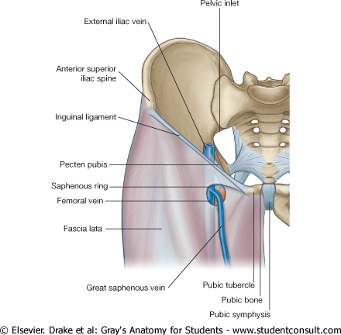
Great Saphenous Vein
  Ascends obliquely upwards, and lies behind the medial border of the patella.
  Passes behind the knee and curves forward around the medial side of the thigh.
  Hooks through the lower part of the saphenous opening in the deep fascia to joins the femoral vein about 1.5 in. (4 cm) below and lateral to the pubic tubercle.

Slide 21
Great Saphenous Vein
It is connected to the small saphenous vein by one or two branches that pass behind the knee.
Numerous perforating veins connect the great saphenous vein with the deep veins.
The perforating veins have valves which allow blood flow from superficial to deep veins.
The great saphenous vein is used in venous grafting and saphenous cut down (take care of the saphenous nerve)

Slide 22
Small Saphenous Vein
Arises from the lateral end of the dorsal venous arch.
Ascends behind the lateral malleolus in company with the sural nerve.
Follows the lateral border of the tendocalcaneus and then runs up to the middle of the back of the leg.
  Pierces the deep fascia in the lower part of the popliteal fossa
  Drains into the popliteal vein
  Has numerous valves along its course.
  Anastomosis freely with great saphenous vein.

Slide 23
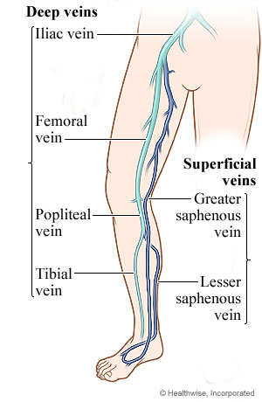
Veins of Lower Limbs
  Deep Veins
  Comprise the venae comitantes, which accompany all the large arteries, usually in pairs.
  Venae comitantes unite to form the popliteal vein, which continues as the femoral vein.
  Receive blood from superficial veins through perforating veins.
      Femoral Vein
      Popliteal vein
      Peroneal vein
      Anterior tibial vein
      Posterior tibial vein

Slide 24
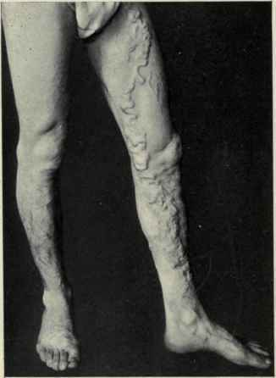
Mechanism of Venous Return from Lower Limb (FYI)
Much of the saphenous blood passes from superficial to deep veins through the perforating veins
The blood is pumped upwards in the deep veins by the contraction of the calf muscles (calf pump).
This action of ‘calf pump’ is assisted by the tight sleeve of deep fascia surrounding these muscles.
Varicose veins: If the valves in the perforating veins become incompetent, the direction of blood flow is reversed and the veins become varicosed. Most common in posterior & medial parts of the lower limb, particularly in old people.

Slide 25
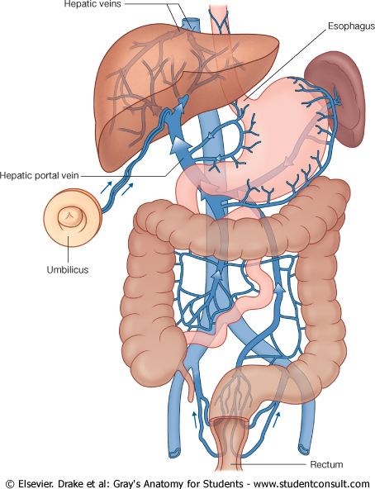
Hepatic Portal Vein
Drains blood from the gastrointestinal tract and spleen
It is formed by the union of the superior mesenteric and splenic veins.
Immediately before reaching the liver, the portal vein divides into right and left that enter the liver.
Tributaries: Gastric and cystic veins

Slide 26
Portocaval Anastomosis
A portacaval anastomosis (also known as portal systemic anastomosis) is a specific type of anastomosis that occurs between the veins of portal circulation and those of systemic circulation.
The anastomotic channels become dilated (varicosed) in case of portal hypertension.

Slide 27
Sites of Portocaval Anastomosis
Lower end of esophagus: left gastric vein & azygos vein
Lower part of rectum: (Hemorrhoids) superior and middle rectal veins & inferior rectal vein
Para umbilical region: (Caput Medusae) Para umbilical veins & superficial epigastric vein
Retroperitoneal: Veins draining colon & veins of the posterior abdominal wall
Patent ductus venosus:
Left branch of portal vein & inferior vena cava.

Slide 28

QUESTION?

