Slide 1
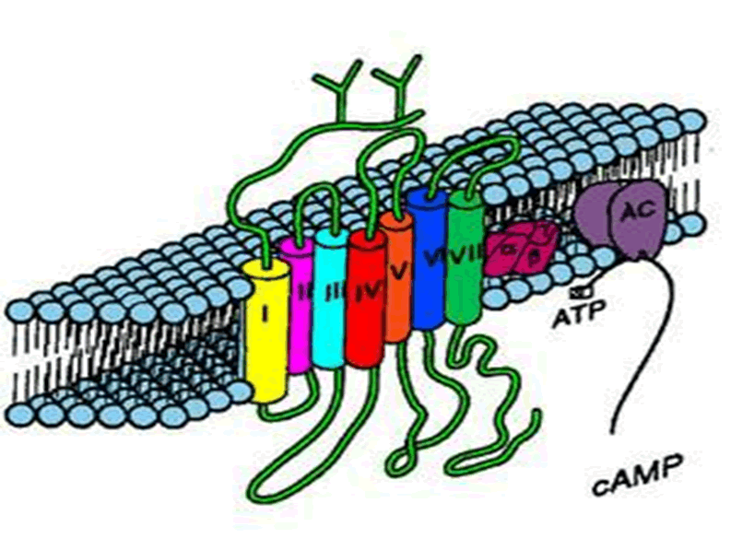
PHARMACOLOGY OFADRENERGICS
Agonists
Antagonist

Slide 2
Adrenergic Neuron Blockers Sympatholytics
Adrenoceptor Blockers
Adrenolytics
Form False Transmitters (alpha-2 agonists)
Deplete Storage
Inhibit Release & Enhance Uptake
Alpha & beta- adrenergic receptor blockers

Slide 3
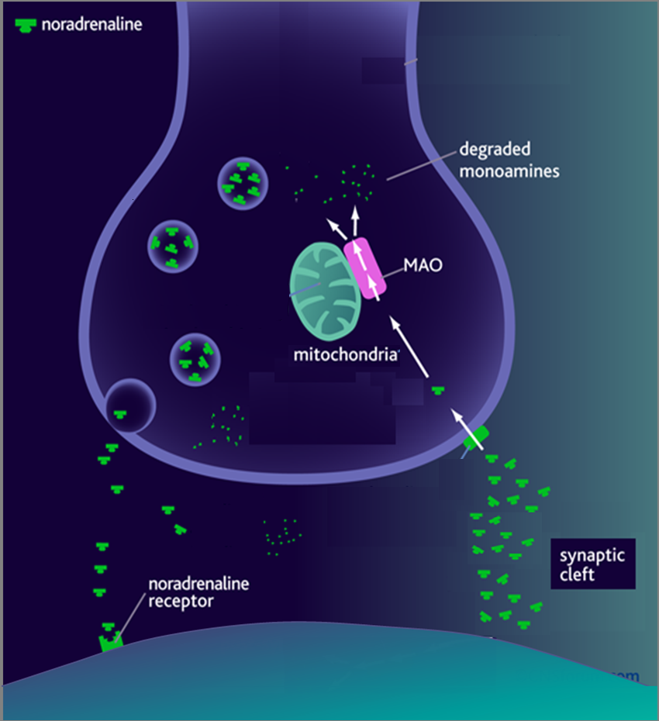
Adrenergic Neuron Blockers [SYMPATHOLYTICS]
1. METHYLDOPA
α-methyl tyrosine
Norepinephrine (NE)
Na
Dopa
Tyrosine
False Transmitters
Tyrosine
◉
Antihypertensive in PREGNANCY
DA
2. RESERPINE
Depletes Stores
NE
α₂
NET
3. Gaunthidine
○ Inhibit Release
○ Enhance Uptake
Adrenoceptor Blockers [ADRENOLYTICS]
α₁
β₁
β₂
COMT

Slide 4
What are α2-adrenoceptors?
Why they are called autoreceptors? Or presynaptics?
METHYLDOPA acts as agonist at α2-adrenoceptors.
Thus inhibits the release Of NE leading to decrease blood pressure.
2. Clonidine similar to methyldopa acts as agonist at α2-adrenoceptors.
Thus inhibits the release Of NE leading to decrease blood pressure.

Slide 5
ADRENERGICS DEPRESSANTS
Adrenolytics
ADRENERGIC ANTAGONISTS
Adrenergic Receptor Blockers

Slide 6
α ADRENOCEPTOR BLOCKERS
α₁ blocker
Non-Selective
Blocks α₁& α₂
Blocks α₁
Selective
Tamsulosin
Prazosin & Doxazosin
Irreversible
Short acting
Long acting
uroselective
Phenoxybenzamine
Indications
Long acting
Raynaud’s disease:
induce peripheral vasodilatation
Can be used in hypertension & HF(heart failure)
Benign prostatic hypertrophy (BPH)
1. In Irreversible shock
2. Before removal of Pheochromocytoma 
to prevent
Hypertensive crisis
ADRs
Contracts bladder wall
Postural hypotension,
syncope,
fluid retention,
head-ache,
nasal stuffiness,
◉ ejaculation & impotence.
Reversible
only
Phentolamine
Short acting
BPH
Relaxes bladder neck
& sphincters

Slide 7
β ADRENOCEPTOR BLOCKERS
Pharmacodynamic Classification
1
According to extent of blocked of each type they are either
Non-Selective
Selective
Block β₁& β₂  Propranolol, Timolol
Block β₁>> β₂  Atenolol, Bisoprolol
Block β & α₁  Labetalol, Carvedilol
2
According to presence of agonistic/antagonistic action (ISA) = PARTIAL AGONISTS or only antagonistic action
Without ISA
With ISA
Propranolol, Timolol,
Atenolol, Bisoprolol,
Labetalol
Carvedilol
intrinsic sympathomimetic activity

Slide 8
β ADRENOCEPTOR BLOCKERS
Pharmacokinetic Classification
According to their lipid solubility
 | Lipophylic | Hydrophilic
Oral absorption | Complete | Irregular
Liver metabolism | Yes | No
t _{1/2} | Short | Long
CNS side effects | High | Low
 | Propranolol, Timolol Labetalol > Carvedilol | Atenolol, Bisoprolol

Slide 9
PROPRANOLOL
Dynamics
Kinetics
1. Non-Selective Blocker of β₁ & β₂
2. Has membrane stabilizing action
3. Has sedative action
Completely absorbed
70% destroyed during 1st pass hepatic metabolism,
90-95% protein bound,
cross BBB
Actions
Heart; by block β₁
Inhibit heart properties   cardiac output
Has antianginal effects   cardiac work +  O₂ consumption
Has anti-arrhythmic effects  excitability, automaticity & conductivity + by membrane stabilizing activity
Blood Vessels [BV]; by block β₂
Vasoconstriction  blood flow to all organs except brain  cold extremities + intermittent claudications
BP; by block β₁ & β₂
Has antihypertensive action by
Inhibiting heart properties   cardiac output
Vasoconstriction to kidney BV:  renin & aldosterone secretion
Presynaptic inhibition of NE release from adrenergic nerves
Inhibiting sympathetic outflow in CNS

Slide 10
PROPRANOLOL
Actions
Cont.
Bronchi: by block β₂
Bronchospasm specially in susceptible patients
Intestine: by block β₂
 Intestinal motility
Metabolism: by block mainly β₂
In liver;  Glycogenolysis  Hypoglycaemia
In pancreas;  Glucagon secretion
In adipocytes;  Lipolysis
In skeletal muscles; glycolysis
On peripheral  tremors & central nervous systems  anxiety (mainly propranolol)

Slide 11
PROPRANOLOL
INDICATIONS of b-blockers
Hypertension (Atenolol; Bisoprolol ; Metoprolol)
Arrhythmias; Ventricular > atrial (propranolol)
Angina (Atenolol; Bisoprolol)
Myocardial infarction  Cardioprotective  death (Proranolol)
Migraine [Prophylaxis] (Propranolol)
Pheochromocytoma; used with α-blockers (never alone) (Atenolol)
Chronic glaucoma (Timolol)
Tremors (Prpranolol)
Anxiety (Prpranolol)
Hyperthyroidism (Prpranolol)
* Controls symptoms; tachycardia, tremors, sweating
* Protects heart against sympathetic over-stimulation.
* Lowers conversion rate of T₄ into T₃

Slide 12
PROPRANOLOL
ADR
Due to block of cardiac β₁-receptors:
Heart failure
Bradycardia
Hypotension
Due to blockade of β₂- receptor: (only with non-selective β-blockers)
Asthma, emphysema, chronic bronchitis
Cold extremities & intermittent claudication
Erectile dysfunction & impotence
Hypoglycemia &  triglycerides
All β-blockers mask hypo-glycaemic manifestations devlop COMA
Depression, nightmares, vivid dreams and hallucinations.
Gastrointestinal disturbances.
Sodium retention
Hypersensitivity reactions: skin rash and fever.
Selective
Safer in : Asthma / Diabetes & Dyslipidemias Rauynald’s phenomenon & vascular diseases
Only (β₁)

Slide 13
PROPRANOLOL
With ISA
Better in patients that exhibit excessive bradycardia
Also in non compliant for fear of sudden stoppage
Not useful in patients with AMI, angina & tachyarrhythmias
Partial agonist
Sudden stoppage will give rise to a withdrawal manifestations:
Rebound angina, arrhythmia, myocardial infarction & hypertension So drug must be withdrawn gradually  to prevent its happening
Contraindications
Depressed myocardial function as in; Uncompensated Heart Failure, Massive Myocardial Infarction, Heart Block.
Hypotension
Bronchial Asthma (safer with cardio-selective β-blockers).
Peripheral vascular disease (safer with cardio-selective β-blockers).
Diabetic patients > (Type I) (specially on Insulin)
for fear of hypoglycaemia)

Slide 14
Interactions
PROPRANOLOL
Pharmacodynamic Interactions
Bradycardia / heart block  with verapamil both induce A.V block
Rebound hypertension & impaired tissue perfusion  if used with cocaine, amphetamine or α-blocker overdose
Attenuation of hypertensive effect  with NSAIDs  because they  formation of vasodilating prostaglandins.
HF  with other cardiac depressants as quinidine.
Claudications, parasthesia, …etc with ergot alkaloids in migraine.
Enhanced neuromuscular blockade  Tubocurarine
Hypoglycaemia  with anti-diabetic drugs ( insulin > sulfonylureas) > Non selective β-blockers

Slide 15
LABETALOL
Blocks β & α₁
Rapid acting, non-selective with little ISA & local anesthetic effect
Do not alter serum lipids or blood glucose
Used in  Severe hypertension in pheochromocytoma & hypertensive crisis (e.g. during abrupt withdraw of clonidine)
Can be used pregnancy-induced hypertension but better alpha-methyldopa
ADR; Orthostatic hypotension, sedation & dizziness
CARVEDILOL
Blocks β > α₁ (so more vasodialating)
Non-selective with no ISA & no local anesthetic effect. Has antioxidant
Favorable metabolic profile.
Used effective in  congestive heart failure  reverses its patho- physiological changes
ADR; Edema

Slide 16
Agents specifically indicated for hypertension
Atenolol, Bisoprolol; Metoprolol
Agents specifically indicated for cardiac arrhythmia
Propranolol
Agents specifically indicated for congestive heart failure Carvedilol, Bisoprolol
Agents specifically indicated for myocardial infarction
Atenolol, Propranolol
Agents specifically indicated for glaucoma
Timolol
Agents specifically indicated for migraine prophylaxis
Timolol, Propranolol

Slide 17
GOOD LUCK

