Slide 1
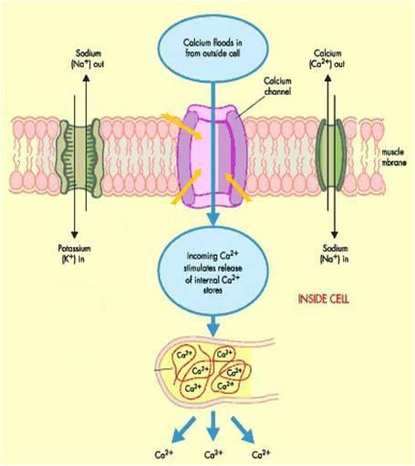
Ca CHANNEL BLOCKERS
ANTIANGINAL DRUGS
Classification
Dihydropyridines:- Nifedipine , Nicardipine, Amlodepine
Phenylalkylamines:- Verapamil
Benzthiazepines:- Diltiazem
Heterogeneous
Mechanism
Binding of calcium channel blockers [CCBs] to the L-type Ca channels
◉ their frequency of opening
in response to depolarization
Nifedipine
X
entry of Ca   Ca from internal stores  No Stimulus-Contraction Coupling  RELAXATION
Diltiazem
Verapamil
Phosphatase
MLCK
P
Ca²⁺ CaM Kinase
Active form
MLCK
P
MLC
MLC
Release Ca from intracellular stores
Ca²⁺ CaM complex
Contraction
Actin
Relaxation

Slide 2
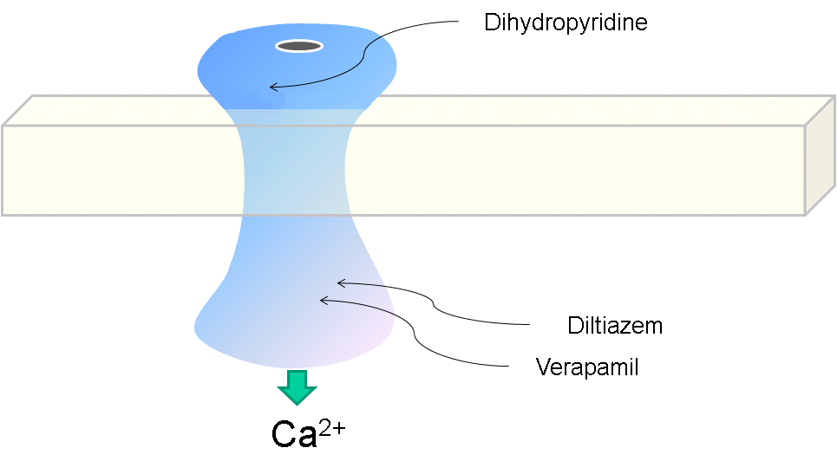
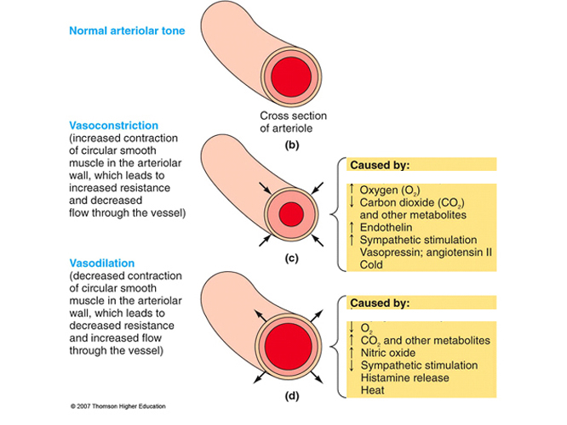
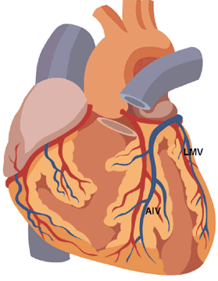
Ca CHANNEL BLOCKERS
Ca Channel Types & Distribution
Pharmacodynamic Actions
Distribution | Type
Cardiac & VSMCs / neurons | L
Heart / neurons | T
Neurons | N
Cerebellar Purkinje neurons | P
1. Anti-Anginal Actions
Nifedipine
Diltiazem
◉ Cardiomyocyte Contraction
Verapamil
cardiac work through their –ve inotropic & chronotropic action (verapamil & diltiazem)  myocardial oxygen demand
VSMC
Contraction
◉ After load  cardiac work 
myocardial oxygen demand
Coronary dilatation (nifedipine & nicardipine (short acting) / amlodipine (long acting) > diltiazem & verapamil  myocardial oxygen supply
N.B. Selectivity of Ca channel blockers
Nifedipine  VSMCs
Verapamil  Cardiomyocytes > VSMCs
Diltaizem  Intermediate action on both

Slide 3
Indications AS ANTIANGINAL
Ca CHANNEL BLOCKERS
IN STABLE ANGINA;
Regular prophylaxis 
Long acting dihydropyridines ; amlodipine & SR formulation nifedipine,
diltiazem > verapamil
Short acting dihydropyridine avoided  BP symathetic activation
refelx tachycardia +syncope impair coronary fillingischemia …..
Can be combined to β-AR blockers??? Which group is much safer???
→ Can be combined with nitrates??? Which group is much safer???
→ Dihydropyridenes  no  contractility  useful antianginal if with CHF
→ Verapamil & diltiazem  < vasoactivity  as antianginal if hypotension
IN VARIANT ANGINA Attacks prevented (> 60%) / sometimes variably aborted
IN UNSTABLE ANGINA; Seldom added in refractory cases

Slide 4
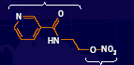
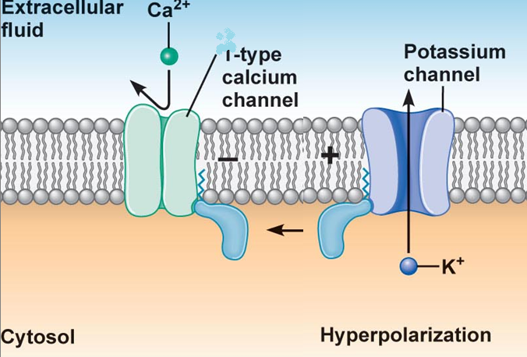
K CHANNEL OPENERS
ANTIANGINAL DRUGS
Nicorandil
Mechanism
It has dual mechanism of action;
1. Opens K_{ATP} channels (> arteriolar dilator)
2. NO donner as it has a nitrate moiety (> venular dilator)
Pharmacodynamic
1. On VSMC
K channel opening
◉
Hyperpolarization
◉
VASODILATATION
L
1. On Cardiomyocyte
Nicorandil
K channel opening
◉
Repolarization
◉
Cardiac work
Inhibit Ca entry
1.Opening of K_{ATP} channels

Slide 5
Nicorandil
K CHANNEL OPENERS
2. Acting as NO donner
2. On VSMC
NO donner
◉
 cGMP/ PKG
◉
VASODILATATION
Indications
Prophylactic 2nd line therapy in stable angina & refractory variant angina
ADRs
Flushing, headache,
Hypotension, palpitation, weakness
Mouth & peri-anal ulcers, nausea and vomiting.

Slide 6
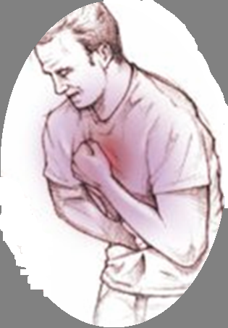
DRUGS USED IN TREATMENT OF ANGINA
β
– AR BLOCKERS

Slide 7
β - AR BLOCKERS
Β₂
VSMC
CARDIOMYOCYTE
Β₁
NO Vasodilatation
◉ Cardiac Work
Β₂
SMC
β₁ – Selective > Non – Selective
NO Relaxation
Atenolol
Bisoprolol
Metoprolol
Pharmacodynamic Actions
1. Anti-Anginal Actions
cardiac work through their
-ve inotropic & chronotropic action
afterload
renin angiotensin release
 myocardial oxygen demand
Though no coronary dilatation, yet  prolonged diastole   perfusion time   coronary filling & flow 
myocardial oxygen supply

Slide 8
β - AR BLOCKERS
ANTIANGINAL DRUGS
Indications as antianginal
IN STABLE ANGINA;
Regular prophylaxis  Cardio-selective are better. Why???  to spare β₂-AR
They are 1st choice on prolonged use   incidence of sudden death specially
due to ventricular tachycardia  by their antiarrhythmic action.
Can be combined with nitrates  abolish its induced reflex tachycardia.
Can be combined with dihydropyridene CCBs but not verapamil nor
diltiazem  for fear of conduction defect (bradycardia, heart block)
IN VARIANT ANGINA contraindicated  as it has no vasodilator action &
allow unopposed α-adrenergic coronary vasoconstriction to occur.
IN UNSTABLE ANGINA  halts progression to AMI  improve survival
In Myocardial Infarction; given early  infarct size,
morbidity & mortality  CARDIOPROTECTIVE
  ◉ myocardial O₂ demand.
   Redistribution of blood flow in the myocardium.
  free fatty acids.
  Anti-arrhythmic action.
  ◉ incidence of sudden death.

Slide 9
β - AR BLOCKERS
Precautions
β- blockers should be withdrawn gradually as sudden stoppage  give rise
to a withdrawal manifestations:
Rebound angina, arrhythmia, myocardial infarction & hypertension
WHY ?  Up-regulation of β-receptors.
Non-selective are better avoided as they blocks vasodilatory effects of
sympathetic stimulation  afterload &  oxygen consumption.
Not used in variant angina  worsen symptoms and aggrevate condition
Given to diabetics with ischemic heart disease  [Benefits > hazards) &
ACE inhibitor must too be added specially in ACSs

Slide 10
DRUGS USED IN TREATMENT OF ANGINA
Metabolically acting agents

Slide 11
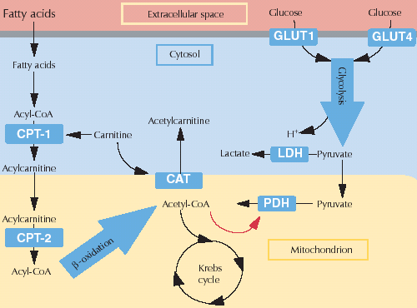
ANTIANGINAL DRUGS
Metabolically Acting Agents
TRIMETAZIDINE
Mechanism
O₂ requirement for glucose utilization is < FFA utilization i.e. oxidation of FFA
requires > oxygen per unit of ATP generated than oxidation of CHO.
During ischemia, metabolism shifts to oxidation of FFA.
So, to treat we can enhance > utilization of CHO (less energy cost) ; by giving 
Partial FFA Oxidation Inhibitors
(pFOX Inhibitors), TRIMETAZIDINE
Pharmacol Effects
Restores energy balance in the cell.
◉ fatty acid metabolism by -ve
3 Ketoacyl Thiolase [3KAT]
-ve anaerobic glycolysis
X
Allowing only aerobic glycolysis
3KAT
-ve acidosis & FR accumulation 
◉ apoptosis  Cytoprotective
Thus shift myocardial metabolism to 
OXYGEN DEMAND WITHOUT ALTERING HEMODYNAMICS

Slide 12
Metabolically Acting Agents
Indication
Used when ever needed as add on therapy to nitrates, CCBs or β-blockers
ADRs  GIT disturbances
Contraindications
Hypersensitivity reaction
In pregnancy & lactation
Ranolazine
Newly introduced. Considered one of the metabolically acting agents like trimetazedine.
+ affects Na dependent-Ca Channels  prevents Ca load   apoptosis  cardioprotective.
It prolongs the QT interval so not given with; Class Ia & III antiarrhthmics
Toxicity develops due to interaction with CYT 450 inhibitors as; diltiazem, verapamil, ketoconazole, macrolide antibiotics, grapefruit juice

Slide 13
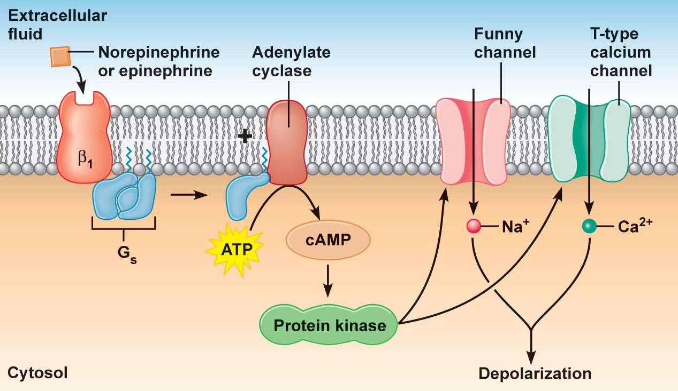
DRUGS USED IN TREATMENT OF ANGINA
OTHERS
Ivabradine
X
SAN
Acts on the “ Funny Channel” a special Na channel in SAN HRmyocardial work Myocardial O₂ demand
OTHERS

Slide 14
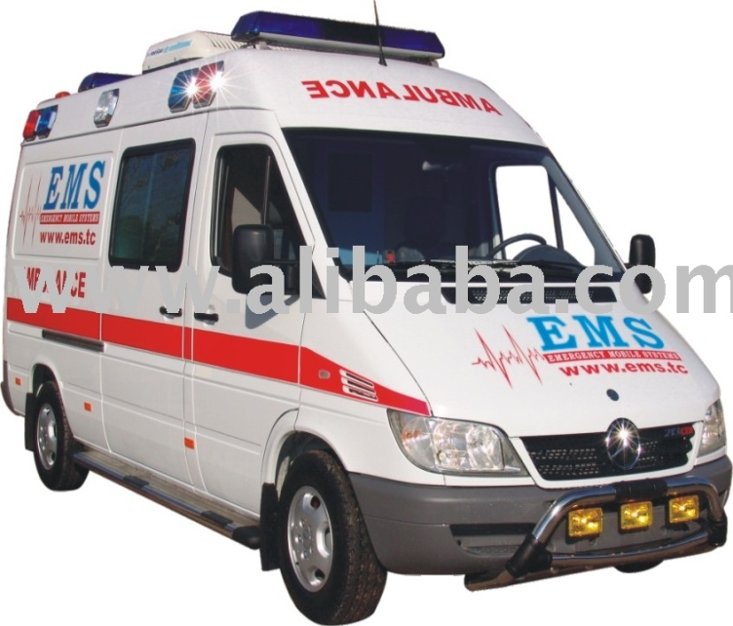
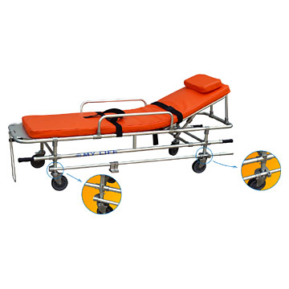
Case
A60-year-old man comes into the office complaining of chest pains that primarily occur in the early morning and do not appear to be associated with stress or exercise. Following coronary angiography and a positive ergonovine test you determine
that this patient has angina pectoris as a result of coronary artery spasm.
Notes:
Ergonovine test
performed if angina is thought to be caused by coronary artery spasm. The procedure is conducted during coronary angiography.
The artery-narrowing drug ergonovine (or, alternatively, acetylcholine) is injected to provoke coronary artery spasm.
If the individual experiences severe arterial spasm in response to ergonovine, he or she probably has variant angina.

Slide 15
Q1
How would you treat the patient to alleviate the acute attacks when they
occur ?
Notes:
Treat the patient with sublingual nitroglycerin for the acute attacks because of its rapid onset of action and its powerful vasodilating effect on the large epicardial conductance coronary arteries, which are normally the primary site of the spasm

Slide 16
Q2
How would you treat chronically to prevent their reoccurrence?
Notes:
For the chronic treatment there are two possibilities, an oral calcium channel blocker, such as amlodipine or verapamil, or a long-acting nitrate preparation, such as the transdermal form of nitroglycerin given once a day at bedtime to prevent the early morning episodes. -Adrenoceptor blockers
are not used for patients with coronary vasospasm, as they may worsen the condition.

Slide 17
DRUGS USED IN TREATMENT OF ANGINA
Agents that improve prognosis
Aspirin / Other antiplatelets
Statins
ACE Inhibitors
β-AD blockers
Main Stay of Prophylactic Treatment
Halt progression
Prevent acute insults
Improve survival

Slide 18
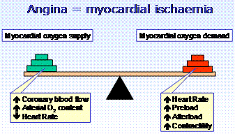
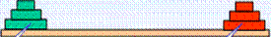
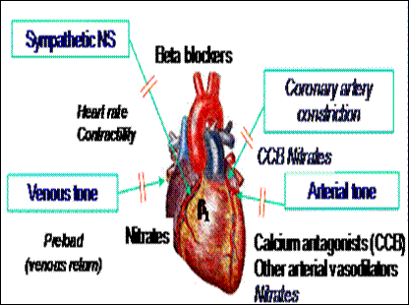
ANTIANGINAL DRUGS SET THE BALANCE BACK
◉
◉
◉
◉
In attack & situational prophylaxsis
Short acting nitrates
For prophylactic therapy
β-adrenoceptors blockers.
Calcium channel blockers
Long - acting nitrates.
Potassium channel openers
Metabolic modifiers & others
In Combinations

Slide 19
THERAPEUTIC GUIDELINES FOR ISCHEMIC HEART DISEASES
    Stable Angina:
    Acute symptoms by short acting nitrates
    Maintain therapy by a suitable antianginal drug (Nitrates and/or β-
    Blockers and/or CCB + metabolic modifiers).
    Vasospastic Angina:
    Prevention and even abortion of an attack of coronary artery
    spasm is achieved by Nitrates and/or CCB.
    Propranolol is contraindicated.
ACS
    Unstable angina:  Better transfer to ICU or CCU.
    Antianginal drugs (Nitrates &/or B-blockers, CCB in refractory cases)
    + Aspirin or Antiplatelets & IV Heparin.
IF THERAPY FAIL to any REVASCULARIZATION ?  OPENING OF OCCLUDED VESSEL either by;
    Percutaneous coronary intervention; PCI
    Surgical coronary artery bypass grapht; CABG

Slide 20
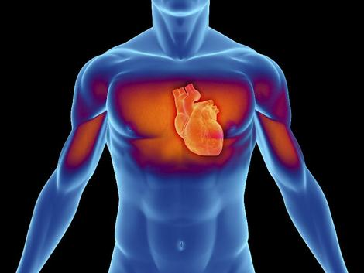
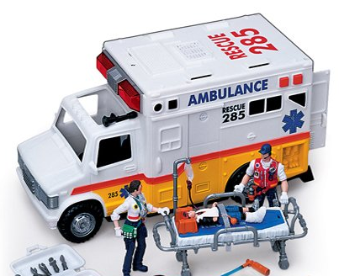
ACS
    AMI: Transfer to CCU & apply the following measures:
Before & During Transfer:
    Cardiopulmonary resuscitation / Oxygen & I.V fluids.
    Nitroglycrine sublingual up to 3 doses with 5 minutes intervals
    Analgesics, as morphine, for severe pain.
    Chewable aspirin 160 mg.
In ICU or CCU units:
    Thrombolytics: to induce clot lysis & restore blood flow
    Anti-coagulant: IV Heparin, continue on aspirin orally
    O₂ & Opiates: IV morphine or meperidine.
    Nitrates: IV infusion of GTN + early β-blockers  myocardial damage.
    ACE Inhibitors start early postmyocardial fibrosis & improve survival
    Statin therapy start early stabilize plaque

Slide 21

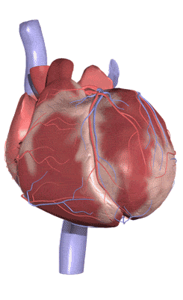
GOOD LUCK

Slide 22
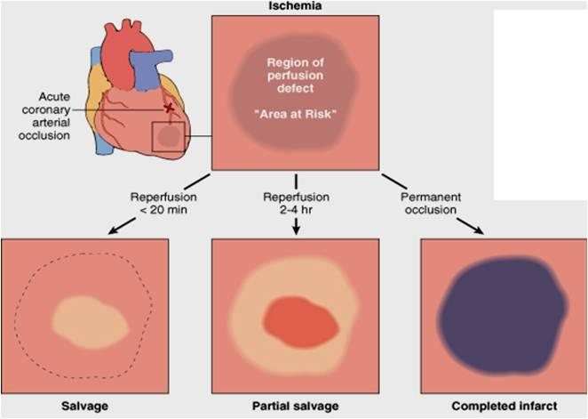
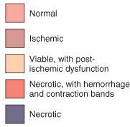
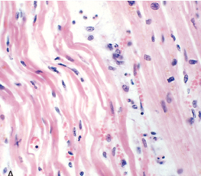
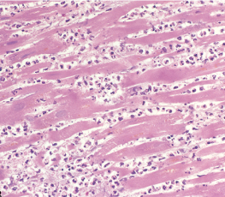
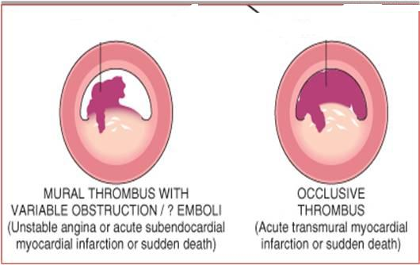
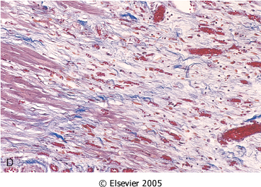
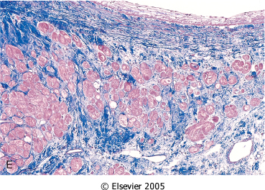
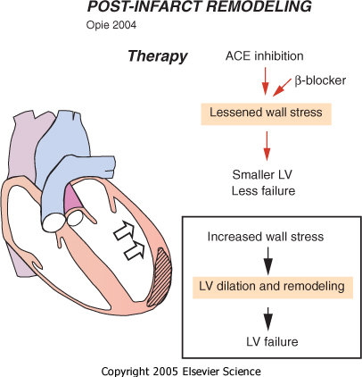
SEQUENCE OF EVENTS AFTER AMI
After 1 day
< 3days
Coagulative Necrosis
Neutrophilic Infiltrate
1-2 weeks
>3 weeks
Benefits of adding ACE Inhibitors & β-blockers
Granulation T.
Scaring & Fibrosis
Post-myocardial Fibrosis

Slide 23
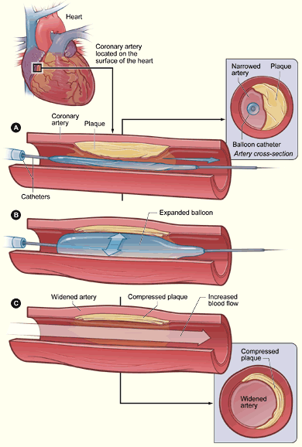
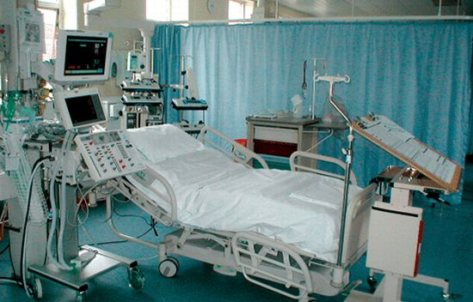
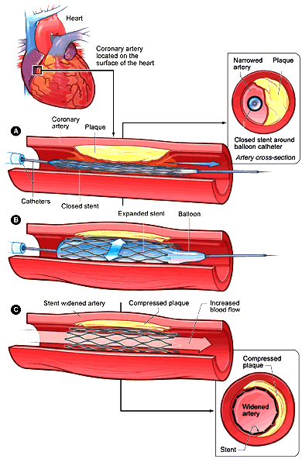
PCI
Ballon Angioplasty
+ STENT DEPLOYMENT

