Slide 1
Renal practical block

Slide 2
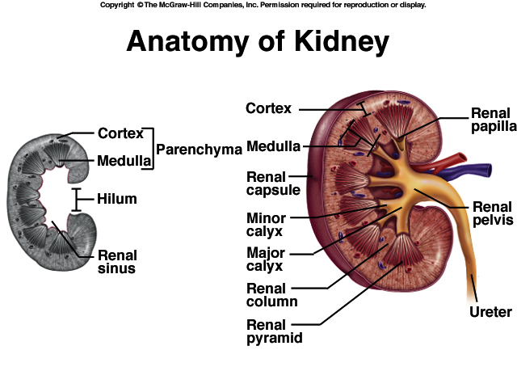

Slide 3
KIDNEY ANATOMY: NEPHRONS
NEPHRONS
FUNCTIONAL UNITS OF KIDNEY
~1.2 MILLION PER KIDNEY
THREE MAIN PARTS
BLOOD VESSELS
RENAL CORPUSCLE
RENAL TUBULE

Slide 4
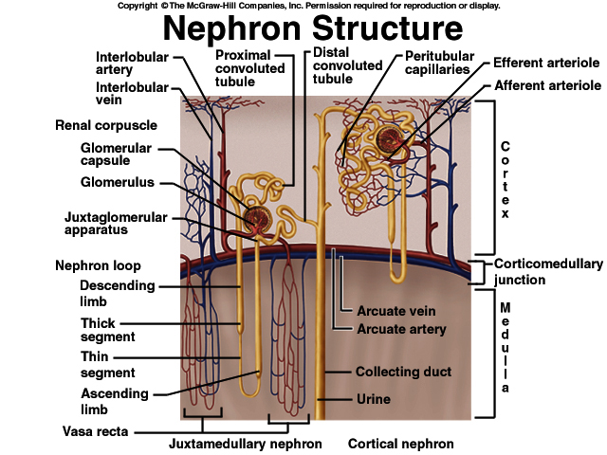

Slide 5
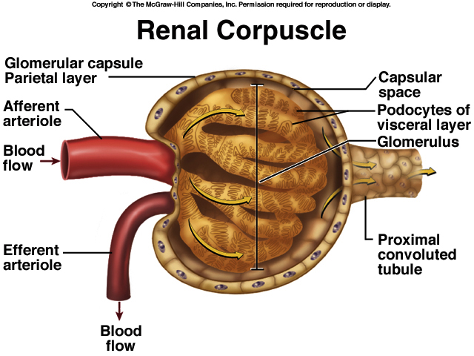

Slide 6
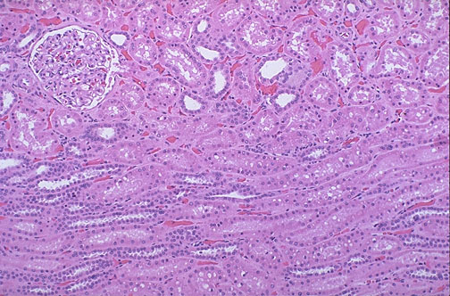

Slide 7
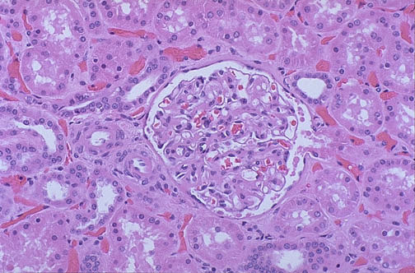
Figure 26.6

Slide 8
Gross and histopathology

Slide 9
1-Polycystic kidney

Slide 10
Adult polycystic kidney disease
The gross picture shows markedly enlarged kidney and replacement of the renal parenchyma by numerous cysts of variable sizes .
The pattern of inheritance for adult form is autosomal dominant and for childhood form is autosomal recessive .

Slide 11
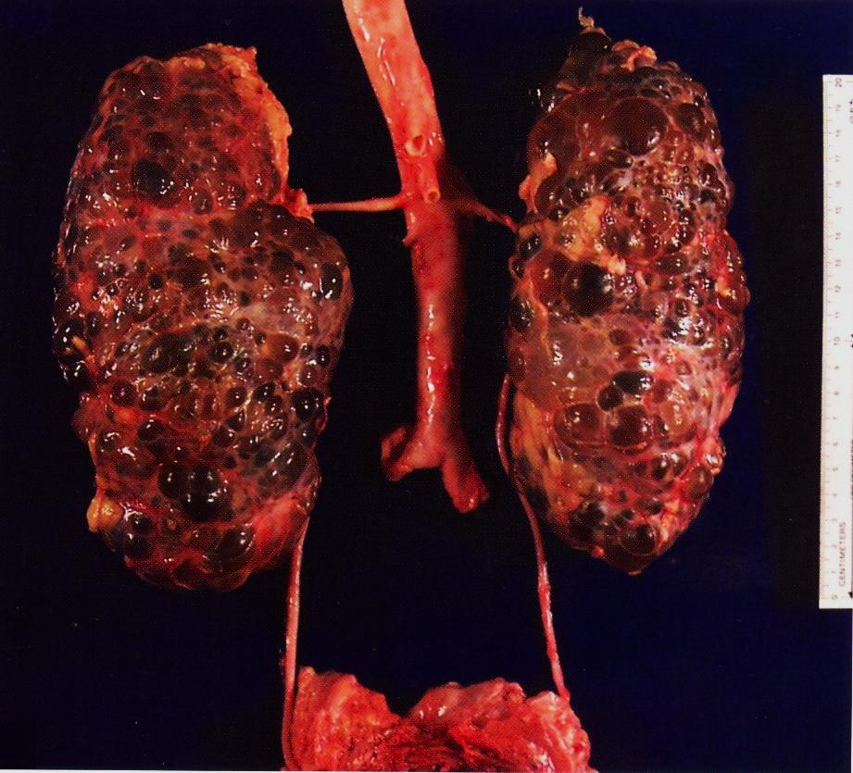
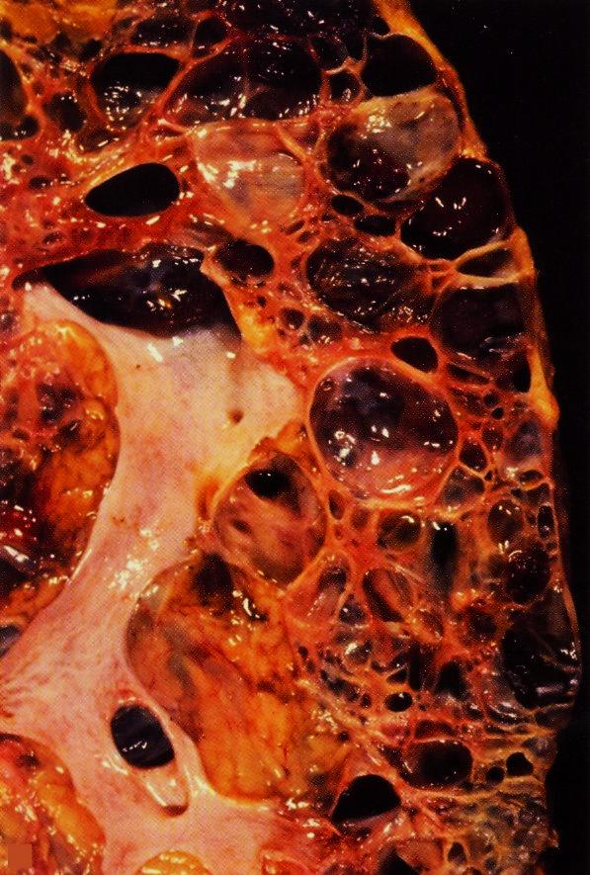

Slide 12
2-Postsreptococcal glomerulonephritis

Slide 13
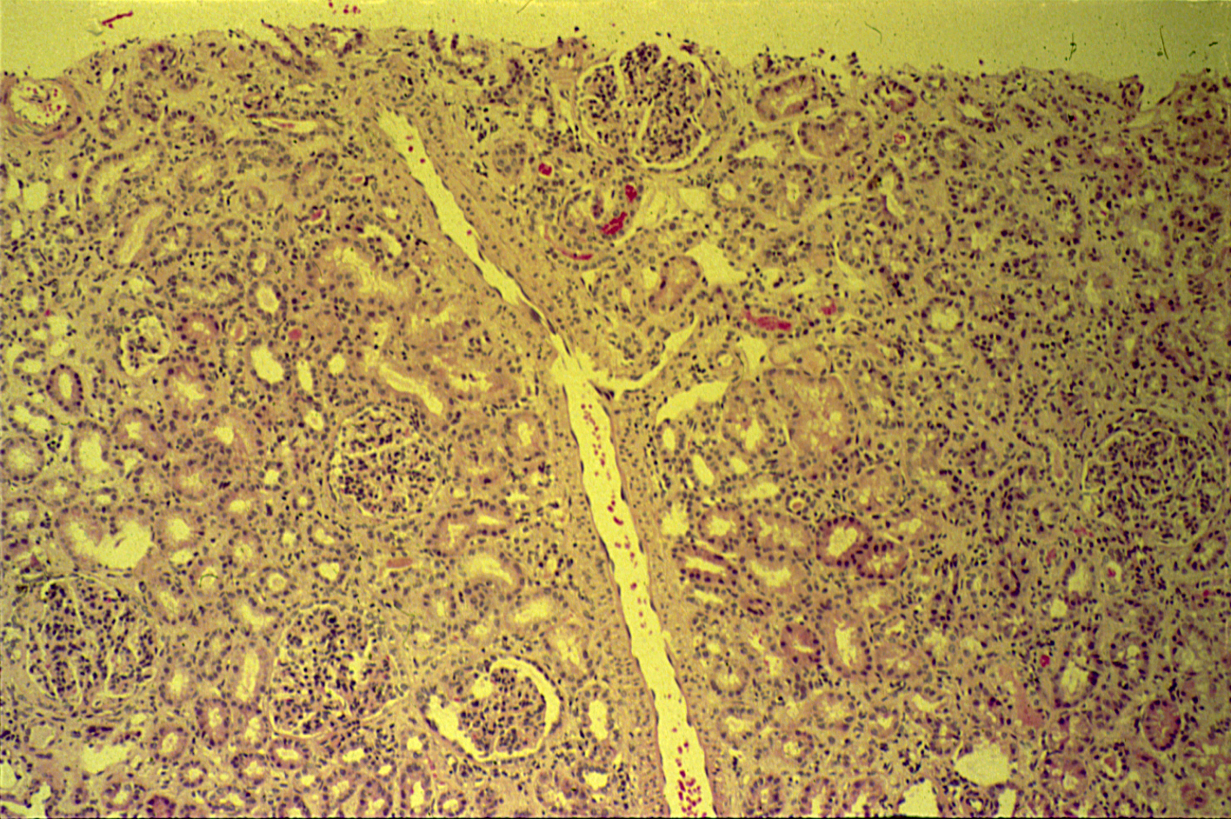
POSTSTREPTOCOCCAL GLOMERULONEPHRITIS

Slide 14
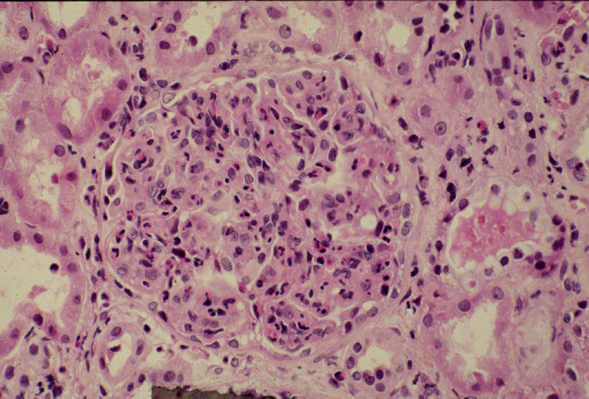
Diffuse proliferative glomerulonephritis: High power view of a hypercellular glomerulus. Numerous capillaries contain inflammatory cells mostly neutrophils. Note the presence of red blood cells in a distal tubule to the left of the glomerulus (arrow).

Slide 15
Hypercellular and enlarged glomeruli
Infiltration by neutrophils
Slide 21.22
Notes:
Clinical syndrome that these patients have: Nephritic Syndrome.

Slide 16
Post streptococcal glomerulonephritis: Section of kidney shows:
The glomeruli are enlarged and hypercellular with obliteration of capsular space.
Cellularity is due to proliferation of endothelial and mesangial cells with some neutrophils.
Many capillaries appear obliterated.
Tubules contain red blood cells and granular casts.
The etiology is Infection by group A Beta-hemolytic streptococci
Serological test: There is usually increased titers of anti-streptolysin O

Slide 17
3- Hydronephrosis

Slide 18
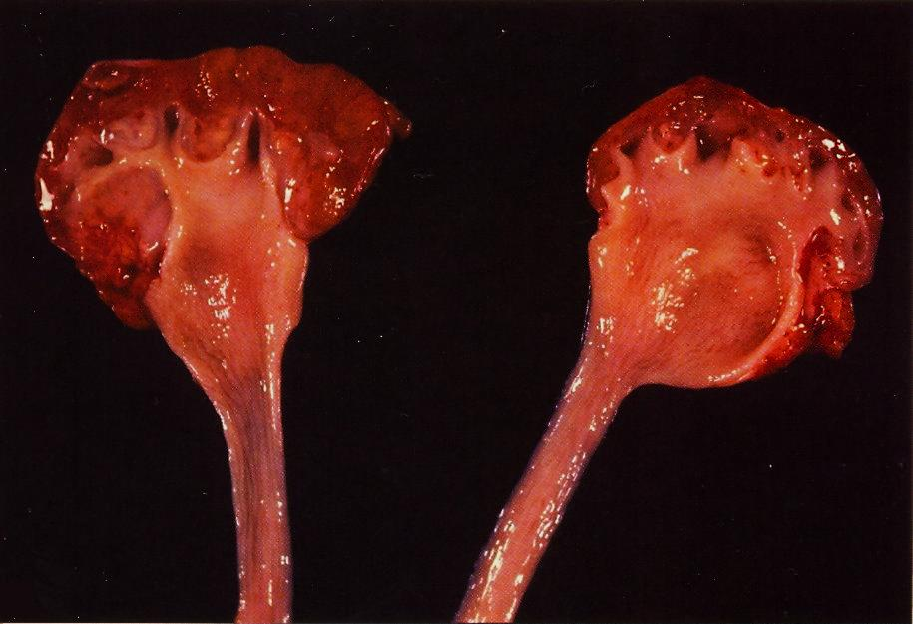
Bisected kidney shows markedly dilated renal pelvis and calyces with atrophic and thin renal cortex /parenchyma

Slide 19
The picture shows markedly dilated renal pelvis and calyces with atrophic and thin renal cortex /parenchyma
Notes:
The most common causes for hydronephrosis are foreign bodies like calculi with obstruction, atresia of the urethra , Benign prostatic hyperplasia ,carcinoma of the prostate and bladder tumours and spinal cord damage with paralysis of the bladder .

Slide 20
4- Pyonephrosis

Slide 21
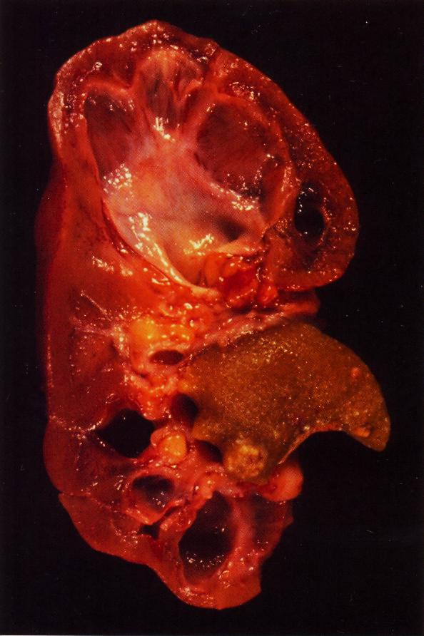
Focal hydronephrosis and pyonephrosis .

Slide 22
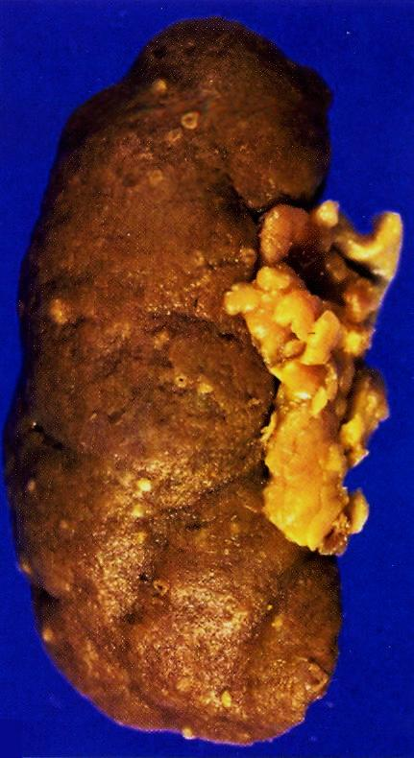
Pyonephrosis with small cortical abscesses

Slide 23
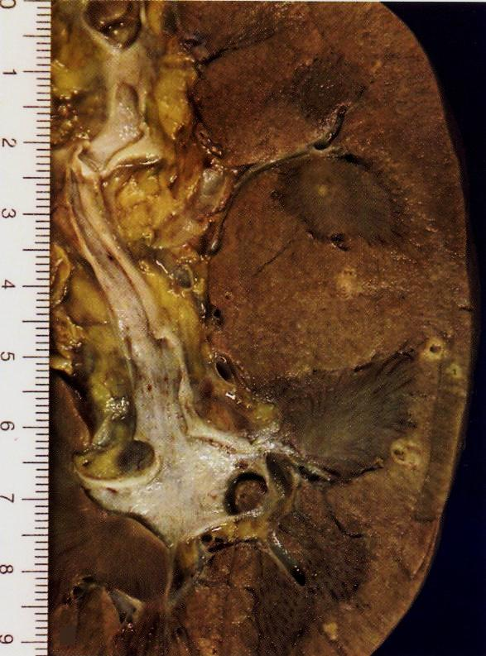
Renal cortical pyonephrosis with renal stone impacted within a calyx
Notes:
.

Slide 24
5- Chronic pyelonephritis

Slide 25
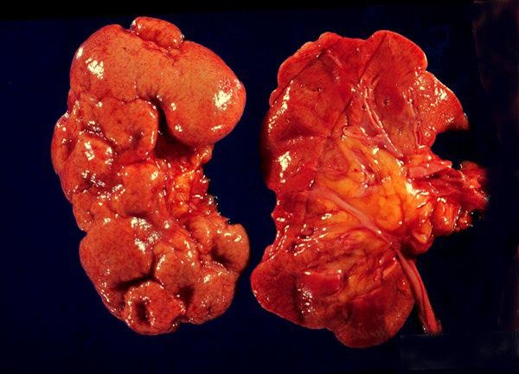
The picture shows atrophic and deformed kidneys with cortical coarse scars .

Slide 26
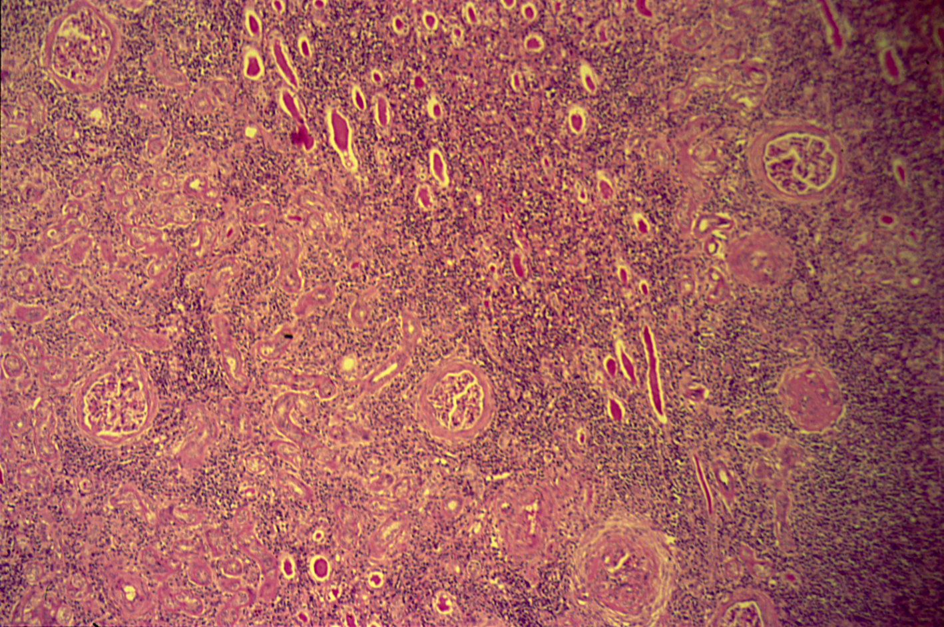
CHRONIC PYELONEPHRITIS

Slide 27
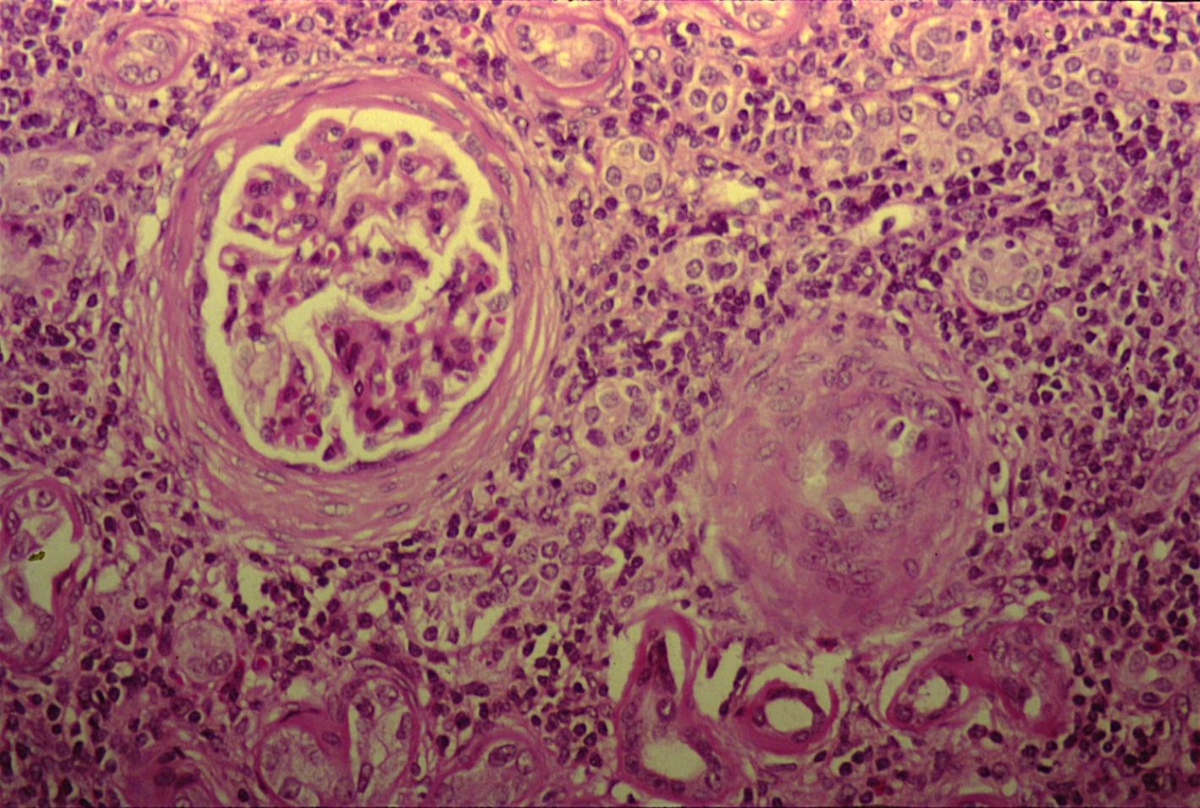
CHRONIC PYELONEPHRITIS
The picture shows periglomerular fibrosis , glomerular sclerosis and hyalinization with marked chronic interstitial inflammation .

Slide 28
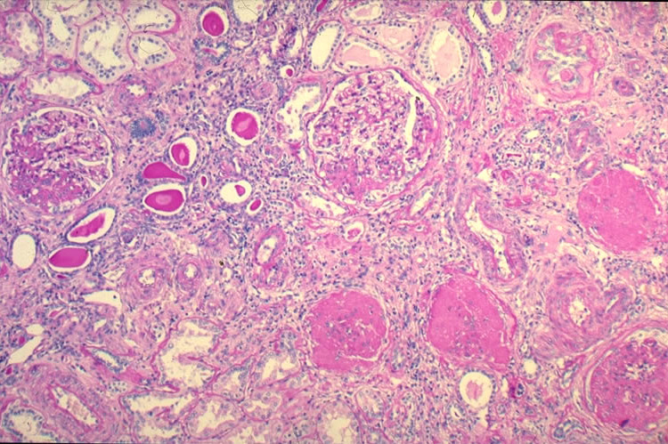

Slide 29
Chronic pyelonephritis: Section of kidney reveals that:
The glomeruli show varying degrees of sclerosis and periglomerular fibrosis.
The tubules show varying degrees of atrophy.
Some tubules are dilated and filled with eosinophilic hyaline casts resembling colloid (thyroidization).
Deformed renal calyces and pelvis
Interstitial tissue shows chronic inflammatory cells infiltrate and fibrosis.

Slide 30
6- Renal Carcinoma

Slide 31
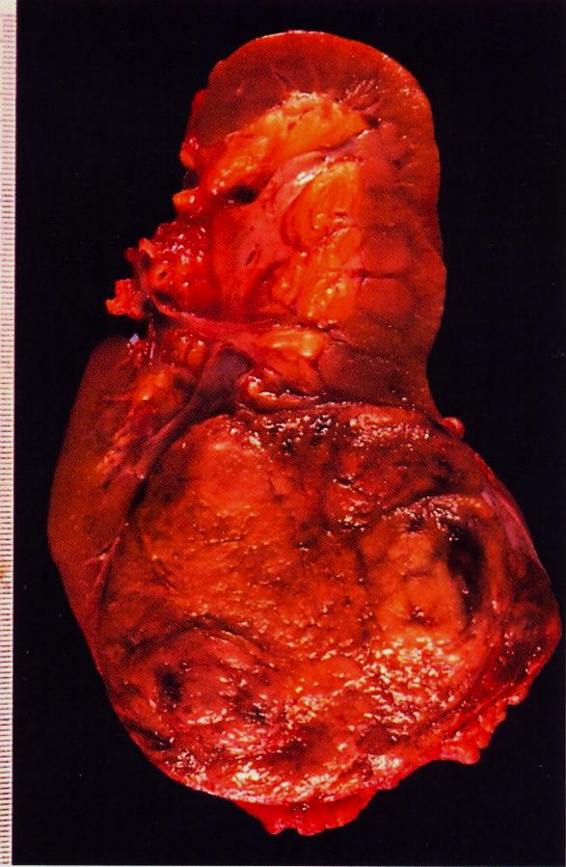
Renal cell carcinoma occupying the lower renal pole
Notes:
Renal clear cell carcinoma may secrete erythropoietin hormone .

Slide 32
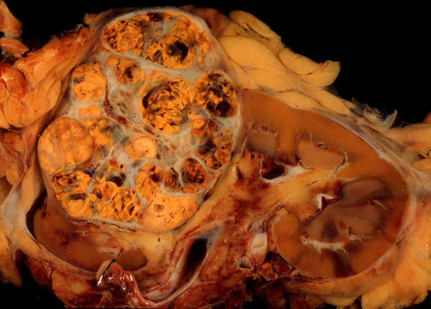
Gross picture shows a well circumscribed renal cortical mass which is partly yellow and partly hemorrhagic with lobulated cut surface .

Slide 33
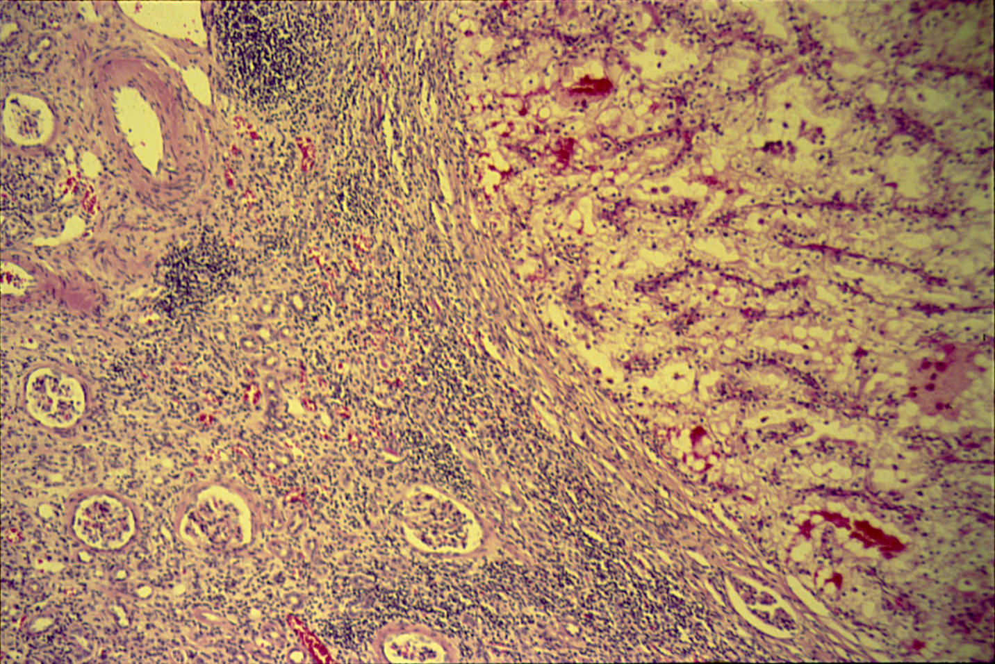
CLEAR CELL CARCINOMA (KIDNEY)

Slide 34
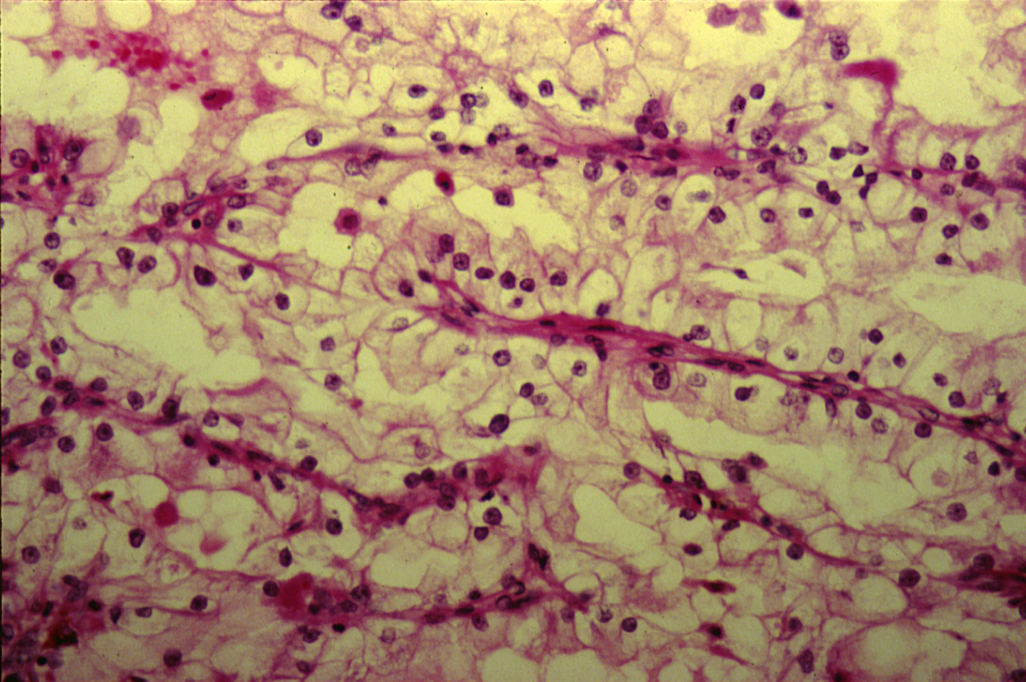
CLEAR CELL CARCINOMA (KIDNEY)

Slide 35
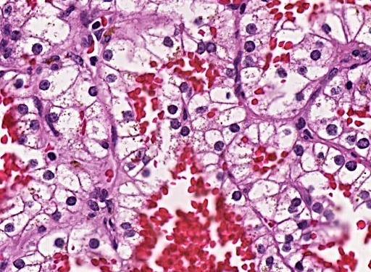
Section shows clear tumour cells with hyperchromatic nuclei and areas of hemorrhage .

Slide 36
Clear cell carcinoma of the kidney: Section of the kidney shows:
Compressed kidney tissue at the margin of the tumour masses.
Tumour cells are large polygonal with clear cytoplasm (dissolved glycogen and lipid) and piknotic nuclei.
Cells are arranged as alveolar groups or tubules with papillary formations separated by thin fibrovascular septae.
Cells show pleomorphism and mitosis.
Areas of haemorrhage and necrosis are present.
Clinical and Lab features include :
Abdominal mass
Flank pain
Hematuria
Fever
Secondary polycythemia
Ectopic production of hormones
Hypercalcemia

Slide 37
7- Wilm’s tumour

Slide 38
Wilms Tumor
Gross picture shows partly pale and partly hemorrhagic solid tumour replacing almost the entire renal parenchyma with areas of necrosis and hemorrhage

Slide 39
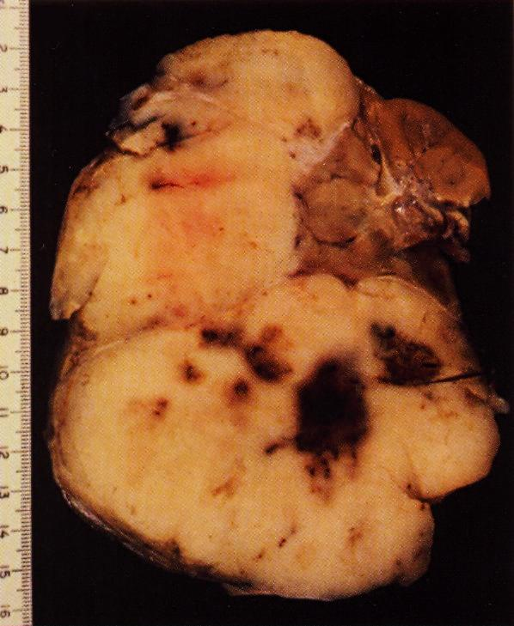

Slide 40
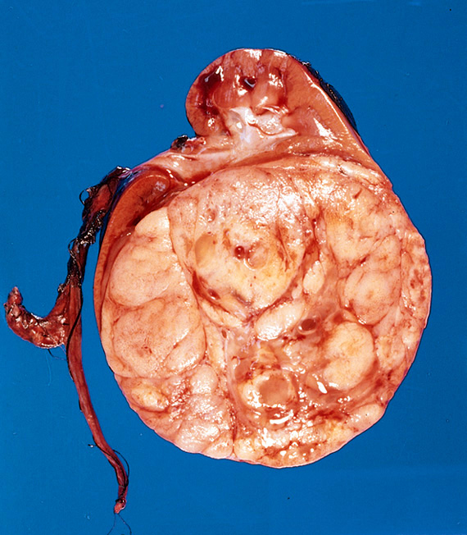
Slide 11.27

Slide 41
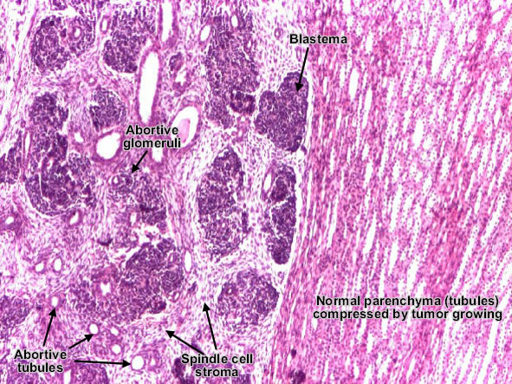

Slide 42
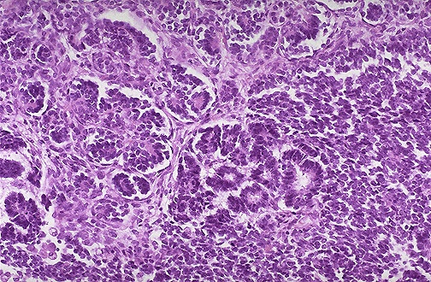
Wilm's tumor resembles the fetal nephrogenic zone of the kidney.
Three major components:
Undifferentiated blastema cells ,
Epithelial tissue which shows attempts to form primitive glomerular and tubular structures and
Mesenchymal (stromal) tissue

Slide 43
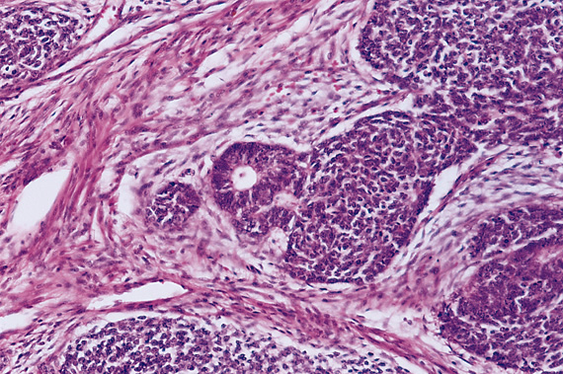
Slide 11.28

Slide 44
8- Carcinoma of the urinary bladder

Slide 45
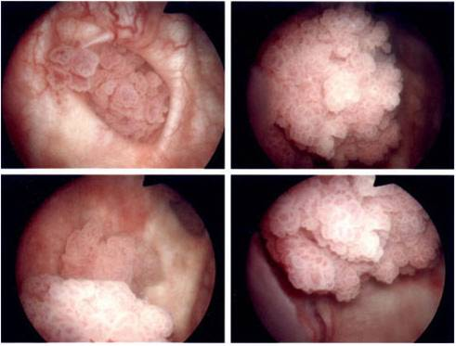
Endoscopic view of a multifocal papillary urinary bladder tumour .

Slide 46
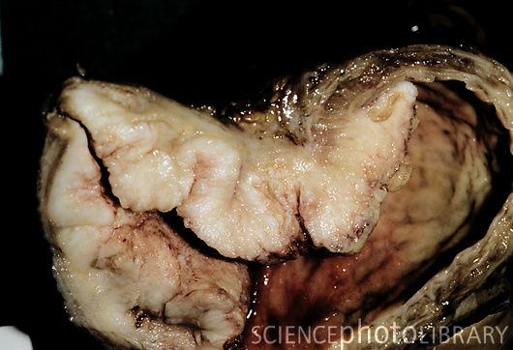
Gross specimen of a malignant (cancerous) tumour (pale area, centre to left) of the urinary bladder.

Slide 47
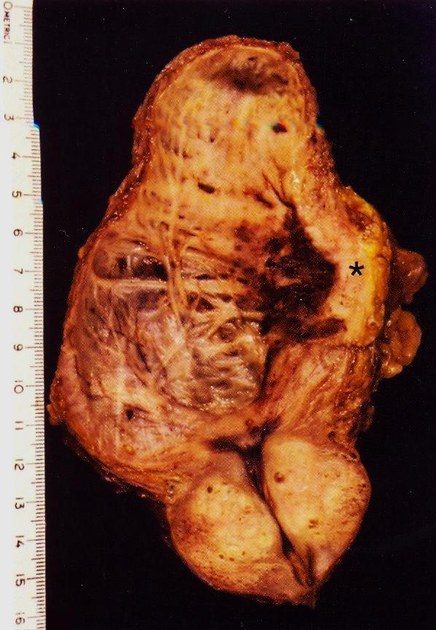
Longitudinal section of urinary bladder and prostate showing benign prostatic hyperplasia , trabeculation of the urinary bladder wall and bladder carcinoma (asterix )which is most likely proved histologically to be Transitional cell carcinoma .
Notes:
Predisposing factors include smoking , Aniline dyes , long term use of analgesics , heavy long term exposure to cyclophosphamide .

Slide 48
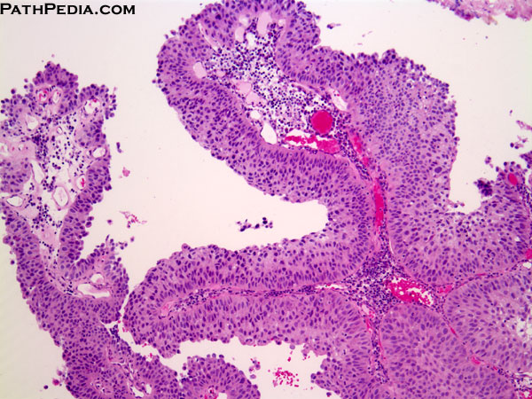
UROTHELIAL CARCINOMA, LOW GRADE.
The low grade tumors show overall preservation of cell polarity, few mitoses, and lack of significant morphologic atypia.
This exophytic papillary tumor shows multiple finger-like projections lined by multiple layers of urothelium (transitional epithelium)

Slide 49
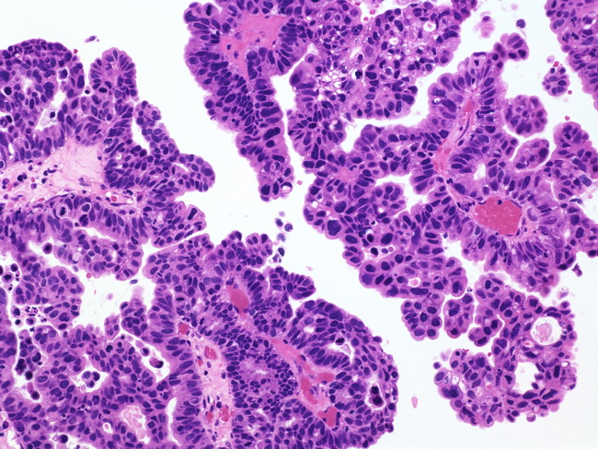
High grade transitional cell carcinoma
High grade Papillary tumor showing pleomorphic and hyperchromatic enlarged nuclei (The nuclei in this high-grade tumor are significantly enlarged and show variably increased chromatin content)

Slide 50
Predisposing risk factors to bladder cancer include:
Exposure to aniline dyes
Cigarette smoking
Treatment with cyclophosphamide
Phenacetin abuse
Squamous cell carcinoma of urinary bladder may occur as a complication to schistosoma hematobium infection.

