Slide 1
Renal Practical Block

Slide 2
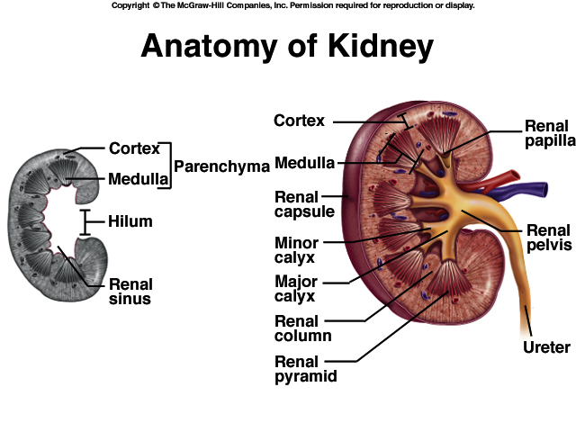

Slide 3
KIDNEY ANATOMY: NEPHRONS
NEPHRONS
FUNCTIONAL UNITS OF KIDNEY
~1.2 MILLION PER KIDNEY
THREE MAIN PARTS
BLOOD VESSELS
RENAL CORPUSCLE
RENAL TUBULE

Slide 4
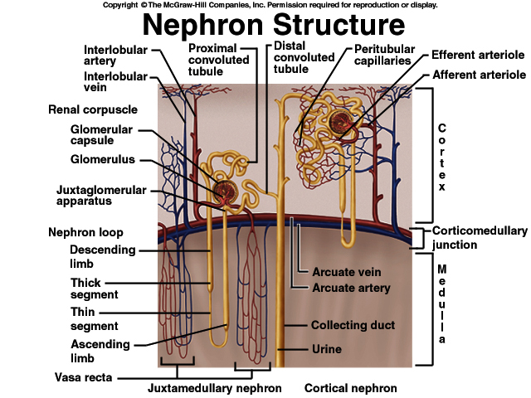

Slide 5
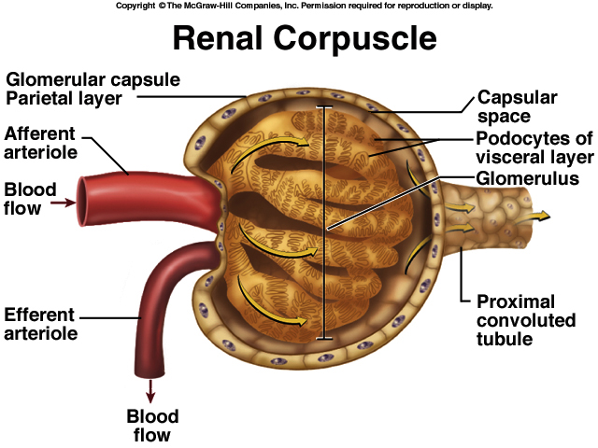

Slide 6
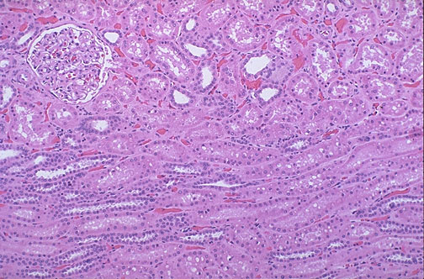

Slide 7
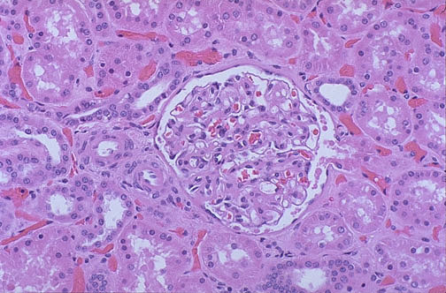

Slide 8
Gross and Histopathology

Slide 9
1- POLYCYSTIC KIDNEY DISEASE
2- POSTSTREPTOCOCCAL GLOMERULONEPHRITIS
3- HYDRONEPHROSIS
4- PYONEPHROSIS
5- CHRONIC PYELONEPHRITIS
6- RENAL CELL CARCINOMA (Clear cell carcinoma of the kidney)
7- WILM’S TUMOR
8- CARCINOMA OF THE URINARY BLADDER Urothelial(transitional cell) carcinoma

Slide 10
1- Polycystic kidney DISEASE

Slide 11
Polycystic kidney disease
-The gross picture shows markedly enlarged kidney and Replacement of the renal parenchyma by numerous cysts of variable sizes.
-The pattern of inheritance for adult form is autosomal dominant and for childhood form is autosomal recessive.

Slide 12
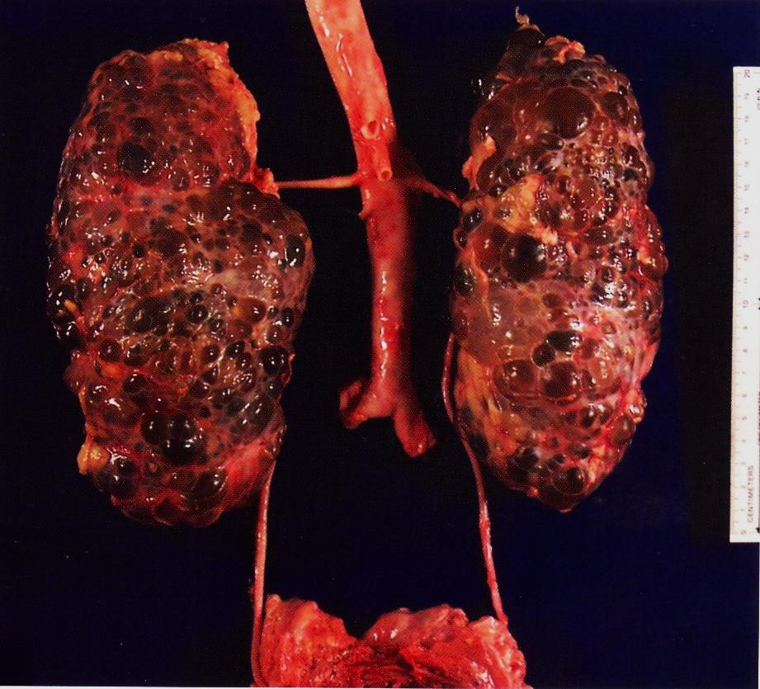

Slide 13
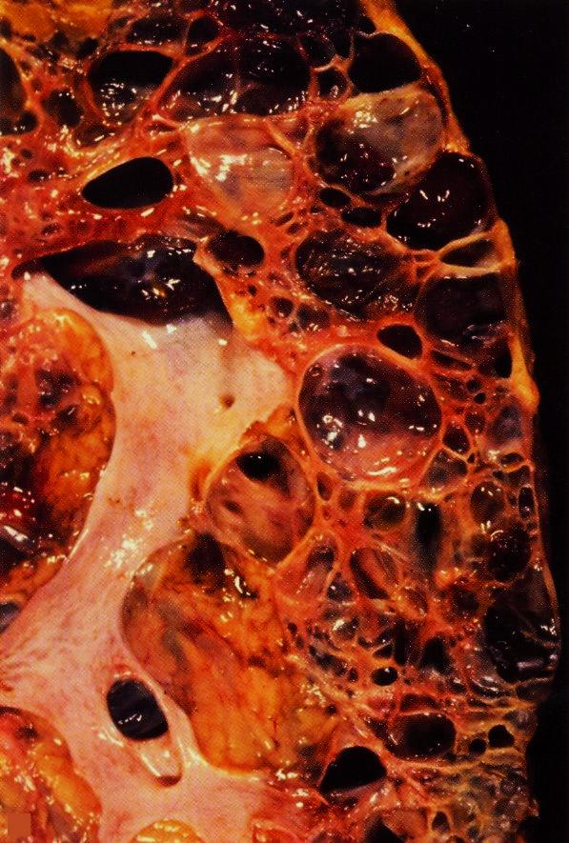

Slide 14
2- POSTSTREPTOCOCCAL GLOMERULONEPHRITIS

Slide 15
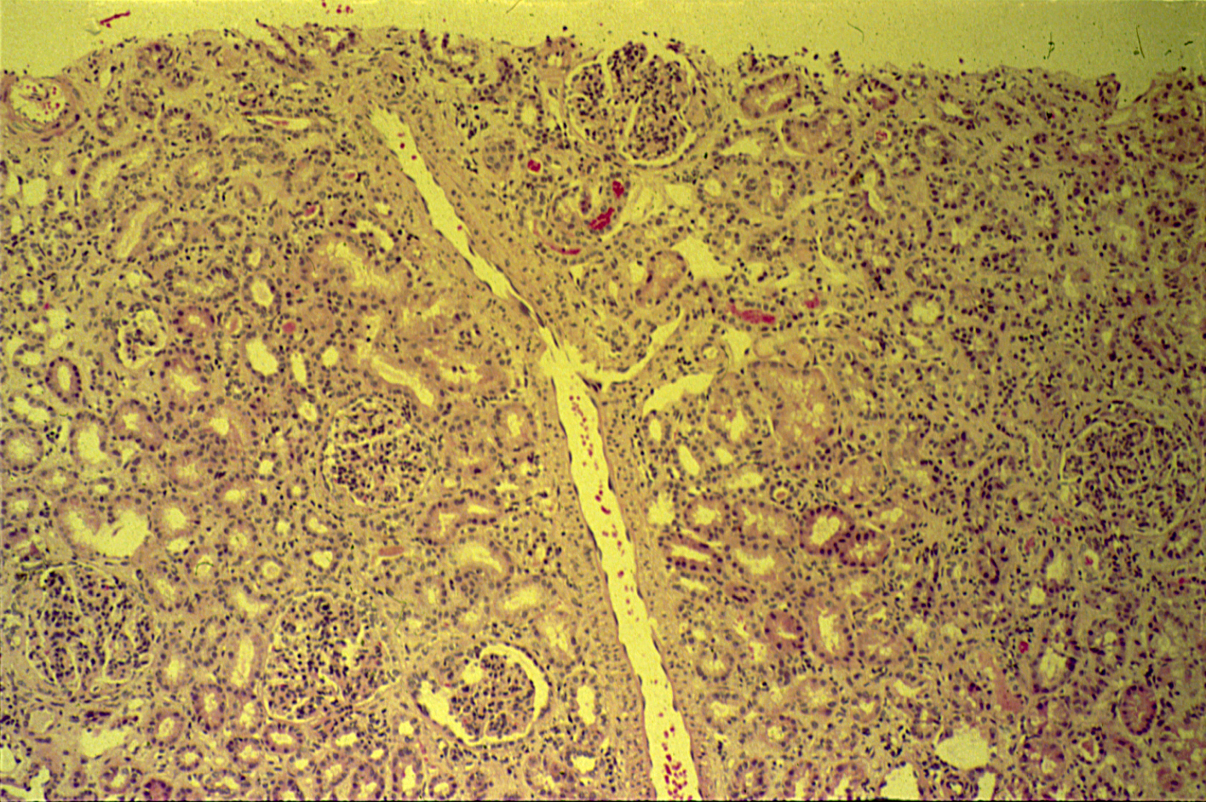
POSTSTREPTOCOCCAL GLOMERULONEPHRITIS

Slide 16
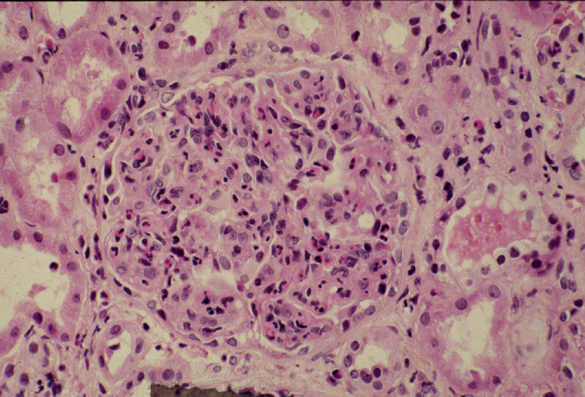
Diffuse proliferative glomerulonephritis: High power view of a hypercellular glomerulus. Numerous capillaries contain inflammatory cells mostly neutrophils. Note the presence of red blood cells in a distal tubule to the left of the glomerulus (arrow).

Slide 18
Post streptococcal glomerulonephritis: Section of the kidney reveals that:
The glomeruli are enlarged and hypercellular with obliteration of capsular space.
Cellularity is due to proliferation of endothelial and mesangial cells with some neutrophils.
Many capillaries appear obliterated.
Tubules contain red blood cells and granular casts.
The etiology is Infection by group A Beta-hemolytic streptococci.
Serological test: There is usually increased titers of anti-streptolysin O.

Slide 19
3- Hydronephrosis

Slide 20
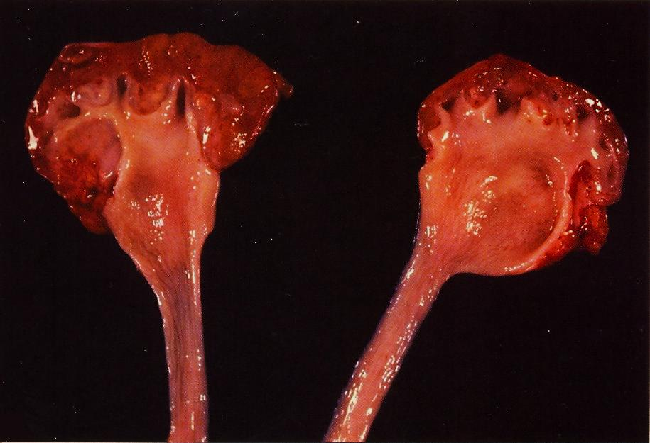
Bisected kidney shows markedly dilated renal pelvis and calyces with atrophic and thin renal cortex /parenchyma.
Notes:
Bisected kidney shows markedly dilated renal pelvis and calyces with atrophic and thin renal cortex /parenchyma

Slide 21
The picture shows markedly dilated renal pelvis and calyces with atrophic and thin renal cortex /parenchyma.
Notes:
The most common causes for hydronephrosis are foreign bodies like calculi with obstruction, atresia of the urethra , Benign prostatic hyperplasia ,carcinoma of the prostate and bladder tumours and spinal cord damage with paralysis of the bladder .

Slide 22
4- Pyonephrosis

Slide 23
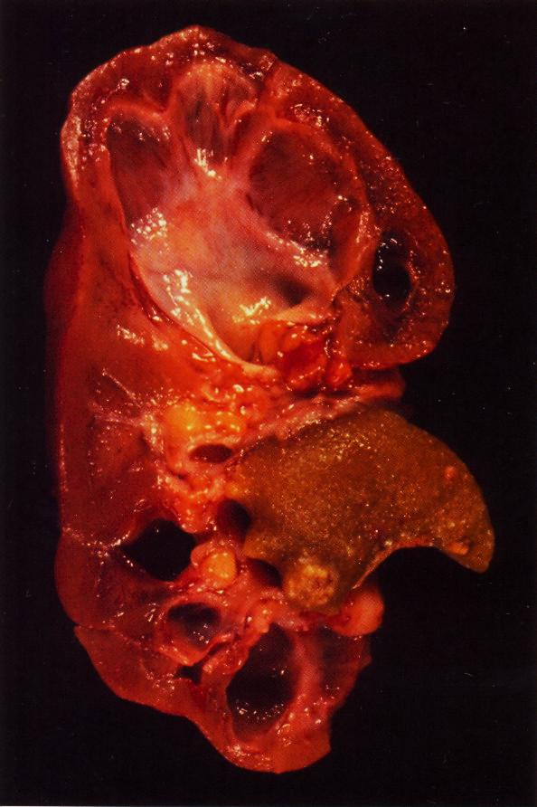
Focal hydronephrosis and pyonephrosis.
Notes:
Focal hydronephrosis and pyonephrosis .

Slide 24
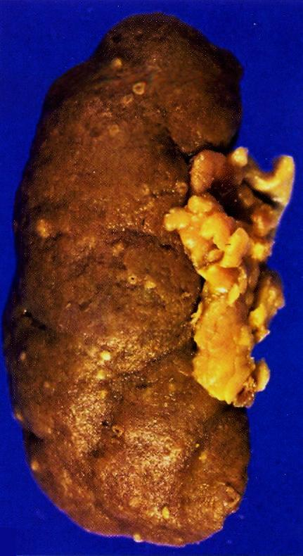
Pyonephrosis with small cortical abscesses.
Notes:
Pyonephrosis with small cortical abscesses .

Slide 25
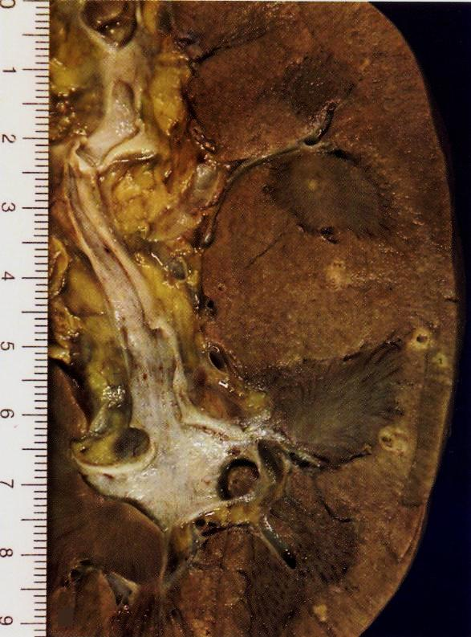
Renal cortical pyonephrosis with renal stone impacted within a calyx.
Notes:
Renal cortical pyonephrosis with renal stone impacted within a calyx .

Slide 26
5- CHRONIC PYELONEPHRITIS

Slide 27
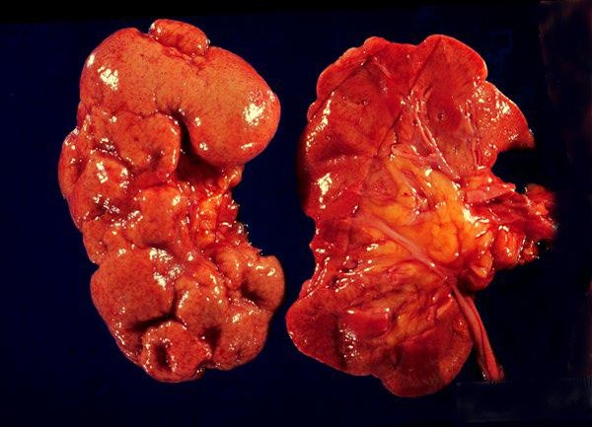
The picture shows slightly atrophic and deformed kidneys with cortical coarse scars.
Notes:
The picture shows slightly atrophic and deformed kidneys with cortical coarse scars .

Slide 28
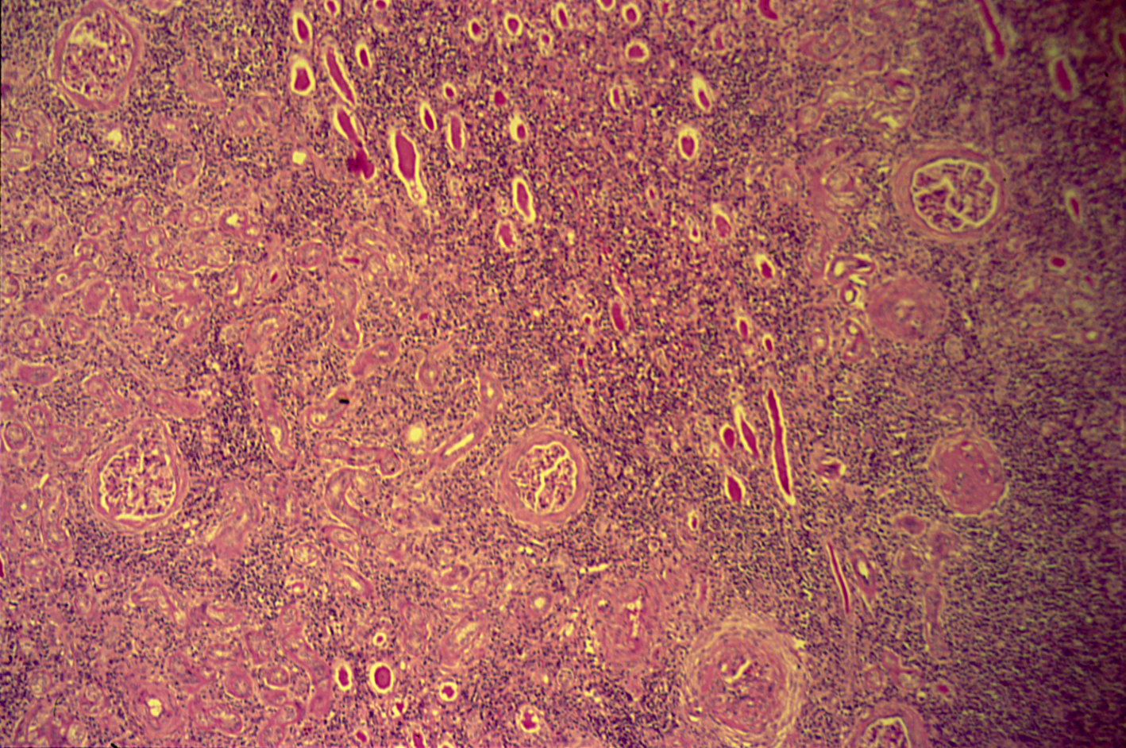
CHRONIC PYELONEPHRITIS

Slide 29
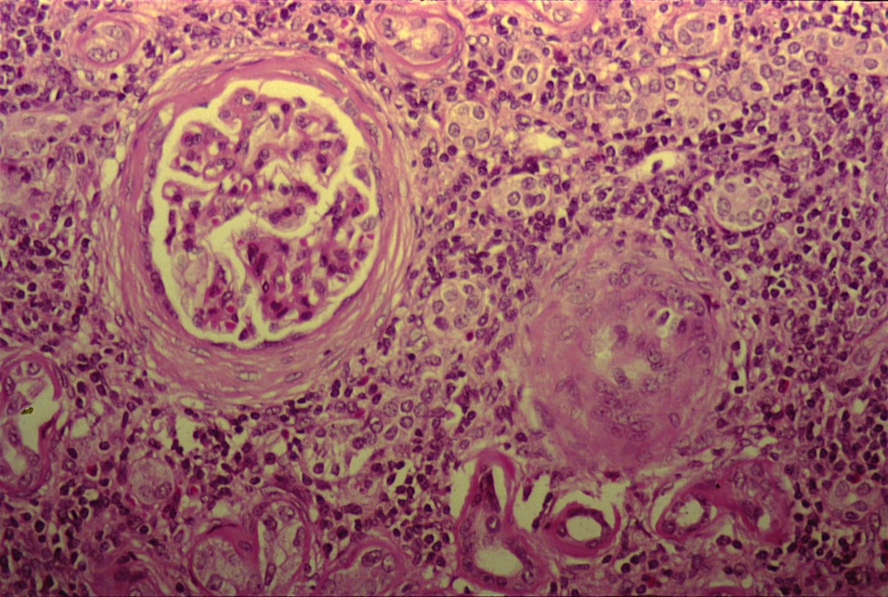
CHRONIC PYELONEPHRITIS
The picture shows periglomerular fibrosis , glomerular sclerosis and hyalinization with marked chronic interstitial inflammation.

Slide 30
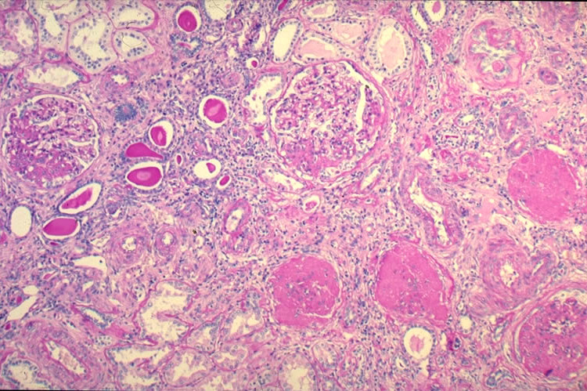

Slide 31
Chronic pyelonephritis: Section of the kidney reveals that:
The glomeruli show varying degrees of sclerosis and periglomerular fibrosis.
The tubules show varying degrees of atrophy. Some tubules are dilated and filled with Eosinophilic hyaline casts resembling colloid (thyroidization).
Deformed renal calyces and pelvis.
Interstitial tissue shows chronic inflammatory cells infiltrate and fibrosis.

Slide 32
6- Renal CELL Carcinoma (Clear cell carcinoma of the kidney)

Slide 33
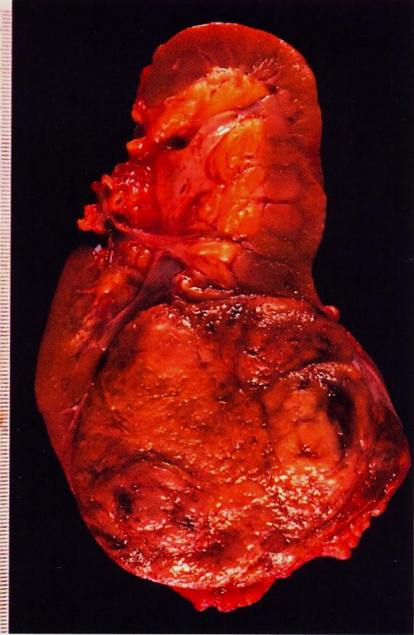
Renal cell carcinoma occupying the lower renal pole.
Notes:
Renal clear cell carcinoma may secrete erythropoietin hormone .

Slide 34
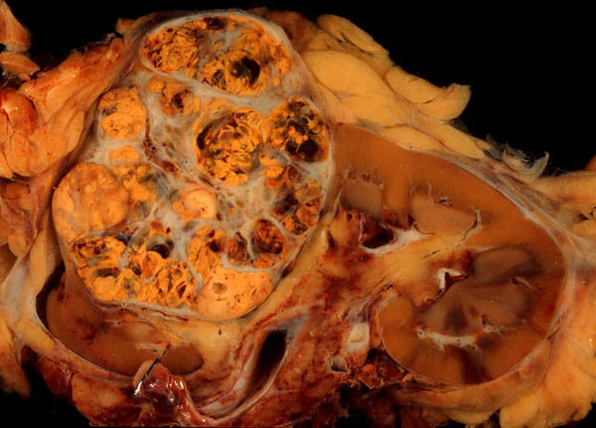
Gross picture shows a well circumscribed renal cortical mass which is partly yellow and partly hemorrhagic with lobulated cut surface.

Slide 35
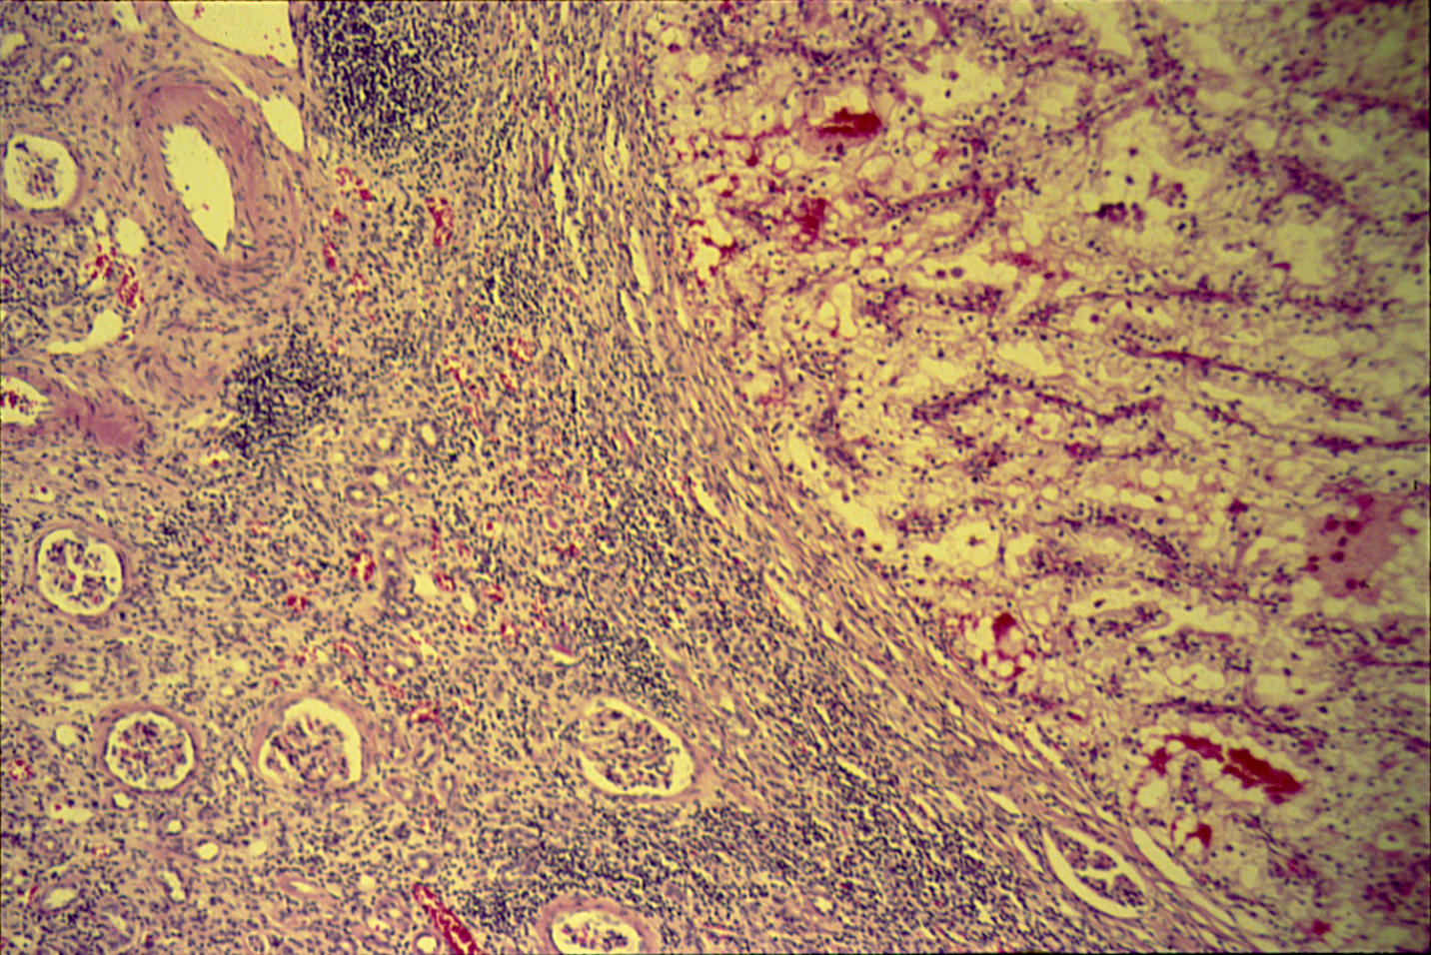
RENAL CELL CARCINOMA Clear cell carcinoma of the kidney

Slide 36
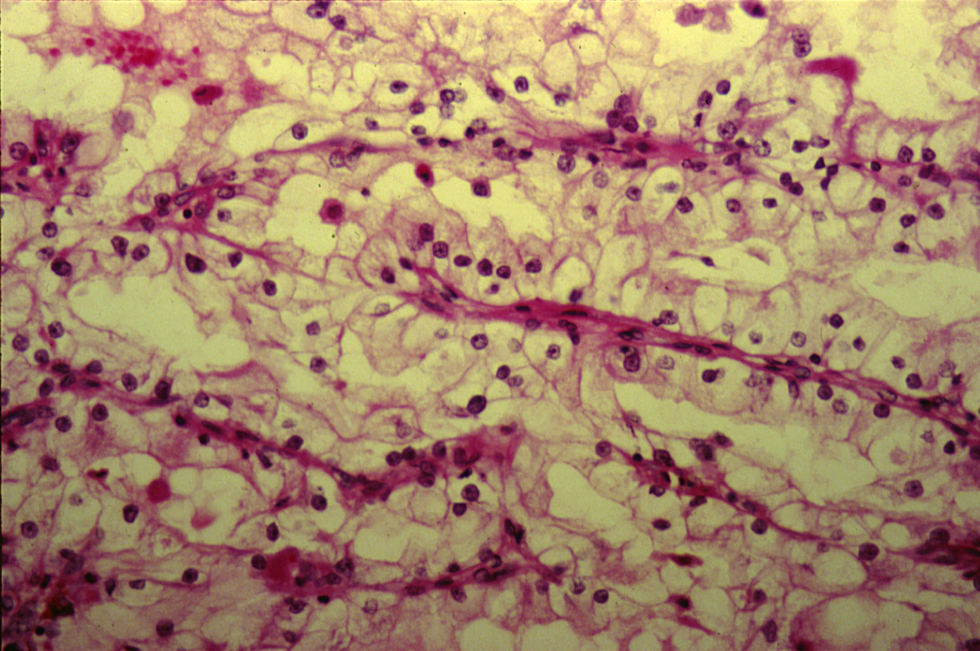
RENAL CELL CARCINOMA Clear cell carcinoma of the kidney

Slide 37
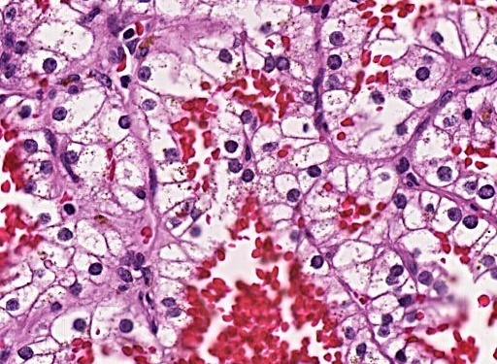
Section shows clear tumor cells with hyperchromatic nuclei and areas of hemorrhage.

Slide 38
Clear cell carcinoma of the kidney: Section of the kidney shows:
Tumour cells are large polygonal with clear cytoplasm (dissolved glycogen and lipid) and piknotic nuclei.
Cells are arranged as alveolar groups or tubules with papillary formations separated by thin fibrovascular septae.
Cells show pleomorphism and mitosis.
Areas of haemorrhage and necrosis are present.
Clinical and Lab features include :
Abdominal mass
Flank pain
Hematuria
Fever
Secondary polycythemia
Ectopic production of hormones
Hypercalcemia

Slide 39
7- Wilm’s tumor

Slide 40
Wilms Tumor
Gross picture shows partly pale and partly hemorrhagic solid tumour replacing almost the entire renal parenchyma with areas of necrosis and hemorrhage.
Notes:
Gross picture shows partly pale and partly hemorrhagic solid tumour replacing almost the entire renal parenchyma and areas of necrosis also seen .

Slide 41
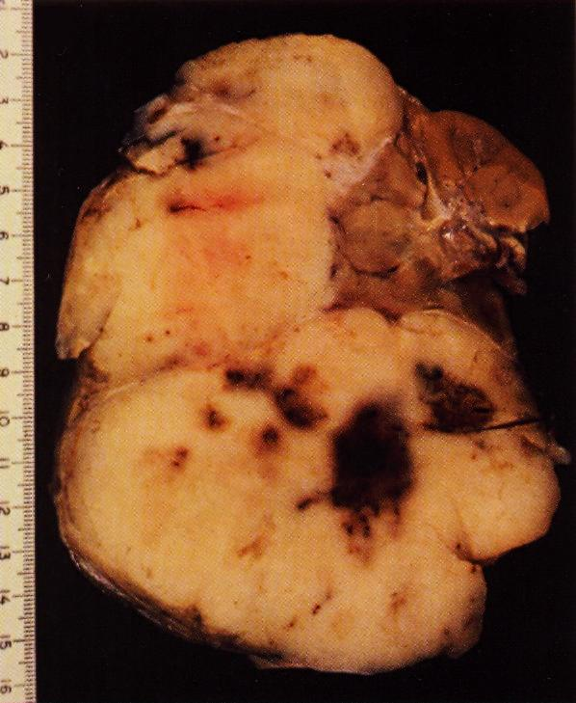

Slide 42
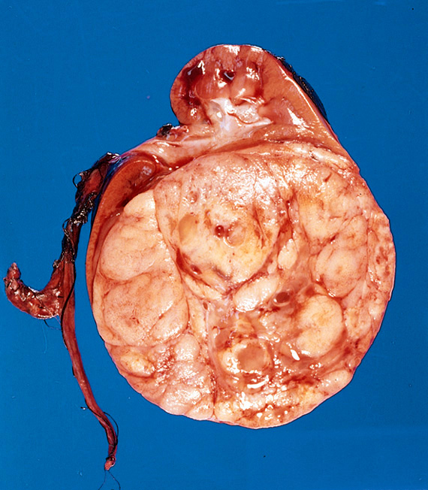

Slide 43
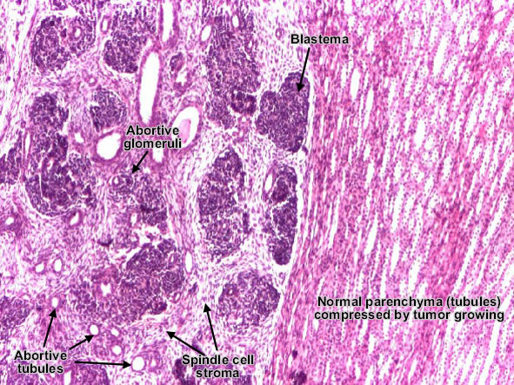

Slide 44
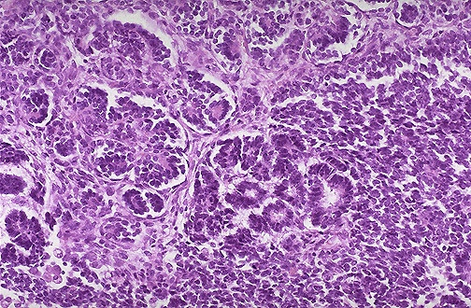
Wilm's tumor resembles the fetal nephrogenic zone of the kidney.
- Three major components:
undifferentiated blastema cells
epithelial tissue which shows attempts to form primitive glomerular and tubular structures
mesenchymal (stromal) tissue

Slide 45
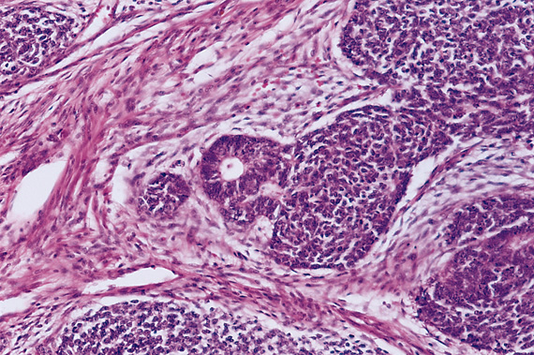

Slide 46
8- CARCINOMA OF THE URINARY BLADDER Urothelial(transitional cell) carcinoma

Slide 47
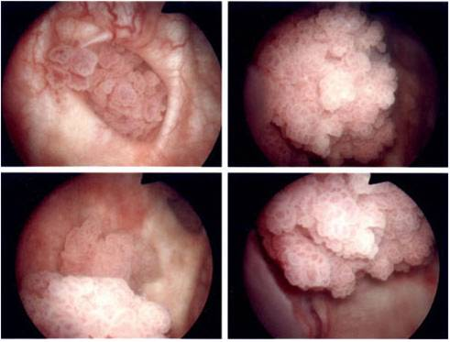
Endoscopic view of a multifocal papillary urinary bladder tumor.

Slide 48
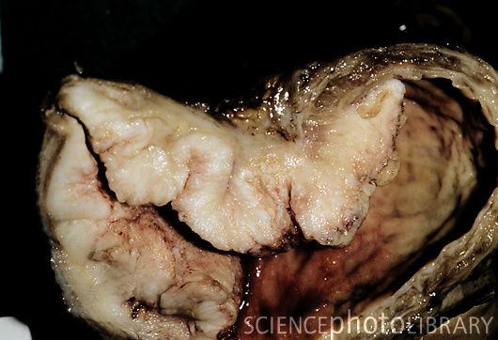
Gross specimen of a malignant tumor (pale area, centre to left) of the urinary bladder.

Slide 49
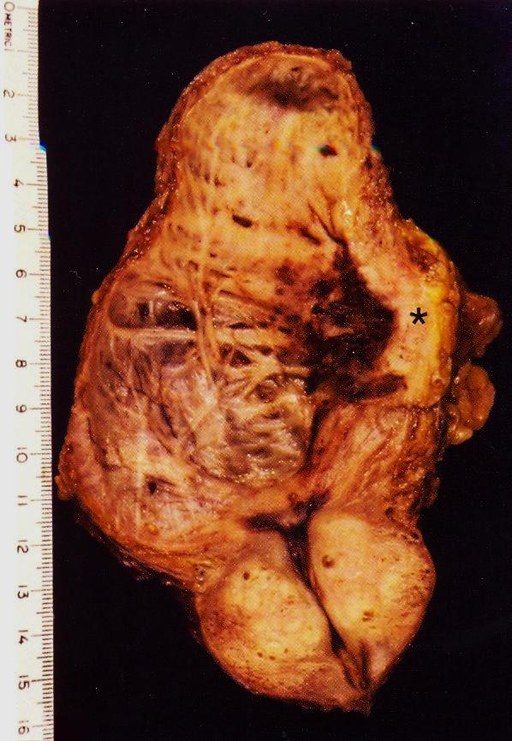
Longitudinal section of urinary bladder and prostate showing benign prostatic hyperplasia , trabeculation of the urinary bladder wall and bladder carcinoma which is most likely proved histologically to be Transitional cell carcinoma.
Notes:
Predisposing factors include smoking , Aniline dyes , long term use of analgesics , heavy long term exposure to cyclophosphamide .

Slide 50
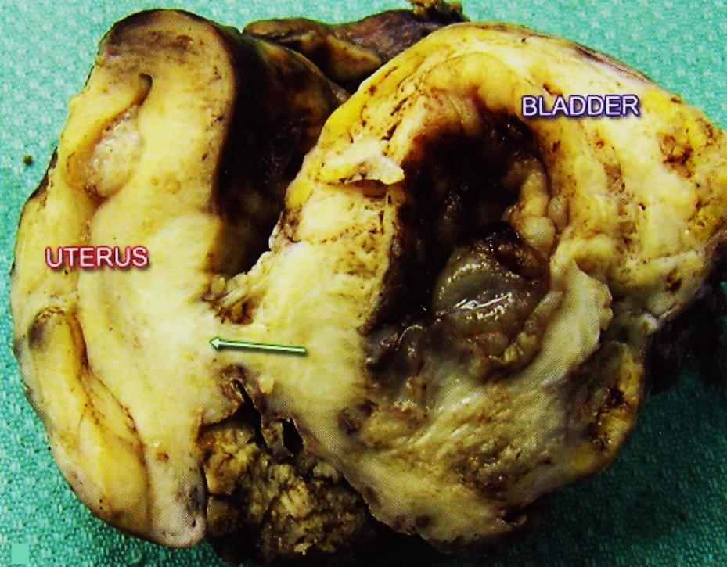
Urinary bladder carcinoma infiltrating the urinary bladder wall with extention to the uterus .
Notes:
Urinary bladder carcinoma infiltrating the urinary bladder wall with extention to the uterus through a fistula (arrow) .

Slide 51
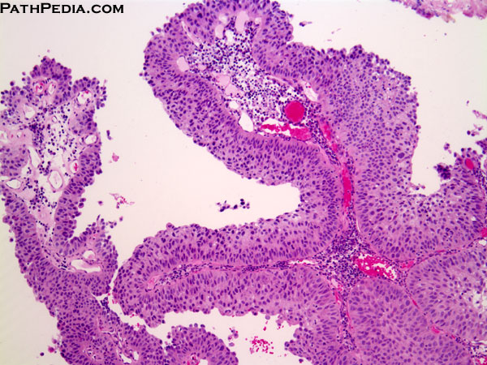
PAPILLARY UROTHELIAL (transitional cell) CARCINOMA, LOW GRADE.
This exophytic papillary tumor shows multiple finger-like projections lined by multiple layers of urothelium (transitional epithelium).
- The tumors show overall preservation of cell polarity, few mitoses, and lack of significant morphologic atypia.

Slide 52
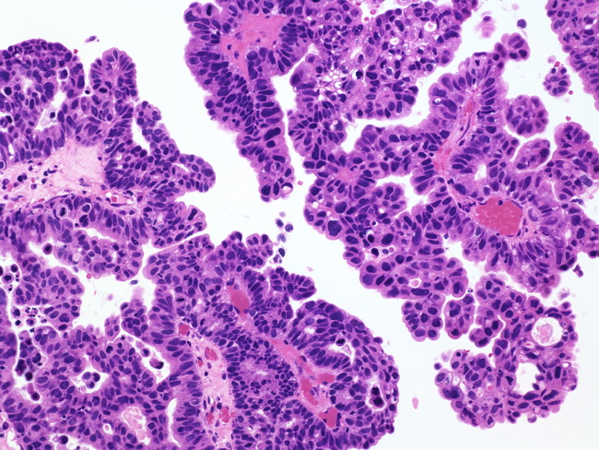
PAPILLARY UROTHELIAL (transitional cell) CARCINOMA, HIGH GRADE.
- The nuclei in this high-grade tumor are significantly enlarged and show variably increased chromatin content

Slide 53
- Predisposing risk factors to bladder cancer include:
Exposure to aniline dyes
Cigarette smoking
Treatment with cyclophosphamide
Phenacetin abuse
- Squamous cell carcinoma of urinary bladeer may occur as a complication to schistosoma hematobium infection.

