Slide 1
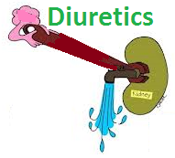

Slide 2
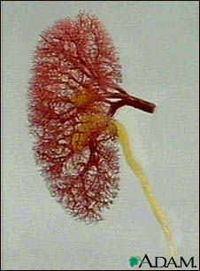
Diuretics
By the end of these three lectures you will be able to:-
Define and classify diuretics.
Identify the site of action of each class of diuretics in the nephron.

Slide 3
Diuretics
Describe the mechanisms of action of diuretics
Detail on the pharmacodynamic actions and pharmacokinetic aspects of diuretics
List ADRS, therapeutic uses, contraindications and drug- drug interactions of diuretics.

Slide 4
i- Carbonic Anhydrase Inhibitors
&
Osmotic Diuretics

Slide 5
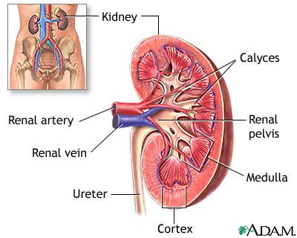
Diuretics
Drugs used to increase renal flow & to remove excess extracellular fluid (oedema).
They act by ↑the quantity of sodium in urine ( natriuretic diuretics)

Slide 7
The main
indications
Oedema of
any origin
Congestive
heart failure
Hypertension
Elimination of toxins

Slide 9
Classification according to mechanism
Diuretic
Target protein
Transporter
Receptor
No Target protein
Osmotic Diuretics
Ion channel
Enzyme
Loop
diuretics
Thiazides
Triamterin
Amiloride
Carbonic Anhydrase inhibitors
Spironolactone

Slide 10
According to efficacy
Diuretics
Moderate efficacy
Thiazides
Low efficacy
K+ sparing
High
efficacy
Loop diuretics
Osmotic
Carbonic anhydrase inhibitors

Slide 11
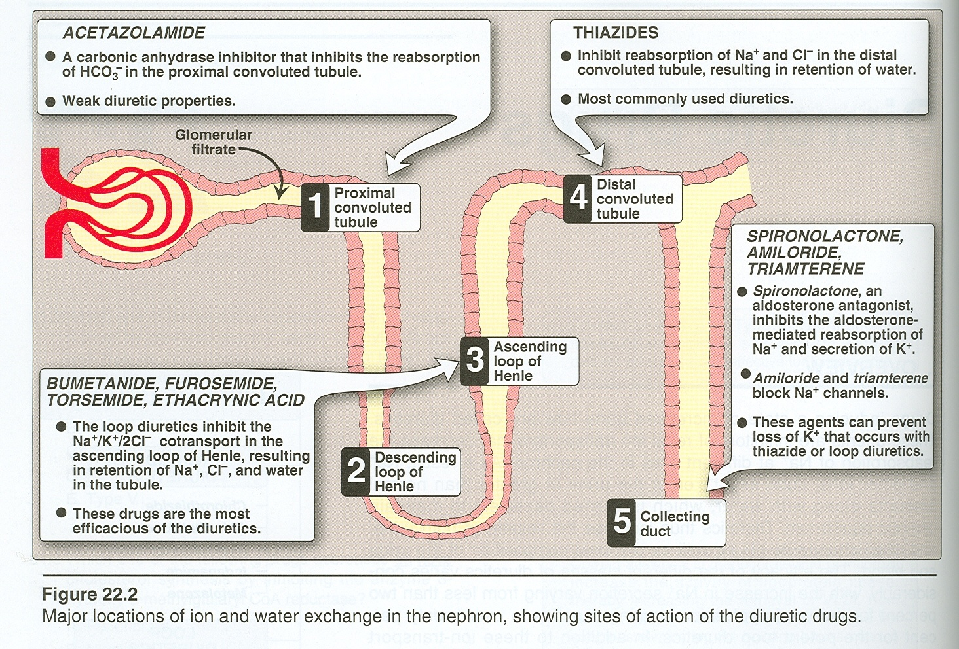

Slide 12
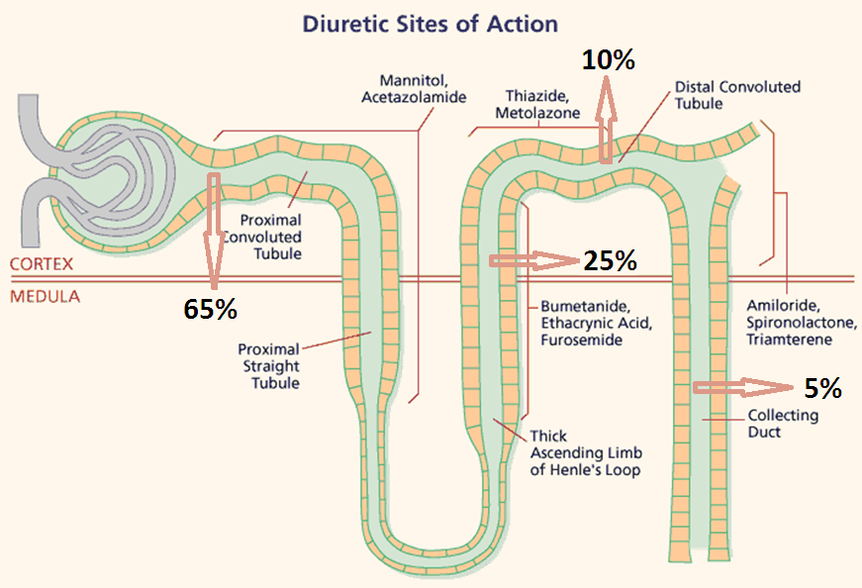

Slide 13
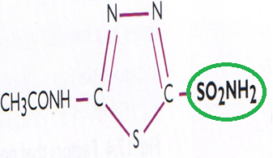
Carbonic anhydrase inhibitors
Carbonic anhydrase accelerates the attainment of equilibrium in the reaction
CO2 + H2O↔H2CO3
Acetazolamide is a is a potent specific inhibitor of carbonic anhydrase, enzyme inhibition is non competitive.

Slide 14
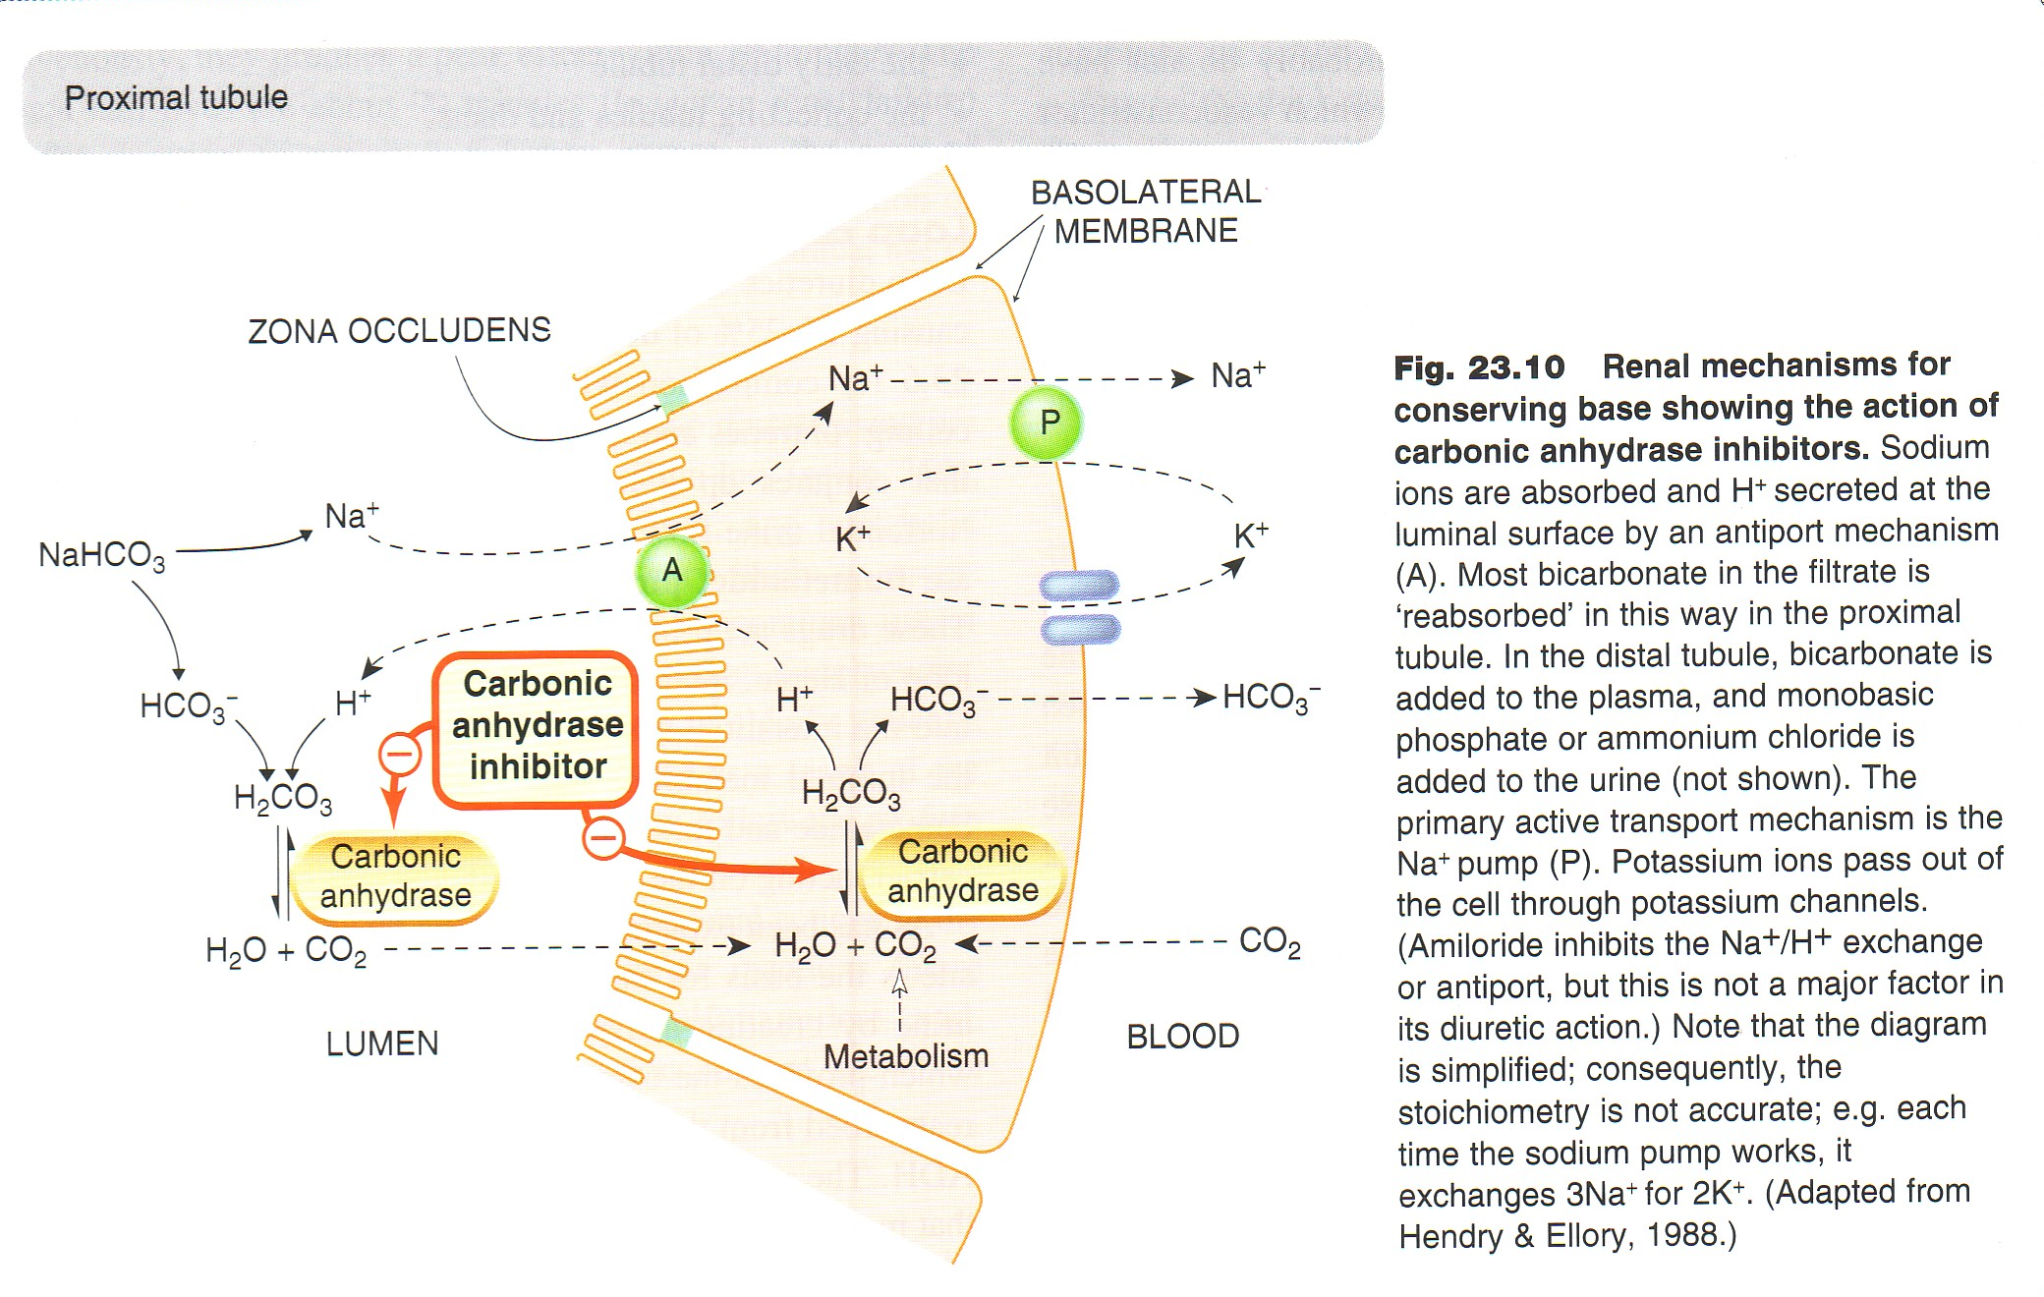

Slide 15
It ↓ reabsorption of bicarbonate in the proximal tubule & prevent the acidification of urine in the distal tubule

Slide 16
Promotes K+ excretion by ↑the load of Na+ delivered to the distal tubules
With repeated dosage the diuretic action is lost →loss of HCO3- & development of acidosis
Self- limiting action of acetazolamide restrict its use to mild oedema e.g. oedema of pregnancy

Slide 17
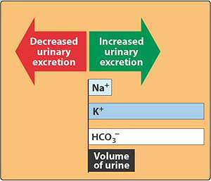

Carbonic anhydrase inhibitors

Slide 18
  Pharmacokinetics:
  given orally once a day.
  Onset of action is rapid (30 min).
  t½ 6-9h
  Excreted by active secretion in proximal convoluted tubules.

Slide 19
ADR:-
Hyperchloremic metabolic acidosis
  Renal stone formation (calcium phosphate stones).
  Renal potassium wasting
Hypersensitivity reactions, bone marrow depression, skin rash.
Reduction of the urinary excretion rate of weak organic bases.

Slide 20
ADR:-
drowsiness,
numbness
, tingling sensation of the face & extremities ,
disturbance of vision
Contraindicated in patients with liver cirrhosis (diversion of ammonia of renal origin from urine into the systemic circulation)

Slide 21
Clinical indications:-
A] Glaucoma:- aqueous humour contains a high concentration of bicarbonates. ↓of carbonic anhydrase↓rate of aqueous humour formation→ ↓intraocular pressure-tolerance does not develop to this effect
B] Urine alkalinization:- uric acid & cysteine are relatively insoluble in acid urine . Renal excretion can be ↑by↑urinary bicarbonate excretion. Effect is short lived & require bicarbonate infusion.

Slide 22
C] Adjunct for treatment of epilepsy:- glial cells contain carbonic anhydrase .
Nerves are highly responsive to rise in pH. ↑7.4→ 7.8 causes convulsions.
↓of neuronal carbonic anhydrase →↓ pH in the vicinity of neurons.

Slide 23
D] ↓Formation of CSF:- ↓of carbonic anhydrase in the chorioid plexus →↓formation of CSF. Useful in management of benign intracranial hypertension.
E] Mountain sickness prophylaxis:- given nightly 5 days before the ascent
↓ weakness, breathlessness , dizziness, nausea , cerebral & pulmonary oedema
F] Useful for correcting a metabolic alkalosis, especially an alkalosis caused by diuretic-induced increases in H⁺ excretion.

Slide 24
Dorzolamide
  Is a carbonic anhydrase inhibitor
  Used topically for treatment of increased intraocular pressure in open-angle glaucoma.
  no diuretic or systemic side effects (Why?).

Slide 25
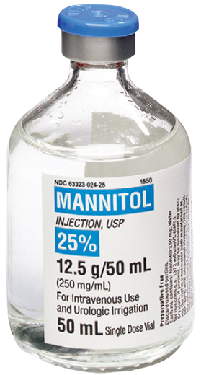
Osmotic diuretics
60–80%

Slide 26
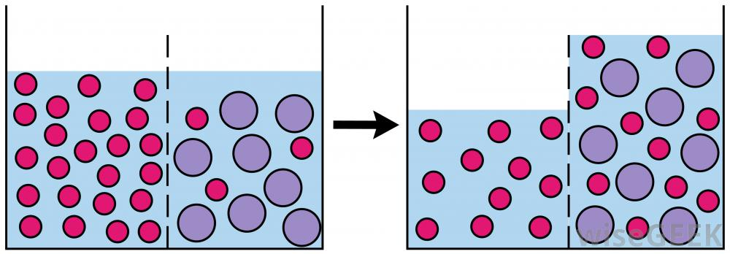
Mannitol increases urine output by osmosis, drawing water out of cells and into the bloodstream.

Slide 27
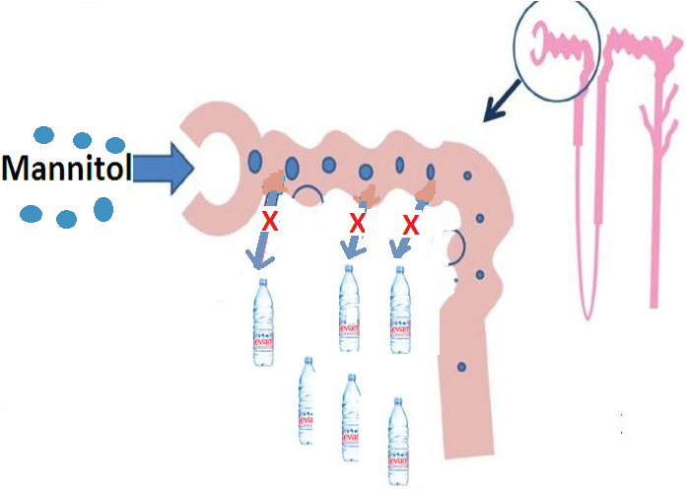

Slide 28
Osmotic Diuretics
(aquaretics)
IV administration of any solute filtered by glomeruli may produce osmotic diuresis when the amount delivered to tubules exceeds their absorptive capacity.
The dissolved compound exert an osmotic pressure →↓water & Na+ reabsorption.
Expand the extracellular fluid volume, decrease blood viscosity, and inhibit renin release,↑renal blood flow.

Slide 29
Pharmacokinetics
Mannitol, IV, not absorbed from the GIT, ↑water excretion with relatively less effect on Na+
If given orally osmotic diarrhea
Little metabolized
Excreted by glomerular filteration.
t½0.25-1.7h, prolonged in renal failure to 36h
Mainly excreted unchanged in urine.

Slide 30
Clinical uses:-
1-To eliminate drugs that are reabsorbed from the renal tubules in acute poisoning e.g. salicylates, bromides, barbiturates.
2-To prevent acute renal necrosis after severe injury , haemorrhage, hypovolaemia, →↓ GFR, absorption of water & salts is complete , distal part dries up→ irreversible damage.

Slide 31
3-To↓ intracranial & intraocular pressure before ophthalmic or brain procedures.
4-To maintain urine volume & to prevent anuria resulting from large pigmentation load to the kidney e.g. haemolysis, rhabdomyolysis.
5-For treatment of dialysis disequilibrium syndrome. (Too rapid removal of solutes by dialysis→↓ osmolality of extracellular fluids→ water moves from extracellular to intracellular compartment→ hypotension & CNS symptoms)

Slide 32
Adverse Effects:
Headache, nausia, vomiting→ hyponatremia
Extracellular volume expansion, complicates heart failure & pulmonary oedema
Excessive use→ dehydration & hypernatraemia,
  (Adequate water replacement is required).
  Contraindications:
  Chronic heart failure
  Anuric patients or patients not responding to a test dose of mannitol.

Slide 33

Quiz?
Which one of the following is a carbonic anhydrase inhibitor?
A) mannitol
B) bumetanide
C) Dorzolamide
D) spironolactone

Slide 34
Quiz?
A 57-old male developed progressive loss of his vision with sensation of pressure behind his eyes. To prevent further progression of the disease and to alleviate symptoms his ophthalmologist prescribed acetazolamide. Which of the following is a mechanism of action of acetazolamide?
A) through osmotic effects
B) through enzyme inhibition
C) interacting with hormonal receptors
D) through inhibition of ion channel

Slide 35
Quiz?
Of the following agents , which one is best avoided in congestive heart failure?
A) acetazolamide
B) hydrochlorothiazide
C) mannitol
D) furosemide

Slide 36
Quiz?
Which of the following agents decrease excretion of chloride ions?
A) furosemide
B) hydrochlorothiazide
C) mannitol
D) acetazolamide

Slide 37
Quiz?
A patient with a compromized renal hemodynamics was given a trial of mannitol. Which of the following is least likely to be associated with the effect of mannitol?
A) retention of water in tubular fluid
B) ability to be metabolized into an
active metabolite
C) capacity to be freely filtered
D) ability to resist complete
reabsorption by kidney tubules

