Slide 1
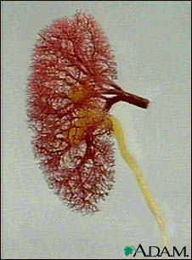
ii- Diuretics
Thiazides &
Loop Diuretics

Slide 2
Na-Cl SYMPORT INHIBITORS
Also Called:
  Thiazide Diuretics
  Thiazide-Like Diuretics
Chlorthalidone
Potency 10, t½ 26h
Hydrochlorothiazide
Potency 1 , t½ 3h
Chlorothiazide
Potency 0.1, t½ 2h
Metolazone
Potency 5, t½ 5h
Indapamide
Potency 20, t½ 16h

Slide 3
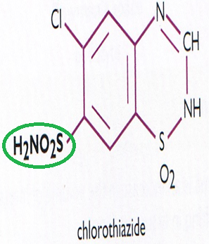
Thiazides
Act on early distal tubule[5-10%of filtered load of sodium is reabsorbed].
Weak inhibitors of carbonic anhydrase , but this does not contribute to their action

Slide 4
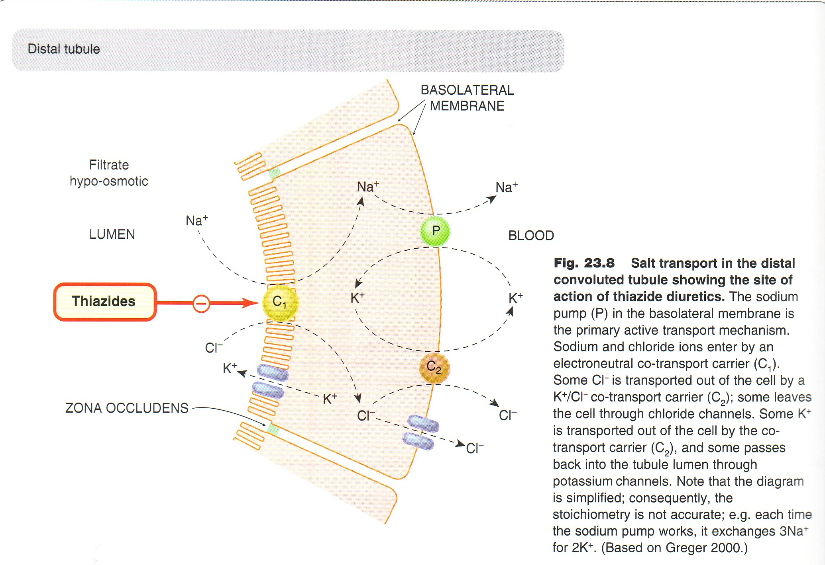
thiazide diuretics.mp4

Slide 5
Pharmacokinetics:
  Thiazides are lipid soluble
  Given orally, efficiently absorbed from the G.I.T.
  Long duration of action
  Eliminated by glomerular filtration & tubular secretion , some is reabsorbed
  May interfere with uric acid secretion and cause hyperuricemia

Slide 6
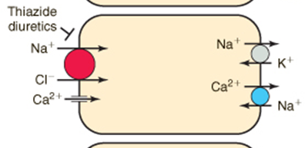
Actions:-
1- considerable K+ loss
2-↓uric acid
↓Ca++ excretion
↑Mg++ excretion

Slide 7
How do thiazides
(and loops) promote
K⁺ loss?
Na⁺
↑tubular Na⁺
collecting
duct
Na⁺
Na⁺
K⁺ H loss
K⁺ H Loss
↑Na⁺/K⁺ exchange
urine
urine
Notes:
Prevent na rab in dct, more na in collecting ducts.
Loops have greater chance for hypokalemia and met alkalosis.

Slide 8
Actions:-
3-May give rise to hypochloraemic alkalosis ,
4- Causes vasodilatation , diazoxide , non diuretic thiazide is a potent vasodilator
5-↓of urine volume in case of diabetes insipidus

Slide 9
Mechanism of antidiuretic effect of thiazide in diabetes insipidus
Thiazide
Urinary output
Distal tubular Na+
reabsorption
Distal delivery of Na+ & water
Urinary excretion
Proximal Na+ & Water
reabsorption in
Extracellula volume

Slide 10
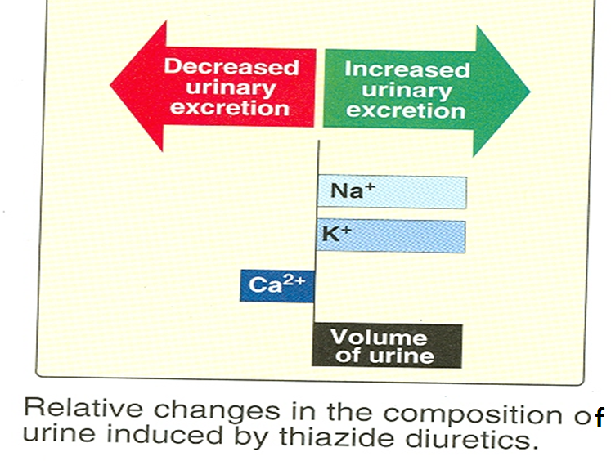

Slide 11
ADVERSE EFFECTS
ECFV
Depletion
Hypercalcemia
Hypokalemia
Hyponatremia
Metabolic
Alkalosis
Hyperuricemia
Hypomagnesemia
Hyperglycemia
Impotence
Increased LDL
(Renal Cell Carcinoma??)

Slide 12
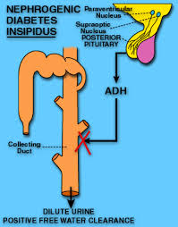
THERAPEUTIC USES
Increase Na Excretion
to 5% of Filtered Load
Treatment for
Mild Edema
Treatment for
Hypertension
Treatment for
Nephrogenic Diabetes Insipidus
Ineffective when the GFR is less than 30 to 40 ml/min except
Treatment for
Calcium Nephrolithiasis
Decrease Ca Excretion
Treatment for Osteoporosis

Slide 13
IMPORTANT THIAZIDE DRUG INTERACTIONS
Thiazides
Diminish
effect
Uricosurics
Sulphonylurea
Thiazides
Increase effect
Digitalis
Diazoxide
Reduce thiazide
efficacy
NSAIDs

Slide 14
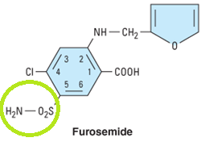
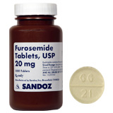
Loop Diuretics

Slide 15
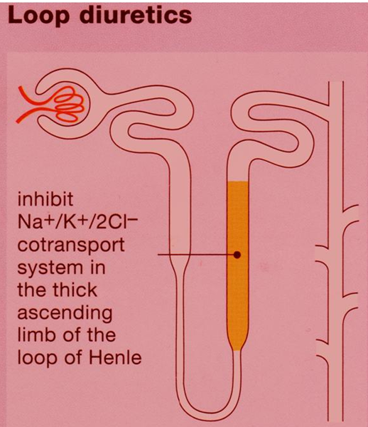
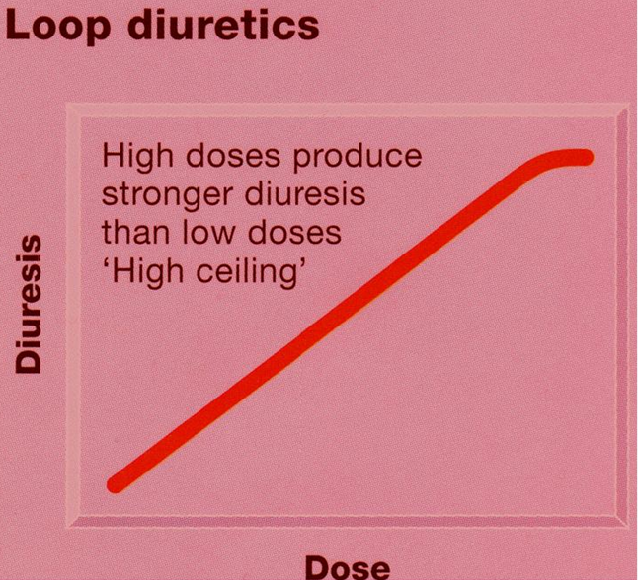
Loop diuretics
Acts on the thick segment of the ascending loop of Henle[25% of glomerular filtrate of Na+ is reabsorbed]
The most potent diuretic , termed “high ceiling diuretic”
↓Renal vascular resistance &↑renal blood flow

Slide 16
Na-K-2Cl SYMPORT INHIBITORS
Also Called:
  Loop Diuretics
  High Ceiling Diuretics
Ethacrynic
Acid
Potency 0.7, t½ 1h
Furosemide
Potency 1, t½ 1.5h
Bumetanide
Potency40 ,t½ 0.8 h
Torsemide
Potency 3, t½ 3.5h

Slide 17
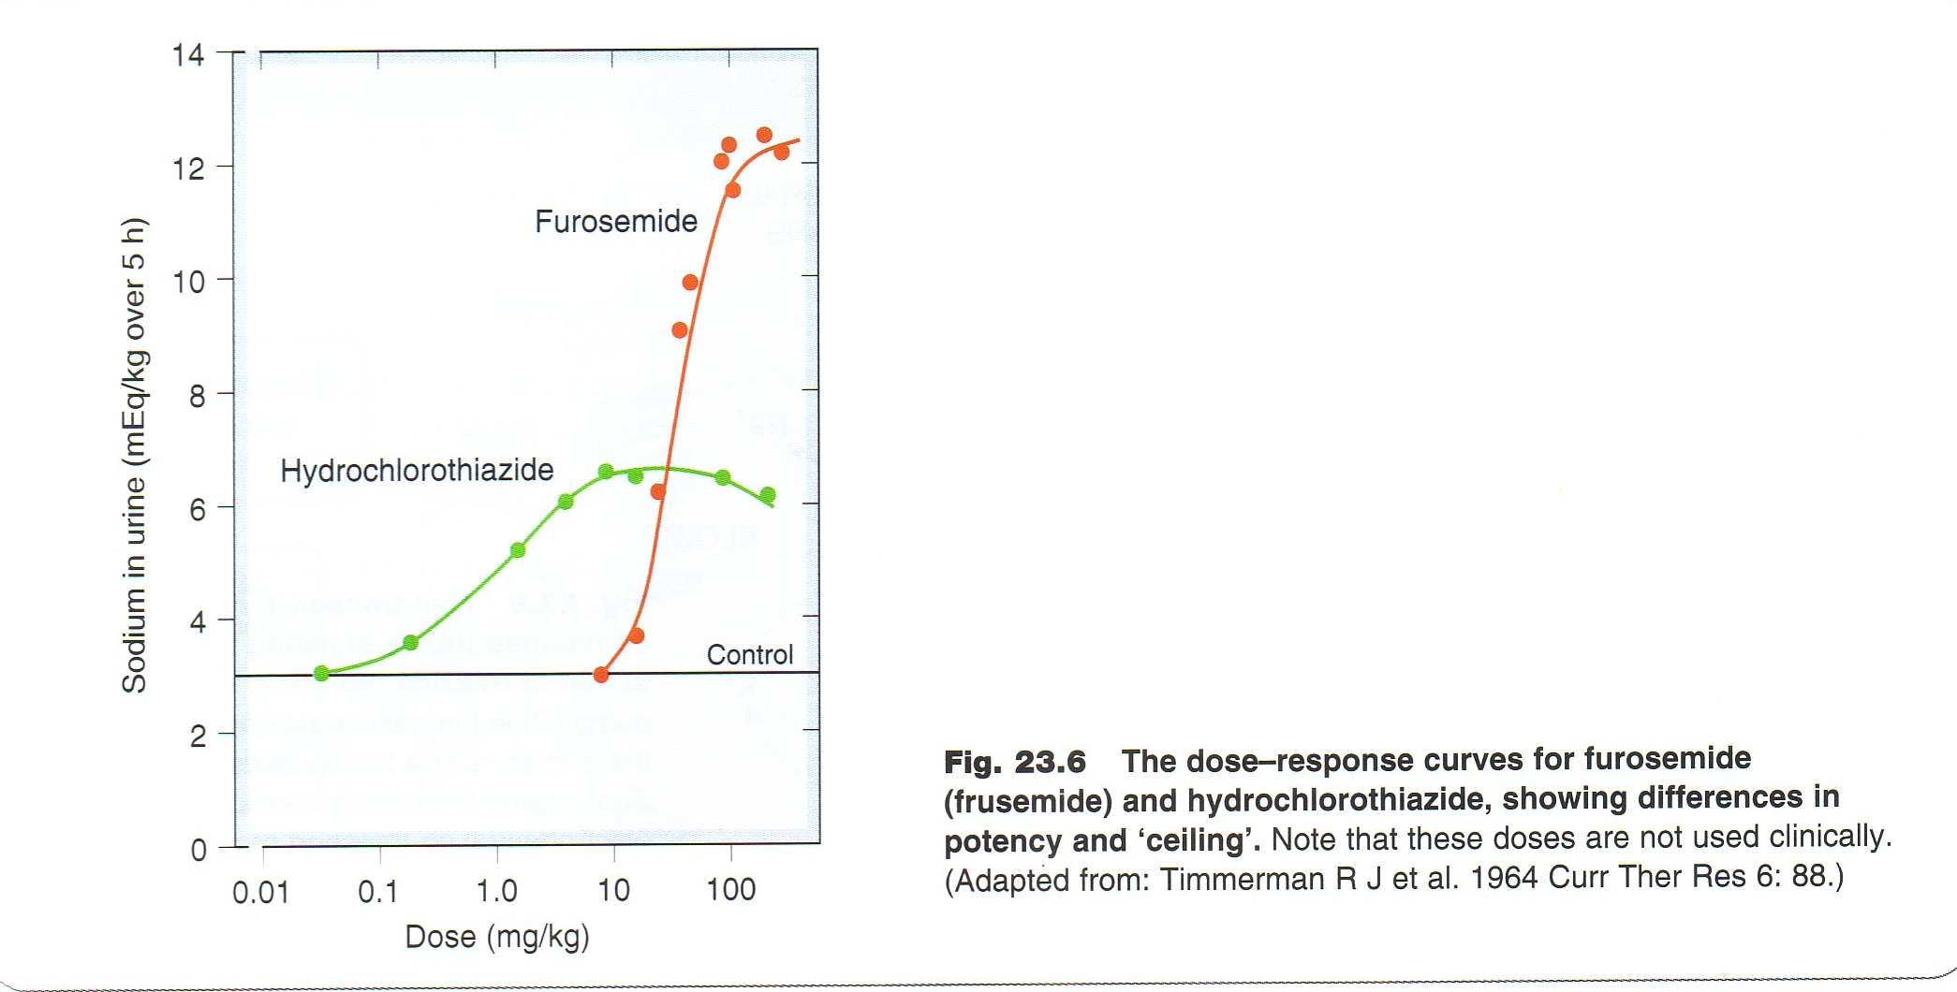

Slide 18
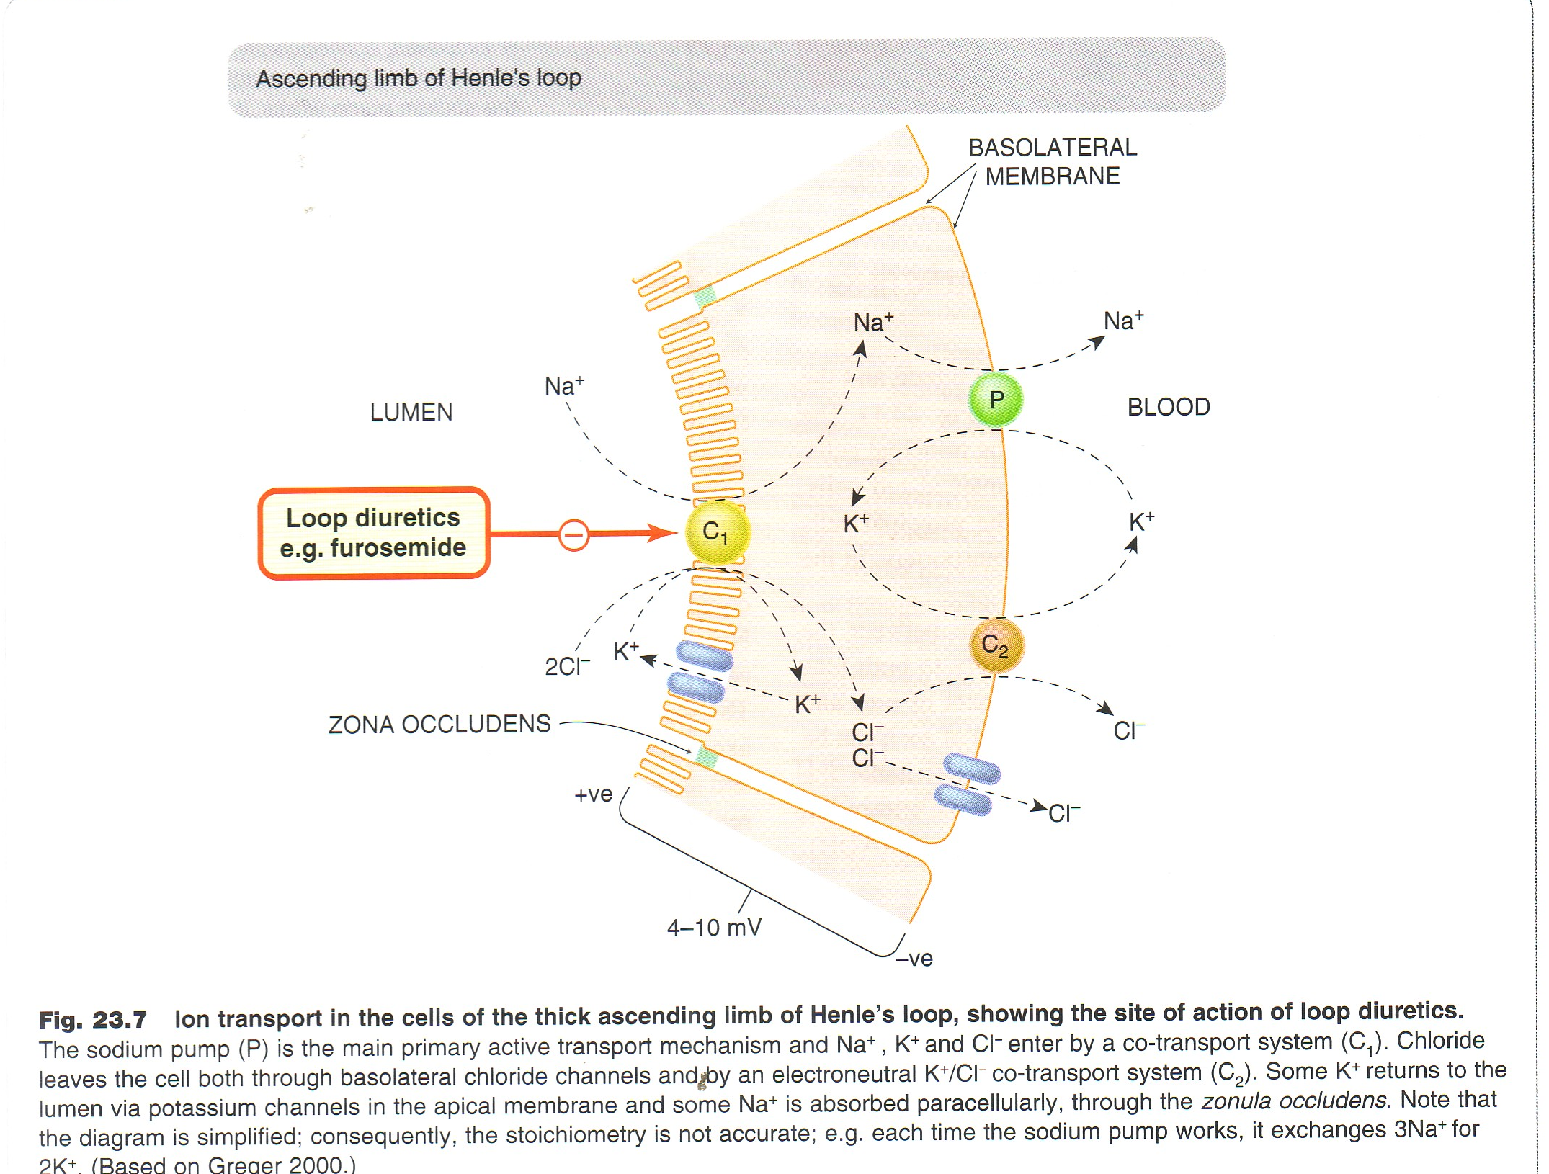
loop diuretics-1.mp4

Slide 19
Pharmacokinetics
  Given orally or I. V.
  Have fast onset of action (suitable for emergency)
  Have short duration of action.
  Bumetanide is the most potent
  Excreted by active tubular secretion of weak acids into urine(avidly bound to plasma proteins).
  Interfere with uric acid secretion.

Slide 20
THERAPEUTIC EFFECTS AND USES
Increase Na Excretion
to 25% of Filtered Load
Treatment for
Severe Edema
Treatment for
Oliguric ARF
Increase Urine Volume
Treatment for
Hypercalcemia
Increase Ca Excretion
Treatment for
Pulmonary Edema
Increase Venous
Capacitance
Acute Treatment for
Hyperkalemia
Increase K+ Excretion

Slide 21
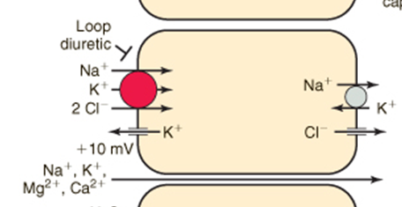
How loop diuretics enhance excretion of magnesium and calcium

Slide 22
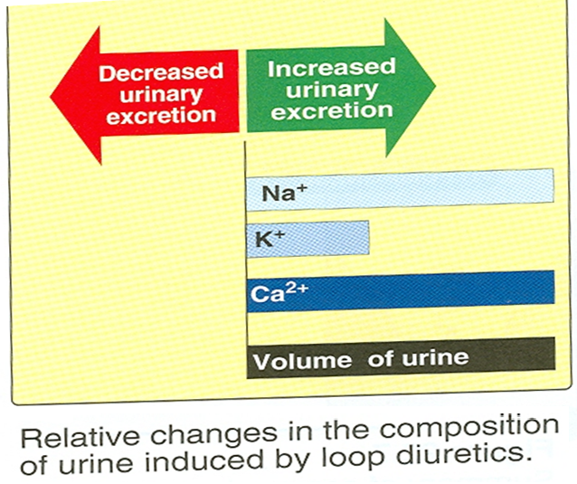

Slide 23
ADVERSE EFFECTS
Profound ECFV
Depletion
Hypocalcemia
Hypokalemia
Ototoxicity
Metabolic
Alkalosis
Hyperuricemia
Hypomagnesemia
Hyperglycemia

Slide 24
IMPORTANT DRUG INTERACTIONS
NSAIDS
Probenecid
Diminished
Diuretic
Response
Arrhythmias
Digitalis
Enhanced Ototoxicity
of Loop Diuretic
Aminoglycosides

Slide 25
Contraindications
1- Severe Na⁺ and volume depletion
2-Hypersensitivity to sulfonamides
3- Anuria unresponsive to a trial dose of loop diuretic.

Slide 26

Quiz-1?
Blockade of the Na/K/2Cl co-transporter is the basis for diuretic effect of which of the following?
A) Metolazone
B) Torsemide
C) Hydrochlorothiazide
D) Triamterene

Slide 27
Quiz-2?
Which of the following diuretics act on specific membrane transport proteins?
A) mannitol
B) indapamide
C) amiloride
D) spironolactone

Slide 28
Quiz-3?
A-7- year old boy is brought to the clinic by his mother. He complains of sharp pain in his flanks as well as dysuria and frequency. The doctor orders a 24-hour urine calcium test, and the results come back abnormal. The child was diagnosed with idiopathic hypercaliuria. What type of medication is used for this disorder?
A) mannitol
B) hydrochlorothiazide
C) amiloride
D) spironolactone

Slide 29
Quiz-4?
Which of the following is an action of loop diuretics on ionic excretion?
A) increased sodium excretion
B) decreased magnesium loss
C) decreased calcium loss
D) decreased potassium loss

Slide 30
Quiz-5?
An 87-year-old female who is taking
multiple medications for her heart
disease is prescribed gentamicin
for diverticulitis. After a few days of
taking the antibiotic, she complains
of dizziness and tinnitus. What heart medication might she be on?
A) spironolactone
B) hydrochlorothiazide
C) ethacrynic acid
D) amiloride

Slide 31
Quiz-6?
A 45-year –old male with history of medication –controlled hypertension presented to you with complaints of a painful swollen big toe. You suspected gout and checked his uric acid levels, which were elevated. Upon looking at the list of his medications you realized that one of them might be the cause. Which medication might that be?
A) spironolactone
B) hydrochlorothiazide
C) acetazolamide
D) amiloride

