Slide 1
Diuretics iii
Aldosterone antagonist
&
Sodium Channel Inhibitors

Slide 2
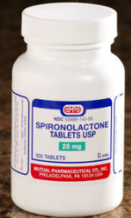
Potassium-
sparing diuretics
Amiloride
Triamterene
Spironolactone
3%

Slide 3
Potassium-sparing diuretics
Competitive
aldosterone
antagonists:
Spironolactone
eplerenone
Inhibitors of Na⁺ channels:
Amiloride
Triamterene

Slide 4
MINERALOCORTICOID RECEPTOR ANTAGONISTS
Also Called:
K-Sparing Diuretics
Aldosterone Antagonists
Spironolactone
Eplerenone

Slide 5
Aldosterone Antagonists
Spironolactone is a lactone steroid, competitive antagonist at the collecting duct→↑Na+,Cl-&↓K+,H+,NH4

Slide 6
Pharmacokinetics
Spironolactone: Well absorbed from the GIT ,t½=1.6h.
Highly protein- bound.
Undergoes enterohepatic recycling.
Converted in gut & liver to canrenone [active metabolite, t½=16h].
Maximum diuretic action 4 days.

Slide 7
Eplerenone, eliminated by metabolism(CYP3A4) , t½ 5h. Low affinity for progesterone and androgen receptors

Slide 8
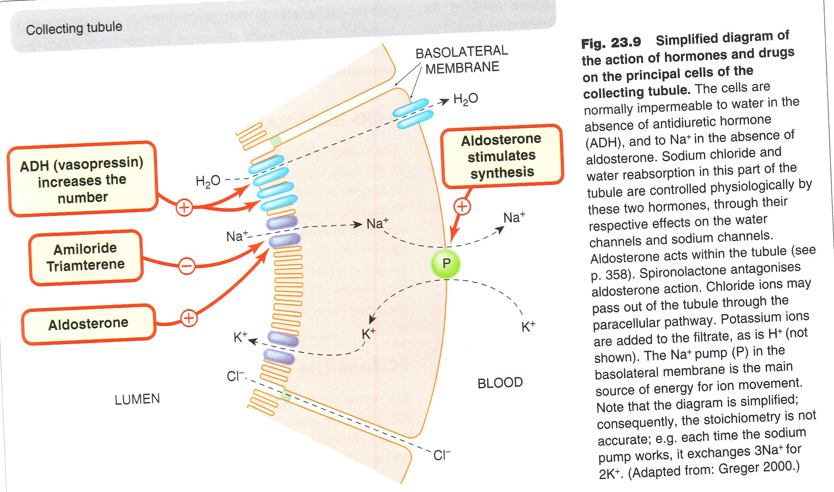

Slide 9
THERAPEUTIC EFFECTS
Enhances Natriuresis
Caused by Other Diuretics
Used in Combination with Loop &
Thiazide Diuretics
Prevents Hypokalemia
Blocks Aldosterone
Treatment for
Primary Hyper-aldosteronism
Treatment for
Heart Failure
Treatment for
Edema of Liver Cirrhosis
Treatment for
Hypertension
Treatment for
Nephrotic
syndrome

Slide 10
ADVERSE EFFECTS
Hyperkalemia
Gastritis
Metabolic
Acidosis in cirrhotic
patients
Peptic Ulcers
CNS Side
Effects
Deepening of
Voice
Impotence
Hirsutism
Gynecomastia
Menstrual
Irregularities

Slide 11
IMPORTANT DRUG INTERACTIONS
↓Secretion of
canrenone
↓Efficacy of
spironolactone
Salicylates
Spironolactone
alters clearance
Digitalis

Slide 12
Na CHANNEL INHIBITORS
sodium channel inhibitors.mp4
Also Called:
K-Sparing Diuretics
Triamterene
Potency 0.1,
t½ 4.2 h,
elimination
by metabolism
Amiloride
Potency 1,
t½ 21h,
renal
elimination

Slide 13
THERAPEUTIC EFFECTS
Enhance Natriuresis
Caused by Other Diuretics
Used in Combination with Loop &
Thiazide Diuretics
Prevent Hypokalemia
Block Na+ Channels
Treatment for
Lithium-Induced Diabetes Insipidus
Treatment for
Liddle’s Syndrome

Slide 14
ADVERSE EFFECTS
Amiloride
Triamterene
Hyperkalemia
Hyperkalemia
Renal Stones
Interstitial
Nephritis
Megaloblastosis
in cirrhotic patients

Slide 15
Contraindications
Hyperkalemia
Increased
Risk of
Hyperkalemia
Hyperkalemia
Renal failure
Other K+
sparing diuretics
ACE-I
K+ suplement

Slide 16
IMPORTANT DRUG-Drug INTERACTIONS
Hyperkalemia-
Induced by
K-Sparing
Diuretics
ACE Inhibitors
Beta-Blockers
K Supplements
K-Sparing Diuretics

Slide 17
Diuretics and doping
The first Olympic games of the new millennium were marred by a doping scandal when three Bulgarian weightlifters tested positive for diuretics. They were stripped of their medals after drug testing revealed the presence of furosemide, a banned substance. After the third suspension, the Bulgarian Weightlifting Federation was sanctioned and suspended from participation in the rest of the 2000 Summer Games in Sydney, Australia. Diuretics are used by athletes to lose weight quickly in order to compete in lower weight classes for sports like wrestling, boxing, and weightlifting. In addition, they are sometimes taken as “masking” drugs to speed the elimination of banned performance-enhancing substances such as steroids from the body.

Slide 18
Quiz-1?
Which of the following is the mechanism of action of spironolactone? A) through osmotic effects B) through enzyme inhibition C) through interaction with hormonal receptors
D) through inhibition of a co-transporter

Slide 19
Quiz-2?
A 54-year-old male develops congestive heart failure after suffering his second myocardial infarction. His physician put him on a regimen of several medications, including frusemide. On follow-up, the patient is found to have hypokalemia. The addition of which medication would likely resolve the problem of hypokalemia, while helping to treat the underling condition? A) hydrochlorothiazide B) spironolactone C) acetazolamide
D) ethacrynic acid

Slide 20
Quiz-3?
A 45-year-old female with a long history of alcohol abuse is being treated for cirrhosis –associated ascites. Her phsician decided to give her amiloride , a diuretic helpful in edema caused by cirrhosis. What common side effect should be monitored in this patient? A) hyponatremia
B) hypercalcemia C) hypermagnesemia
D) hyperkalemia

Slide 21
Quiz-4?
A 50-year-old-male with pitting edema of the ankles developed gynaecomastia and erectile dysfunction while being treated with which of the following drugs? A) hydrochlorothiazide
B) metolazone C) spironolactone
D) triamterine

Slide 22
Quiz-5?
Spironolactone can be characterized by which of the following properties? A) it binds to a transmembrane receptor B) it inhibits aldosterone synthesis
C) it is biotransformed to an active metabolite
D) it is more potent than hydrochlorothiazide

Slide 23
Quiz-6?
A 55-year-old-female of a blood pressure of 170/105 mmHg has pitting edema of the lower extremities and an elevated serum creatinine associated with a normal serum potassium. Which of the following agents is contraindicated in this patien? A) acetazolamide
B) hydrochlorothizide C) torsemide
D) triamterine

Slide 24
Effects | Mechanism of action | Diuretics
Urinary Na HCO3, K Urinary alkalosis Metabolic acidosis | Inhibition of NaHCO3 reabsorption in PCT | CA inhibitors Acetohexamide Dorzolamide
Urine excretion Little Na | Osmotic effect in PCT & DLH | Osmotic diuretic Mannitol
Urinary Na, K, Ca, Mg | Na/K/2Cl transporter in TAL the most effective | Loop diuretics Furosemide
Urinary Na, K, Mg BUT↓ urinary Ca (hypercalcemia) Metabolic alkalosis | Na and Cl cotransporter in DCT | Thiazide diuretics hydrochlorothiazide
↑ Urinary Na ↓ K, H secretion Metabolic acidosis | competitive antagonist of aldosterone in CCT | K-sparing diuretic Spironolactone.

Slide 25
Uses | Diuretics
Glaucoma, epilepsy Mountain sickness | CA inhibitors Acetohexamide Dorzolamide (topically) for glaucoma
Cerebral edema Acute renal failure | Osmotic diuretic Mannitol
Acute pulmonary edema (Drug of choice) Heart failure Hyperkalemia, Hypercalcemia | Loop diuretics Furosemide
Commonly used Hypertension, heart failure, hypercalciuria, kidney stones, diabetes inspidus | Thiazide diuretics hydrochlorothiazide
Hepatic cirrhosis (Drug of choice) | K-sparing diuretic Spironolactone.

Slide 26
Side effects | Diuretics
Metabolic acidosis , Urinary alkalosis Hypokalemia | CA inhibitors Acetohexamide Dorzolamide
Extracellular water expansion Dehydration Hypernatremia | Osmotic diuretic Mannitol
Hypokalemia, hypovolemia, hyponatremia, hypomagnesemia, hypocalcemia Precipitate gout, alkalosis | Loop diuretics Furosemide
Hypokalemia, hyponatremia, hypovolemia, hypomagnesemia, hypercalcemia Alkalosis, precipitate gout Hyperlipidemia, hyperglycemia | Thiazide diuretics hydrochlorothiazide
Gynaecomastia Hyperkalaemia, Metabolic acidosis. GIT upset and peptic ulcer | K-sparing diuretic Spironolactone.

