Slide 1
Physiology of micturition
Notes:
1
This is something to understand well so you can then simplify for your clients or patients

Slide 2
Urinary Bladder
Anatomical consideration:
Wall of bladder contain smooth muscle in different arrangement (detrusor muscle), contraction → emptying of bladder during micturition.
Muscle bundles (internal urethral sphincters) in either side of urethra, made of smooth muscle.
External urethral sphincter, made of skeletal muscle.

Slide 3
Detrusor – smooth muscle of the bladder wall
Trigone – smooth muscle at bladder base
Internal sphincter – smooth muscle at the bladder neck
External urethral sphincter – skeletal muscle

Slide 4
Movement of Urine
Wall of ureter contain spiral, longitudinal and circular bundles of smooth muscle
Peristaltic contractions occur 1 to 5 times per minute
Moves the urine from pelvis to bladder

Slide 5
Micturition
Once urine enters the renal pelvis, it flows through the ureters
And enters the bladder, where urine is stored.
Micturition is the process of emptying the urinary bladder.
Two processes are involved:
The bladder fills progressively until the tension in its wall is above a threshold level, and then
A nervous reflex called the micturition reflex occurs that empties the bladder → at 150-200mls of urine volume
The micturition reflex is an autonomic spinal cord reflex: however, it can be inhibited or facilitated by centers in the brainstem and cerebral cortex.

Slide 6
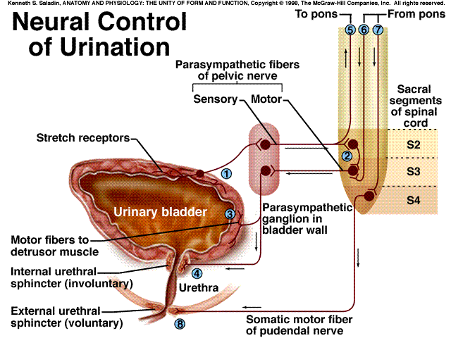
Micturition reflex
stretch
receptors

Slide 7
1) APs generated by stretch receptors
2) reflex arc generates APs that
3) stimulate smooth muscle lining bladder
4) relax internal urethral sphincter (IUS)
5) stretch receptors also send APs to Pons
6) if it is o.k. to urinate
APs from Pons excite smooth muscle of bladder and relax IUS
relax external urethral sphincter
7) if not o.k.
APs from Pons keep external
urethral sphincter contracted
stretch
receptors

Slide 8
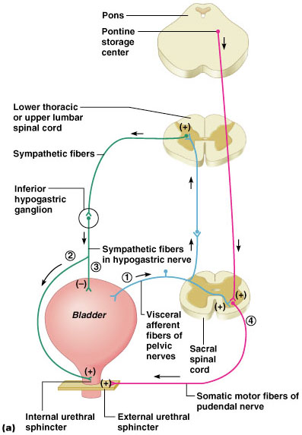
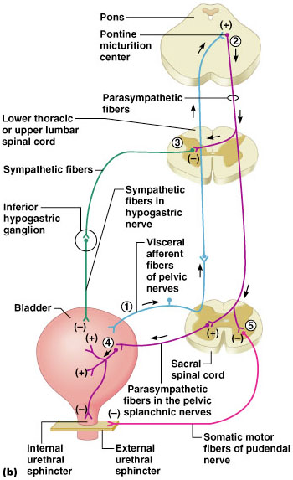
Micturition (Voiding or Urination)

Slide 9
Reflex Control
Urinary bladder distension reaches the conscious level to void at 150-200 mls.
In adult, volume of urine in bladder that initiates urge reflex contraction (urge to void) is about 400mL.
Sympathetic nerve to bladder play no part in micturition, but they mediate the contraction of the internal urethral sphincter that prevent semen from entering the bladder during ejaculation.

Slide 10
Reflex and Voluntary Control of Micturition
Reflex Control
Voluntary Control
Bladder fills
Cerebral cortex
+
Stretch receptors
+
+
Motor neuron to external sphincter
Parasympathetic nerve
+
Bladder
External urethral sphincter opens when motor neuron is inhibited
Bladder contracts
External urethral sphincter remains closed when motor neuron is stimulated
Internal urethral sphincter mechanically opens when bladder contracts
Urination
No urination

Slide 11
Cystometry
Study the relationship between intravesical volume and pressure.
Done by inserting catheter and emptying the bladder, then recording the pressure while bladder filled at 50ml increment of water.
This plot is known as the cystometrogram.

Slide 12
Cystometrogram
Filling or Storage Phase Micturition
Reflex
60
50
40
30
20
10
0
II
(400mL)
Voiding
Bladder Pressure (mmHg)
Ib
(150mL)
Ia
0 100 200 300 400 500 600
mV
Bladder Volume (mL)
EMG of External Sphincter

Slide 13
Plot has 3 components (segments):
Ia – initial slight rise in pressure when the first increment in volume are produced
Ib – a long, nearly flat segment as further increments are produced (conscious level to void at about 150mL)
II – a sudden, sharp rise in pressure as the micturition reflex is triggered (sense of fullness and urge to void at about 400mL)

Slide 14
Laplace Law
The flatness of segment Ib is a manifestation of the law of Laplace, which states that the pressure in the spherical viscus equal to twice the wall tension divided the radius.
P = 2T / r

Slide 15
THUS, MICTURITION REFLEX IS A SINGLE COMPLETE CYCLE OF:
Progressive and rapid increase of pressure,
A period of sustained pressure, and
Return of the pressure to the basal tone of the bladder

Slide 16
Storage
Bladder is a reservoir that stores urine (400-600 ml,
Usually fills at a constant rate (slower at night, faster with bladder irritants).
Accommodation – detrusor is elastic and allows filling by staying relaxed thus maintaining low bladder pressure.
The trigone stays closed during filling.
Notes:
16

Slide 17
Storage
Postponement of voiding
Signals go to sacral micturition center
Travels up to the pons
Via lateral spinothalamic tract
Result - brain inhibits sacral center, bladder keeps filling.
Outlet pressure is higher than bladder pressure
Notes:
17
We tell ourselves there is no bathroom and we need to postpone voiding

Slide 18
Emptying
At critical level of filling
Stretch receptors produce a strong sensation to void – urge
Urgency – is sudden compelling desire to void which is difficult to stop.
Signals go from bladder to brain (pons)
Signal returns via somatic track
Decision is made to get to the toilet
Notes:
18

Slide 19
Autonomic Control of Micturition
Type of nerve | Name of nerve | Spinal innervation | Action
Somatic | Pudendal nerves Nerve to the levator ani | S2-4 | Sensory and voluntary motor to external sphincter
Sympathetic | Hypogastric nerves | T11-L2 | Detrusor relaxation Internal sphincter contraction
Parasympathetic | Pelvic nerves | S2-4 | Inhibit sympathetics causing detrusor contraction Internal sphincter relaxation
Notes:
19

Slide 20
Changes with aging include:
Decline in the number of functional nephrons
Reduction of GFR
Reduced sensitivity to ADH
Problems with the micturition reflex

