Slide 1
Tubular reabsorption and tubular secretion

Slide 2
Type of Transport
Transcellular reabsorption
Primary active transport
Secondary active transport
Ion channel – passive transport
Paracellular reabsorption

Slide 3
Tubular Reabsorption

Slide 4
LUMEN
apical
basal
BLOOD

Slide 5
Reabsorption routes and transport mechanisms
Reabsorption routes
1- Paracellular reabsorption
Between adjacent tubule cells
Tight junction do not completely seal off interstitial fluid from tubule fluid
Passive
2- Transcellular reabsorption – through an individual cell
Primary active transport (ATP)
Sodium-potassium pumps in basolateral membrane only
Secondary active transport (co-transport)
Symporters, Antiporters (exchange)
Transport maximum (T_{m})
Upper limit to transport a substance
Obligatory (Osmosis) vs. facultative (ADH) water reabsorption

Slide 6
Mechanisms of secondary active
transport

Slide 7
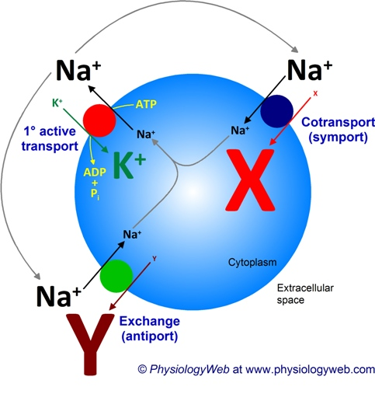
Notes:
In secondary active transport, the movement of a driving ion down an electrochemical gradient (entropic energy) is used to drive the uphill transport of another ion/molecule against a concentration or electrochemical gradient.
Two types of secondary active transport processes exist: cotransport (also known as symport) and exchange (also known as antiport).

Slide 8
Sodium reabsorption in proximal convoluted tubule (PCT)
65 -70% of filtered sodium is reabsorbed in PCT
Followed by water & chloride
Sodium is important for the absorption of
Glucose
Amino acids
phosphates

Slide 9
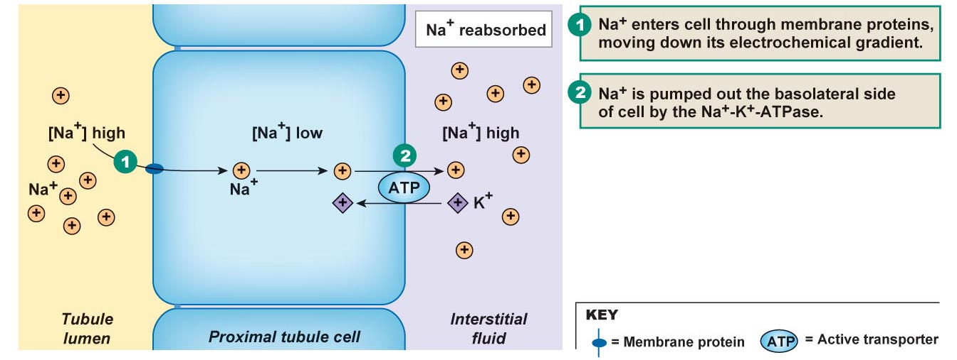
Nephron Tubular Reabsorption
Na⁺ reabsorption
An active process
Occurs on the basolateral membrane (Na⁺/K⁺ ATPase)
Na⁺ is pumped into the interstitial fluid
K⁺ is pumped into the tubular cell
Creates a Na+ gradient that can be utilized for 2ºry active transport

Slide 10
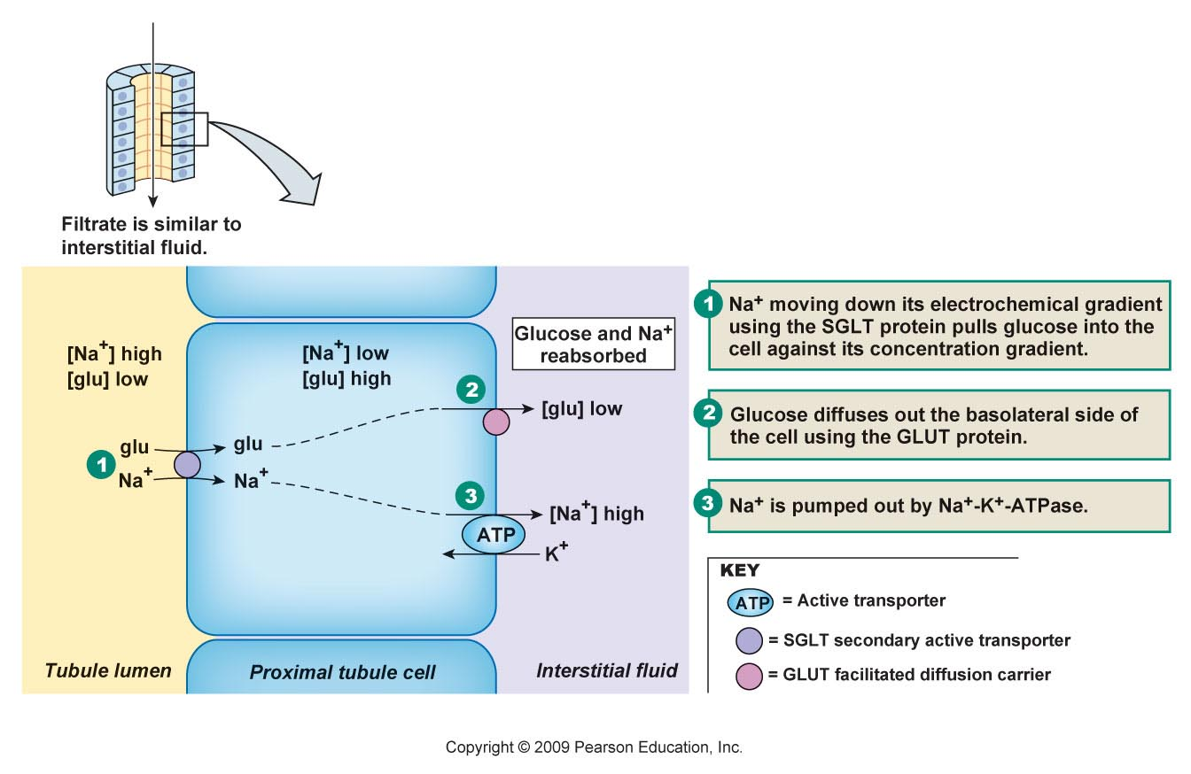
Nephron Tubular Reabsorption
Secondary Active Transport utilizing Na⁺ gradient
(Sodium Symport)
Used for transporting:
Glucose, amino acids, ions, metabolites

Slide 11
Mechanism of Na Reabsorption
Steps
Luminal side. Movement of Na from lumen to intracellular fluid by electrochemical gradient.
Basolateral membrane, Na+/K+ ATPase, 3 Na / 2 K pumped, results in Low intracellular Na concentration and ↑ osmolarity in the basolateral space.
Peritubular side (bulk flow). Movement of hyperosmotic fluid from basolateral space to peritubular capillaries.

Slide 12
Reabsorption of Water and Solutes is Coupled to Na⁺ Reabsorption
Interstitial
Fluid
Tubular
Cells
Tubular
Lumen
- 70 mV
H ⁺
Na ⁺
Na ⁺
glucose, amino
acids
ATP
Na ⁺
K⁺
Urea
Na ⁺
H₂0
ATP
Na ⁺
K⁺
Cl⁻
0 mv
- 3 mV

Slide 13
Movement of NaCl & water into peritubular capillaries (Bulk Flow)
NaCl enter the peritubular capillaries by simple diffusion
Water follows Na due to the high oncotic pressure in the capillaries
In peritubular capillaries the high plasma oncotic pressure is due to fluid filtration in glomerulus
↑ GFR → ↑ oncotic pressure & ↓ hydrostatic pressure in efferent & peritubular capillaries →
↑ bulk flow from lateral space to peritubular capillaries → ↑ reabsorption
↓ GFR → ↓ oncotic pressure & ↑ hydrostatic pressure → ↓ bulk flow → fluid go back to lumen through tight junction → ↓ reabsorption

Slide 14
Mechanisms by which Water, Chloride, and Urea Reabsorption are Coupled with Sodium Reabsorption

Slide 15
Water reabsorption
60-70 % of filtered water is reabsorped in PCT
Active transport of Na from the renal cell to peritubular space
Increased osmolality of peritubular space
Drag water by osmosis
Filterate remain iso-osmotic (~equal quantity of water & solute are absorbed)

Slide 16
TUBULAR REABSORPTION OF GLUCOSE, AMINO ACIDS, UREA & OTHER ELECTROLYTES

Slide 17
Glucose reabsorption general consideration
Glucose reabsorption is calculated as the difference between the amount of glucose filtered by the kidney and the amount excreted.
When plasma glucose (P_{G}) is increased to near 200 mg/dl, glucose begins to appear in urine – this is called the “glucose renal threshold” corresponds to filtered load of 250mg/min.

Slide 18
As glucose is further increased, more glucose appears in urine.
At very high filtered glucose, reabsorption remains constant, this is called “tubular transport maximum” for glucose (Tm_{G})
= 375 mg/min (corresponds to blood glucose level of 300mg/dl)
At this maximum transport, all glucose carriers are saturated and no more glucose can be transported.

Slide 19
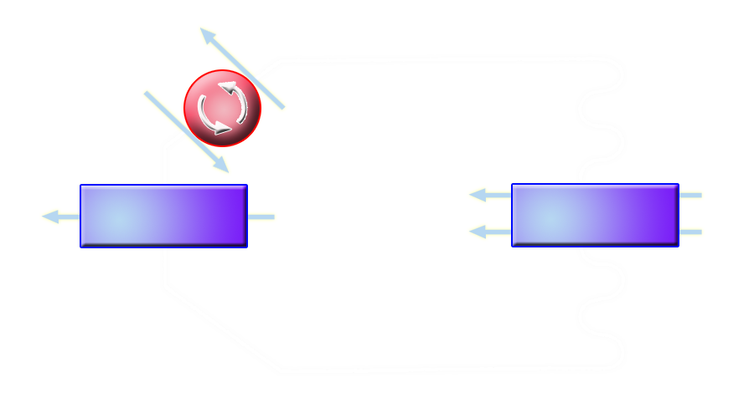
Glucose Reabsorption
INTERSTITIAL
FLUID
K⁺
TUBULAR
LUMEN
Na⁺
Glucose
Glucose
GLUT 2
SGLT 2
One Na⁺
Early proximal
tubule cell
K⁺
Na⁺
Glucose
Glucose
GLUT 1
SGLT 1
Two Na⁺
Late proximal
tubule cell

Slide 20
Tubular maximum (TmG)
Maximum absorptive capacity for glucose by renal tubular cells
= 375 mg/min in males (females 300mg/min)
Renal threshold
Plasma glucose level at which glucose first appear in urine
= 200mg/dl in arterial; 180 mg/dl in venous blood.

Slide 21
Glucose Transport Maximum

Slide 22
Amino acid reabsorption
All filtered aminoacids are reabsorbed in PCT
Luminal membrane
Cotransport with Na
Basolateral membrane
diffusion

Slide 23
Bicarbonate reabsorption
90% of filtered bicarbonate is reabsorbed in PCT
Filtered HCO₃ + H → H₂CO₃
H₂CO₃ → H₂O + CO₂
CO₂ diffuses into the cell + H₂O→ H₂CO₃ in the presence of carbonic anhydrase
H₂CO3 → → H + HCO₃
HCO₃ is reabsorped
H⁺ is secreted in exchange for Na ⁺

Slide 24
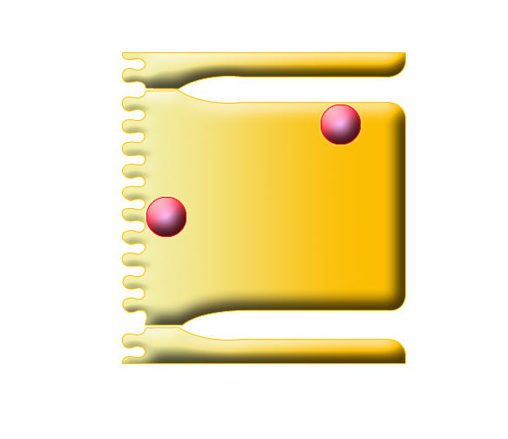
Bicarbonate reabsorption cont.
Lumen
Tubular cell
Blood
Filtrate
↓
Na⁺
HCO₃⁻
+
H+
↓
H₂CO₃
↓
H₂O + CO₂
Na⁺
H⁺
HCO₃⁻
H₂CO₃
↑ CA
CO₂ + H₂O
Tight junction
Brush border

Slide 25
Phosphate reabsorption
Freely filtered
1/3 of filtered load is excreted in urine
Cotransported with Na
Compete with glucose: blocking glucose → ↑ Phosphate reabsorption

Slide 26
Urea reabsorption
Plasma urea concentraion 15-40mg/100ml
End product of protein metabolism
40-50% of filtered urea reabsorbed
Passive diffusion
Coupled with Na reabsorption
50-60% excreted

Slide 27
Urea reabsorption cont.
↓GFR (renal disease; low renal blood flow) →↑urea concentraion in plasma
↓GFR→ ↓ urea filtered
↓GFR→ slow flow rate of filterate → more urea is absorbed to blood

Slide 28
Filtration, reabsorption, and excretion rates of substances by the kidneys
Filtered Reabsorbed Excreted Reabsorbed
(meq/24h) (meq/24h) (meq/24h) (%)
Glucose (g/day) 180 180 0 100
Bicarbonate (meq/day) 4,320 4,318 2 > 99.9
Sodium (meq/day) 25,560 25,410 150 99.4
Chloride (meq/day) 19,440 19,260 180 99.1
Water (l/day) 169 167.5 1.5 99.1
Urea (g/day) 48 24 24 50
Creatinine (g/day) 1.8 0 1.8 0

Slide 29
Tubular secretion
Potassium:
90% of filtered K is reabsorbed (PCT)
K secreted in DCT In exchange for Na; under the control of Aldosterone
Hydrogen:
Excretion is inversely proportional to K

Slide 30
Proximal Tubule
GFR delivers ~125ml/min of filtered plasma to the nephron (tubule)
Nearly 70% of this volume is reabsorbed by the proximal tubule and returned back to the blood.
Needed products such as glucose and amino acids are reabsorbed rapidly whereas;
Other products such as creatinine and urea are slowly reabsorbed or not at all
Proximal tubule also secretes substances that the body need to get rid of rapidly. These include toxins, drugs, H+, urea and ammonia.

Slide 31
Proximal tubule transports the largest %age of most substances of the entire nephron.
about 70% of the filtered H₂O is reabsorbed in the proximal tubule
About 70% of the filtered Na⁺ is reabsorbed in the proximal tubule
Therefore ~30% of the fluid filtered (GFR) is delivered to the “Loop of Henle”

Slide 32
Cellular Ultrastructure and Primary Transport Characteristics of Proximal Tubule

Slide 33
The Loop of Henle
Thin descending loop
Major function → H₂O reabsorption
At start of descending loop osmolarity is same as plasma (~280 mOsm)
At end of descending loop osmolarity = 1200 mOsm
Most of the osmolarity is due to NaCl and little due to Urea

Slide 34
Cellular Ultrastructure and Transport Characteristics of Thin and Thick Loop of Henle
very permeable
to H₂O)
not permeable
to H₂O)

Slide 35
NaCl
Urea
NaCl
Urea
280
mOsmol/kg H₂O
H₂O
H₂O
H₂O
H₂O
NaCl
Urea
NaCl
Urea
1200
mOsmol/kg H₂O

Slide 36
Thin & thick ascending loop
No H₂O reabsorption
Increases solute reabsorption (mainly NaCl)
This part of the loop (thin ascending loop) is very permeable to Na⁺ and Cl¯
Passive diffusion out of tubule
As NaCl diffuses out of the tubule, the osmolarity becomes more dilute due to the movement of only solutes and not H₂O

Slide 37
In thick ascending limb reabsorption of NaCl is active (requiring energy). Movement of NaCl from tubule to interstitial fluid is active
Na⁺-K⁺-2Cl¯ cotransport causes movement of these ions into cells from tubule lumen
Na⁺ actively transported out of cell
Cl¯ increases in cell due to the cotransporter (Na⁺-K⁺-2Cl¯ cotransport). This causes an increase in Cl¯ in the cell which is greater than the interstitial fluid. Therefore Cl¯ moves out of cell passively.

Slide 38
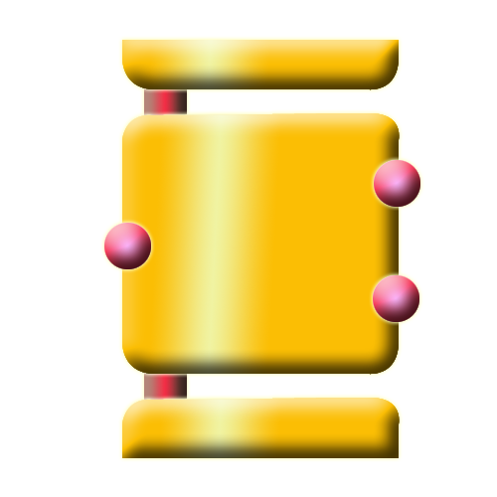
Tubular
lumen
Tubular
Epithelial Cells
Renal
interstitium
Na⁺
3Na⁺
Na⁺
2K⁺
2Cl¯
2Cl⁻
K⁺
K⁺
+10-20 mV

Slide 39
Distal Tubule and Collecting Duct
Function as proximal tubule but absorbs less and has a smaller capacity:
Reabsorbs 9% filtered Na⁺
Reabsorbs 19% filtered H₂O
Thoughout distal tubule Na⁺ is actively reabsorbed and K⁺ secreted
Cl¯ also reabsorbed

Slide 40
Reabsorption and secretion in the late distal convoluted tubule and collecting duct
90-95% of filtered solutes and fluid have been returned by now
Principal cells reabsorb Na⁺ and secrete K⁺
Intercalated cells reabsorb K⁺ and HCO₃⁻ and secrete H⁺
Amount of water reabsorption and solute reabsorption and secretion depends on body’s needs

Slide 41
Cellular Ultrastructure and Transport Characteristics of Early and Late Distal Tubules and Collecting Tubules
Not permeable to H₂O
Not very permeable to urea
permeability to H₂O depends on ADH
not very permeable to urea

Slide 42
Hormonal regulation of tubular reabsorption and secretion
Angiotensin II - when blood volume and blood pressure decrease
Decreases GFR, enhances reabsorption of Na⁺, Cl⁻ and water in PCT
Aldosterone - when blood volume and blood pressure decrease
Stimulates principal cells in collecting duct to reabsorb more Na⁺ and Cl⁻ and secrete more K⁺
Parathyroid hormone
Stimulates cells in DCT to reabsorb more Ca²⁺

Slide 43
Regulation of facultative water reabsorption by ADH
Antidiuretic hormone (ADH or vasopressin)
Increases water permeability of cells by inserting aquaporin-2 in last part of DCT and collecting duct
Atrial natriuretic peptide (ANP)
Large increase in blood volume promotes release of ANP
Decreases blood volume and pressure by inhibiting reabsorption of Na⁺ and water in PCT and collecting duct, suppress secretion of ADH and aldosterone

