Slide 1
RENAL REGULATION
OF BODY FLUIDS

Slide 2
Water Diuresis
By drinking large amount of fluid diuresis begins 15 mins after ingestion of H₂O load and reaches maximum in 40 mins.
This produce decrease in osmolarity and in antidiuretic hormone (ADH) secretion.

Slide 3
Osmotic Diuresis
The presence of large quantities of unreabsorbed solutes in renal tubules causes increase in urine volume → osmotic diuresis.
Solutes that are not reabsorbed in the PT exert an osmotic effect as the volume of tubular fluid decreases and their concentration rises (i.e. Mannitol). Hold H₂O in the tubule.

Slide 4
Retention of Water is controlled by
Anti Diuretic Hormone (ADH)
  ADH Release Is Controlled By:
    1) Decrease in Blood Volume
    2) Decrease in Blood Pressure
    3) Increase in extracellular fluid osmolarity

Slide 5
Secretion of ADH
Urge to drink
STIMULUS
Increased osmolarity
Post. Pituitary
ADH
cAMP
+

Slide 6
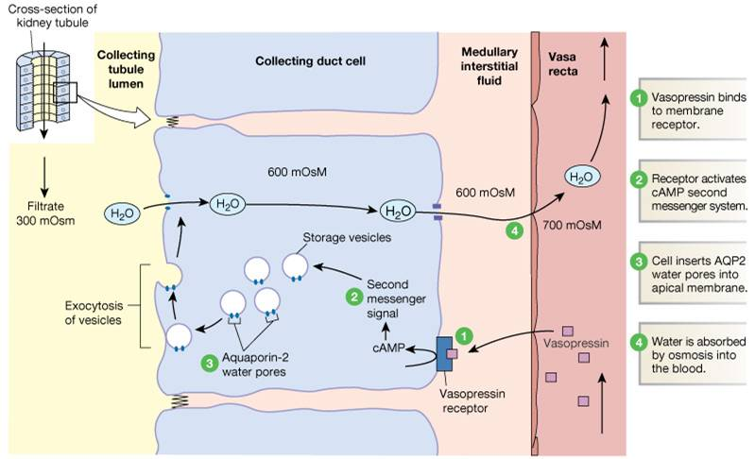
Formation of Water Pores:
Mechanism of Vasopressin Action

Slide 7
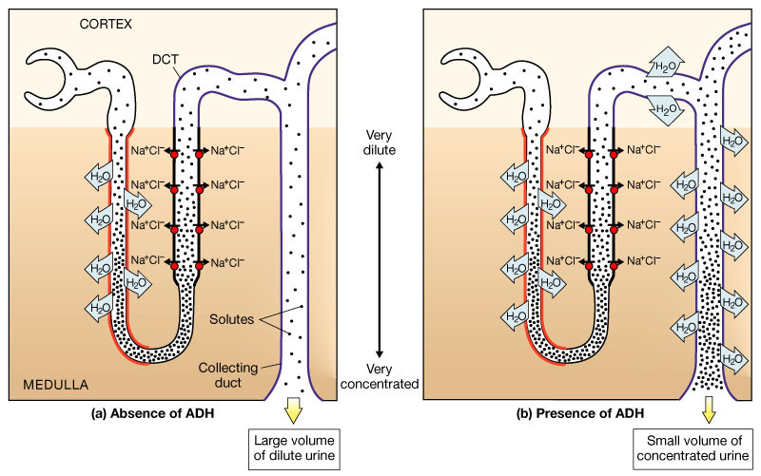
The Effects of ADH on the distal collecting tubules and collecting ducts
Figure 26.15a, b

Slide 8
Role of the Distal Tubule and Collecting Ducts in Forming Concentrated or Diluted urine

Slide 9
Water reabsorption - 1
Obligatory water reabsorption:
Using sodium and other solutes.
Water follows solute to the interstitial fluid
(transcellular and paracellular pathway).
Largely influenced by sodium reabsorption

Slide 10
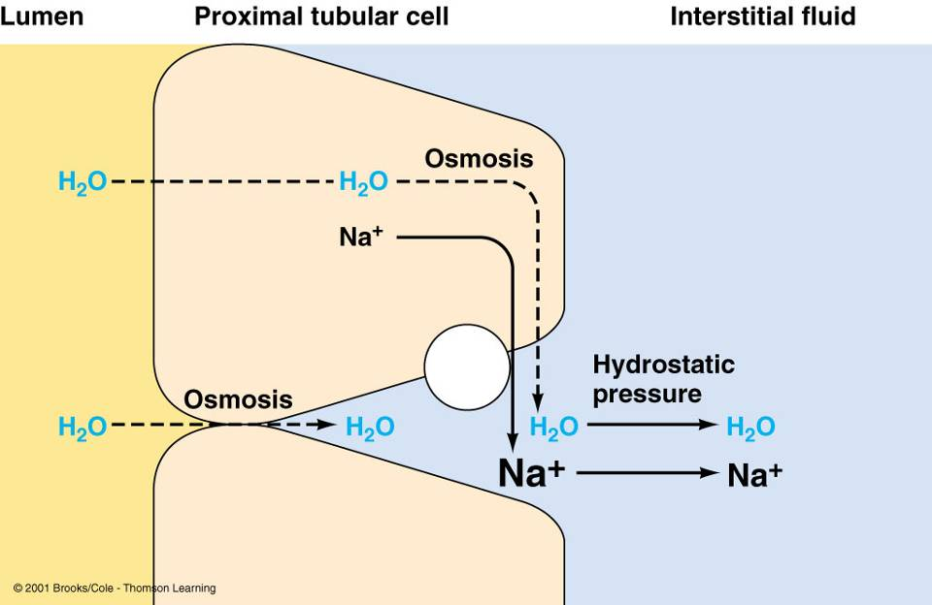
Obligatory water reabsorption

Slide 11
Water reabsorption - 2
Facultative (selective) water reabsorption:
Occurs mostly in collecting ducts
Through the water pores (aquaporin-2)
Regulated by the ADH

Slide 12
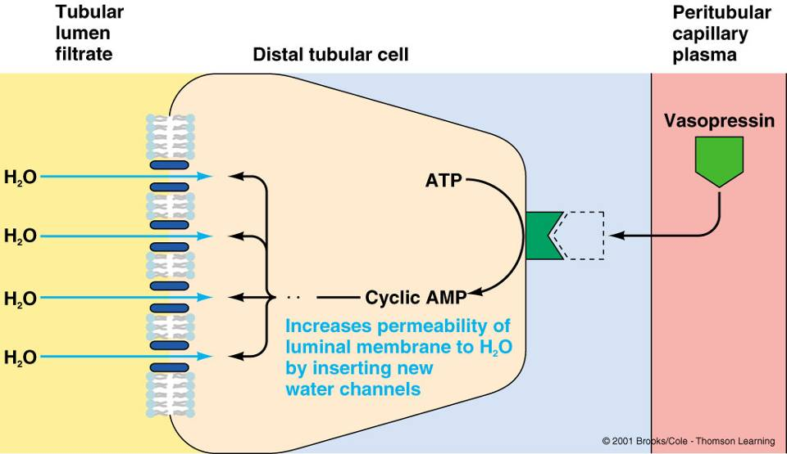
Facultative water reabsorption

Slide 13
Regulation of Renin Secretion:
Renal Mechanism:
Tension of the afferent artery (stretch receptor)
Macula densa (content of the Na+ ion in the distal convoluted tubule)
Nervous Mechanism:
Sympathetic nerve →↑ afferent arteriolar constriction
→↑ Renin secretion →↑ Aldosterone secretion
Humoral Mechanism:
E, NE, PGE₂, PGI₂

Slide 14

↓ NaCl / ↓ Extracellular fluid volume /
↓ Arterial blood pressure
Helps correct
+
H₂O conserved
+
Na⁺ (and Cl¯) osmotically hold more H₂O in ECF
+
Angiotensin-converting enzyme
Renin
Na⁺ (and Cl¯) conserved
Angiotensinogen
Angiotensin I
Angiotensin II
Aldosterone
↑ Na⁺ reabsorption by renal tubules
(↑ Cl¯ reabsorption follows passively)
Circulation
+
+
+
ADH
Thirst
Arteriolar vasoconstriction
↑ H₂O reabsorption by kidney tubules
↑ Fluid intake
Renin-Angiotensin-Aldosterone System

Slide 15
Atrial natriuretic peptide (ANP)
ANP is released by atrium in response to atrial stretching due to increased blood volume
ANP inhibits Na⁺ and water reabsorption, also inhibits ADH secretion
Thus promotes increased sodium excretion (natriuresis) and water excretion (diuresis) in urine

Slide 16
The thick ascending limb is very sensitive to diuretic drugs (Furosamide). These diuretics block the operation of the Na⁺-K⁺-2Cl¯ cotransporter .
The result is:
  Decreased NaCl reabsorption
  Isotonic fluid delivered to distal tubule instead of a hypotonic fluid
  Increased fluid excreted – “diuresis”
  These drugs are called “Loop” diuretics
  NaCl reabsorption acts to dilute urine
  Osmolarity at end of thick ascending limb is near 130 mOsm and is dilute compared to plasma, which is ~300 mOsm

Slide 17
In distal tubule, drugs like the “thiazide” diuretics act to block Na⁺ entry by blocking the Na⁺-Cl¯ cotransport. This cotransport is different from the cotransport on the loop (Na-K-2Cl). Other drugs like amiloride block Na⁺ entry. All diuretics, including these drugs would result in decreased Na⁺ reabsorption – leading to an “osmotic diuresis” and increased urine formation.
  Since more Na⁺ is reabsorbed in the ascending loop, the “Loop” diuretics are more effective than diuretics which act in the distal tubule – about 10 times more effective)
  K⁺ secreted more in collecting duct than in distal tubule

Slide 18
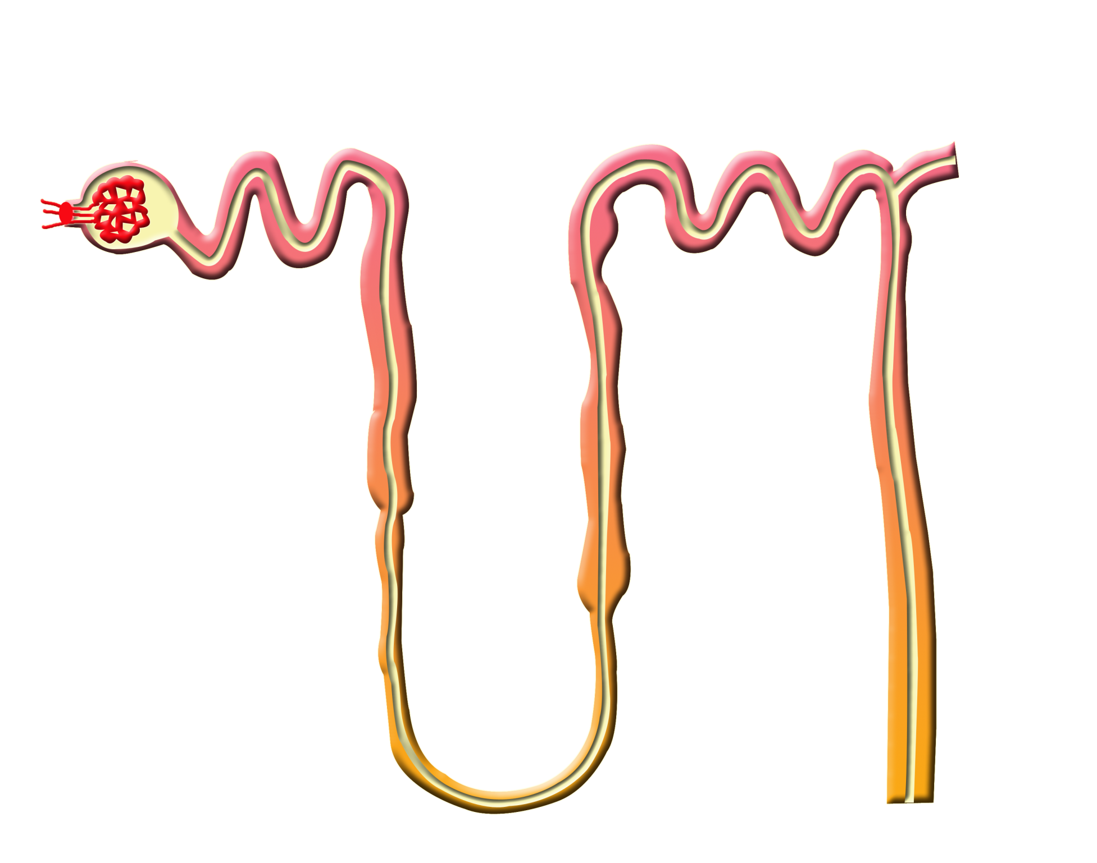
NaCl
NaCl
Ca²⁺
(+PTH)
DCT
NaHCO₃
❍
PCT

PST
K⁺
H⁺

K⁺
Ca²⁺
Mg²⁺
●
Glomerulus
CT
Na⁺
K⁺
2Cl¯
■
NaCl
(+aldosterone)
Na⁺
K⁺
2Cl¯
Diuretics
●
K⁺
H⁺
 Acetazolamide
 Osmotic agents
(mannitol)
● Loop agents
(furosamide)
❍ Thiazides
■ Aldosterone
antagonists
□ ADH antagonists
Thick
ALH
Thin
DLH
H₂O
(+ADH)
□

Thin
ALH

CD
H₂O
LH

