Slide 1
Countercurrent Mechanism

Slide 2
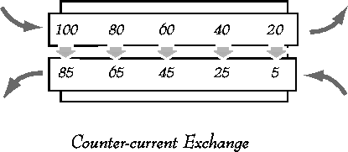
Countercurrent Exchange
The exchange of a chemical substance or heat between two fluids flowing in opposite directions.

Slide 3
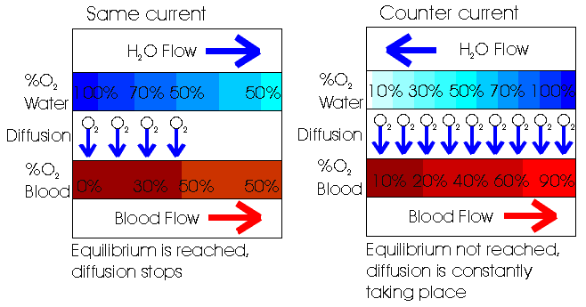
Same current vs. Counter current

Slide 4
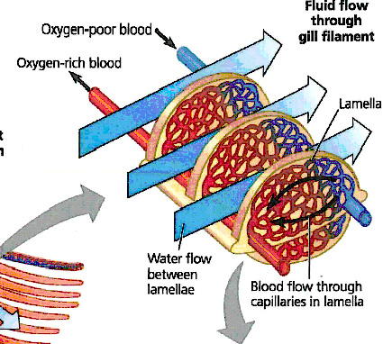
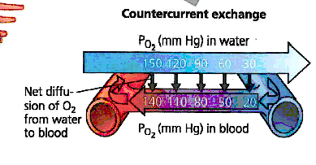
Fish Gills

Slide 5
Countercurrent Mechanism
Interaction between the flow of filtrate through the loop of Henle (countercurrent multiplier) and the flow of blood through the vasa recta blood vessels (countercurrent exchanger)
Countercurrent multiplication expends energy to create a concentration gradient.
Countercurrent exchanger is similar, with different mechanism, where gradients are maintained but not established.

Slide 6
Loop of Henle: Countercurrent Multiplier
The descending loop of Henle:
  Is relatively impermeable to solutes
  Is permeable to water
The ascending loop of Henle:
  Is permeable to solutes
  Is impermeable to water (lack aquaporin)
Collecting ducts in the deep medullary regions are permeable to urea.

Slide 8
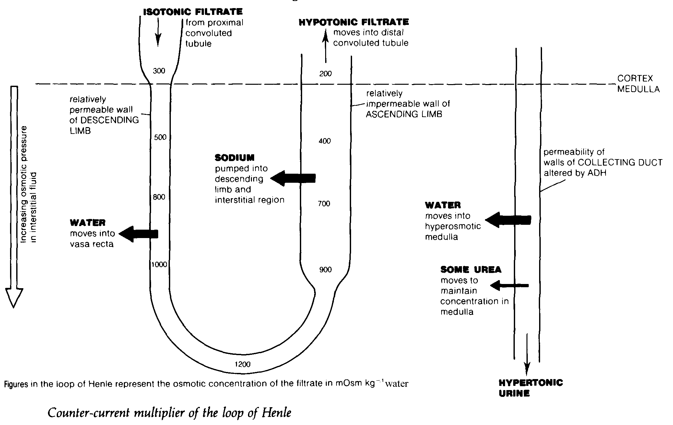

Slide 9
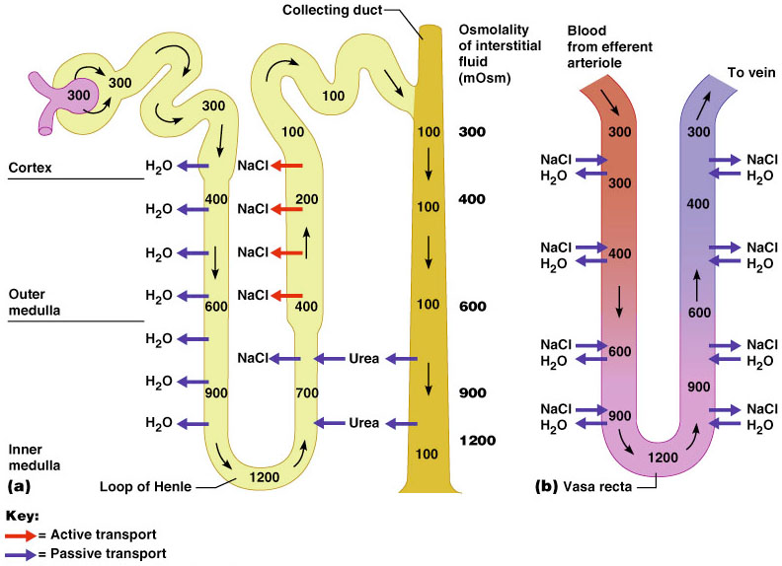
Loop of Henle: Countercurrent Mechanism

Slide 10
2 Benefits of
Countercurrent Multiplication
Efficiently reabsorbs solutes and water before tubular fluid reaches DCT and collecting system
Establishes concentration gradient that permits passive reabsorption of water from tubular fluid in the collecting ducts.

Slide 11
Countercurrent Exchanger
The vasa recta is a countercurrent exchanger that:
Returns solutes and water reabsorbed in medulla to general circulation without disrupting the medullary
concentration gradient
  Provides oxygen and nutrients to medulla without washing out of salts and maintain a high osmolality at the inner medulla.

Slide 12
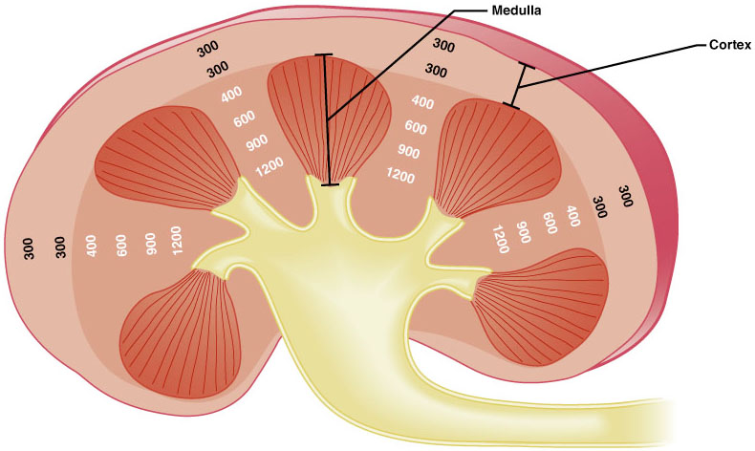
Osmotic Gradient in the Renal Medulla

Slide 13
Formation of Dilute Urine
Filtrate is diluted in the ascending loop of Henle.
Dilute urine is created by allowing this filtrate to continue into the renal pelvis.
This will happen as long as antidiuretic hormone (ADH) is not being secreted (Diabetes insipidus).

Slide 14
Formation of Dilute Urine
Collecting ducts remain impermeable to water, no further water reabsorption occurs.
Sodium and selected ions can be removed by active and passive mechanisms.
Urine osmolality can be as low as 50 mOsm
(one-sixth that of plasma).

Slide 15
Formation of Concentrated Urine
Antidiuretic hormone (ADH) inhibits diuresis.
This equalizes the osmolality of the filtrate and the interstitial fluid.
In the presence of ADH, 99% of water in filtrate is reabsorbed.

Slide 16
Formation of Concentrated Urine
ADH-dependent water reabsorption is called facultative water reabsorption.
ADH is the signal to produce concentrated urine.
The kidneys’ ability to respond depends upon the high medullary osmotic gradient.

Slide 17
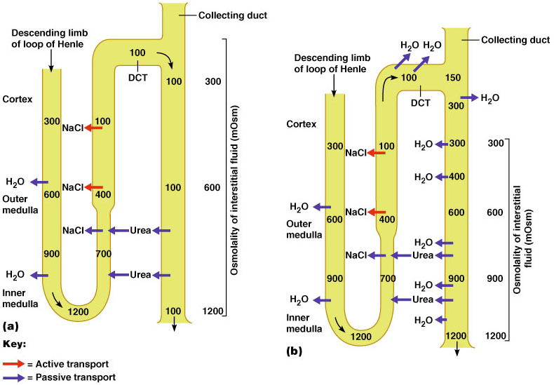
Formation of Dilute and Concentrated Urine

Slide 19
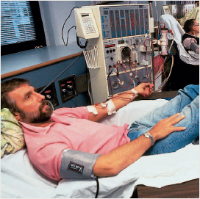
MULTIPLE FUNCTIONS OF THE KIDNEYS IN HOMEOSTASIS
Excretion of metabolic waste products and foreign chemicals
Regulation of water and electrolyte balances
Regulation of body fluid osmolality and electrolyte concentrations
Regulation of acid-base balance
Regulation of arterial pressure
Secretion, metabolism, and excretion of hormones
Gluconeogenesis

