Slide 1
Basics of Acid-Base Physiology

Slide 2
Acid-Base homeostasis involves chemical and physiologic processes responsible for the maintenance of the acidity of body fluids at levels that allow optimal function of the whole body.

Slide 3
ACID BASE HOMEOSTASIS
The chemical processes represent the first line of defense to an acid or base load and include the extracellular and intracellular buffers.
The physiologic processes modulate acid-base composition by changes in cellular metabolism and by adaptive responses in the excretion of volatile acids by the lungs and fixed acids by the kidneys.

Slide 4
Effects of PH on CNS
PH decrease ( acidosis) depresses the central nervous system.
Can lead to loss of consciousness
↑ Ionized Ca⁺⁺ concentration (Hypercalcemia)
PH increase ( alkalosis) can cause over-excitability
→ Tingling sensations, nervousness, muscle twitches
↓ Ionized Ca⁺⁺ concentration (Hypocalcemia)

Slide 5
Acid-base abnormalities alter the ionized Ca⁺⁺ con. by changing the fraction of Ca⁺⁺ bound to plasma albumin.
Albumin has negatively charged sites, which can bind either H⁺ ions or Ca⁺⁺ ions.
Acidosis Alkalosis
Ionized [ Ca⁺⁺] ionized [Ca⁺⁺]
Hyperventilation Respiratory alkalosis
↓ ionized Ca⁺⁺ Tetany.
H⁺
H⁺
H⁺
Ca⁺⁺
Albumin
H⁺
Albumin
Ca⁺⁺
Ca⁺⁺
Ca⁺⁺
Ca⁺⁺
Ca⁺⁺

Slide 6
Acid - Base balance is primarily concerned with two ions:
Hydrogen (H⁺)
Bicarbonate (HCO₃⁻ )

Slide 7
H⁺ ion has special significance because of the narrow ranges that it must be maintained in order to be compatible with life.

Slide 8
Acids can be defined as:
- A proton (H⁺) donor
- Hydrogen containing substances which dissociate in solution to release H⁺
Bases can be defined as:
- A proton (H⁺) acceptor
- Molecules capable of accepting a hydrogen ion (OH⁻)

Slide 9
Strong Acid
An acid that nearly completely dissociates
All molecules of the acid break up to form the ions soluble in water

Slide 10
Weak Acid
An acid that only slightly dissociates in a water solution
Only a small percent of acid molecules donate their hydrogen, and most remain the same.

Slide 11
Physiologically important acids include:
- Carbonic acid (H₂CO₃)
- Phosphoric acid (H₃PO₄)
- Pyruvic acid (C₃H₄O₃)
- Lactic acid (C₃H₆O₃)
These acids are dissolved in body fluid
Physiologically important bases include:
- Bicarbonate (HCO₃⁻ )
- Biphosphate (HPO₄⁻² )

Slide 12
EQUATION OF ACID-BASE PHYSIOLOGY
The hydrogen ion concentration [H⁺] in extracellular fluid is determined by the balance between the partial pressure of carbon dioxide (PCO2) and the concentration of bicarbonate [HCO3⁻] in the fluid. This relationship is expressed as follows:
[H⁺] in nmol/L = 24 x (PCO2 / [HCO3 ⁻] )

Slide 13
NORMAL VALUES Using a normal arterial PCO2 of 40 mm Hg and a normal serum [HCO3⁻ ] concentration of 24mEq/L, the normal [H⁺] in arterial blood is:
24 × (40/24) = 40 nmol/L

Slide 14
Acid-base Balance Henderson-Hasselbalch Equation
[HCO₃⁻]
pH = pK + log ----------------
.03 [PaCO₂]
For teaching purposes, the H-H equation can be shortened to its basic relationships:
HCO₃⁻
pH ~ ---------
PaCO₂

Slide 15
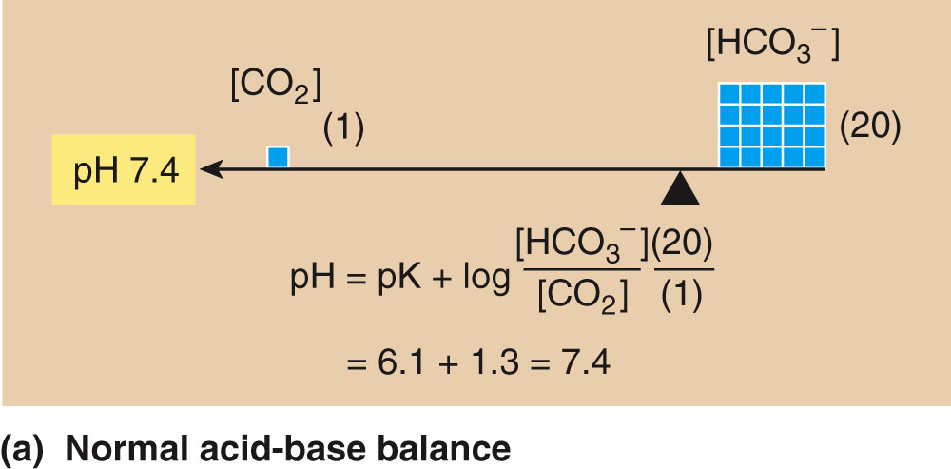

Slide 16
Normal Range
pH = 7.35 - 7.45
PCO₂ = 35-45 mmHg (40 mmHg)
HCO₃⁻ = 22-26 mEq/L (24 mEq/L)

Slide 17
pH is inversely related to [H⁺]; a pH change of 1.00 represents a 10-fold change in [H⁺]
pH [H⁺] in nanomoles/L
7.00 100
7.10 80
7.30 50
7.40 40
7.52 30
7.70 20
8.00 10

Slide 18
SOURCES OF HYDROGEN IONS
1) Cell Metabolism (CO₂)
2) Food Products
3) Medications
4) Metabolic Intermediate by-products
5) Some Disease processes

Slide 19
SOURCES OF HYDROGEN IONS
1) Cellular Metabolism of carbohydrates release CO₂ as a waste product
Aerobic respiration
C₆H₁₂O₆ → CO₂ + H₂O + Energy
2) Food products
Yogurt
Citric acid in fruits
3) Medications
May stimulate HCl production by parietal cells of the stomach.

Slide 20
SOURCES OF HYDROGEN IONS
4) Metabolic Intermediate by-products
Lactic acid
Pyruvic acid
Acetoacetic acid
Fatty acids
5) Some disease processes
Ex: diabetes causes improper metabolism of fats which results in the generation of a waste product called a Keto Acids.

Slide 21
Normal Arterial Blood Gas Values*
pH 7.35 - 7.45
PaCO₂ 35 - 45 mm Hg
PaO₂ 70 - 100 mm Hg **
SaO₂ 93 - 98%
HCO₃¯ 22 - 26 mEq/L
%MetHb < 2.0%
%COHb < 3.0%
CaO₂ 16 - 22 ml O₂/dl
* At sea level, breathing ambient air
** Age-dependent

