Slide 1
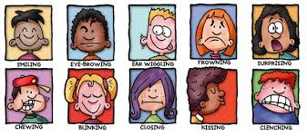
Clinical Anatomy of the Face
DR JAMILA EL MEDANY

Slide 2
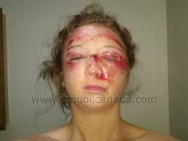
Skin of the Face
It is characterized by having numerous sweat and sebaceous glands.
It is connected to the underlying bone by loose connective tissue.
No deep fascia is in the face, because of this facial lacerations tend to gap.
The skin must be sutured with great care to prevent scarring.
The looseness of the subcutaneous tissue enables fluid and blood to accumulate in the loose connective tissue following bruising of the face.
Similarly , facial inflammation causes considerable swelling.

Slide 3
As a person ages, the skin loses its resiliency, as a result wrinkle lines and
ridges occur in the skin perpendicular to the direction of the facial muscle fibers.
Incisions along these wrinkle lines heal with minimal scaring.

Slide 4
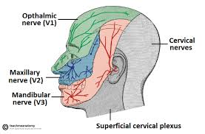
Cutaneous Nerve Supply
The skin of the face is supplied mostly through the Trigeminal nerve (5th cranial), in front of the ear and partly through the Cervical plexus, behind the ear.

Slide 5
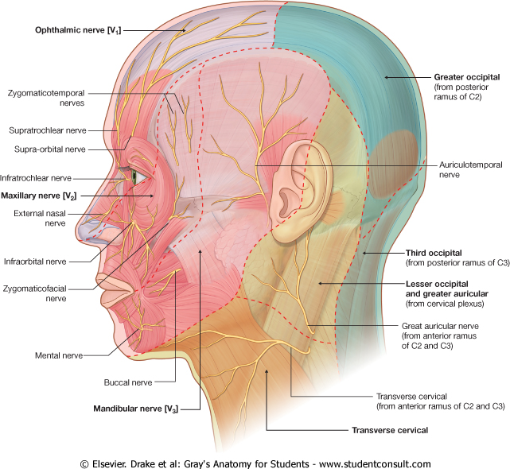
OPHTHALMIC NERVE
Supplies:
Skin of the forehead.
Upper eye lid & Conjunctiva.
Side of the nose down to and including the tip.

Slide 6
MAXILLARY NERVE
Supplies:
Skin of the posterior part of the side of the nose.
Lower eye lid.
Cheek & Upper lip .
Lateral side of the orbital opening.

Slide 7
Mandibular Nerve
Supplies:
Lower lip& chin.
Lower part of the face &cheek.
Temporal region.
Part of the auricle, external auditory meatus and outer surface of tympanic membrane

Slide 8
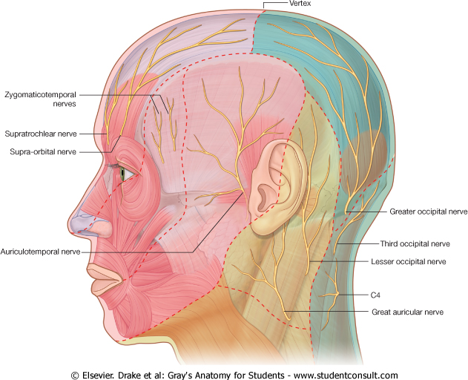
Great Auricular Nerve
It is a branch of the cervical plexus (C2&3).
It supplies the parotid sheath and the skin over the angle of the mandible.

Slide 9
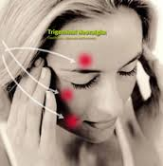
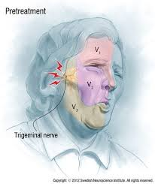
It is a sensory disorder of the sensory root of the CNV.
The maxillary nerve is most frequently involved then the mandibular
The pain is initiated by touching a sensitive trigger zone of the skin.
The paroxysms can last for 15 minutes or more.

Slide 10
Causes
Treatment depends mostly on the use of & antiepileptic (AED) & antidepressant drugs (ADD) to relieve pain. In some cases section of the sensory root is necessary.

Slide 11
Muscles of Facial Expression
They are subcutaneous as they are embedded in the Superficial Fascia.
They move the skin and change facial expressions to convey mood.
Origin:
Bones of the skull.
Insertion:
Skin of the face or mucous membrane.

Slide 12
Action
1. Sphincters or dilators of the eyelids, nostrils and lips.

Slide 13
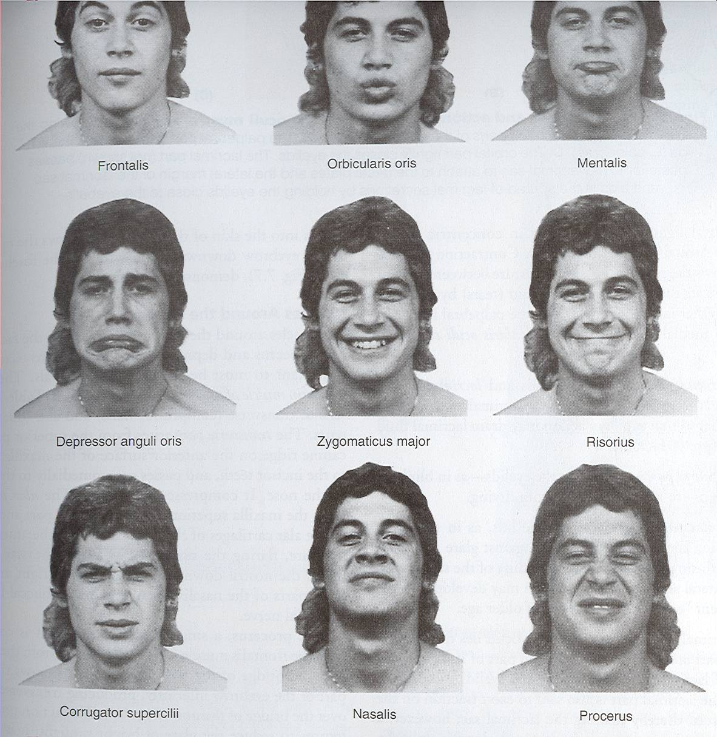
2.Modify the different expressions of the face to convey mood.

Slide 14
MUSCLES OF THE EYE LIDS
The Sphincter muscle is the Orbicularis Oculi.
It has orbital part & palpebral part.
Palpebral part : closes the eye lightly (as in plinking and sleeping).
Orbital part :
Closes the eye firmly (as in exposure to strong light).

Slide 15
MUSCLES OF THE LIPS
The Sphincter muscle is:
Orbicualris Oris.
Its fibers encircle the oral orifice within the lips.
It is important during speech and compresses the lips against the teeth , working with the tongue to hold food between the teeth during mastication.
The Dilator muscles radiate out from the lips and separate them:
zygomaticus major, minor
Risorus.

Slide 16
MUSCLE OF THE CHEEK (BUCCINATOR)
Origin:
Alveolar margins of the maxilla &mandible and a raphe in between.
Insertion:
Upper fibers to upper lip.
Lower fibers to lower lip.
Middle fibers decussate:
the upper part to the lower lip
The lower part to the upper lip.
Action:
1. Blowing.
2. Whistling.
3.Closes the vestibule of the mouth by compressing the lips
and cheeks against the teeth.

Slide 17
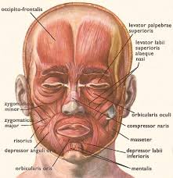
Occipito Frontalis
The frontal bellies arise from the anterior part of the epicranial aponeurosis and is inserted into the skin of the eye brows.
It elevates the eyebrows giving the face a surprised looking and produce transverse wrinkles of the forehead.

Slide 18
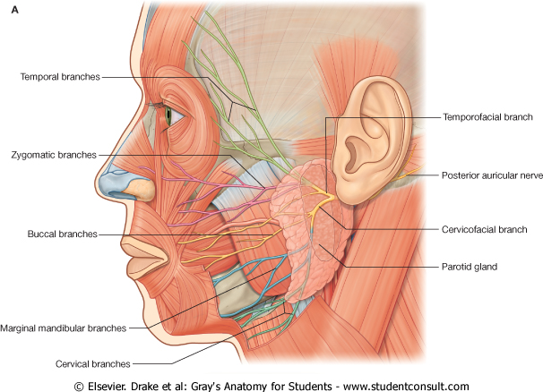
Motor Supply
Facial Nerve
(7th cranial nerve).
It gives motor supply to all muscles of facial expression.
It does not supply the skin.

Slide 19
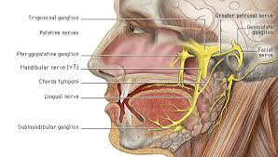
Course & Distribution
The facial nerve leaves the tympanic cavity by passing through the Stylomastoid foramen and enters the Parotid gland.
Within the parotid gland:
It passes forward superficial to retromandibular vein and external carotid artery.
At the anterior border of the gland, it divides into its five terminal branches.

Slide 20
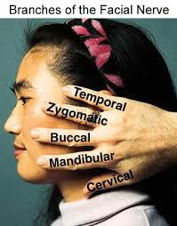

Slide 21
Injury to the Branches of the Facial Nerve
Because the branches of the facial nerve are superficial, they are subject to injury by stab, gunshot wounds, cuts and injury at birth.
A lesion of the zygomatic branch causes loss of tonus of the orbicularis oculi to the lower eye lid, thus the lower eye lid drops and tears don not spread over the cornea, the dry cornea ulcerates, the resulting corneal scar impairs vision.
Paralysis of the buccal branch prevents emptying of food from the vestibule of the cheeks

Slide 22
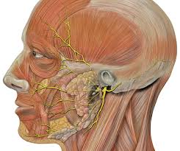
Injury to the marginal mandibular branch may occur when an incision is made along the inferior border of the mandible as in surgical approach to the submandibular gland, it results in dropping of the corner of the mouth.

Slide 23
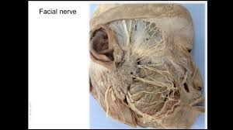
Facial nerve paralysis(Bell’ s Palsy)
It is paralysis (palsy) of the facial muscles due to injury of the facial nerve.
The most common cause is idiopathic but it can results from exposure to cold , tumor of parotid gland, lacerations of the face.
The palsy is due to weakens or paralysis of :
Buccinator.
Orbicularis Oris.
Cheek and Lip muscles that aid chewing.
Orbicularis oculi.

Slide 24
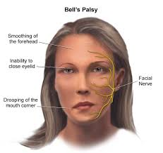
Manifestations

Slide 25
Manifestations
Food accumulates during chewing and often must be continually removed by a finger.
Patients frequently dab their eyes and mouth with a handkerchief to wipe the fluid (tears & saliva)which runs from the dropping lid and mouth.
The fluid and constant wiping result in localised skin irritation.

Slide 26
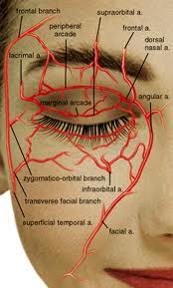
ARTERIAL SUPPLY
The face has a rich blood supply so that it is rare for skin flaps in the face to necrose in plastic surgery.
Facial wounds bleed freely but heal rapidly.
It is supplied mostly through two branches of the external carotid artery:
Facial.
Superficial temporal.
A small part of the face is supplied through the internal carotid artery ( supra orbital & supratrochlear branches)

Slide 27
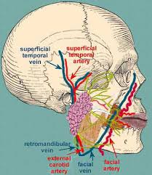
Course & Distribution of Facial Artery
It arches upward deep to the submandibular salivary gland.
It curves around the inferior margin of the body of the mandible at the anterior border of masseter muscle.
It runs upward in a tortuous course to the angle of the mouth deep to the muscles. It ascends along the side of the nose to the medial angle of the eye.
It terminates by anastomosing with the terminal branches of the opthalmic artery.

Slide 28
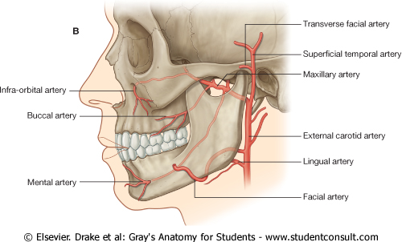
Where to feel Facial Pulsation?
As the artery crosses the inferior margin of the body of the mandible at the anterior border of the masseter muscle.

Slide 29
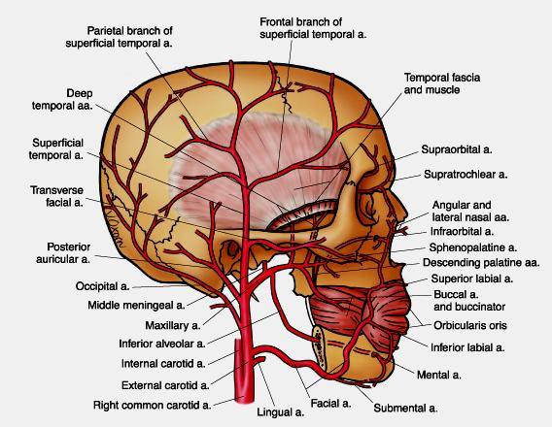
Branches
SUBMENTAL
INFERIOR
LABIAL
SUPERIOR
LABIAL
LATERAL
NASAL

Slide 30
Compression of the Facial Artery
The facial artery can be occluded by pressure against the mandible as the vessel crosses it. Because of the numerous anastomoses of the arteries of the face, compression of the facial artery on one side does not stop all bleeding from a lacerated facial artery or one of its branches.
In lacerations of the lip, pressure must be applied on both sides of the cut to stop bleeding

Slide 31
Superficial Temporal Artery
It is the smaller terminal branch of the External Carotid Artery.
It arises within the parotid gland and ascends in front of the auricle to supply the scalp.
It gives the Transverse Facial artery that runs across the cheek just above the parotid duct.

Slide 32
Where to feel Pulsation of Superficial Temporal artery?
In front of the auricle as the artery crosses the root of the zygomatic arch.
Anesthetists mostly depend upon the facial and superficial temporal arteries to take patient’s pulse.

Slide 33
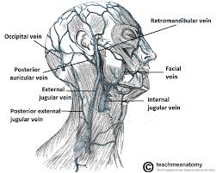
Facial Vein
Where it begins?
At the medial angle of the eye.
How it is formed?
By the union of the Supratrochlear & Supra orbital veins.
Course:
It descends behind the facial artery to the lower margin of the body of the mandible (superficial to submandibular gland).
How it terminates?
It is joined by the anterior division of the retromandibular vein to form common facial vein which drains into
Internal Jugular Vein.

Slide 34
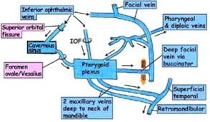
Tributaries & Connections
The facial vein receives tributaries that correspond to the branches of the facial artery.
It is Connected to:
(1) Pterygoid venous plexus through deep facial vein.
(2) Cavernous sinus: through superior ophthalmic vein

Slide 35
Blood from the nose, medial angle of the eye and lips usually drains inferiorly through the facial vein
especially when the person is erect.
Because the facial vein has no valves, blood may pass through it in the opposite direction so venous blood from the face may enter the cavernous sinus.

Slide 36
Thrombophlebitis of the facial vein
In patients with inflammation of the facial vein with secondary thrombus, pieces of the infected clot may extend into the intracranial venous system and produce thrombophlebitis of the cavernous sinuses.
This may result from lacerations of the nose or by squeezing pustules on the side of the nose and upper lip

Slide 37
What is the Dangerous Area of the Face?
It is a triangular area bounded by: the side of nose, medial angle of the eye and upper lip.

