Slide 1

Time Management
Learning Skills Course
Dept of medical education
College of Medicine

Slide 2
Objectives
At the end of this session, the student will be able to:
Identify the importance of TM
Plan your schedules effectively
Enumerate Time wasters
Identify procrastination signs & tackle it

Slide 3
Contents
Introduction
Importance of TM
Daily schedules planning
Time wasters
Procrastination
Take home messages

Slide 4

What did you do yesterday?
We need one volunteer on the board. [5 minutes]
Dear colleague, tell us how did you consume your time yesterday [the whole day, bed to bed] ?

Slide 5
Time management important?
Time cannot be bought, stored or stopped - every second that passes is gone forever and can never be recovered or re-used
"Perhaps the most valuable result of any work is the ability to make yourself do the things that you have to do, when it ought to be done, whether you like it or not."—
Thomas Huxley
“ Be regular and orderly in your life so that you may be violent and original in your work.”
Gustave Flaubert

Slide 6
أهمية الوقت في حياة المسلم
عن معاذ بن جبل رضي الله عنه قال قال رسول الله صلى الله عليه وسلم " لن تزول قدما عبد يوم القيامة حتى يسأل عن أربع:
    عن عمره فيما أفناه
    وعن شبابه فيما أبلاه
    وعن ماله من أين اكتسبه وفيما أنفقه
    وعن علمه ماذا عمل به؟ "
(Age , youth, money and deeds)
  عن ابن عباس رضي الله عنهما قال قال رسول الله صلى الله عليه وسلم " نعمتان مغبون فيهما كثير من الناس: الصحة والفراغ “
  “The majority of humanity is at a loss as they do not recognize the value of two of God’s gifts: Health and (discretionary) time.”

Slide 7

The Basic Rule
Time can't be managed, time is uncontrollable
We can only manage ourselves and our use of time

Slide 8
Myths about Time Management
Time management is nothing but common sense. I do well in college, so I must be managing my time effectively.
No matter what I do, I won’t have enough time!
Time management? I work better under pressure.
It takes all the fun out of life!!!

Slide 9
Time Management Tips
  Use a planner
  a planner can be an effective and easy way to help you organize your time
  look at a number of different kinds of planners before you select one- some will help you more than others
  choose one that is easy to carry with you
  commit to checking/updating it daily
  try to include your daily to-do list in your plan

Slide 10
The Truth!
As college students, you are very busy people, and to make those 168 hours effective, you have to do some planning.
The Benefits of Time Management
You are more productive.
You reduce your stress.
You improve your self-esteem.
You achieve balance in your life.
You feel more confident in your ability to get things done.
You reach your goals.

Slide 11
What is Time Management?
Simply, making use of most of your time and energy!

Slide 12
8,8,8 = Balance
There are only 24 hours in a day!
8 hours of work/school keeps you from burning out by doing too much, or from not devoting enough time to your goals.
8 hours of personal time keeps your life well-rounded with time for fun and enjoyment!
The day is made of only 24 hours (even though we wish it had more). Three segments of 8 hours keeps things simple.
8 hours of sleep gives you the rest your body needs to accomplish your goals and remain healthy.

Slide 13
A Word about ENERGY
The most overlooked aspect of time management is your energy level.
Evaluate your energy level at different times of day.
Schedule tasks when you have the energy level to match.
Now that you know your “smart” hours – peaks and your slump hours – use that information to guide your study time selection.
If you are a “morning person,” seize the early hours to study and do assignments that require focus.
If you are an “evening person,” make sure that you are being productive and not sacrificing sleep for extra hours to socialize.
Losing sleep is the easiest way to sabotage your energy level!

Slide 14
What are the steps to Managing Your Time
Set goals
Make a schedule
Revisit and revise your plan

Slide 15
1. Set Goals!
Make your goals specific and concrete. Don’t be vague.
Set both long-term goals and short-term ones to support them.
Set a deadline for your goals.
Integrate your goals: school, personal and career.
Realize that goals change, but know which goals to stick to!

Slide 16
From your goals, set priorities.
What’s important and what isn’t?
What order do things need to be done in?
Once you know what your priorities are, you need to plan out a schedule for the semester, the week and the day.
Planning may seem hard at first, but the more you do it, the easier and more natural it gets.

Slide 17
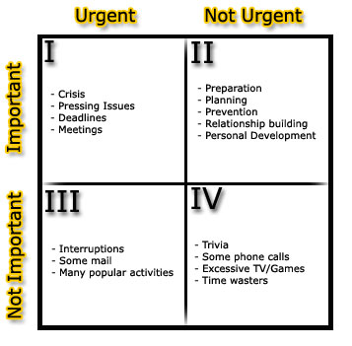
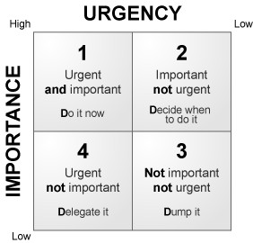
Plan your time (Eisenhower method)
People don't plan to fail but a lot of people do fail to plan."
To Do List:
- Break things down into small steps
- Like a child cleaning his/her room
- Do the ugliest thing first

Slide 18
Assess your task!!
Is the task urgent & important?
yes
yes
Do you need to complete it today?
Take immediate action
A
No
Allocate time to complete it
Is the task urgent or important?
yes
Does it has a definite deadline?
yes
B
No
No
Set realistic deadline for it
Is the task necessary?
yes
Save the task for quiet time
C
No
Discard

Slide 19
2. Make a Schedule
Set Up Your Semester Calendar
Look at the syllabus for the class schedule.
Begin with blocking all class and lab times.
Block all other set time obligations:
  Work, mosque, meetings and so on…
Highlight all exams and project due dates.
Identify routine homework days.
Work backwards from exams and papers and map out study/writing time.
Don’t forget to take a break once in a while.

Slide 20
Make a Schedule continued
Set Up Your Weekly Plan
Spend 30 minutes or so mapping out the week.
Ask yourself these questions about the week:
  What do I expect to accomplish?
  What will I have to do to reach these goals?
  What tasks are more important than others?
  How much time will each activity take?
  When will I do each activity?
  How flexible do I have to be to allow for unexpected things?

Slide 21
Ask yourself !!
How effective is my schedule?
Does I allow enough time to accomplish what the schedules?
Am I paying attention to my energy level?
Does it look like I will accomplish everything I plan?
How well will I be able to accomplish certain tasks?

Slide 22
“Work smarter, not harder.”- Alan Lakein
Set realistic goals, there are only 24 hours in a day.
Study at the same time each day: make it a habit
Divide study time into 50-minute blocks.
Don’t forget to reward yourself when you do something right!

Slide 23
Complete a term assignment preview.
Use a “week at a glance” organizer.
Enter in due dates and social events as soon as you can.
Review your calendar daily for the current week and upcoming week.
It just takes a moment to review your calendar and it relieves stress to know you are on top of things.

Slide 24
How busy are you?
Because we are not concentrating on the right things
To succeed, we must concentrate on:
1. The results to be achieved, not on being busy
2. Setting priorities, which is vital
The aims to ensure that we concentrate our effort on the high payoff tasks

Slide 25
Plan your time
Remember, plans and schedules for managing time are useless if one does not follow them

Slide 26
Crisis Management
It can lead to situations such as:
1- High levels of stress
2- A disrupted private life
3- Tiredness
4- Failure of projects

Slide 27
Common Time Wasters
Interruption
Meetings
Tasks to delegate
Procrastination
Acting with incomplete information
Dealing with classmates
Crisis management
Unclear communication
Inadequate technical knowledge
Unclear objectives and priorities
Lack of planning
Stress and fatigue
Inability to say "No“
Personal disorganization

Slide 28
Procrastination:
“Never do today what you can put off ‘till tomorrow!”
Forms of procrastination:
Ignoring the task, hoping it will go away
Underestimating how long it will take
Overestimating your abilities and resources
Telling yourself that poor performance is okay
Doing something else that isn’t very important
Believing that repeated “minor” delays won’t hurt you
Talking about a hard job rather than doing it
Putting all your work on only one part of the task
Becoming paralyzed when having to make choices

Slide 29
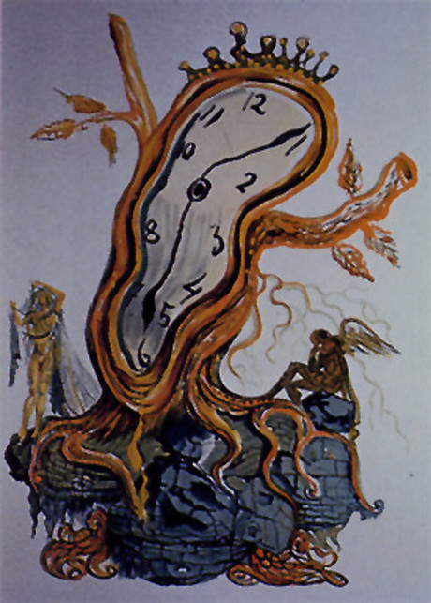
Procrastination Signs (Thief of Time)
How to tackle procrastination?
Set deadlines by which goals should be achieved

Slide 30
Why don't people manage their time?
They don't know about it
They are too lazy to plan
They enjoy the adrenaline buzz of meeting tight deadlines
They enjoy crisis management
Failing to plan is planning to fail

Slide 31
How to Overcome Procrastination
Win the mental battle by committing to being on time.
Set and keep deadlines.
Organize, schedule & plan.
Divide a big job into smaller ones.
Find a way to make a game of your work or make it fun.
Reward yourself when you’re done.
Tell your friends and room mates to remind you of
priorities and deadlines.
Learn to say “no” to time wasters.

Slide 32
Tackle Time Wasters
  Learn to say ‘NO’
  Examples of good ways to say “no”
  Instead of: “I really should study”, say “You caught me in the middle of something important, I’ll call you later.”
  “I can’t go the movies tonight, but I can go on Saturday.”
  “Before I say yes, let me check my planner and get back to you.”

Slide 33

how long should I study?
The rule-of-thumb in college
To spend two hours studying for every one hour in class each week

Slide 34
YES, Benefits….
Having good time management can provide you with:
-Guilt-free time!
-No procrastination!
-Less decision-making!
-A sense of control!
-Success!

Slide 35
Summary
Time and energy management can make you more productive and reduce your stress level.
The Three Steps
  Set goals
  Make a schedule
  Revisit and revise your plan
Be tough with your time. Actively avoid procrastination and time wasters. Learn to say “no” to distractions.
Employ a variety of time management strategies to maximize your time.
Relax and enjoy the extra time that you’ve discovered!

Slide 36
TASK
Portfolio
1. All the completed “Portfolio” assignments should be submitted in English using computer
word processor.
2. The Deadlines for submission of these papers are 12/10/2014 for the first assignment and
07/11/2014 for the second two topics assignment. But you can submit all topics on the first
date or even before.
3. Good quality, well written assignments are expected from you, which will help you
to get higher grades in the evaluation.
4. Evaluation of your Portfolio Assignments will be based on the following criteria.
TASK:
Briefly write (500 to 1000 words)
1. What are the causes of procrastination? Talk about your own experience and how you tackle them?
2. What are your strategies of time management, after taking the session?
Briefly describe the changes in your daily work, talking about 1-2 of your own experiences.
3. Make your one week time table after implementing time management in your daily schedule.
How to get the full mark
Please follow the students guide under the following topic
(Criteria for portfolio assessment : Marking rubric for portfolio entries page 12, 13)

Slide 37

Questions !!
T
H
A
N
K
Y
O
U

