Slide 1

Lecture Title:
Fungi and their pathogenesis
(Foundation Block, Microbiology)

Slide 2

Lecture Objectives..
To describe the general characteristics of fungi and recognize a fungus from all other living organisms
To establish familiarity with the terminology needed by medical students
To know certain fundamental facts about classification reproduction and identification of fungi

Slide 3
What is Mycology?..
Mycology: Study of fungi
Kingdom myceteae (= Kingdom fungi)
Medical mycology : Study of medically important fungi and the mycotic diseases.
Mycoses: A disease caused by a fungus

Slide 4
What is a Fungus ?
Characteristics of fungi:
All Eukaryotic organisms (a true nucleus)
Heterotrophic (Saprobic, symbiotic, parasitic)
Do not have chlorophyll (Achlorophyllous)
The cell is surrounded by rigid cell wall made of chitin and complex carbohydates (Mannan, glucan)
Cell membrane : (sterol, ergosterol)

Slide 5
What is a Fungus ?
Characteristics of fungi
  Saprobic
  feed on dead tissues or organic waste (decomposers)
  Symbiotic
    mutually beneficial relationship between a fungus and another organism
  Parasitic
    feeding on living tissue of a host. (disease)

Slide 6
MORPHOLGY
Yeasts : are unicellular organisms
Filamentous fungi (Hyphae, mycelium)
  Hyhpae are multicellular filamentous structures, constituted by tubular cells with cell walls.
Dimorphic
    Yeast : Parasitic form, Tissue form, Cultured at 37° C
    Filamentous : Saprophytic form, Cultured at 25 C
  Dimorphic: Have two forms depending on change in the environmental factors Mold form Yeast form

Slide 7
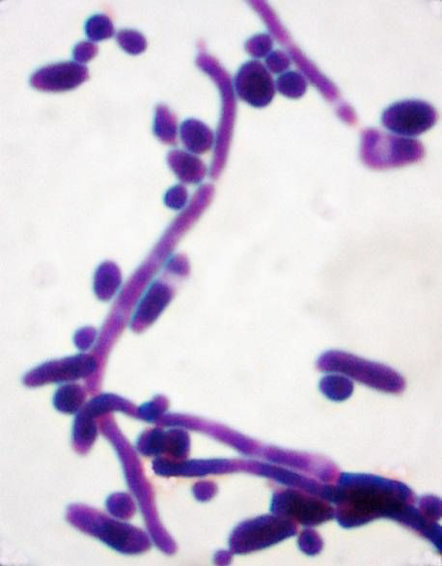
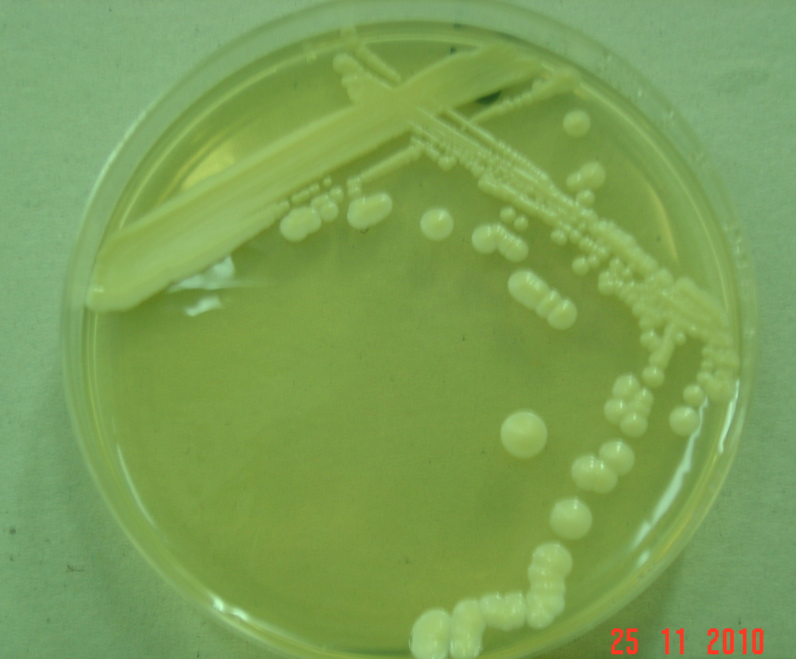
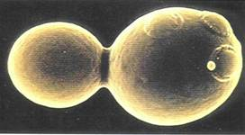
MORPHOLGY
Yeast:
Colony morphology (Culture)
Have same appearance
How do we differentiate between them?
Budding yeast cell
  In Clinical samples
    Budding yeast cells
    +/- Pseudohyphae
  Examples : Candida albicans,
  Saccharomyces cerevisiae

Slide 8
MORPHOLGY
Filamentous fungi (Mould=Mold)
  A hypha (plural hyphae)
  is a long, branching filamentous cell. hyphae are the main mode of vegetative growth.
  Mycelium:
  The intertwined mass of hyphae that forms the fungal colony.
  Conidia/ Spore:
    asexual spores borne externally on hyphae or on a conidiophore.
Examples:
    Aspergillus,
    Penicillium,
    Rhizopus

Slide 9
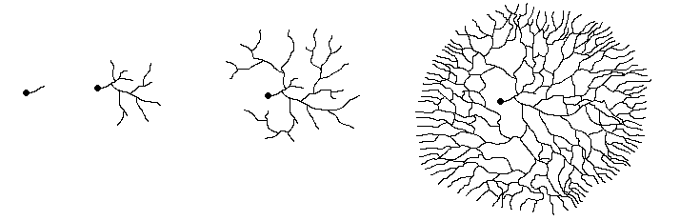
Filamentous fungi
Hyphal growth from spore
MORPHOLGY
Spore/ conidia
mycelium

Slide 10
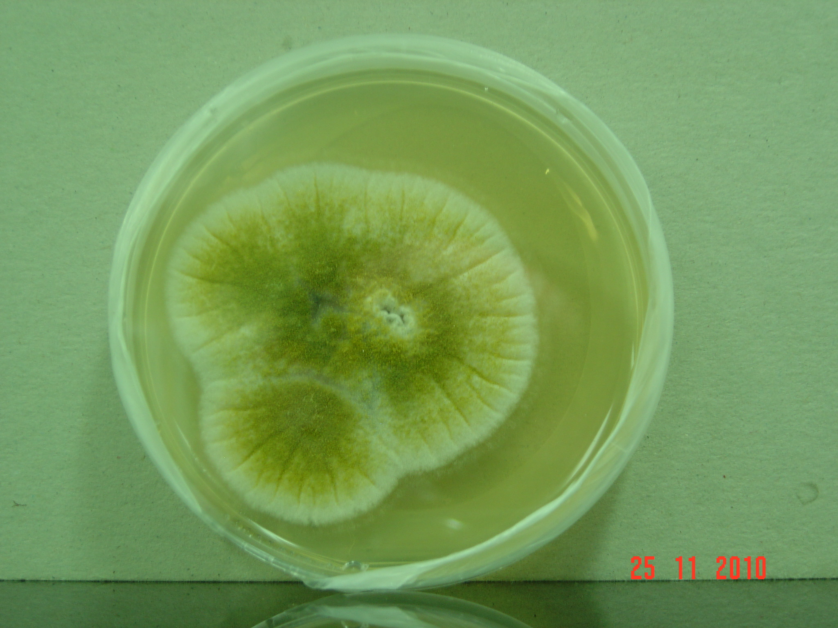
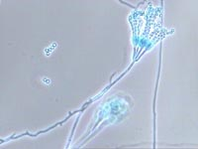
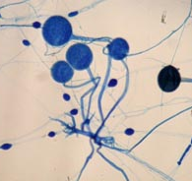
Filamentous fungi
MORPHOLGY
Colonial morphology
Penicillium,
Rhiaopus

Slide 11
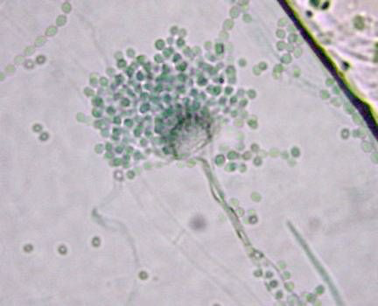
MORPHOLGY
Filamentous fungi
Conidia / spore : asexual spores borne externally on hyphae or on a conidiophore.
Conidia

Slide 12
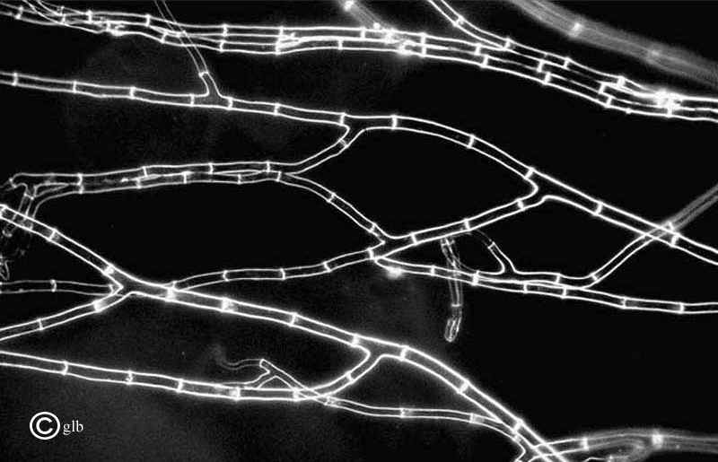
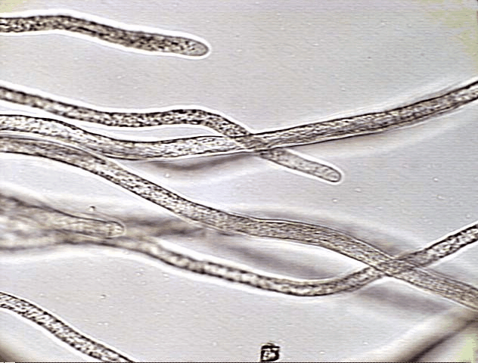
Fungal Hypha
Filamentous fungi
Septa:
  Cross-walls (septa) that divide hyphae into segments. (septate hypha)
If there are no cross-walls, the hyphae are considered to be non-septate.

Slide 13
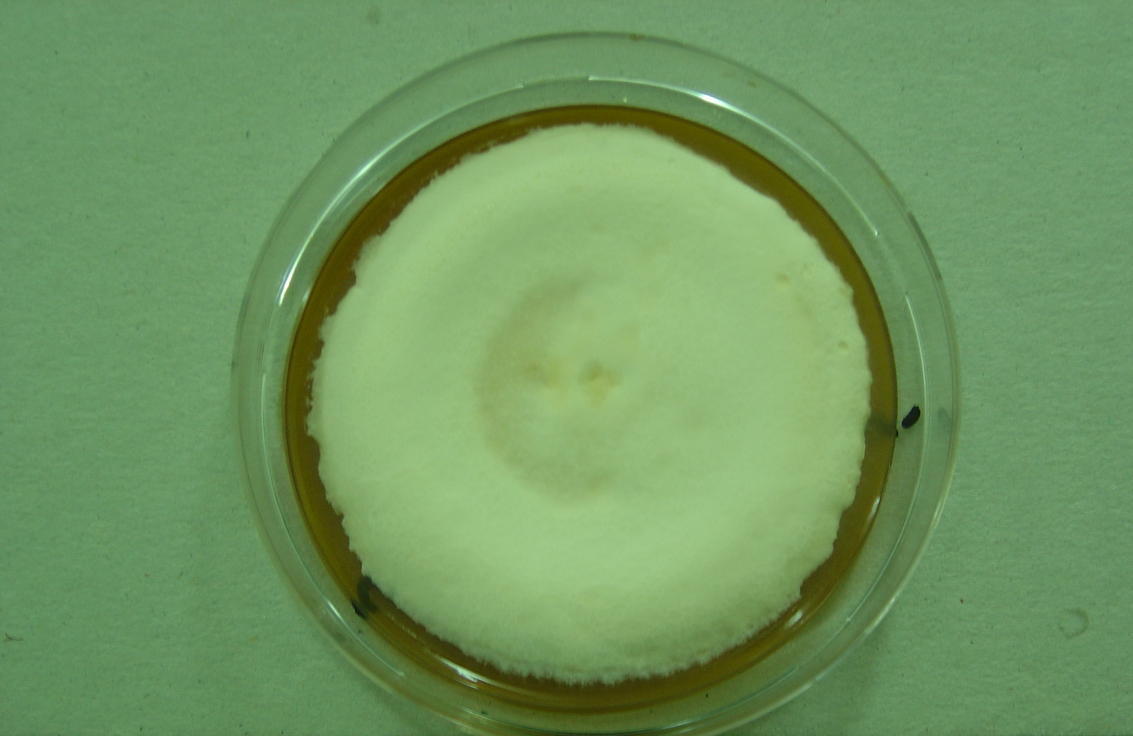
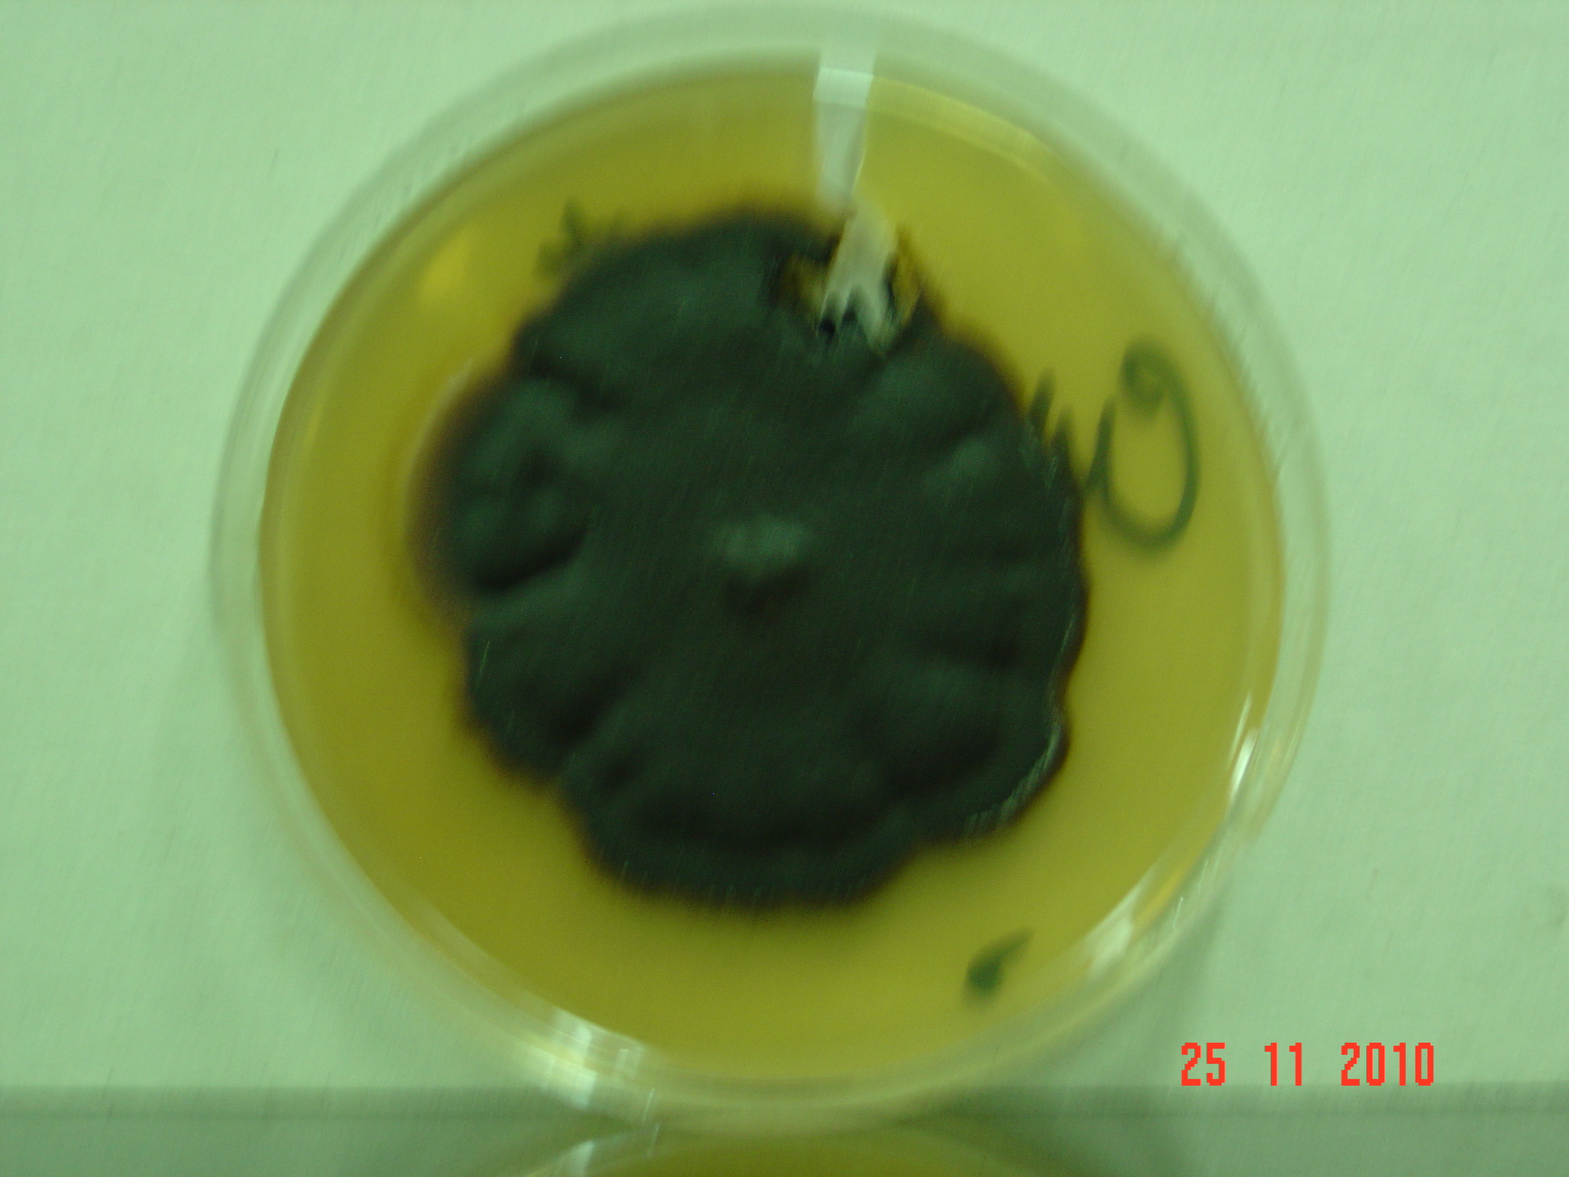
MORPHOLGY
Filamentous fungi (mold)
Moniliaceous molds
hyaline or lightly pigmented conidia or hyphae, colorless
Dematiaceous Molds
Are pigmented.
Because of the pigment, the colonies appear dark, brown, or black

Slide 14
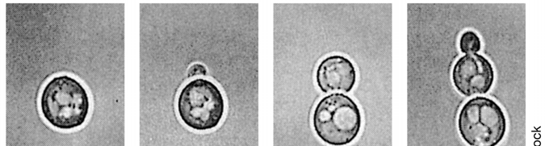
Reproduction in Fungi
I) Asexual: Only mitotic cell division
1) Somatic Yeasts by budding
Molds by hyphal fragmentation
2) Spore formation:
II) Sexual: Fusion, mitosis, meiosis

Slide 15
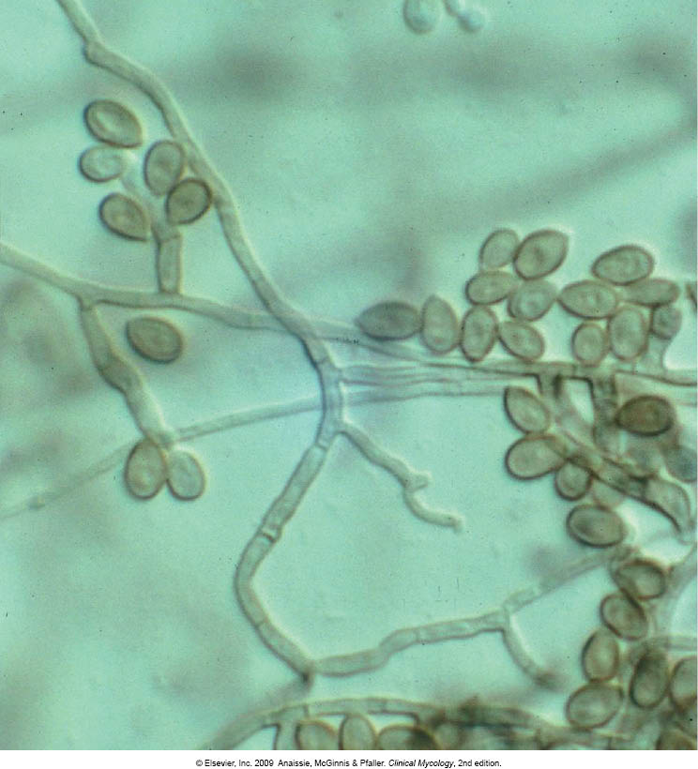
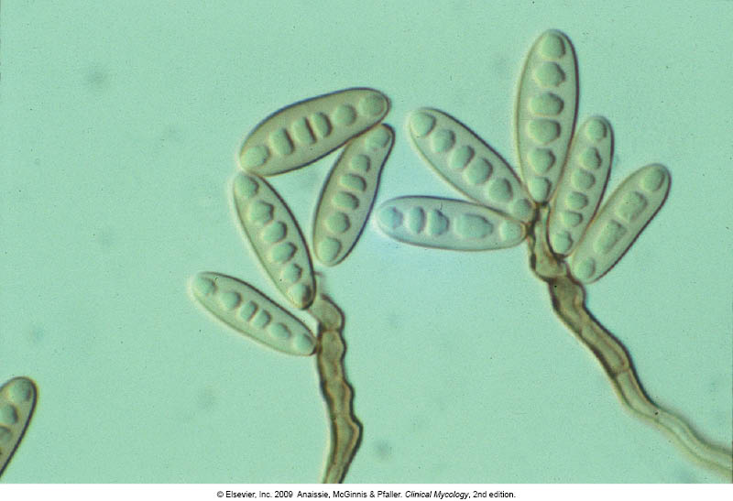
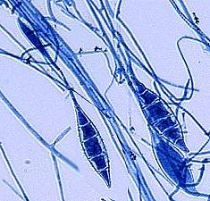
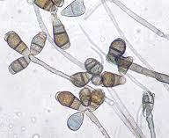
Spores?
These are the small airborne particles by which fungi reproduce.
They are produced by mitosis and readily disseminate in the air.
SPORES

Slide 16
PATHOGENICITY OF FUNGI
Fungi can cause diseases to humans
  Cause superficial infections,
  some can cause allergic reactions
  Few cause invasive infections
Not all fungi are pathogenic
To cause the disease:
  Thermotolerance
  Ability to survive in tissue environment
  Ability to withstand host defenses

Slide 17
Thank You ☺
(Foundation Block, Microbiology)

