Slide 1
Neoplasia
Lecture 1
Maha Arafa,MD,KSFP
Abdulmalik Alsheikh, MD, FRCPC

Slide 2
Neoplasia
Upon completion of these lectures, the student should:
Define a neoplasm. Contrast neoplastic growth with hyperplasia, metaplasia, and dysplasia.
Know the basic principles of the nomenclature of benign and malignant processes.
Define and use in the proper context:
  Adenoma.
  Papilloma.
  Polyp.
  Cystadenoma.
  Carcinoma.
  Adenocarcinoma.
  Sarcoma.
  Teratoma.
  Blastoma.
  Hamartoma.

Slide 3
Neoplasia
Cancer is one of the leading causes of death worldwide.
Emotional and physical suffering by the patient.
Different mortality rate …..
  Some are curable
  Others are fatal

Slide 4
Neoplasia
Neoplasia = new growth
Neoplasm = tumor
Tumor = swelling
The study of tumors = Oncology
  Oncos = tumor + ology = study of

Slide 5
Neoplasia
Definition:
  is an abnormal mass of tissue,
  the growth of which is uncoordinated with that of normal tissues,
  and that persists in the same excessive manner after the cessation of the stimulus which evoked the change“
  With the loss of responsiveness to normal growth controls
  Different from hyperplasia, metaplasia and dysplasia.

Slide 6
Neoplasia
Classification
  Benign
  malignant

Slide 7
Neoplasia
Benign tumors :
  Will remain localized
  Cannot spread to distant sites
  Generally can be locally excised
  Patient generally survives
  hypotrophy

Slide 8
Neoplasia
Malignant neoplasms:
  Can invade and destroy adjacent structure
  Can spread to distant sites
  Cause death (if not treated )

Slide 9
Neoplasia
All tumors have two basic components:
  Parechyma: made up of neoplastic cells
  Stroma: made up of non-neoplastic, host-derived connective tissue and blood vessels
The parenchyma:
  Determines the biological behavior of the tumor
  From which the tumor derives its name
The stroma:
  Carries the blood supply
  Provides support for the growth of the parenchyma

Slide 10
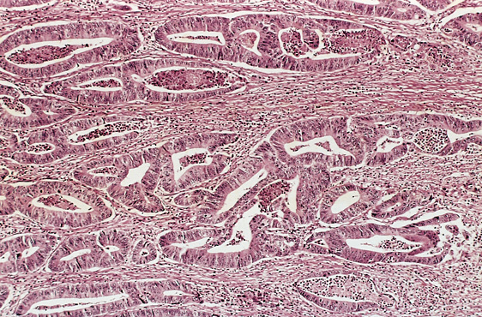

Slide 11
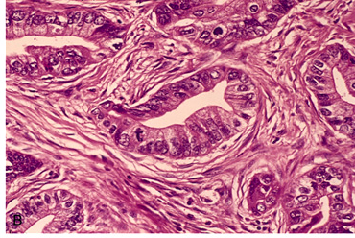

Slide 12
Neoplasia
Nomenclature
  Benign tumors:
    prefix + suffix
    Type of cell + (-oma)

Slide 13
Neoplasia
Examples:
  Benign tumor arising in fibrous tissue:
  Fibro + oma = Fibroma
  Benign tumor arising in fatty tissue:
  Lipo + oma = lipoma

Slide 14
Neoplasia
Benign tumor arising in cartilage
chondro + oma = chondroma
Benign tumor arising in smooth muscle
Leiomyo + oma = leiomyoma
Benign tumor arising in skeletal muscle
Rhabdomyo + oma = rhabdomyoma

Slide 15
Neoplasia
epithelial benign tumors are classified on the basis of :
  The cell of origin
  Microscopic pattern
  Macroscopic pattern

Slide 16
Neoplasia
  Adenoma : benign epithelial neoplasms producing gland pattern….OR … derived from glands but not necessarily exhibiting gland pattern
  Papilloma : benign epithelial neoplasms growing on any surface that produce microscopic or macroscopic finger-like pattern
  Same finger

Slide 17
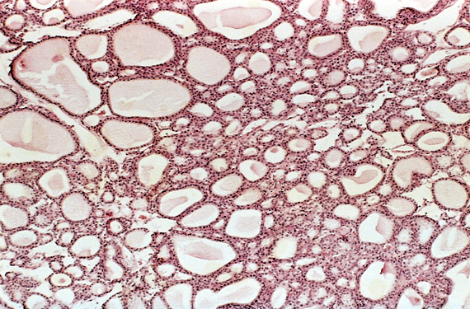
Adenoma

Slide 18
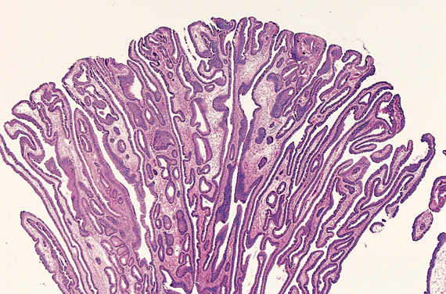
Papilloma

Slide 19
Neoplasia
Polyp : a mass that projects above a mucosal surface to form a macroscopically visible structure.
e.g. - colonic polyp
- nasal polyp

Slide 20
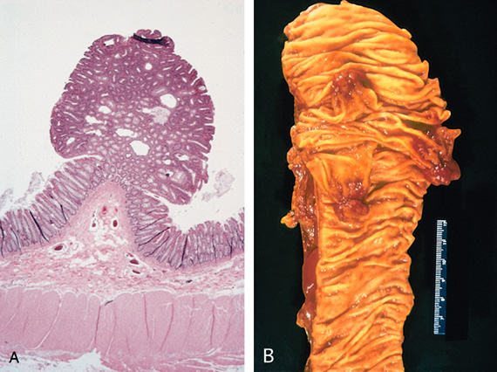
Polyp

Slide 21
Neoplasia
Examples :
  Respiratory airways: Bronchial adenoma
  Renal epithelium: Renal tubular adenoma
  Liver cell : Liver cell adenoma
  Squamous epithelium: squamous papilloma

Slide 22
Neoplasia
Malignant tumors:
  Malignant tumor arising in mesenchymal tissue : SARCOMA
    From fibrous tissue: Fibrosarcoma
    From bone : Osteosarcoma
    From cartilage : chondrosarcoma
    Macron tissue

Slide 23
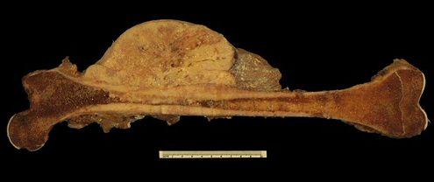
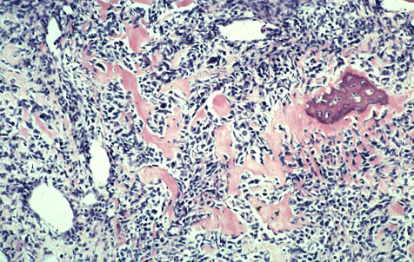
Osteosarcoma

Slide 24
Neoplasia
Malignant tumors arising from epithelial origin : CARCINOMA
  Squamous cell carcinoma
  Renal cell adenocarcinoma
  cholangiocarcinoma

Slide 25
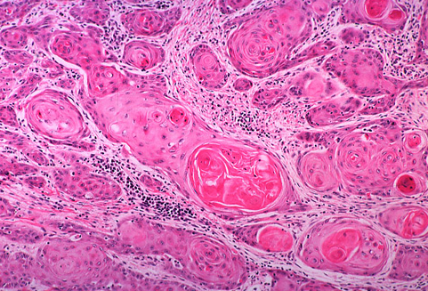
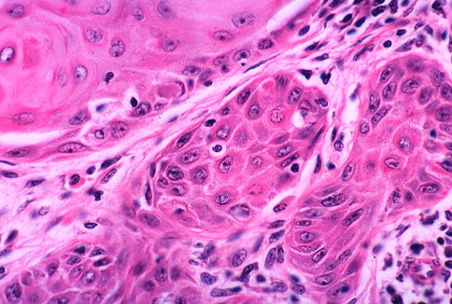
Carcinomas arising from any epithelium of the body that exhibit squamous differentiation are termed squamous cell carcinoma.

Slide 26
Nomenclature
other descriptive terms may be added such as:
Papillary Cystadenocarcinoma of the Ovary
Cyst كيس

Slide 27
Neoplasia
Exceptions
Melanoma ( skin ) malignant
Mesothelioma (mesothelium ) malignant
Seminoma ( testis ) malignant
Lymphoma ( lymphoid tissue ) malignant
See table 6 – 1 page 168 ( Robbin’s )

Slide 28
Neoplasia
Based on the biological behavior :
  Benign and malignant
Based on the cell of origin :
  One neoplastic cell type : lipoma, adenocarcinoma
  More than one neoplastic cell type : fibroadenoma
  More than one neoplastic cell type derived from more than one germ-cell layer: teratoma
  Derived from embryonic tissue: blastoma (could be benign e.g. osteoblastoma, or malignant e.g. neuroblastoma)

Slide 29
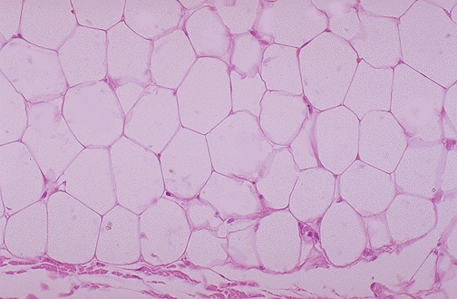
Lipoma

Slide 30
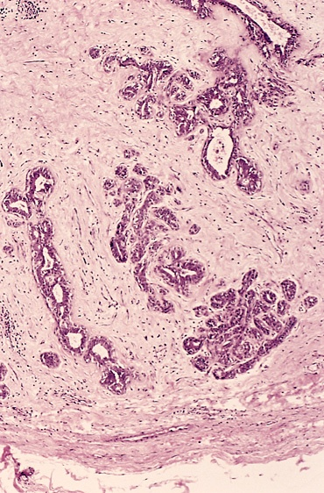
Fibroadenoma

Slide 31
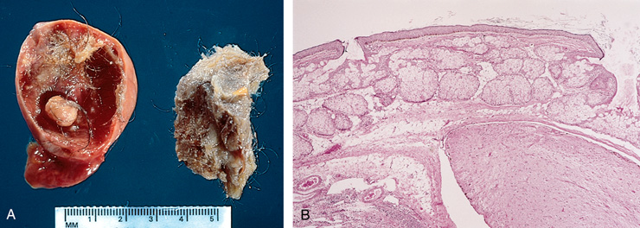
Teratoma

Slide 32
Neoplasia
Teratoma:
  Teratoma contains recognizable mature or immature cells or tissues representative of more than one germ-cell layer and some times all three.
  Teratomas originate from totipotential cells such as those normally present in the ovary and testis.

Slide 33
Neoplasia
Such cells have the capacity to differentiate into any of the cell types found in the adult body. So they may give rise to neoplasms that mimic bone, epithelium, muscle, fat, nerve and other tissues.
Most common sites are: ovary & testis

Slide 34
Neoplasia
If all the components parts are well differentiated, it is a benign (mature) teratoma.
If less well differentiated, it is an immature (malignant) teratoma.

Slide 35
Neoplasia nomenclature
- historic eponyms – “first described by…”
Malignant lymphoma (HL) of B Ly cell origin | Hodgkin’s disease
NHL – B Ly cell in children (jaw and GIT) | Burkitt tumor
Bone tumor (PNET) | Ewing tumor
Kidney tumor - clear cell adenocarcinoma | Grawitz tumor
Malignant tumor derived from vascular epithelium (AIDS) | Kaposi sarcoma
Ovarian tumor derived from Brenner cells | Brenner tumor
Malignant chest wall tumor of PNET | Askin tumor
Skin tumor derived from Merkel cell | Merkel tumor

Slide 36
WHAT ARE HAMARTOMAS AND CHORISTOMA?
Hamartoma: a mass composed of cells native to the organ
e.g. pulmonary hamartoma.
Choristoma: a mass composed of normal cells in a wrong location
e.g. pancreatic choristoma in liver or stomach.
Malformation and not neoplasm.

Slide 37
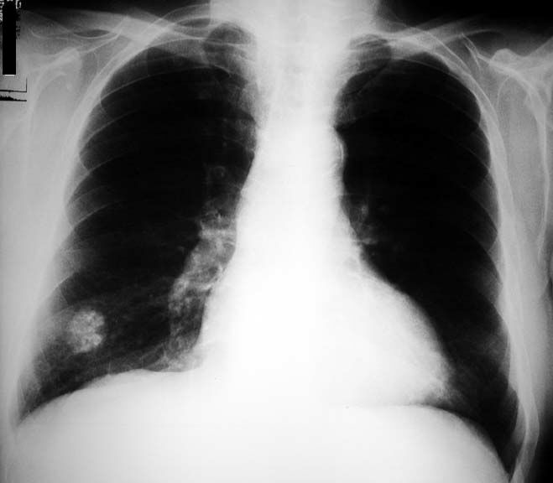
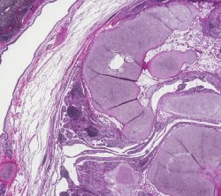
Pulmonary Hamartoma

Slide 38
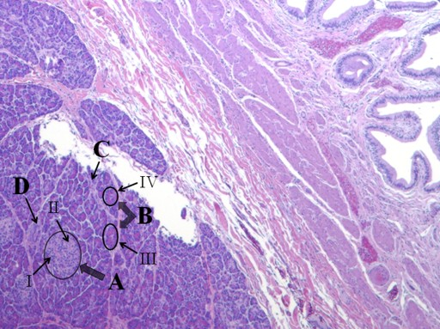
Pancreatic choristoma in gall bladder

Slide 39
Neoplasia
Hamartoma and Choristoma
They are distinguished from neoplasms by the fact that they do not exhibit continued growth. they are group of tumor-like tissue masses which may be confused with neoplasms

Slide 41
Neoplasia
Lecture 2
Maha Arafa,MD,KSFP
Abdulmalik Alsheikh, MD, FRCPC

Slide 42
Objectives
Compare and contrast benign and malignant tumors with respect to:
  demarcation from surrounding tissue (capsule, local invasiveness.
  rate of growth
  degree of differentiation (Explain the meaning of differentiation).
  distant spread (metastases).
Describe the morphologic changes associated with poorly differentiated tumors; define and understand the usage of the terms anaplasia, pleomorphism, nuclear atypia, abnormal mitoses and tumor giant cells.
Understand the clinical significance of invasiveness and metastasis.
Describe the anatomic pathways utilized by tumors in metastatic spread. Know which pathways are commonly used by carcinomas versus sarcomas.
List some common sites of distant metastases.
Recognize the epidemiologic data of cancer distribution in regard to age, race, geographic factors, and genetic backgrounds.
List some inherited syndromes with a genetic predisposition to cancer.

Slide 43
Neoplasia
Characteristics of benign and malignant neoplasms
Differentiation and anaplasia
Rate of growth
Local invasion
metastasis

Slide 44
Neoplasia
Differentiation and anaplasia:
Differentiation means : the extent to which the parenchymal cells of the tumor resemble their normal counterparts morphologically and functionally

Slide 45
Neoplasia
well differentiated = closely resemble their normal counterparts
Moderately differentiated
Poorly differentiated
Undifferentiated ( Anaplasia )

Slide 46
Neoplasia
Benign tumors = well differentiated
Malignant tumors =
well differentiated -----> anaplastic

Slide 47
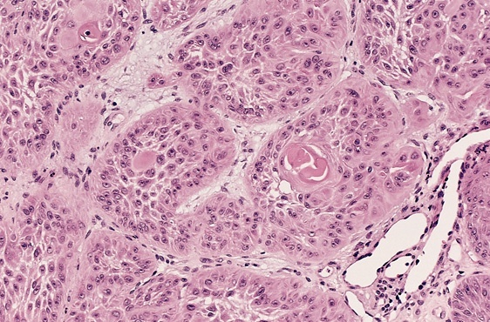

Slide 48
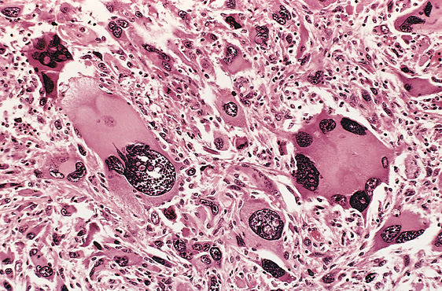

Slide 49
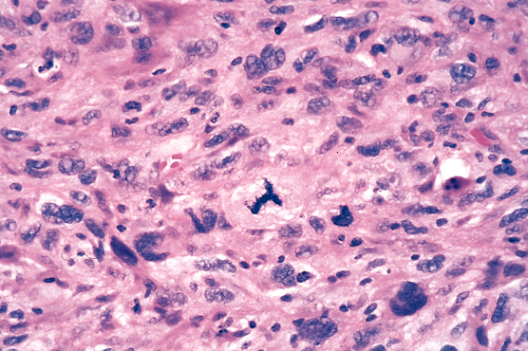

Slide 50
Neoplasia
In the histological examination of a tumor you should look for :
  Pleomorphism : variation in size
  High nuclear/ cytoplasm ratio ( N/C ratio)
  Hyperchrmasia ( dark cell )
  Mitosis ….?abnormal one

Slide 51
Neoplasia
Characteristics of benign and malignant neoplasms
Differentiation and anaplasia
Rate of growth
Local invasion
metastasis

Slide 52
Neoplasia
Rate of growth:
  Benign tumors:
    grows slowly
    are affected by blood supply, hormonal effects , location
  Malignant tumors :
    grows faster
    Correlate with the level of differentiation

Slide 53
Neoplasia
Characteristics of benign and malignant neoplasms
Differentiation and anaplasia
Rate of growth
Local invasion
metastasis

Slide 54
Neoplasia
Local invasion :
  Benign tumors :
    Remain localized
    Cannot invade
    Usually capsulated
  Malignant tumors :
    Progressive invasion
    Destruction
    Usually not capsulated

Slide 55
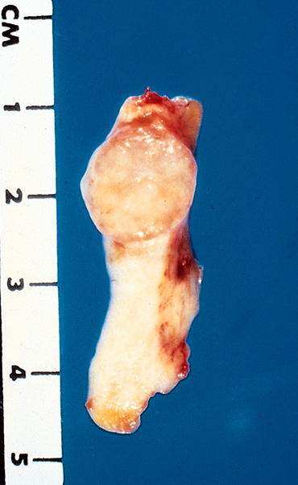

Slide 56
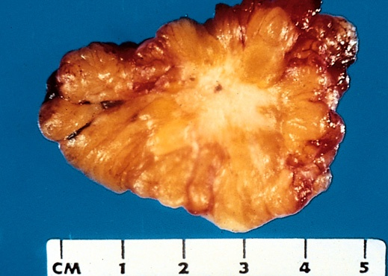
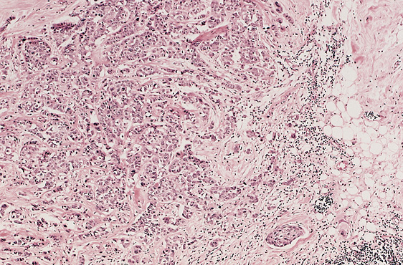

Slide 57
Neoplasia
Characteristics of benign and malignant neoplasms
Differentiation and anaplasia
Rate of growth
Local invasion
Metastasis

Slide 58
Neoplasia
Metastasis :
  Definition : the development of secondary implants discontinuous with the primary tumor, possibly in remote tissues

Slide 59
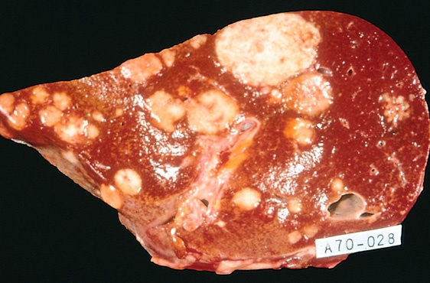

Slide 60
Neoplasia
Metastasis :
  Cancers have different ability to metastasize
  Approximately 30% patients present with clinically evident metastases.
  Generally, the more anaplastic and the larger the primary tumor, the more likely is metastasis

Slide 61
Neoplasia
Metastasis : three pathways
  Lymphatic spread :
  Hematogenous spread :
  Seeding of the body cavities: pleural, peritoneal cavities and cerebral ventricles

Slide 62
Neoplasia
Lymphatic spread :
  favored by carcinomas
  Breast carcinoma → axillary lymph nodes
  Lung carcinomas → bronchial lymph nodes

Slide 63
Neoplasia
Hematogenous spread :
favored by sarcomas
Also used by carcinomas
Veins are more commonly invaded
The liver and lungs are the most frequently involved secondary sites

Slide 64
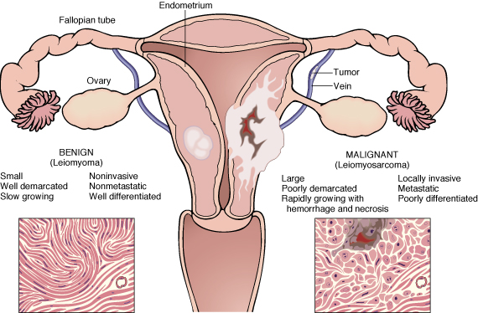

Slide 65
Neoplasia
In the histological examination of a tumor you should look for :
  Pleomorphism : variation in size
  High nuclear/ cytoplasm ratio ( N/C ratio)
  Hyperchrmasia ( dark cell )
  Mitosis ….?abnormal one

Slide 66
Neoplasia
Dysplasia :
  Definiton: a loss in the uniformity of the individual cells and a loss in their architectural orientation.
  Non-neoplastic
  Occurs mainly in the epithelia
  Dysplastic cells shows a degree of : pleomorphism, hyperchrmasia,increased mitosis and loss of polarity.

Slide 67
Neoplasia
Dysplasia does not mean cancer
Dyplasia does not necessarily progress to cancer
Dysplasia may be reversible
If dysplastic changes involve the entire thickness of the epithelium it is called :
CARCINOMA IN-SITU

Slide 68
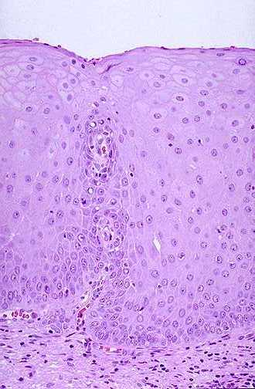
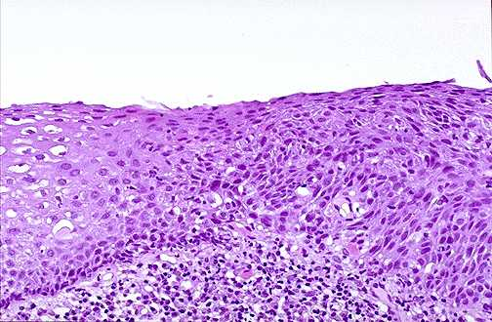

Slide 69
Neoplasia
Carcinoma in-situ
  Definition: an intraepithelial malignancy in which malignant cells involve the entire thickness of the epithelium without penetration of the basement membrane.
  Applicable only to epithelial neoplasms.

Slide 70
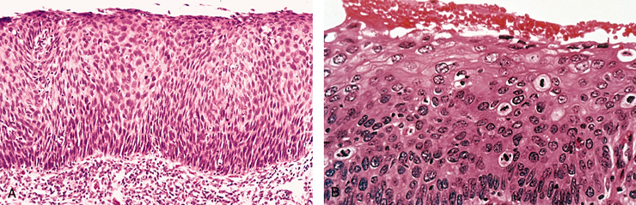

Slide 71
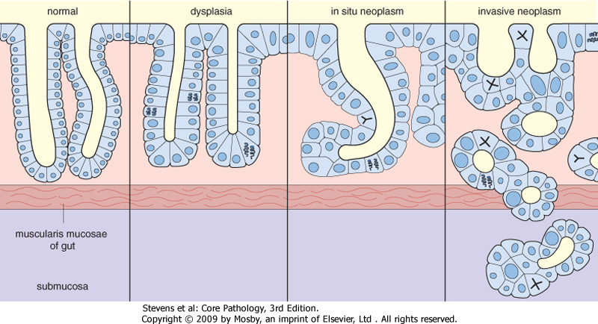

Slide 72
Dysplasia Features:
Nuclear abnormality
  Increased N/C ratio
  Irregular nuclear membrane
  Increased chromatin content
Cytoplasmic abnormalities due to failure of normal maturation
Increased rate of multiplication.
Disordered maturation.

Slide 73
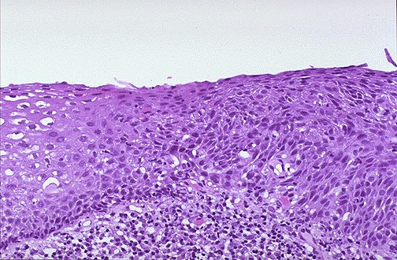
Dysplasia
Uterine cervix
Sever Dysplasia
Mild Dysplasia

Slide 74
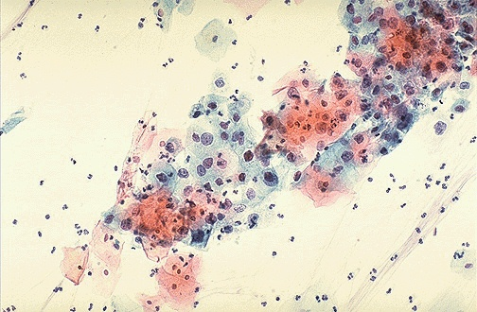
Dysplasia (cervical pap smear)

Slide 75
Dysplasia
Clinical significance:
  It is a premalignant condition.
  The risk of invasive cancer varies with:
grade of dysplasia (mild, moderate, sever)
duration of dysplasia
site of dysplasia

Slide 76
Dysplasia
Differences between dysplasia and cancer.
∗lack of invasiveness.
∗Reversibility

Slide 77
Carcinoma in situ
A true neoplasm with all of the features of malignant neoplasm except invasiveness
Displays the cytological features of malignancy without invasion of the basement membrane.

Slide 78
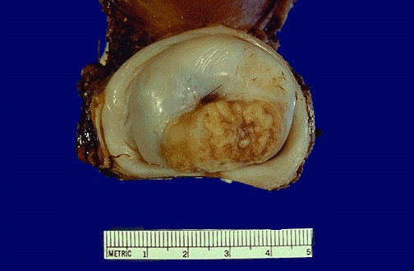
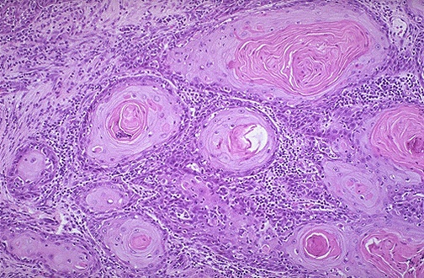
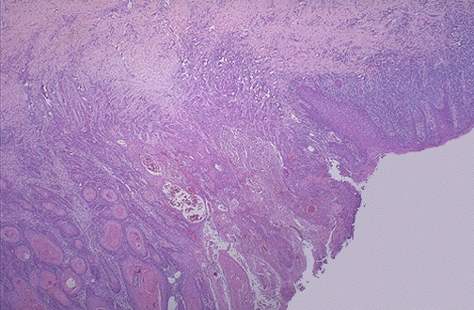
Squamous cell Carcinoma
Uterine Cervix
Dysplasia
Notes:
Cervical SC carcinoma - infiltrating

Slide 79
Neoplasia
Epidemiology
  Will help to discover aetiology
  Planning of preventive measures
  To know what is common and what is rare.
  Development of screening methods for early diagnosis

Slide 80
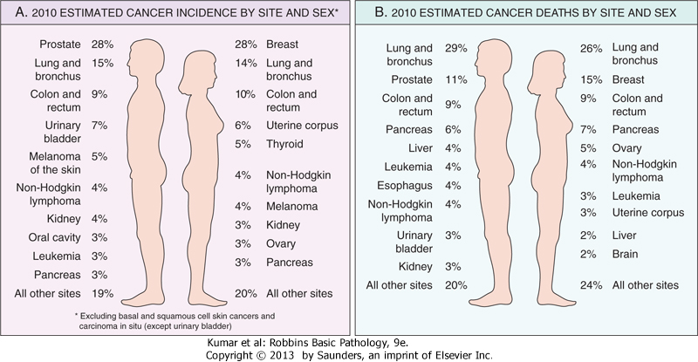

Slide 81
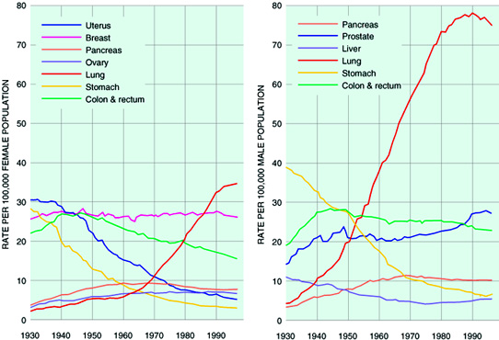

Slide 83
Neoplasia
Factors affecting incidence of cancer
  Geographic and Environmental
  Age
  Heredity
  Aquired preneoplastic disorders

Slide 84
Neoplasia
Factors affecting incidence of cancer
  Geographic and Environmental
  Age
  Heredity
  Aquired preneoplastic disorders

Slide 85
Neoplasia
Geographic and Environmental factors:
  Rate of stomach carcinoma in Japan is seven times the rate in North America and Europe.
  Breast carcinoma is five times higher in North America comparing to Japan
  Liver cell carcinoma is more common in African populations

Slide 86
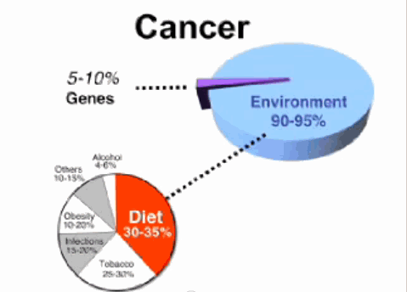

Slide 87
Neoplasia
Geographic and Environmental factors:
  Asbestos : mesothelioma
  Smoking : lung cancer
  Multiple sexual partners: cervical cancer
  Fatty diets : colonic cancer
  Please see table 6-3 for occupational cancers

Slide 88
Neoplasia
Factors affecting incidence of cancer
  Geographic and Environmental
  Age
  Heredity
  Aquired preneoplastic disorders

Slide 89
Neoplasia
Age:
  Generally, the frequency of cancer increases with age.
  Most cancer mortality occurs between 55 and 75.
  Cancer mortality is also increased during childhood
  Most common tumors of children: Leukemia, tumors of CNS, Lymphomas, soft tissue and bone sarcomas.

Slide 90
Neoplasia
Factors affecting incidence of cancer
  Geographic and Environmental
  Age
  Heredity
  Aquired preneoplastic disorders

Slide 91
Neoplasia
Heredity
  Inherited Cancer Syndromes
  Familial Cancers
  Autosomal Recessive Syndromes of Defective DNA repair

Slide 92
Heredity
Inherited Cancer Syndromes:
  Inheritance of a single mutant gene greatly increases the risk of developing neoplasm
  E.g. Retinoblastoma in children :
    40% of Retinoblastomas are familial
    carriers of the gene have 10000 fold increase in the risk of developing Retinoblastoma
  E.g. multiple endocrine neoplasia

Slide 93
Heredity
Familial Cancers:
  All common types of cancers occur in familial form
  E.g. breast, colon, ovary,brain
  Familial cancers usually have unique features:
    Start at early age
    Multiple or bilateral
    Two or more relatives

Slide 94
Heredity
  Autosomal Recessive Syndromes of Defective DNA repair :
    Small group of autosomal recessive disorders
    Characterized by DNA instability
Please see table 6-4 for more examples

Slide 95
Neoplasia
Factors affecting incidence of cancer
  Geographic and Environmental
  Age
  Heredity
  Aquired preneoplastic disorders

Slide 96
Neoplasia
  Aquired preneoplastic disorders: Some Clinical conditions that predispose to cancer
    Dysplastic bronchial mucosa in smokers→ lung carcinoma
    Liver cirrhosis → liver cell carcinoma
    Margins of chronic skin fistula → squamous cell carcinoma

