Slide 1
Dr. Mohammed Al Otaibi
Assistant Professor of Physiology
College of Medicine, KKUH, KSU
mfalotaibi@ksu.edu.sa

Slide 2
Physiology lectures in Foundation Block
Introduction, body fluids, cell membrane structure and homeostasis | 5 lectures
Autonomic nervous system I & II | 2 lectures
Blood Physiology | 6 lectures
 | 13 lectures

Slide 3
Introduction to Physiology
Physiology is one of the cornerstones of medicine.
Physiology is the study of how the body works, the ways in which cells, organs and the whole body functions, and how these functions are maintained in a changing environment.
Cellular physiology is the study of the cellular components that primarily determines organ function.
Systems physiology is the study of the coordinated and networked processes that determine whole body function and adaption to change.

Slide 4
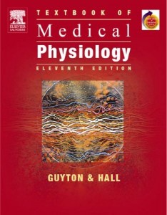
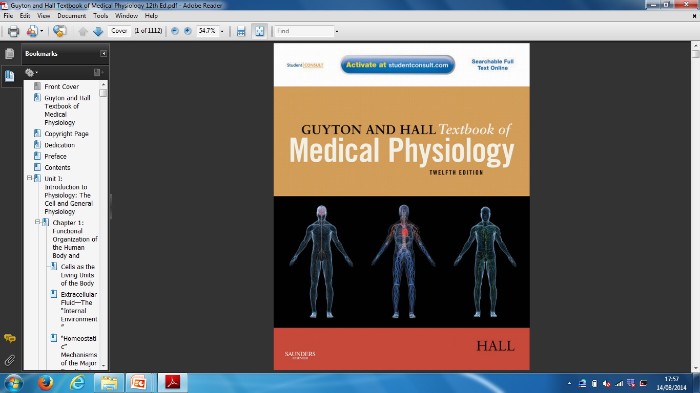
11th
12th

Slide 5
Functional Organization of the Human Body

Slide 6
Objectives
Understand the level of body organization
Distinguish the primary tissues and their subtypes
Recognize the regulation of extracellular fluid transport and mixing system

Slide 7
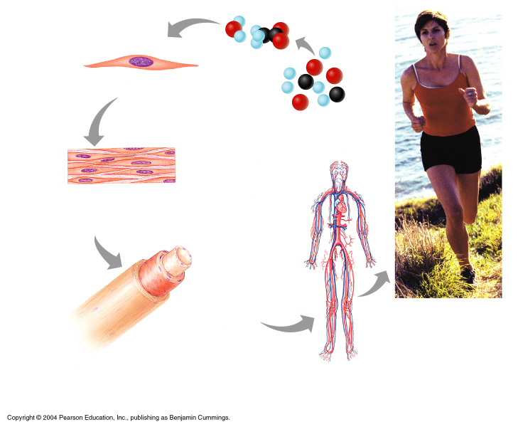
Levels of Structural Organization
Smooth muscle cell
Molecules
2
Cellular level
Cells are made up of molecules
Atoms
1
Chemical level
Atoms combine to form molecules
Smooth muscle tissue
Tissue level
Tissues consist of similar types of cells
Heart
3
Cardiovascular system
Blood vessels
Epithelial tissue
Smooth muscle tissue
Blood vessel (organ)
Connective tissue
6
Organismal level
The human organism is made up of many organ systems
4
Organ level
Organs are made up of different types of tissues
5
Organ system level
Organ systems consist of different organs that work together closely

Slide 8
Levels of Structural Organization
Cells: the basic structural and functional unit
(~ 100 trillion)
Tissues: (e.g. muscles, epithelial, nervous )
Organs: (e.g. kidney, heart, liver, pancreas)
Organ systems: (e.g. cardiovascular, respiratory, urinary)

Slide 9
THE PRIMARY TISSUES
FOUR MAJOR TYPES OF TISSUES IN THE HUMAN BODY:
EPITHELIAL: Covers body surfaces and lines body cavities
CONNECTIVE: Binds and supports body parts
MUSCULAR: Causes body parts to move
NERVOUS: Responds to stimuli and transmits impulses from one body part to another

Slide 10
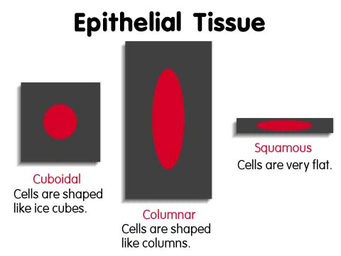
EPITHELIAL TISSUES: covers body, lines cavities
Covers entire body surface and most of the body's inner cavities.
Outer epidermis (skin) protects from injury and drying out
Inner epidermal tissue, on internal surfaces protects, secretes mucus (e.g. along digestive tract)

Slide 11
What are Glands?
Gland: a single cell, or a collection of cells that secrete chemicals. Glands are derived from epithelial membranes.
i. Exocrine glands: secrete into ducts. e.g. the gall bladder is an exocrine gland because it secretes bile in a duct. Sweat glands are exocrine glands.
ii. Endocrine glands: secrete chemicals (especially hormones) into bloodstream (e.g. pituitary gland, pancreas secretes insulin into the blood).

Slide 12
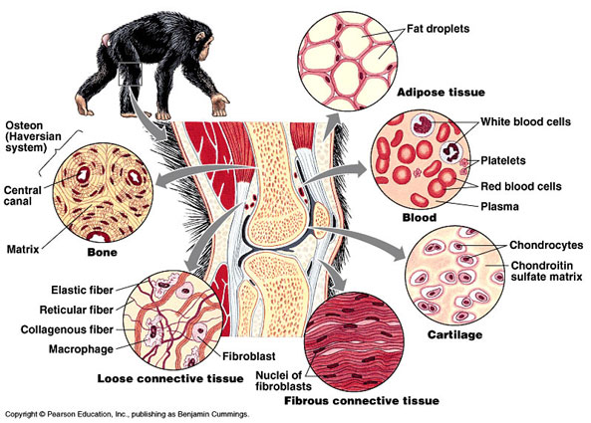
CONNECTIVE TISSUES
Connects organs
Functions:
- bind structures together
- fill up spaces
- provide support and protection
- store fat

Slide 13
Muscle Tissues: Contract for Movement
Skeletal Muscle
Striated
Voluntary
Smooth Muscle
Non-striated
Involuntary
Cardiac Muscle
Striated
Involuntary

Slide 14
Muscle Tissues
SMOOTH MUSCLE:
non-striated,
involuntary control,
found in walls of
internal organs,
intestine, stomach,
blood vessels.
Contracts more slowly,
but can contract over a
longer period of time.
CARDIAC MUSCLE:
striated, involuntary,
forms heart muscle.
Found only in the
heart.
Can contract quickly,
and beats your whole
life through.
SKELETAL MUSCLE:
striated (alternating
light and dark bands)
attached to bones,
used for movement
voluntary control.
Can contract quickly
and strongly but will
fatigue in time.

Slide 15
Nervous Tissues: Conduct Electrochemical Messages
Specialized tissue that forms nerves, brain, spinal cord
Conduct electrical & chemical messages along special cells called neurons. Composed of cell body, dendrites (conduct messages to cell body), axon (send messages away from cell body).

Slide 16
What are Glial cells?
Glial cells are cells that surround nerve cells. They help to support, protect, and nourish nerve cells. They provide nutrients to the neurons and help keep the tissue free of debris.

Slide 17
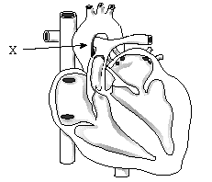
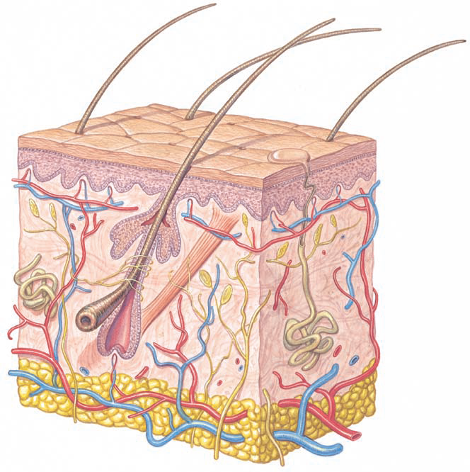
ORGANS: Tissues working together
Organs (e.g. the heart) are made up of one or more types of tissues (usually more).
SKIN is also an example of an organ. It is the largest organ, and has several tissue layers.
Skin covers body surfaces, gives protection from water loss and invasion by microorganisms, contains sense organs, helps to regulate body temperature

Slide 18
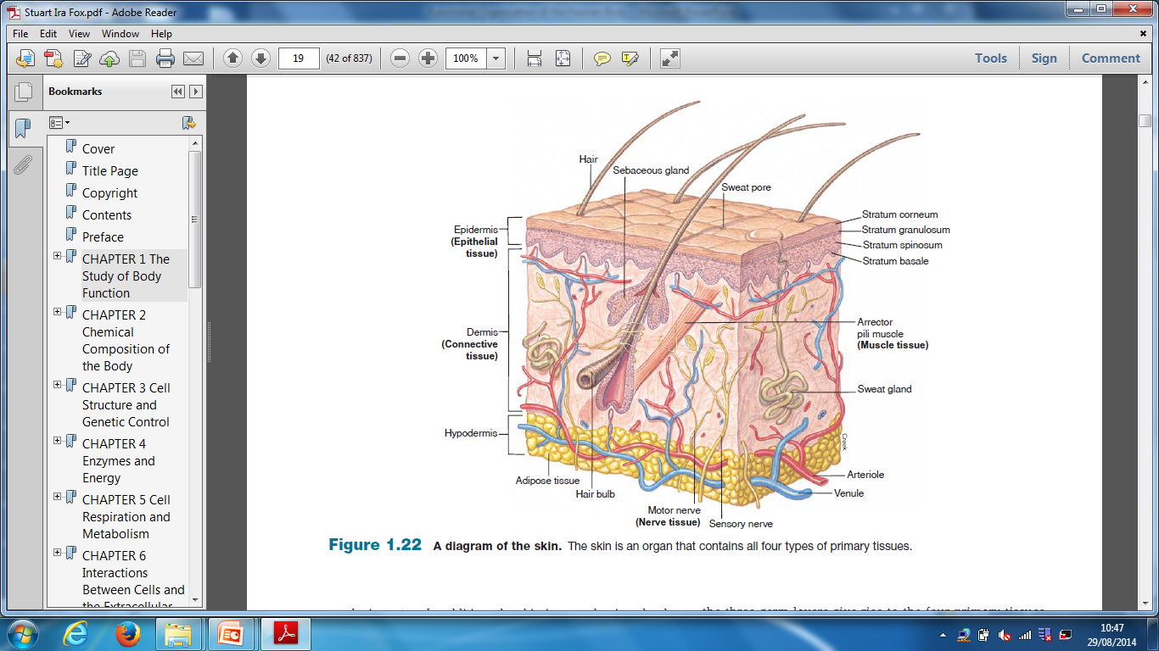
SKIN Organ

Slide 19
Human Organ Systems
Each located in specific location, with specific functions. (e.g. digestive system).
Many internal organ systems enclosed within coelom, a cavity within the body.
Organ systems contribute to maintaining a stable internal environment (homeostasis). e.g. Temp, pH, [glucose], blood pressure.

Slide 20
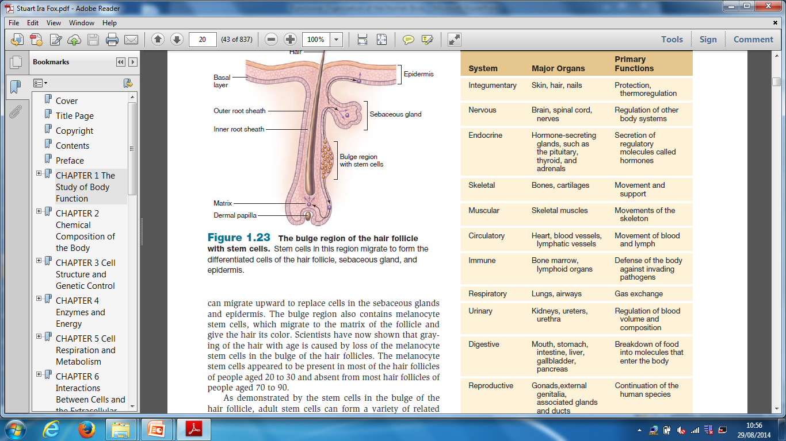

Slide 21
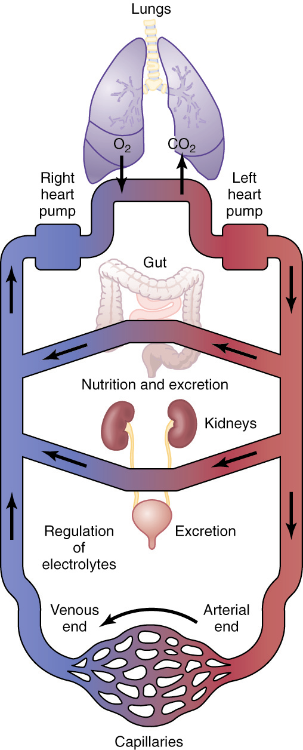
General Organization
of the Circulatory System
Figure 1-1;
Guyton & Hall

Slide 22
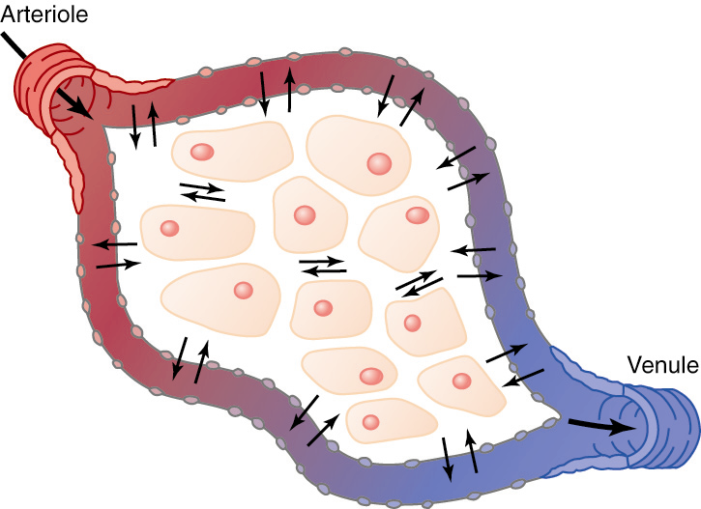
Exchange Between the Capillaries
and Interstitial Fluid
Figure 1-2; Guyton & Hall

Slide 23
Origin of nutrients in the extracellular fluid
Respiratory system: O₂
Gastrointestinal tract:
  Carbohydrates
  Fatty acids
  Amino acids
Liver and other organs
Musculoskeletal system

Slide 24
Removal of Metabolic End–products
CO₂ (by lung)
Urea, uric acid, excess water and ions (kidneys)
others

Slide 25
The End
Thank You

