Slide 1
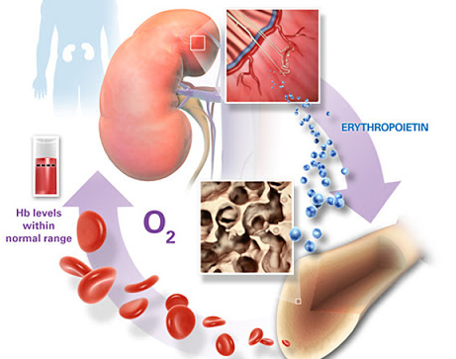
Control of erythropoiesis, iron metabolism, and hemoglobin
TEXTBOOK OF MEDICAL PHYSIOLOGY
GUYTON & HALL 11TH EDITION
UNIT VI CHAPTERS 32
Dr.Salah Elmalik
Department of Physiology
College of Medicine
King Saud University

Slide 2
Objectives of the today’s lecture
At the end of this lecture student should be able to:
1. Describe essential elements needed for RBC formation.
2. Describe the process of Vit B12 absorption and its malabsorption.
3. Recognize the structure and the function of hemoglobin.
4. Understand the metabolism of iron (absorption, storage and transport).
5. Recognize the causes of anemia and polycythemia.

Slide 3
Regulation of Erythropoiesis
Importance
Factors affecting Erythropoiesis
Tissue Oxygenation
Anemia, High Altitudes, heart and lung problems.
ERYTHROPOITEN (EPO)

Slide 4
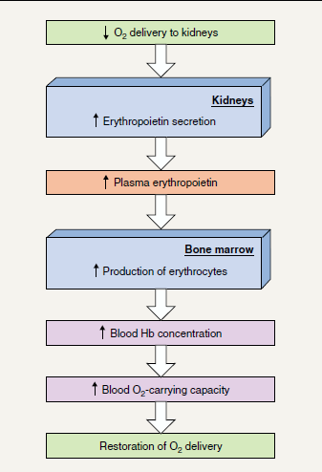
The regulation of RBC production and erythropoietin hormone secretion in response to hypoxia

Slide 5
Regulation of Erythropoiesis
Importance
Factors affecting Erythropoiesis
Tissue Oxygenation
Anemia, High Altitudes, heart and lung problems.
ERYTHROPOITEN
Vitamins
Metals
Proteins
Hormones

Slide 6
Vitamins
Vit B₁₂ & Folic acid
Essential for formation of thymidine triphosphate
Essential building block of DNA
Diminished DNA
Other vitamins : Vit B6, Riboflavin, nicotinic acid, biotin, Vit C, Vit E
Failure of nuclear maturation
Inadequate Erythropoiesis

Slide 7
Minerals
Iron
- Formation of hemoglobin
- Deficiency can lead to anaemia
Copper
Necessary for Iron metabolism
Cobalt
Forms a part of Vitamin B₁₂
Zinc and Manganesium

Slide 8
Amino acids and hormones
Proteins & Amino acids: formation of globin in hemoglobin
–sever protein deficiency results in anaemia
Hormones:
- Testosterone
Growth hormone
Thyroid hormone
Cortisol
Adrenocorticotrophic hormone (ACTH)

Slide 9
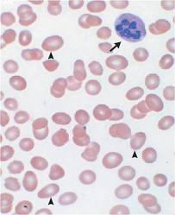
Vitamin B12 & Folic acid
Important for DNA synthesis and final maturation of RBC.
Dietary source: meat, milk, liver, green vegetables.
Deficiency leads to:
Failure of nuclear maturation & division
Abnormally large & oval shape RBC
Short life span
Reduced RBC count & Hb
Macrocytic (megaloblastic) anemia

Slide 10
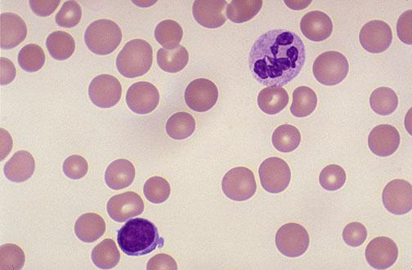
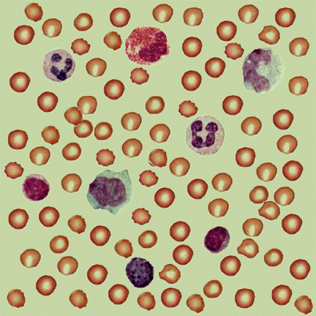
Macrocytic anemia
Normal blood film
Note the hypersegmented neurotrophil and also that the RBC are almost as large as the lymphocyte. Finally, note that there are fewer RBCs.

Slide 11
Malabsorption of Vit. B12
Pernicious Anemia
VB12 absorption needs intrinsic factor secreted by parietal cells of stomach.
VB12 + intrinsic factor are absorbed in the terminal Ileum.
Causes of deficiencies:
Inadequate intake
Poor absorption due to Intestinal disease

Slide 12
Iron metabolism (Fe)
Iron is needed for the synthesis of haemoglobin, myoglobin, cytochrome oxidase, peroxidase & catalase
Total Iron in the body = 4-5g
65% ….. Hemoglobin
4% …….. In the form of myoglobin
1% ……. other heme-containg proteins
0.1% …….. Is combined with transferrin in the bood plasma
15-30% …… stored iron in the form of ferritin in the liver, spleen and bone marrow.

Slide 13
Iron absorption
Iron in food mostly in oxidized form (Ferric, F³⁺)
Better absorbed in reduced form (Ferrous, F²⁺)
Iron in stomach is reduced by gastric acid, Vitamin C.
Rate of iron absorption depend on the amount of iron stored

Slide 14
Transport and storage of iron
Iron is transported in the plasma in the form of Transferrin (apotransferrin + iron).
Iron is stored in two forms:
Ferritin (apoferritin + iron)
Hemosiderin (insoluble complex molecule, in liver, spleen, bone marrow)
Daily loss of iron is 0.6 mg in male & 1.3mg/ day in females.

Slide 15
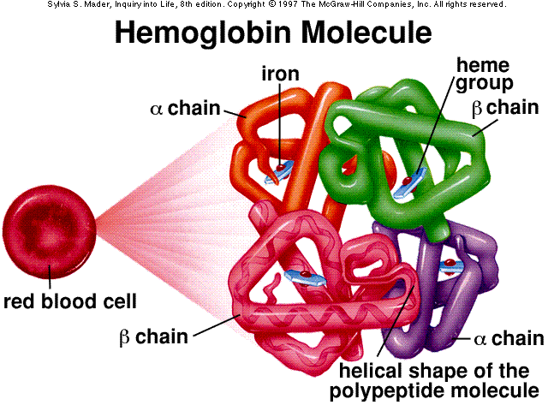
HEMOGLOBIN (Hb)
Each RBC contains 280 million Hb molecules.
Hb molecules consist 4 chains each formed of heme & polypeptide chain (globin).
Heme consist of porphyrin ring + iron (F²⁺).

Slide 16
Types of normal Hb:
-Hb A (2 alpha and 2 beta chains) (adult Hb) (98%).
- Hb A2 (2 alpha and 2 delta chains) (2%)
-Hb F (2 alpha and 2 gamma chains) (Hb of intrauterine life).
-Abnormality in the polypeptide chain - abnormal Hb (hemoglobinopathies) e.g thalassemias, sickle cell (HbS).

Slide 17
Functions of Hemoglobin
Carriage of O2
- Hb reversibly binds O2 to form Oxyhemoglobin, affect by pH, temperatre, H+
Carriage of CO2
- Hb binds CO2 = Carboxyhemaglobin
Buffer

Slide 18
Destruction of RBC
RBC life span in circulation = 120 days.
Metabolic active cells.
Old cell has a fragile cell membrane, cell will rupture as it passes in narrow capillaries (and spleen).
Released Hb is taken up by macrophages in liver, spleen & bone marrow:
Hb is broken into its component:
○ Polypeptide—amino acids (protein pool = storage)
○ Iron ---- stored in liver and bone marrow as ferrtin
○ Heme (Porphyrin)>>—bilirubin>>—secreted by the liver into bile. [excess destruction of RBC ---Jaundice]

Slide 19
Extravascular Pathway for RBC Destruction
(Liver, Bone marrow,
& Spleen)
Phagocytosis & Lysis
Hemoglobin
Globin
Heme
Bilirubin
Amino acids
Fe²⁺
Amino acid pool
Excreted

Slide 20
ANAEMIAS
Definition:
○ Decrease number of RBC
○ Decrease Hb
Symptoms: Tired, Fatigue, short of breath, heart failure.

Slide 21
Physiological Causes of anaemia
1.Blood Loss
–Rapid hemorrhage caused by accident (RBC return to normal 3-6w)
–Chronic blood loss caused by microcytic hypochromic anaemia (iron)
2.Decrease RBC production
Nutritional causes:
•Iron deficiency results in microcytic hypochromic anaemia.
•Vit B12 & Folic acid deficiencies result in megaloblastic anaemia.
Bone marrow failure: destruction by cancer, radiation, and drugs result in Aplastic anaemia.
3.Haemolytic leading to excessive destruction of RBCs
Abnormal cells or Hb
•Hereditary Spherocytosis anemia •sickle cells anemia
Erythroblastosis fetalis.

Slide 22
Polycythemia
(Increased number of RBC)
Types:
1.Primary polycythemia (Polycythemia Vera -(Erythremia):
Uncontrolled RBC production (genetic).
The RBC count can reach 7-8 millions/ mm³ and the hematocrit may be 60 to 70%
2.Secondary polycythemia: secondary to hypoxia caused by high altitude (physiological), chronic respiratory or cardiac disease

Slide 23
Thank you

