Slide 1
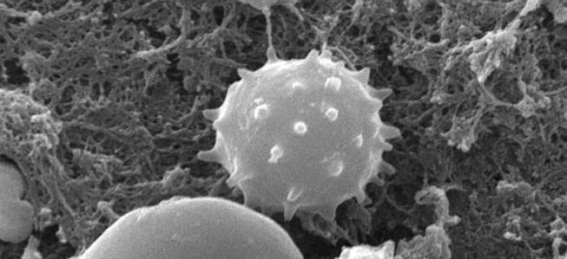
TEXTBOOK OF MEDICAL PHYSIOLOGY
GUYTON & HALL 11TH EDITION
UNIT VI CHAPTERS 33
Dr.Salah Elmalik
Department of Physiology,
King Saud University
White Blood Cells (Leukocytes)

Slide 2
Objectives of Lecture
At the end of this lecture the student should be able to:
Describe the different types of WBCs
Recognize the general functions of WBCs
Describe the genesis and site of formation of WBCs
Describe the role of the neutrophil in defending the body against infections
Describe the process of phagocytosis
Describe the reticuloendothelial system components and function

Slide 3
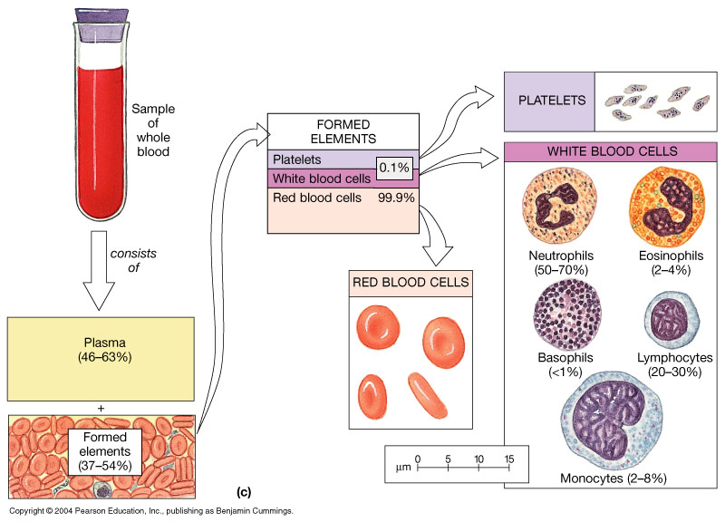
WBCs
Counts 4,000 to 11,000 / mm³

Slide 4
Types of WBCs (Leukocytes)
Classified according to cell morphology and cytoplasmic staining (hematoxylin and eosin )
Granular leukocytes
Neutrophils
Eosinophils
Basophils
Agranular leukocytes
Lymphocytes
Monocytes

Slide 5
General Characteristics & types of WBCs
Granular WBCs (Polymorphonuclear):
1. Neutrophils 62%.
Nucleus 2-5 lobes, purple cytoplasmic granules, main function is phagocytosis
2. Eosinophils 2.3%.
2 lobes nucleus, coarse red granules
Phagocytise allergens
High eosinophil count (eosinophilia):
- Parasitic (hook worm, ascaris, bilharzia) infection.
- Allergy (asthma, rhinitis, drug reaction).
- Allergic skin diseases
Eosinophils attach themselves to the parasites by way of special surface molecules and release substances that kill many of the parasites (by releasing hydrolytic enzymes from their granules)

Slide 6
General Characteristics & types of WBCs
3. Basophils 0.4%.
- Have 2 to 3 lobed nucleus, nucleus hidden by large round bluish granules, smaller than other granulocytes, easy to identify because of the numerous granules in their cytoplasm.
- They are very similar functionally to mast cell.
- Release histamine >>>> inflammation (redness, swelling, and pain)
- Release heparin >>>> anticoagulant (prevent clotting)
- The release of those substances cause local and vascular reactions characteristic of allergic manifestation

Slide 7
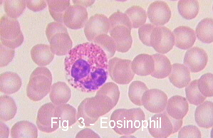
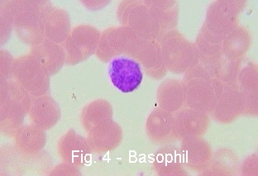
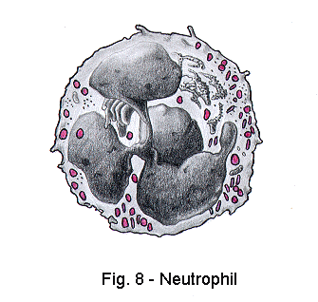
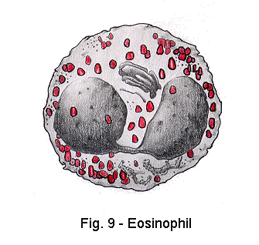
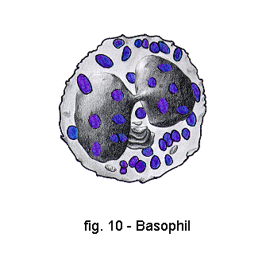

Slide 8
General Characteristics & types of WBCs, cont.
Agranular WBC
Monocytes 5.3%
These cells are the largest of all WBCs.
Kidney-shaped or horse-shoe nucleus, they develop into macrophages that phagocytose bacteria and debris in the tissues.
Lymphocytes 30%
Round and large nucleus which occupies most of the cell, the smallest of all WBCs, immunity cells

Slide 9
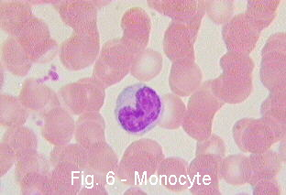
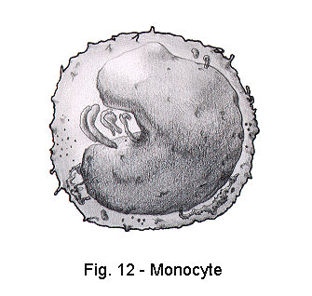
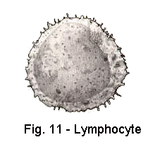

Slide 10
Blood Film
Eosinophil
Monocyte
Neutrophil
Lymphocyte
Basophill

Slide 11
Genesis (Production) of WBCs
Pluripotential hematopoietic stem cell
Committed Stem cell
RBCs WBCs Platelets
Mylocytic Lymphocytic
Lineage Lineage

Slide 12
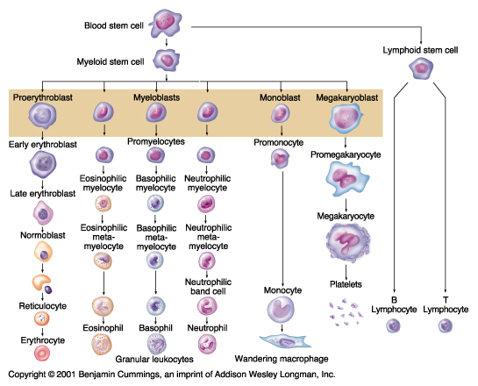
Leukopoiesis

Slide 13
Genesis (Production) of WBCs (leukopoiesis)
Sites of WBC formation:
Granulocytes (neutrophil, basophil, eosinophil):
bone marrow
Agranulocytes
Lymphocytes
bone marrow, thymus, lymphoid tissues
Monocytes
- bone marrow

Slide 14
Life Span of WBCs
Granulocytes:
4 to 8 hrs (transit time ) in blood circulation
4 to 5 days in tissues
In infections life span a few hours
Monocytes:
10 to 20 hrs in blood circulation
Leave capillaries to tissues, increase in size to become tissue macrphages which live for months

Slide 15
Life Span of WBCs-cont.
Lymphocytes:
A few hrs in blood circulation >> tissues >> lymph >>> Blood (Recirculation)
Life span: weeks to months

Slide 16
Defense properties of neutrophil
Attack and destroy invading bacteria, viruses
Sequence of events:
Chemotaxis
Margination
Diapedesis
Amaeboid Motion
Phagocytosis

Slide 17
Chemotaxis
The attraction of the neutrophils to inflamed area following chemotactic substances that are released from the infected site.
Chemotactic substances:
Bacterial toxin
Complement system
Degenerative products of inflamed tissue
Reaction product of plasma clotting

Slide 18
Margination & Diapedesis
WBC marginate along the wall of blood capillaries
WBC squeezes itself through endothelial holes leaving blood capillaries (diapedesis)
WBC move by amoeboid motion towards inflammation area following chemotactic substance released from site of infection
Upon reaching the site of infection,neutrophils start to engulf infecting organisms

Slide 19
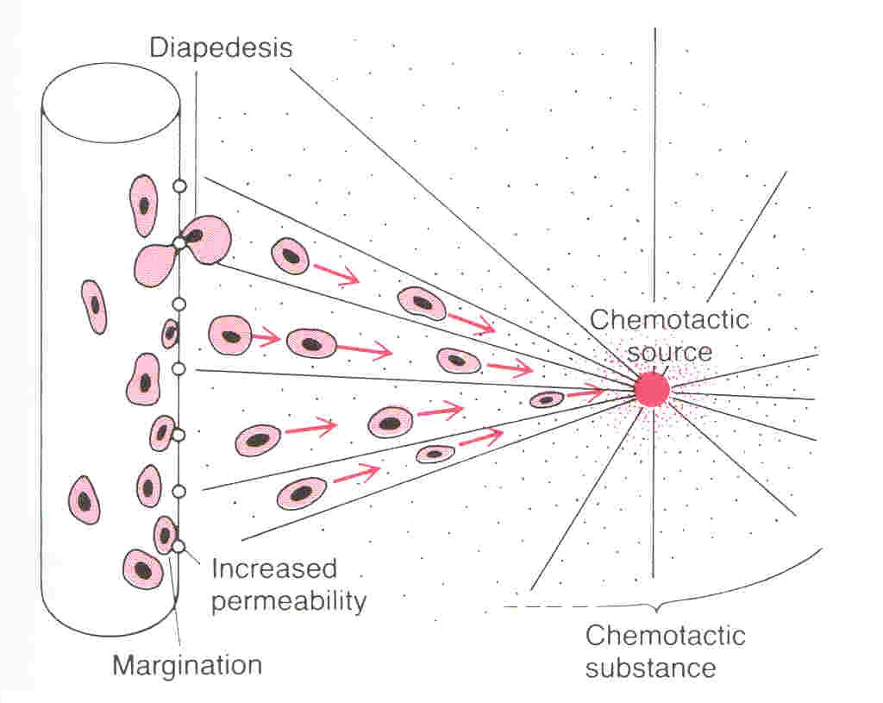
Bacterial or viral toxins, degenerative products of the inflamed tissues

Slide 20
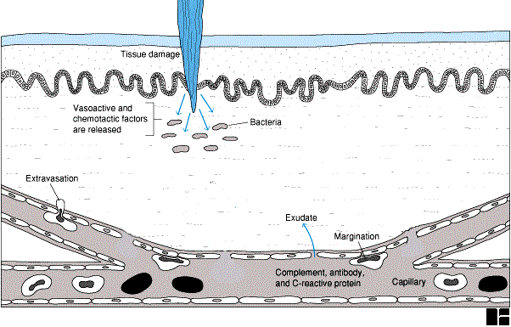
Diapedesis

Slide 21
Phagocytosis
Phagocytosis is selective process:
Foreign substances are recognized by:
Rough surfaces.
Does not have protective protein coats that repel phagocytes.
Marked by certain substance e.g Complement 3 or antibodies making them ready for killing; a process known as opsonization

Slide 22
Phagocytosis by neutrophils
Neutrophils attach to bacteria & encircled it with pseudopodia and take it into a vacuole (phagosome).
One Neutrophil can engulf 3 to 20 bacteria
One Macrophage can engulf up to 100 bacteria
Microbial killing: fusion of neutrophil granules with vacuole,
Discharge of lysosomal enzymes (myeloperoxidase) into the vacuole, killing and digesting the engulfed bacteria.
Release of bactericidal such as: superoxide, hydrogen peroxide to kill the bacteria

Slide 23
Microbial killing

Slide 24
Reticuloendothelial system (RES)
It is an essential component of the immune system, comprised of phagocytic cells located in different organs of the human body
Consists of:
Monocytes
Mobile and fixed macrophages
Endothelial cells (bone marrow, spleen, lymph nodes)
Located in all tissues especially: skin
(histocytes), liver (kupffer), spleen, bone marrow, lymph nodes, lung

Slide 25
Functions of Reticuloendothelial system (RES)
Phagocytosis: Bacterial, dead cells, foreign particles
2. Breakdown of Hb
3. Immune function: processing antigen and antibodies production (indirect)
4. Storage of iron

Slide 26
Lymphocytes formation and maturation
Lymphopoiesis
Stem cell
(thymus, lymphoid tissue & bone marrow)
lymphoblast
intermediate pyronophilic blast cells
lymphocytes

Slide 27
Lymphocytes (Immune cells)
Two types:
B-Lymphocytes (plasma cells)
(Thymus independent, B-cell immunity), Produce antibodies (Humoral Immunity)
T- lymphocytes
(Thymus dependent, T-cell immunity), Cellular mechanisms, (Cellular Immunity)
Types of T-lymphocytes:
T-helper
T-cytotoxic

Slide 28
Leukocytosis (Increased WBC Count)
Causes:
Physiological
Diurnal: ↓ morning ↑ evening
After physical exercise
Stress or during labour and pain
Disease (pathological)
Bacterial infections (tonsillitis, appendicitis)

Slide 29
Leukopenia (Decreased WBC Count)
Causes:
Malnutrition
Typhoid fever
Depressed bone marrow
Deficiency of Vit B12 or folic acid

Slide 30
Leukaemia
Cancer of white blood cells due to chromosomal abnormality caused by chemicals, radiation, and viruses.
WBC more than 50,000
Types of leukaemia:
– Myeloblast leukaemia cancerous production of young myeloid cells
– Lymphoblast leukaemia cancerous production of lymphocytic cells
Acute or chronic onset
Accompanied with anaemia, bleeding

Slide 31
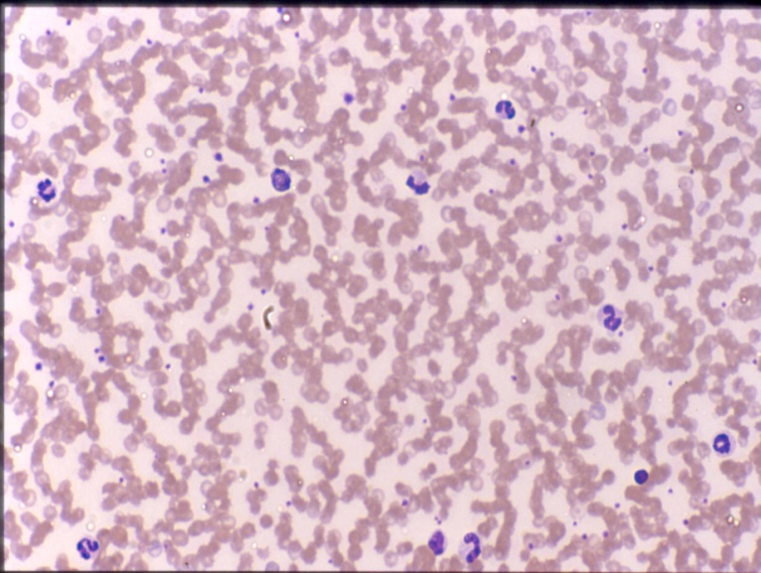
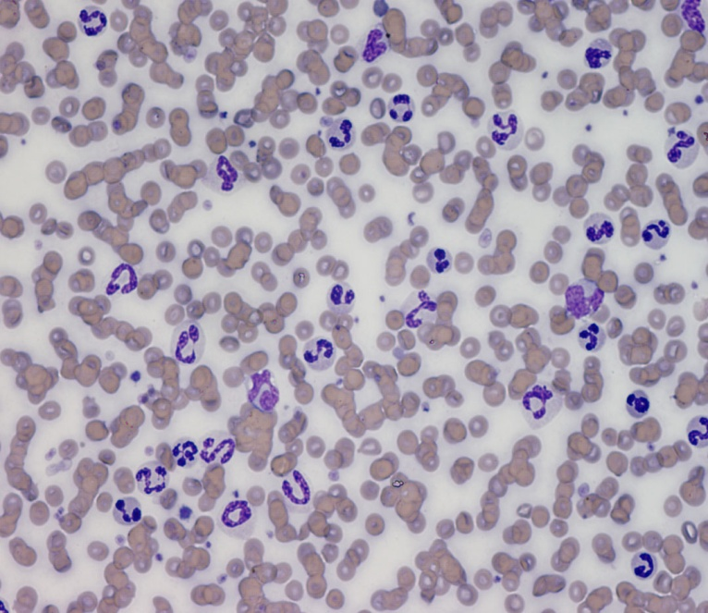
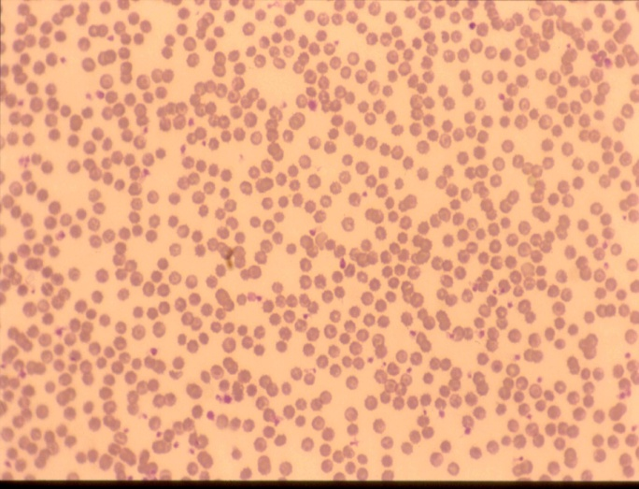
Leukocytes Estimation
Normal number
Increased
Decreased

Slide 32
Functions of Leukocytes- WBC Summary
Defence of the body against infections and foreign invadors
Neutrophils & monocytes (Blood macrophages)- Phagocytosis/ + Immunity
Macrophage (RES) system Phagocytosis + Immunity
Lymphcytes ….. IMMUNITY

Slide 33
THANK YOU
لكم جزيل الشكر

