Slide 1
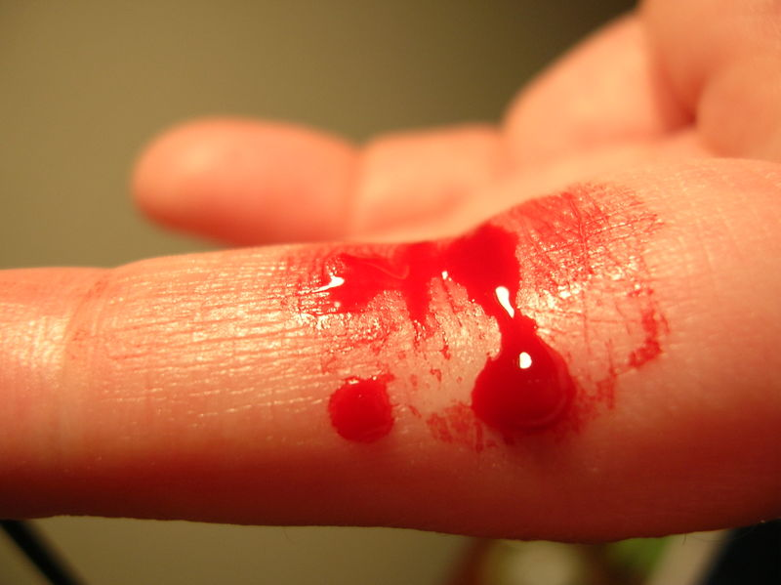
Haemostasis
TEXTBOOK OF MEDICAL PHYSIOLOGY
GUYTON & HALL 11TH EDITION
UNIT VI CHAPTER 36
Dr.Salah Elmalik
Department of Physiology
College of Medicine
King Saud University

Slide 2
Haemostasis or Hemostasis
NOT
Homeostasis
The ability to maintain a constant internal environment in response to environmental changes

Slide 3
Objectives
At the end of this lecture student should be able to:
Describe the formation and development of platelets
Recognize different mechanisms of hemostasis
Describe the role of platelets in hemostasis.
Recognize different clotting factors
Describe the cascades of intrinsic and extrinsic pathways for clotting.
Recognize process of fibrinolysis and function of plasmin

Slide 4
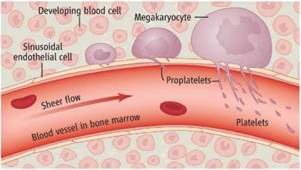
Megakayocyte and platelets formation

Slide 5
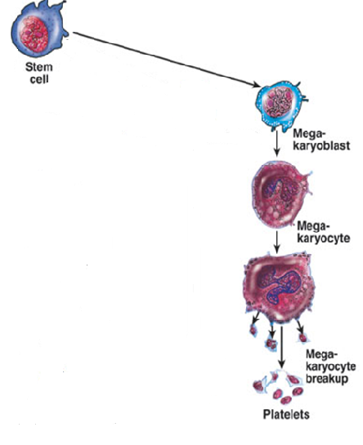
Platelets – cont.
Site of formation:
(Bone marrow)
Myeloid stem cell
Megakaryoblast
Megakaryocyte
Platelets

Slide 6
Platelets (Thrombocytes)
They are fragments of megakaryocytes formed in the bone marrow. Their production (thrombopoiesis) is regulated by Thrombopoietin, a hormone released from the liver

Slide 7
Platelets - cont
Are round/oval disc with diameter about 2-3 µm
Coated by a glycoprotein layer which prevents their sticking to normal endothelial cells
Platelet count = 250,000-500,000/ mm³
life span 8-12 days
Active cells contain contractile protein such as actin, myosin, and thrombosthenin
Contain high calcium content & rich in ATP

Slide 8
Hemostasis:
prevention or stoppage of blood loss.
Hemostatic Mechanisms:
Vessel wall (Vasoconstriction)
Platelets (Production and activation, Platelets Plug formation)
Blood coagulation
Clot formation (intrinsic & extrinsic pathways)
4. Fibrinolysis

Slide 9
Lumen of blood vessel
Platelets
Intact endothelium

Slide 10
Memostatic Mechanisms
Vessel wall
Immediately After injury a localized Vasoconstriction of smooth muscles
Mechanism
-Humoral factors:
local release of thromboxane A2 & serotonin (5HT) from platelets
Systemic release of adrenaline
- Nervous reflexes (pain nerve impulses)

Slide 11
Platelet plug formation

Slide 12
Platelet Functions
Begins with Platelet activation

Slide 13
Platelet Activation
Adhesion
Shape change
Aggregation
Release
Clot Retraction

Slide 14
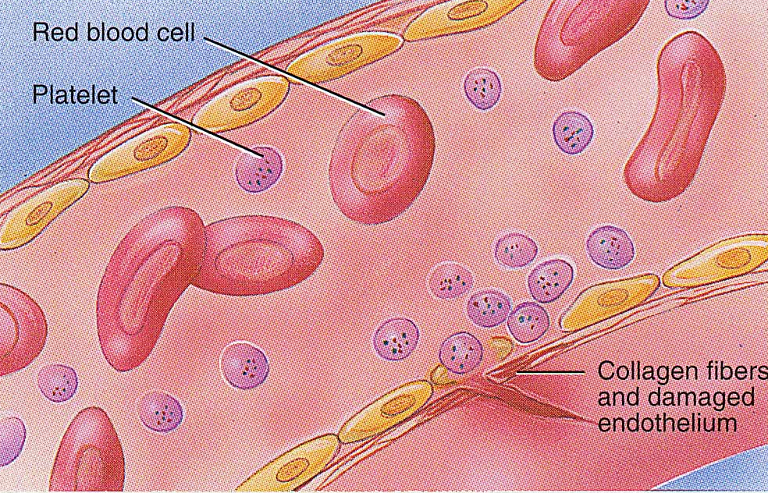
Platelet Adhesion
Platelets stick to the exposed collagen underlying damaged endothelial cells in vessel wall

Slide 15
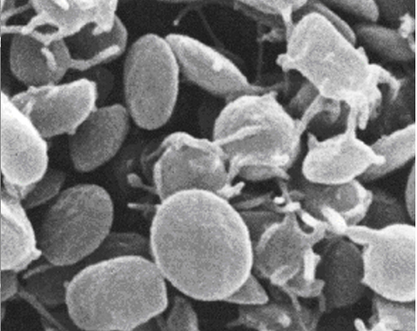
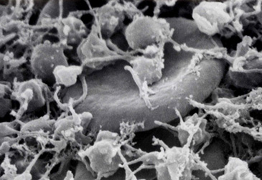
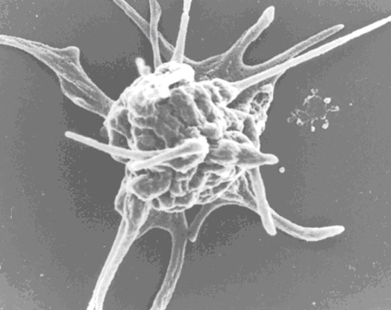
Platelet shape change and Aggregation
Resting platelet
Activated platelet

Slide 16
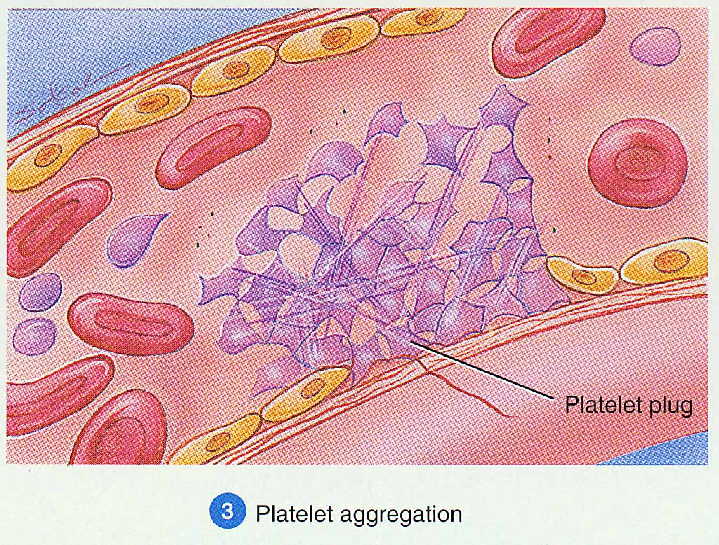
Platelet Aggregation
Activated platelets stick together and activate new platelets to form a mass called a platelet plug
Plug reinforced by fibrin threads formed during clotting process

Slide 17
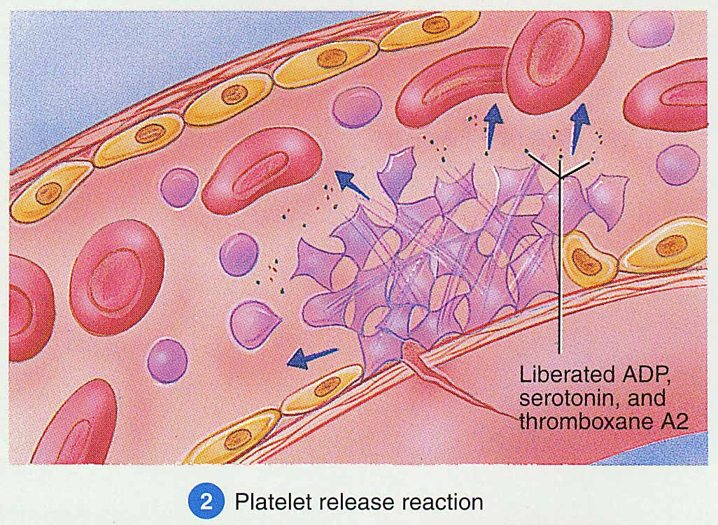
Platelet Release Reaction
Platelets activated by adhesion
Extend projections to make contact with each other
Release thromboxane A2, serotonin & ADP activating other platelets
Serotonin & thromboxane A2 are vasoconstrictors decreasing blood flow through the injured vessel. ADP causes stickiness

Slide 18
Platelet plug formation

Slide 19
Platelet Plug
Aggregation of platelets at the site of injury to stop bleeding
Exposed collagen attracts platelets
Activated platelets release ADP & Thromboxane A2 (TXA2) → ↑ the stickiness of platelets → ↑ Platelets aggregation → plugging of the cut vessel
Intact endothelium secretes prostacyclin → inhibition of aggregation

Slide 20
Activated Platelets
Secrete:
5HT → vasoconstriction
Platelet phospholipid Factor (PF3) → clot formation
Thromboxane A2 (TXA2) is a prostaglandin formed from arachidonic acid
Function:
Vasoconstriction
Platelet aggregation
(TXA2 inhibited by aspirin)

Slide 21
Platelets aggregation

Slide 22
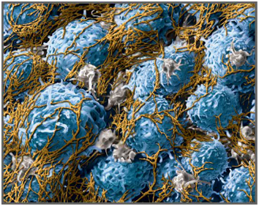
Coagulation: Formation of fibrin meshwork (Threads) to form a
CLOT

Slide 23
Clotting Factors
Names | Factors
Fibrinogen Prothrombin Thromboplastin (tissue factor) Calcium Labile factor Stable factor Antihemophilic factor Antihemophilic factor B Stuart-Prower factor Plasma thromboplastin antecedent (PTA) Hageman factor Fibrin stablizing factors | I II III IV V VII VIII IX X XI XII XIII

Slide 24
The Coagulation Cascades
Intrinsic pathway
Extrinsic pathway
Activators:
Collagen and damaged endothelium
Common pathway
Activator:
Tissue factor (III) (Thromboplastin)
XII XII activated
X X activated
V, Ca,
Phospholipids
VII VII activated
XI XI activated
III,
Ca,
Phospholipids
Prothrombin activator
Ca
IX IX activated
Prothrombin Thrombin
IX activated, VIII
Ca,
Phospholipids
Fibrinogen Fibrin
XIII
Ca
Insoluble fibrin

Slide 25
Blood coagulation (clot formation)
A series of biochemical reactions leading to the formation of a blood clot within few seconds after injury
Prothrombin (inactive thrombin) is activated by a long intrinsic or short extrinsic pathways
This reaction leads to the activation of thrombin enzyme from inactive form prothrombin
Thrombin will change fibrinogen (plasma protein) into fibrin (insoluble protein)

Slide 26
Intrinsic pathway
The trigger is the activation of factor XII by contact with foreign surface, injured blood vessel, and glass.
Activated factor XII will activate factor XI
Activated factor Xl will activate IX
Activated factor IX + factor VIII + platelet phospholipid factor (PF3)+ Ca activate factor X
Following this step the pathway is common for both intrinsic and extrinsic

Slide 27
Extrinsic pathway
Triggered by material released from damaged tissues (tissue thromboplastin)
Tissue thromboplastin + VII + Ca → activate X
Common pathway
Activated factor X + factor V +PF3 + Ca activate prothrombin activator; a proteolytic enzyme which activates prothrombin.
Activated prothrombin activates thrombin
Thrombin acts on fibrinogen and change it into insoluble thread like fibrin.
Factor XIII + Calcium → strong fibrin (strong clot)

Slide 28
Activation of Blood Coagulation
Intrinsic Pathway: all clotting factors present in the blood
Extrinsic Pathway: triggered by tissue factor (thromboplastin)
Common Pathway

Slide 29
Thrombin
Thrombin changes fibrinogen to fibrin
Thrombin is essential in platelet morphological changes to form primary plug
Thrombin stimulates platelets to release ADP & thromboxane A2; both stimulate further platelets aggregation
Activates factor V

Slide 30
Fibrinolysis
Formed blood clot can either become fibrous or dissolved.
Fibrinolysis (dissolving) = Break down of fibrin by naturally occurring enzyme plasmin therefore prevent intravascular blocking.
There is a balance between clotting and fibrinolysis
Excess clotting → blocking of Blood Vessels
Excess fibrinolysis → tendency for bleeding

Slide 31
Released from injured tissues and vascular endothelium
Fibrinolysis
Tissue Plasminogen Activator (t-PA)
Plasminogen
Plasmin
(Protein in the blood)
Anti-activators
Fibrinolysis
Anti-plasmin
Fibrinogen
Fibrin
Thrombin
FDP*
FDP*: Fibrin Degradation Products

Slide 32
Plasmin
Plasmin is present in the blood in an inactive form plasminogen
Plasmin is activated by tissue plasminogen activators (t-PA) in blood.
Plasmin digests intra & extra vascular deposit of Fibrin → fibrin degradation products (FDP)
Unwanted effect of plasmin is the digestion of clotting factors

Slide 33
Plasmin
Plasmin is controlled by:
Tissue Plasminogen Activator Inhibitor (TPAI)
Antiplasmin from the liver
Uses:
Tissue Plasminogen Activator (TPA) used to activate plasminogen to dissolve coronary clots

