Slide 1
Cell Membrane Structure and Transport Across Cell Membrane
Dr Mohammed Alotaibi, MRes, Ph.D.

Slide 2
Objectives
At the end of this session, the students should be able to:
Describe the fluid mosaic model of membrane structure and function
Define permeability and list factors influencing permeability
Identify and describe carried‐mediated transport processes: Primary active transport, secondary active transport, facilitated diffusion.

Slide 3
Organization of the Cell
Figure 2-1

Slide 4
Cell membrane
It covers the cell.
It is a fluid and not solid.
It is 7-10 nanometer thick.
It is also referred to as the plasma membrane.
Composition
Phospholipids 25 %
Cholesterol 13 %
Glycolipids 4 %

Slide 5
The Cell Membrane Phospholipids
hydrophilic
“head”
hydrophobic
FA “tail”

Slide 6
The Cell Membrane Structure
Organized in a bilayer of phospholipid molecules
1. Glycerol head (hydrophilic).
2. Two fatty acid ‘’tails’’ (hydrophobic).
Heads (hydrophilic) facing ICF and ECF and tails (hydrophobic) face each other in the interior of the bilayer (Amphipathic)

Slide 7
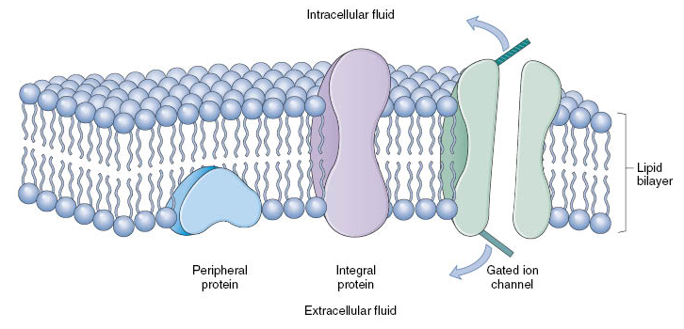
The cell membrane proteins
Integral proteins span the membrane
- Proteins provide structural channels or pores
2. Peripheral proteins (carrier proteins)
‐ Present in one side
‐ Hormone receptors
‐ Cell surface antigens

Slide 8
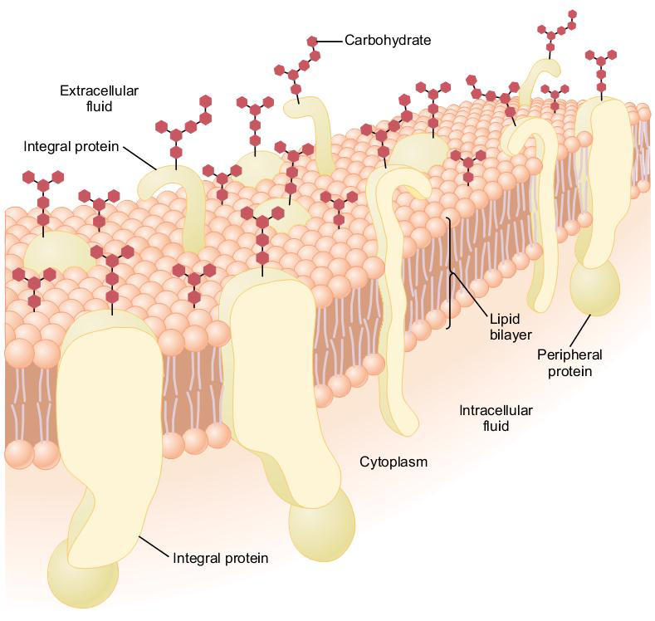
The cell membrane carbohydrates
- Glycoproteins (most of it )
- Glycolipids (1/10)
- Proteoglycans (mainly carbohydrate substance bound together by protein)
Glycocalyx (loose coat of carbohydrates)
- ‘’glyco’’ part is in the surface forming

Slide 9
The cell membrane carbohydrates
Function of carbohydrates:
Attaches cell to each others.
Act as receptors substances (help ligand to recognize its receptor )
Some enter into immune reactions.
Give most of cells overall –ve surface.

Slide 10
Cholesterol
present in membranes in varying amounts
controls much of the fluidity of the membrane
increases membrane FLEXIBILITY and STABILITY
(-)
(-)
(-)
(-)
(-)
(-)
(-)

Slide 11
Transport through the cell membrane
Cell membrane is selectively permeable.
Through the proteins.
- water –soluble substances e.g. ions, glucose
Directly through the lipid bilayer.
- fat – soluble substance (O2, CO2, N2, alcohol)

Slide 12
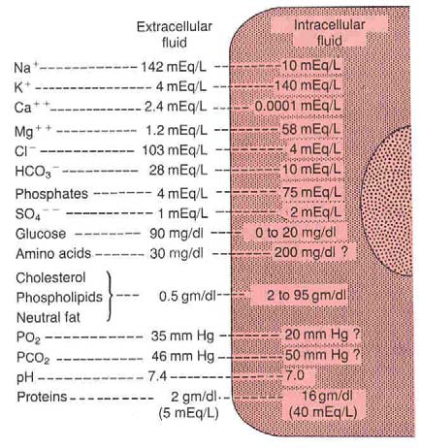
Types of membrane transport
1‐ Diffusion
‐ simple diffusion.
‐ facilitated diffusion.
2‐ Active transport
‐ primary active transport.
‐ secondary active transport.
3‐ Osmosis

Slide 13
Diffusion
Random movement of substance either through the membrane directly or in combination with carrier protein down an electrochemical gradient
1‐ Simple diffusion
2‐ Facilitated diffusion

Slide 14
Simple Diffusion

Slide 15
Simple Diffusion
- Non carrier mediated transport down an electrochemical gradient
- Diffusion of non-electrolytes (uncharged) from high concentration to low concentration
- Diffusion of electrolytes (charged) depend on both chemical as well as electrical potential difference
Through the interstices of the lipid bilayer if the diffusing substance is lipid-soluble
Through watery channels if lipid-insoluble

Slide 16
Simple Diffusion
Rate of simple diffusion depends on:
1‐ Amount of substance available
2‐ The number and sizes of opening in the membrane for the substance (selective gating system)
3‐ Chemical concentration difference
net rate of diffusion= P x A (Co‐Ci)
(P = permeability constant , A = membrane surface area)
4‐ Electrical potential difference, EPD= ± 61 log C1/C2
5‐ Molecular size of the substance
6‐ Lipid solubility
7‐ Temperature

Slide 17
Facilitated diffusion
• e.g. Glucose, most of amino acids
High concentration
Low concentration
Substance → binding site → substance protein complex → conformational changes release of substance

Slide 18
Facilitated diffusion
Carrier mediated transport down an electrochemical gradient
Features of Carrier Mediated Transport:
1‐ Saturation: ↑ concentration → ↑ binding of protein
If all protein is occupied we achieve full saturation
2‐ Stereo specificity:
The binding site recognize a specific substance, e.g. D‐glucose but not L‐glucose
3‐ Competition:
Chemically similar substance can compete for the same binding site D‐ galactose, D‐glucose

Slide 19
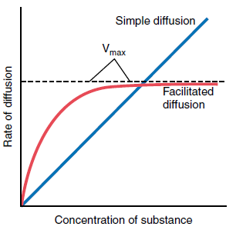
Facilitated diffusion
• Glucose, most of amino acids

Slide 20
Active transport
The net movement of molecules against an electrochemical gradient
Requires energy → direct
→ indirect
Requires carrier protein

Slide 21
Active transport
1‐ Primary active transport
Energy is supplied directly from ATP. ATP → ADP +P+ energy
(A) Sodium‐Potassium pump (Na‐K pump):
It is found in all cell membranes
Na in → out
K out → in

Slide 22
Active transport
Characteristic of the Na‐K pump:
Carrier protein
Binding site for Na inside the cell
Binding site for K outside the cell
It has ATPase activity
3 Na out
2 K in
Function
1. Maintaining Na and K concentration difference
2. It’s the basis of nerve signal transmition
3. Maintaining –Ve potential inside the cell

Slide 23
Active transport
(B) Primary active transport of calcium (Ca ²+ ATPase)
‐ sarcoplasmic reticulum (SR)
‐ mitochondria
‐ in some cell membranes
Function: Maintaining a low Ca²+ concentration inside the cell
(C) Primary active transport of hydrogen ions (H+‐K ATPase)
‐ stomach
‐ kidneys
‐ pumps to the lumen
‐ H+‐K ATPase inhibitors (treat ulcer disease). (omeprazol)

Slide 24
Active transport
2‐ Secondary active transport
Transport of one or more solutes against an electrochemical gradient, coupled to the transport of another solute down an electrochemical gradient
‘’downhill’’ solute is Na.
Energy is supplied indirectly form primary transport.
Co transport:
- All solutes move in the same
direction ‘’ inside cell’’. e.g.
Na ‐ glucose Co transport.
Na – amino acid Co transport
in the intestinal tract kidney.

Slide 25
Active transport
Counter transport:
Na is moving to the interior causing other substance to move out.
Ca²+ ‐ Na+ exchanger (present in many cell membranes)
Na –H+ exchanger in the kidney.

Slide 26
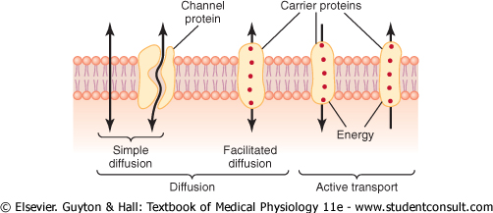
Transport through the cell membrane

Slide 27
The End
Thank You

