Slide 1
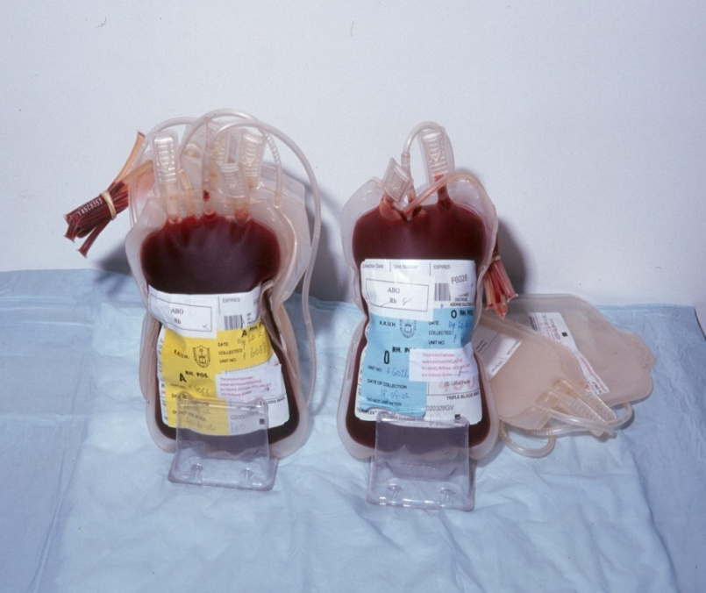
COMPOSITION AND FUNCTION OF BLOOD
TEXTBOOK OF MEDICAL PHYSIOLOGY
GUYTON & HALL 11TH EDITION
UNIT VI CHAPTERS 32-36
Dr.Salah Elmalik
Department of Physiology
College of Medicine
King Saud University

Slide 2
Objectives
At the end of this lecture student should be able to:
Recognize functions of blood
Describe Cellular and non-cellular components of blood
Define Erythropoiesis; leukopoiesis, and thrombopoiesis.
Describe features of RBCs, WBCs, and Platelets.

Slide 3
What is Blood?
Blood is a fluid connective tissue found within the cardiovascular system
accounts for about 8% of TBW
Its volume is 5-6 L in males and 4-5 L in females
Much more dense than pure water
It is slightly alkaline, with a pH of 7.35- 7.45
Its color varies from bright to dark red
It has a salty metallic taste

Slide 4
General Function of the Blood
1- Transportation:
A) Gases: O2 , CO2 , …..
B) Nutrient and metabolic Wastes: Glucose, amino acids, ….
C) Hormones and Enzymes
D) Antibodies
E) Electrolytes and Ions

Slide 5
General Function of the Blood
Cont.
2- Regulation:
A) Temperature regulation
B) pH regulation: By buffering systems found in the blood that maintain the pH between 7.35 to 7.45
C) Electrolytes regulation (Na, K, Cl,…..)
D) Blood pressure regulation: by increasing or decreasing blood flow to the kidneys

Slide 6
General Function of the Blood
Cont.
3- Protection:
A) Defense mechanism: By white blood cells
B) Clotting mechanism: Blood contains materials that stop bleeding when vessels are damaged (Hemostasis)

Slide 7
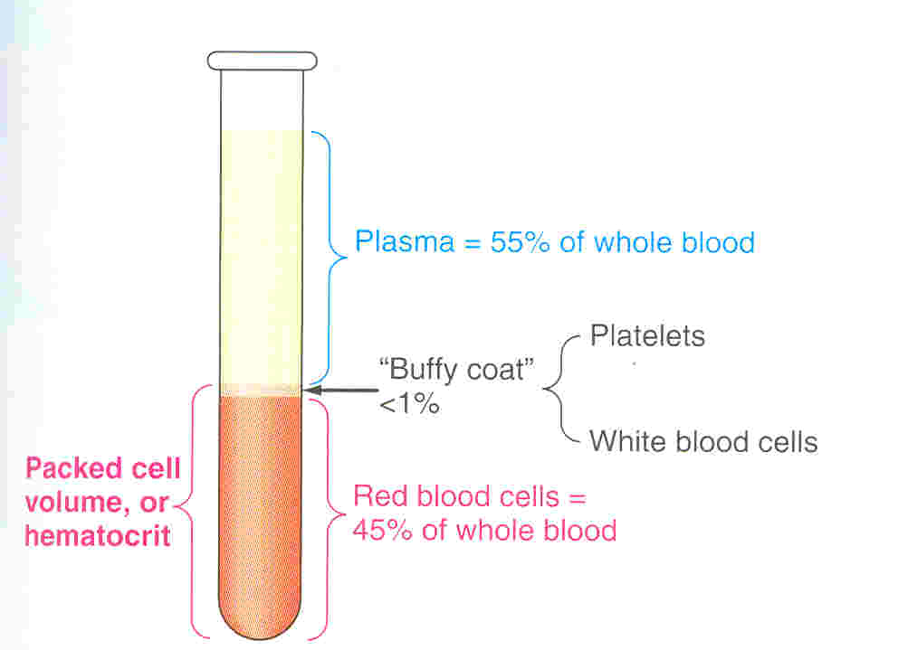
Composition of blood
Blood consists of formed elements that are suspended and carried in a fluid called plasma

Slide 8
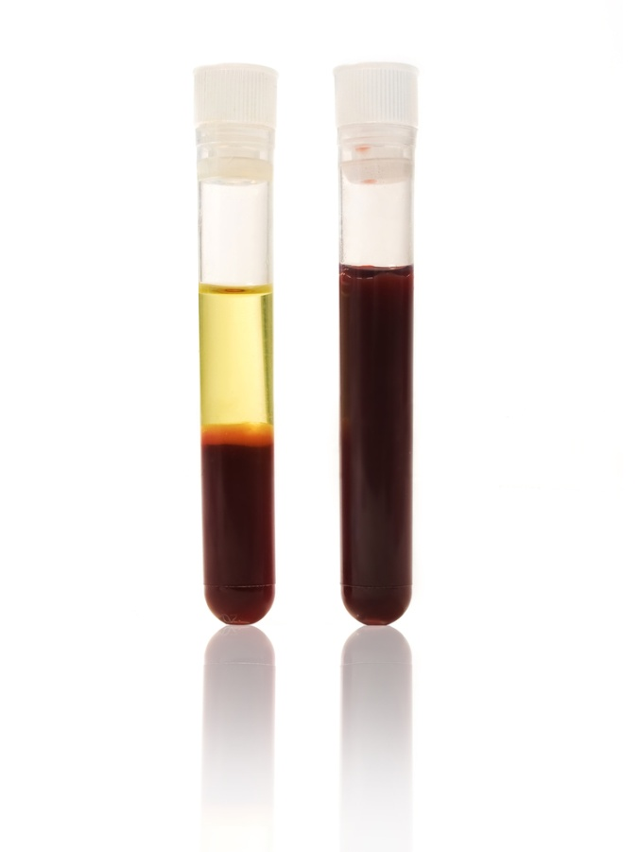
Blood Film
Formed Elements

Slide 9
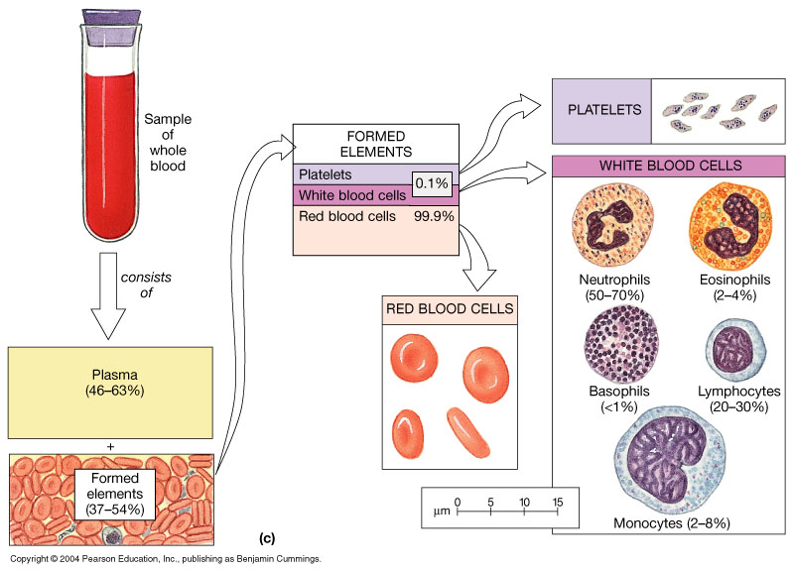
55 %
45 %

Slide 10
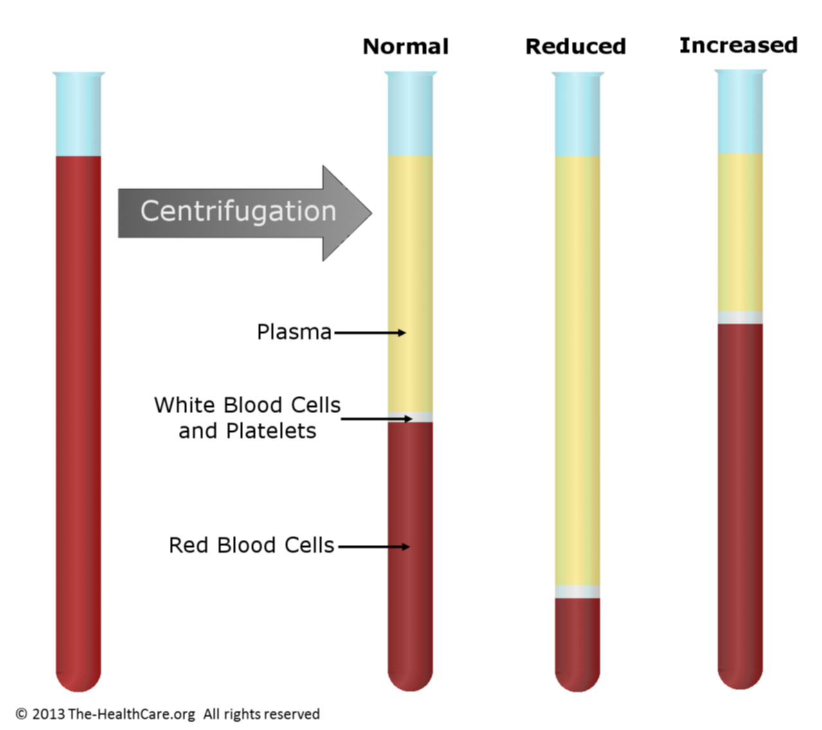
65 %
45 %
15 %
Normal
Anemia
Polycythemia
Hematocrit: is the percentage of blood volume occupied by red blood cells (RBCs)

Slide 12
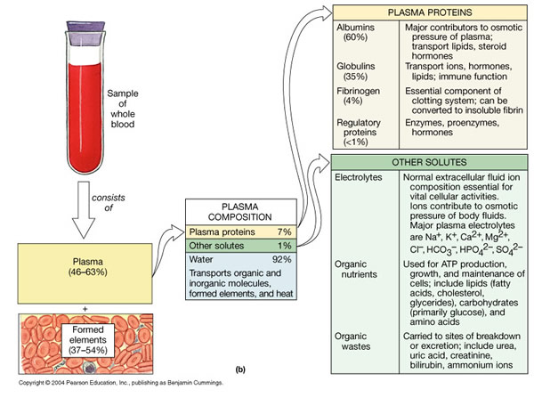
55 %
45 %

Slide 13
Plasma
Straw colored fluid made of water (~92%), other contents include:
Proteins make the bulk of the solutes: manufactured in the liver
- Albumins (60%), are the most abundant type of plasma proteins, maintain the plasma volume by osmotic pressure. ( No edema).
- Globulins (35%), alpha and beta Globulins transport lipids and certain minerals through the bloodstream. Gamma Globulins are antibodies.
- Fibrinogen (4%) for blood clotting

Slide 14
Plasma, cont.
Nutrients: glucose, amino acids, lipids, cholesterol
Electrolytes: Na⁺, K⁺, Ca⁺⁺, Mg⁺⁺, H⁺, Cl⁻, HCO₃⁻, PO₄⁻⁻, SO₄⁻⁻
Waste: urea, creatinine, uric acid, bilirubin
Gases: O₂ , CO₂
Protein bound hormones
Plasma without clotting factors is called “serum”

Slide 15
BLOOD COMPOSITION
Cellular components
Red Blood Cells, RBCs (Erythrocytes)
White Blood Cells ,WBCs (Leukocytes)
Platelets (Thrombocytes)
Plasma
92% water, ions, plasma proteins (Albumin, globulin, Fibrinogen)
Same ionic composition as interstitial fluid

Slide 16
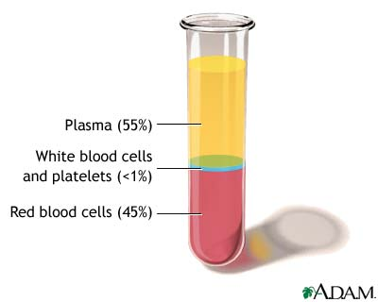
Blood Volume
5 liter in adult
45% is packed cells volume (PCV)
55% is plasma volume

Slide 17
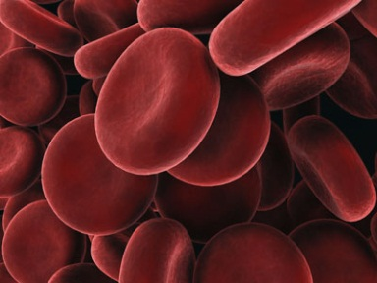
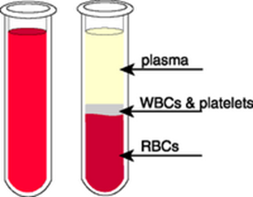
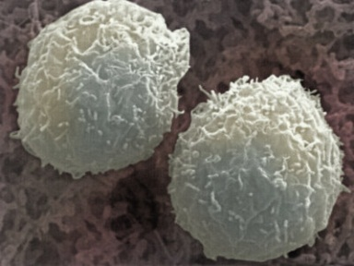
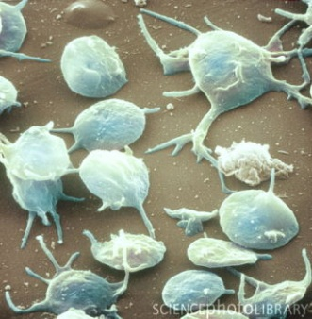
Blood Cells
Each type of blood cell performs a different function
Red blood cells (Erythrocytes)
White blood cells (Leukocytes)
Platelets (Thrombocytes)

Slide 18
Hematopoiesis
• Is a formation of blood cells from stem cells in the red bone marrow (myeloid stem cell) & lymphatic tissue (lymphoid stem cell)
• Erythropoiesis is formation of RBCs – Stimulated by erythropoietin (EPO) from kidney
• Leukopoiesis is formation of WBCs – Stimulated by variety of cytokines
• Thrombopoiesis is formation of platelets

Slide 19
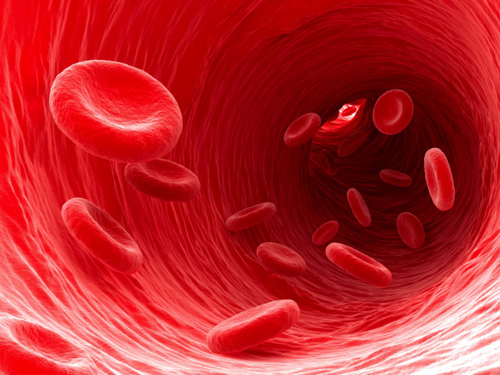
Red Blood Cells
Function
O₂ transport
CO₂ transport
Buffer

Slide 20
Red Blood Cells (Erythrocytes)
Shape & size
Flattened Biconcave Disc
Lack nuclei and mitochondria
Diameter 7-8 µm
Flexible
Life span- 120 days
Number =4.7-5.2 million/ mm³
Notes:
Shape biconcave to provide wide surface area for diffusion.

Slide 21
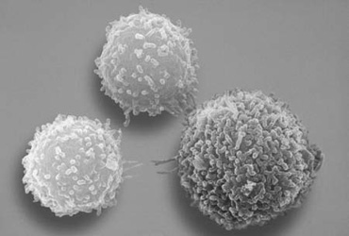
White Blood Cells (Leukocytes)
Shape & size
Have nucleus and mitochondria
Two types: granular and non-granular, Amoeboid
Diapedesis - can "slip between" capillary wall
Number =4,000-11,000 / mm³

Slide 22
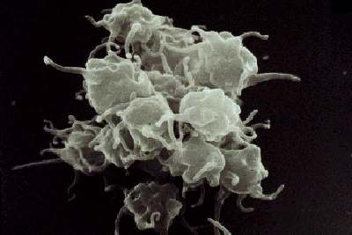
Platelets (Thrombocytes)
Shape & size
Are smallest of formed elements.
Lack nucleus
Irregularly shaped fragments of megakaryocytes, amoeboid.
Diameter: 2-3 µm
Life span- from 5 to 10 days
Essential for clotting
Number =250,000-500,000/ mm³

Slide 23
What we have learnt today?

Slide 24
Objectives
At the end of this lecture student should be able to:
Recognize functions of blood
Describe Cellular and non-cellular components of blood
Define Erythropoiesis; leukopoiesis, and thrombopoiesis.
Describe features of RBCs, WBCs, and Platelets.

