Slide 1
Erythropoiesis
TEXTBOOK OF MEDICAL PHYSIOLOGY
GUYTON & HALL 11TH EDITION
Dr.Salah Elmalik
Department of Physiology
College of Medicine
King Saud University

Slide 2
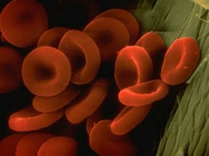
The process of formation of RBCs is called Erythropoiesis

Slide 3
Learning Objectives of Today’s Lecture
At the end of this lecture student should be able to recognize:
Sites of Erythropoiesis
Main features of different stages of Erythropoiesis
Features of mature RBCs
The regulation of RBC production and erythropoietin hormone secretion in response to hypoxia

Slide 4
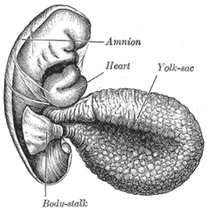
Site of RBC Production
Early weeks of embryonic life:
Nucleated RBCs - Yolk sac

Slide 5
Site of RBC Production, Cont.
Middle trimester of gestation:
Liver form blood cells (mainly)
Spleen + lymph nodes form blood cells
Last month of gestation and after birth:
- Red bone marrow (exclusively)

Slide 6
RBC Production after birth
The bone marrow of all bones - 5 years
Marrow of the long bones (except for the proximal humeri and tibiae) stop producing red blood cells are produced after the age of 20 years.
Most RBCs continue to be produced in the marrow of the membranous bones, such as
Vertebrae, Sternum, Ribs, and Ilia

Slide 7
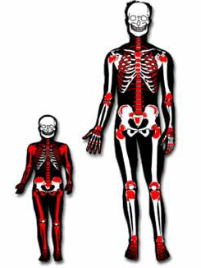

Slide 9
. Production of RBC-cont

Slide 10
Hematopoiesis

Slide 11
Genesis (Production) of RBC
Pluripotential hematopoietic stem cell (PHSC).
Committed stem cell that produces erythrocytes is called Colony-forming unit–erythrocyte, CFU-E
Factors:
Growth inducers, such as interleukin-3
Differentiation inducers.

Slide 12
Stages of Erythropoiesis
PHSC
Comittes stem cell, CFU-E
Proerythroblast
Basophil erythroblast
Polychromatophil erythroblast
Orthochromatophil erythroblast
Reticulocyte
Erythrocyte

Slide 13
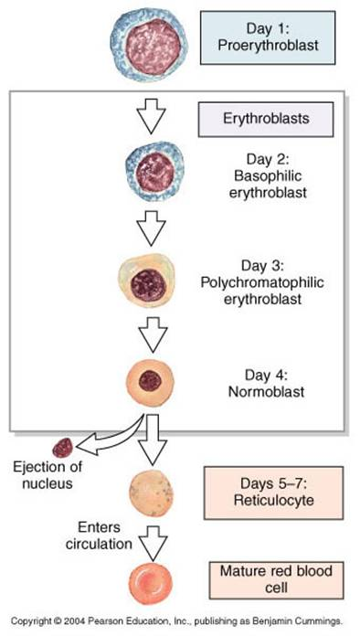
Maturation Times
Erythroblasts actively synthesize Hb. They are categorized on the basis of total size, the amount of Hb present, and the size of nucleus.

Slide 14
Erythropoiesis
RBC development is characterized by:
A decrease in cell size
A disappearance of nucleus
An appearance of hemoglobin

Slide 15
Reticulocyte
Reticulum
Remnant of ER & GA
Contains RNA in the cytoplasm to:
Synthesize Hb
synthesize other proteins
Few Mitochondria
Young RBCs (80% Hb)
< 1 % of RBCs

Slide 16
Stages of differentiation of RBC
Proerythroblast
Basophilic Erythroblast
Polychromatophil Erythroblast
Orthochromatic erythroblast
Reticulocyte
Erythrocyte

Slide 17
Transfer of RBC to Circulation
RBC pass from the bone marrow into the blood capillaries
By
Diapedesis
(squeezing through the pores of the capillary membrane).

Slide 18
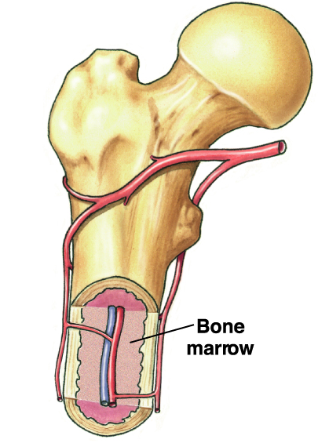
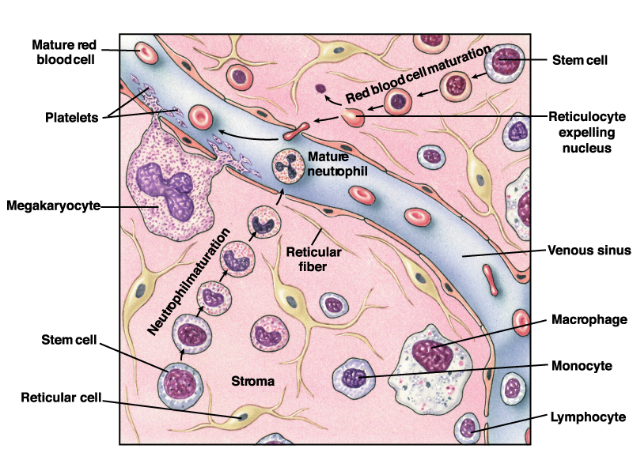

Slide 19
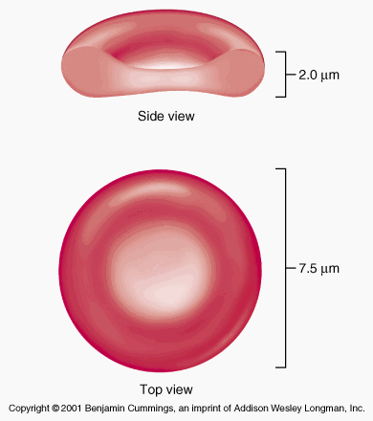
Erythrocytes
Round, biconcave, disc shaped.
Smooth contours
Diameter 7- 8 um.
Normally no variation in size and shape.
Can deform easily
Hb =34g/dl of cells
Hb= 14-16 g/dl in the blood

Slide 20
STRUCTURE OF RBC
Negative surface charge
Bag of fluid with dissolved substances and hemoglobin
Membrane –
Outer glycoprotein coat
Lipid bilayer (PL 55%,Cholesterol 45%)
Inner protein molecules cytoskeleton
Spectrin, Actin, Ankyrin etc.

Slide 21
ENERGY METABOLISM
Less energy required
Utilize Glucose for energy by:
- Anaerobic glycolysis
- Pentose phosphate pathway

Slide 22
RBC Count
MALE :
5,200,000 ± 300000 per mm³ (uL).
FEMALE :
4,700,000 ± 300000 per mm³ (uL).
LIFE SPAN: 120 Days.

Slide 23
Regulation of RBC production
Erythropoiesis is stimulated by erythropoietin (EPO) hormone produced by the kidney in response to hypoxia (low oxygen in the blood)
Hypoxia caused by:
Low RBC count (Anaemia)
Hemorrhage
High altitude
Prolong heart failure
Lung disease

Slide 24
Tissue oxygenation and RBC formation
CFU-E

Slide 25
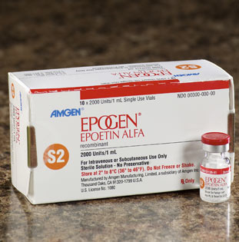
Erythropoietin (EPO)
Glycoprotein
90% of EPO is produced from peritubular fibroblasts in the renal cortex and 10% from the liver
Renal failure or Chemotherapy)? Low levels of EPO

Slide 26
Erythropoietin (EPO)
Glycoprotein
90% of EPO is produced from peritubular fibroblasts in the renal cortex and 10% from the liver
Renal failure?
Stimulate the growth of early stem cells
Can be measured in plasma & urine
High levels of erythropoietin
Anemia, hemorrhage
High altitude
Heart failure
Lung Disease
(Result in polycythemia)

Slide 27
Role of EPO
EPO stimulates increased cell division rates in erythroblasts and stem cells that produce erythroblasts.
EPO speeds up the maturation of RBCs by accelerating the rate of Hb synthesis.
Under maximum EPO stimulation, bone marrow can increase the rate of RBC production tenfold.
Blood doping?

Slide 28
Thank you

