Slide 1
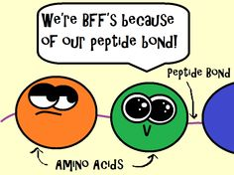
Foundation block
*Learning objectives of amino acids :
What are the amino acids?
General structure.
Classification of amino acids.
Optical properties.
Amino acid configuration.
Non-standard amino acids.
Derivatives of amino acids.

Slide 2
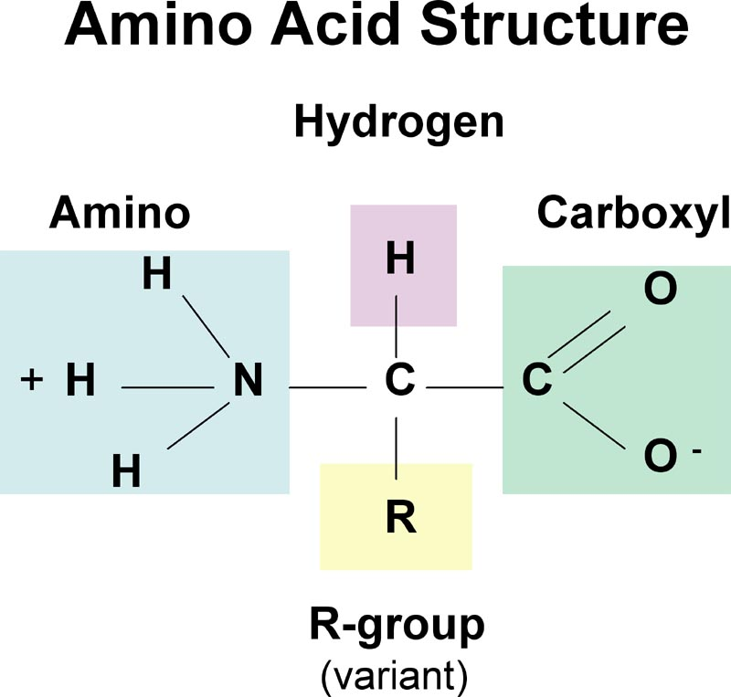
What amino acids are?
*building blocks of proteins .
*Organic acids that contains a side chain(R)
Group “that makes each amino acid different “
,Hydrogen atom and two functional
Groups:
(COOH) Carboxylic group
(NH2) Amino group
*Half of the 20 amino acids can be produced by humans , the other half must be supplied in the food .
*Amino acids plays an intermediates role in metabolism .
Common to all
α-amino acid of proteins

Slide 3
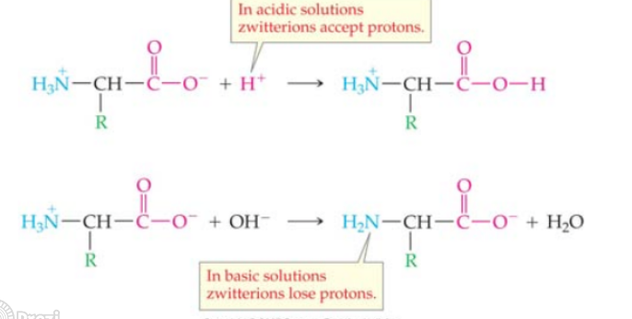
Isoelectric point
In acidic solution-cationic.
In alkaline solution- anionic.

Slide 4
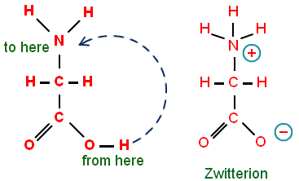
Isoelectric point is the PH at which an amino acid is electrically neutral .
Which means that the sum of the + charge equals the sum of the – charge . (the net charge = ZERO)
The amino acid at isoelectric point is called zwitterion .

Slide 5
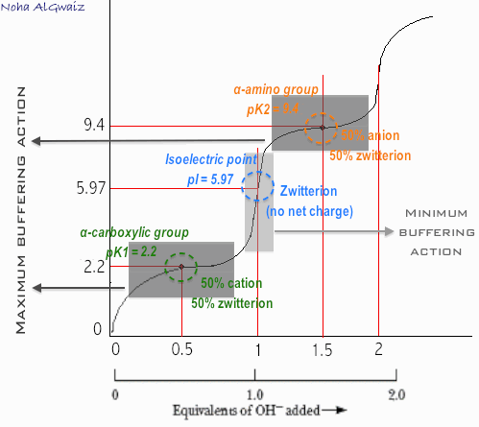
pK Value
- Ability of an acid to donate a proton (how fast it dissociates)
- Known as pKa or Acid Dissociation Constant.
- Carboxylic group = 2.2 (gives proton in LOW pH)
- Amino group = 9.4 (gives proton in HIGH pH)

Slide 7
Non Polar Amino Acids.
This kind of amino acids formed when R group isn’t polar(has no net charge).
So,,what are non polar amino acids??
The amino acids that don’t (give=bind off=participate) protons in hydrogen or ionic bond.
If the protein was located in aqueous solution(hydrophilic environment), the non polar side chains will cluster together in the interior of the protein
On the other hand if it was located in hydrophobic environment, the R groups will be on outside surface interacting with lipid environment.

Slide 8
Examples of non polar amino acids
As you see, PROLINE(secondary amino group) has different structure from other non polar amino acids.
its α-amino group form a ring structure (an IMINO GROUP).

Slide 9
Uncharged amino acids
These amino acids have zero net charge at neutral pH.
Cysteine
Asparagine
Therionine
Glutamine
Tyrosine
serine
The side chains of cysteine and tyrosine can lose a proton at an alkaline ( basic ) pH.
Serine, Therionine and Tyrosine each contain a polar hydroxyl group that can participate in hydrogen bond formation.
The side chains of asparagine and glutamine each contain a carboxyl group and an amide group, both of which can also participate in hydrogen bonds.

Slide 10
Polar amino acids
Amino acids with acidic side chains :
Amino acids with basic side chains:
Histidine
Arginine
Aspartic acid
glutamic acid
Lysine
They are are proton donors.
At neutral pH, these amino acids are fully ionized (negatively charged). So, they are called aspartate and glutamate
They are proton acceptors.
At neutral pH, lysine and arginine are fully ionized (positively charged).

Slide 11
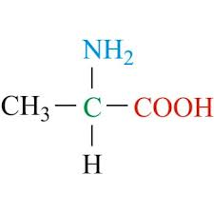
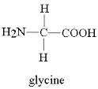
Optical properties
Asymmetrical
symmetrical
α-C attached to 4 different groups
α-C is not attached to different groups
Active
Inactive
The ability to rotate the plane of polarized light in a polarimeter.
The inability to rotate the plane of polarized light in a polarimeter.
All amino acids are optically active except glycine.

Slide 12
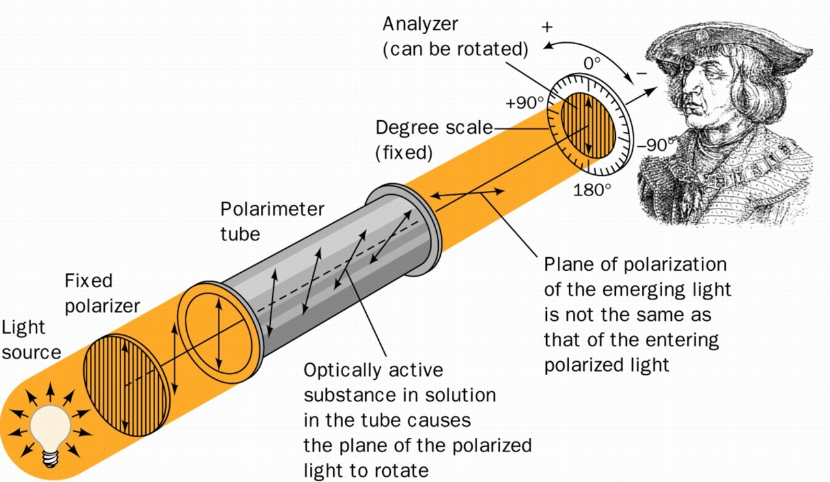
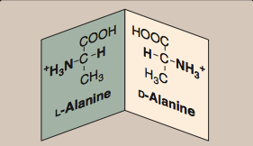
Amino acid configuration
❖ They are chemically the same.
D- Amino Acid | L- Amino Acid
Rotate polarized light to the Right. | Rotate polarized light to the left. | Rotation :
1.Antibiotics. 2. Plants Bacterial cell walls. | Natural amino acid * All mammalian Amino acids are in L- configuration | Found in :

Slide 13
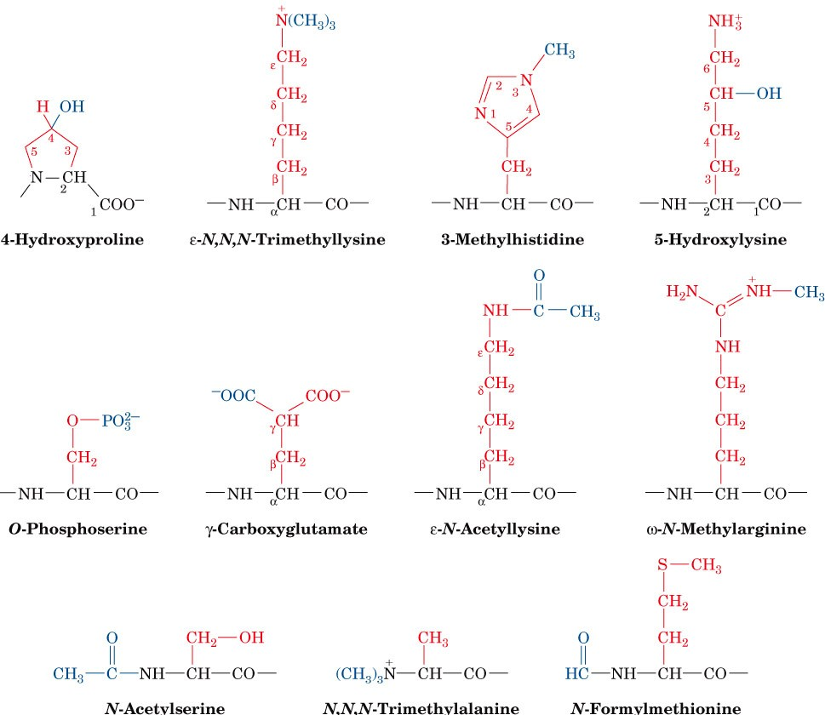
Non-Standard amino acids
Some uncommon amino acid residues that are components of certain proteins

Slide 14
Neurotransmitters
Gamma amino butyric acid (GABA) Derivative of glutamic acid
Dopamine from Tryosine
Mediator of allergic reaction
Thyroid Hormone
Throxine from Tryosine
Histamine from Histidine

Slide 15
Quiz yourself : quiz
Helpful videos:
Amino Acid Structure:
Memorize the 20 amino acids:
Isoelectric Point and Zwitterions:
Our biochemistry heroes:
ريما الرشيد
لمى القحطاني
نجود الرشيد
حنان محمد
رنا البراك
فتون المطيري
ارياف السلمه
شيخة الدوسري
نهى القويز
مشاعل امين
جمانة فطاني
رنا الجنيدل
نوف العريني
محمد الخراز
محمد الدماس
عبدالعزيز السعود
انس الزهراني
محمد المعشوق

