Slide 1
Foundation block..
Molecular biology(1) objectives :
To learn the central dogma of molecular biology.
To have an understanding of the composition, types and structure of DNA and RNA.
To have an idea about the organization of DNA in the chromosome and the role of histone proteins.

Slide 2
The central dogma of molecular Biology: *human genome contain about 35,000 genes *A portion of DNA, called a gene
Nucleic acids :
Required for storage (in form of DNA) and expression (in form of RNA).
its Bulding blocks: nuclueoside triphosphate.
(nucleotides)
Two types of nuclic acids:
DNA(deoxyribonucleic acid)
RNA(ribonucleic acid)

Slide 3
Nucleotides
Nucleotides are composed of :
2-pentose sugar.
3-phosphate group.
1-Nitrogen base.
*Purines:
*Pyrimidines
Adenine(A)
Guanine(G)
Cytosine(C)
Thymine(T)
Uracil(U) in RNA

Slide 4
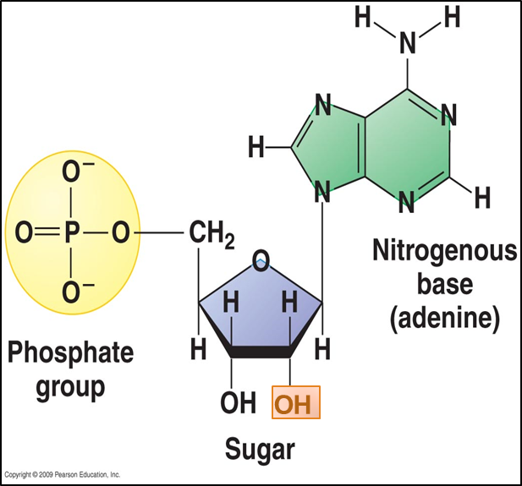
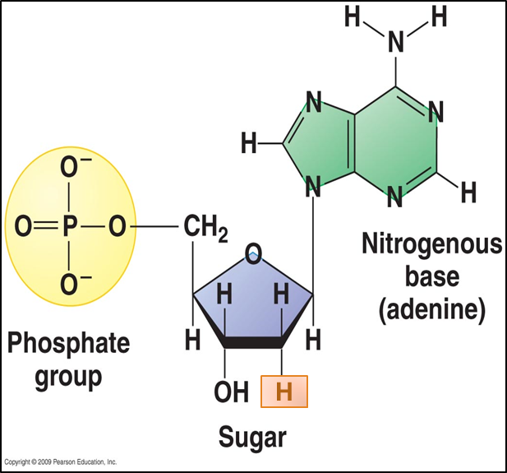
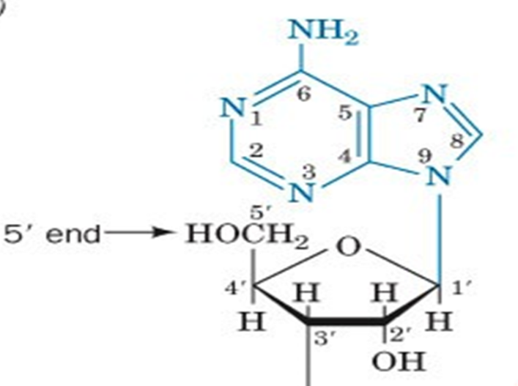
2. Sugar:
pentose with 5 carbon ring:
Ribose (with ــOH at C2)
Deoxyribose
Ribonucleotides
Deoxyribonucleotides
The sugar carbon numbers are primed (1’ 2’ 3’ etc.), while the nitrogenous base atoms are unprimed.
The nitrogenous base is bonded to C1’ of sugar.
The PO4 group is bonded to C3’ or C5’ of sugar.

Slide 5
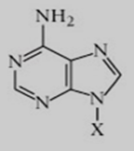
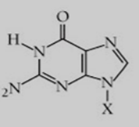
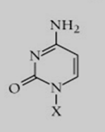
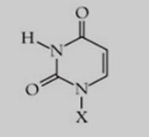
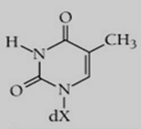
Base Formula | Base (X = H) | Nucleotide (X = ribose phosphate)
 | Adenine | Adenosine monophosphate
 | Guanine | Guanosine monophosphate
 | Cytosine | Cytidine monophosphate
 | Uracil | Uridine monophosphate
 | Thymine | Deoxythymidine monophosphate

Slide 6
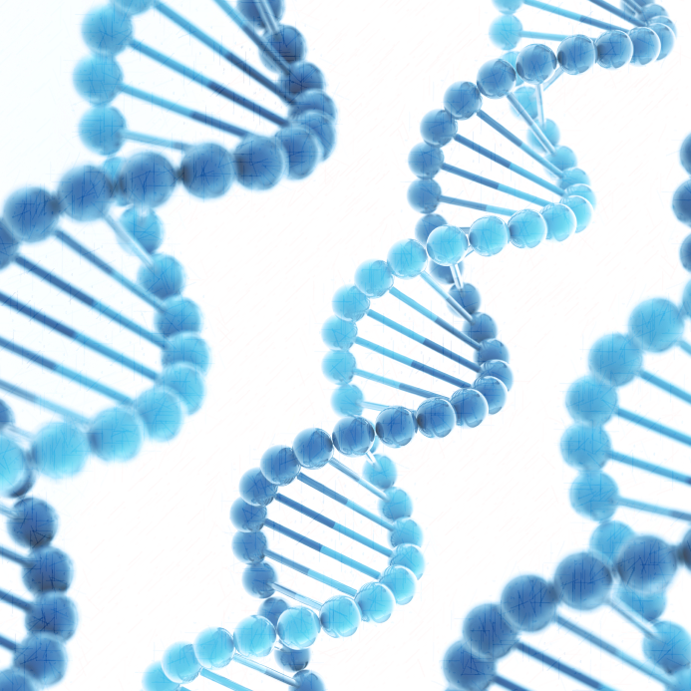
Function of nucleotides
Polymers of nucleotides (as DNA or RNA) store and transfer genetic information.
Free nucleotides and their derivatives perform various metabolic functions not related to genetic information.
Other nucleotides: FAD, NAD, CoA.

Slide 7
((The double helix DNA)) A structure of DNA was first determined by James Watson and Francis Crick in 1953 also know as (Watson- Crick structure)
Chemical structure of DNA & RNA ::
The po4 bridges the 3’ and 5’ positions of ribose sugar.
The backbone of DNA is made from po4 and sugar bonding.
Phosphodiester bond is the linkage between two nucleotides
Note ::
* Nitrogenous base inside the helix and it makes the base pairs.
* We always read from 5’ to 3’

Slide 8
Two polynucleotide chains wind around a common axis to form a double helix.
The two strands are anti-parallel
(5’ to 3’ & 3’ to 5’)
Each strands is right-handed helix
Features of Watson-Crick DNA structure
The helix has 10 base pairs (bp) per turn
Between each base there is hydrogen bonded to form base pair
(A-T & C-G)known as complementary base pairing
Nitrogenous bases (in the center) sugar-phosphate chains (on the sides) of the double helix
The surface of the double helix contains 2 grooves ; major & minor

Slide 10
Watson-Crick base pairs
IN RNA | IN DNA
Adenine (A) Uracil (U) Guanine (G) Cytosine (C) | Adenine (A) Thymine (T) Guanine(G) Cytosine (C)
The bonds between two nitrogen bases are hydrogen bonds ,so they are weak .

Slide 11
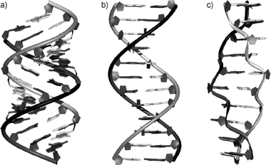
Types of DNA structure
a-DNA
B-DNA
Z-DNA
THIS IS THE Watson-Crick model (B-DNA)
 | A-DNA | B-DNA | Z-DNA
Direction | Right-handed | Right-handed | Left-handed
Helix length | Short | Elongated | More elongated
Major groove | Deep and narrow | Wide | Not real groove
Minor groove | Wide | Narrow | Narrow
Placement of bp | Displaced away from the helical axis | Centred over the helical axis | Zig-zag pattern (nearly perpendicular to the helical axis)
bp per turn | 11 | 10 | 12
Conformation of deoxyribose | C₃ | C₂ | G (C₂) ; C (C₃)

Slide 12
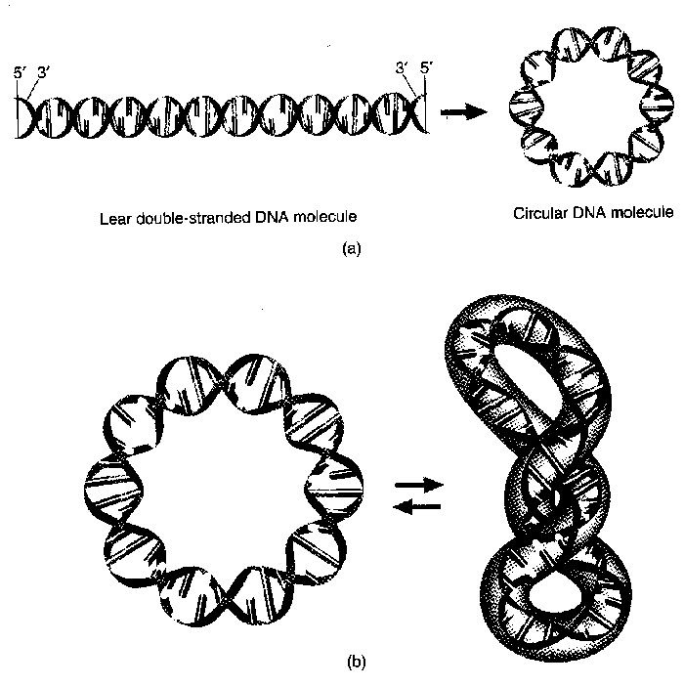
DNA supercoiling:
The chromosomes of many bacteria and viruses contain circular DNA which is supercoiled
What is the Melting temperature (MT) ??
It is the temperature at which the double-stranded DNA is separated into two single strands.
Note that :MT of DNA depends on nitrogenous base content , so the bonds between G-C is stronger than the bonds which is between A-T

Slide 13
What is RNA and It’s Types ?
RNA is a single-stranded polymer of ribonucleotides
The Composition of RNA is:
Ribose sugar which is different from DNA by having oxygen
Nitrogen bases
Phosphate group
mRNA | tRNA | rRNA
Transcription Form DNA into mRNA and this mRNA translate To create protein The codons on mRNA only for one amino acid | tRNA has two ends :: At top : is OH position At down : anticodon position which is complementery to code on mRNA At down tRNA will read codon on mRNA to know which amino acid should it bring at top tRNA will bring amino acid to match the codon on mRNA | Makes up subunits of ribosomes “ which are protein maker “ Site of protein synthesis

Slide 14
DNA organized ?
Nucleus is very small to have a large of DNA so DNA will organized into chromatin
Our DNA contains 3.5 billion base pair “ 95% of DNA is non coding to protein so that mean only 5% are coding with protein
Chromatin is DNA + protein
The kind of this protein is histone(50% of chromatin)
There are 5 major Types of histone :
H1
H2A
H2B
H3
H4
Histone have (+) charge which bind to phosphate (-) charge to keep chromatin more stabilize

Slide 15
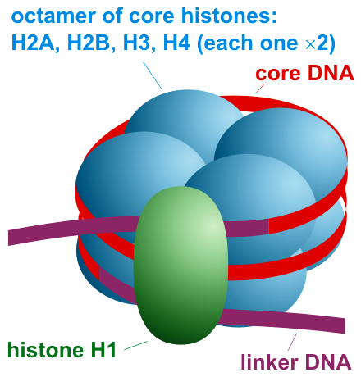
Nucleosomes
What are they?
Nucleosomes are the individual units of chromatin
They consist of a segment of DNA wrapped around a core called histone octamer
( 8 particles of histone protein )
Two particles of each histone ( H2A, H2B, H3 and H4 ) assemble to form the core
While the fifth type of histone H1 forms the bond between the core and the DNA.

Slide 16
A thin strand of DNA called linker DNA links the nucleosomes together.
Nucleofilament is formed when the nucleosomes are foiled and packed.
Nucleofilament is then coiled around a protein called scaffold protein to form chromatin.

Slide 17
Quiz yourself :
quiz
Helpful videos:
Types of RNA :
How DNA is Packaged:
Chromatin, Histones and Modifications:
Our biochemistry heroes:
ريما الرشيد
لمى القحطاني
نجود الرشيد
حنان محمد
رنا البراك
فتون المطيري
ارياف السلمه
شيخة الدوسري
نهى القويز
مشاعل امين
جمانة فطاني
رنا الجنيدل
نوف العريني
محمد الخراز
محمد الدماس
عبدالعزيز السعود
انس الزهراني
محمد المعشوق

