Slide 1
Antibody-mediated Immunity
Dr. Hend Alotaibi
Assistant Professor & Consultant
College of Medicine, King Saud University
Dermatology Department /KKUH

Slide 2
Lecture objectives
1. To describe B-cells as the mediators of humoral immunity, (antibody-mediated immunity)
2. To describe activation of B-cells which involve:
-Antigen recognition
-T-dependent & T-independent antigens
- Requirement for T-helper cells
3. To explain clonal selection, clonal expansion &
generation of plasma cells & memory cells
4. To describe primary & secondary immune responses
5. To describe the structure & function of Immunoglobulins

Slide 3
Humoral immunity is so named because it involves substances found in the:
humours or body fluids
The Humoral Immune Response is the aspect of immunity that is mediated by secreted antibodies

Slide 4
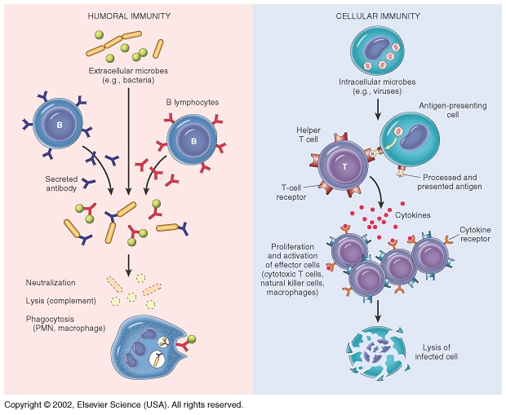
Nature of antigen determine type of response either
EXTRACELLULAR or INTERACELLUALR

Slide 5
Activation of B cells by antigens
Two types of antigens:
1. T-dependant :
- Antibody production by B-cells require T- helper cells
- Macrophages recognize antigen & present it to T-helper cells
- T-helper cells stimulate B-cells specific for that antigen to become plasma cells
- T-dependant antigens are mainly proteins on viruses, bacteria & other foreign materials.

Slide 6
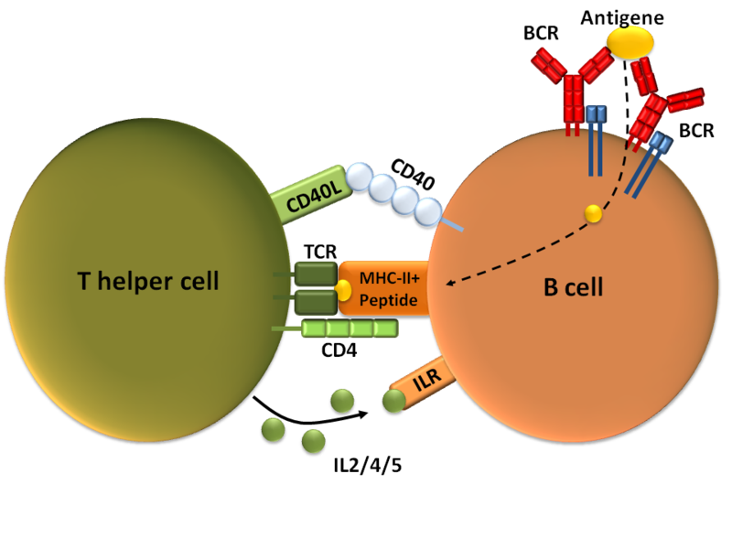
(Th2)

Slide 7
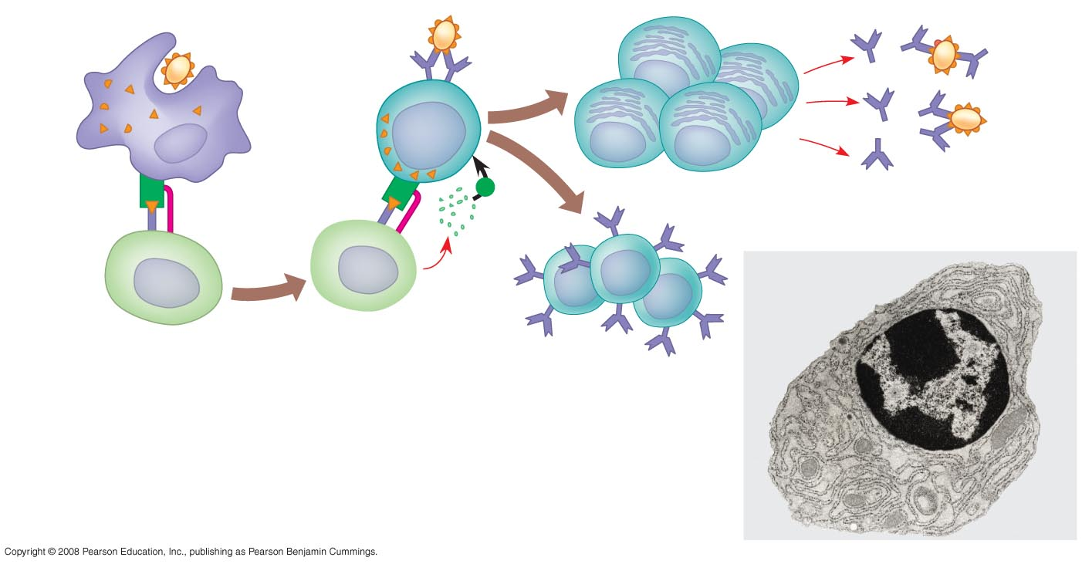
Antigen-presenting cell
Bacterium
Peptide
antigen
B cell
Class II MHC
molecule
+
Clone of plasma cells
Secreted
antibody
molecules
TCR
CD4
Cytokines
Endoplasmic
reticulum of
plasma cell
Activated
helper T cell
Helper T cell
Clone of memory
B cells
2 µm

Slide 8
Clonal selection and clonal proliferation

Slide 9
2. T- independent antigens
  B-cells do not require T-helper cells to produce antibody.
  2. Antigens are mainly polysaccharides or
lipopolysaccrides with repeating subunits
(bacterial capsules).
3. Immune responses are weak compared to
T-dependant responses.

Slide 10
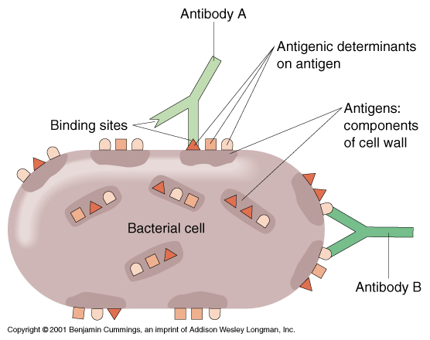
Antigens
“Self” versus “non-self”
  T cells and B cells removed if they recognize self proteins
Antigens are mostly proteins or polysaccharides
Antigenic determinants (epitopes)
  Each bacterial cell has many different epitopes

Slide 11
Antibodies
Antibodies are immunoglobulins (Ig) with specific functions.
Antibodies are found in extracellular fluids (blood plasma, lymph, mucus, etc.) and the surface of B cells.
Antibodies bind to specific sites on antigen surfaces and perform protective functions by different mechanisms.
There is a SPECIFIC antibody for any one given type of an antigen

Slide 12
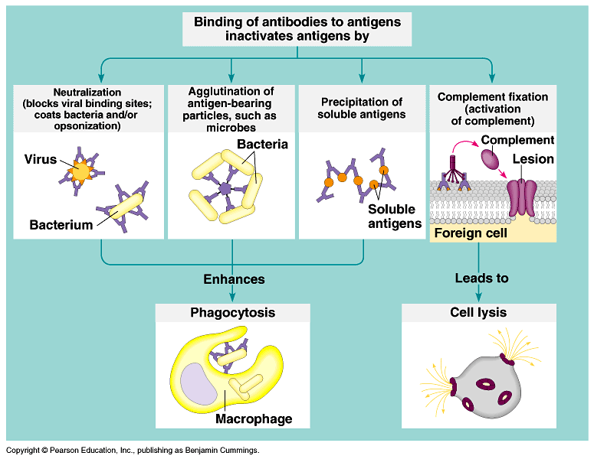
Protective functions of antibodies

Slide 13
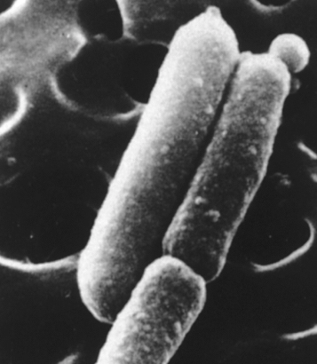
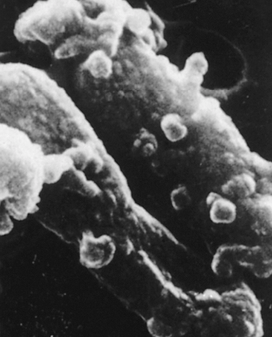
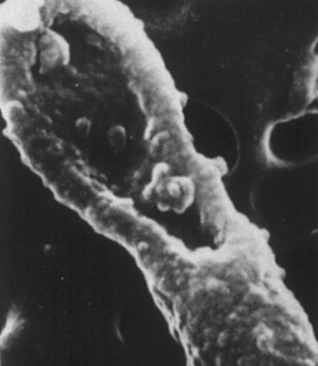
Electron micrographs of the effect of antibodies and complement upon bacteria
Antibody + complement-mediated
damage to E. coli
Healthy E. coli

Slide 14
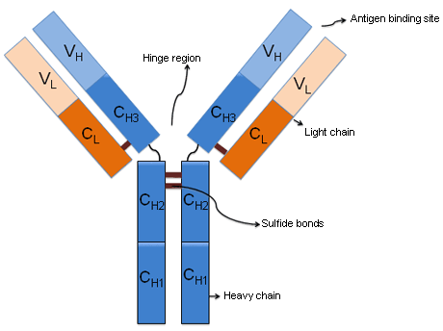
Antibody structure and functions
Made up of four polypeptides (amino acid chains).
Two longer and larger (heavy chains ) and the other two shorter and smaller (light chains)
Have the shape of a letter “Y”
Variable region
Fc Region binds to receptors on different cells

Slide 15
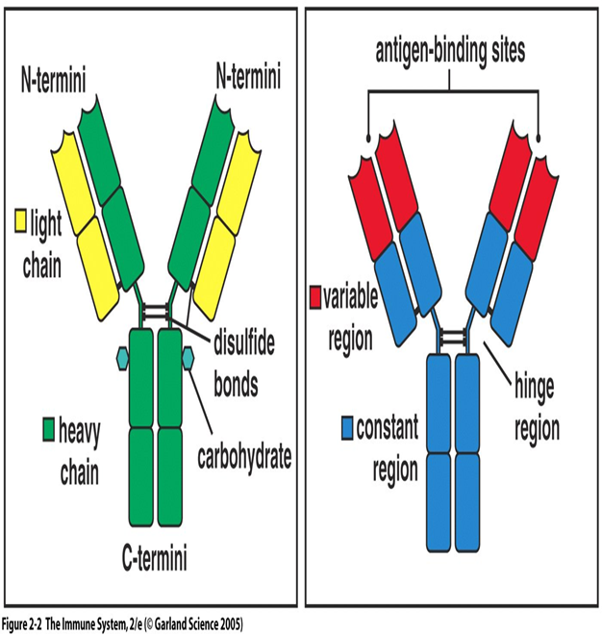
Variable region has the potential to bind with particular classes of antigens. Once a raw antibody is stimulated to fit to a specific antigen, it can then react with ONLY that antigen .This is known as SINGLE SPECIFICITY
Can fit as precisely as a lock-and-key to an antigen.
Constant regions.
Fc region (stem) - can bind complement

Slide 16
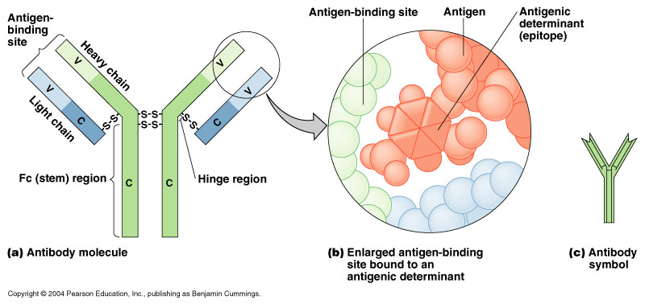

Slide 17
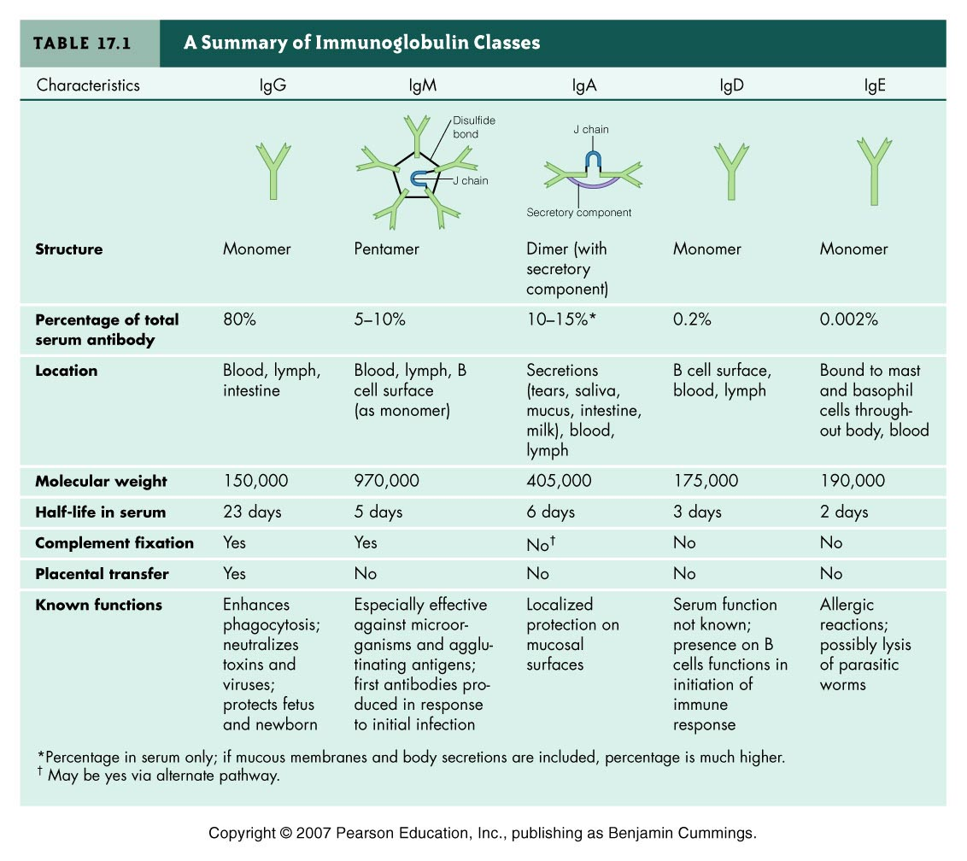

Slide 18
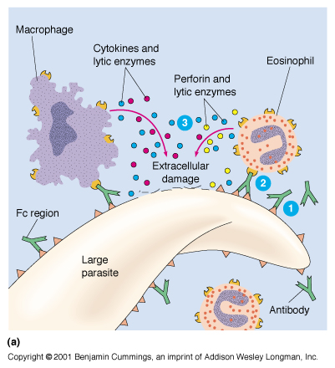
Functions of Antibodies
Antibody dependent cell-mediated cytotoxicity
  Antibodies coat infecting cell (large parasite usually) - FC facing outwards
  NK (lysing ability), Macrophage, neutrophils, and eosinophils have receptors for FC region of antibody
  Secretion of lytic enzymes to destroy parasite

Slide 19
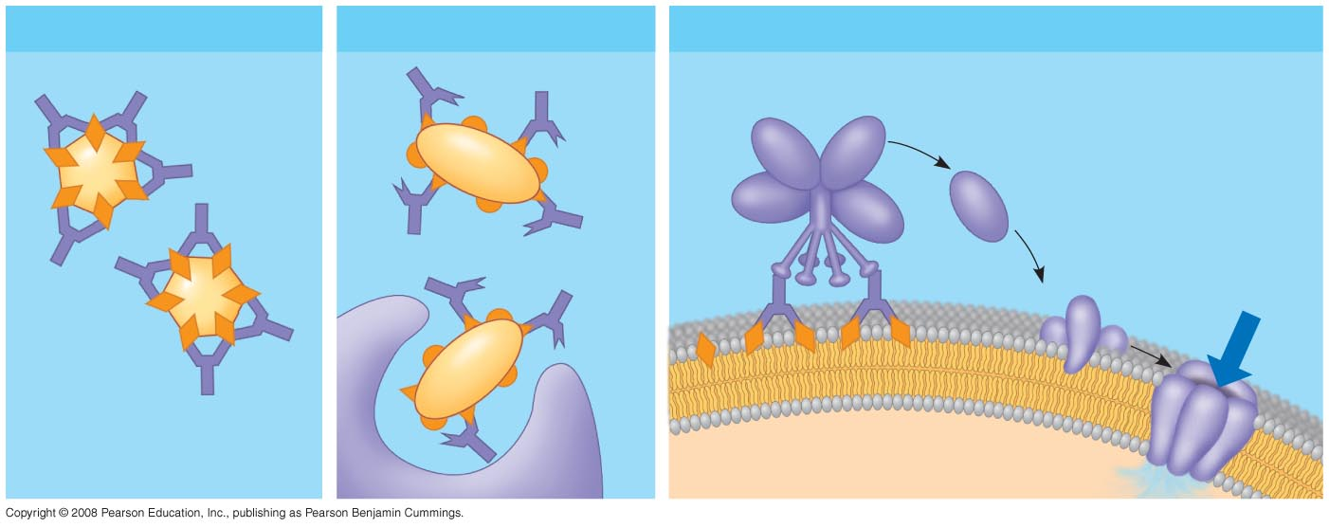
Functions of Antibodies
Virus neutralization
Opsonization
Activation of complement system and pore formation
Bacterium
Virus
Complement proteins
Formation of
membrane
attack complex
Flow of water
and ions
Macrophage
Pore
Foreign cell
Notes:
Figure 43.21 Antibody-mediated mechanisms of antigen disposal

Slide 20
Primary & Secondary immune responses
Initial encounter with antigen produce primary immune response.
Subsequent challenge with same antigen produce secondary immune response.
Antibody titer: amount of antibody in the serum
IgM is the first antibody produced in low titer
IgG peaks first: quickly and in larger amounts

Slide 21
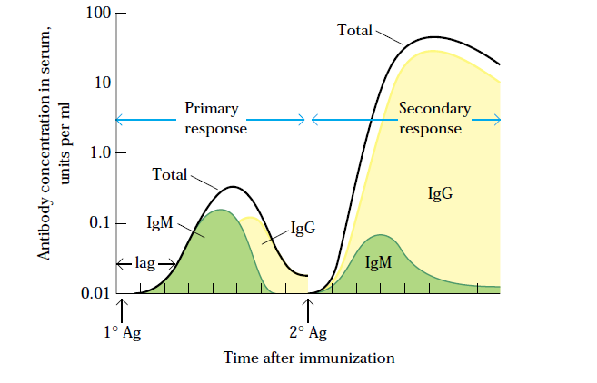
Concentration & type of antibody in primary & secondary immune responses

Slide 22
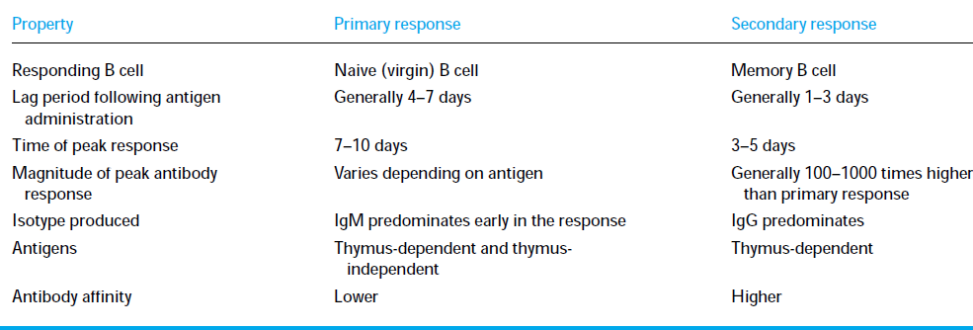
Comparison between primary & secondary responses

Slide 23
Take Home Message
B cells can be activated by antigen to produce antibodies either with the assistance of helper T cells or directly by the antigen itself
Antibodies are made up of two heavy and two light amino acid chains and have a shape of letter “Y”
Different types of antibodies are located at various sites to provide protection by agglutination, precipitation, complement fixation etc.
Secondary humoral immune response is swift and a stronger immune response mediated by IgG class of antibodies because of the memory cells.

Slide 24
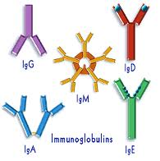
Thank you
Email: halotaibi1@ksu.edu.sa

