Slide 1
Stress Management
Dr. Nehal Khamis
Ass. Professor of Medical Education
Head of Faculty Development Unit
LEARNING SKILL COURSE
Dept. of Medical Education
COLLEGE OF MEDICINE
King Saud University

Slide 2
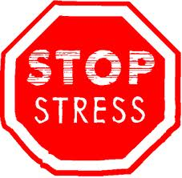
Objectives of the session :
    Define stress
    Identify the types of stress
    Explain the mechanisms of stress
    Relate stress to health problems
    Outline a stress management strategy

Slide 3
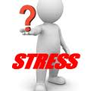
What is stress?

Slide 4
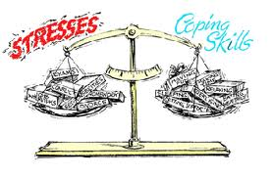
Stress Definition
Stress is a condition or feeling experienced when a person perceives that demands exceed the personal and social resources the individual is able to mobilize.
  “An external demand made upon the adaptive capacities of the mind and body”.

Slide 5
Are you stressed?

Slide 6
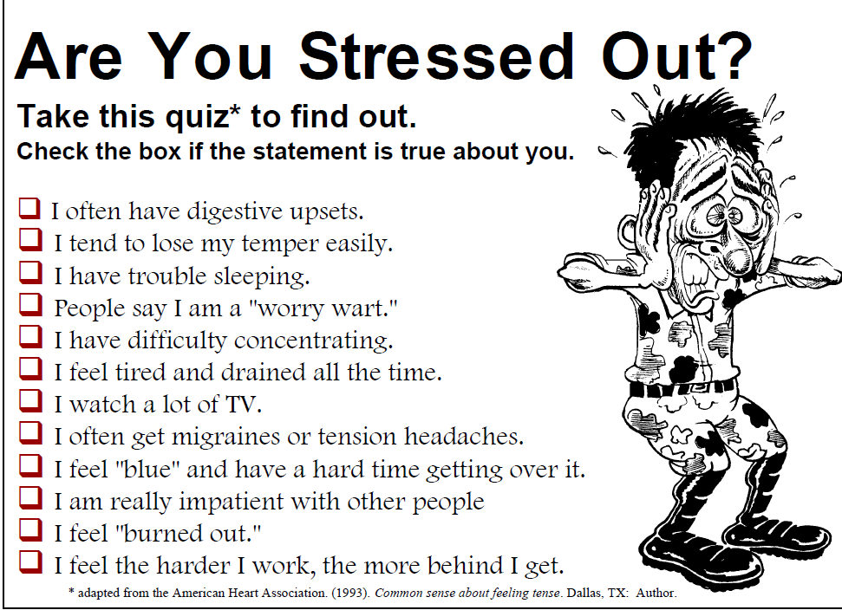
0-3
4-8
8-12

Slide 7
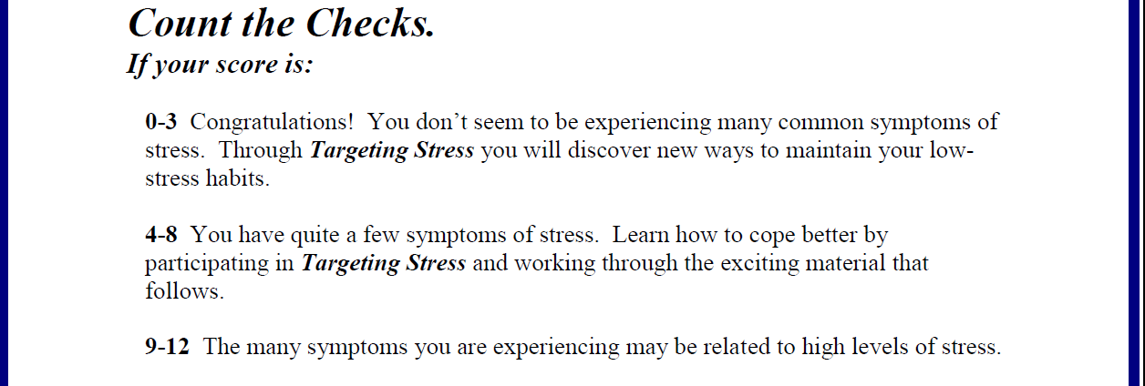

Slide 8
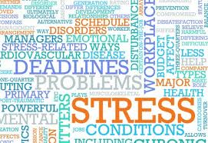
What are the causes of stress?

Slide 9
Developmental Factors
Coping Style
Personal Illness
Work PTSD
Finances
Long hours; Multiple subordination; Email, etc. Heightened work expectations; Projects
PATIENT DISTRESS
NON-PATIENT WORK ENVIRONMENT
FAMILY DISTRESS
PERSONAL DISTRESS
PHYSICIAN DISTRESS
FAMILY DISTRESS
Emotional Physical Illness Severity
Coping Style
Temperament
Interaction & Anxiety
Culture
HEALTH CARE SYSTEM
Significant Others
Children
Aging
Illness & Death
Finances
Fragmented – Un-integrated
Low reimbursement
Documentation
Measure Outcome

Slide 10
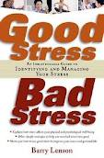
Can be useful in enhancing performance
& efficiency
Can be harmful & negative especially when it becomes chronic & excessive

Slide 11
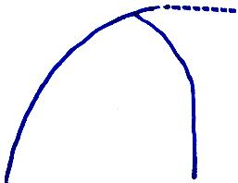
HUMAN FUNCTION CURVE
Intended Performance
PERFORMANCE
Exhaustion
Fatigue
III Health
Actual Performance
P
Healthy Tension
Breakdown
AROUSAL
P = The point at which minimum arousal may bring on a breakdown

Slide 12
STRESS AS A RESPONSE
It results in certain physiological changes:
  gastrointestinal,
  glandular and
  cardiovascular disorders
  etc.
It affects the entire body, not just a single part.
Differences in response within and between individuals.

Slide 13
STRESS AS A STIMULUS
If too many positive or negative changes (such as marriage and divorce) occur in a very short period, they can tax the adaptive capacity of the individual and lead to increased susceptibility to mental and physical illness.

Slide 14
What are the mechanisms of stress?

Slide 15
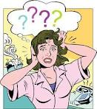
Mechanisms of stress :
Fight-or-Flight
The General Adaptation Syndrome and Burnout

Slide 16
Mechanisms of stress
Fight-or-Flight
    When an animal experiences a shock or perceives a threat, it quickly releases hormones that help it to survive.
    These hormones help us to run faster and fight harder.
    Fight-or-flight, or adrenaline, response is not only triggered by obviously life-threatening danger. It can be triggered when simply encountering something unexpected

Slide 17
Power, but little control :
    Unfortunately, this mobilization of the body for survival also has negative consequences
    In this state, we are excitable, anxious, jumpy and irritable
    it difficult to execute precise, controlled skills
    We find ourselves more accident-prone and less able to make good decisions

Slide 18
THREE STAGES OF ADAPTATION IN STRESS
1.Alarm reaction: when a person is exposed to an unadapted stimulus there is an initial shock followed by a rebound reaction (counter shock phase) during which the organism’s defense mechanisms become active.
  2.Stage of resistance: full adaptation may lead to successful return to equilibrium. General Adaptation Syndrome operates in response to longer-term exposure to causes of stress.
3.Stage of exhaustion: in case of failure of adaptability the organism becomes exhausted.

Slide 19
Burnout
It is state of fatigue or frustration brought about by devotion to a cause, way of life, or relationship that failed to produce the expected reward.”
It mainly strikes highly-committed, passionate, hard working and successful people.

Slide 20
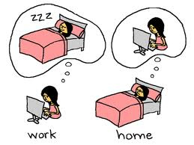
Burnout
Symptoms of Burnout
    Physical: fatigue, frequent illness and sleep problems.
    Emotional: the loss of a sense of meaning ,
      feelings of helplessness; frustration of efforts and a lack of power to change events
      feelings of depression and isolation
    Behavioural: increasing detachment from co-workers, an increased harshness in dealing with our teams

Slide 21
Stress and our health
Stress and the immune system :
    Medical school examinations associated with decreases in cellular immunity and increases in proinflammatory and humoral immunity
    increases in vulnerability to infectious disease as well as allergy
    Life stress is associated with 2-fold increase in susceptibility to the common cold virus
    Severe life stress is associated with a 4-fold increase in risk of HIV progression and 2.6-fold increase in mortality

Slide 22
Stress and our health
Stress and the cardiovascular system
    The incidence of major depression is ~20% after MI
    cardiovascular mortality is tripled in this group (15%) compared to nondepressed patients (5%)

Slide 23
Why stress in health professionals?

Slide 24
Health professionals face many stressors in their work environment:
    Sleep deprivation
    Disruptions in social support
    Clinical vs. educational conflicts
    Caring for critically ill or dying patients
    Certification or licensing examinations
Documented link between stress and mental health
    Higher than normal levels of depression and anxiety
    (French et al., 1982; Peterlini et al., 2002 )

Slide 25
How to manage stress?

Slide 26
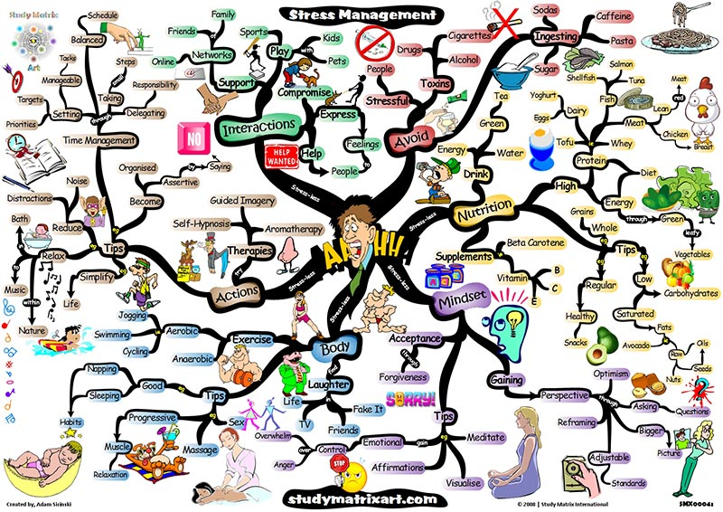
Stress Management Strategies are too many!

Slide 27
الاستعانة بالله
”اللهم إني عبدك ابن عبدك ناصيتي بيدك ماض في حكمك عدل في قضاؤك أسالك بكل اسم هو لك سميت به نفسك أو أنزلته في كتابك أو علمته أحدا من خلقك أو استأثرت به في علم الغيب عندك أن تجعل القران العظيم ربيع قلبي ونور صدري وجلاء حزني وذهاب همي وغمي“.

Slide 28
Stress Management Strategies
Strategy #1 :
Avoid unnecessary stress:
    Learn how to say “no”
    Avoid people who stress you out
    Pare down your to-do

Slide 29
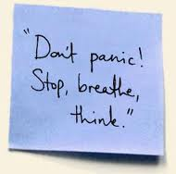
Strategy #2:
Alter the situation :

Slide 30
Relaxation Response
Pick a focus word, phrase, image, or prayer; or focus on breathing.
Sit quietly in comfortable position.
Close eyes & relax muscles
Breathe slowly & naturally – as you do, repeat focus word or phase as you exhale.
When other thoughts come to mind, just go back to repetition of word or breathing.

Slide 31
Interrupting Stress – A 4 Step Approach
Stop
    Each time you encounter a stress…stop…before (automatic) thoughts escalate into worst possible scenarios.
Breathe
    After you stop, breathe deeply to release physical tension…most time one tends to hold breath in the midst being stressed…even a momentary interruption can help.
Reflect
    Focus energy on problem & reflect on the cause of stress
Choose
    Time to choose how to deal with stress

Slide 32
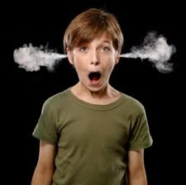
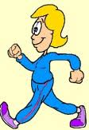
Strategy #2:
Alter the situation :
    Express your feelings instead of bottling them up
    Be willing to compromise
    Be more assertive
    Manage your time better

Slide 33
The "Three Ps" of Effective Time Management
Planning.
Priorities.
Procrastination.
Notes:
Planning:
If you don’t have time for planning, you’d better find the time.
Priorities:
Not everything you do is of equal importance.
Priorities are not constant, they must e re-evaluated.
Procrastination:
The anti-Nike – just don’t do it.

Slide 34
Time management grid
URGENT NOT URGENT
I Crises Pressing Problems Deadlines 20-25% | II Preparation Prevention Planning Relationship Building 65-80%
III Interruptions Some mail/reports Some meetings Some “pressing matters” 15% | IV Time wasters less than 1%
NOT
IMPORTANT IMPORTANT

Slide 35
How to estimate time of a task?
Break assignment into steps
Estimate how long each step will take.
Total the estimation
Add a safety margin “sanity zone” to the total (50% over the initial estimate).

Slide 36
Meeting Management
Manage your meetings
    Set agenda
    Set leader
    Set time (i.e., Does it need to be 1 hour?)
    Stay on task

Slide 37
Take into account when you are most effective: plan to do priority tasks when your energy is high and conc. at its best.

Slide 38
Maximize your Efficiency
Work With Your Body Cycles-not Against Them
Time | Appropriate activity
8am-12 noon | Cognitive Tasks such as reading, calculating, and problem solving
6 am - 10 am | Short term memory such as last minute reviewing for tests
1 pm - 4pm | Long term memory such as memorizing speeches and information for application

Slide 39
Maximize your Efficiency
Work With Your Body Cycles-not Against Them
Time | Appropriate activity
2 pm to 6 pm | Manual Dexterity such as keyboarding and carpentry
4 pm to 9 pm | Physical Workouts large muscle coordination is at its peak
Note | *If you are a Night Owl, shift these times about 3-4 hours later in the day.

Slide 40
Strategy #3:
Adapt to the stressor :
    Reframe problems
    Look at the big picture
    Adjust your standards
    Focus on the positive

Slide 41
Strategy #4:
Accept the things you can’t change :
    Don’t try to control the uncontrollable
    Look for the upside.
    Share your feelings
    Learn to forgive

Slide 42
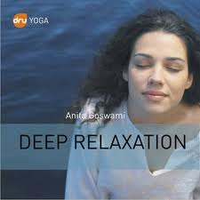

Strategy #5:
Make time for fun and relaxation :
    Set aside relaxation time
    Connect with others
    Do something you enjoy every day
    Keep your sense of humor

Slide 43
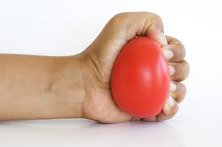


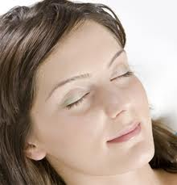

Relaxation

Slide 44
Strategy #6:
Adopt a healthy lifestyle:
    Exercise regularly
    Eat a healthy diet
    Reduce caffeine and sugar
    Avoid alcohol, cigarettes, and drugs
    Get enough sleep

Slide 45
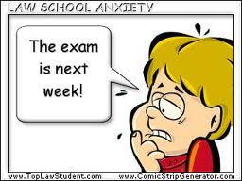
Examination stress , how to handle it?

Slide 46
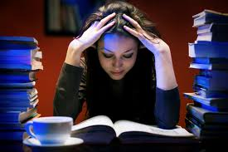
Examination stress , how to handle it?
Preparation :
  Simple study routine , have a clear plan of action
  Adequate early preparation
  Regular and systematic revision
  Practice (Mock exams) as it would reduce anxiety

Slide 47
Examination stress , how to handle it
Time management ;
  Priority tasks , evaluate how you are budgeting your time.
  Set achievable goals keeping in mind your strengths and weakness
  Make a realistic schedule and follow it through.

Slide 48
Examination stress , how to handle it
Motivation;
  Drive to achieve goals
  Don’t get discouraged’ learn to appreciate your strengths
  Learn from mistakes
  Visualize success

Slide 49
Examination stress , how to handle it
Maintain confidence ;
  Know yourself , have an accurate perception of yourself ( to look at yourself without any judgment is of the greatest importance , because that is the only way you can understand and know about yourself ) J.KRISHNAMURTI.
  Resist comparisons , don’t compare yourself to other people .compare yourself to the best you can do . In other words , compete within yourself.

Slide 50

Last but not least
Have a balanced diet and get adequate sleep
Do your best!
Above all think there is life beyond revision and exams !!

Slide 51
CONCLUSION
One third of the illnesses are caused by stress, either directly or indirectly.
If handled properly,
  Stress can help improve performance,
  but too much stress without appropriate strategy to control it can be harmful for the mind and the body.

Slide 52
    There is a lot that you can do to avoid burnout
    The most important thing is to recognize that you are at risk, and take this seriously
    If you can
      focus on managing workload,
      dealing with people problems,
      avoiding exhaustion and protecting the meaning of your work

Slide 53

Thanks

