Slide 1
GRANULOMATOUS INFLAMMATION
2014
Dr. Maha Arafah
Assiociate Professor and consultant of histopathology
Office phone number: 011-4671067

Slide 2
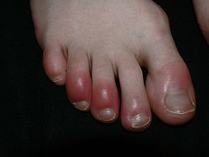
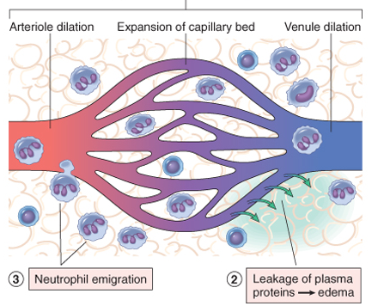
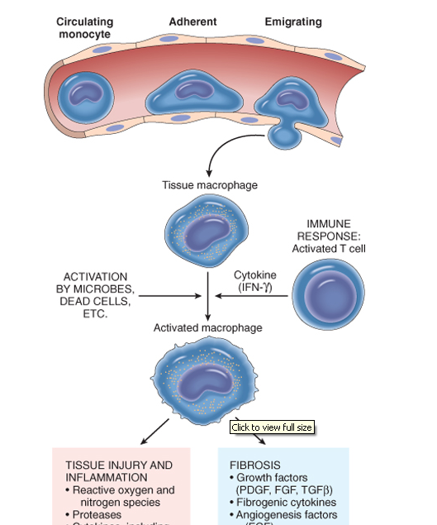
Inflammation
Acute inflammation
Chronic inflammation
Neutrophils
Macrophage
Lymphocytes
Plasma cells

Slide 3
OBJECTIVES AND KEY PRINCIPLES TO BE TAUGHT:
Upon completion of this lecture, the student should:
Define Granulomatous inflammation.
Recognize the morphology of granulomas (tubercles) and list the cells found in granuloma along with their appearance.
Understands the pathogenesis of granuloma formation.
Identify the two types of granulomas, which differ in their pathogenesis.
  Foreign body granulomas
  Immune granulomas
List the common causes of Granulomatous Inflammation.

Slide 4
Granulomatous inflammation
A form of chronic inflammation characterized by the formation of granulomas.

Slide 5
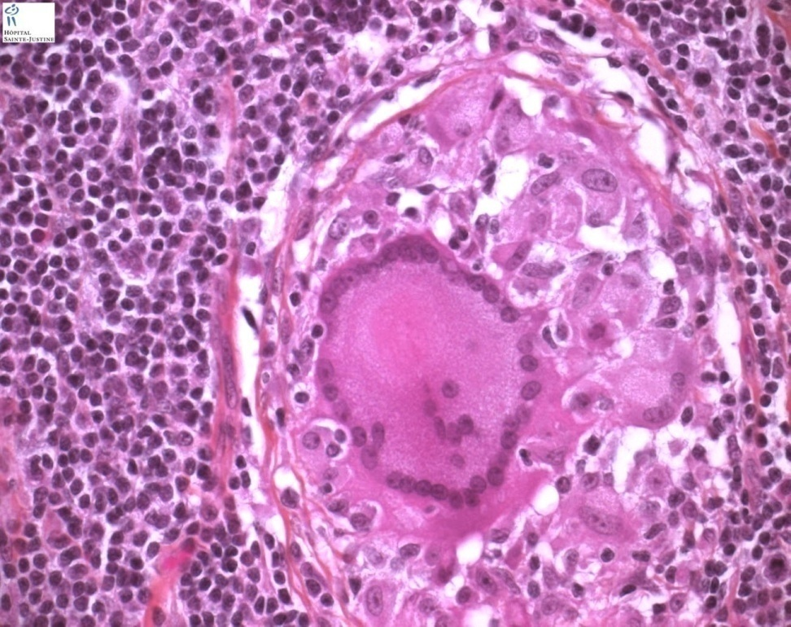
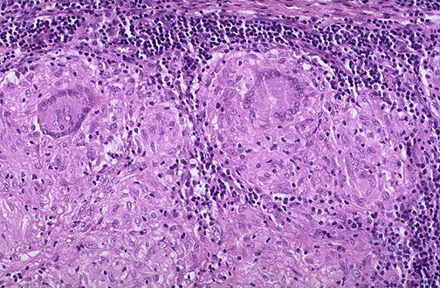
Granuloma = Nodular collection of epithelioid macrophages surrounded by a rim of lymphocytes
Epitheloid macrophages: squamous cell-like appearance

Slide 6
Why is it important?
Granulomas are encountered in certain specific pathologic states.
Recognition of the granulomatous pattern is important because of the limited number of conditions (some life-threatening) that cause it

Slide 7
Granulomatous Inflammation pathogenesis
Neutrophils ordinarily remove agents that incite an acute inflammatory response. However, there are circumstances in which reactive neutrophils cannot digest the substances that provoke acute inflammation.

Slide 8
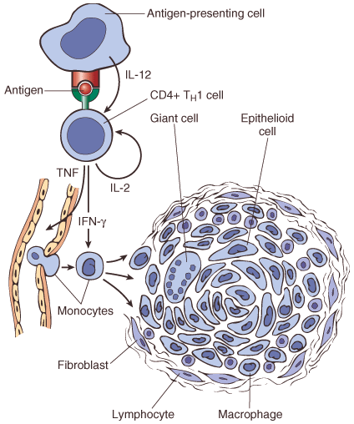
Granulomatous Inflammation mechanism
What is the initiating event in granuloma formation?
deposition of a indigestible antigenic material
IFN-γ released by the CD4+ T cells of the T_{H}1 subset is crucial in activating macrophages.
Type IV hypersensitvity

Slide 9
Epithelioid cell granulomas
When macrophages have successfully phagocytosed the injurious agent but it survives inside them.
When an active T lymphocyte-mediated cellular immune response occurs. Lymphokines produced by activated T lymphocytes inhibit migration of macrophages and cause them to aggregate in the area of injury and form granulomas.

Slide 10

Pathogenesis
There are two types of granulomas
Foreign body granuloma
Immune granuloma
are incited by relatively inert foreign bodies. Typically, foreign body granulomas form when material such suture are large enough to preclude phagocytosis by a single macrophage
These material do not incite any specific inflammatory immune response.
The foreign material can usually be identified in the center of the granuloma, by polarized light (appears refractile).
are caused by insoluble particles, typically microbes, that are capable of inducing a cell-mediated immune response.

Slide 11
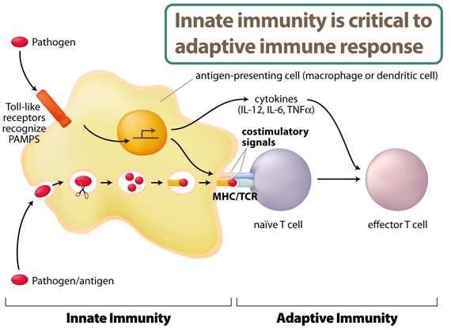
IL-2, and IFN-γ,

Slide 12
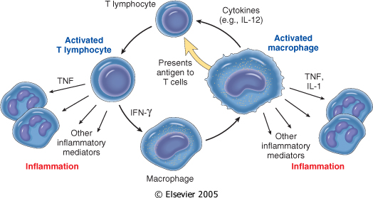

Slide 13
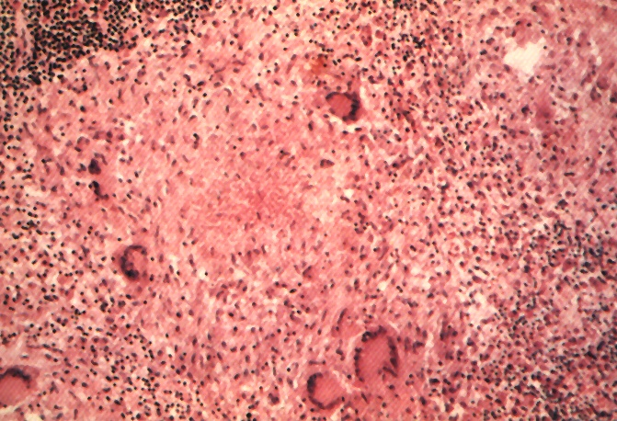
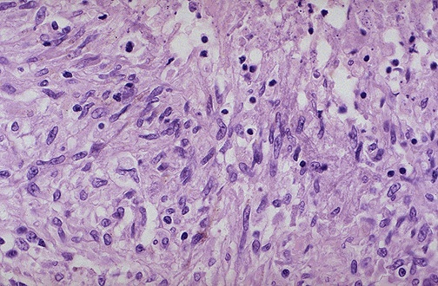
Granuloma
Langhans Giant Cell
Lymphocytic Rim
Caseous Necrosis
Epithelioid Macrophage

Slide 14
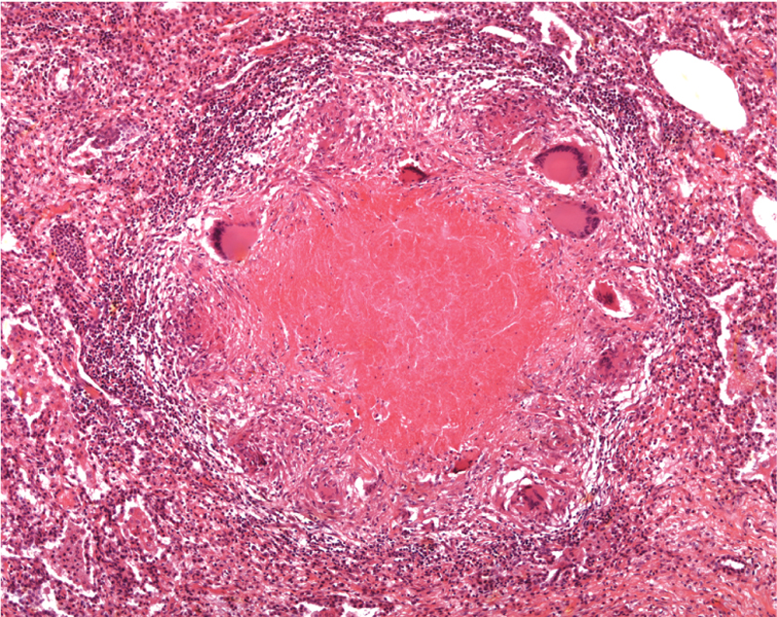
Epitheliod histiocytes
Lymphocytes
Multinucleated cell
Necrosis

Slide 15

Granulomatous Inflammation
Causes
Non-immune granuloma
Immune granuloma:
Foreign body
  Suture
  Graft material
  talc (associated with intravenous drug abuse)
Bacteria
  Tuberculosis
  Leprosy
  Actinomycosis
  Cat-scratch disease
Parasites
  Schistosomiasis
  Leishmaniasis
Fungi
  Histoplasmosis
  Blastomycosis
Metal/Dust
  Berylliosis
unknown
Sarcoidosis
Crohn’s disease

Slide 16
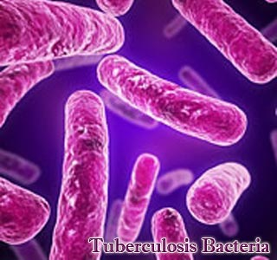
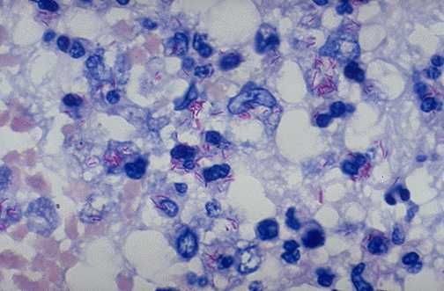
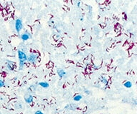
Tuberculosis
Mycobacterum tuberculosis
Mycobacteria – ‘fungus like..
slender rods
acid fast bacilli [AFB] (i.e., they have a high content of complex lipids that readily bind the Ziehl-Neelsen [carbol fuchsin] stain and subsequently resist decolorization).

Slide 17
Pathogenesis of TB
Cord factor is a glycolipid molecule found in the cell wall of Mycobacterium tuberculosis and similar species.
It protects M. tuberculosis from the defenses of the host
Cord factor presence increases the production of the cytokines interleukin-12 (IL-12), IL-1β, IL-6 and TNF which are all pro-inflammatory cytokines important for granuloma formation

Slide 18
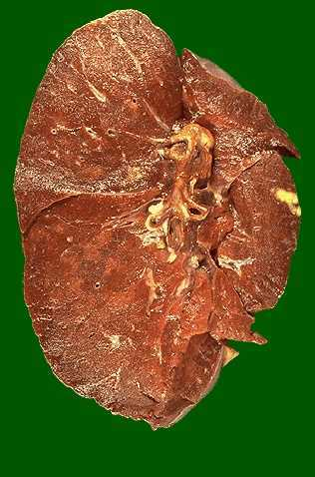
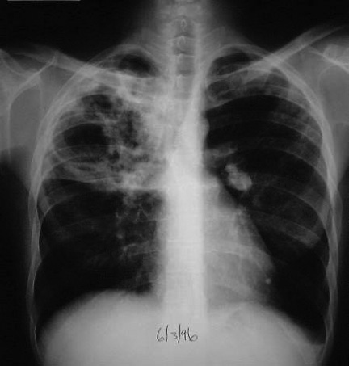
Tuberculosis

Slide 19
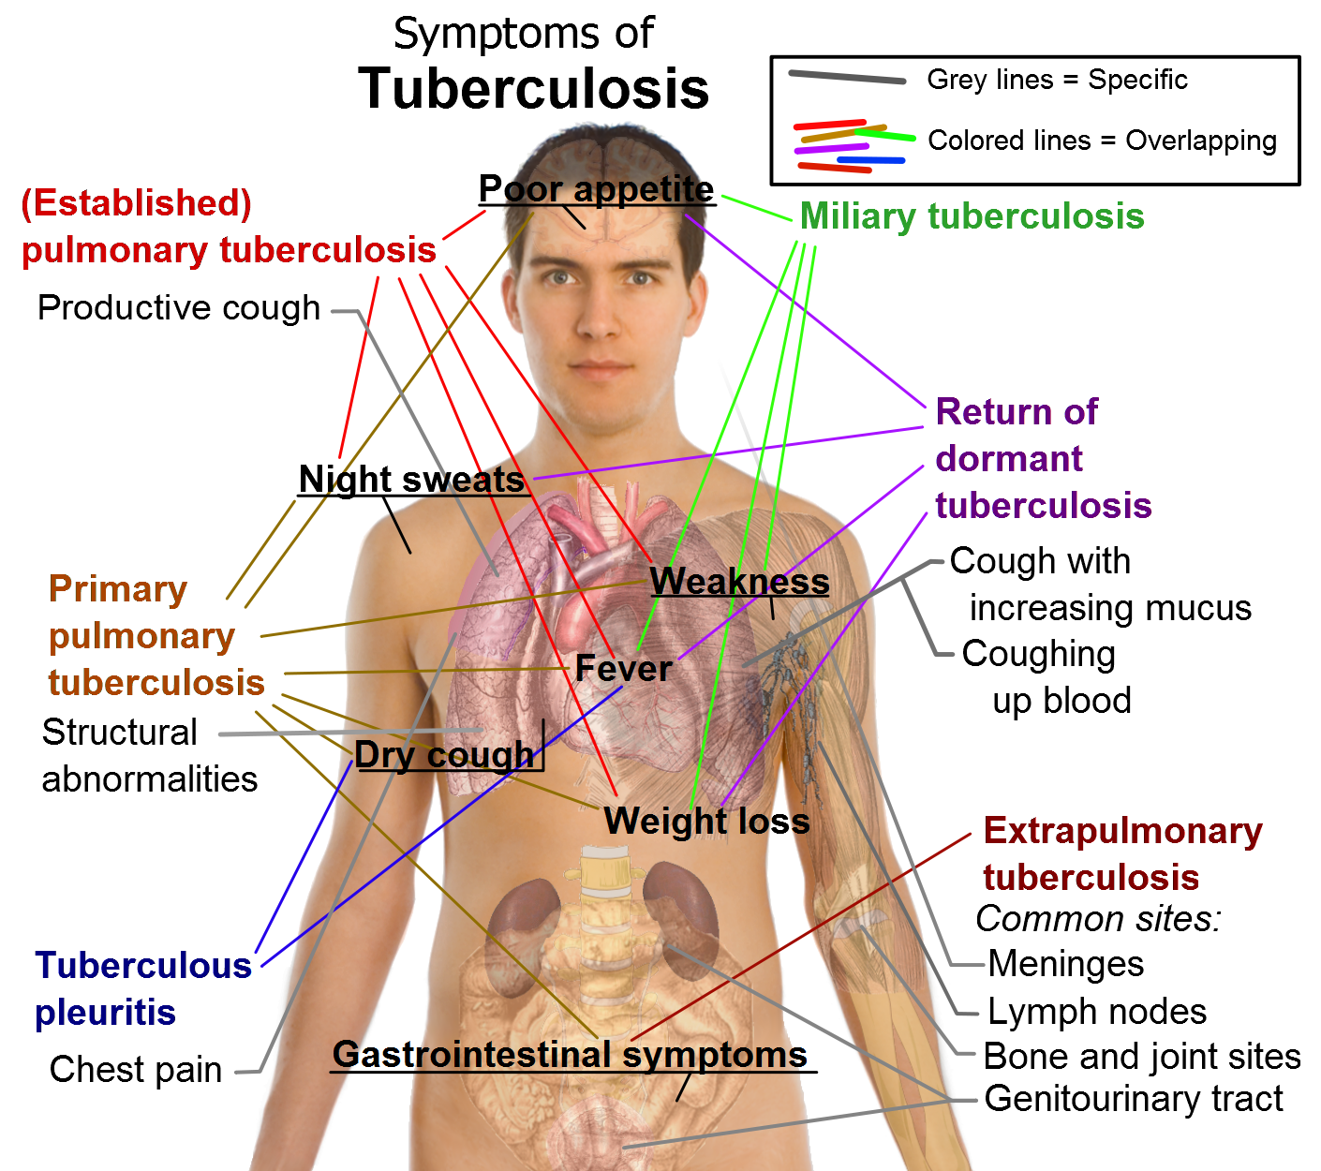

Slide 20
Sputum , TB bacilli

Slide 21
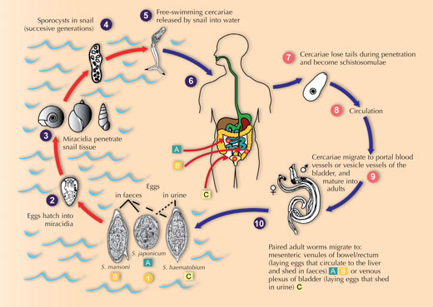
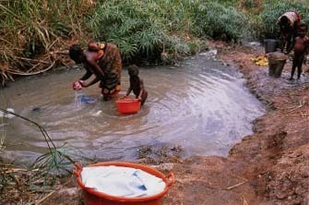
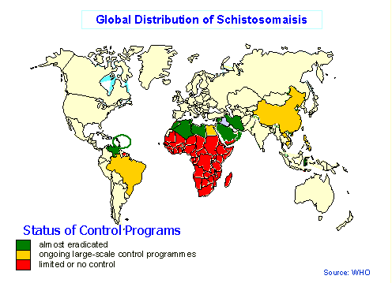
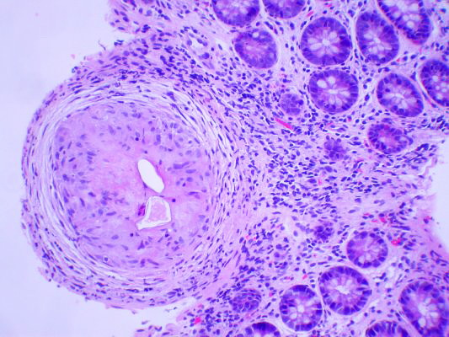
Schistosomiasis

Slide 22
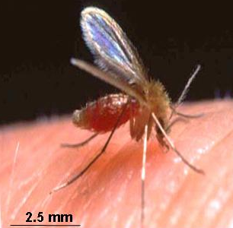
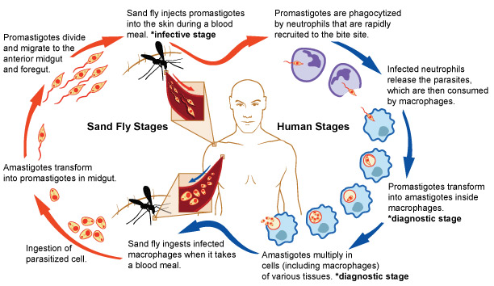
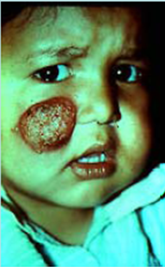
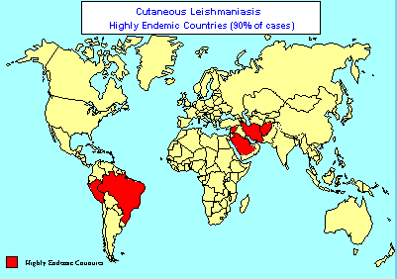

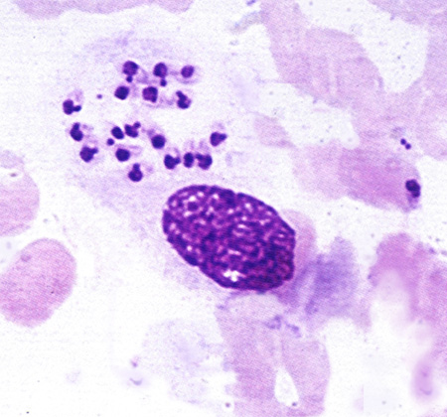
Leishmaniasis

Slide 23
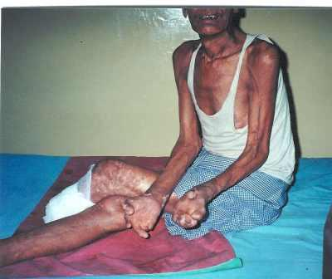
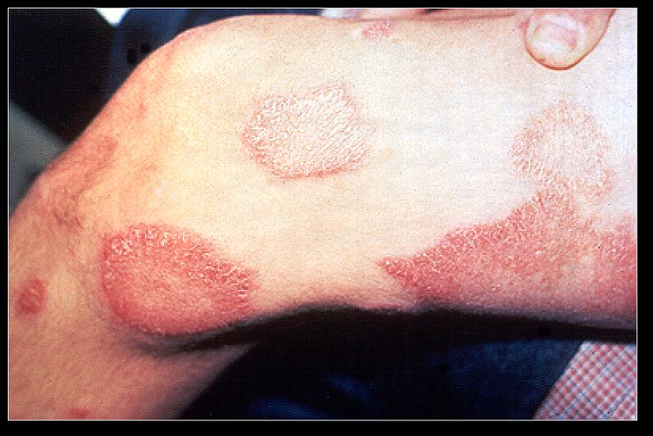
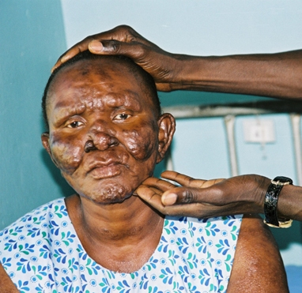
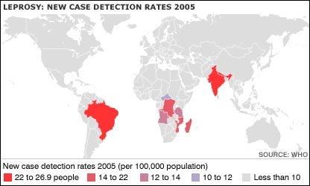
Leprosy

Slide 24
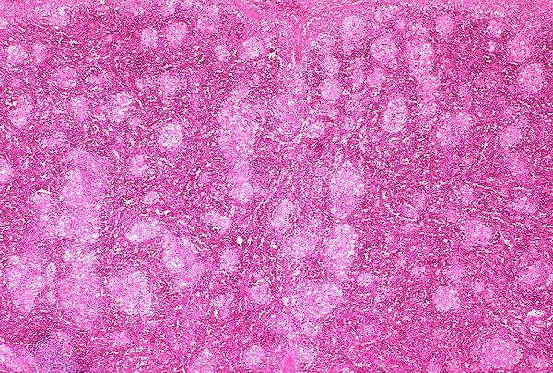
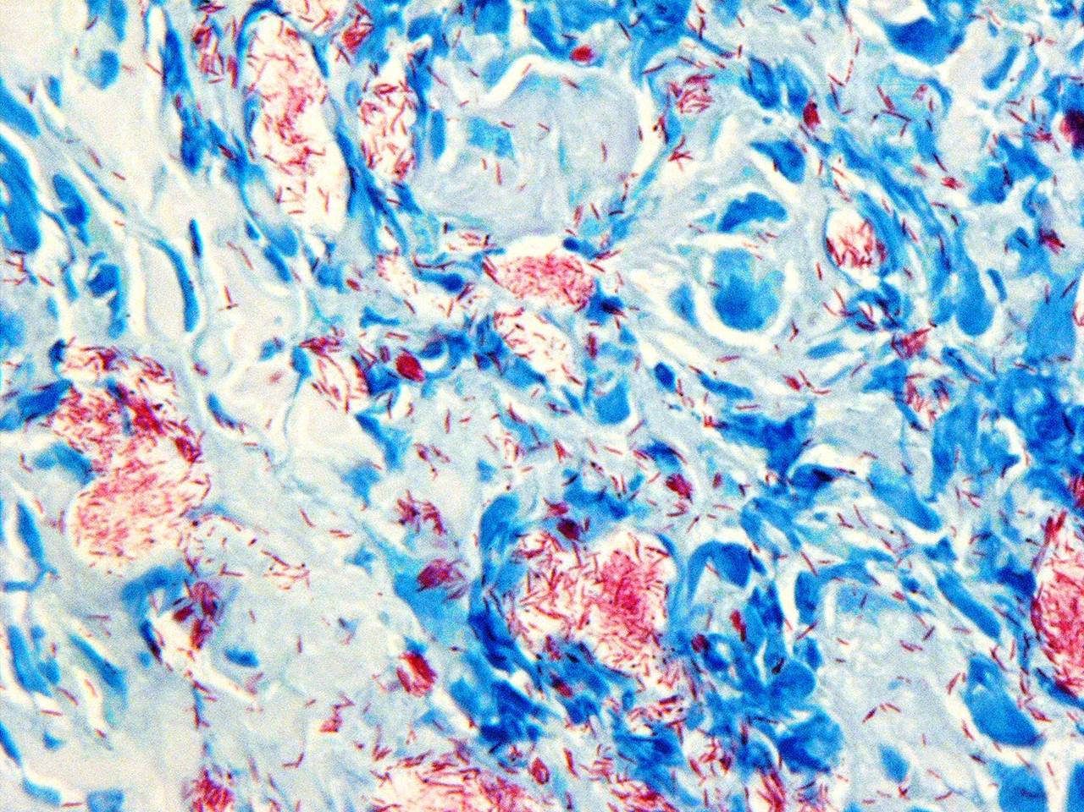
Leprosy

Slide 25
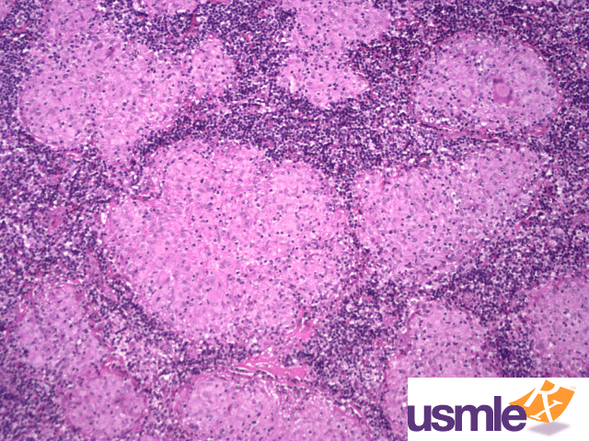
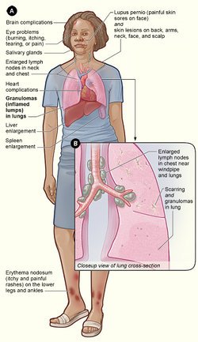
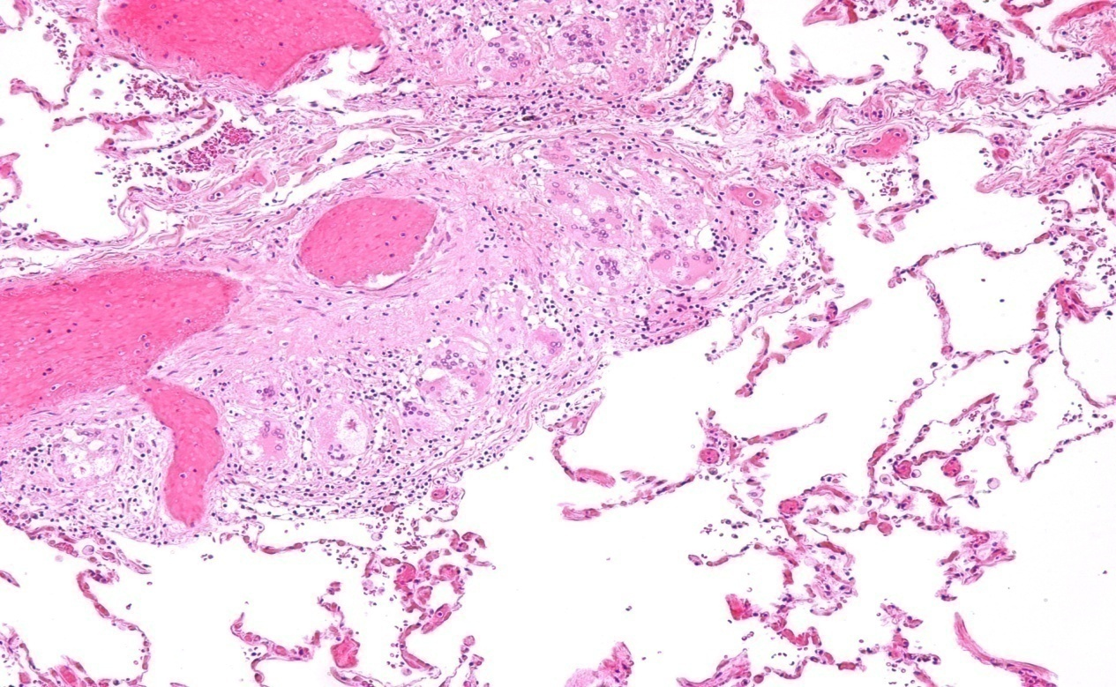
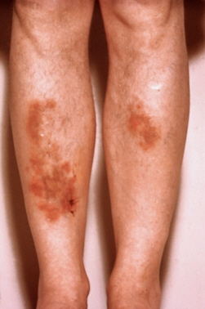
Sarcoidosis
Non-caseating granuloma

Slide 26
Match A and B
A
B
The most important cell in granulomatous inflammation
A cytokines that is important in activating macrophages and transforming them into epithelioid cells
Multinucleated cell in TB
Antigen presenting cells
pathogenesis of immune type granulomatous inflammation
Microscopic finding of TB
Found in the cell wall of TB
IFN-γ
Langhans cells
Epitheliod histiocyes
Cord factor
Langerhan’s cells
Type IV hypersensitivity reaction
Caseating granuloma

Slide 27
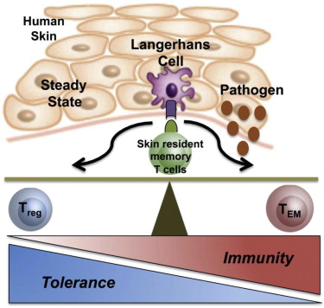
Langerhan’s` cells
Antigen presenting cells

Slide 28
Which of the following diseases does not cause granulomatous inflammation
Cat-scratch disease
Actinomycosis
Sarcoidosis
Leishmaniasis
Staphylococcus infection

Slide 29
TAKE HOME MESSAGES:
Granulomatous inflammation is a distinctive pattern of chronic inflammation characterized by aggregates epithelioid macrophages
Damaging stimuli which provoke a granulomatous inflammatory response include: Microorganisms which are of low inherent pathogenicity but which excite an immune response.
Granulomata are produced in response to:
    Bacterial infection
    parasitic infection: e.g. Schistosoma infection
    Certain fungi cannot be dealt with adequately by neutrophils, and thus excite granulomatous reactions.
    Non-living foreign material deposited in tissues, e.g. keratin from ruptured epidermal cyst.
    Unknown factors, e.g. in the disease 'sarcoidosis' and Crohn's diseas

