Slide 1
Neoplasia
Lecture 1
Definition and Nomenculature
Abdulmalik Alsheikh, M.D, FRCPC
Dr. Maha Arafah, MBBS, KSFP
Foundation block 2014
Pathology

Slide 2
Neoplasia
Cancer is one of the second leading causes of death worldwide.
Emotional and physical suffering by the patient.
Different mortality rate …..
  Some are curable such as Hodgkin lymphoma
  Others are fatal such as pancreatic adenocarcinoma

Slide 3
Neoplasia
Upon completion of these lectures, the student should:
Define a neoplasm. Contrast neoplastic growth with hyperplasia, metaplasia, and dysplasia.
Know the basic principles of the nomenclature of benign and malignant processes.
Define and use in the proper context:
  Adenoma.
  Papilloma.
  Polyp.
  Cystadenoma.
  Carcinoma.
  Adenocarcinoma.
Compare and contrast benign and malignant tumors with respect to:
  demarcation from surrounding tissue (capsule, local invasiveness)
  rate of growth
  degree of differentiation (Explain the meaning of differentiation).
  distant spread (metastases).
Describe the morphologic changes associated with poorly differentiated tumors; define and understand the usage of the terms anaplasia, pleomorphism, nuclear atypia, abnormal mitoses and tumor giant cells.
  - Sarcoma.
  - Teratoma.
  - Blastoma.
  - Hamartoma.

Slide 4
Neoplasia
Neoplasia = new growth
Neoplasm = tumor
Tumor = swelling
The study of tumors = Oncology
  Oncos = tumor + ology = study of

Slide 5
Neoplasia
Definition:
  is an abnormal mass of tissue,
  the growth of which is uncoordinated with that of normal tissues,
  and that persists in the same excessive manner after the cessation of the stimulus which evoked the change“
  With the loss of responsiveness to normal growth controls
  Different from hyperplasia, metaplasia and dysplasia.

Slide 6
Neoplasia Classification
Benign
Malignant
  Will remain localized
  Cannot spread to distant sites
  Generally can be locally excised
  Patient generally survives
  Can invade and destroy adjacent structure
  Can spread to distant sites
  Cause death (if not treated)

Slide 7
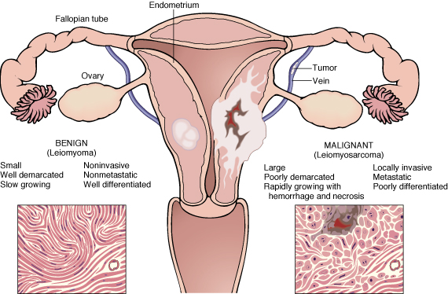
Benign – malignant

Slide 8
Neoplasia
All tumors have two basic components:
  Parechyma: made up of neoplastic cells
  Stroma: made up of non-neoplastic, host-derived connective tissue and blood vessels
The parenchyma:
  Determines the biological behavior of the tumor
  From which the tumor derives its name
The stroma:
  Carries the blood supply
  Provides support for the growth of the parenchyma

Slide 9
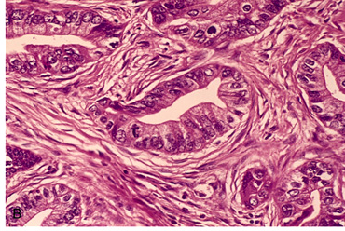

Slide 10
Nomenclature of benign and malignant neoplasm
Benign tumors

Slide 11
Neoplasia
Nomenclature
  Benign tumors:
    prefix + suffix
    Type of cell + (-oma)

Slide 12
Neoplasia
  Benign tumor arising in fibrous tissue:
  Fibro + oma = Fibroma
  Benign tumor arising in fatty tissue:
  Lipo + oma = lipoma
  Benign tumor arising in cartilage
chondro + oma = chondroma
  Benign tumor arising in smooth muscle
Leiomyo + oma = leiomyoma
  Benign tumor arising in skeletal muscle
Rhabdomyo + oma = rhabdomyoma

Slide 13
Neoplasia
epithelial benign tumors are classified on the basis of :
  The cell of origin
  Microscopic pattern
  Macroscopic pattern

Slide 14
Neoplasia
  Adenoma : benign epithelial neoplasms producing gland pattern….OR … derived from glands but not necessarily exhibiting gland pattern
  Papilloma : benign epithelial neoplasms growing on any surface that produce microscopic or macroscopic finger-like pattern

Slide 15
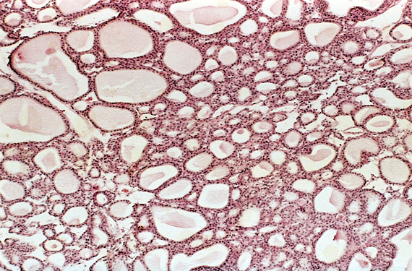
Adenoma

Slide 16
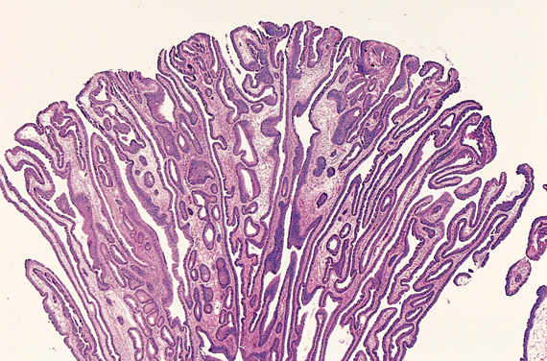
Papilloma

Slide 17
Neoplasia
Polyp : a mass that projects above a mucosal surface to form a macroscopically visible structure.
e.g. - colonic polyp
- nasal polyp

Slide 18
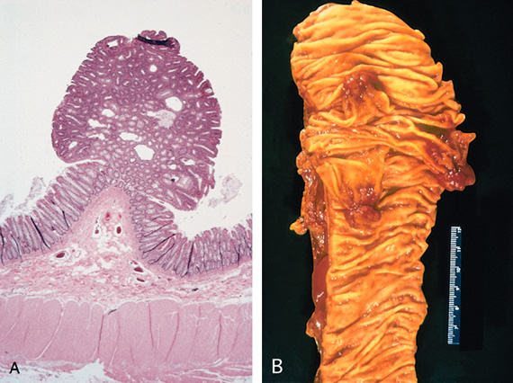
Polyp

Slide 19
Neoplasia
Examples of benign epithelial neoplasms :
  Respiratory airways: Bronchial adenoma
  Renal epithelium: Renal tubular adenoma
  Liver cell : Liver cell adenoma
  Squamous epithelium: squamous papilloma

Slide 20
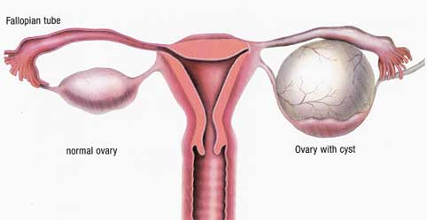
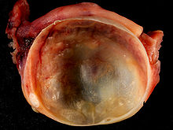
Cystadenoma

Slide 21
Malignant tumor

Slide 22
Neoplasia
Malignant tumors:
  Malignant tumor arising in mesenchymal tissue: SARCOMA
    From fibrous tissue: Fibrosarcoma
    From bone : Osteosarcoma
    From cartilage : chondrosarcoma

Slide 23
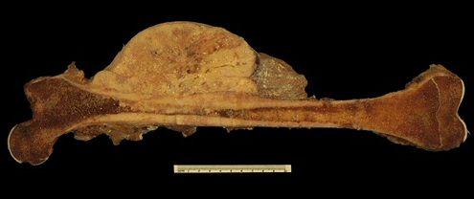
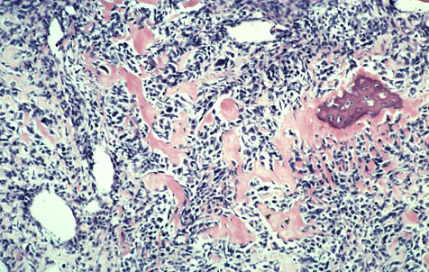
Osteosarcoma

Slide 24
Neoplasia
Malignant tumors arising from epithelial origin: CARCINOMA
  Squamous cell carcinoma
  Renal cell adenocarcinoma
  Cholangiocarcinoma

Slide 25
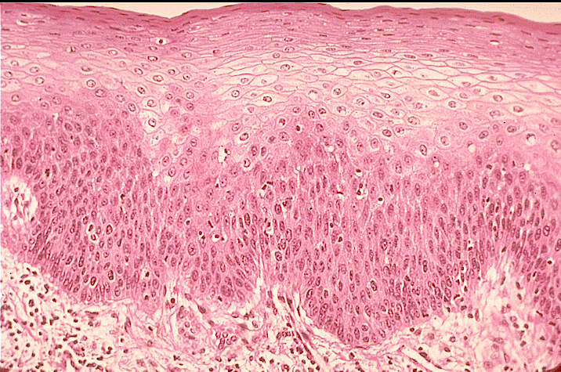
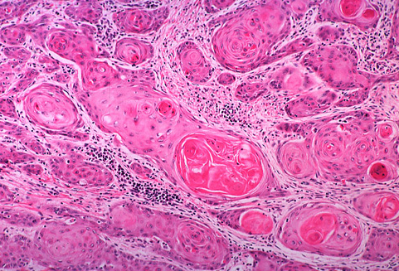
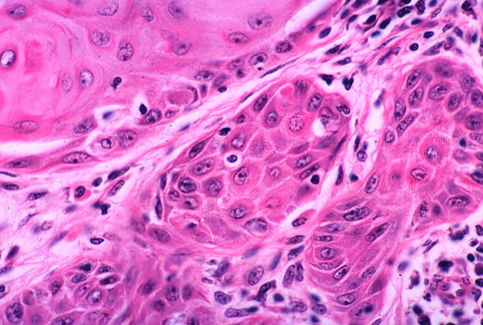
Carcinomas arising from any epithelium of the body that exhibit squamous differentiation are termed squamous cell carcinoma.
Normal squamous epithlium
Squamous cell carcinoma

Slide 26
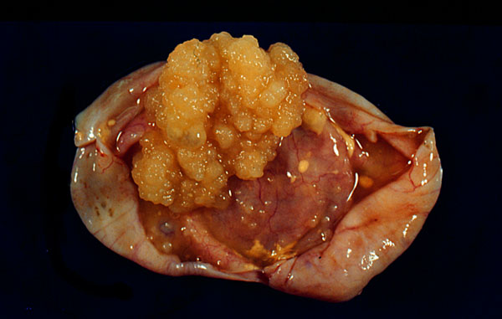
Nomenclature
other descriptive terms may be added such as:
Papillary Cystadenocarcinoma of the Ovary

Slide 27
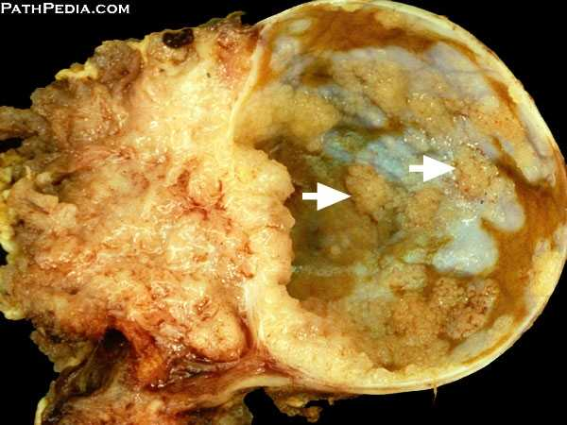
Nomenclature
other descriptive terms may be added such as:
Papillary Cystadenocarcinoma of the Ovary

Slide 28
Neoplasia
Exceptions
Melanoma ( skin )
Mesothelioma (mesothelium )
Seminoma ( testis )
Lymphoma ( lymphoid tissue )
See table 5-1 page 164 ( Robbin’s )

Slide 29
Nomenclature of benign and malignant neoplasm
Based on the biological behavior :
  Benign and malignant
Based on the cell of origin :
  One neoplastic cell type : lipoma, adenocarcinoma
  More than one neoplastic cell type : fibroadenoma
  More than one neoplastic cell type derived from more than one germ-cell layer: teratoma
  Derived from embryonic tissue: blastoma (could be benign e.g. osteoblastoma, or malignant e.g. neuroblastoma)

Slide 30
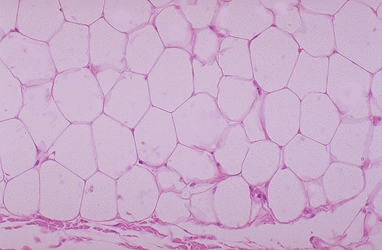
Lipoma

Slide 31
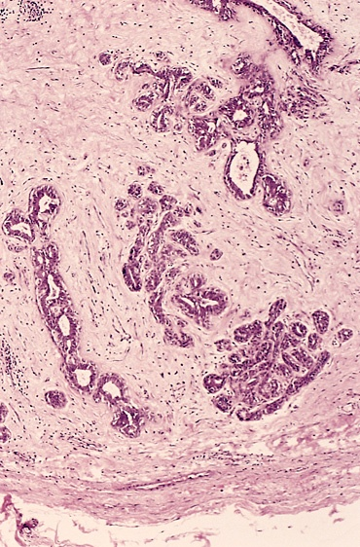
Fibroadenoma

Slide 32
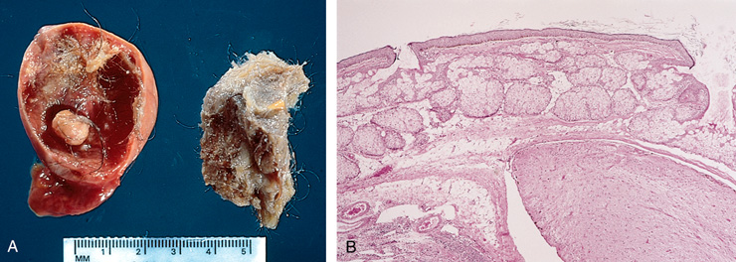
Teratoma

Slide 33
Neoplasia
Teratoma:
  Teratoma contains recognizable mature or immature cells or tissues representative of more than one germ-cell layer and some times all three.
  Teratomas originate from totipotential cells such as those normally present in the ovary and testis.

Slide 34
Neoplasia
Such cells have the capacity to differentiate into any of the cell types found in the adult body. So they may give rise to neoplasms that mimic bone, epithelium, muscle, fat, nerve and other tissues.
Most common sites are: ovary & testis

Slide 35
Neoplasia
If all the components parts are well differentiated, it is a benign (mature) teratoma.
If less well differentiated, it is an immature (malignant) teratoma.

Slide 36
Neoplasia nomenclature
- historic eponyms – “first described by…”
Malignant lymphoma (HL) of B Lymphocyte cell origin | Hodgkin’s disease
NHL – B Lymphocyte cell in children (jaw and GIT) | Burkitt tumor
Bone tumor: Primitive neuroectodermal tumor (PNET) | Ewing tumor
Kidney tumor - clear cell adenocarcinoma | Grawitz tumor
Malignant tumor derived from vascular epithelium (AIDS) | Kaposi sarcoma
Ovarian tumor derived from Brenner cells | Brenner tumor
Skin tumor derived from Merkel cell | Merkel tumor

Slide 37
WHAT ARE HAMARTOMAS AND CHORISTOMA?
Hamartoma: a mass composed of cells native to the organ
e.g. pulmonary hamartoma.
Choristoma: a mass composed of normal cells in a wrong location
e.g. pancreatic choristoma in liver or stomach.
Malformation and not neoplasm.

Slide 38
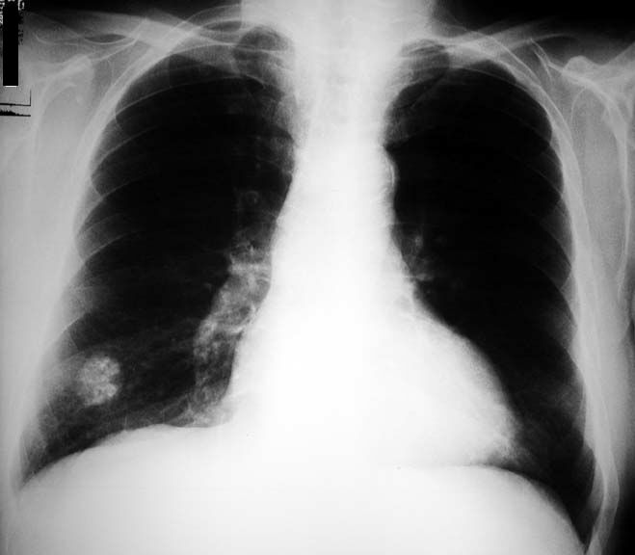
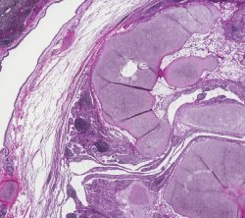
Pulmonary Hamartoma

Slide 39
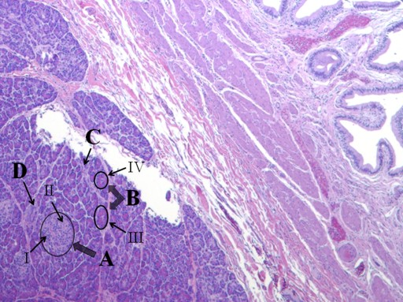
Pancreatic choristoma in gall bladder

Slide 40
Neoplasia
Hamartoma and Choristoma
They are distinguished from neoplasms by the fact that they do not exhibit continued growth. they are group of tumor-like tissue masses which may be confused with neoplasms

Slide 41
Characteristics of benign and malignant neoplasms
Differentiation and anaplasia
Rate of growth
Local invasion
Metastasis

Slide 42
Characteristics of benign and malignant neoplasms
1. Differentiation and anaplasia
Differentiation means : the extent to which the parenchymal cells of the tumor resemble their normal counterparts morphologically and functionally

Slide 43
Characteristics of benign and malignant neoplasms
1. Differentiation and anaplasia
well differentiated = closely resemble their normal counterparts
Moderately differentiated
Poorly differentiated
Undifferentiated ( Anaplasia )

Slide 44
Characteristics of benign and malignant neoplasms
1. Differentiation and anaplasia
Benign tumors = well differentiated
Malignant tumors =
well differentiated -----> anaplastic

Slide 45
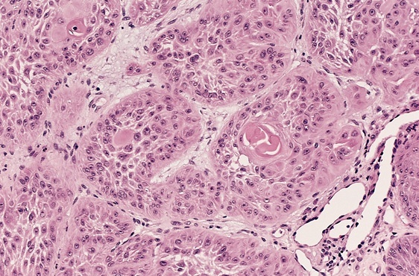

Slide 46
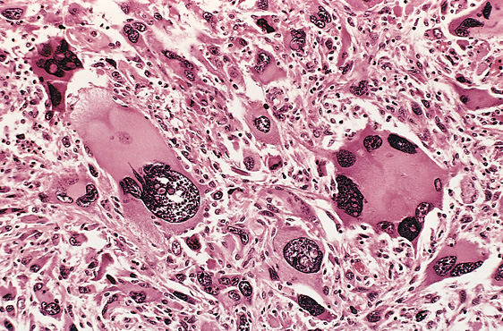

Slide 47
Characteristics of benign and malignant neoplasms
1. Differentiation and anaplasia
In the histological examination of a tumor you should look for :
  Pleomorphism : variation in size
  High nuclear/ cytoplasm ratio ( N/C ratio)
  Hyperchrmasia ( dark cell )
  Mitosis ….?abnormal one

Slide 48
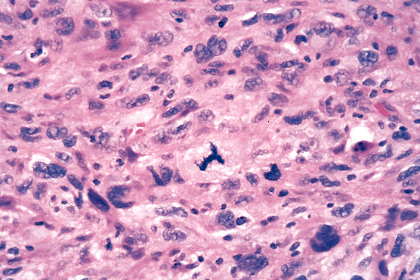

Slide 49
Neoplasia
In the histological examination of a tumor you should look for :
  Pleomorphism : variation in size
  High nuclear/ cytoplasm ratio ( N/C ratio)
  Hyperchrmasia ( dark cell )
  Mitosis ….?abnormal one

Slide 50
anaplasia
Anaplastic cells: undifferentiated cells
Lose their resemblance to the normal cells from which they have arisen whatever their tissue of origin
Loss of function

Slide 52
Dysplasia
  Definiton: a loss in the uniformity of the individual cells and a loss in their architectural orientation.
  Non-neoplastic
  Occurs mainly in the epithelia
  Dysplastic cells shows a degree of : pleomorphism, hyperchrmasia, increased mitosis and loss of polarity.

Slide 53
Neoplasia
Dysplasia
Dysplasia does not mean cancer
Dyplasia does not necessarily progress to cancer
Dysplasia may be reversible
If dysplastic changes involve the entire thickness of the epithelium it is called :
CARCINOMA IN-SITU

Slide 54
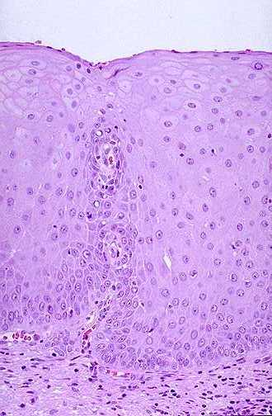
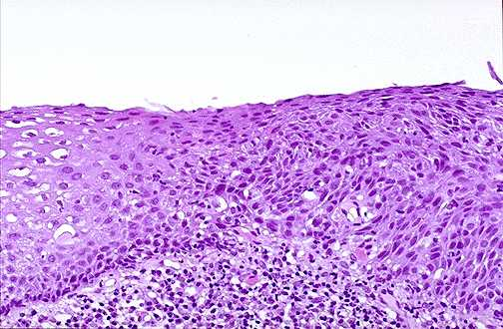
Dysplasia

Slide 55
Neoplasia
Carcinoma in-situ
  Definition: an intraepithelial malignancy in which abnormal cells involve the entire thickness of the epithelium without penetration of the basement membrane.
  Applicable only to epithelial neoplasms.

Slide 56
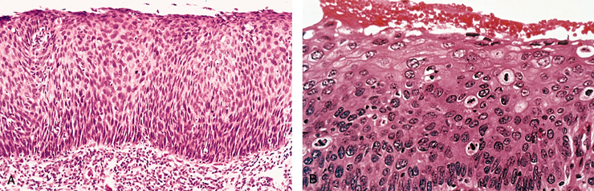

Slide 57
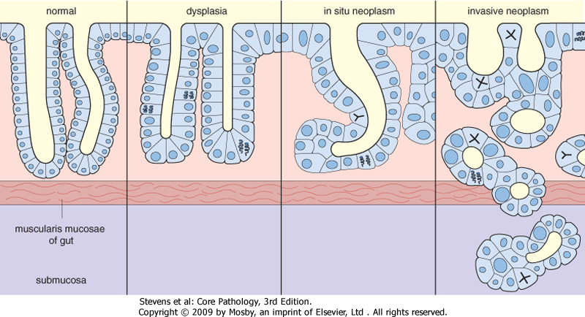

Slide 58
Dysplasia
Dysplasia: Features
Nuclear abnormality
  Increased N/C ratio
  Irregular nuclear membrane
  Increased chromatin content
Cytoplasmic abnormalities due to failure of normal maturation
Increased rate of multiplication.
Disordered maturation.

Slide 59
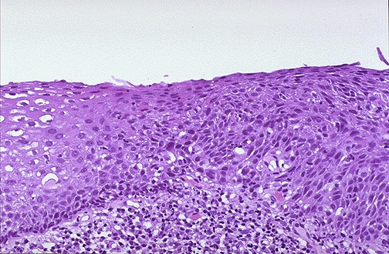
Dysplasia
Dysplasia
Uterine cervix
Sever Dysplasia
Mild Dysplasia

Slide 60
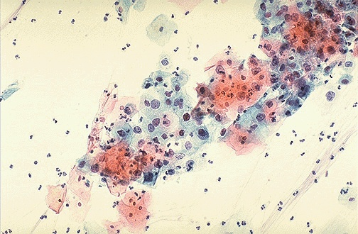
Dysplasia
(cervical pap smear)

Slide 61
Dysplasia
Dysplasia
Clinical significance:
  It is a premalignant condition.
  The risk of invasive cancer varies with:
grade of dysplasia (mild, moderate, sever)
duration of dysplasia
site of dysplasia

Slide 62
Dysplasia
Dysplasia
Differences between dysplasia and cancer.
  ∗ lack of invasiveness
  ∗ Reversibility

Slide 63
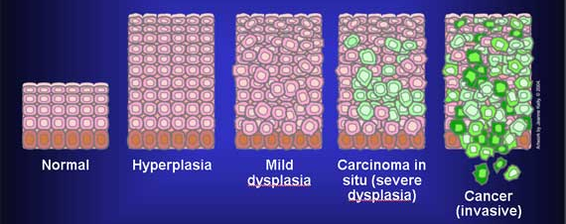
Dysplasia
Carcinoma in situ
A true neoplasm with all of the features of malignant neoplasm except invasiveness
Displays the cytological features of malignancy without invasion of the basement membrane.

Slide 64
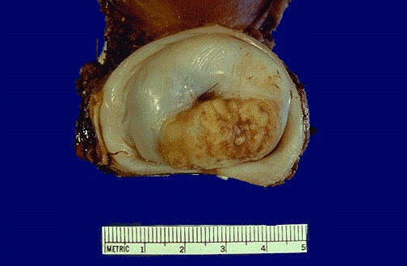
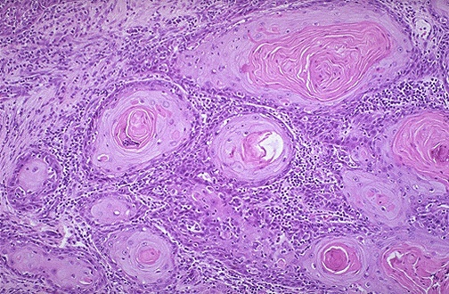
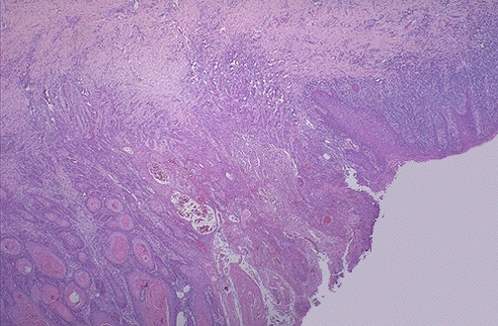
Squamous cell Carcinoma
Uterine Cervix
Dysplasia
Notes:
Cervical SC carcinoma - infiltrating

Slide 65
Thank you

