Slide 1
Neoplasia
Lecture 2
CHARACTERISTICS OF BENIGN AND MALIGNANT NEOPLASMS
EPIDEMIOLOGY
Abdulmalik Alsheikh, MD, FRCPC
Maha Arafah, MBBS, KSFP
Foundation block 2014
Pathology

Slide 2
Objectives
Compare and contrast benign and malignant tumors with respect to:
  demarcation from surrounding tissue (capsule, local invasiveness)
  rate of growth
  degree of differentiation (Explain the meaning of differentiation).
  distant spread (metastases).
Describe the morphologic changes associated with poorly differentiated tumors; define and understand the usage of the terms anaplasia, pleomorphism, nuclear atypia, abnormal mitoses and tumor giant cells.
Define dysplasia and its clinical significant.
Understand the clinical significance of invasiveness and metastasis.
Describe the anatomic pathways utilized by tumors in metastatic spread. Know which pathways are commonly used by carcinomas versus sarcomas.
List some common sites of distant metastases.
Recognize the epidemiologic data of cancer distribution in regard to age, race, geographic factors, and genetic backgrounds.
List some inherited syndromes with a genetic predisposition to cancer.

Slide 3
Characteristics of benign and malignant neoplasms
Differentiation and anaplasia
Rate of growth
Local invasion
Metastasis

Slide 4
Characteristics of benign and malignant neoplasms
1. Differentiation and anaplasia
Differentiation means : the extent to which the parenchymal cells of the tumor resemble their normal counterparts morphologically and functionally

Slide 5
Characteristics of benign and malignant neoplasms
1. Differentiation and anaplasia
well differentiated = closely resemble their normal counterparts
Moderately differentiated
Poorly differentiated
Undifferentiated ( Anaplasia )

Slide 6
Characteristics of benign and malignant neoplasms
1. Differentiation and anaplasia
Benign tumors = well differentiated
Malignant tumors =
well differentiated -----> anaplastic

Slide 7
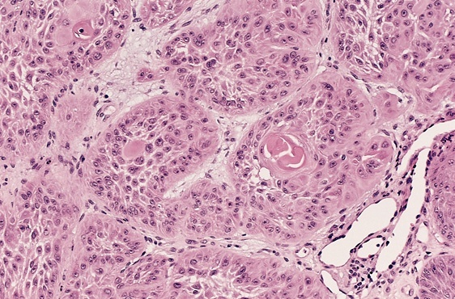

Slide 8
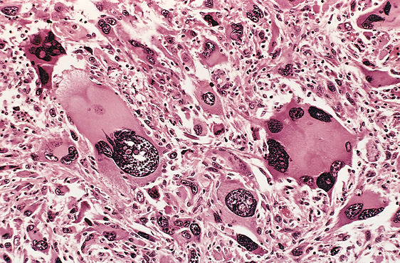

Slide 9
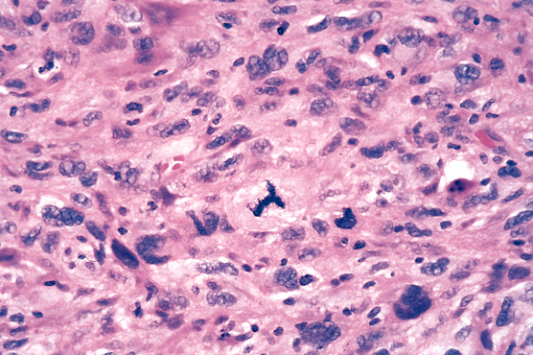

Slide 10
Characteristics of benign and malignant neoplasms
1. Differentiation and anaplasia
In the histological examination of a tumor you should look for :
  Pleomorphism : variation in size
  High nuclear/ cytoplasm ratio ( N/C ratio)
  Hyperchrmasia ( dark cell )
  Mitosis ….?abnormal one

Slide 12
Dysplasia
  Definiton: a loss in the uniformity of the individual cells and a loss in their architectural orientation.
  Non-neoplastic
  Occurs mainly in the epithelia
  Dysplastic cells shows a degree of : pleomorphism, hyperchrmasia, increased mitosis and loss of polarity.

Slide 13
Neoplasia
Dysplasia
Dysplasia does not mean cancer
Dyplasia does not necessarily progress to cancer
Dysplasia may be reversible
If dysplastic changes involve the entire thickness of the epithelium it is called :
CARCINOMA IN-SITU

Slide 14
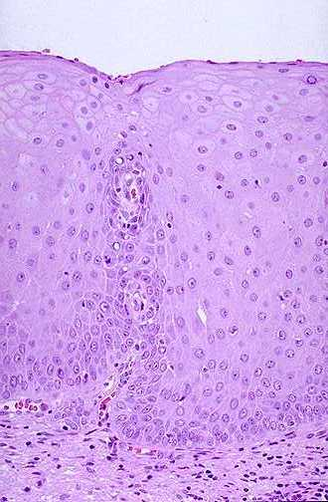
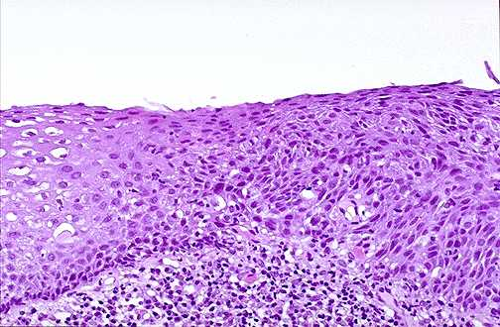
Dysplasia

Slide 15
Neoplasia
Carcinoma in-situ
  Definition: an intraepithelial malignancy in which malignant cells involve the entire thickness of the epithelium without penetration of the basement membrane.
  Applicable only to epithelial neoplasms.

Slide 16
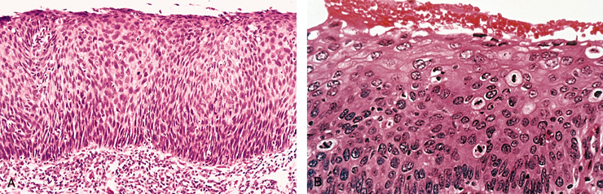

Slide 17
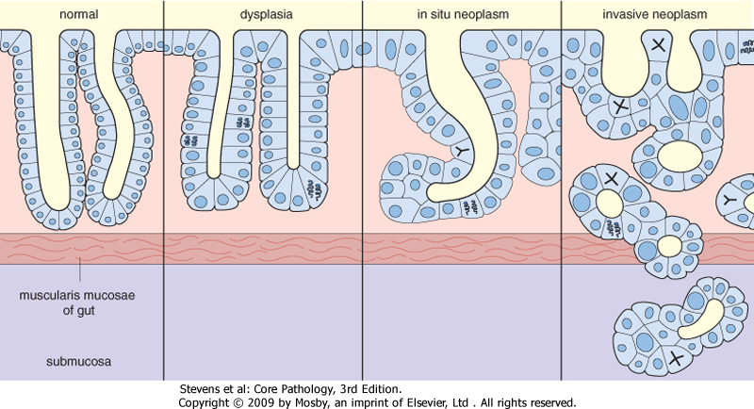

Slide 18
Dysplasia
Dysplasia: Features
Nuclear abnormality
  Increased N/C ratio
  Irregular nuclear membrane
  Increased chromatin content
Cytoplasmic abnormalities due to failure of normal maturation
Increased rate of multiplication.
Disordered maturation.

Slide 19
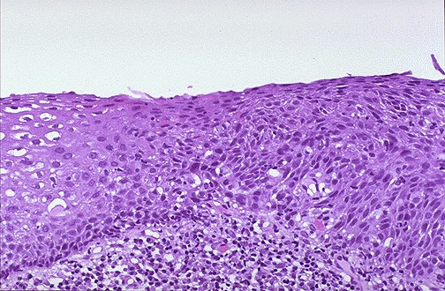
Dysplasia
Dysplasia
Uterine cervix
Sever Dysplasia
Mild Dysplasia

Slide 20
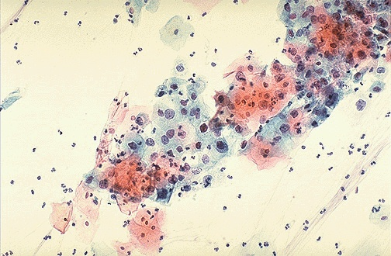
Dysplasia
(cervical pap smear)

Slide 21
Dysplasia
Dysplasia
Clinical significance:
  It is a premalignant condition.
  The risk of invasive cancer varies with:
grade of dysplasia (mild, moderate, sever)
duration of dysplasia
site of dysplasia

Slide 22
Dysplasia
Dysplasia
Differences between dysplasia and cancer.
∗lack of invasiveness.
∗Reversibility

Slide 23
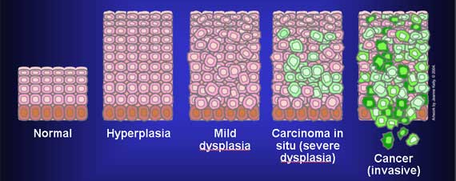
Dysplasia
Carcinoma in situ
A true neoplasm with all of the features of malignant neoplasm except invasiveness
Displays the cytological features of malignancy without invasion of the basement membrane.

Slide 24
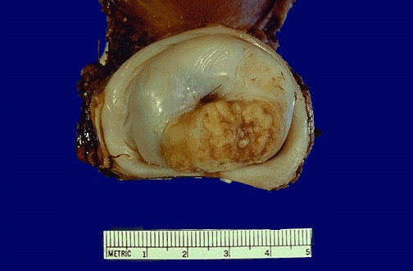
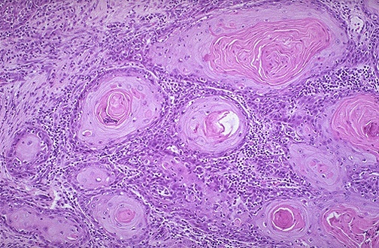
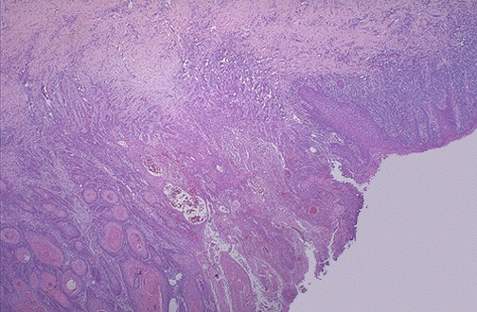
Squamous cell Carcinoma
Uterine Cervix
Dysplasia
Notes:
Cervical SC carcinoma - infiltrating

Slide 25
Characteristics of benign and malignant neoplasms
Differentiation and anaplasia
Rate of growth
Local invasion
Metastasis

Slide 26
Characteristics of benign and malignant neoplasms
Rate of growth
  Benign tumors:
    grows slowly
    are affected by blood supply, hormonal effects, location
  Malignant tumors :
    grows faster
    Correlate with the level of differentiation

Slide 27
Characteristics of benign and malignant neoplasms
Differentiation and anaplasia
Rate of growth
Local invasion
Metastasis

Slide 28
Characteristics of benign and malignant neoplasms
Local invasion
  Benign tumors :
    Remain localized
    Cannot invade
    Usually capsulated
  Malignant tumors :
    Progressive invasion
    Destruction
    Usually not capsulated

Slide 29
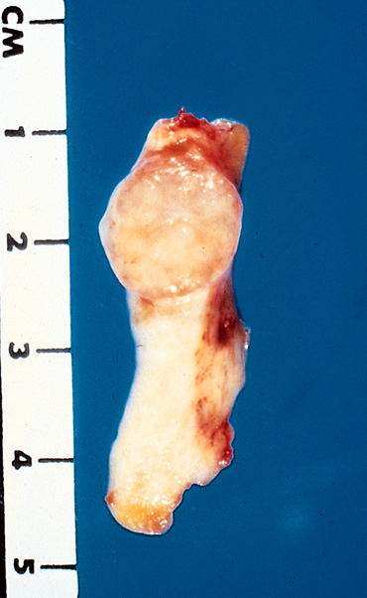
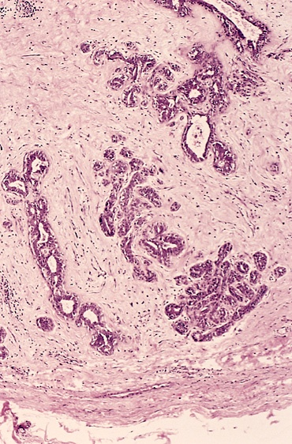

Slide 30
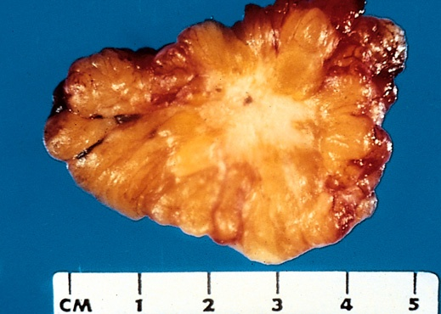
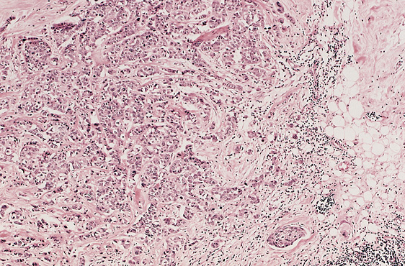

Slide 31
Characteristics of benign and malignant neoplasms
Differentiation and anaplasia
Rate of growth
Local invasion
Metastasis

Slide 32
Characteristics of benign and malignant neoplasms
Metastasis
  Definition : the development of secondary implants discontinuous with the primary tumor, possibly in remote tissues

Slide 33
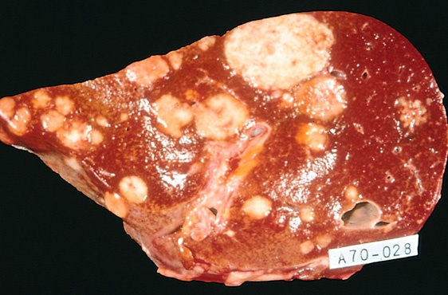

Slide 34
Characteristics of benign and malignant neoplasms
Metastasis
  Cancers have different ability to metastasize
  Approximately 30% patients present with clinically evident metastases.
  Generally, the more anaplastic and the larger the primary tumor, the more likely is metastasis

Slide 35
Characteristics of benign and malignant neoplasms
Metastasis
Metastasis : three pathways
  Lymphatic spread :
  Hematogenous spread :
  Seeding of the body cavities: pleural, peritoneal cavities and cerebral ventricles

Slide 36
Characteristics of benign and malignant neoplasms
Metastasis
Lymphatic spread :
  favored by carcinomas
  Breast carcinoma → axillary lymph nodes
  Lung carcinomas → bronchial lymph nodes

Slide 37
Characteristics of benign and malignant neoplasms
Metastasis
Hematogenous spread :
  favored by sarcomas
  Also used by carcinomas
  Veins are more commonly invaded
  The liver and lungs are the most frequently involved secondary sites

Slide 38
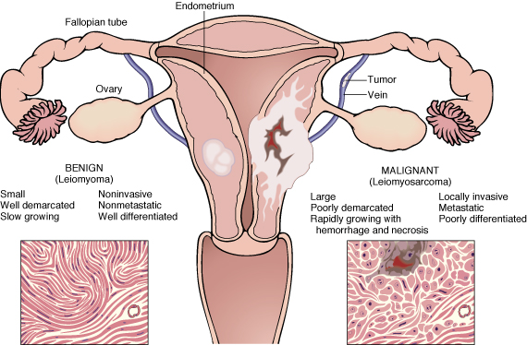

Slide 39
Epidemiology of Neoplasia

Slide 40
Epidemiology of
Neoplasia
  Will help to discover aetiology
  Planning of preventive measures
  To know what is common and what is rare.
  Development of screening methods for early diagnosis

Slide 41
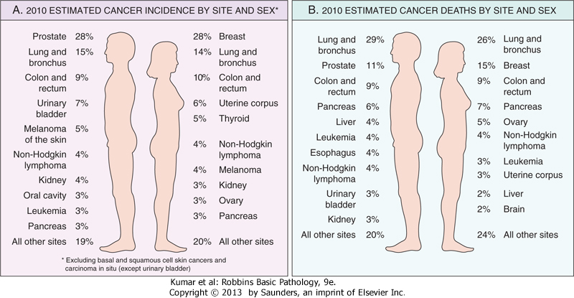
Epidemiology

Slide 42
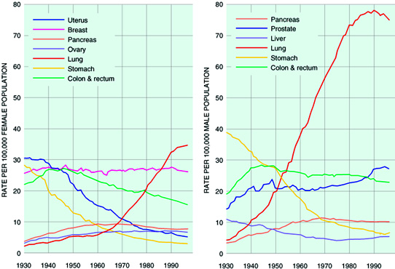

Slide 44
Epidemiology
Factors affecting incidence of cancer
  Geographic and Environmental
  Age
  Heredity
  Aquired preneoplastic disorders

Slide 45
Epidemiology
Geographic and Environmental factors:
  Rate of stomach carcinoma in Japan is seven times the rate in North America and Europe.
  Breast carcinoma is five times higher in North America comparing to Japan
  Liver cell carcinoma is more common in African populations

Slide 46
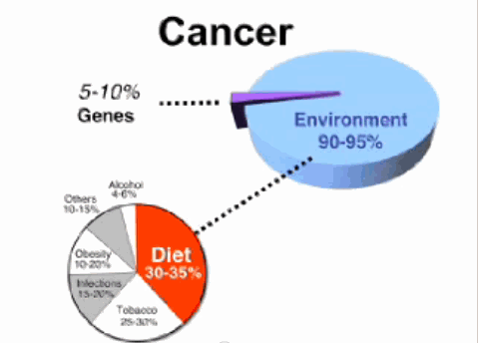

Slide 47
Neoplasia
Epidemiology
Geographic and Environmental factors:
  Asbestos : mesothelioma
  Smoking : lung cancer
  Multiple sexual partners: cervical cancer
  Fatty diets : colonic cancer
  Please see table 5-2 page 171 for occupational cancers

Slide 48
Epidemiology
Factors affecting incidence of cancer
  Geographic and Environmental
  Age
  Heredity
  Aquired preneoplastic disorders

Slide 49
Neoplasia
Epidemiology: Age
  Generally, the frequency of cancer increases with age.
  Most cancer mortality occurs between 55 and 75.
  Cancer mortality is also increased during childhood
  Most common tumors of children: Leukemia, tumors of CNS, Lymphomas, soft tissue and bone sarcomas.

Slide 50
Epidemiology
Factors affecting incidence of cancer
  Geographic and Environmental
  Age
  Heredity
  Aquired preneoplastic disorders

Slide 51
Epidemiology: Heredity
  Autosomal dominant cancer syndromes
  Autosomal Recessive Syndromes of Defective DNA Repair
  Familial Cancers of Uncertain Inheritance

Slide 52
Epidemiology: Heredity
Autosomal dominant cancer syndromes
  Inheritance of a single mutant gene greatly increases the risk of developing neoplasm
  E.g. Retinoblastoma in children :
    40% of Retinoblastomas are familial
    carriers of the gene have 10000 fold increase in the risk of developing Retinoblastoma

Slide 53
Epidemiology: Heredity
Aquired preneoplastic disorders:
Examples of Autosomal Dominant Cancer Syndromes
Inherited Predisposition | Gene
Retinoblastoma | RB
Li-Fraumeni syndrome (various tumors) | TP53
Melanoma | p16INK4A
Familial adenomatous polyposis/colon cancer | APC
Breast and ovarian tumors | BRCA1, BRCA2
Multiple endocrine neoplasia 1 and 2 | MEN1, RET

Slide 54
Heredity
Epidemiology: Heredity
  Autosomal Recessive Syndromes of Defective DNA Repairir :
    Small group of autosomal recessive disorders
    Characterized by DNA instability
    E.g. xeroderma pigmentosum

Slide 55
Heredity
Epidemiology: Heredity
Familial Cancers of Uncertain Inheritance
  All common types of cancers occur in familial form
  E.g. breast, colon, ovary, brain
  Familial cancers usually have unique features:
    Start at early age
    Multiple or bilateral
    Two or more relatives

Slide 56
Epidemiology
Factors affecting incidence of cancer
  Geographic and Environmental
  Age
  Heredity
  Aquired preneoplastic disorders

Slide 57
Neoplasia
Epidemiology:
Acquired preneoplastic disorders
  Some Clinical conditions that predispose to cancer
    Dysplastic bronchial mucosa in smokers→ lung carcinoma
    Liver cirrhosis → liver cell carcinoma
    Margins of chronic skin fistula → Squamous cell carcinoma

Slide 58
Summary of Epidemiology of Cancer
The incidence of cancer varies with age (most common at the two extremes of age), race, geographic factors (results mostly from different environmental exposures), and genetic backgrounds.
Most cancers are sporadic, but some are familial. Predisposition to hereditary cancers may be autosomal dominant or autosomal recessive.
Familial cancers tend to be bilateral and arise earlier in life than their sporadic counterparts.
Some acquired diseases (preneoplastic disorders) are known to be associated with an increased risk for development of cancer.

