Slide 1
NEOPLASIA Lecture 3
ETIOLOGY OF CANCER: CARCINOGENIC AGENTS
Maha Arafah, MD, KSFP
Abdulmalik Alsheikh, M.D, FRCPC
Foundation block 2014 Pathology

Slide 2
Objectives
List the various causes of neoplasms

Slide 3
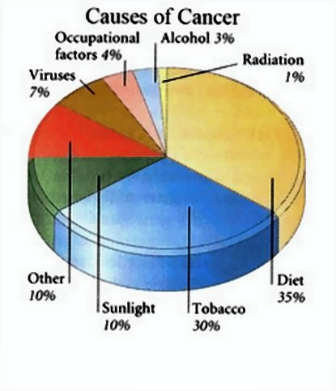
Carcinogenic Agents
Chemicals
Radiation
Microbial agents

Slide 4
Carcinogenic Agents Chemical Carcinogens
Natural or synthetic
Direct reacting or indirect
Indirect → need metabolic conversion to be active and carcinogenic
Indirect chemicals are called “ procarcinogens “ and their active end products are called “ ultimate carcinogens”

Slide 6
Carcinogenic Agents Chemical Carcinogens
All direct reacting and ultimate chemical carcinogens are highly reactive as they have electron-deficient atoms
They react with the electron rich atoms in RNA, DNA and other cellular proteins

Slide 7
Carcinogenic Agents Chemical Carcinogens
Examples:
Alkylating agents
Polycyclic hydrocarbons:
Cigarette smoking
Animal fats during broiling meats
Smoked meats and fish

Slide 8
Carcinogenic Agents Chemical Carcinogens
Aromatic amines and azo dyes:
Β-naphthylamine cause bladder cancer in rubber industries and aniline dye
Some azo dyes are used to color food also can cause bladder cancer

Slide 9
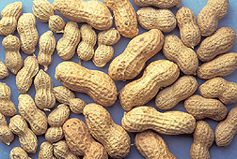
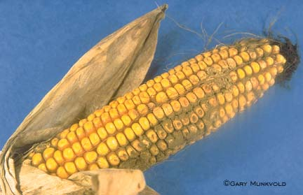
Carcinogenic Agents Chemical Carcinogens
Other sustances:
Nitrosamines and nitrosamides are used as preservatives. They cause gastric cancer.
Aflatoxin B: produced by Aspergillus growing on improperly stored grains. It cause hepatocellular carcinoma

Slide 10
Carcinogenic Agents Chemical Carcinogens
Mechanism of action of chemical carcinogens:
Most of them are mutagenic. i.e. cause mutations
RAS and P53 are common targets

Slide 11
Carcinogenic Agents Radiation Carcinogenesis
UV rays of sunlight
X-rays
Nuclear radiation
Therapeutic irradiations
Radiation has mutagenic effects: chromosomes breakage, translocations, and point mutations

Slide 12
Carcinogenic Agents Radiation Carcinogenesis
UV rays of sunlight :
Can cause skin cancers: melanoma, squamous cell carcinoma, and basal cell carcinoma
It is capable to damage DNA
With extensive exposure to sunlight, the repair system is overwhelmed→ skin cancer
They cause mutations in P53 gene

Slide 13
Carcinogenic Agents
Viral and Microbial oncogenesis
DNA viruses
RNA viruses
other organisms

Slide 14
Carcinogenic Agents Viral Carcinogenesis
carry genes that induce cell replication as part of the viral life cycle
host cell has endogenous genes that maintain the normal cell-cycle
Viral infection mimics or blocks these normal cellular signals necessary for growth regulation

Slide 15
Carcinogenic Agents Viral Carcinogenesis
RNA Oncogenic viruses
Human T-Cell Leukemia Virus type 1 (HTLV-1)
RNA retrovirus targets / transforms T-cells
causes T-Cell leukemia/Lymphoma
Endemic in Japan and Caribbean
Transmitted like HIV but only 1% of infected develop T-Cell leukemia/Lymphoma
20-30 year latent period
No cure or vaccine
Treatment : chemotherapy with common relapse

Slide 16
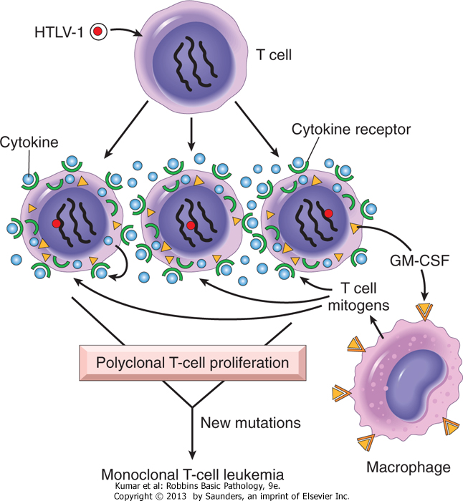

Slide 17
Carcinogenic Agents Viral Carcinogenesis
DNA Oncogenic Viruses
virus DNA forms stable association with host’s DNA
transcribed viral DNA transforms host cell
Examples: Human papilloma viruses (HPV)
Epstein-Barr (EBV)
Hepatitis B (HBV)
Kaposi sarcoma herpes virus

Slide 18
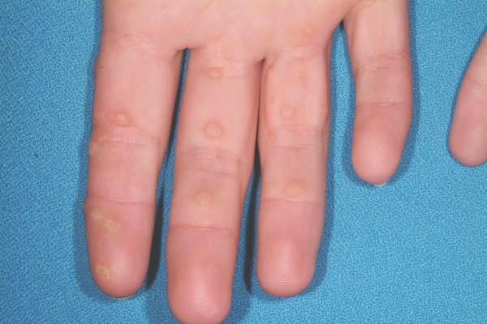
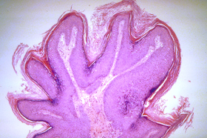
Carcinogenic Agents Human Papillomavirus (HPV)
HPV causing benign tumors:
types 6, 11

Slide 19
Carcinogenic Agents Viral Carcinogenesis
Human Papillomavirus (HPV)
70 types
squamous cell carcinoma of
cervix
anogenital region
mouth
larynx

Slide 20
Carcinogenic Agents Human Papillomavirus (HPV)
sexually transmitted
Cervical cancer
85% have types 16 and 18
Genital warts
types 6 and 11

Slide 21
Carcinogenic Agents Human Papillomavirus (HPV)
HPV causing malignant tumors :
types 16, 18, 31
vDNA integrates w/ host

Slide 22
Carcinogenic Agents Viral Carcinogenesis
HPV (types 16 and 18)
over-expression of Exon 6 and 7
E6 protein binds to Rb tumor suppressor
replaces normal transcription factors
decreases Rb synthesis
E7 protein binds to P53
facilitates degradation of P53

Slide 23
Carcinogenic Agents Viral Carcinogenesis
HPV infection alone is not sufficient -
other risk factors:
cigarette smoking
coexisting infections
hormonal changes

Slide 24
Carcinogenic Agents Viral Carcinogenesis
Epstein-Barr Virus
common virus worldwide
Infects B lymphocytes and epithelial cells of oropharynx
causes infectious mononucleosis
EBV infection may cause malignancy
Burkitt’s Lymphoma
B cell lymphoma in immunosuppressed
Nasopharyngeal carcinoma

Slide 25
Carcinogenic Agents Viral Carcinogenesis Epstein-Barr Virus related
Nasopharyngeal carcinoma
Cancer of nasopharygeal epithelium
Endemic in South China, parts of Africa
100% of tumors contain EBV genome in endemic areas

Slide 26
Carcinogenic Agents Viral Carcinogenesis Epstein-Barr Virus related
Burkitt Lymphoma
highly malignant B cell tumor
sporadic rare occurrence worldwide
most common childhood tumor in Africa
all cases have t(8:14)

Slide 27
Carcinogenic Agents Viral Carcinogenesis Epstein-Barr Virus related
causes B lymphocyte cell proliferation
loss of growth regulation
predisposes to mutation, esp. t(8:14)

Slide 28
Carcinogenic Agents Viral Carcinogenesis
Hepatitis B virus (HBV)
Strong association with Liver Cancer
World-wide, but HBV infection is most common in Far East and Africa
HBV infection incurs up to 200-fold risk to hepatocellular carcinoma

Slide 29
Carcinogenic Agents
Helicobacter Pylori
bacteria infecting stomach
implicated in:
peptic ulcers
gastric lymphoma
Mucosal Associated Lymphoid Tumor (MALT)
gastric carcinoma

