Slide 1
INFLAMMATION AND REPAIR
Lecture 1
Definition of inflammation; acute inflammation
Vascular Events in Inflammation
Lecturer: Dr. Maha Arafah
(Foundation Block, pathology
14/10/2014

Slide 2
Learning Objectives:
Define inflammation.
Recognize the cardinal signs of inflammation.
List cells & molecules that play important roles in inflammation
Compare between acute and chronic inflammation
Describe the sequence of vascular changes in acute inflammation (vasodilation, increased permeability) and their purpose.
Know the mechanisms of increased vascular permeability.
Compare normal capillary exchanges with exchange during inflammatory response.
Define the terms edema, transudate, and exudate.

Slide 3
Reference book and the relevant page numbers..
Robbins Basic Pathology 9th edition
Page: 29 - 34

Slide 4
Infection.
Trauma.
Physical injury (burns).
Chemical injury.
Immunological injury (AID).
Tissue death (MI).
Injury
Tissue damage
Tissue response
Eliminates the effect of injury (pathogen and necrotic tissue)
Repair

Slide 5
What is Inflammation?
  Inflammation, the local response of the vascularized living tissue to injury
  Immediate response with limited specificity
A series of events start which leads as far as possible to the healing and reconstitution of the damaged tissue.
➔ Therefore, Inflammation is part of a broader protective response (innate immunity )
  Aim: eliminate the initial cause of cell injury as well as the necrotic cells and tissues resulting from the original insult

Slide 6
Can inflammation be harmful ! ?
Inflammation can induce harm:
e.g. anaphylactic reaction
rheumatoid arthritis
atherosclerosis

Slide 7
What happens then?
Inflammation is terminated when the offending agent is eliminated and the secreted mediators are broken down or dissipated.
  There are active anti-inflammatory mechanisms that serve to control the response and prevent it from causing excessive damage to the host.

Slide 8
INFLAMMATION AND REPAIR
The steps of the inflammatory response can be remembered as the five Rs:
(1) recognition of the injurious agent
(2) recruitment of leukocytes
(3) removal of the agent
(4) regulation (control) of the response
(5) resolution (repair)

Slide 9
Learning Objectives:
Upon completion of these lectures, the student should:
Define inflammation.
Recognize the cardinal signs of inflammation.
List cells & molecules that play important roles in inflammation
Compare between acute and chronic inflammation
Describe the sequence of vascular changes in acute inflammation (vasodilation, increased permeability) and their purpose.
Know the mechanisms of increased vascular permeability.
Compare normal capillary exchanges with exchange during inflammatory response.
Define the terms edema, transudate, and exudate.

Slide 10
Clinical Features
The 5 ancient cardinal signs of inflammation are
Tumor:-swelling
Rubor :– redness
Calor: – warmth
Dolor :– pain
Functio Laesa :–loss of function
The suffix “its” is added to the base word to state the condition as in appendix/appendicitis

Slide 11
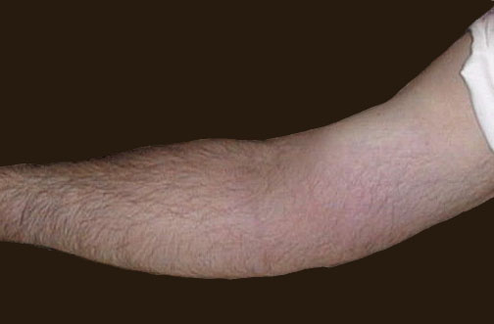
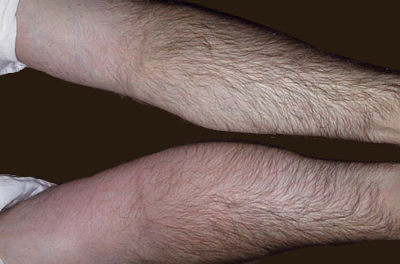
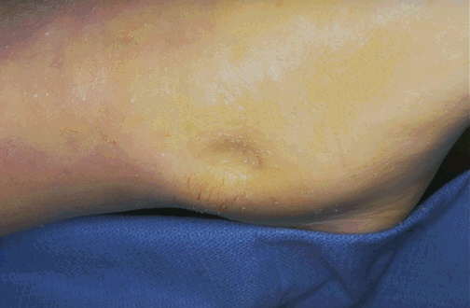
Redness
Notes:
The cardinal signs of inflammation are rubor (redness), calor (heat), tumor (swelling), dolor (pain), and loss of function. Seen here is skin with erythema, compared to the more normal skin at the far right.

Slide 12
Learning Objectives:
Upon completion of these lectures, the student should:
Define inflammation.
Recognize the cardinal signs of inflammation.
List cells & molecules that play important roles in inflammation
Compare between acute and chronic inflammation
Describe the sequence of vascular changes in acute inflammation (vasodilation, increased permeability) and their purpose.
Know the mechanisms of increased vascular permeability.
Compare normal capillary exchanges with exchange during inflammatory response.
Define the terms edema, transudate, and exudate.

Slide 13
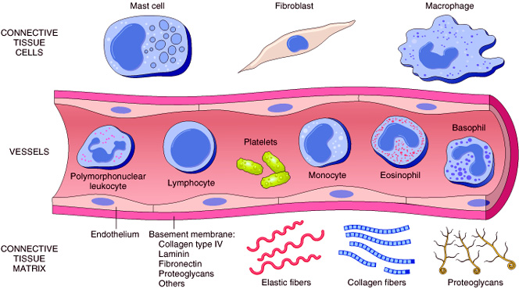
A protective response
Cells & molecules that play important roles in inflammation
Cells of surrounding C.T.
    The circulating cells:
Blood leukocytes
Plasma proteins
Extracellularmatrix of surrounding C.T.
Cells of vascular wall
The extracellular matrix

Slide 15
Chemical Mediators
Inflammation is mediated by chemical substances called
What is the source of these chemical mediators?
1. Phagocytes and other host cells
  Leukocyte
  Endothelium
  Mast cell
2. Plasma proteins

Slide 16
The outcome of acute inflammation
is either
elimination of the noxious stimulus, followed by decline of the reaction and repair of the damaged tissue
or
persistent injury resulting in chronic inflammation

Slide 17
Learning Objectives:
Upon completion of these lectures, the student should:
Define inflammation.
Recognize the cardinal signs of inflammation.
List cells & molecules that play important roles in inflammation
Compare between acute and chronic inflammation
Describe the sequence of vascular changes in acute inflammation (vasodilation, increased permeability) and their purpose.
Know the mechanisms of increased vascular permeability.
Compare normal capillary exchanges with exchange during inflammatory response.
Define the terms edema, transudate, and exudate.

Slide 18
TYPES OF Inflammation
Acute inflammation
Chronic Inflammation

Slide 19
Features of acute and chronic inflammation
Chronic | Acute | Feature
Slow : days, weeks | Fast : minutes or hours | Onset
lymphocytes and macrophages | neutrophils | Cellular infiltrate
Often sever & progressive | Mild, self limited | Tissue injury, fibrosis
Less prominent, may be subtle | Prominent | Local & systemic signs

Slide 20
Acute inflammation
A rapid response to an injurious agent that serves to deliver mediators of host defense-leukocytes and plasma proteins-to the site of injury.
What are the steps of the inflammatory response?
5Rs
(1) Recognition of the injurious agent
(2) Recruitment of leukocytes
(3) Removal of the agent
(4) Regulation (control) of the response
(5) Resolution and Repair

Slide 21
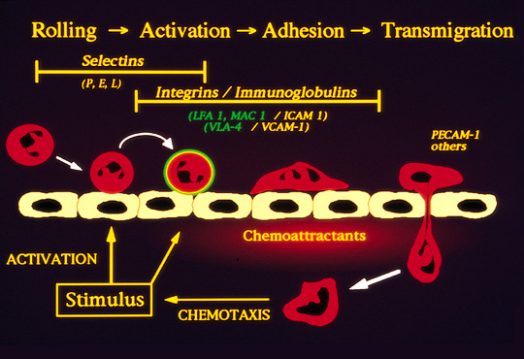

Slide 22
Learning Objectives:
Upon completion of these lectures, the student should:
Define inflammation.
Recognize the cardinal signs of inflammation.
List cells & molecules that play important roles in inflammation
Compare between acute and chronic inflammation
Describe the sequence of vascular changes in acute inflammation (vasodilation, increased permeability) and their purpose.
Know the mechanisms of increased vascular permeability.
Compare normal capillary exchanges with exchange during inflammatory response.
Define the terms edema, transudate, and exudate.

Slide 23
Events of acute Inflammation
Acute inflammation has three main events:
  (1) Hemodynamic changes
  (alterations in vascular caliber that lead to an increase in blood flow)
  (2) Increased vascular permeability
  (structural changes in the microvasculature that permit plasma proteins and leukocytes to leave the circulation)
  (3) Emigration of the leukocytes from the microcirculation
  (their accumulation in the focus of injury, and their activation to eliminate the offending agent)
vascular
cellular
Notes:
9

Slide 24
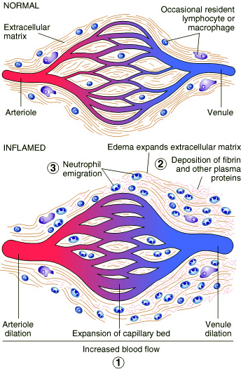
Vascular Events
Vasodilatation
Hemodynamic changes

Slide 25
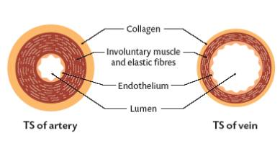
Hemodynamic changes
Vasodilation is induced by the action of several mediators, notably histamine, on vascular smooth muscle. It is one of the earliest manifestations of acute inflammation.
Vasodilation first involves the arterioles and then leads to opening of new capillary beds in the area. The result is increased blood flow, which is the cause of heat and redness (erythema) at the site of inflammation.

Slide 26
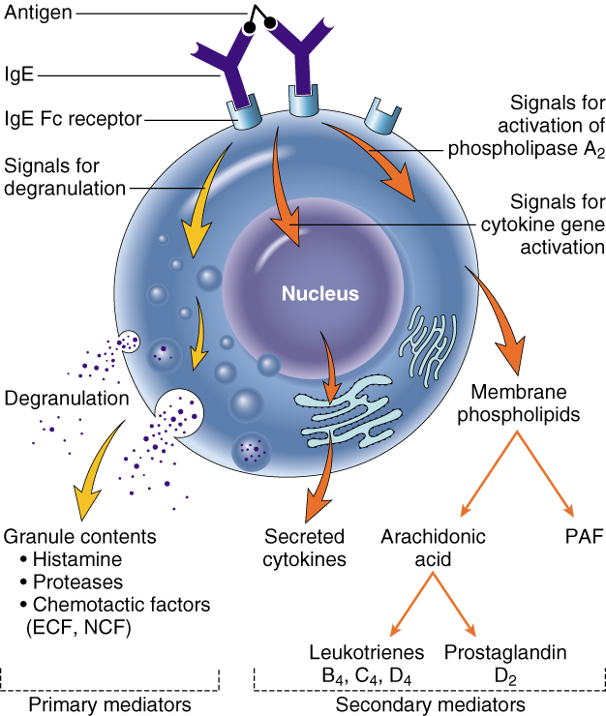
Phases of changes in Vascular Caliber and Flow
1. Transient vasoconstriction of arterioles
It disappears within 3-5 seconds in mild injuries
2. Vasodilatation: It involves the arterioles results in opening of new microvasculature beds in the area leading to increasing blood flow – Histamine effect
3. Slowing of the circulation
due to increased permeability of the microvasculature, this leads to outpouring of protein-rich fluid in the extravascular tissues.
4. Stasis: slow circulation due to dilated small vessels packed with red cells

Slide 27
Slowing of the circulation

Slide 28
Learning Objectives:
Upon completion of these lectures, the student should:
Define inflammation.
Recognize the cardinal signs of inflammation.
List cells & molecules that play important roles in inflammation
Compare between acute and chronic inflammation
Describe the sequence of vascular changes in acute inflammation (vasodilation, increased permeability) and their purpose.
Know the mechanisms of increased vascular permeability.
Compare normal capillary exchanges with exchange during inflammatory response.
Define the terms edema, transudate, and exudate.

Slide 29
2. Increased Vascular Permeability
A hallmark of acute inflammation (escape of a protein-rich fluid).
  induced by histamine, kinins, and other mediators
It affects small & medium size venules, through gaps between endothelial cells

Slide 30
Increased Vascular Permeability
It is elicited by histamine, bradykinin, leukotrienes, and other chemical mediators

Slide 31
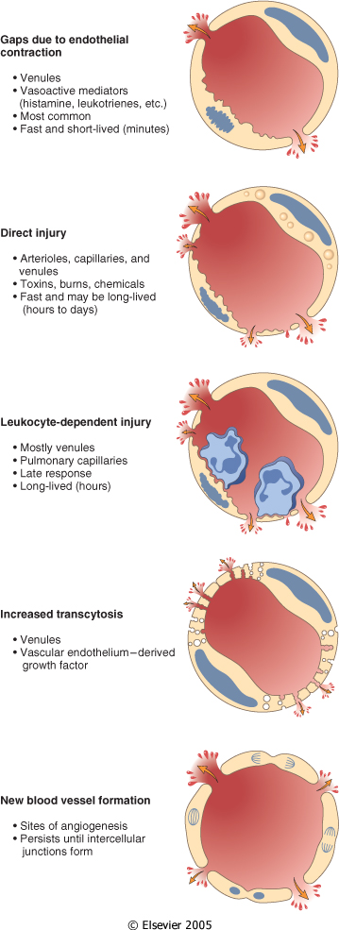
Mechanisms lead to increased vascular permeability
Endothelial cell contraction 15-30 min
Endothelial injury
  immediate sustained response 6-24 hours
  delayed prolonged leakage 12 hours- days
Leukocyte-mediated endothelial injury
Transcytosis (occurs via channels formed by fusion of intracellular vesicles)
Leakage from new blood vessels

Slide 32
Learning Objectives:
Upon completion of these lectures, the student should:
Define inflammation.
Recognize the cardinal signs of inflammation.
List cells & molecules that play important roles in inflammation
Compare between acute and chronic inflammation
Describe the sequence of vascular changes in acute inflammation (vasodilation, increased permeability) and their purpose.
Know the mechanisms of increased vascular permeability.
Compare normal capillary exchanges with exchange during inflammatory response.
Define the terms edema, transudate, and exudate.

Slide 33
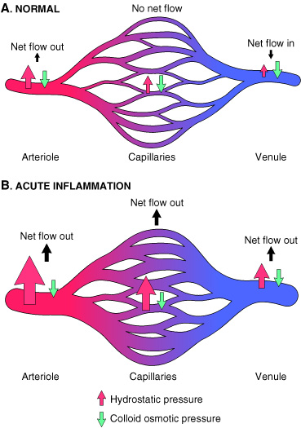
Increased blood volume lead to increased local hydrostatic pressure leading to transudation of protein-poor fluid into the extravascular space.
What is the edema?
denotes an excess of fluid in the interstitial or serous cavities
It can be either an exudate or a transudate

Slide 34
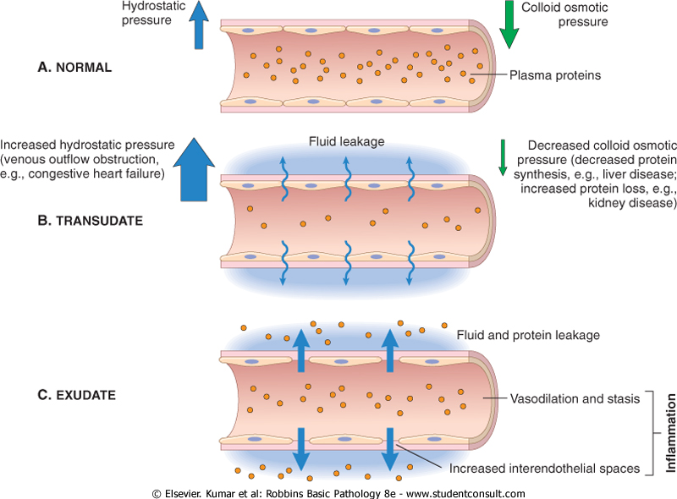

Slide 35
Learning Objectives:
Upon completion of these lectures, the student should:
Define inflammation.
Recognize the cardinal signs of inflammation.
List cells & molecules that play important roles in inflammation
Compare between acute and chronic inflammation
Describe the sequence of vascular changes in acute inflammation (vasodilation, increased permeability) and their purpose.
Know the mechanisms of increased vascular permeability.
Compare normal capillary exchanges with exchange during inflammatory response.
Define the terms edema, transudate, and exudate.

Slide 36
What is the difference between transudates and exudates?
is a fluid with low protein content and a specific gravity of less than 1.012
It is essentially an ultrafiltrate of blood plasma that results from osmotic or hydrostatic imbalance across the vessel wall
without an increase in vascular permeability
An inflammatory extravascular fluid that has a high protein concentration, cellular debris, and a specific gravity above 1.020
It implies significant alteration in the normal permeability of small blood vessels in the area of injury
Transudate
Exudate

Slide 37
TAKE HOME MESSAGES
Inflammation, the local response of the vascularised living tissue to injury.
Could be acute or chronic.
Several cells & molecules that play important roles in inflammation.
Inflammation has vascular and cellular events to eliminate the cause.
Vascular events include vasodilation and increased permeability to deliver a protein rich fluid to site of inflammation.

Slide 38
Thank you

