Slide 1
INFLAMMATION AND REPAIR
Lecture 2
Cellular Events in Inflammation
(Foundation Block, pathology)
Maha Arafah
Associate Professor
Department of Pathology
King Saud University
Email: marafah @hotmail.com
2014
Dr. Maha Arafah

Slide 2
Objectives
Describe the steps involved in extravasation of leukocytes from the blood to the tissues. Know the steps at which selectins and integrins act.
Describe the meaning and utility of chemotaxis. Understand the role that chemokines play in inflammation.
Describe the steps involved in phagocytosis and the role of IgG and C3b as opsonins and receptors.
List the mechanisms of microbial killing.
Know various defects in leukocyte function.

Slide 3
Reference book and the relevant page numbers..
Robbins Basic Pathology 9th edition, pages 34-41

Slide 4
Acute Inflammation
CELLULAR EVENTS:
A critical function of inflammation is to deliver leukocytes to the site of injury
and to activate the leukocytes to perform their normal functions in host defense.
WHAT ARE THESE FUNCTION?
Leukocytes ingest offending agents, kill bacteria and other microbes, and get rid of necrotic tissue and foreign substances.
They may induce tissue damage and prolong inflammation, since the leukocyte products that destroy microbes and necrotic tissues can also injure normal host tissues.
LEUKOCYTE EXTRAVASATION

Slide 5
Recruitment of leukocytes
A multistep process involving attachment of circulating leukocytes to endothelial cells and their migration through the endothelium (extravasation)
3 steps:
In the lumen:
  Margination
  rolling
  adhesion to endothelium
  Vascular endothelium normally does not bind circulating cells
Transmigration across the endothelium (also called diapedesis)
Migration in interstitial tissues toward a chemotactic stimulus

Slide 6
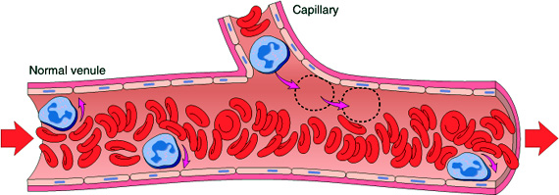
Acute Inflammation
CELLULAR EVENTS:
LEUKOCYTE EXTRAVASATION AND PHAGOCYTOSIS
  Margination

Slide 7
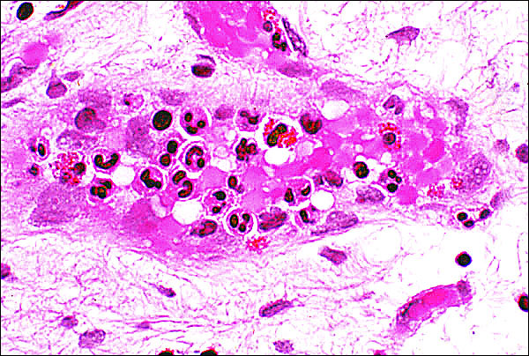
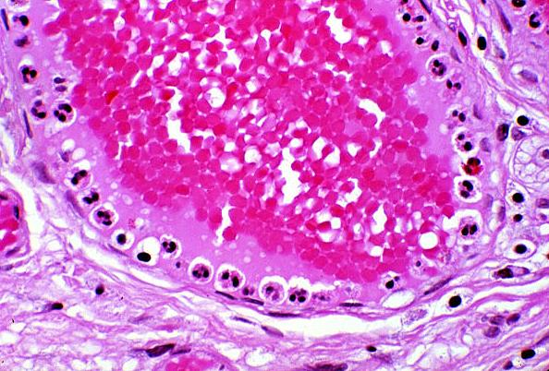
Leukocytes Rolling
Within a Venule
Margination
because blood flow slows early in inflammation (stasis), the endothelium can be lined by white cells
(pavementation)

Slide 8
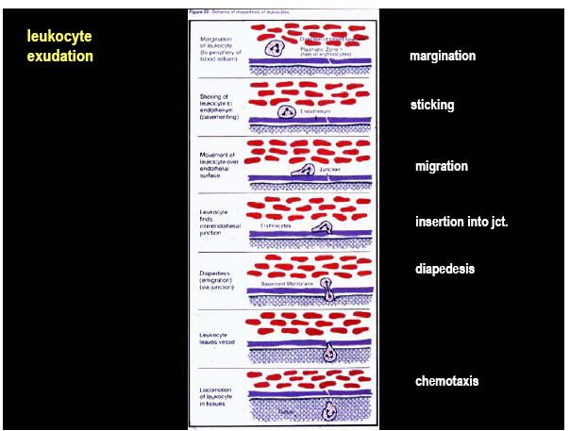
Notes:
2. LEUKOCYTE INFILTRATION AND PHAGOCYTOSIS
The next phase, which we will now examine, is the migration of WBC
from the circulation to the site of injury.
Leukocyte Exudation
The most striking finding in inflammation under the microscope - what
we call a "pathognomonic" feature - is the presence of leukocytes. The sequence
events in leukocyte infiltration (SLIDE) can be divided into (1) margination, (2)
sticking, (3) emigration and (4) phagocytosis.
In a typical course of inflammatory events, vasodilation, transudation,
and then slowing of circulation occurs as the blood viscosity increases. As stasis
develops, one begins to see the peripheral orientation of leukocytes, principally
neutrophils, along the vascular endothelium (margination). Leukocytes first stick
transiently and then more avidly (sticking). Soon after they migrate through the
vascular wall into the interstitial tissue (emigration).

Slide 9
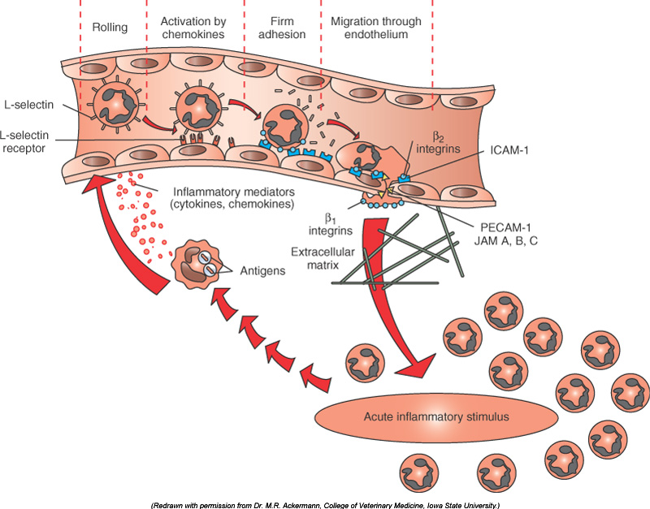
Resident tissue macrophages, mast cells, and endothelial cells respond to injury by secreting the cytokines TNF, IL-1, and chemokines

Slide 10
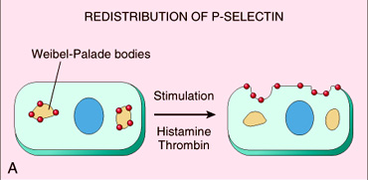
Leukocyte Adhesion
Mediators such as histamine, thrombin, and platelet activating factor (PAF) stimulate the redistribution of P-selectin from its normal intracellular stores in granules (Weibel-Palade bodies) to the cell surface.
P-selectin

Slide 11
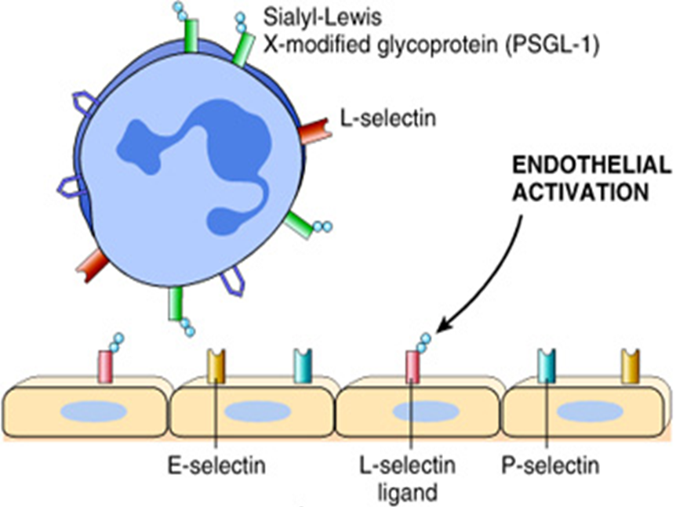
Adhesion Molecules and Receptors
1. Selectins, consist of:
1. E-selectin: confined to endothelium induced by TNF&IL-1
2. P-selectin: present in endothelium and platelets from Weibel-Palade bodies
3. L-selectin: expressed on most leukocyte and endothelium
E-selectin & P-selectin bind to Sialyl-Lewis X glycoprotein and slow the leukocytes

Slide 12
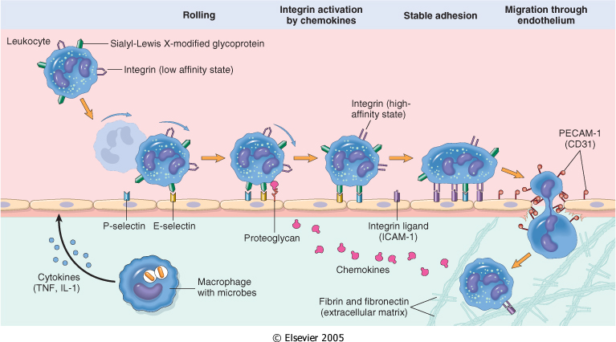
LEUKOCYTE EXTRAVASATION AND PHAGOCYTOSIS

Slide 13
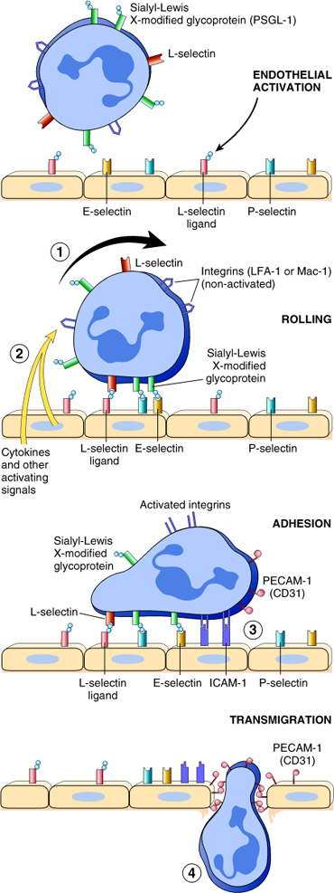
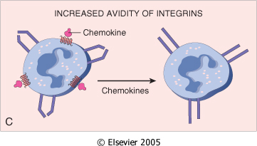
Adhesion Molecules and Receptors
2. Integrins
rolling
are transmembrane heterodimeric glycoproteins, made up of α and β chains expressed on leukocytes and bind to ligands on endothelial cells
Integrins are up regulated on leukocytes by C5a & LTB4 resulting in firm adhesion with vessel wall

Slide 14
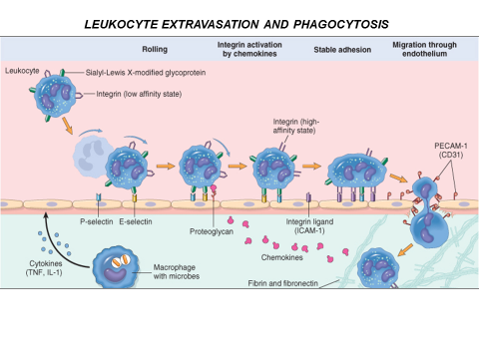

Slide 15
Leukocyte Adhesion Deficiency
Autosomal recessive defect of integrins
Clinical findings:
  Delayed separation of umbilical cord
  Increased circulating neutrophils
  Recurrent bacterial infection that lack pus formation

Slide 16
Adhesion Molecules and Receptors
3. The immunoglobulin family molecules :
  ICAM-1 (intercellular adhesion molecule 1)
  VCAM-1 (vascular cell adhesion molecule 1)
  induced by TNF and IL-1
adhesion to endothelium

Slide 17
Adhesion Molecules and Receptors
4. Mucin-like glycoproteins
- these glycoproteins are found in the extracellular matrix and on cell surfaces.
Neutrophils, monocytes, lymphocytes, eosinophils, and basophils all use the same pathway to migrate from the blood into tissues.

Slide 18
Leukocyte Adhesion and Transmigration
Migration of the leukocytes through the endothelium is called:
Transmigration
or Diapedesis
Diapedesis occurs predominantly in the postcapillary venules
BV lumen
Extravascular
Neutrophils moving along the venular endothelium dissolve the venular
basement membrane (release type IV collagenase) exposed by previous histamine-mediated endothelial cell contraction and enter the interstitial tissue.

Slide 19
Leukocyte Adhesion and Transmigration
The type of emigrating leukocyte varies with the age of the inflammatory response
In most forms of acute inflammation: neutrophils predominate in the inflammatory infiltrate during the first 6 to 24 hours, then are replaced by monocytes in 24 to 48 hours
WHY?

Slide 20
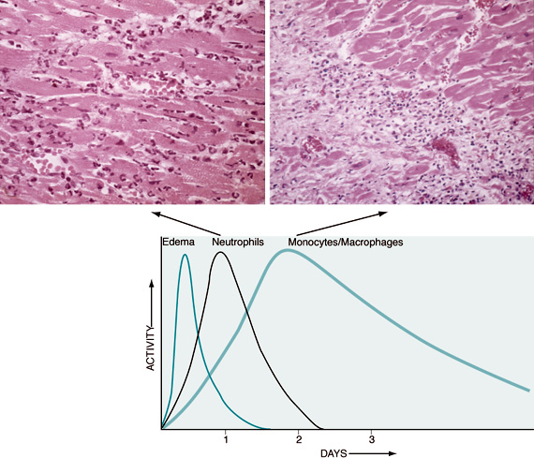
Leukocyte Adhesion and Transmigration
  neutrophils are more numerous in the blood, they respond more rapidly to chemokines,
  but are short-lived; they undergo
  apoptosis and disappear after 24 to 48 hours,
  whereas monocytes survive longer.

Slide 21
Leukocyte Adhesion and Transmigration
  The type of emigrating leukocyte varies with the type of stimulus:
  In viral infections, lymphocytes may be the first cells to arrive
  In some hypersensitivity reactions and parasitic infection, eosinophil may be the main cell type
  Chronic inflammation lymphocytes plasma cells and macrophages are present

Slide 22
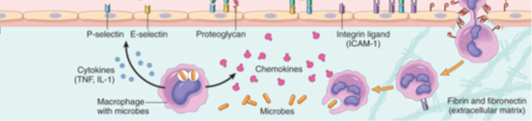
Chemotaxis
After extravasation, leukocytes emigrate in tissues toward the site of injury by a process called chemotaxis, defined as locomotion oriented along a chemical gradient !!!!
Chemoattractants
Neutrophils are attracted by bacterial products, IL-8, C5a & LTB4
Chemokines act on the adherent leukocytes and stimulate the cells to migrate toward the site of injury or infection

Slide 23
Chemotaxis
Chemoattractants
Exogenous and endogenous substances
  The most common exogenous agents are bacterial products.
  Endogenous chemoattractants include several chemical mediators:
  components of the complement system, particularly C5a
  products of the lipoxygenase pathway, mainly leukotriene B₄ (LTB₄)
  cytokines, particularly those of the chemokine family (e.g., IL-8).

Slide 24
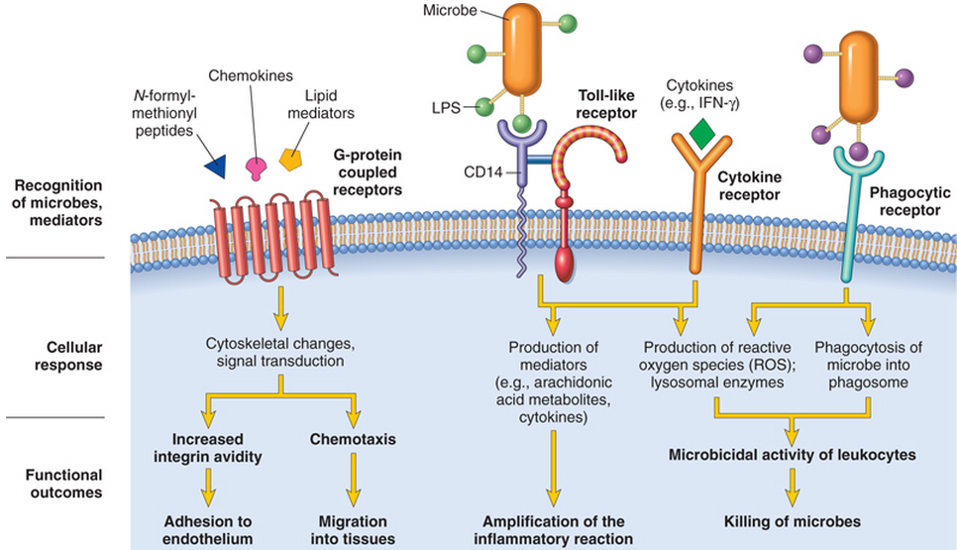
All these chemotactic agents bind to specific seven-transmembrane G-protein-coupled receptors (GPCRs) on the surface of leukocytes.

Slide 25
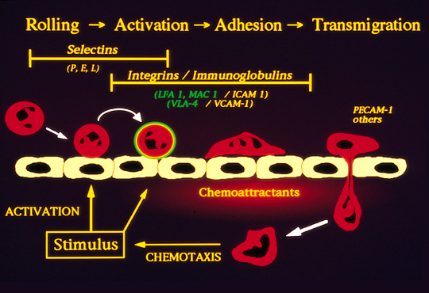
Leukocyte emigration

Slide 26
Leukocyte Activation
Phagocytosis
Intracellular destruction
Liberation of substances that destroy
extracellular microbes and dead tissues
Production of mediators

Slide 27
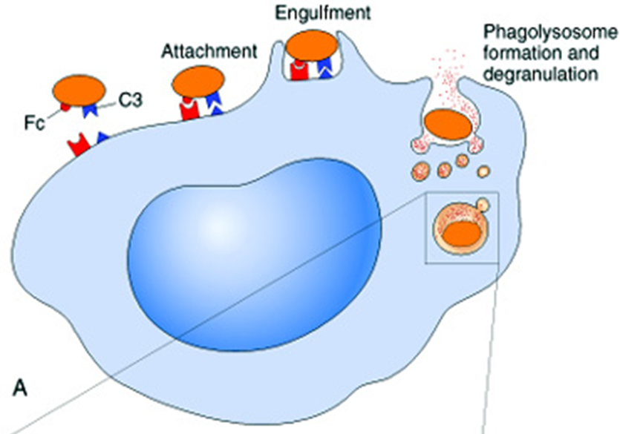
Phagocytosis
Phagocytosis involves three distinct but interrelated steps
  Recognition and Attachment of the particle to be ingested by the leukocyte
  (2) its Engulfment, with subsequent formation of a phagocytic vacuole
  (3) killing or Degradation of the ingested material.

Slide 28
Leukocyte activation
(1) Recognition and Attachment
(Opsonization)
Is the process of coating a particle, such as a microbe, to target it for phagocytosis
The substances that do this are opsonins.
These substances include:
  antibodies (IgG)
  complement proteins (C3)
  And others: lectins (mannose-binding lectin (MBL), collectins,fibronectin, fibrinogen, and C-reactive protein
These can coat microbes and are recognized by receptors on phagocytes (Fc and C3b receptors).

Slide 29
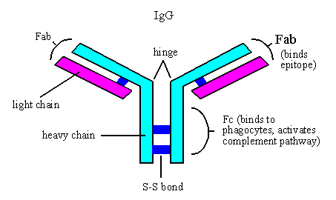

Slide 30
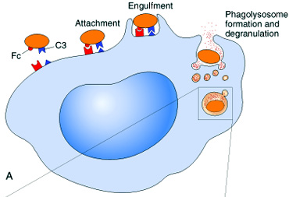
Phagocytosis
2. Engulfment
During engulfment, extensions of the cytoplasm (pseudopods) flow around the particle to be engulfed, eventually resulting in complete enclosure of the particle within a phagosome
The phagocytic vacuole then fuses with a lysosomal granule, resulting in phagolysosome

Slide 31
Defect in phagolysosome formation
Chediak-Higashi Syndrome:
  Protein trafficking defect ( microtubule defect)
  Autosomal recessive
  Lead to impaired phagolysosome formation
  Clinical feature:
    Increased risk of pyogenic infection
    Neutropenia (defect in generation from BM)
    Giant granule formation (granules formed cannot move in cytoplasm)
    Defective primary hemostasis ( platelet granule are not secreted)
    Albinism
    Peripheral neuropathy

Slide 32
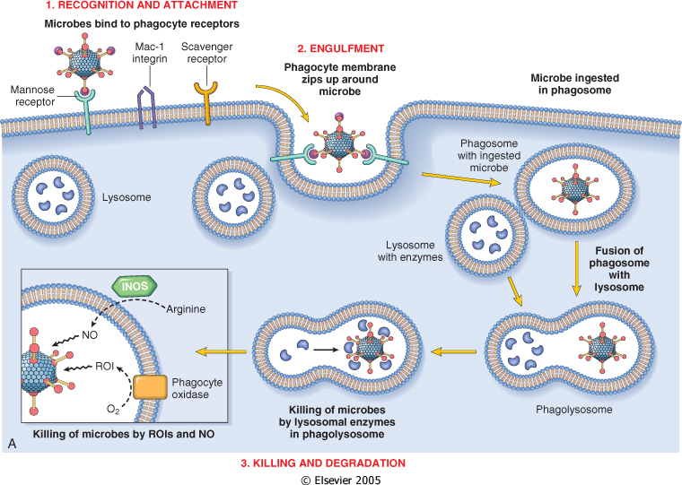

Slide 33
Phagocytosis
Killing and Degradation
2 mechanisms for Microbial killing:
1. Oxygen-dependent mechanisms
2. Oxygen-independent mechanisms

Slide 34
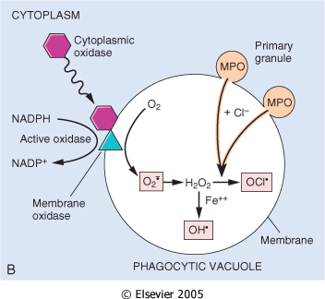
Oxygen-Dependent Mechanisms
The H₂O₂-MPO-halide system is the most efficient bactericidal system in neutrophils
_
O2
oxidase
O2
H2O2
MPO
HOCL
SOD

Slide 35
Oxygen-independent mechanisms
through the action of substances in leukocyte granules. These include:
  bactericidal permeability increasing protein (BPI
  lysozyme
  lactoferrin
  major basic protein
  defensins
In addition, neutrophil granules contain many enzymes, such as elastase, that also contribute to microbial killing

Slide 36
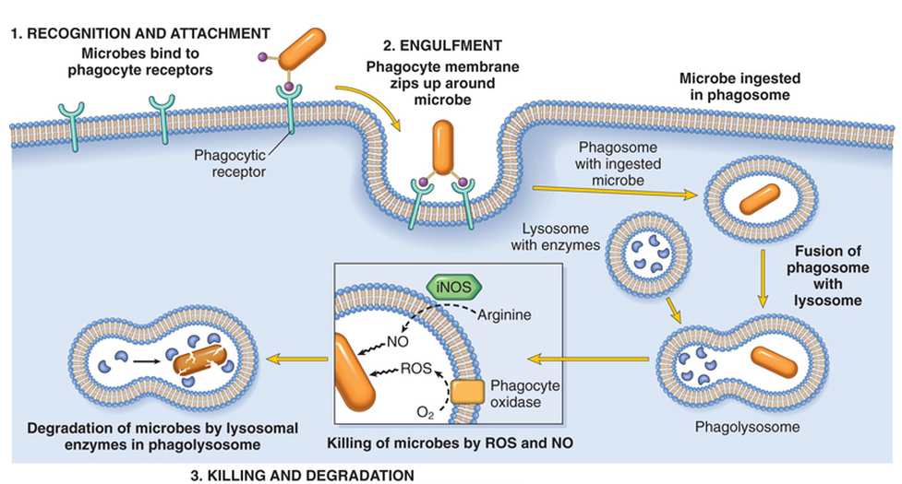
Summary of Phagocytosis

Slide 37
Defects in Leukocyte Function
Defects in leukocyte function, both genetic and acquired, lead to increased vulnerability to infections:
  Defects in leukocyte adhesion
  Defects in phagolysosome function
  Defects in microbicidal activity

Slide 38
Defects in Leukocyte Function
Genetic
Leukocyte adhesion deficiency 1and 2
Chédiak-Higashi syndrome
    Protein involved in organelle membrane fusion (no phagolysosomes)
Chronic granulomatous disease
    Decreased oxidative burst. 2 types:
  A. X-linked: NADPH oxidase (membrane component)
  B. Autosomal recessive:
  a. NADPH oxidase (cytoplasmic components)
  b. Myeloperoxidase deficiency: (absent MPO-H2O2 system) pt. have increased risk of candida infection

Slide 39
Chronic Granulomatous Disease
(CGD)
Infection and granuloma formation with catalase positive organisms e.g. S aureus, P cepacia, S marcescens, Norcardia and aspergillus
Nitroblue tetrazolium test (NBT), turn blue if NADPH oxidase can convertO2 to O2-
Remains colorless in CGD (NADPH oxidase)
NBT test is normal in Myeloperoxidase deficiency type

Slide 40
Defects in Leukocyte Function
Acquired
Thermal injury, diabetes, malignancy, sepsis, immunodeficiencies
  Chemotaxis
Hemodialysis, diabetes mellitus
  Adhesion
Leukemia, anemia, sepsis, diabetes, neonates, malnutrition
  Phagocytosis and microbicidal activity

Slide 41
TAKE HOME MESSAGES:
Several steps are involved in extravasation of leukocytes from the blood to the tissues.
Phagocytosis is important step to get rid of necrotic material and bacteria.
Various defects in leukocyte function are present. These could be genetic defects or acquired.

