Slide 1
INFLAMMATION AND REPAIR
Lecture 3
Chemical Mediators in Inflammation and
Patterns of Acute Inflammation
Foundation block: pathology
Dr. Maha Arafah
2014

Slide 2
Outcomes of acute inflammation Different patterns of inflammation Chemical mediators

Slide 3
Objectives
List and describe the outcome of acute inflammation.
Recognize the different patterns of inflammation.
Chemical mediators of inflammation:
Definition
Know the general principles for chemical mediators.
Know the cellular sources and major effects of the mediators.
List the most likely mediators of each of the steps of inflammation.

Slide 4
Outcomes of Acute Inflammation
Acute inflammation may have one of the four outcomes:
Complete resolution
Healing by connective tissue replacement (fibrosis)
Progression of the tissue response to chronic inflammation
Abscess formation

Slide 5
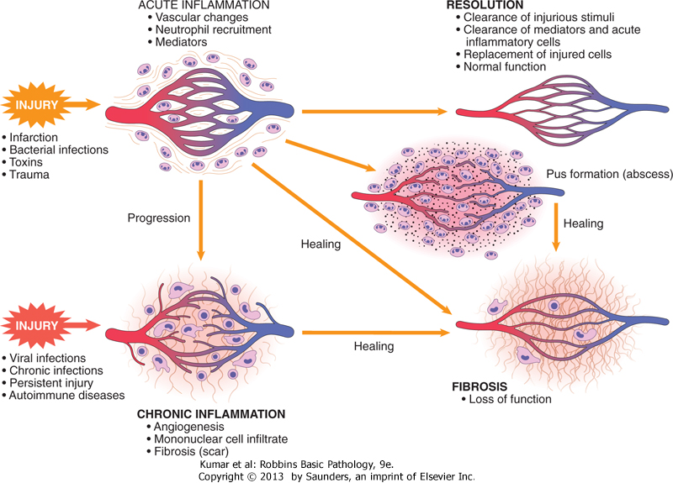

Slide 6
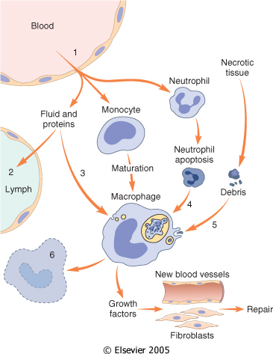
Events in the resolution of inflammation
This involves neutralization, decay, or enzymatic degradation of the various chemical mediators; normalization of vascular permeability; and cessation of leukocyte emigration and apoptosis
The necrotic debris, edema fluid, and inflammatory cells are cleared by phagocytes and lymphatic drainage

Slide 7
Objectives
Upon completion of this lecture, the student should:
List and describe the outcome of acute inflammation.
Recognize the different pattern of inflammation.
Define the chemical mediators of inflammation.
Know the general principles for chemical mediators.
Know the cellular sources and major effects of the mediators.
List the most likely mediators of each of the steps of inflammation.

Slide 8
Morphologic Patterns of Acute Inflammation
Several types of inflammation vary in their morphology and clinical correlates. Why?
The severity of the reaction
specific cause
the particular tissue
site involved

Slide 9
Morphologic Patterns of Acute Inflammation
SEROUS INFLAMMATION
FIBRINOUS INFLAMMATION
SUPPURATIVE OR PURULENT INFLAMMATION
ULCERS

Slide 10
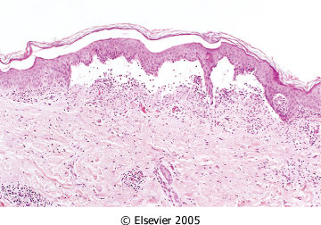
SEROUS INFLAMMATION: marked by the outpouring of a thin fluid

Slide 11
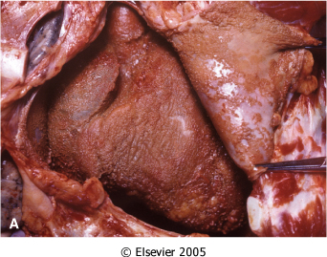
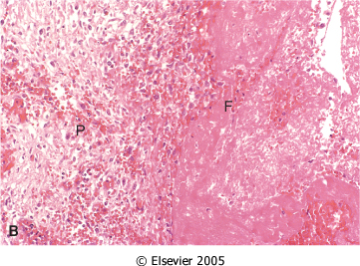
FIBRINOUS INFLAMMATION
A fibrinous exudate is characteristic of inflammation in the lining of body cavities, such as the meninges, pericardium and pleura (larger molecules such as fibrinogen pass the vascular barrier)
Fibrinous exudates may be removed by fibrinolysis, if not: it may stimulate the ingrowth of granulation tissue (organization)

Slide 12
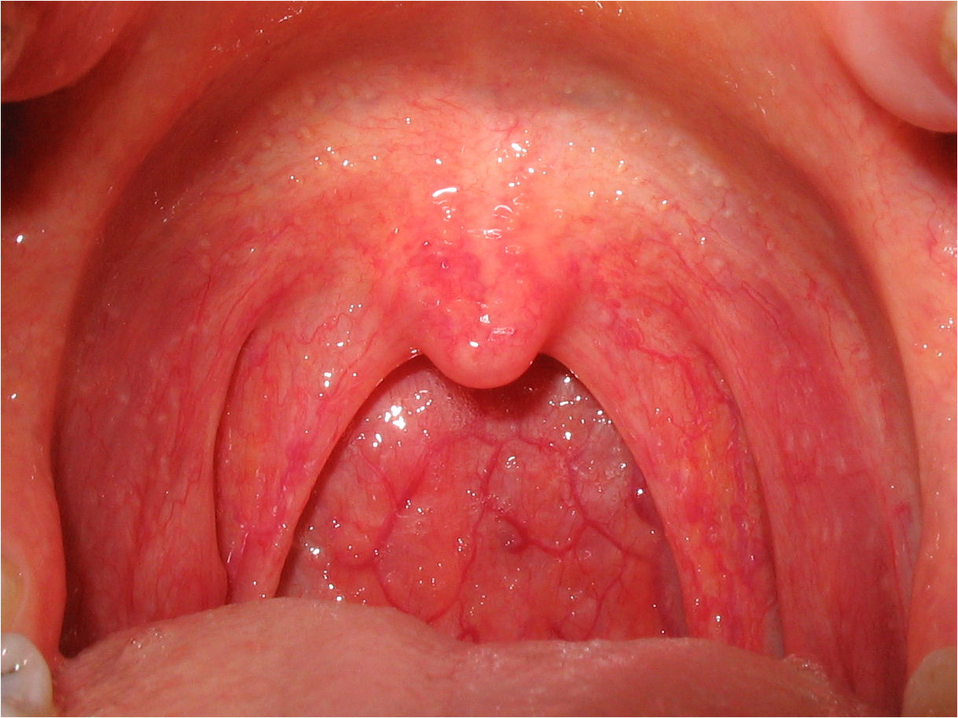
Catarrhal inflammation.
Inflammation affects mucosa-lined surfaces with the outpouring of watery mucus

Slide 13
SUPPURATIVE OR PURULENT INFLAMMATION
characterized by the production of large amounts of pus or purulent exudate consisting of neutrophils, necrotic cells, and edema fluid caused by pyogenic (pus-producing) bacteria

Slide 14
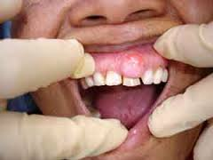
Suppurative abscess.
An enclosed collection of pus consisits of a mixture of neutrophils and necrotic debris.

Slide 15
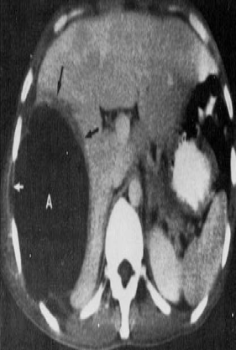
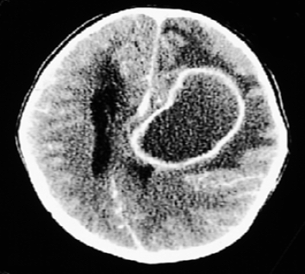
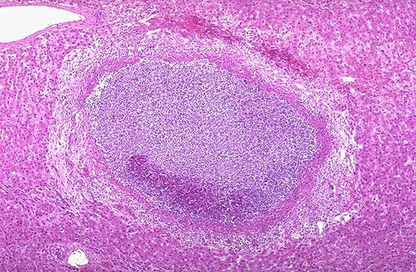
Morphologic Patterns of Acute Inflammation SUPPURATIVE OR PURULENT INFLAMMATION
Abscesses : localized collections of purulent inflammatory tissue caused by suppuration buried in a tissue, an organ, or a confined space

Slide 16
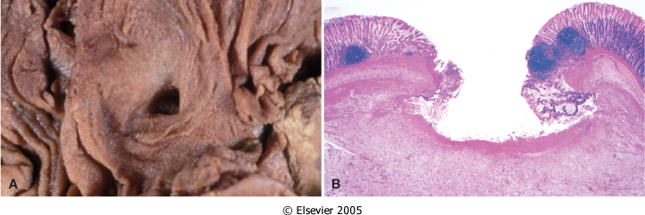
ULCERS
An ulcer is a local defect of the surface of an organ or tissue that is produced by the sloughing (shedding) of inflammatory necrotic tissue
Epithelial Defect
Necrotic base
Fibrinopurulent exudates
Granulation tissue
Fibrosis

Slide 17
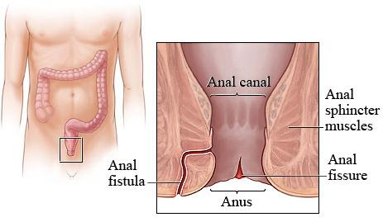
Fistula
A tract between two surfaces.

Slide 18
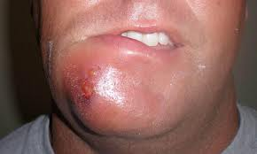
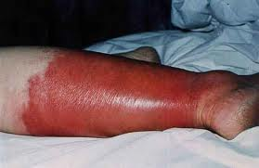
Cellulitis
denotes a spreading acute inflammation through interstitial tissues.

Slide 19
Objectives
Upon completion of this lecture, the student should:
List and describe the outcome of acute inflammation.
Recognize the different pattern of inflammation.
Chemical mediators of inflammation:
Definition
Know the general principles for chemical mediators.
Know the cellular sources and major effects of the mediators.
List the most likely mediators of each of the steps of inflammation.

Slide 20
What are mediators?
Chemical mediators of inflammation are substances produced during inflammation inducing a specific events in acute inflammation.

Slide 21
General principles for chemical mediators
The production of active mediators is triggered by:
microbial products
host proteins, such as the proteins of the complement, kinin and coagulation systems
( these are themselves activated by microbes and damaged tissues)

Slide 22
General principles for chemical mediators
Most mediators have the potential to cause harmful effects.
Therefore, there should be a mechanism to checks and balances their action.
Mediator function is tightly regulated by:
decay (e.g. AA metabolites)
inactivated by enzymes (kininase inactivates bradykinin)
eliminated ( antioxidants scavenge toxic oxygen metabolites)

Slide 23
Source of Chemical mediators
Plasma-derived:
Complement
kinins
coagulation factors
Many in “pro-form” requiring activation (enzymatic cleavage)
Cell-derived:
Synthesized as needed (prostaglandin)
Preformed, sequestered and released (mast cell histamine)

Slide 24
Notes:
.

Slide 26
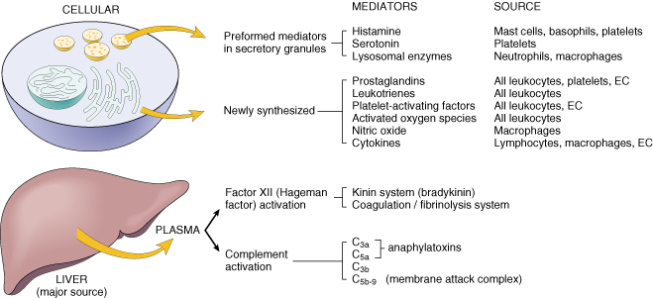
Cell-Derived Mediators
Producing cells:
Tissue macrophages
Mast cells
Endothelial cells
Leukocytes
Notes:
Endothelial cells at the site of inflammation
Leukocytes recruited to the site form the blood

Slide 27
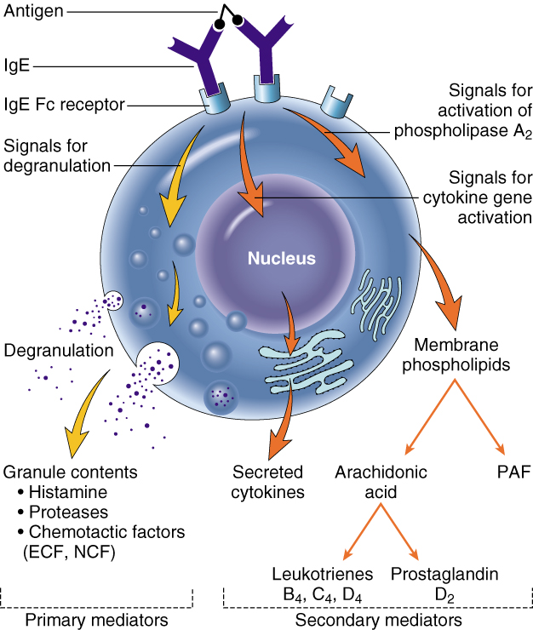
Vasoactive Amines Histamine & Serotonin
Among first mediators in acute inflammatory reactions
Preformed mediators in secretory granules

Slide 28
Histamine
Source:
many cell types, esp. mast cells, circulating basophils, and platelets
Stimuli of Release:
Physical injury
Immune reactions
C3a and C5a fragments
Leukocyte-derived histamine-
releasing proteins
Neuropeptides
Cytokines (e.g. IL-1 and IL-8)
Actions:
ARTERIOLAR DILATION
INCREASED VASCULAR PERMEABILITY (venular gaps)
ENDOTHELIAL ACTIVATION
Inactivated by:
Histaminase
Notes:
Histamine is the principal mediator of the immediate phase of increased vascular permeability, inducing venular endothelial contraction and interendothelial gaps.

Slide 29
Serotonin (5-HT)
Source:
Platelets
Action:
Similar to histamine
Stimulus:
Platelet aggregation

Slide 30
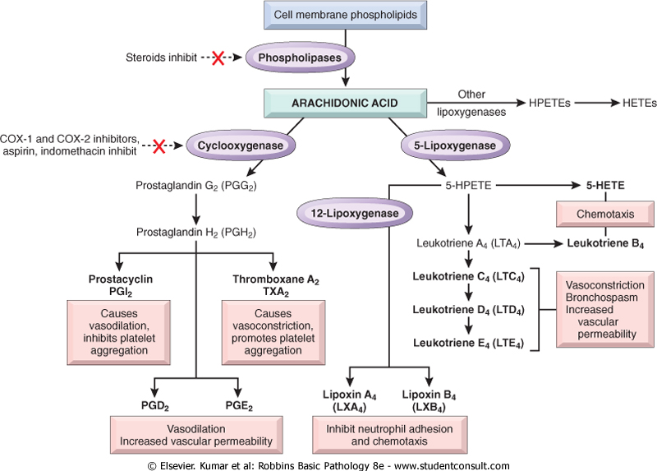
Source:
Leukocytes
Mast cells
Endothelial cells
Platelets
Notes:
.

Slide 31
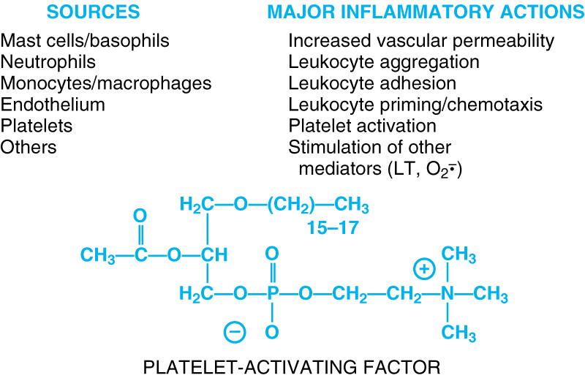
Notes:
.

Slide 32
Cytokines
Polypeptides
Actions:
Involved in early immune and inflammatory reactions
Some stimulate bone marrow precursors to produce more leukocytes
Notes:
.

Slide 33
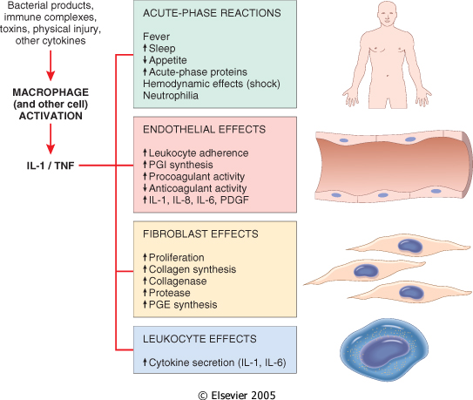
Cytokine of
Acute inflammation:
Interleukin (IL-1) & TNF

Slide 34
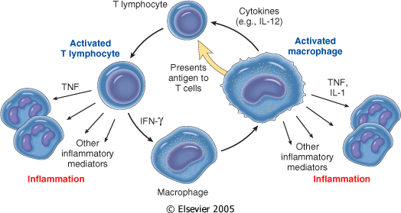
Chronic Inflammation: Cytokines of
Interferon-γ (INF- γ) & Interleukin ( IL-12)
Activated lymphocytes and macrophages influence each other and also release inflammatory mediators that affect other cells.

Slide 35
Chemokines
Small proteins
They are chemoattractants for leukocytes
Main functions:
Leukocyte recruitment & activation in inflammation
Normal anatomic organization of cells in lymphoid and other tissues
Notes:
.

Slide 36
Reactive Oxygen Species
Synthesized via
NADPH oxidase pathway
Source:
Neutrophils and Macrophages
Stimuli of release:
Microbes
Immune complexes
Cytokines
Action:
Microbicidial (cytotoxic) agent
Notes:
.

Slide 37
Nitric Oxide ( NO)
Short-lived
Soluble free-radical gas
Functions:
Vasodilation
Antagonism of platelet activation (adhesion, aggregation, & degranulation)
Reduction of leukocyte recruitment
Microbicidial (cytotoxic) agent (with or without ROS) in activated macrophages
Notes:
.

Slide 38
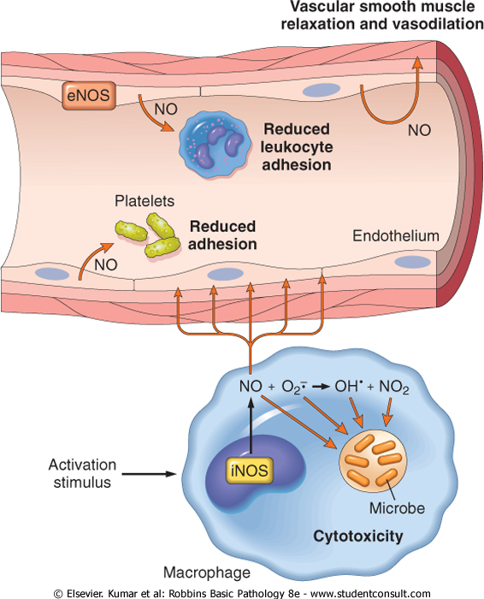

Slide 39
Lysosomal Enzymes of Leukocytes
Neutrophils & Monocytes
Enzymes:
Acid proteases
Neutral proteases (e.g. elastase, collagenase, & cathepsin)
Their action is checked by:
Serum antiproteases (e.g. α1-antitrypsin)
Notes:
.

Slide 40
Neuropeptides
Small proteins
Secreted by nerve fibers mainly in lung & GIT
Initiate inflammatory response
e.g. Substance P :
Transmits pain signals
Regulates vessel tone
Modulates vascular permeability
Notes:
.

Slide 42
PLASMA PROTEASES
A variety of phenomena in the inflammatory response are mediated by plasma proteins that belong to three interrelated systems
1. Kinin
2. the complement
3. clotting systems

Slide 43
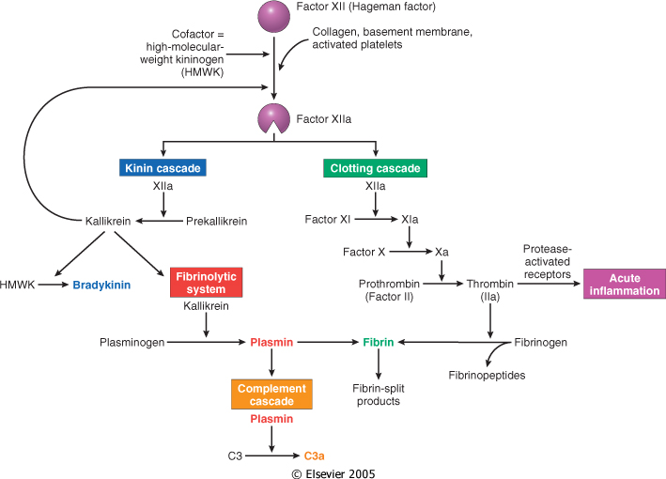
Kinin & clotting systems
enhanced leukocyte adhesion & activation
increases vascular permeability, pain
increases vascular permeability, Chemotaxis

Slide 44
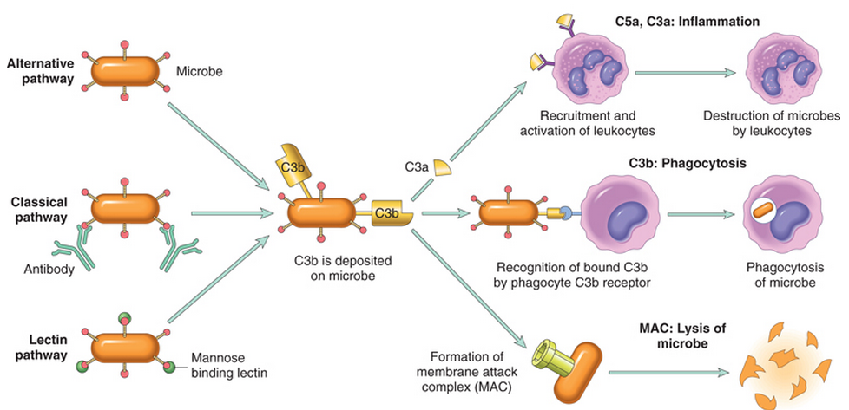
Complement System

Slide 45
Complement protein
C3a & C5a ➔ Increase vascular permeability
( anaphylatoxins)
C5a ➔ Chemotaxis
C3b ➔ Opsonization
C5-9 ➔ membrane attack complex

Slide 46
Objectives
Upon completion of this lecture, the student should:
List and describe the outcome of acute inflammation.
Recognize the different pattern of inflammation.
Define the chemical mediators of inflammation.
Know the general principles for chemical mediators.
Know the cellular sources and major effects of the mediators.
List the most likely mediators of each of the steps of inflammation.

Slide 47
Vasodilation | Prostaglandins Histamine Nitric oxide
Increased vascular permeability | Vasoactive amines Bradykinin Leukotrienes C4, D4, E4 PAF Substance P
Chemotaxis, leukocyte recruitment and activation | C5a Leukotriene B4 Chemokines IL-1, TNF Bacterial products
Fever | IL-1, TNF Prostaglandins
Pain | Prostaglandins Bradykinin
Tissue damage | Neutrophil and macrophage lysosomal enzymes Oxygen metabolites Nitric oxide
Role of Mediators in Different Reactions of Inflammation

