Slide 1
Foundation Block, pathology
INFLAMMATION AND REPAIR
Lecture 4
Chronic inflammation
Systemic effect of inflammation
Dr. Maha Arafah
Associate Professor
Department of Pathology
King Khalid University Hospital and King Saud University
Email: marafah@ksu.edu.sa
marafah @hotmail.com
2014

Slide 2
Objectives
Compare and contrast acute vs chronic inflammation with respect to causes, nature of the inflammatory response, and tissue changes.
Compare and contrast the clinical settings in which different types of inflammatory cells (eg, neutrophils, eosinophils, monocyte-macrophages, and lymphocytes) accumulate in tissues.
Describe the systemic manifestations of inflammation and their general physiology, including fever, leukocyte left shift, and acute phase reactants.

Slide 3
CHRONIC INFLAMMATION
Inflammation of prolonged duration (weeks to years) in which continuing inflammation, tissue injury, and healing, often by fibrosis, proceed simultaneously

Slide 4
CHRONIC INFLAMMATION
It is slow evolving (weeks to months) resulting into fibrosis
It occurs in two major patterns :chronic non specific and specific granulomatous inflammation

Slide 5
Chronic inflammation may arise in the following settings:
Persistent infections by microbes that are difficult to eradicate.
These include :
Mycobacterium tuberculosis
Treponema pallidum (the causative organism of syphilis)
certain viruses and fungi
All of which tend to establish persistent infections and elicit a T lymphocyte-mediated immune response called delayed-type hypersensitivity.

Slide 6
Chronic inflammation may arise in the following settings:
2. Immune-mediated inflammatory diseases (hypersensitivity diseases): Diseases that are caused by excessive and inappropriate activation of the immune system leading to autoimmune diseases.
e.g.
Rheumatoid arthritis
inflammatory bowel disease
psoriasis
or
Immune responses against common environmental substances that cause allergic diseases, such as bronchial asthma.

Slide 7
Chronic inflammation may arise in the following settings:
3. Prolonged exposure to potentially toxic agents.
Examples are nondegradable exogenous materials such as inhaled particulate silica, which can induce a chronic inflammatory response in the lungs (silicosis)
Endogenous agents such as cholesterol crystals, which may contribute to atherosclerosis

Slide 8
Chronic inflammation may arise in the following settings:
4. Mild forms of chronic inflammation may be important in the pathogenesis of many diseases
Such diseases include:
neurodegenerative disorders such as Alzheimer disease
atherosclerosis
metabolic syndrome and the associated type 2 diabetes,
and some forms of cancer in which inflammatory reactions promote tumor development

Slide 9
CHRONIC INFLAMMATION
Characterized by a different set of reactions:
Infiltration with mononuclear cells, including:
Macrophages
Lymphocytes
Plasma cells
Tissue destruction, largely induced by the products of the inflammatory cells
Repair, involving new vessel proliferation (angiogenesis) and fibrosis
Acute inflammation is distinguished by vascular changes, edema, and a predominantly neutrophilic infiltrate

Slide 10
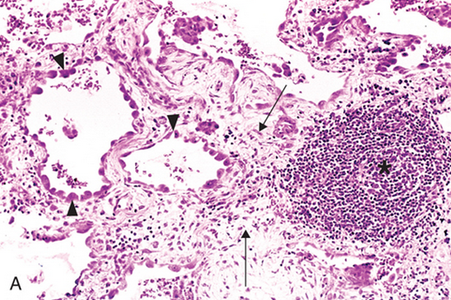
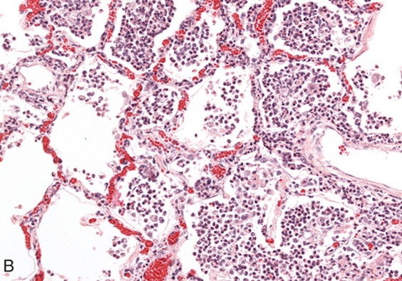

Slide 11
Cells in Chronic inflammation
Complex interactions between several cell populations and their secreted mediators.
Mediated by the interaction of monocyte macrophages with T and B lymphocyte, plasma cells and others

Slide 12
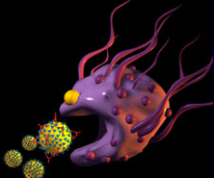
Macrophages
In tissue:
the liver (Kupffer cells)
spleen and lymph nodes (sinus histiocytes)
central nervous system (microglial cells)
and lungs (alveolar macrophages)
In blood: monocytes
Under the influence of adhesion molecules and chemokines, they migrate to a site of injury within 24 to 48 hours after the onset of acute inflammation
(macrophages)

Slide 13
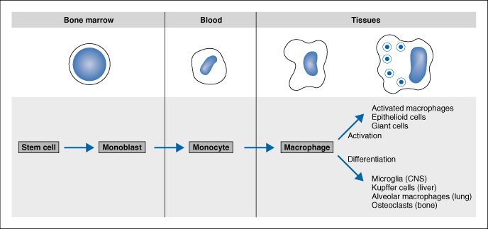
mononuclear phagocyte system
monocytes begin to emigrate into extravascular tissues quite early in acute inflammation and within 48 hours they may constitute the predominant cell type

Slide 14
MONONUCLEAR CELL INFILTRATION Macrophages
Macrophages may be activated by a variety of stimuli, including
cytokines (e.g., IFN-γ) secreted by sensitized T lymphocytes and by NK cells
bacterial endotoxins

Slide 15
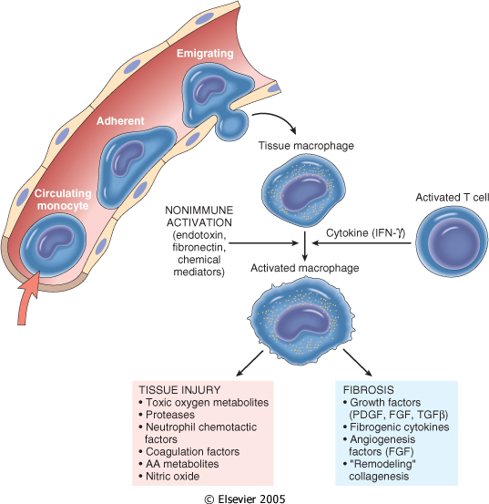
The roles of activated macrophages in chronic inflammation
to eliminate injurious agents such as microbes
to initiate the process of repair
secrete mediators of inflammation, such as cytokines (TNF, IL-1, chemokines, and eicosanoids).
display antigens to T lymphocytes and respond to signals from T cells, thus setting up a feedback loop
It is responsible for much of the tissue injury in chronic inflammation

Slide 16
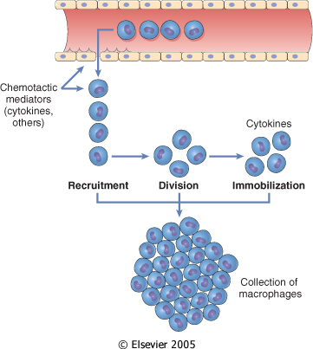
Macrophages
In chronic inflammation, macrophage accumulation persists, this is mediated by different mechanisms:
Recruitment of monocytes from the circulation
Local proliferation of macrophages
Immobilization of macrophages
Collection of activated macrophages :
GRANULOMA

Slide 17
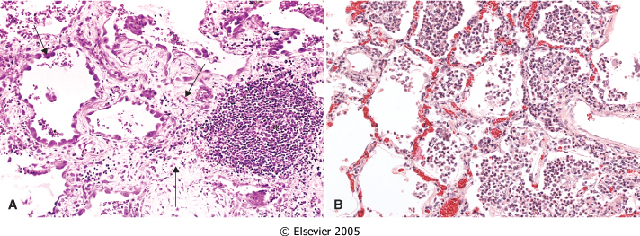
OTHER CELLS IN CHRONIC INFLAMMATION
Lymphocytes
Both T & B Lymphocytes migrates into inflammation site

Slide 18
Lymphocytes
B lymphocytes may develop into plasma cells, which secrete antibodies
T lymphocytes are activated to secrete cytokines:
CD4+ T lymphocytes promote inflammation and influence the nature of the inflammatory reaction

Slide 20
CD4+ helper T cells
There are three subsets of CD4+ helper T cells :
T_{H}1 cells produce the cytokine IFN-γ,
Function: activates macrophages in the classical pathway.
T_{H}2 cells secrete IL-4, IL-5, and IL-13
Function: recruit and activate eosinophils and are responsible for macrophage activation.
T_{H}17 cells secrete IL-17 and other cytokines
Function: induce the secretion of chemokines responsible for recruiting neutrophils and monocytes into the reaction.

Slide 21
OTHER CELLS IN CHRONIC INFLAMMATION
Plasma cells
Lymphoid cell (Mature B cells)
Common cell in chronic inflammation
Primary source of antibodies
Antibodies are important to neutralize antigen and for clearance of foreign Ag

Slide 22
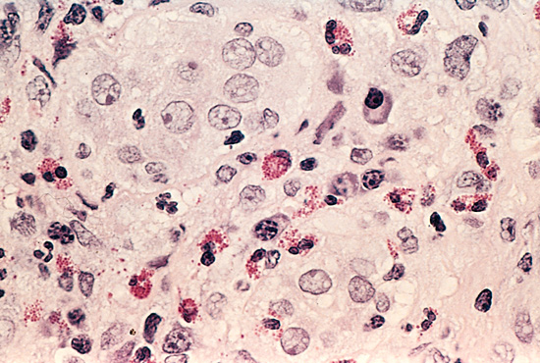
Eosinophils
are abundant in immune reactions mediated by IgE and in parasitic infections
respond to chemotactic agents derived largely from mast cells
Granules contain major basic protein: toxic to parasites and lead to lysis of mammalian epithelial cells

Slide 23
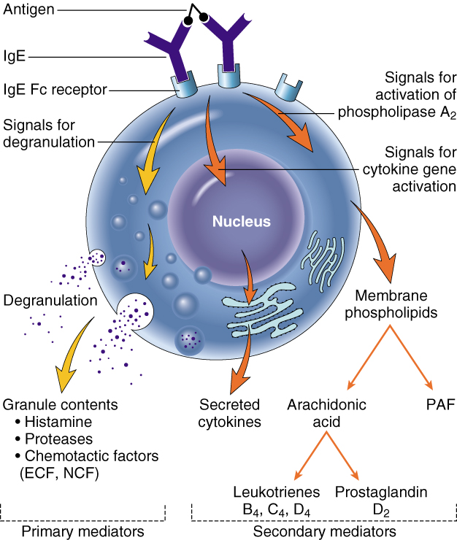
Mast cells
are widely distributed in connective tissues
express on their surface the receptor that binds the Fc portion of IgE antibody ,
the cells degranulate and release mediators, such as histamine and products of AA oxidation

Slide 25
Systemic effects of Inflammation
Acute phase reaction/response
- IL-1 and TNF
- Fever
- Malaise
- Anorexia
Bone marrow
- leukocytosis
- IL-1 + TNF
Lymphoid organs
Liver
-IL-6, IL-1, TNF
-Acute phase proteins
C-reactive protein
Lipopolysaccharide binding protein
Serum amyloid A
a-2 macroglobulin
Haptoglobin
Ceruloplasmin
fibrinogen

Slide 26
Fever Produced in response to Pyrogens
Types of Pyrogens:
Exogenous pyrogens: Bacterial products
Endogenous pyrogens:
IL-1 and TNF
Bacterial products stimulate leukocytes to release cytokines such as IL-1 and TNF that increase the enzymes (cyclooxygenases) that convert AA into prostaglandins.

Slide 27
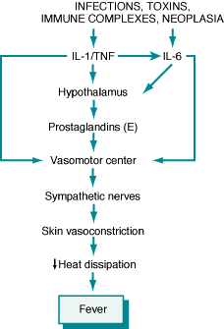
Fever
In the hypothalamus, the prostaglandins, especially PGE₂, stimulate the production of neurotransmitters such as cyclic AMP, which function to reset the temperature set-point at a higher level.
NSAIDs, including aspirin , reduce fever by inhibiting cyclooxygenase and thus blocking prostaglandin synthesis.

Slide 28
Increased erythrocyte sedimentation rate
The rise in fibrinogen causes erythrocytes to form stacks (rouleaux) that sediment more rapidly at unit gravity than do individual erythrocytes.

Slide 30
Inflammation Systemic Manifestations
Leukocytosis:
WBC count climbs to 15,000 or 20,000 cells/μl
most bacterial infection (Neutrophil)
Lymphocytosis:
Infectious mononucleosis, mumps,
German measles
Eosinophilia: bronchial asthma,
hay fever, parasitic infestations
Leukopenia: typhoid fever,
infection with rickettsiae/protozoa

Slide 31
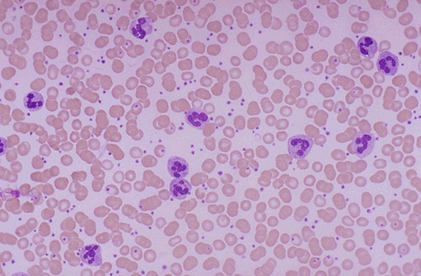
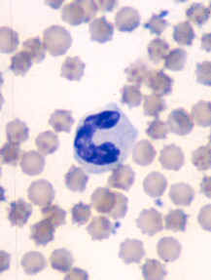
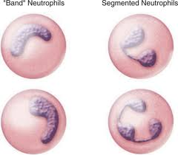
Shift to left
Notes:
Acute inflammation is marked by an increase in inflammatory cells. Perhaps the simplest indicator of acute inflammation is an increase in the white blood cell count in the peripheal blood, here marked by an increase in segmented neutrophils (PMN's).

