Slide 1
INFLAMMATION AND REPAIR
Lecture 5
Tissue Repair and Regeneration
Foundation Block, pathology
2014
Dr. Maha Arafah
Associate Professor
Department of Pathology
King Khalid University Hospital and King Saud University
Email: marafah@ksu.edu.sa
marafah @hotmail.com

Slide 2
Clinical Features
The 5 ancient cardinal signs of inflammation are
Tumor:-swelling
Rubor :– redness
Calor: – warmth
Dolor :– pain
Functio Laesa :–loss of function
The suffix “its” is added to the base word to state the condition as in appendix/appendicitis

Slide 3
Inflammation is divided into:
Acute inflammation:
Immediate and early response to tissue injury (physical, chemical, microbiologic, etc.)
Acute inflammation has three major components:
Vasodilatation
Vascular leakage and edema
Leukocyte emigration (mostly PMNs)
Chronic inflammation:
Inflammation of prolonged duration (weeks to years) in which continuing inflammation, tissue injury, and healing, often by fibrosis, proceed simultaneously

Slide 4
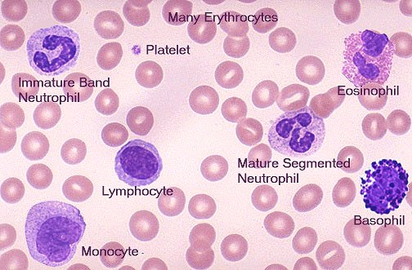

Slide 5
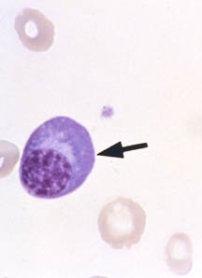
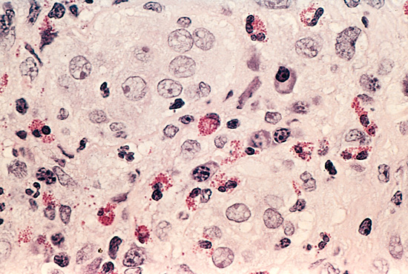
“clock face” pattern of nuclear chromatin with perinuclear halo

Slide 6
Vascular reaction:

Slide 7
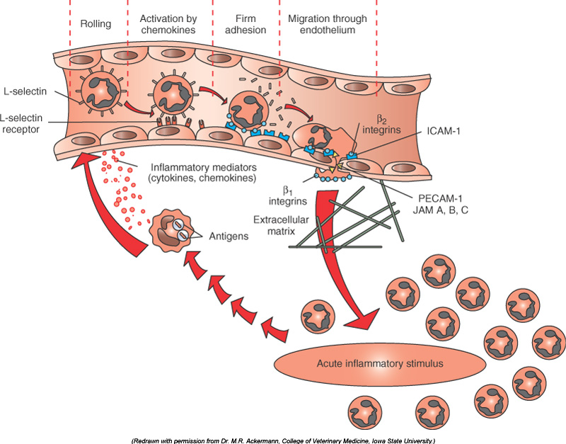
Chemical mediators of the acute inflammatory response.
Margination: movement of leukocyte to periphery
CD31
Activation of endothlium and leukocyte to express selectin by IL1 and TNF
Chemotaxis: C5a
Leukotriene B4
Chemokines
IL-1, TNF
Bacterial products

Slide 8
Oxygen dependent and Oxygen independent killing occur in macrophages and neutrophils

Slide 9
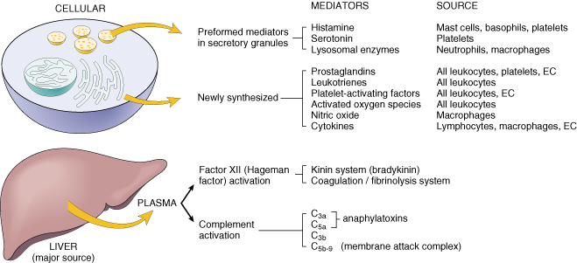
Chemical Mediators

Slide 10
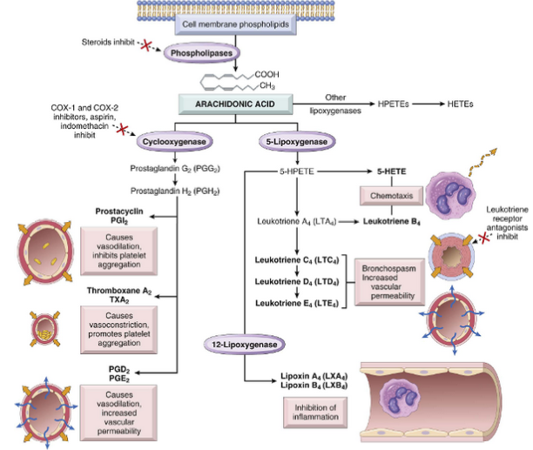
Prostaglandin are capable of causing pain, fever, chemotaxis and vasodilatation during the inflammatory process

Slide 11
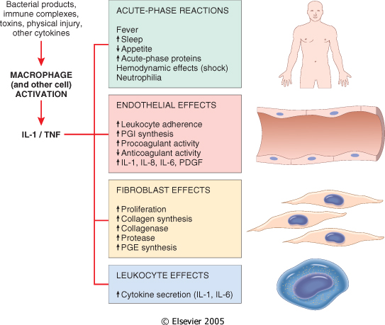
Cytokine of
Acute inflammation:
Interleukin (IL-1) & TNF

Slide 12
Vasodilation | Prostaglandins Histamine Nitric oxide
Increased vascular permeability | Vasoactive amines Bradykinin Leukotrienes C4, D4, E4 PAF Substance P
Chemotaxis, leukocyte recruitment and activation | C5a Leukotriene B4 Chemokines IL-1, TNF Bacterial products
Fever | IL-1, TNF Prostaglandins
Pain | Prostaglandins Bradykinin
Tissue damage | Neutrophil and macrophage lysosomal enzymes Oxygen metabolites Nitric oxide
Role of Mediators in Different Reactions of Inflammation

Slide 13
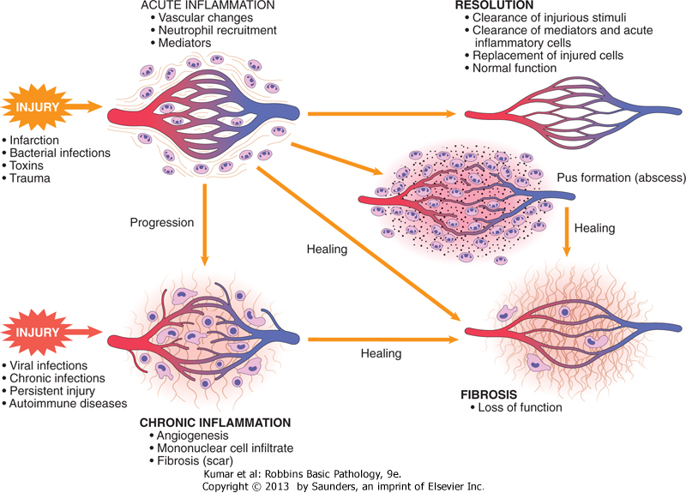

Slide 14
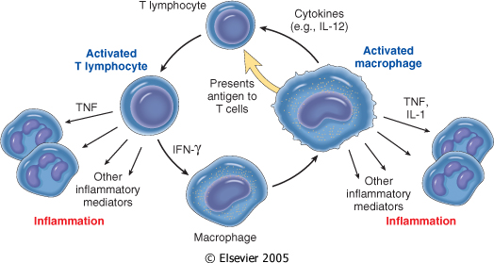
Chronic Inflammation: Cytokines of
Interferon-γ (INF- γ) & Interleukin ( IL-12)
Activated lymphocytes and macrophages influence each other and also release inflammatory mediators that affect other cells.

Slide 15
Systemic effects of Inflammation
Acute phase reaction/response
- IL-1 and TNF
- Fever
- Malaise
- Anorexia
Bone marrow
- leukocytosis
- IL-1 + TNF
Lymphoid organs
Liver
-IL-6, IL-1, TNF
-Acute phase proteins
  C-reactive protein
  Lipopolysaccharide binding protein
  Serum amyloid A
  a-2 macroglobulin
  Haptoglobin
  Ceruloplasmin
  fibrinogen

Slide 16
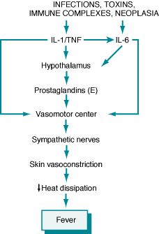
Fever
In the hypothalamus, the prostaglandins, especially PGE₂, stimulate the production of neurotransmitters such as cyclic AMP, which function to reset the temperature set-point at a higher level.
NSAIDs, including aspirin , reduce fever by inhibiting cyclooxygenase and thus blocking prostaglandin synthesis.

Slide 17
Increased erythrocyte sedimentation rate
The rise in fibrinogen causes erythrocytes to form stacks (rouleaux) that sediment more rapidly at unit gravity than do individual erythrocytes.

Slide 18
Objectives
Upon completion of this lecture, the student should:
Describe the differences between the various cell types (ie, labile, stable, and permanent cells) in terms of their regeneration potential. List examples of each cell type.
Know the factors that are most important in determining whether regeneration will restore normal tissue architecture.
List the three main phases of cutaneous wound healing.
Compare and contrast the difference between healing by primary intention and healing by secondary intention.
List factors which are associated with delayed wound healing.
List complication of wound healing.

Slide 19
Goal of the repair process
To restore the tissue to its original state after inflammatory reaction
Some tissues can be completely reconstituted after injury, such as the repair of bone after a fracture or the regeneration of the surface epithelium in a cutaneous wound.
For tissues that are incapable of regeneration, repair is accomplished by
connective tissue deposition, producing a scar.
Notes:
The goal of the repair process is to restore the tissue to its original state. The inflammatory reaction set in motion by the injury contains the damage, eliminates the damaging stimulus, removes injured tissue, and initiates the deposition of ECM components in the area of injury.
Some tissues can be completely reconstituted after injury, such as the repair of bone after a fracture or the regeneration of the surface epithelium in a cutaneous wound. For tissues that are incapable of regeneration, repair is accomplished by connective tissue deposition, producing a scar. This term is most often used in connection to wound healing in the skin, but it is also used to describe the replacement of parenchymal cells by connective tissue, as in the heart after myocardial infarction.
If damage persists, inflammation becomes chronic, and tissue damage and repair may occur concurrently. Connective tissue deposition in these conditions is usually referred to as fibrosis. In the broader sense, the term fibrosis applies to any abnormal deposition of connective tissue, regardless of cause.

Slide 20
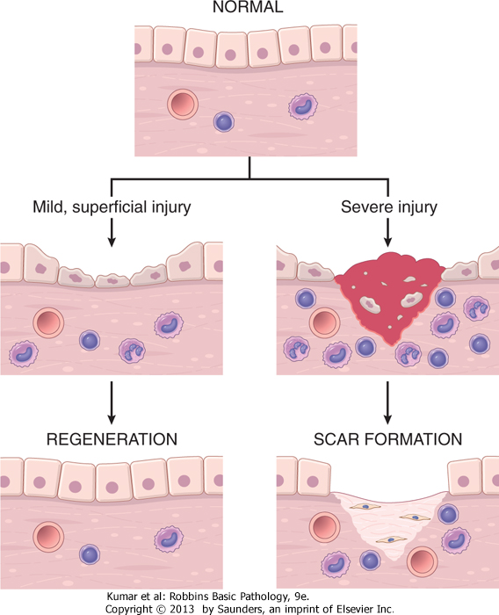

Slide 21
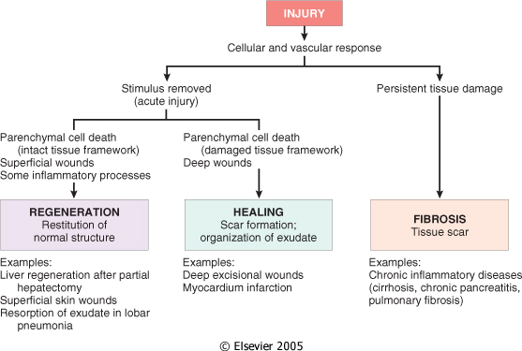
If damage persists, inflammation becomes chronic, and tissue damage and repair may occur concurrently. Connective tissue deposition in these conditions is usually referred to as fibrosis.

Slide 22
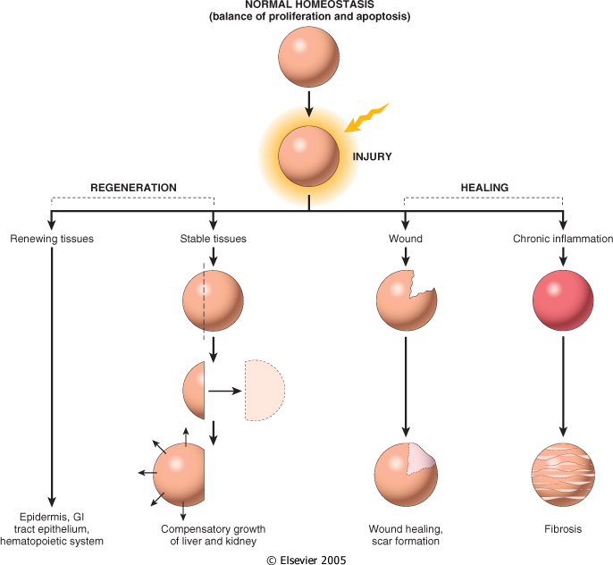

Slide 23
Repair by tissue regeneration or healing depend on cell type.
Labile cells: continue to proliferate throughout life : squamous, columnar, transitional epithelia; hematopoitic and lymphoid tissues
Stable cells: retain the capacity of proliferation but they don’t replicate normally: parenchymal cells of all glandular organs & mesenchymal cells
Permanent cells: cannot reproduce themselves after birth: neurons, cardiac muscle cells

Slide 24
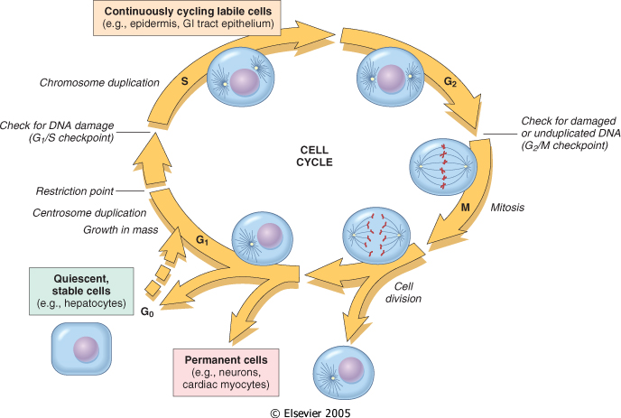

Slide 25
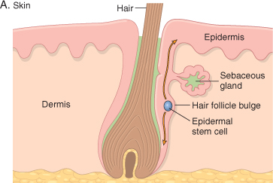
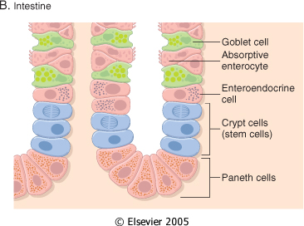
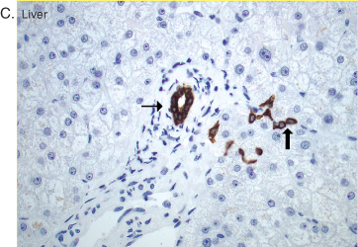
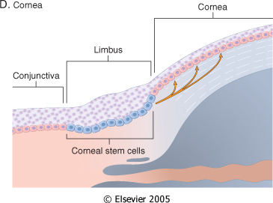

Slide 26
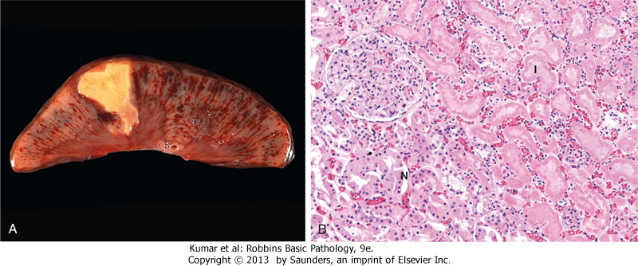
Healing
Healing is usually a tissue response
  (1) to a wound (commonly in the skin)
  (2) to inflammatory processes in internal organs
  (3) to cell necrosis in organs incapable of regeneration

Slide 28
Mechanism of repair
Repair begins early in inflammation.
At site of inflammation, fibroblasts and vascular endothelial cells begin proliferating to form a specialized type of tissue (hallmark of healing) called:
granulation tissue
The process is called organization
Notes:
Repair begins early in inflammation. Sometimes as early as 24 hours after injury, if resolution has not occurred, fibroblasts and vascular endothelial cells begin proliferating to form a specialized type of tissue that is the hallmark of healing, called granulation tissue. The term derives from its pink, soft, granular appearance on the surface of wounds, but it is the histologic features that are characteristic: the formation of new small blood vessels (angiogenesis) and the proliferation of fibroblasts (Fig. 3-17). These new vessels are leaky, allowing the passage of proteins and red cells into the extravascular space. Thus, new granulation tissue is often edematous. We next discuss mechanisms of angiogenesis and scar formation, the main components of the healing process.

Slide 29
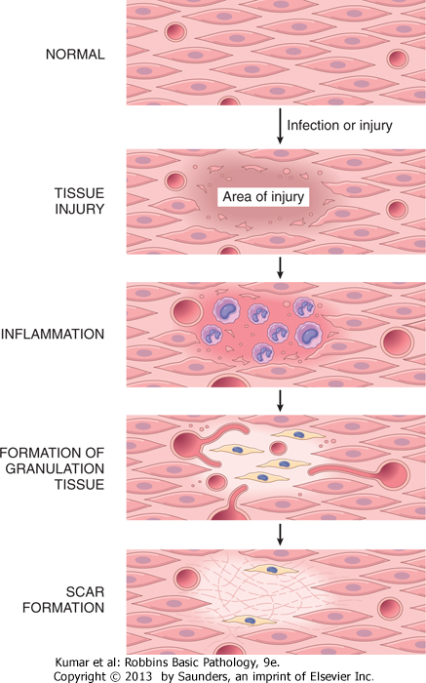
© 2005 Elsevier

Slide 30
Repair by connective tissue (granulation tissue)
It consists of:
  fibroblasts surrounded by abundant extracellular matrix
  newly formed blood vessels
  scattered macrophages and some other inflammatory cells.

Slide 31
What is the role of macrophages in wound healing?
Cleanup of debris, fibrin, and other foreign material at the site of repair.
Macrophages recruit other cells: fibroblasts and angioblasts
Stimulation of matrix production , interleukins that stimulate fibroblasts and angioblasts to produce the extracellular matrix.
Remodeling of the scar. They secrete collagenases

Slide 32
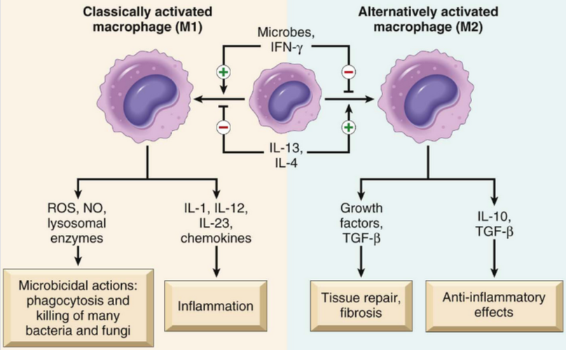
Role of macrophages in wound healing

Slide 33
Fibroblast Migration and Proliferation
Migration of fibroblasts to the site of injury and their subsequent proliferation are triggered by multiple growth factors, including mainly TGF-β and others e.g. PDGF, EGF, FGF, and the cytokines IL-1 and TNF
This lead to:
  increased synthesis of collagen and fibronectin
  decreased degradation of extracellular matrix (ECM) by metalloproteinases
Notes:
SCAR FORMATION Body_ID: HC003028 Growth factors and cytokines released at the site of injury induce fibroblast proliferation and migration into the granulation tissue framework of new blood vessels and loose ECM that initially forms at the repair site. We discuss three processes that participate in the formation of a scar: (1) emigration and proliferation of fibroblasts in the site of injury, (2) deposition of ECM, and (3) tissue remodeling. Body_ID: P003089 Fibroblast Migration and Proliferation Body_ID: HC003029 Granulation tissue contains numerous newly formed blood vessels. As discussed previously, VEGF promotes angiogenesis but is also responsible for a marked increase in vascular permeability (VEGF was first named vascular permeability factor).¹⁰⁷ The latter activity leads to exudation and deposition of plasma proteins, such as fibrinogen and plasma fibronectin, in the ECM and provides a provisional stroma for fibroblast and endothelial cell ingrowth. Migration of fibroblasts to the site of injury and their subsequent proliferation are triggered by multiple growth factors, including TGF-β, PDGF, EGF, FGF, and the cytokines IL-1 and TNF (see Table 3-5). The sources of these growth factors and cytokines include platelets, a variety of inflammatory cells (notably macrophages), and activated endothelium. Macrophages are important cellular constituents of granulation tissue, clearing extracellular debris, fibrin, and other foreign material at the site of repair. These cells also elaborate TGF-β, PDGF, and FGF and therefore promote fibroblast migration and proliferation.¹⁰⁸ If the appropriate chemotactic stimuli are present, mast cells, eosinophils, and lymphocytes may also accumulate. Each of these cells can contribute directly or indirectly to fibroblast migration and proliferation. Of the growth factors involved in inflammatory fibrosis, TGF-β appears to be the most important because of the multitude of effects that favor fibrous tissue deposition. TGF-β is produced by most of the cells in granulation tissue and causes fibroblast migration and proliferation, increased synthesis of collagen and fibronectin, and decreased degradation of ECM by metalloproteinases (discussed later). TGF-β is also chemotactic for monocytes and causes angiogenesis in vivo, possibly by inducing macrophage influx. TGF-β expression is increased in tissues in a number of chronic fibrotic diseases in humans and experimental animals. Body_ID: P003090 ECM Deposition and Scar Formation Body_ID: HC003030 As repair continues, the number of proliferating endothelial cells and fibroblasts decreases. Fibroblasts progressively deposit increased amounts of ECM. Fibrillar collagens form a major portion of the connective tissue in repair sites and are important for the development of strength in healing wounds. As described later in the discussion of cutaneous wound healing, collagen synthesis by fibroblasts begins within 3 to 5 days after injury and continues for several weeks, depending on the size of wound. Many of the same growth factors that regulate fibroblast proliferation also stimulate ECM synthesis (see Table 3-4). For example, collagen synthesis is enhanced by several factors, including growth factors (PDGF, FGF, TGF-β) and cytokines (IL-1, IL-13), which are secreted by leukocytes and fibroblasts in healing wounds. Net collagen accumulation, however, depends not only on increased collagen synthesis but also on decreased degradation. Ultimately, the granulation tissue scaffolding is converted into a scar composed of spindle-shaped fibroblasts, dense collagen, fragments of elastic tissue, and other ECM components. As the scar matures, vascular regression continues, eventually transforming the richly vascularized granulation tissue into a pale, avascular scar. Body_ID: P003091 Tissue Remodeling Body_ID: HC003031 The replacement of granulation tissue with a scar involves transitions in the composition of the ECM. Some of the growth factors that stimulate synthesis of collagen and other connective tissue molecules also modulate the synthesis and activation of metalloproteinases, enzymes that degrade these ECM components. The balance between ECM synthesis and degradation results in remodeling of the connective tissue framework-an important feature of both chronic inflammation and wound repair.

Slide 34
ECM Deposition and Scar Formation
As repair continues, the number of proliferating endothelial cells and fibroblasts decreases.
Net collagen accumulation, however, depends not only on increased collagen synthesis but also on decreased degradation.
Notes:
SCAR FORMATION Body_ID: HC003028 Growth factors and cytokines released at the site of injury induce fibroblast proliferation and migration into the granulation tissue framework of new blood vessels and loose ECM that initially forms at the repair site. We discuss three processes that participate in the formation of a scar: (1) emigration and proliferation of fibroblasts in the site of injury, (2) deposition of ECM, and (3) tissue remodeling. Body_ID: P003089 Fibroblast Migration and Proliferation Body_ID: HC003029 Granulation tissue contains numerous newly formed blood vessels. As discussed previously, VEGF promotes angiogenesis but is also responsible for a marked increase in vascular permeability (VEGF was first named vascular permeability factor).¹⁰⁷ The latter activity leads to exudation and deposition of plasma proteins, such as fibrinogen and plasma fibronectin, in the ECM and provides a provisional stroma for fibroblast and endothelial cell ingrowth. Migration of fibroblasts to the site of injury and their subsequent proliferation are triggered by multiple growth factors, including TGF-β, PDGF, EGF, FGF, and the cytokines IL-1 and TNF (see Table 3-5). The sources of these growth factors and cytokines include platelets, a variety of inflammatory cells (notably macrophages), and activated endothelium. Macrophages are important cellular constituents of granulation tissue, clearing extracellular debris, fibrin, and other foreign material at the site of repair. These cells also elaborate TGF-β, PDGF, and FGF and therefore promote fibroblast migration and proliferation.¹⁰⁸ If the appropriate chemotactic stimuli are present, mast cells, eosinophils, and lymphocytes may also accumulate. Each of these cells can contribute directly or indirectly to fibroblast migration and proliferation. Of the growth factors involved in inflammatory fibrosis, TGF-β appears to be the most important because of the multitude of effects that favor fibrous tissue deposition. TGF-β is produced by most of the cells in granulation tissue and causes fibroblast migration and proliferation, increased synthesis of collagen and fibronectin, and decreased degradation of ECM by metalloproteinases (discussed later). TGF-β is also chemotactic for monocytes and causes angiogenesis in vivo, possibly by inducing macrophage influx. TGF-β expression is increased in tissues in a number of chronic fibrotic diseases in humans and experimental animals. Body_ID: P003090 ECM Deposition and Scar Formation Body_ID: HC003030 As repair continues, the number of proliferating endothelial cells and fibroblasts decreases. Fibroblasts progressively deposit increased amounts of ECM. Fibrillar collagens form a major portion of the connective tissue in repair sites and are important for the development of strength in healing wounds. As described later in the discussion of cutaneous wound healing, collagen synthesis by fibroblasts begins within 3 to 5 days after injury and continues for several weeks, depending on the size of wound. Many of the same growth factors that regulate fibroblast proliferation also stimulate ECM synthesis (see Table 3-4). For example, collagen synthesis is enhanced by several factors, including growth factors (PDGF, FGF, TGF-β) and cytokines (IL-1, IL-13), which are secreted by leukocytes and fibroblasts in healing wounds. Net collagen accumulation, however, depends not only on increased collagen synthesis but also on decreased degradation. Ultimately, the granulation tissue scaffolding is converted into a scar composed of spindle-shaped fibroblasts, dense collagen, fragments of elastic tissue, and other ECM components. As the scar matures, vascular regression continues, eventually transforming the richly vascularized granulation tissue into a pale, avascular scar. Body_ID: P003091 Tissue Remodeling Body_ID: HC003031 The replacement of granulation tissue with a scar involves transitions in the composition of the ECM. Some of the growth factors that stimulate synthesis of collagen and other connective tissue molecules also modulate the synthesis and activation of metalloproteinases, enzymes that degrade these ECM components. The balance between ECM synthesis and degradation results in remodeling of the connective tissue framework-an important feature of both chronic inflammation and wound repair.

Slide 35
Granulation tissue morphology
As early as 24 hr. after injury, fibroblasts and vascular endothelial cells begin proliferating to form (by 3-5 days) granulation tissue - pink soft granular appearance on the surface of the wound.
New granulation tissue is often edematous.
histologically : granulation tissue is composed of :
  proliferation of new small blood vessels and
  proliferation of fibroblasts
  macrophags

Slide 36
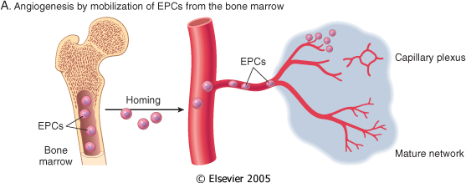
Angiogenesis
Angiogenesis from Endothelial Precursor Cells

Slide 37
SCAR FORMATION
Further healing: increased collagen, decreased active fibroblasts and new vessels(thrombosis and degeneration)
At the end: scar (inactive fibroblasts, dense collagen, fragments of elastic tissue, extracellular matrix, few vessels).

Slide 38
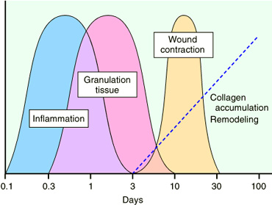
Slide 4.19

Slide 39
Functions of the Extracellular Matrix
The ECM is much more than a space filler around cells. Its various functions:
  Mechanical support
  Control of cell proliferation
  Scaffolding for tissue renewal
  Establishment of tissue microenvironments.

Slide 40
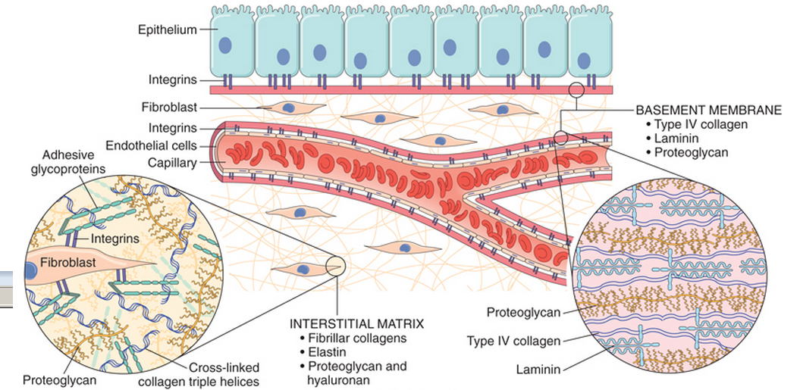

Slide 41
Cutaneous Wound healing
2. Secondary union
(healing by 2nd intention)
more extensive loss of cells and tissue:
-infarction
-inflammatory ulceration
-abscess formation
surface wound with large defect
large tissue defect that must be filled
Primary union
(healing by 1st intention)
clean surgical incision
no significant bacterial contamination
minimal loss of tissue
clot, scab formation

Slide 42
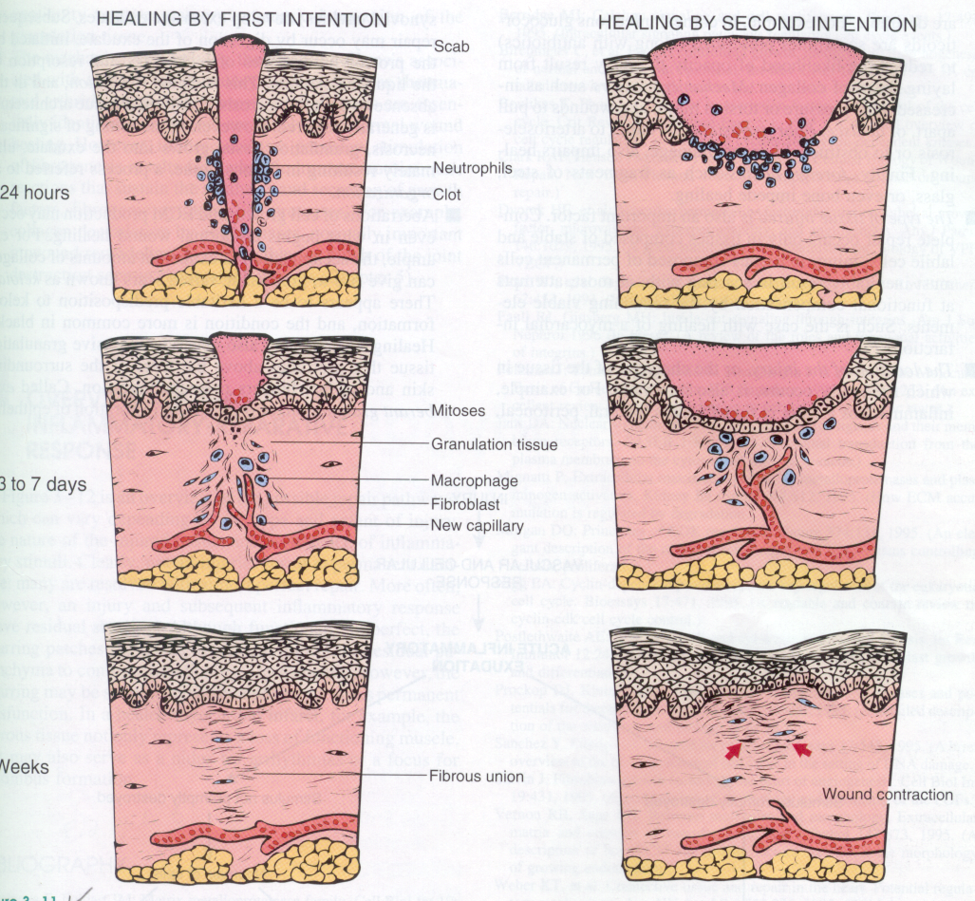
Primary union
(healing by first intention)
24 hr.: hematoma & neutrophils, mitotic activity of basal layer, thin
epithelial layer
Hageman factor (factor 12) will activate both the coagulation sequence and the kinin system as an initial response to this injury
day 3: macrophages, granulation tissue
day 5: collagen bridges the incision, epidermis thickens
2nd week:: continued collagen and fibroblasts, blanching
End of 1st month: scar (cellular connective tissue, intact epidermis, lost appendages).

Slide 43
Primary union
(healing by first intention)
Later, collagen type III is slowly replaced by collagen type I and the wound acquires tensile strength.
By the end of third month, the tissue has approximately 80% of its original strength.

Slide 45
Cutaneous Wound healing
Secondary union (healing by 2nd intention)
It occur in large, gaping wounds, as well those that are infected or contain foreign material

Slide 46
Difference between primary intention and secondary intention
The basic process of healing is the same in all wounds. In contrast to healing by primary intention, wounds healing by secondary intention
  Require more time to close because the edges are far apart
  Show a more prominent inflammatory reaction in and around the wound
  Contain more copious granulation tissue inside the tissue defect
  wound contraction (5 to 10%), ?myofibroblasts

Slide 47
Mechanisms of fibrosis
Persistent tissue injury leads to chronic inflammation and loss of tissue architecture.
Cytokines produced by macrophages and other leukocytes stimulate the migration and proliferation of fibroblasts and myofibroblasts and the deposition of collagen and other extracellular matrix proteins.
The net result is replacement of normal tissue by fibrosis.

Slide 48
Delayed wound healing

Slide 49
What is the most common cause of delayed wound healing?
Infection
Foreign bodies in the wound
Mechanical factors
Nutritional deficiencies
Poor perfusion
Excess corticosteroid
the most important cause of delay in healing; it prolongs inflammation and potentially increases the local tissue injury.
Suture help healing of wound
protein deficiency and vitamin C deficiency inhibit collagen synthesis and retard healing. Zinc and copper deficiency
due either to arteriosclerosis and diabetes or to obstructed venous drainage

Slide 50
Excess corticosteroid
have well-documented anti-inflammatory effects, and their administration may result in weakness of the scar
however, the anti-inflammatory effects of glucocorticoids are sometime desirable. For example, in corneal infections

Slide 51
COMPLICATIONS IN CUTANEOUS WOUND HEALING
Complications in wound healing can arise from abnormalities in any of the basic components of the repair process. These aberrations can be grouped into three general categories:
  (1) deficient scar formation
  (2) excessive formation of the repair components
  (3) formation of contractures.

Slide 52
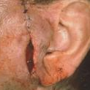
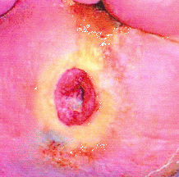
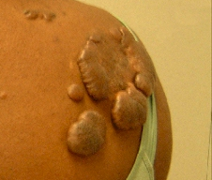
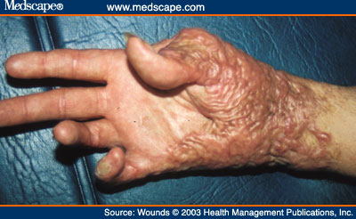
Wound dehiscence
Wound ulceration
Keloid
Contracture

Slide 53
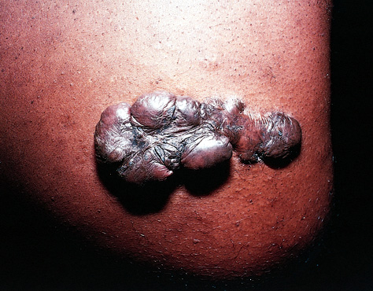
What is a keloid?
Keloids are excessive scars composed of irregularly deposite hyalinized collagen bands. They may appear as bulging masses.

Slide 54
TAKE HOME MESSAGES:
The various cell types (ie, labile, stable, and permanent cells) affect the outcome of healing.
Three main phases of cutaneous wound healing:
  (1) inflammation, (2) formation of granulation tissue, and (3) ECM deposition and remodeling
Healing by primary intention occur in surgical clean wound and healing by secondary intention occur when excessive tissue damage is present.
Several factors are associated with delayed wound healing.
Complication of wound healing include failure of healing, contracture and excessive scar formation.

