Slide 1
NEOPLASIA ------- (Malignant Tumors)
PRACTICAL 6
Pathology Dept, KSU
Foundation Block

Slide 2
1- Squamous cell carcinoma of the skin
Pathology Dept, KSU
Foundation Block

Slide 3
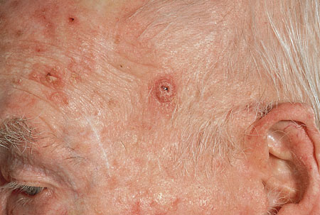
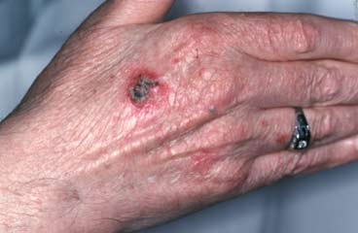
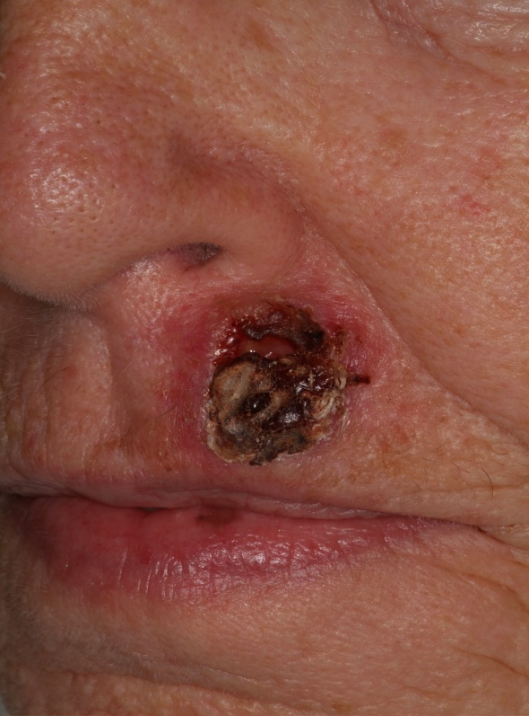
Squamous Cell Carcinoma - Gross
Squamous cell carcinoma (SCC) is the second most common cancer of the skin A sore that does not heal or any change in an existing mole, wart, or skin lesion can point to SCC. There may be an ulcer or reddish skin plaque that grows very slowly, may bleed occasionally (especially if located on the lip), may have an ulcerated center with raised, hard edges, may have a pearly quality with tiny blood vessels, is commonly present on sun-exposed areas (back of hands, lip
(usually a small ulcer which will not heal and bleeds sporadically, ears and the scalp.
Pathology Dept, KSU
Foundation Block

Slide 4
Squamous Cell Carcinoma - Histopathology
Sq Cell Carcinoma
The normal squamous epithelium at the right merges into the squamous
cell carcinoma at the left, which is infiltrating downward. The neoplastic squamous cells are still similar to the normal squamous cells, but are less orderly
Pathology Dept, KSU
Foundation Block

Slide 5
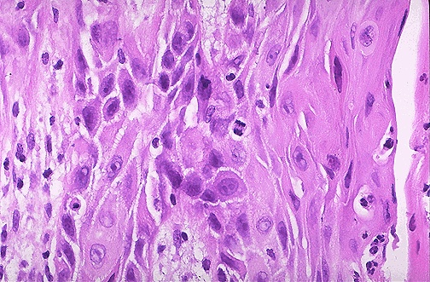
Squamous Cell Carcinoma - HPF
At high magnification, this squamous cell carcinoma demonstrates enough differentiation to tell that the cells are of squamous origin. The cells are pink
and polygonal in shape with intercellular bridges.
The neoplastic cells show pleomorphism, with hyperchromatic nuclei.
A mitotic figure is present near the center
Pathology Dept, KSU
Foundation Block

Slide 6
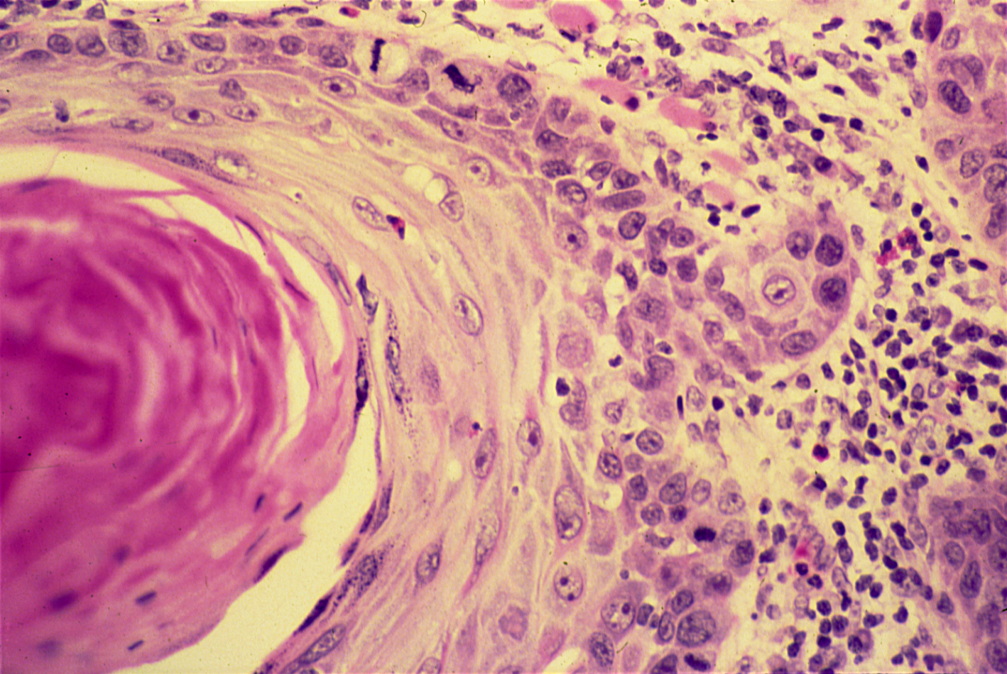
Squamous Cell Carcinoma - HPF
The dermis is infiltrated by masses of well differentiated neoplastic squamous cells separated by fibrous tissue stroma with chronic inflammatory cells. Tumour cells show pleomorphism, hyperchromatism and many mitotic figures .
Pinkish laminated keratin pearls (epithelial cell nests) are present
in the center of some cell masses
Pathology Dept, KSU
Foundation Block

Slide 7
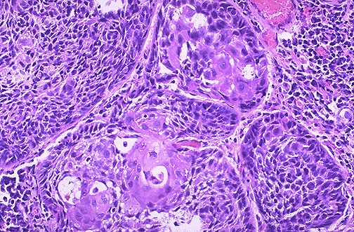
Squamous Cell Carcinoma - Histopathology
Here is a moderately differentiated squamous cell carcinoma in which some, but not all, of the neoplastic cells in nests have pink cytoplasmic keratin
Pathology Dept, KSU
Foundation Block

Slide 8
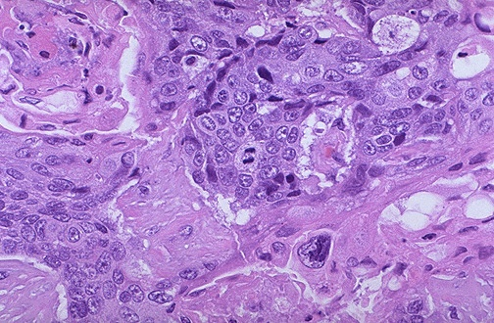
Squamous Cell Carcinoma - HPF
A mitotic figure is seen here in the center, surrounded by cells of a poorly differentiated squamous cell carcinoma, with pleomorphic cells that have minimal pink keratinization in their cytoplasm. In general, mitoses are more likely to be seen in malignant neoplasms
Pathology Dept, KSU
Foundation Block

Slide 9
2- Adenocarcinoma of the large intestine
Pathology Dept, KSU
Foundation Block

Slide 10
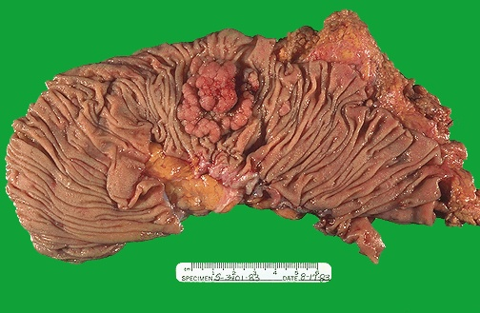
Adenocarcinoma of the Colon
Colon showing polypoid mass with haemorrhagic area on its surface. Because of this , occult blood in the faeces can be detected on lab examination of the patient which is at used to confirm and support our histopathological diagniosis.
Pathology Dept, KSU
Foundation Block

Slide 11
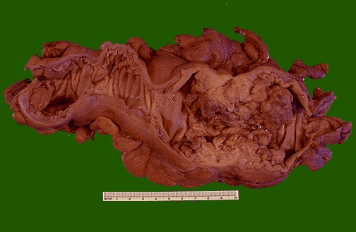
Adenocarcinoma of the Colon
This cancer is more exophytic in its growth pattern.
Thus, one of the complications of a carcinoma is obstruction (usually partial).
Pathology Dept, KSU
Foundation Block

Slide 12
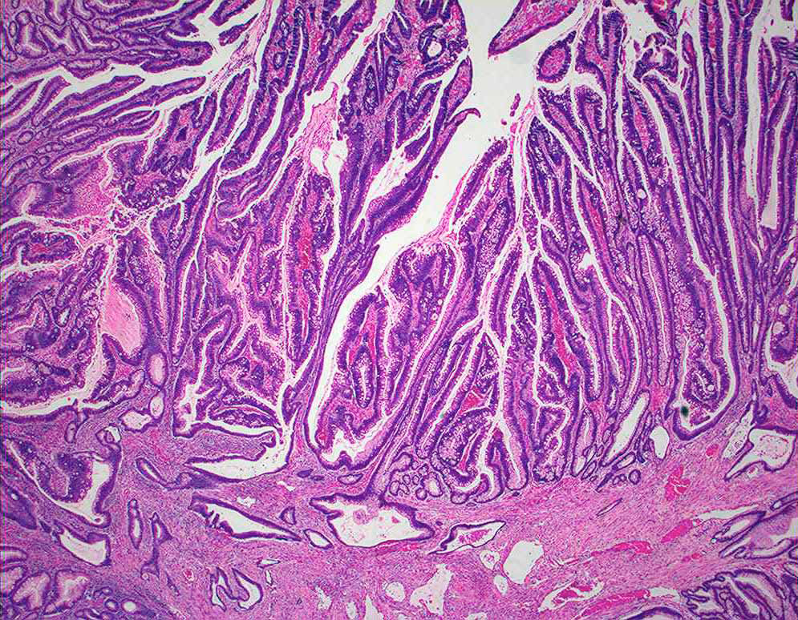
Adenocarcinoma of the Colon, arising from villous adenoma
Tumor consists of crowded irregular malignant acini separated by
thin fibrovascular stroma.
Colonic adenocarcinoma arising from villous adenoma .
Pathology Dept, KSU
Foundation Block

Slide 13
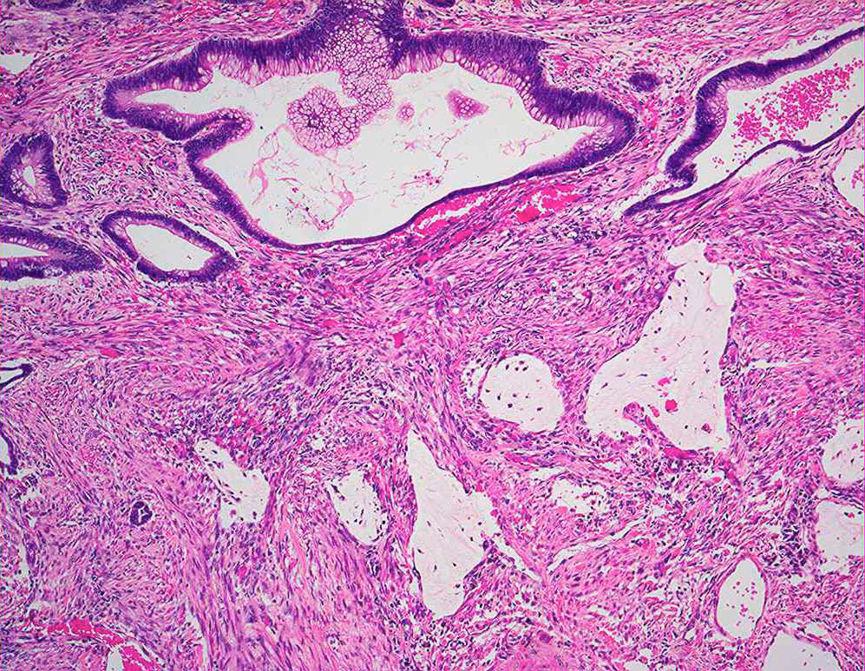
Adenocarcinoma of the Colon - LPF
The acini are lined by one or several layers of neoplastic cells with papillary projection showing pleomorphism, hyperchromatism and few mitoses.
Sometimes, the patient with 100’s polyps in their lumen (Familial polyposis coli) with APS gene mutation are more prone to develop Adenocarcinoma of the colon.

Slide 14
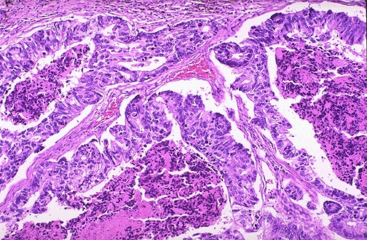
Adenocarcinoma of the Colon - LPF
Here is an adenocarcinoma in which the glands are much larger
and filled with necrotic debris.
Pathology Dept, KSU
Foundation Block

Slide 15
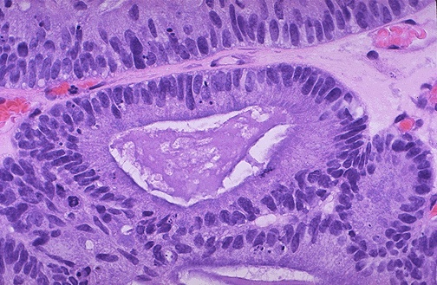
Adenocarcinoma of the Colon - HPF
At high magnification, the neoplastic glands of adenocarcinoma have crowded nuclei with hyperchromatism and pleomorphism. No normal goblet cells are seen
Pathology Dept, KSU
Foundation Block

Slide 16
3- Leiomyosarcoma
Pathology Dept, KSU
Foundation Block

Slide 17
Leiomyosarcoma
Cut surface of this leiomyosarcoma showing ill defined pale and soft large fleshy mass with hemorrhage and necrosis.
Pathology Dept, KSU
Foundation Block

Slide 18
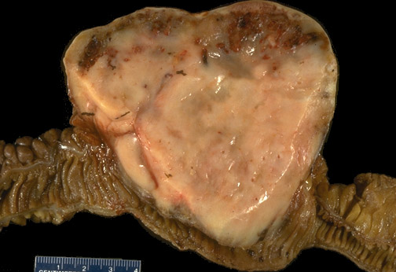
Leiomyosarcoma of Small Intestine
It is a large mass obstructing the small bowel lumen.
Pale firm and partly haemorrhagic cut surface with focal necrosis.
.
Pathology Dept, KSU
Foundation Block

Slide 19
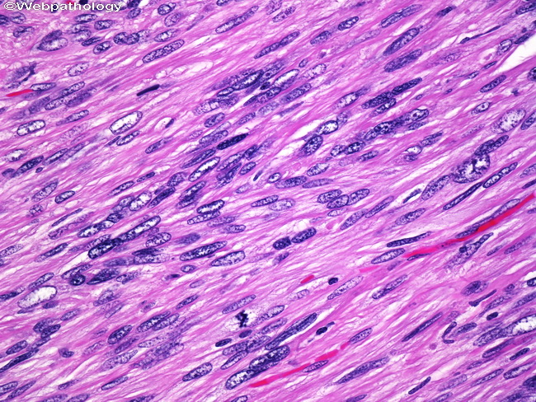
Leiomyosarcoma – HPF Microscopy
Marked atypia and cellularity with multiple mitoses present. Classic features of leiomyosarcoma including cigar shaped nuclei and arrangement of cells in fascicles are seen.
Pathology Dept, KSU
Foundation Block

Slide 20
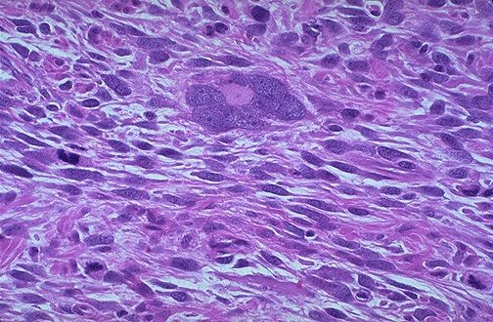
Leiomyosarcoma of the Uterus - HPF
Multinucleation / large bizarre giant cells.
Mitotic figures
cigar shaped nuclei and arrangement of cells in fascicles.
Pathology Dept, KSU
Foundation Block

Slide 21
Immunohistochemistry is performed for confirmation of the diagnosis of this sarcoma.
The neoplastic cells are positive for actin and desmin stain confirming cell of origin as Smooth muscle cell or fiber .
Hence we can make the final histopathological diagnosis of leiomyosarcoma.

Slide 22
THE END

