Slide 1

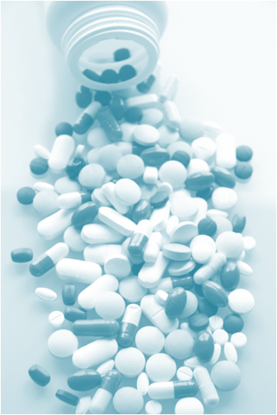

VARIATION IN DRUG RESONSIVNESS
Decrease in drug effects.
Development of side effects
Between different individuals
Within the same individual

Slide 2

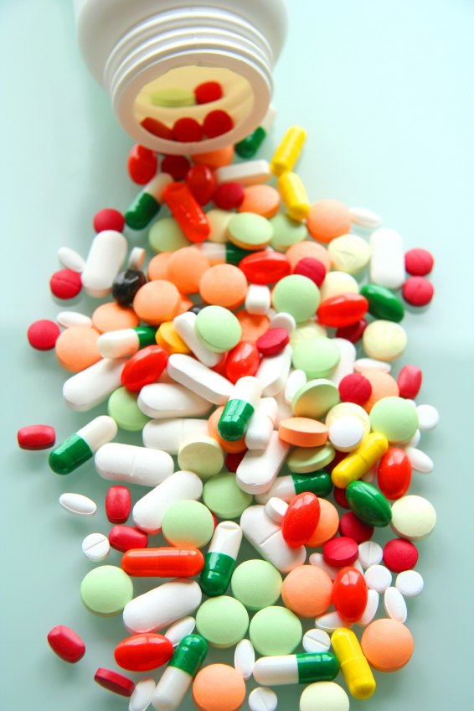
ilos
By the end of this lecture you will be able to :
Distinguish difference between tolerance
and desensitization ( tachyphylaxis ) and
reasons for their development
Recognize patterns of adverse drug
reactions (ADR)
TOLERANCE / DESENSITIZATION &
ADVERSE DRUG REACTIONS
By
Prof. Omnia Nayel
Assoc. Prof. Osama Yousif

Slide 3
Phenomenon of variation in drug response, where by there is a gradual diminution of the response to the drug when given continuously or repeatedly
TOLERANCE and DESENSITIZATION

Slide 4
DIMINUTION OF A RESPONSE
Rapid, in the course of few minutes
Gradual in the course of few days to weeks
TACHYPHYLAXIS / DESENSITIZATION
TOLERANCE
These SHOULD BE DISTINGUISHED FROM
Loss of effectiveness of antimicrobial agent
Resistance

Slide 5
REASONS FOR DEVELOPMENT OF TOLERANCE
PRE RECEPTOR EVENTS
EVENTS AT RECEPTORS
POST RECEPTOR EVENTS
↓ drug availability at the relevant receptors due to pharmaco- kinetic variables
Nullification of drug response by a physiological adaptative homeostatic response
Drug becomes:
> metabolized or excreted
< absorbed
altered distribution to tissues
Antihypertensive effects of ACE Is become nullified by activation of renin angiotensin system by NSAIDs
eg. Barbiturates  metabolism of Contraceptive pills =  it availability
LOSS OF THERAPEUTIC EFFICACY
Refractoriness

Slide 6
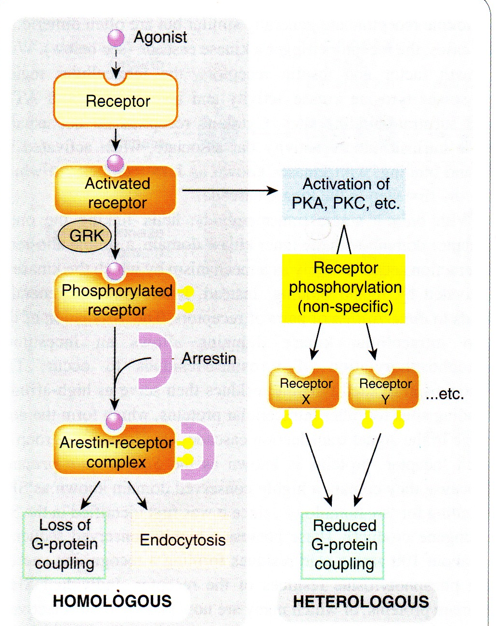
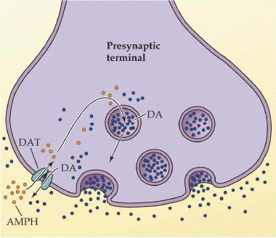
REASONS FOR DEVELOPMENT OF TOLERANCE
PRE RECEPTOR EVENTS
EVENTS AT RECEPTORS
POST RECEPTOR EVENTS
BINDING ALTERATION
DOWN REGULATION
EXHUSTION
OF MEDIATORS
Depletion of mediator stores by amphetamine
Phosphorylation of R i.e. ß-adrenoceptors → ↓ activation of AC to related ionic channel [functional defect]
↓ number of receptors.
Isoprenaline activation to β receptors →↑ R recycling by endocytosis [structural defect]
DOWN REGULATION
BINDING ALTERATION

Slide 7
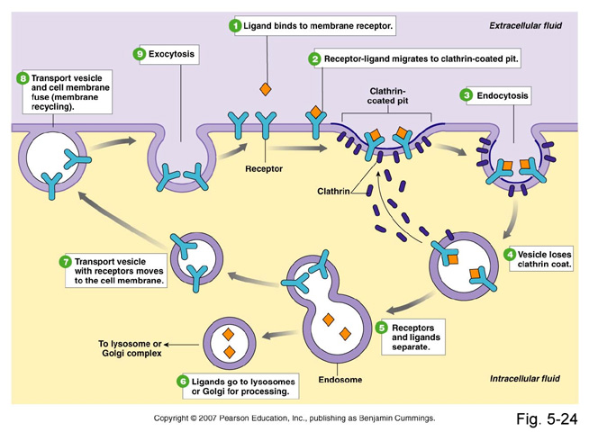
DOWN REGULATION

Slide 8
ADVERSE DRUG REACTIONS [ADR]
Harmful or seriously unpleasant effects occurring at doses intended for therapeutic effects.

Slide 9
TYPES OF ADR
Type A
Type C
Type E
Augmented
Continuous
End-of-Use
PREDICTABLE
Occurs during chronic drug administration
Occurs by sudden stop- page of chronic drug use due to existing adaptive changes
Occurs consequent but in excess of drug primary pharmacological effect.
Of quantitative nature
Osteoporosis  chronic corticosteroid intake
.. Withdrawal
syndrome  Morphine
Hemorrhage Warfarin
Type D
Delayed
Type B
Occurs after long period of time even after drug stoppage
Bizzar
UNPREDICTABLE
TERATOGENICITY →
Retinoids
CARCINOGENICITY →
tobacoo smoking
Occurs different [heterogenous / idiosyncrotic ] to known drug pharmacological effect. Usually due to patient’s genetic defect or immunological response.
Of qualitative nature
Thrombocytopenia  Quinidine

Slide 10
Comparison between typeA & B ADRs
 | Type A Augmentation | Type B Idiosyncrotic
Pharmacological predictability | Yes | No
Nature | Quantitative [ extension of pharmacology effect ] | Qualitative [ immune or genetic base]
Dose dependent | Yes (dose response relationship present) | No (dose response relationship absent)
Onset of symptoms | Usually Rapid | Usually delayed
Incidence and morbidity | High | Low
Mortality | Low | High
Treatment | Dose adjustment or Substitute by > selective + Antagonize unwanted effect of 1st drug | Stop drug + Symptomatic treatment
Example | Hemorrhage Warfarin | Thrombocytopenia Quinidine

Slide 11
Examples of TYPE A & B ADR
Drug Type A Type B
Chlorpromazine Sedation Cholestatic jaundice
Naproxen GIT haemorrhage Agranulocytosis
Phenytoin Ataxia Hepatitis, lymphadenopathy
Thiazides Hypokalaemia Thrombocytopenia
Quinine Tinnitus Thrombocytopenia
Warfarin Bleeding Breast necrosis
Genetics Variation / defect
Immunological Predisposition

Slide 12
TYPE B
If due to immunological response
1st exposure to a drug
Repeated exposures
Sensitization
HYPERSENSITIVITY REACTION
TYPE I
Anaphylaxsis
TYPE II
Cytotoxic
TYPE III
Immune complex
TYPE IV
Cell mediated
Urticaria rhinitis, bronchial asthma
by Penicillin,
Haemolytic anaemia thrombocytopenia by Quinidine
Serum sickness (fever arthritis enlarged lymph nodes, urticaria)
by Sulphonamides,
Contact dermatitis by l
Local anaesthetics creams

Slide 13
G
O
O
D
L
U
C
K
G
O
O
D
L
U
C
K
TOLERANCE / DESENSITIZATION & ADVERSE DRUG REACTIONS

