Slide 1
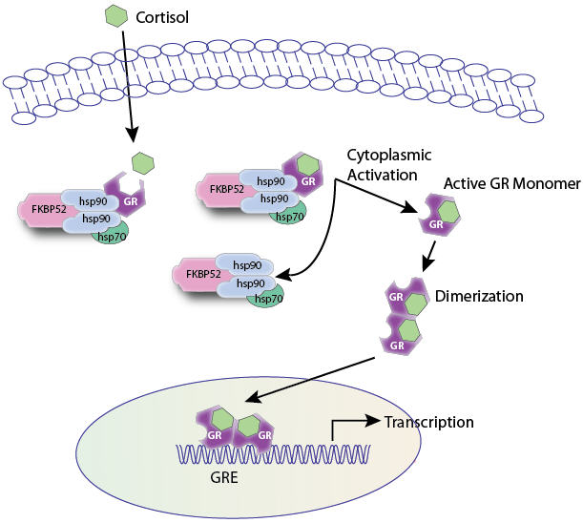
RECEPTOR FAMILIES
RECEPTOR FAMILIES
RECEPTOR FAMILIES
By
Prof. Omnia Nayel
Assoc. Prof. Osama Yousif

Slide 2
ilos
By the end of this lecture you will be able to :
Classify receptors into their main superfamilies
Recognize their different transduction mechanism
Identify the nature & time frame of their response

Slide 3
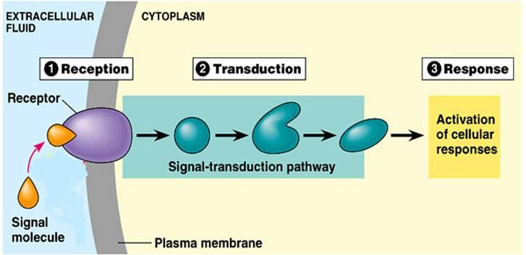
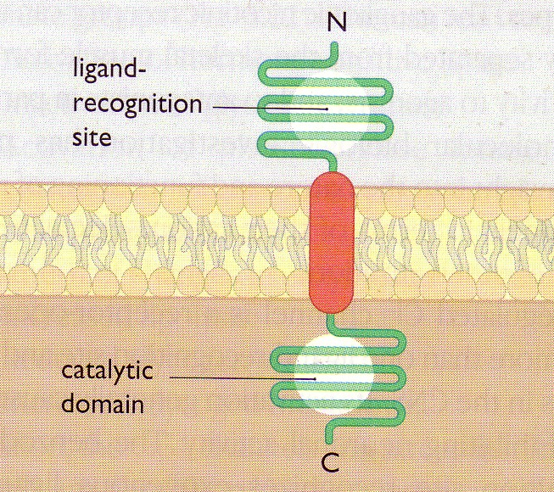
A RECEPTOR
◉
Its Structure:
2
3
4
2. Reception
3. Transduction
4. Response
1
1. Recognition
Direct
◉
Coupler Transduction

Slide 4
RECEPTOR FAMILIES
Classified according to their
Location
Structure
Transduction Mechanism
Nature of Response
Time scale of Response
 4 Main SUPERFAMILIES
Channel-Linked Receptor
G-Protein Coupled Receptors
Enzyme-Linked Receptors
Nuclear Receptors

Slide 5
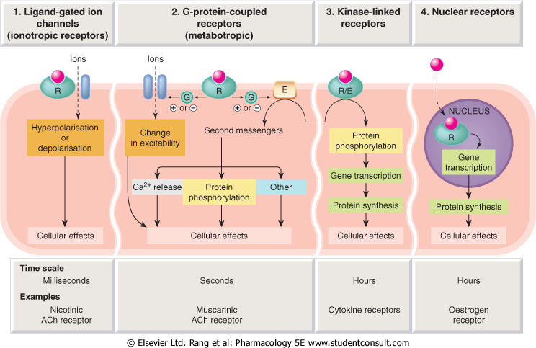
1
2
3
4
Conductance
Cell Signal  
Cell Signal 
Transcription
& Translation
Minutes / Hours
Hours / Days

Slide 6
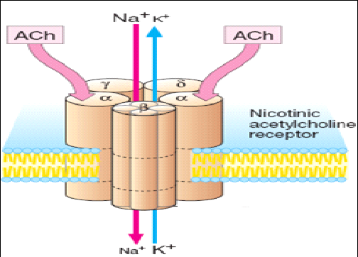
Channel-Linked Receptor
1
Ionotropic Receptor
Ligand-Gated-Ion Channel
Involved in fast synaptic neurotransmittion occurring over milliseconds
It is activated directly when a ligand comes to bind to receptors that are incorporated as part of its structure
Examples;
Nicotinic Ach receptor activated by Ach
Different from [Voltage-Gated ]Ion Channel
That is activated by a change in action potential
Not by occupancy of a ligand

Slide 7
G-Protein-Coupled Receptor
Involved in less rapid transmission of
Transmitters: Adrenaline at Adr R, Ach at mAch R …etc.
Hormones; Glucagon
Others; Peptides, Purines, …etc
2
Metabotropic Receptor
a G-Protein
Is Composed of 3 subunits [α β γ] & Guanyle Di-Phosphate [GDP]
◉
Agonist
1. Agonist occupancy dissociates [α] subunit, so GTP replaces GDP & go to activate effector
2. Agonist loss cleaves GTP by GTPase with return of GDP so [α β γ] bind again
Go-between proteins
Coupler
G-Protein

Slide 8
G-Protein-Coupled Receptor
Agonist
2
a G-Protein
Metabotropic Receptor
Go-between proteins
Coupler
?
RESPONSE
G-Protein
PHOSPHORYLATION OF TARGET PROTEINS
An enzyme coupled to 2nd messenger  Activates a Kinase
1. Adenyl cyclase cyclic Adenosine Mono-  Protein Kinase A
[AC] Phosph [cAMP] [PKA]
2. Phospholipase C (PLC)Inositol triphsph. [IP3] Ca⁺⁺ intracellular CaM dependent PK [CAMPK]
Diacyl Glycerol [DAG ]  Protein Kinase [PKC]
acts on Phosph Inositol di-Phosph [PIP₂]

Slide 9
G-Protein-Coupled Receptor
Adenyle cyclase
R
G-Protein
E
α
β
γ
ATP
ATP
ATP
ATP
3 subunits [α β γ]
◉ + GDP
PKA

Slide 10
?
?
R
Channels
E
α
α
α
P
β
γ
ATP
ATP
ATP
ATP
cAMP
Enzymes
P
PKA
Cytoskeletal Proteins
P

Slide 11
G-Protein-Coupled Receptor
Agonist
2
a G-Protein
Metabotropic Receptor
Go-between proteins
Coupler
?
?
RESPONSE
G-Protein
PHOSPHORYLATION OF TARGET PROTEINS
An enzyme coupled to 2nd messenger  Activates a Kinase
1. Adenyl cyclase c yclic Adnosine Mono-  Protein Kinase A
[AC] Phosph [cAMP] [PKA]
2. Phospholipase C (PLC)Inositol triphsph. [IP3] Ca⁺⁺ intracellular CaM dependent PK [CAMPK]
Diacyl Glycerol [DAG ]  Protein Kinase [PKC]
acts on Phosph Inositol di-Phosph [PIP₂]

Slide 12
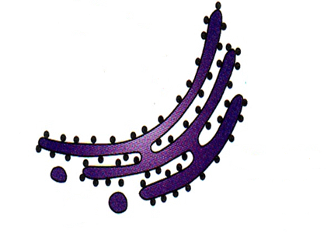
G-Protein-Coupled Receptor
Phospholipase C
E
α
α
PIP₂
DAG
Channels
β
γ

Phosphatidic a
Inositol
↑
P
IP₃
PKC
?
?
Ca⁺⁺
+CaM
CAMPK
P
P
P
Enzymes
P
Cytoskeletal Proteins

Slide 13
G-Protein-Coupled Receptor
Are the Most Abundant Type
Different Classes of Receptors
Ach R  n, m Adrenergic R  α & β
Different Receptors Subtypes
m Ach; m₁, m₂, m₃, m₄
β Adrenergic receptors; β₁, β₂ , β₃
Difference in their related G-Protein Classes
Divided according to their α-subunits into G_{s}, G_{i} and G_{q}
G_{s} and G_{i} produce, respective, stimulation and inhibition of AC
G_{q} is linked to activation of PLC-IP₃ -Ca⁺⁺ CaM & PKC

Slide 14
ADRENOCEPTORS
a₁ Adrenoceptors couple to G_{q} to stimulate PLC.
α₂ Adrenoceptors couple to G_{i} to inhibit AC.
β_{1&2} Adrenoceptors couple to G_{s} to stimulate AC
Adr
Adr
Inhibitory Receptor
Stimulatory Receptor
G_{i}
G_{s}
AC
α₂ Adrenoceptor
β Adrenoceptor
+
cAMP
↑cAMP

Slide 15
CHOLINERGIC RECEPTORS
M₁ & M₃ Ach receptors couple to G_{q} to stimulate PLC
M₂ & M₄ Ach receptors couple to G_{i} to inhibit AC
Ach
Adr
Stimulatory Receptor
Stimulatory Receptor
G_{q}
G_{q}
PLC
PLC
M₃ Ach receptor
α₁ Adrenoceptor
+
+
Bronchi
↑Ca ⁺⁺
↑Ca ⁺⁺
Blood Vessel

Slide 16
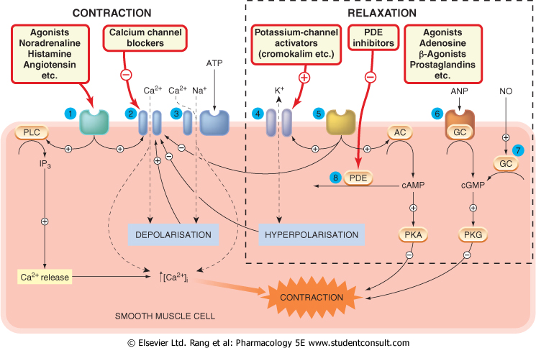
Complexity of a response is governed by many ligands, receptors & effectors

Slide 17
Enzyme-Linked Receptors
3
Involved in slow action of; hormones (insulin), growth factors, cytokines, …..
Their cytosolic domain either:
1. Associate directly with an enzyme like guanyl cyclase [GC] as in atrial natriuretic peptide [ANP] receptor.
2. Possess intrisic kinase activity (as tyrosine or serine/threonine kinase) that can phosphorylate itself (autophosphorylation) & / or other proteins that dock or bind to it. Example; insulin receptor
They control many cellular functions as motility, growth, different-iation, division & morphogenesis.
This usually require many intracellular signaling steps that take time [min. to hrs.] to process.

Slide 18
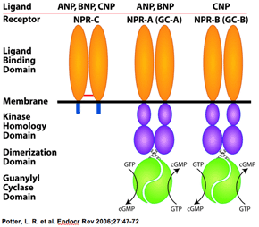
Enzyme-Linked Receptors
3
1.Guanyle cyclase-Linked Receptors
They have a single transmembrane spanning element.
These have integral intrinic guanylate cyclase activity .
Their 2nd messenger is cyclic guanyl mono-phosph. [cGMP]
→ activates PKG
→ to phosphorylate other
down stream protein signaling molecules.
Example
[ANP] Receptor
↑cGMP

Slide 19
3
Enzyme-Linked Receptors
Tyrosine Kinase-Linked Receptors
Ligands dimerize receptors
Activated Receptor autophosphorylates
Phosphorylate other proteins that it docks
Phosphorylated docked proteins
Example
Insulin Receptor
RESPONSE

Slide 20
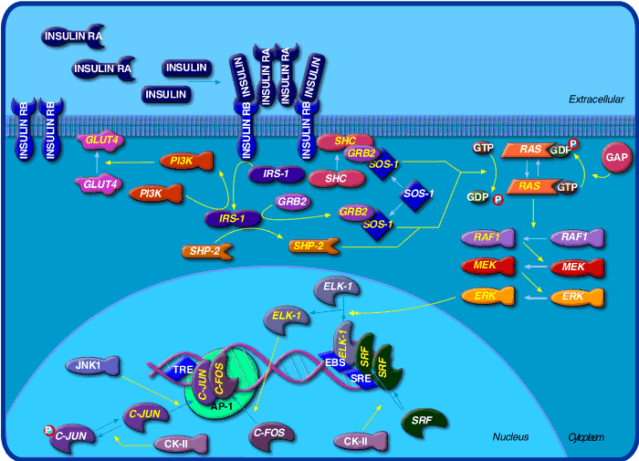
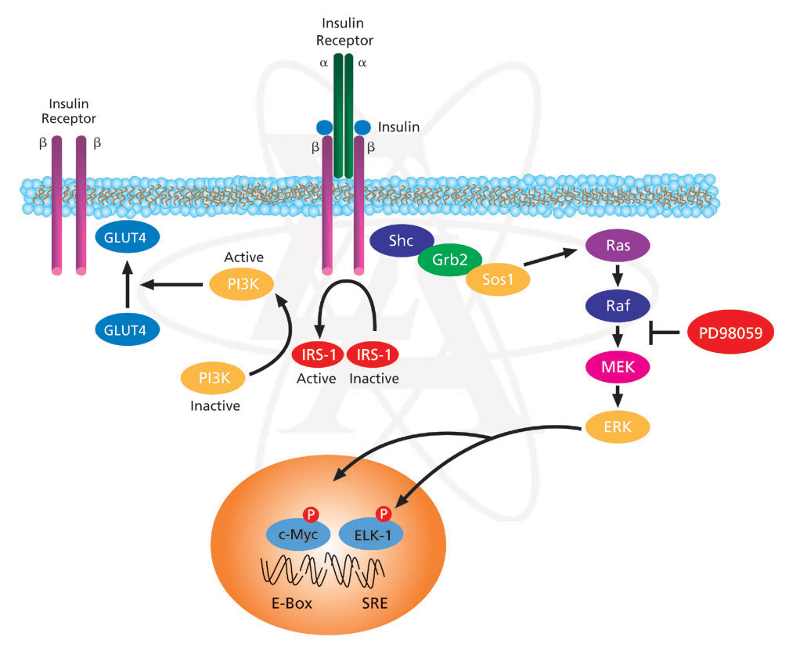
3
Enzyme-Linked Receptors
Non activated Insulin Receptor
Activated
Insulin Receptor
Tyrosine Kinase-Linked Receptors
INSULIN RECEPTOR
Insulin

Slide 21
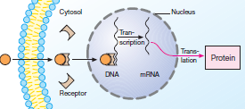
Are intra-cellularly located whether in cytosol or the nucleus.
Nuclear Receptors
4
Their natural ligands are usually :
Extracellular lipophylic hormones; steroids, thyroids, …etc
Extracellular lipids; linolinic a., retinoic a.
Phosphorylated protein end product of 2nd messenger signaling
◆ Involved in regulation of PROTEIN SYNTHESIS →most slowest in action.
They possess an area that recognizes specific DNA sequence in the nucleus which can bind it. This sequence is called a Responsive Element [RE]
This means that the activated receptors are acting as
TRANSCRIPTION FACTORS
[TF] → expressing or repressing target genes.
Protein
Translation
Transcription

Slide 22
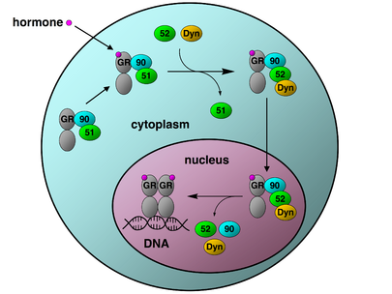
Nuclear Receptors
4
GLUCOCORTICOID [GC] RECEPTOR
proteins
The activated GC R complex
◆ Up-regulates expression of anti- inflammatory proteins
◆ Represses expression of pro-inflammatory proteins by preventing the translocation of their transcription factors from the cytosol into the nucleus).

Slide 23
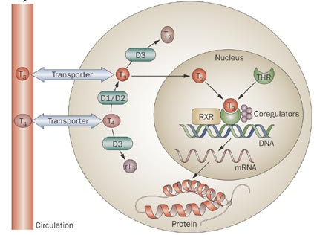
Nuclear Receptors
4
THYROID HORMONE
RECEPTOR

Slide 24
RECEPTOR FAMILIES
L
G
U
O
C
O
K
D

