Slide 1
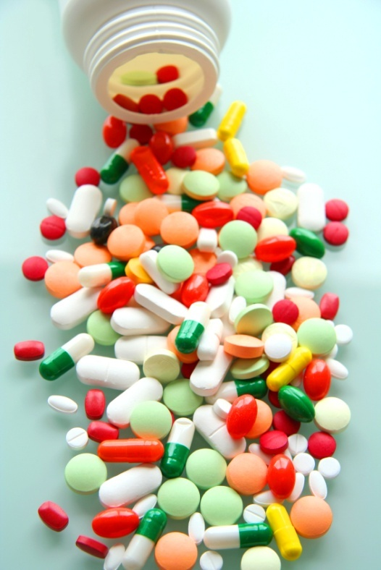
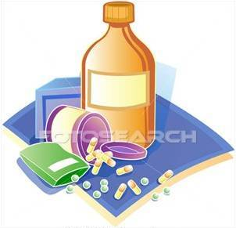
PHARMACOLOGY
PHARMACOLOGY

Slide 2
PHARMACOKINETICS
Absorb
Distribute
Metabolize
Excrete
The body
Interacts with body’s biological molecules
TARGETS Of Drug Action
To alter their biochemical &/or biophysical activity
Depress
Activate
Replace
Irritate
Destroy
The DRUG
RESPONSE
PHARMACODYNAMICS

Slide 3
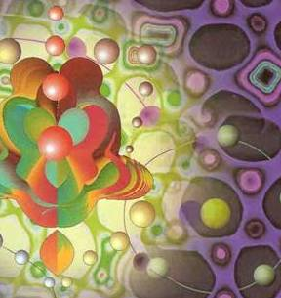
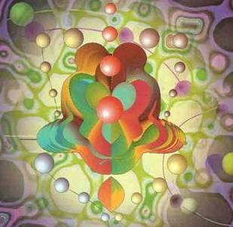
ilos
By the end of this lecture you will be able to :
Identify different targets of drug action
Differentiate between their patterns of action; agonism versus antagonism
Elaborate on drug binding to receptors
MOLECULAR MECHANISMS OF DRUG ACTION
By
Prof. Omnia Nayel
Assoc. Prof. Osama Yousif

Slide 4
PHARMACODYNAMICS
TARGETS
> Proteins
STRUCTURAL
REGULATORY
ENZYME
CARRIER MOLECULE
ION CHANNEL
RECEPTOR

Slide 5
TARGETS
STRUCTURAL PROTEIN
Examples of drugs acting on:
Tubulin are
Vincristine
Colchicine

Slide 6
TARGETS
REGULATORY PROTEIN
ENZYME
The drug competes with the natural substrate
for the enzyme
Examples of drugs acting:
REVERSIBLE
Neostigmine reversibly compete with ACH for cholinestrase at MEP
IRREVERSIBLE
Organophosphates irreversibly competes with ACH for cholinestrase

Slide 7
TARGETS
REGULATORY PROTEIN
CARRIER MOLECULE
The drug binds to such molecules altering their transport ability
Examples of drugs acting:
On a Passive Transporter
Cocaine blocks transport of catecholamines at synaptic cleft in CNS
On an Active Transporter
Digitalis blocks efflux of Na by Na pump

Slide 8
ION CHANNEL
TARGETS
REGULATORY PROTEIN
Drugs can act as a:
*Channel blocker
or
*Channel modulator
Local Anesthetics block Na influx through Na channel in nerve fibers.
They are Na channel Blockers.
Sulfonylurea drugs block K⁺ out flux via the K channels in pancreatic cells . They are K Channel Modulator

Slide 9
TARGETS
REGULATORY PROTEIN
RECEPTOR
Drugs bind and alter receptor (R) signal transduction machinery.
Bind
Occupy
Initiate
Activate
L
Physiological
RESPONSE
L
R
LR*
ENDOGENOUS
LIGAND
AFFINITY
EFFICACY
Agonist
R
Pharmacological
RESPONSE
A
A
R
AR*
ACh
A drug that possesses both affinity and efficacy
Antagonist
NO RESPONSE
B
B
R
Tubocurarine
A drug that possesses an affinity but no efficacy

Slide 10
The tendency of a drug to bind to the receptors is governed by its affinity.
AFFINITY
The ability for it, once bound, to activate the receptor is denoted by its efficacy.
EFFICACY
Agonist
A drug that possesses both affinity and efficacy
Is that inherent property intrinsic to the agonist that determines how "good" an agonist is.
high intrinsic efficacy
↓
a full agonist
low intrinsic efficacy ↓
a partial agonist.
Antagonist
A drug that possesses an affinity but no efficacy
Notes:
10

Slide 11
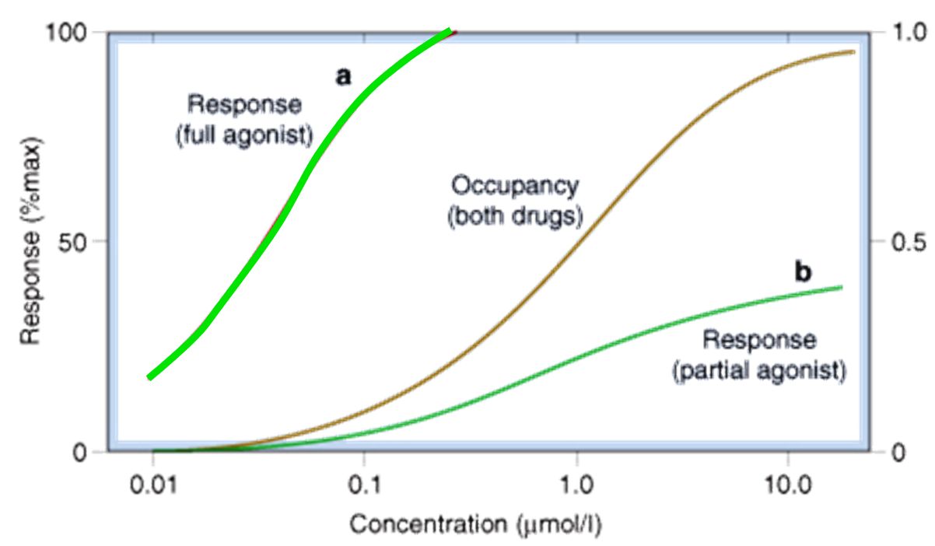
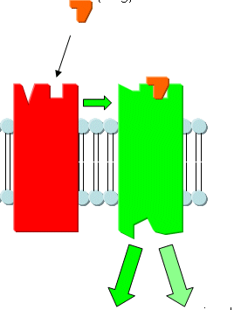
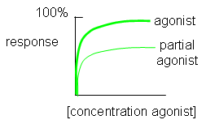
Ligand
Agonist
High intrinsic efficacy
↓
Max response
Low intrinsic efficacy
↓
Submax response
Ligand
A Full Agonist
A Partial
Agonist
Has Agonistic-Antagonistic Potentials
Pindolol, is a partial agonist, produces less decrease in heart rate than pure antagonists such as propranolol.
Notes:
11

Slide 12
Quiz?
Vincristine binds to:
A) a structural protein B) an ion channel C) an enzyme D) a carrier molecule

Slide 13
Quiz?
Local anaesthetics are:
A) Reversible enzyme inhibitors B) Irreversible enzyme inhibitors C) Channel blockers D) Channel modulators

Slide 14
Quiz?
An agent that can bind and maximally activate the receptor .
A) Reversible antagonist B) Full agonist C) Partial agonist D) Irreversible antagonist

Slide 15
Quiz?
Tubocurarine is a drug that possesses
A) Affinity and efficacy B) Affinity but no efficacy C) No affinity but efficacy D) No affinity and efficacy

