Slide 1
ANTERIOR, LATERAL COMPARTMENTS OF THE LEG & DORSUM OF THE FOOT
Dr JAMILA EL MEDANY
&
Dr SAEED VOHRA

Slide 2
OBJECTIVES
At the end of the lecture, student should be able to
Identify the deep fascia of leg
Identify the fascial compartments of the leg
Describe the anatomy of the anterior & lateral compartments
List the contents of each compartment (muscles, vessels & nerves)
Describe the anatomy and contents of the dorsum of the foot

Slide 3
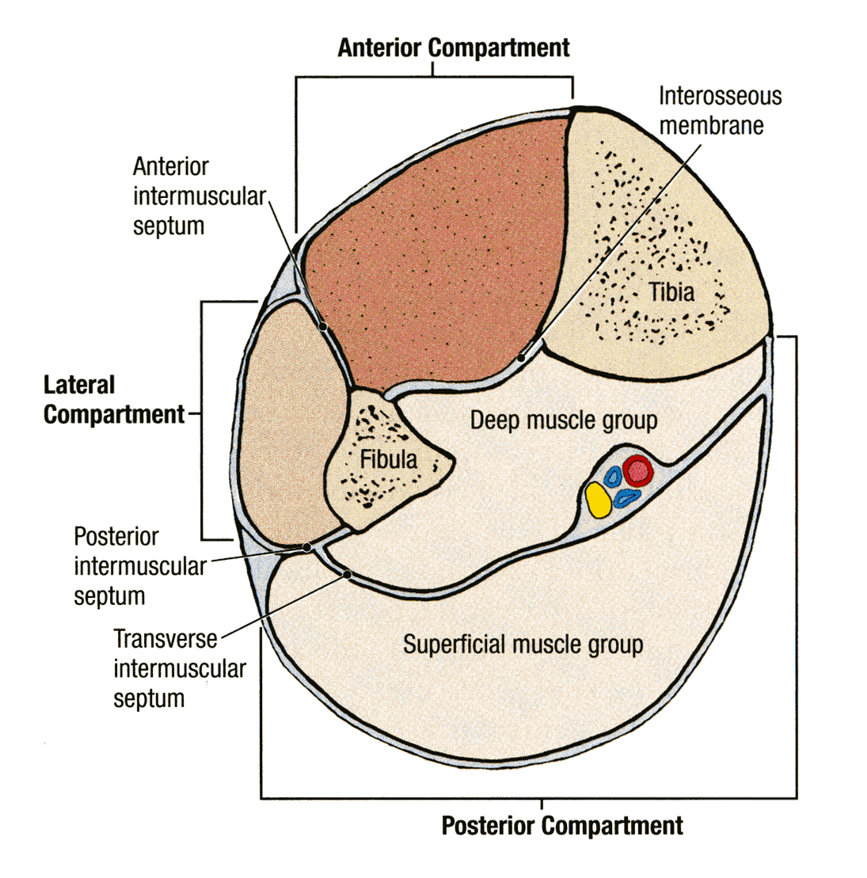
Fascia of the Leg
The deep fascia surrounds the leg and attached to Anterior & Medial borders of Tibia.
Two Intermuscular Septa
Pass from the deep aspect of this fascia to be attached to :
Anterior border of fibula (Anterior intermuscular septum)
Posterior border of fibula (Posterior intermuscular septum)
Interosseous membrane:
A thin & strong membrane, that binds the interosseous borders of tibia & fibula. It binds the two bones and provides attachment for muscles.

Slide 4
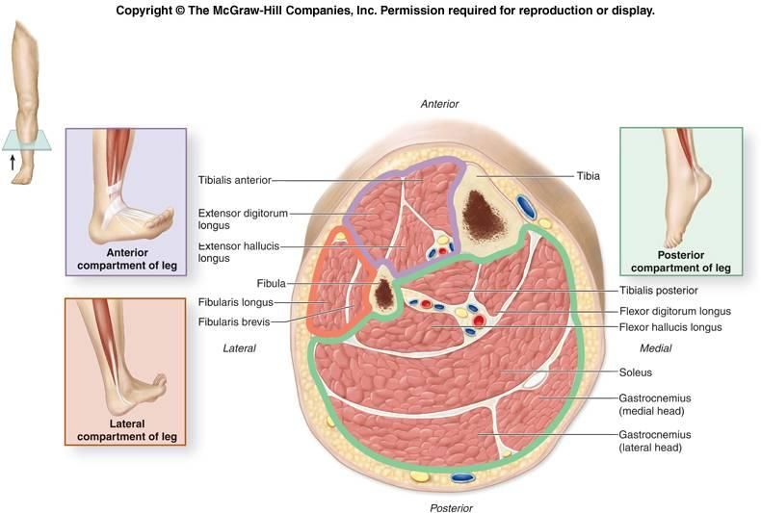
Fascial Compartments of Leg
Together with the interosseus membrane, the two intermuscular septa divide the leg into
(3) Compartments : 1-Anterior
2-Lateral (peroneal)
3-Posterior
Each one has its own Muscles (with specific action), Blood vessels and Nerves.

Slide 5
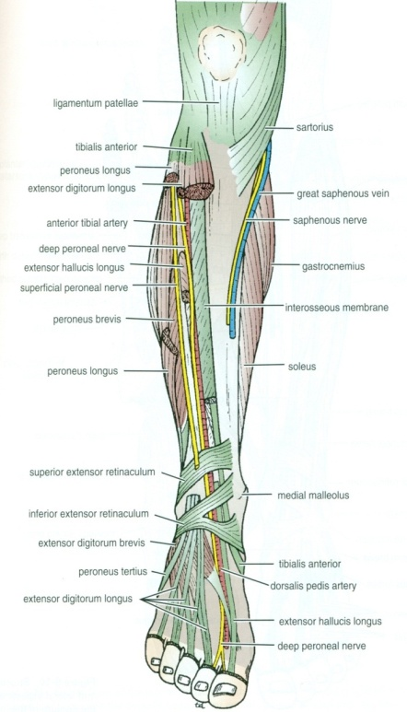
Criteria of the Anterior Compartment
Muscles :
All muscles take origin from the fibula EXCEPT Tibialis Anterior .
Nerve supply:
Deep
Peroneal.
Blood Supply:
Anterior tibial.
Action: Dorsiflexion of the ankle joint & Extension of the toes & (Inversion).

Slide 6
Muscles of Anterior Compartment
Tibialis Anterior
Extensor Hallucius Longus
Extensor Digitorum Longus
Peroneus Tertius

Slide 7
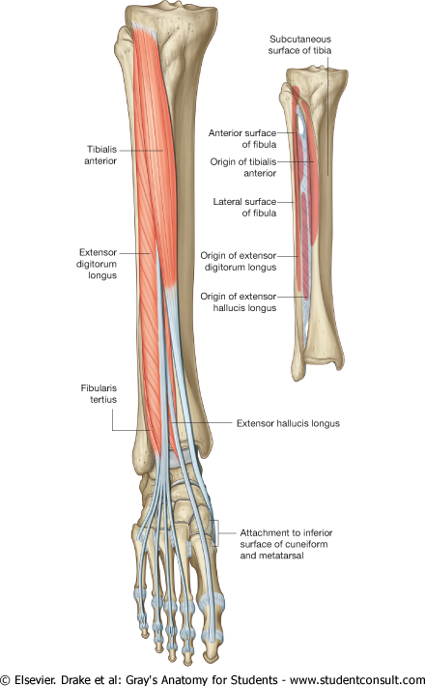
Tibialis Anterior & Extensor Digitorum Longus
Muscle | Origin | Insertion | Action
Tibialis anterior | Lateral surface of shaft of tibia & interosseous membrane | Medial cuneiform & base of 1st metatarsal bone | Extends foot at ankle joint; Inverts foot at subtalar & transverse tarsal joints & Holds up medial longitudinal arch of foot
Extensor Digitorum Longus | Anterior surface of shaft of fibula | Extensor expansion of lateral four toes | Extends toes; Dorsi flex foot at ankle joint

Slide 8
Peroneus Tertius, & Extensor Hallucis Longus
Muscle | Origin | Insertion | Action
Peroneus tertius | Anterior surface of shaft of fibula | Base of 5th metatarsal bone | Dorsi flex foot at ankle joint; Everts foot at subtalar and transverse tarsal joints
Extensor hallucis longus | Anterior surface of shaft of fibula | Base of distal phalanx of great toe | Extends big toe, Dorsi flex foot at ankle joint; Inverts foot at subtalar and transverse tarsal joints

Slide 9
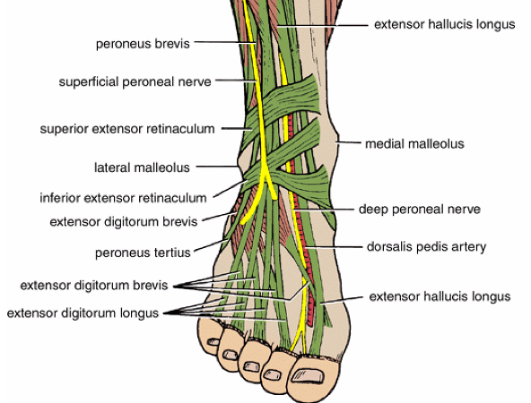
Extensor Retinacula
A thickening of deep fascia that keep the long tendons around ankle joint in position
Superior Extensor retinaculum :
Attached to anterior borders of tibia & fibula above ankle
Inferior Extensor retinaculum:
Y-shaped band located inferior to ankle

Slide 10
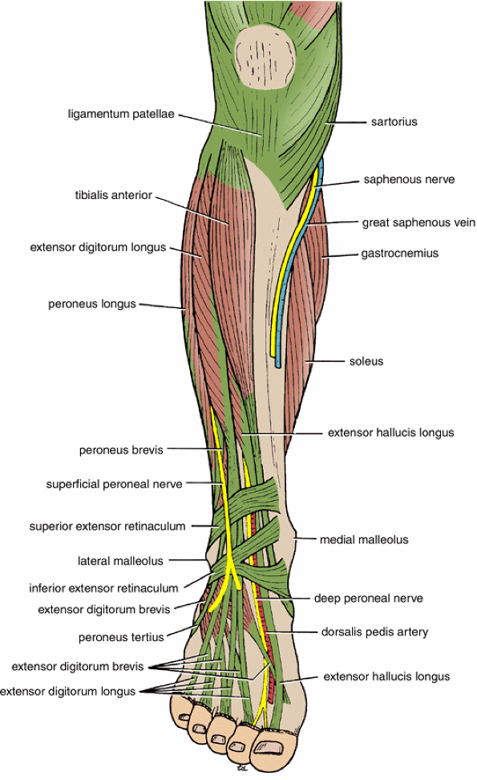
Structures Passing Deep to Extensor Retinacula
From medial to lateral:
1.Tom
2.Has
3.Very (vessels)
4.Nice ( nerve)
5.Dog &
6.Pigion

Slide 11
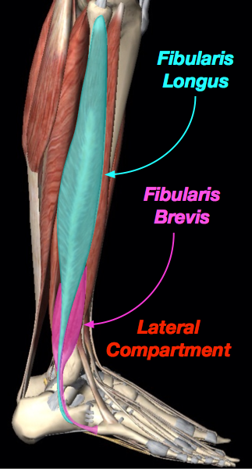
Lateral Compartment of Leg
MUSCLES | NERVE | BLODD SUPPLY
PERONEUS LONGUS | Superficial Peroneal | Peroneal A
PERONEUS BREVIS
Action:
Plantar flexion & Eversion

Slide 12
Peroneus Longus
Origin
Insertion
Action
Lateral surface of shaft of fibula | Base of first metatarsal & the medial cuneiform (Insertion of?) | Plantar flexes foot at ankle joint; Everts foot at subtalar and transverse tarsal joints; Supports Lateral longitudinal & Transverse arches

Slide 13
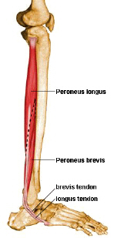
Peroneus Brevis
Origin Insertion Action
Lateral surface of shaft of fibula | Base of fifth metatarsal bone (Insertion of?) | Plantar flexes foot at ankle joint; Everts foot at subtalar and transverse tarsal joint; Supports Lateral longitudinal arch of foot

Slide 14
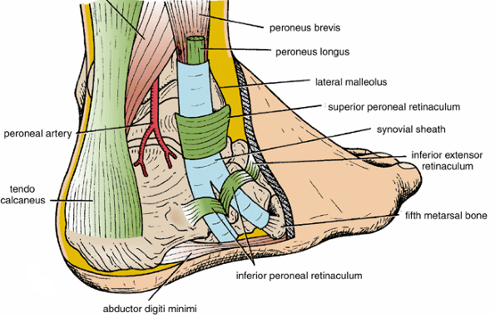
Peroneal Retinacula
Superior peroneal retinaculum
Connects the lateral malleolus to calcaneum & holds the tendons of peroneus longus & brevis
Inferior peroneal retinaculum
Synovial Sheaths of Peroneal Longus & Brevis:
Tendons of peronei are surrounded by a single common tubular synovial sheath,
deep to inferior peroneal retinaculum, they have separate sheaths

Slide 15
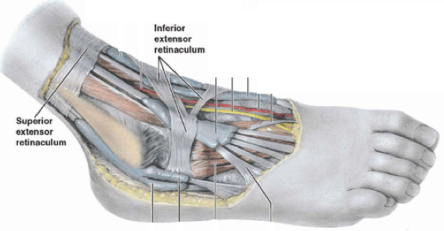
Deep Fascia of Dorsum of Foot
It is very thin, but just distal to ankle joint, it is
thickened to form Inferior extensor retinaculum

Slide 16
Dorsum of Foot
MUSCLE | BLODDD VESSEL | NERVE
Extensor Digitorum Brevis | Dorsalis Pedis | DEEP & Superficial Peroneal

Slide 17
Extensor Digitorum Brevis
Origin | Insertion | Action
Anterior part of upper surface of the Calcaneum & from the Inferior extensor retinaculum | four tendons into the proximal phalanx of big toe (ex hall brevis) and second, third, and fourth toes | Extend toes

Slide 18
Insertion of Long Extensor Tendons (Extensor Expansion)
The tendons of Extensor digitorum longus pass to the lateral four toes.
Each tendon to the 2nd , 3rd & 4th toes is joined on its lateral side by a tendon of Extensor digitorum brevis.
The extensor tendons form
a Fascial Expansion (Extensor Expansion) on the dorsum of each toe.
The expansion divides into (3) parts.
Central part: inserted into the Base of Middle ph.
Two Lateral parts: inserted into the Base of Distal ph.
The (Extensor Expansion) receives insertion of :
Interossei & Lumbrical muscles.

Slide 19
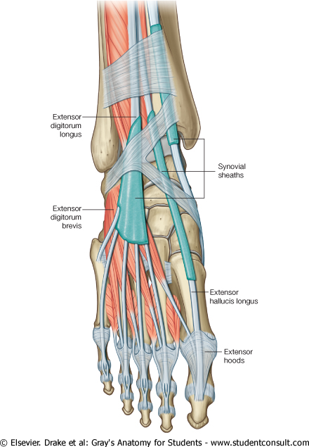
Synovial Sheaths of Extensor Tendons on the Dorsum of Foot
Tibialis anterior
Extensor hallucis longus
(Both have their own synovial sheath)
Extensor digitorum longus &
peroneus tertius : have a common sheath, it extends to the level of Base of 5th Metatarsal bone.

Slide 20
THANK YOU

