Slide 1
Glycogen Metabolism
By
Dr. Reem M. Sallam, MD, MSc, PhD
Clinical Chemistry Unit
Department of Pathology
College of Medicine, King Saud University

Slide 2
Objectives:
By the end of this lecture, students should be familiar with:
The need to store carbohydrates in muscle
The reason for carbohydrates to be stored as glycogen
An overview of glycogen synthesis (Glycogenesis)
An overview of glycogen breakdown (Glycogenolysis)
Key elements in regulation of both Glycogenesis and Glycogenolysis
Example of glycogen storage diseases

Slide 3
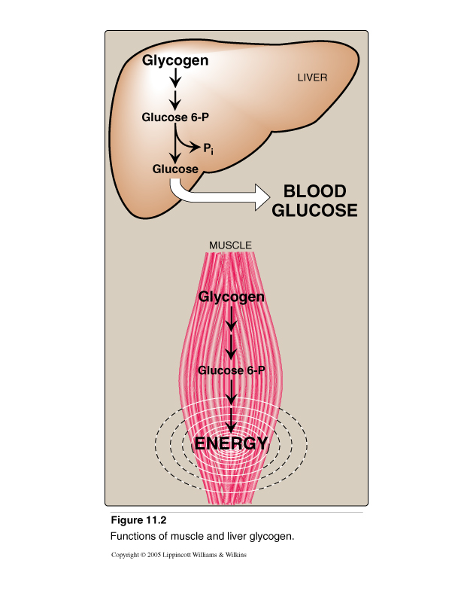
Location & Functions of Glycogen
Location of glycogen in the body
skeletal muscle & liver are the main stores of glycogen in the body
~400 g in muscles (1-2% of resting muscles weight)
~100 g in liver (~ 10% of well-fed liver)
Functions of glycogen:
Function of muscle glycogen: fuel reserve (ATP)
(during muscular exercise)
Function of liver glycogen: a source for blood glucose
(especially during early stages of fasting)

Slide 4
Structure of Glycogen
Glycogen is a branched-chain large homopolysaccharide made
exclusively from α- D-glucose
Glucose residues are bound by α(1 - 4) glucosidic linkage
Branches (every 8-10 residue) are linked by α(1-6) glucosidic linkage
Glycogen is present in the cytoplasm in the form of granules which contain most of the enzymes necessary for glycogen synthesis & degradation

Slide 5
Metabolism of Glycogen in Skeletal Muscle
Glycogenesis:
Synthesis of Glycogen from Glucose
Glycogenolysis:
Breakdown of Glycogen to Glucose-6-phosphate

Slide 6
GLYCOGENESIS
(Synthesis of Glycogen in Skeletal Muscles)
Steps of glycogenesis:
Activation of building blocks (formation of UDP-Glucose)
Initiation of synthesis
Elongation (the enzyme is Glycogen synthase)
Branching (the enzyme is Branching enzyme)

Slide 7
GLYCOGENESIS
(Synthesis of Glycogen in Skeletal Muscles)
Activation of building blocks (formation of UDP-Glucose):
The source of all the glucose molecules that are added to the growing glycogen chain is uridine diphosphate-glucose (UDP-glucose).
A glucose 6-phosphate molecule is converted to glucose 1-phosphate by phosphoglucomutase enzyme.
A glucose 1-phosphate and a UTP will form UDP-glucose in a reaction catalyzed by UDP-glucose pyrophosphorylase enzyme. The products of this reaction are: UDP-glucose and pyrophosphate (PP_{i})
The high-energy bond in PP_{i} is hydrolyzed (broken) by pyrophophatase enzyme. The products of this reaction are inorganic phosphate P_{i} and energy. The energy is used in glycogenesis.

Slide 8
GLYCOGENESIS, continued...
(Synthesis of Glycogen in Skeletal Muscles)
2- Initiation of synthesis:
Glycogen synthase is responsible for making the a1-4 linkages in glycogen.
This enzyme cannot initiate synthesis.
It can only elongate a pre-existing molecule.
This pre-existing molecule can be a glycogen fragment or a glycogen primer (glycogenin)
Glycogenin is a protein that can be the acceptor of glucose residues from UDP-glucose. Glycogenin also catalyzes this reaction and the transfer of the next few molecules of glucose from UDP-glucose to produce a short chain.
The short chain will serve as a primer that can be used by the glycogen synthase enzyme.

Slide 9
GLYCOGENESIS, continued...
(Synthesis of Glycogen in Skeletal Muscles)
3- Elongation by Glycogen synthase:
Glycogen synthase is responsible for making the α1-4 linkages in glycogen.
This involves the transfer of glucose from UDP-glucose to the nonreducing end of the growing chain forming a new glycosidic bond .
The products of this reaction are:
  a glycogen molecule with an extra glucose residue
  a UDP (which can be converted back to UTP by nucleoside diphosphate kinase)

Slide 10
GLYCOGENESIS, continued...
(Synthesis of Glycogen in Skeletal Muscles)
4- Branching:
Glycogen synthase will continue working till sufficient number of glucose residues has been added. Then a branch has to be introduced.
The branching enzyme will transfer a chain of 6-8 glucose residues from the nonreducing end of the straight chain by breaking an α 1-4 linkage, to another residue on the chain, and will attach it by an α 1-6 linkage.
This results in a molecule with 2 nonreducing ends and a branch
The resulting new nonreducing end and the old nonreducing end from which the glucose residues were removed can now be further elongated by glycogen synthase
This process of elongation and branching continues.

Slide 11
Synthesis of Glycogen

Slide 12
Glycogenolysis
(Breakdown of glycogen in skeletal muscles)
Shortening of glycogen chain by glycogen phosphorylase
Removal of branches by debranching enzymes
Fate of glucose 1-phosphate (G-1-P)

Slide 13
Glycogenolysis
(Breakdown of glycogen in skeletal muscles)
1- Shortening of glycogen chain by glycogen phosphorylase:
The enzyme requires pyridoxal phosphate as a coenzyme.
This enzyme sequentially cleaves α (1-4) bonds from the nonreducing ends of the glycogen chain producing glucose 1-phosphate.
Glucose 1-phosphate is converted to glucose 6-phosphate (by phosphoglucomutase enzyme)
Glycogen phosphorylase will continue its action of phosphorolysis until 4 glucose units remain on each chain of the glycogen molecule which will be called: limit dextrin.
The glycogen phosphorylase cannot degrade the limit dextrin any further
(Pyridoxal phosphate)

Slide 14
Glycogenolysis
(Breakdown of glycogen in skeletal muscles)
2- Removal of branches by debranching enzymes :
The debranching enzyme has 2 enzymic activities:
α (1-4)→ α (1-4) transferase: It removes the outer 3 of the 4 glucose residues attached at a branch. It then transfers them to the nonreducing end of another chain. (i.e. an α (1-4) bond is broken and an α (1-4) bond is made.
Hydrolytic cleavage of the α (1-6) bond at the branch point producing free glucose.

Slide 15
Glycogenolysis
(Breakdown of glycogen in skeletal muscles)
2- Fate of glucose 1-phosphate (G-1-P):
Glucose 1-Phosphate is converted to Glucose 6-Phosphate by phosphoglucomutase.
In the skeletal muscles: G-6-P is not converted to free glucose
It is used as a source of energy for skeletal muscles during muscular exercise (by anaerobic glycolysis starting from G-6-P step.

Slide 16
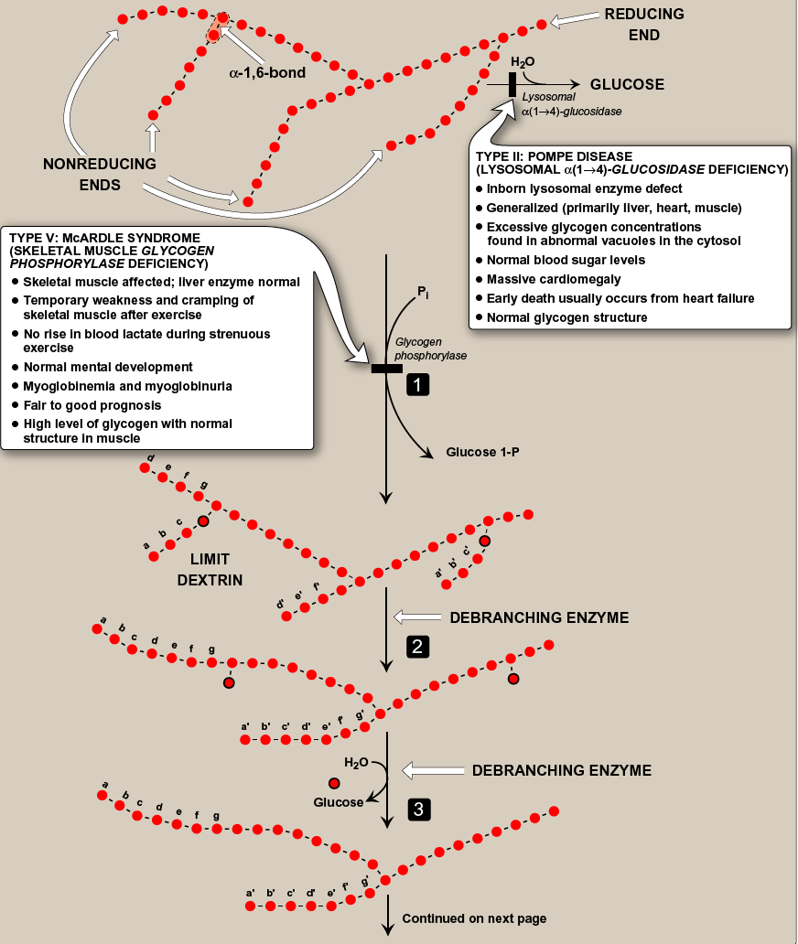
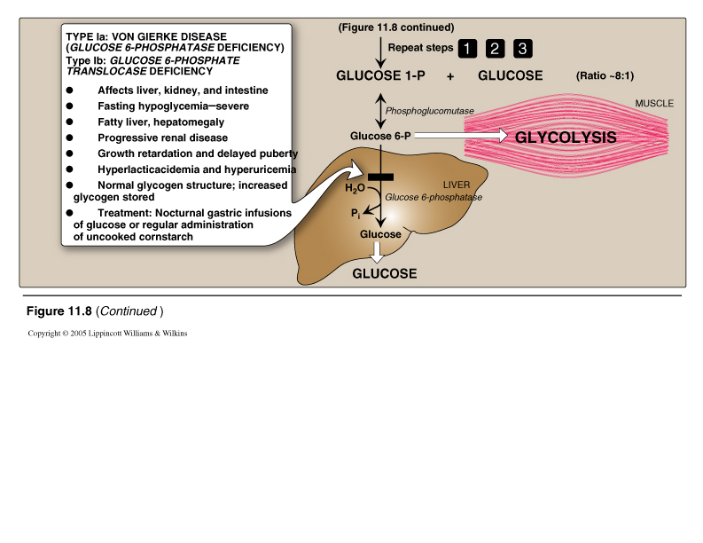
Glycogenolysis

Slide 17
Regulation of
Glycogen Metabolism
Synthesis & degradation of glycogen are tightly regulated
In Skeletal Muscles:
Glycogen degradation occurs during active exercise
Glycogen synthesis begins when the muscle is at rest
Regulation occurs by 2 mechanisms:
1- Allosteric regulation
2- Hormonal regulation

Slide 18
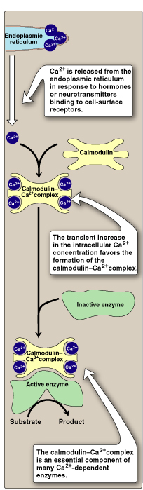
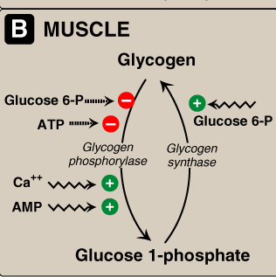
Regulation of
Glycogen Metabolism
1- Allosteric regulation
Glycogen synthase is allosterically activated by glucose 6-P (when it is present in elevated concentrations in the well-fed state)
Glycogen phosphorylase is allosterically inhibited by glucose 6-P and by ATP (High energy signal in the cell)
Nerve impulses cause membrane depolarization→ Ca²⁺ release from the sarcoplasmic reticulum into the sarcoplasm → Ca ²⁺ binds to calmodulin→ Formation of Ca ²⁺ -calmodulin complex → Activation of Ca ²⁺ -dependent enzymes (e.g., glycogen phosphorylase)
Muscle glycogen phosphorylase is allosterically activated by AMP

Slide 19
Regulation of
Glycogen Metabolism
2- Hormonal regulation (Covalent modification) by epinephrine:
In muscle, epinephrine binds to membrane receptors → signals the need for glycogen to be degraded to provide energy for exercising muscle.
Epinephrine binds to cell-membrane receptors → cAMP-mediated activation of cAMP-dependent protein kinase →
  phosphorylation and activation of glycogen phosphorylase enzyme→ activation of glycogen degradation
  Phosphorylation and inactivation of glycogen synthase enzyme → inhibition of glycogen synthesis.

Slide 20
Regulation of Glycogen Metabolism:
2. Hormonal Regulation by Epinephrine
Muscle contraction
Epinephrine release
Skeletal muscle: Epinephrine/receptor binding
Second messenger: cAMP
Response: Enzyme phosphorylation
P
P
Glycogen synthase
(Inactive form)
Inhibition of glycogenesis
Glycogen phosphorylase
(Active form)
Stimulation of glycogenolysis

Slide 21
Glycogen Storage Diseases (GSD)
A group of genetic diseases that result from a defect
in an enzyme required for glycogen synthesis or degradation
They result in:
1- Formation of abnormal glycogen structure
OR
2- Excessive accumulation of normal glycogen in a specific tissue

Slide 22
Example of GSD
GSD Type V = McArdle syndrome
A syndrome due to deficiency of skeletal muscle glycogen phosphorylase.
The liver enzyme is normal, while the skeletal muscle is affected.
Skeletal muscle cells show high level of glycogen with normal structure.
It is a relatively benign, chronic condition
Normal mental development
Clinical picture:
  Temporary weakness and cramping of skeletal muscle after exercise.
Diagnostic criteria:
No rise in blood lactate during strenuous exercise
High level of myoglobin in blood (myoglobinemia) and in urine (myoglobinuria)

Slide 23
THANK YOU ☺

