Slide 1
Lecture Title:
Mycetoma
and other Subcutaneous Mycoses
(Musculoskeletal Block, Microbiology)

Slide 2
Lecture Objectives..
Acquire the basic knowledge about mycetoma and the clinical features of the disease
Acquire the basic knowledge about other common subcutaneous mycosis and their clinical features.
Know the main fungi that affect subcutaneous tissues, muscles and bones.
Identify the clinical settings of such infections
Know the laboratory diagnosis, and treatment of these infections.

Slide 3
Subcutaneous Mycoses
Fungal infections involving the dermis, subcutaneous tissues, muscle and may extend to bone.
They are initiated by trauma to the skin.
Are difficult to treat and surgical intervention is frequently employed.
Diseases in healthy host, however, more severe disease in immunocompromised host.

Slide 4
Subcutaneous Mycoses
Mycetoma
Subcutaneous zygomycosis
Sporotrichosis
Chromoblastomycosis
Pheohyphomycosis
Rhinosporidiosis
Lobomycosis

Slide 5
Mycetoma
Mycetoma is a chronic, granulomatous disease of the skin and subcutaneous tissue, which sometimes involves muscle, and bones.
It is characterized by Swelling , abscess formation, and multiple draining sinuses that exude characteristic grains of clumped organisms .
It typically affects the lower extremities, but also other areas of the body e.g. hand, back and neck.
The disease was first described in the Madura district of India in 1842, (Madura foot).

Slide 6
Mycetoma
Classified as :
Eumycetoma: those caused by fungi
Actinomycetoma: those caused by aerobic filamentous bacteria (Actinomycetes)
Mycetoma is endemic in tropical, subtropical, and temperate regions. Sudan, Senegal, Somalia, India, Pakistan, Mexico, Venezuela
Is more common in men than in women (ratio is 3:1).
Commonly in people who work in rural areas, framers

Slide 7
Mycetoma
Mycetoma is acquired via trauma of the skin
Trauma
painless subcutaneous firm nodule is observed
massive swelling with skin rupture, and sinus tract formation
old sinuses close and new ones open, draining exudates with grains (granules)
Grains may sometimes be seen with the naked eye.

Slide 8
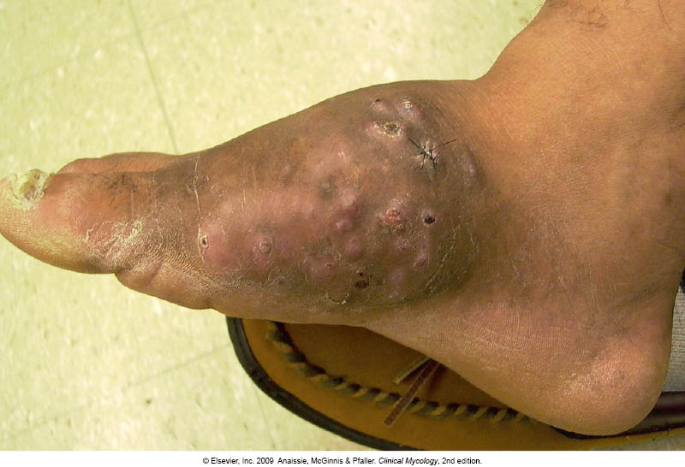
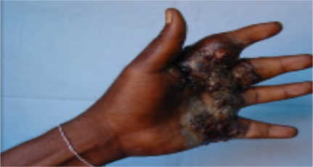

Slide 9
Mycetoma
Etiology
Eumycetoma
Caused by a several mould fungi
The most common are
Madurella mycetomatis, Madurella grisea, and Pseudallescheria boydii
The color of grains is black or white
Actinomycetoma
Caused by aerobic filamentous bacteria , gram positive
Actinomadura madurae
Streptomyces somaliensis
Nocardia brasiliensis
Color of grains yellow, white, yellowish-brown, pinkish – red.

Slide 10
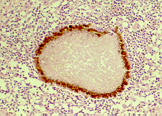
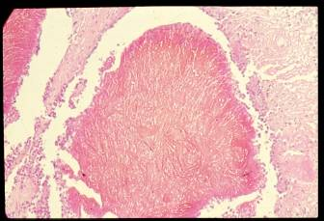
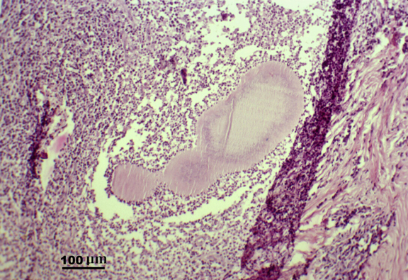
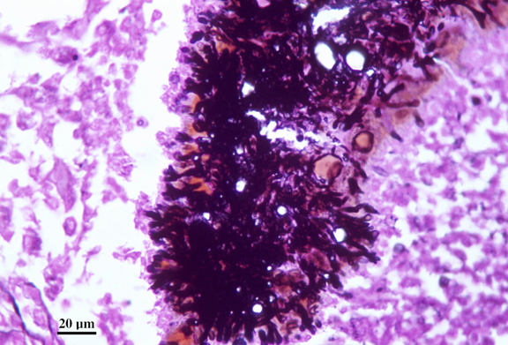
Mycetoma
Diagnosis:
Clinical samples:
Biopsy tissue (Superficial samples of the draining sinuses are inadequate)
Pus
Blood (for serology only)
Direct microscopic examination
Microscopic examination:
Histological sections: Hematoxylin-Eosin,
Smears: Stain with Giemsa , Gomori methenamine silver (Fungi)
Stain with Gram (Actinomycetes)
Grains (Observing the size of the filaments , the color of the grain)
e.g.
White-to-yellow grains indicate P . boydii, Nocardia species, or A. madurae infection.
Black grains indicate, Madurella species infection.

Slide 11
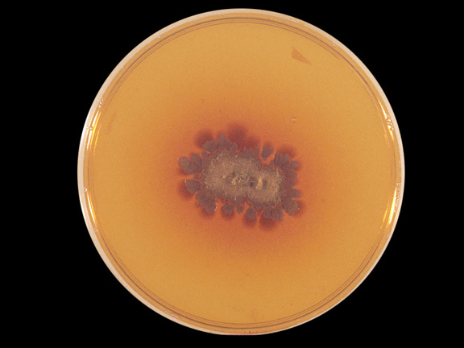
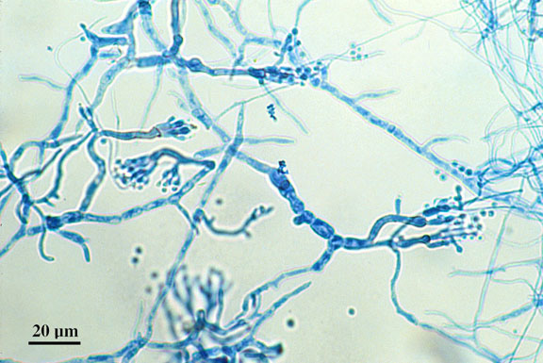
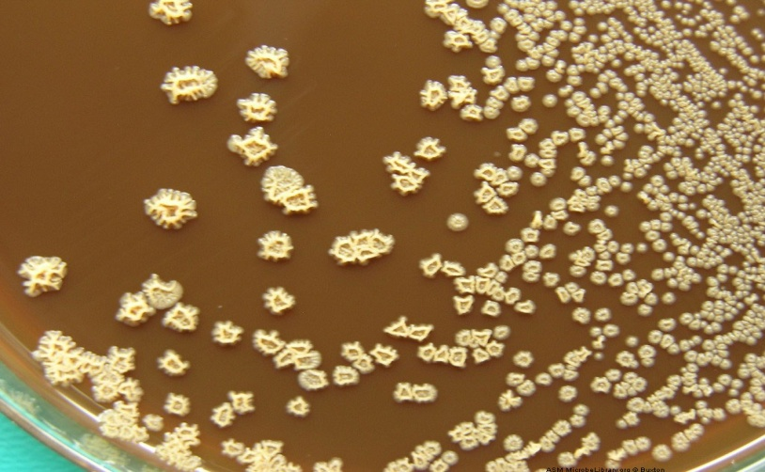
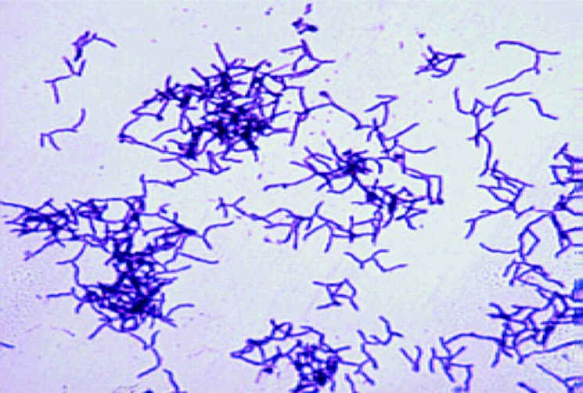
Mycetoma
Diagnosis
Culture
Media such as Sabouraud dextrose agar (SDA) to isolate fungi
Blood agar to isolate bacteria.
Fungi are identified based on the macroscopic and microscopic features.
For Actinomycetes biochemical and other tests are used for identification

Slide 12
Mycetoma
Treatment
Eumycetoma : Itraconazole
Actinomycetoma: Trimethoprim-sulfamethoxazole
Dapsone
Streptomycin
Combination of 2 drugs is used
Therapy is suggested for several months or years (1-2 years or more)
Actinomycetoma generally respond better to treatment than eumycetoma
Radiologic tests (bone radiographs) if bone involvement is suspected
Surgical Care: In eumycetoma, surgical treatment (debridement or amputation) in patient not responding to medical treatment alone and if bone is involved.

Slide 13
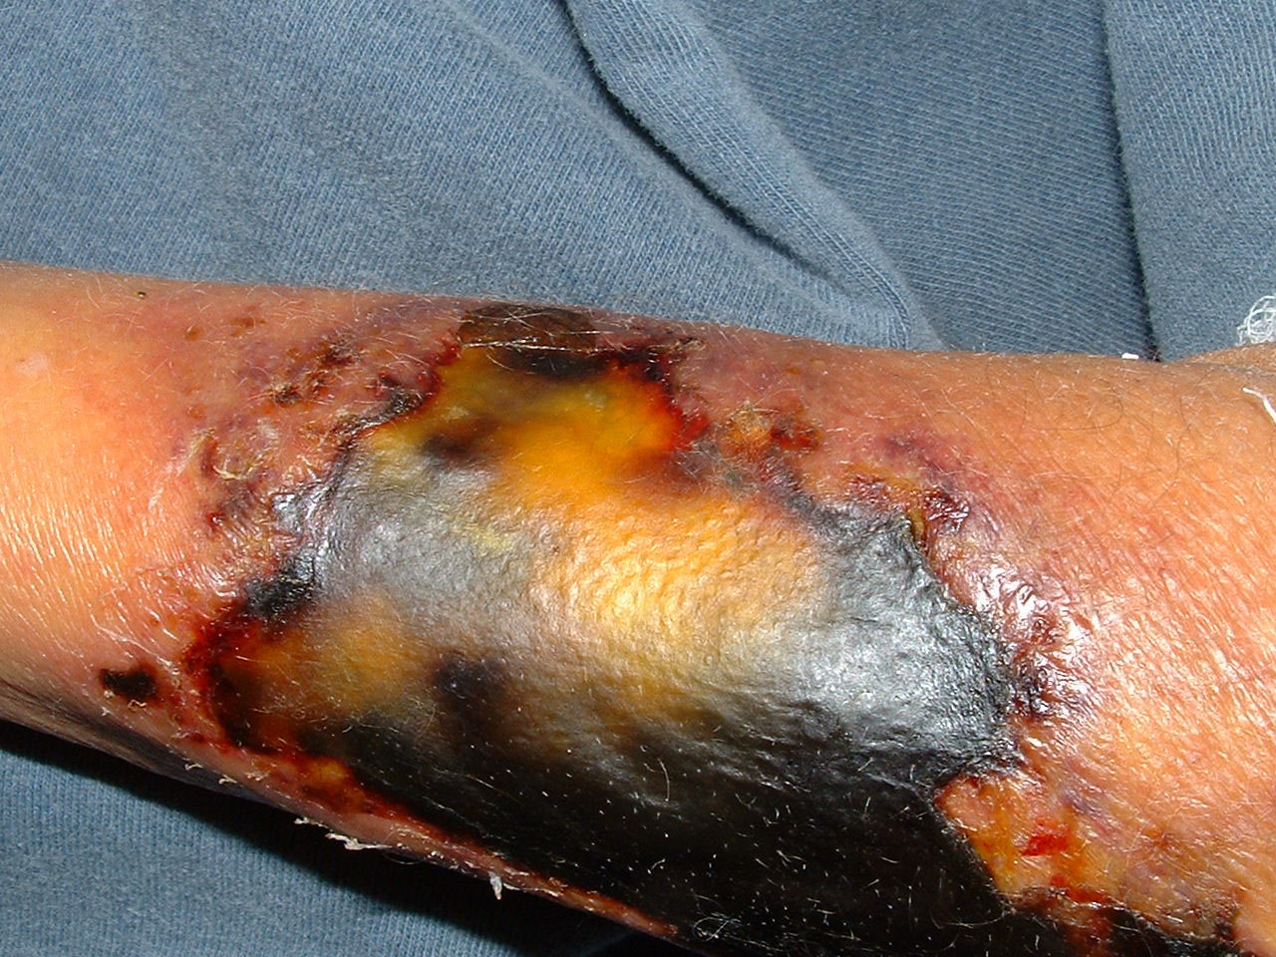
Subcutaneous zygomycosis
Chronic localized firm Subcutaneous masses
facial area or other like hand, arm, leg, thigh.
Firm swelling of site with intact skin-Distortion. Direct spread to adjacent bone and tissue.
Acquired via traumatic implantation of spores
needle-stick, tattooing, contaminated surgical dressings, burn wound
Etiology:
Mould fungi of the Zygomycetes, Entomophthorales
Conidiobolus coronatus, Basidiobolus ranarun, and few mucorales.

Slide 14
Subcutaneous zygomycosis
Laboratory Diagnosis:
Specimen: Biopsy tissue
Direct microscopy:
stained sections or smears: broad non-septate hyphae
Culture: Culture on SDA
Treatment:
Oral Potassium iodide (KI)
Amphotericin B
Posaconazole

Slide 15
Phaeohyphomycosis
Is a group of fungal infections caused by dematiaceous (darkly pigmented) fungi widely distributed in the environment
Subcutaneous or brain Abscess
Presents as nodules or erythematous plaques with no systemic involvement
Affected site: Thigh, legs, feet, arms
Etiology
Dematiaceous mold fungi.
common: Cladosporium, Exophiala, Wangiella, Cladophialophora, Bipolaris
Diagnosis
Specimens: Pus, biopsy tissue
Direct Microscopy: KOH & smears will show brown septate fungal hyphae
Culture: On SDA
Treatment
The treatment of choice is Surgical excision of the lesion
Antifungal ( Itraconazole, Posaconazole)

Slide 16
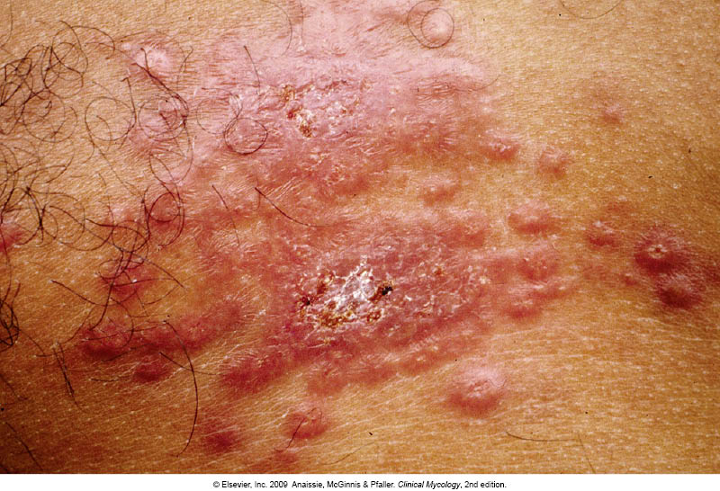
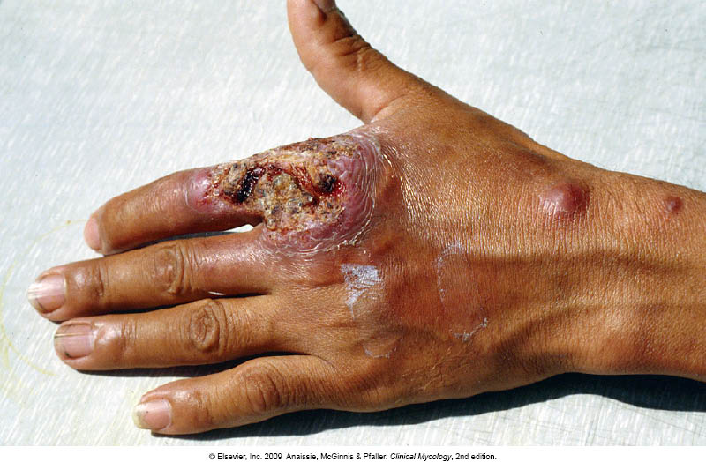
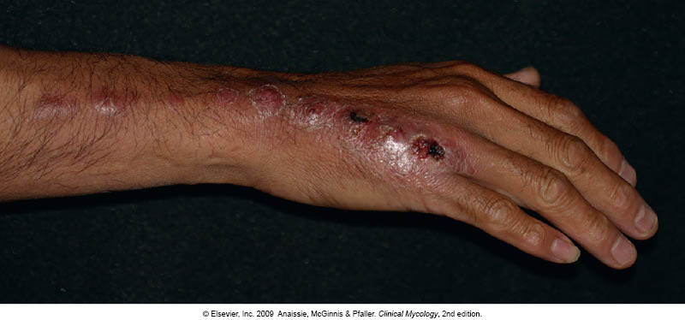
Sporotrichosis
Subcutaneous , deep cutaneous or systemic fungal infection
Inoculaion into the skin
Can present as
plaque (subcutaneous nodules)
Lymphanginitic
Dissiminated
Etiology: Sporothrix schenckii.
Dimorphic fungus
Laboratory Diagnosis:
Specimen: Biopsy tissue, pus
Direct Microscopy: smear will show Finger-like yeast cells or
Cigar shaped
Culture: On SDA at room temperature and at 37ºC
Treatment
Itraconazole, KI

Slide 17
Other subcutaneous fungal infections
Lobomycosis | Rhinosporidiosis | Chromoblastomycosis | Phaeohyphomycosis | Sporotrichosis
Subcutaneous Nodular lesions, keloids | Granulomatous, mucocutaneous polyps | Subcutaneous Verrucous plaques, cauliflower aspect, hyperkeratotic, Ulcerative | Subcutaneous or brain Abscess Nodules and erythematous plaques | Subcutaneous or systemic infection Nodular subcutaneous lesions, verrucous plaques or Lymphatic | Clinical features
Obligatory parasitic fungus Lacazia loboi | Obligatory parasitic fungus Rhinosporidium seeberi | Dematiaceous mould fungi | Dematiaceous (darkly pigmented) mould fungi | Dimorphic fungus Sporothrix schenckii | Etiology
Biopsy tissue | Biopsy tissue | Biopsy tissue | Biopsy tissue | Biopsy tissue | Clinical sample
Chains of yeast cells | Spherules with endospores | Muriform cells (sclerotic bodies) | Brown setpate hyphae | Elongated yeast cells | Direct Microscopy
Surgery | Surgery | Surgery (Antifungal therapy) | Surgery (Antifungal therapy) | Potassium iodide Itraconazole | Treatment

Slide 18
Bone and joint infections
They are uncommon
Not as isolated clinical problem
Result from:
Hematogenous dissemination
Presence of foreign body
Direct inoculation of organism (trauma, surgery , etc)
Spared through direct extension of infection to the bone
e.g. Rhinocerebral zygomycosis, Aspergillosis, mycetoma
Osteomyelitis
Joint infections
Etiology:
Candida species
Aspergillus species and mould fungi
Blastomyces dermatiditis
Coccidioides immitis
Histoplasma capsulatum
Paracoccidiodes brasiliensis

Slide 19
Thank You ☺
(Musculoskeletal Block, Microbiology)

