Slide 1
MUSCULOSKELETAL BLOCK
Pathology
Lecture 2:
Congenital and developmental bone diseases
Dr. Maha Arafah
2014

Slide 2
Diseases of Bones
Objectives
  Be aware of some important congenital and developmental bone diseases and their principal pathological features
  Be familiar with the terminology used in some important developmental and congenital disorders.
  Understand the etiology, pathogenesis and clinical features of osteoporosis

Slide 3
Bone
206 bones
organic matrix (35%) and inorganic elements (65%): calcium hydroxyapatite [Ca₁₀(PO₄)₆(OH)₂]
The bone-forming cells include osteoblasts and osteocytes, while cells of the bone-digesting lineage are osteoclasts
is very dynamic and subject to constant breakdown and renewal: remodeling

Slide 4
Diseases of Bones
Congenital
Acquired
  Metabolic
  Infections
  Traumatic
  Tumors

Slide 5
Congenital Diseases of Bones
Localized or entire skeleton
Dysostoses: e.g.
  aplasia
  extra bones
  abnormal fusion of bones
Dysplasias: e.g.
  Osteogenesis imperfecta
  Achondroplasia
  Osteopetrosis
Developmental anomalies resulting from localized problems in the migration of mesenchymal cells and the formation of condensations
Mutations that interfere with bone or cartilage formation, growth, and/or maintenance of normal matrix components

Slide 6
Osteogenesis imperfecta

Slide 7
Congenital Diseases of Bones
Osteogenesis imperfecta
(brittle bone disease)
  Osteogenesis imperfecta is a group of inherited diseases characterized by brittle bones
  Defect in the synthesis of type I collagen leading to too little bone resulting in extreme skeletal fragility with susceptibility to fractures
  Four main types with different clinical manifestations classified according to the severity of bone fragility, the presence or absence of blue scleras, hearing loss, abnormal dentition, and the mode of inheritance, some are fatal.
    Type 1: blue sclera in both eye, deformed teeth and hearing loss

Slide 8
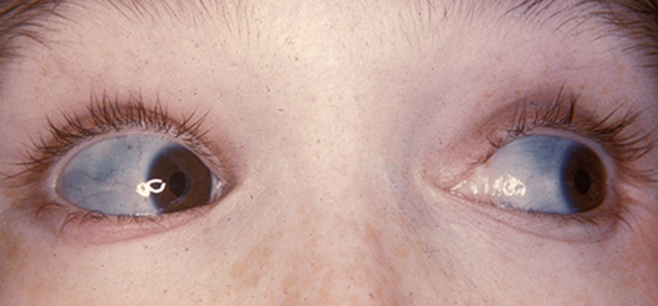
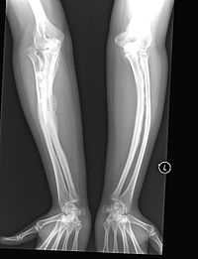
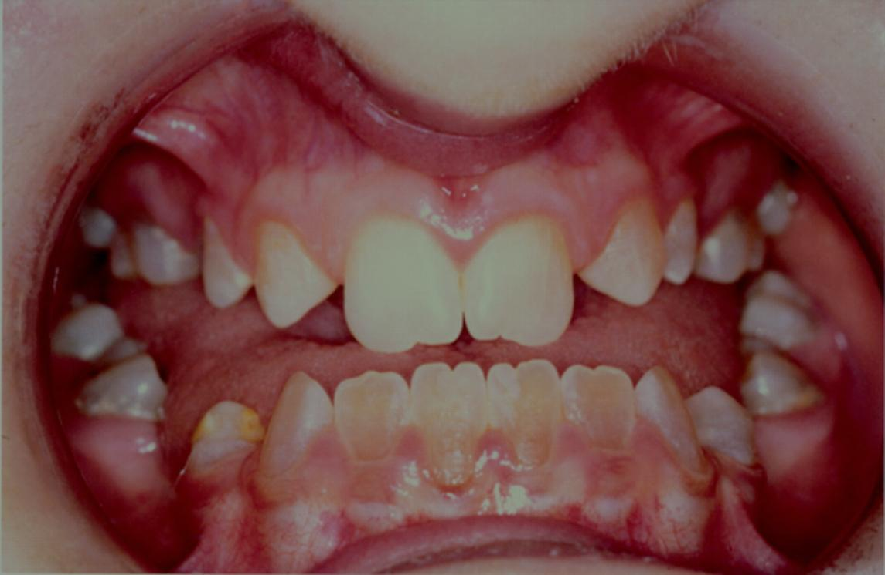
Osteogenesis imperfecta, type 1
blue scleras
brittle bones
deformed teeth

Slide 9
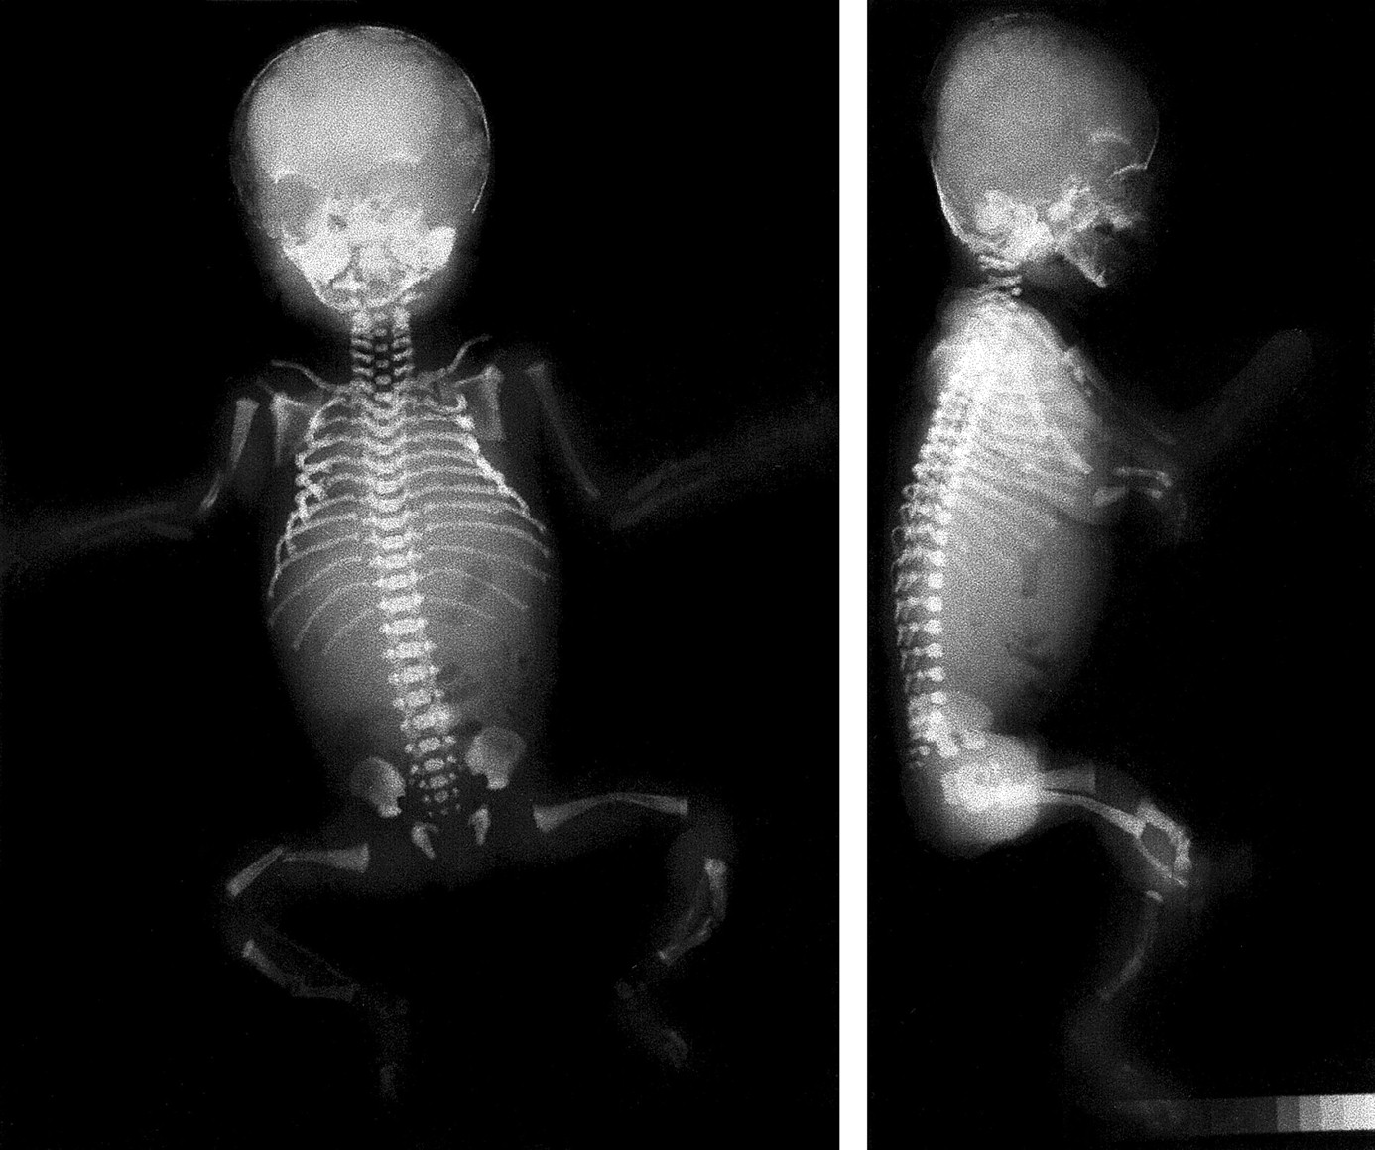
Osteogenesis imperfecta

Slide 10
Skeletal radiograph of a fetus with lethal type 2 osteogenesis imperfecta

Slide 11
Achondroplasia
Achondroplasia is the most common skeletal dysplasia and a major cause of dwarfism.

Slide 12
Congenital Diseases of Bones
Achondroplasia
Is transmitted as an autosomal dominant trait resulting from:
  Defect in the cartilage synthesis at growth plates due to gain-of-function mutations in the FGF receptor 3 (FGFR3).
  Normally, FGF-mediated activation of FGFR3 inhibits endochondral growth. Therefore gain-of-function mutation lead to inhibition of chondrocytes proliferation.
It is characterized by failure of cartilage cell proliferation at the epiphysial plates of the long bones, resulting in failure of longitudinal bone growth and subsequent short limbs.
Membranous ossification is not affected, so that the skull, facial bones, and axial skeleton develop normally.

Slide 13

Bones Congenital Diseases of
Achondroplasia
  Known as Dwarfism
  Affected individuals have shortened proximal extremities, a trunk of relatively normal length, and an enlarged head with bulging forehead and conspicuous depression of the root of the nose.
  General health, intelligence, or reproductive status are not affected, and life expectancy is normal

Slide 14
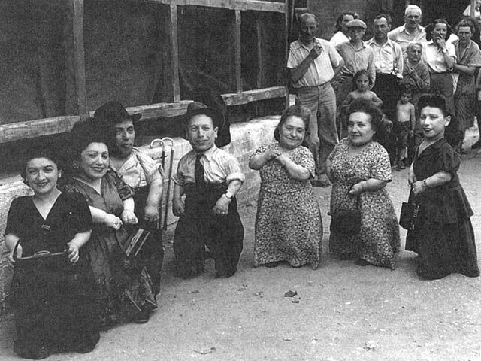
Achondroplasia
Autosomal Dominant

Slide 15
Achondroplasia
Approximately 90% of cases stem from new mutations (sporadic mutation), almost all of which occur in the paternal allele (associated with advanced paternal age).

Slide 16
Osteopetrosis
Marble bone disease

Slide 17
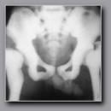
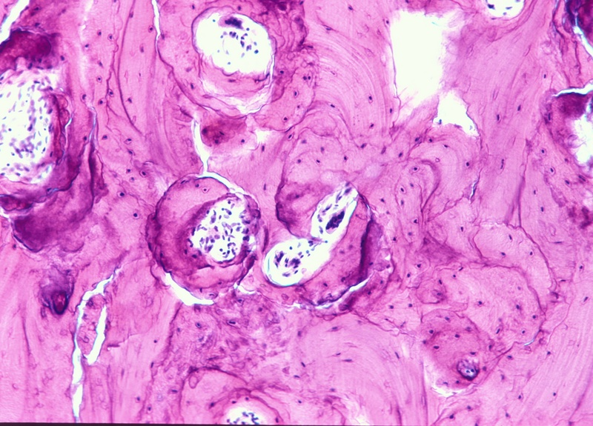
Congenital Diseases of Bones Osteopetrosis
Rare diseases
failure of normal bone resorption by osteoclasts results in uniformly thickened, dense bones
due to abnormal function of osteoclasts (deficiency of carbonic anhydrase leads to an abnormal environment around the osteoclast, resulting in defective bone resorption)
Sclerotic Bone
Sclerotic Bone
increased tendency to fractures and osteomyelitis
anemia and extramedullary hematopoiesis

Slide 18
METABOLIC BONE DISESES

Slide 19
Metabolic bone disease
comprises four fairly common conditions in which there is an imbalance between osteoblastic (bone forming) and osteoclastic (bone destroying) activity:
Osteoporosis
Osteomalacia
Paget's disease of bone
Hyperparathyroidism

Slide 20
OSTEOPOROSIS

Slide 21
OSTEOPOROSIS
Osteoporosis is an acquired condition characterized by reduced bone mass, leading to bone fragility and susceptibility to fractures.
There is a slowly progressive increase in bone erosion
The cortical bone is thinned, and the bone trabeculae are thinned and reduced in number
→ increased porosity of the skeleton leading to reduction in the bone mass but without distortion of architecture.
It may be localized → disuse osteoporosis of a limb.
or
may involve the entire skeleton, as a metabolic bone disease.

Slide 22
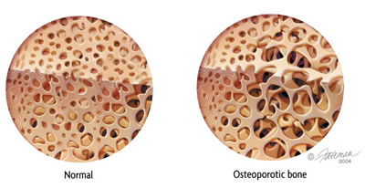

Slide 23
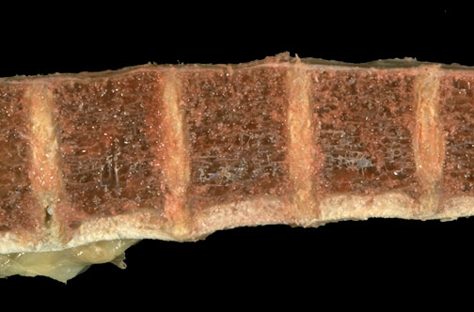
OSTEOPOROSIS

Slide 24
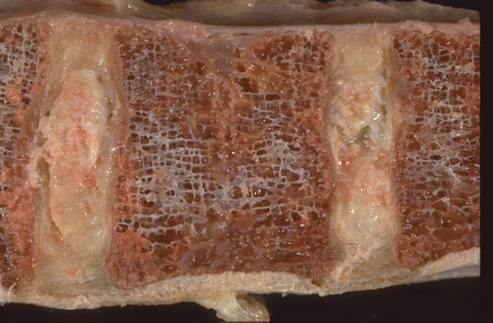

Slide 25
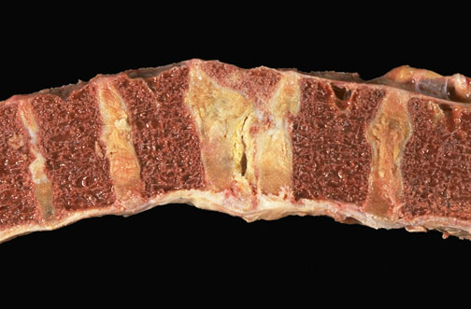
Vertebral bone with osteoporosis and a compression fracture

Slide 26
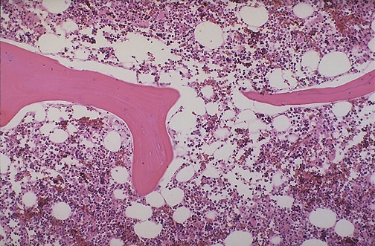
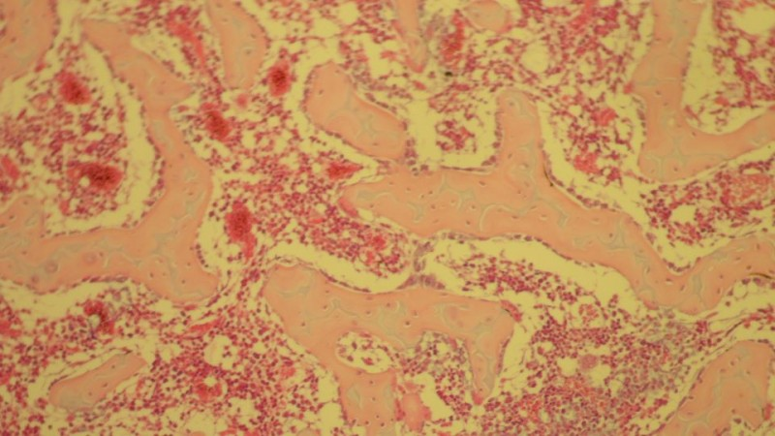
OSTEOPOROSIS
Notes:
Normal vertebral bone and marrow is demonstrated at low power microscopically. Note the size and number of bone spicules.

Slide 27
OSTEOPOROSIS
Categories of Generalized Osteoporosis
Primary
Secondary

Slide 28
OSTEOPOROSIS
PRIMARY:
Idiopathic
Post menopausal probably a consequence of declining levels of estrogen
Senile
Environmental factors may play a role in osteoporosis in the elderly: decreased physical activity and nutritional protein or vitamin deficiency (1,25-dihydroxycholecalciferol)

Slide 29
Post menopausal Osteoporosis
In the decade after menopause, yearly reductions in bone mass may reach up to 2% of cortical bone and 9% of cancellous bone. Women may lose as much as 35% of their cortical bone and 50% of their cancellous bone by 30 to 40 years after menopause.

Slide 30
OSTEOPOROSIS
such as Addison disease, DM type1, hypo or hyperthyroidism, and acromegaly.
Secondary:
  Endocrine Disorders
  Gastrointestinal disorders
  Neoplasia
  Drugs
  Others ( Smoking, Immobilization,
Anemia, Pulmonary disease)
Malnutrition
Malabsorption
Hepatic insufficiency
Vitamin C, D deficiencies
Drugs:
Anticoagulants
Chemotherapy
Corticosteroids
Anticonvulsants
Alcohol
  Neoplasia:
Multiple myeloma
Carcinomatosis

Slide 31
OSTEOPOROSIS
The most common forms of osteoporosis are the senile and postmenopausal types.

Slide 32
OSTEOPOROSIS
Pathophysiology:
Occur when the balance between bone formation and resorption tilts in favor of resorption

Slide 33
OSTEOPOROSIS
Pathophysiology:
  Genetic factors
  Nutritional effects
  Physical activity
  Aging
  Menopause
Vitamin D receptor polymorphisms
A majority of adolescent girls (but not boys) have insufficient dietary calcium.
reduced physical activity increases bone loss.
Bone mass peaks during young adulthood; the greater the peak bone mass, the greater the delay in onset of osteoporosis. In both men and women, beginning in the third or fourth decade of life, bone resorption begins to outpace bone formation.
The bone loss, averaging 0.5% per year
The postmenopausal drop in estrogen leads to increased cytokine production (especially IL-1, IL-6, and TNF), presumably from cells in the bone. These stimulate RANK-RANK ligand activity and suppress OPG production

Slide 36
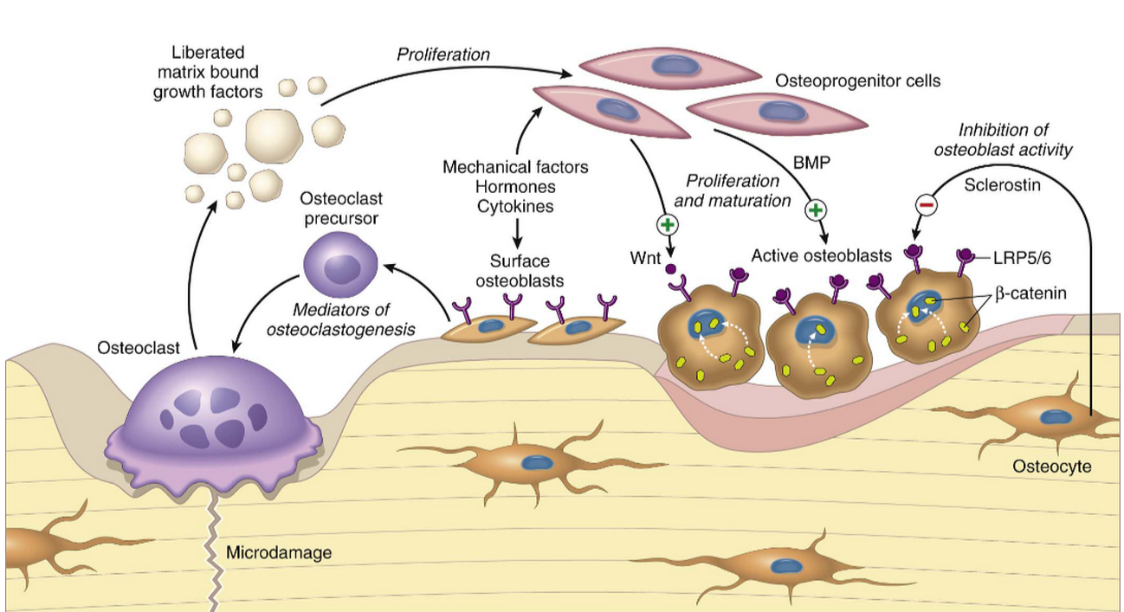

Slide 37
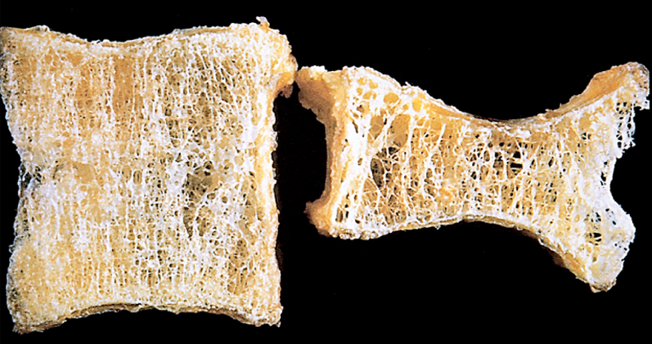

Slide 38
OSTEOPOROSIS
Clinical features
  Difficult to diagnose
  Remain asymptomatic ----fracture
  Fractures
    Vertebrae
    Femoral neck
  Patients with osteoporosis have normal serum levels of calcium, phosphate, and alkaline phosphatase

Slide 39
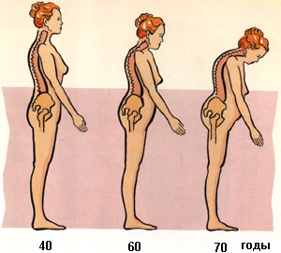

Slide 40
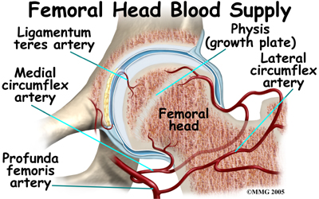
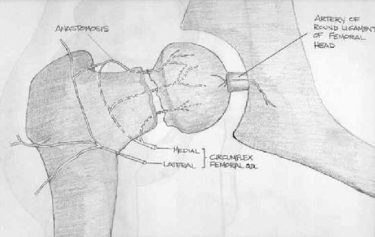
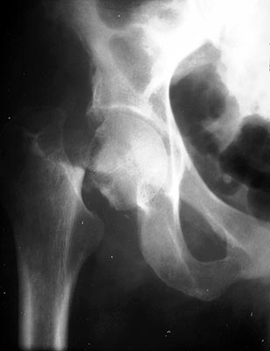
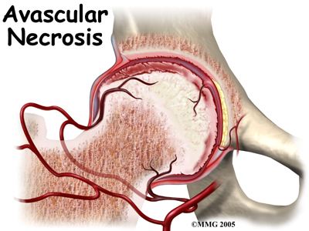
Complication of fracture

Slide 41
  Diagnosis
  Bone density by radiographic measures
Plain X ray: cannot detect osteoporosis until 30% to 40% of bone mass has already disappeared.
Dual-emission X-ray absorptiometry (DXA scan): is used primarily to evaluate bone mineral density, to diagnose and follow up pt. with osteoporosis.

Slide 42
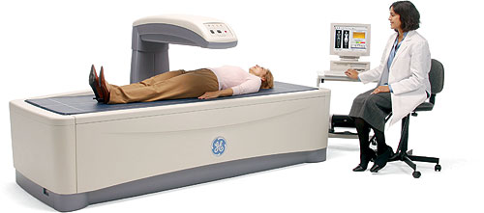
DXA scan

Slide 43
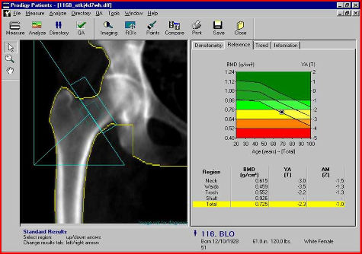

Slide 45
Prognosis
Osteoporosis is rarely lethal.
Patients have an increased mortality rate due to the complications of fracture.
e.g. hip fractures can lead to decreased mobility and an additional risk of numerous complications: deep vein thrombosis, pulmonary embolism and pneumonia

Slide 46
OSTEOPOROSIS
Prevention Strategies
The best long-term approach to osteoporosis is prevention.
children and young adults, particularly women, with a good diet (with enough calcium and vitamin D) and get plenty of exercise, will build up and maintain bone mass.
This will provide a good reserve against bone loss later in life. Exercise places stress on bones that builds up bone mass

Slide 47
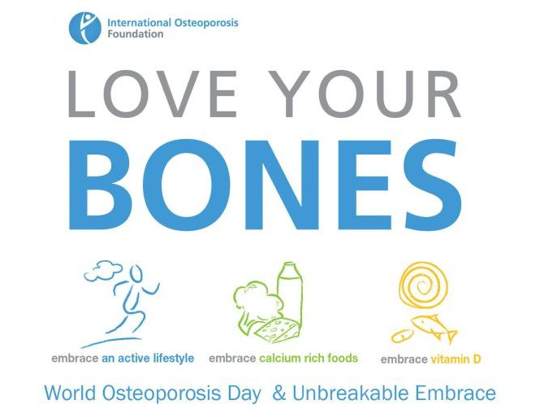

Slide 48
Metabolic bone disease
In osteomalacia and Rickets, osteoblastic production of bone collagen is normal but mineralization is inadequate. It is a manifestations of vitamin D deficiency
In Paget's disease of bone there is excessive uncontrolled destruction of bone by abnormally large and active osteoclasts, with concurrent inadequate attempts at haphazard new bone formation by osteoblasts, producing physically weak woven bone. It may result from a paramyxovirus infection in genetically susceptible persons.
In hyperparathyroidism, excessive secretion of PTH produces increased osteoclastic activity. There is excessive destruction of cortical and trabecular bone, with inadequate compensatory osteoblastic activity.

Slide 49
Paget disease of bone
The three phases in the evolution of the disease

Slide 50
Metabolic bone disease

Slide 51
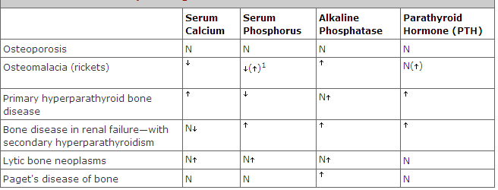

Slide 52
